Slide 1
Intelligent Visual Interfaces for Text Analysis An Introduction
Michelle Zhou
Co-Organizers:
Shixia Liu, Giuseppe Carenini, Humin Qu

Slide 2
Why Are We Here?
Let’s go round the table and introduce ourselves to each other …

Slide 3
Let’s Start with This…
Intelligent Visual Interfaces for Text Analytics
Text Analytics

Slide 4
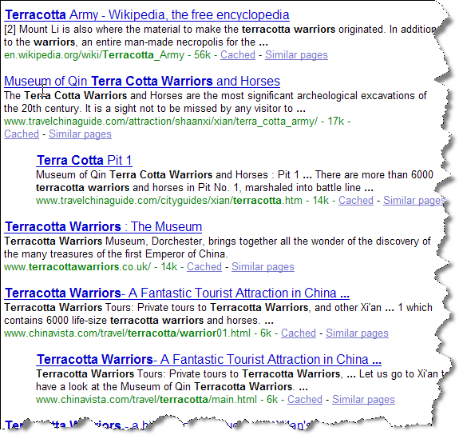
Text Analytics: Our Understanding
How can I find information buried inside the piles of text?
Search

Slide 5
Text Analytics: Our Understanding
What is in my text?
What’s inside the NHTSA Data: 450,000+ documents | What are the major causes of injuries 70,000+ patient emergency room records | What did my customers say about my hotels 3000+ customer-posted reviews
Text Summarization

Slide 6
Text Analytics: Our Understanding
What is in my text?
Which hotel features do my customers like/dislike 3000+ customer reviews | How customers’ sentiment have changed toward my hotels 3000+ customer-posted reviews | How do customers feel about my new product launch thousands of e-opinion postings
Sentiment Analysis

Slide 7
Text Analytics: Our Understanding
What is in my text?
What are the correlations of tire problems and highway death in the NHTSA Data: 450,000+ documents | What are the correlations of patient gender and the cause of injury 70,000+ patient emergency room records | Compare the customers’ attitude toward our product with theirs for our competitors thousands of e-opinion postings
Text Analysis++

Slide 8
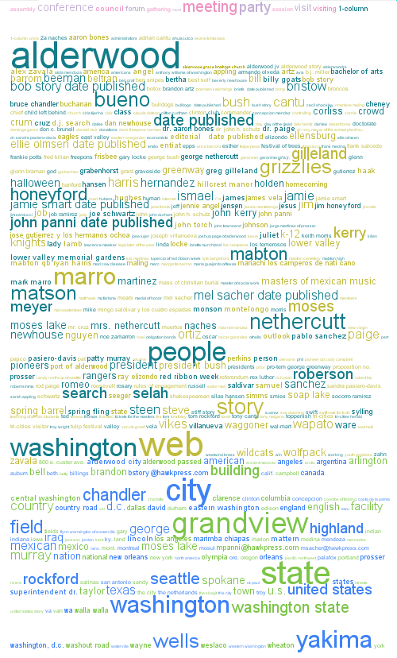
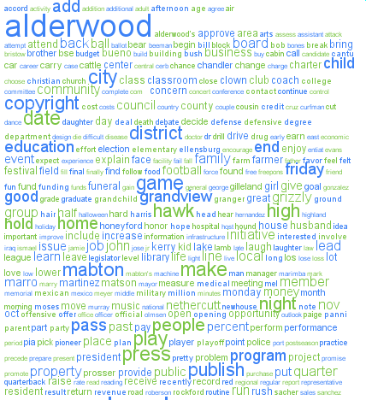
Text Analytics: Major Challenges
Huge amounts of complex information
Understanding the meanings of free text is just hard
Performing analysis on top of that is harder
Different people want different things
No one-size-fits-all solutions
People may not know what they want
“Tell me something I don’t know”
“I will tell you when I see it”
Machines are *not* just smart enough.

Slide 9
Now Let’s Switch Gear…
Intelligent Visual Interfaces for Text Analytics

Slide 10
Now Let’s Switch Gear…
Intelligent Visual Interfaces for Text Analytics

Slide 11
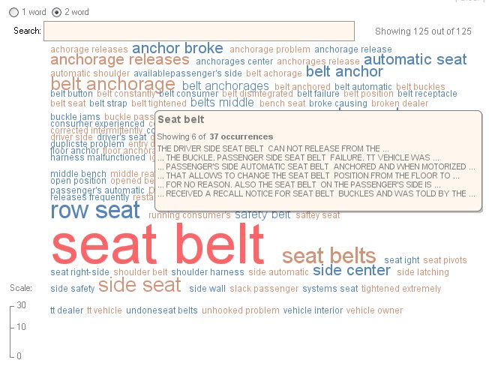
Visualizing Textual Information: By Words
Tag Cloud

Slide 12
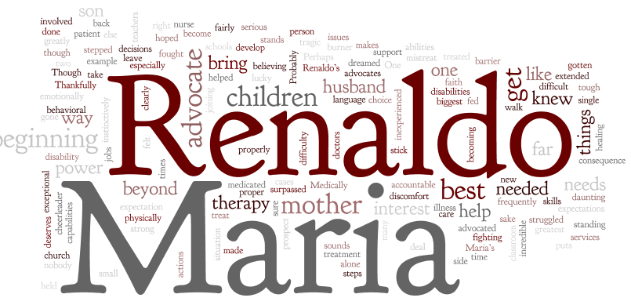
Visualizing Textual Information: By Words
Wordle

Slide 13
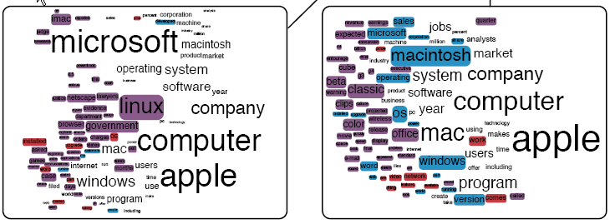
Visualizing Textual Information: By Words
Dynamic Word Cloud

Slide 14
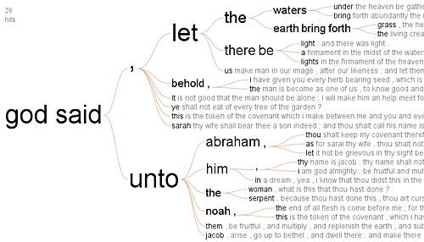
Visualizing Textual Information: By Words
Word Tree

Slide 15
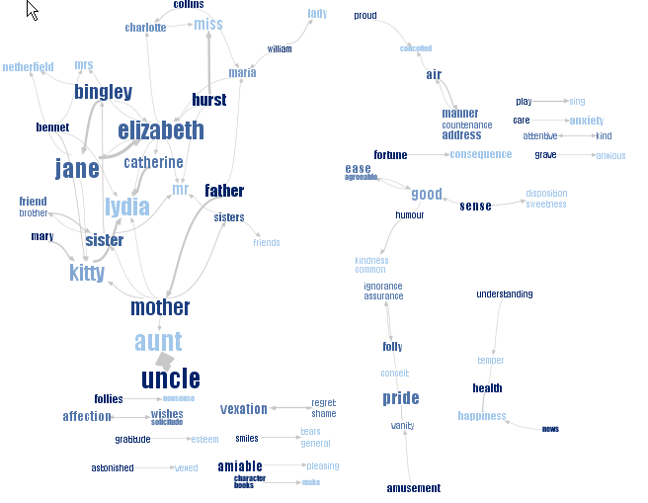
Visualizing Textual Information: By Phrases
Phrase Net

Slide 16
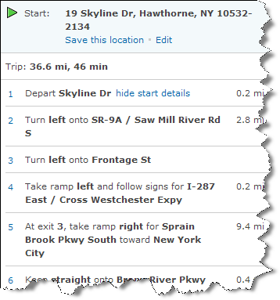
Visualizing Textual Information: By Statements
LineDrive

Slide 17
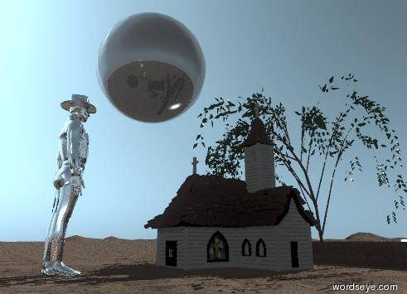
Visualizing Textual Information: By Paragraphs
The brick wall is 120 feet wide and 4 feet tall. The wall is behind the willow tree. The tree is on the mountain range. the mountain range has a dirt texture. The church is 10 feet behind the wall. The shiny sphere is 40 feet above the ground and 10 feet to the right of the church. The sphere is 30 feet tall. The huge silver cowboy is 12 feet behind the church.
WordsEye

Slide 18
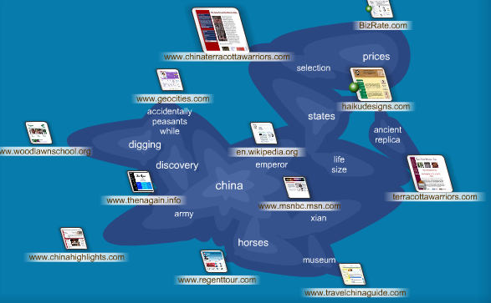
Visualizing Textual Information: By Clusters
Cartoo.com

Slide 19
Visualizing Textual Information: By Themes
Theme River

Slide 20
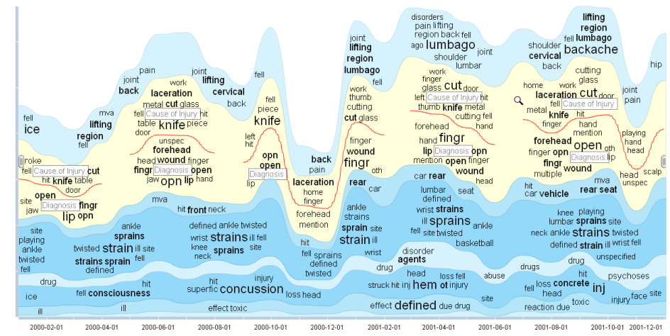
Visualizing Textual Information: By Themes
TIARA

Slide 21
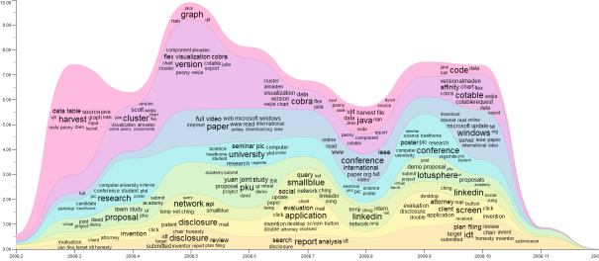
Visualizing Textual Information: Major Challenges
Which visual metaphors to use
Very much depending on user situations (e.g., data, task, and environment)
How to switch between visualizations
From words → phrases → themes → documents
How to get something different than what I am seeing
How to tell the text analytic engine
Text Analytics
Visualization

Slide 22
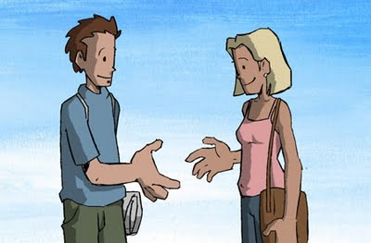
So We Are at this Workshop to Figure out…
Intelligent Visual Interfaces for Text Analytics
?
Visualization + Text Analytics

Slide 23
Workshop Summary
11 presentations in three (3) sessions
Interactive Text Analytics (Session Chair: Huamin Qu)
Space and Time (Session Chair: Giuseppe Carenini)
Visual Text Summarization (Session Chair: Shixia Liu)
Group discussions
Focus areas and future directions (Session Chair: Pak Chung Wong)

