Slide 1
IDRG/MUX Forum
Research Overview - Matthew Brehmer
Jan 12, 2011

Slide 2
Meta-Info
12-credit thesis M.Sc Supervised by Joanna
Co-supervised by Claudia Jacova in Medicine (Div. of Neurology)
Also working with Charlotte Tang
Joined project in May 2010
Aiming for a end-of-summer completion
Keywords:
Universal Usability, Gerontechnology, Interruptions, Cognitive Impairments

Slide 3
Projects
Cognitive Testing on a Computer (C-TOC)
Self-administered web-based screening test for age-related cognitive impairments
Usability studies, iterative prototyping, cross-cultural focus groups, clinical validity studies
Age & Interruption Lab Study
How do interruptions affect older adults, as compared to younger adults?
Implementation complete, pre-piloting stage

Slide 4
C-TOC
A battery of 15 short tests adapted from clinical neuropsychological tests for diagnosing cognitive impairment, intended for pre-screening purposes
Tests memory (recall and recognition), spatial awareness, temporal awareness, reaction time, sentence comprehension and production, response inhibition, executive functioning, reasoning, semantic knowledge

Slide 5
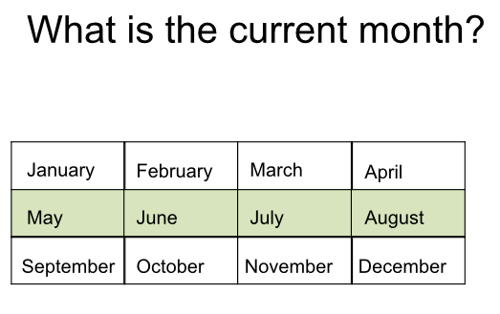
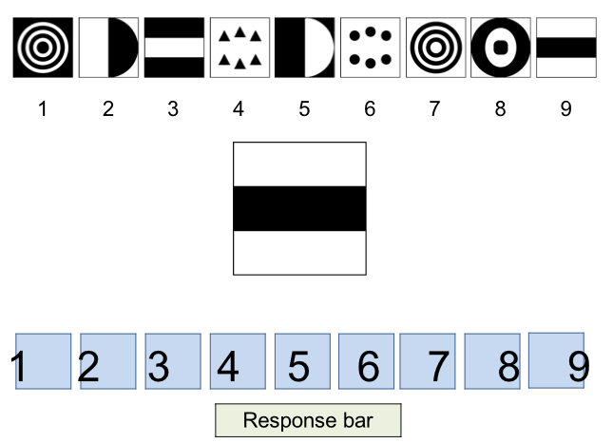
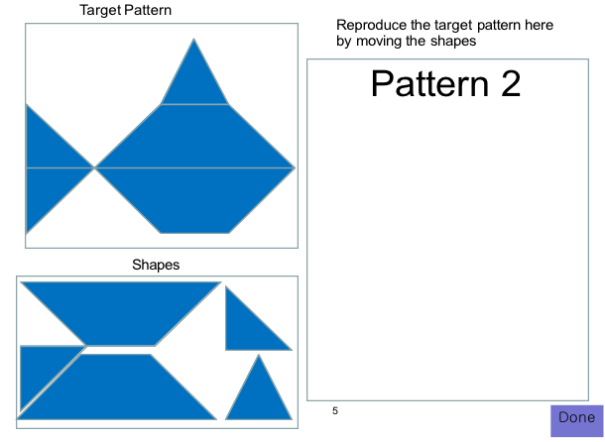
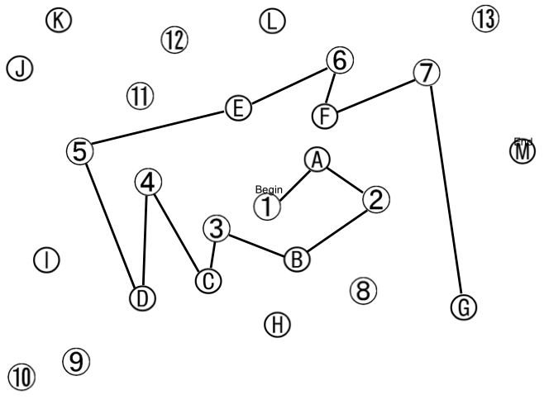
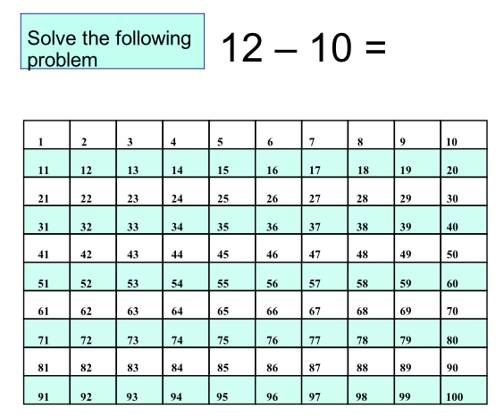
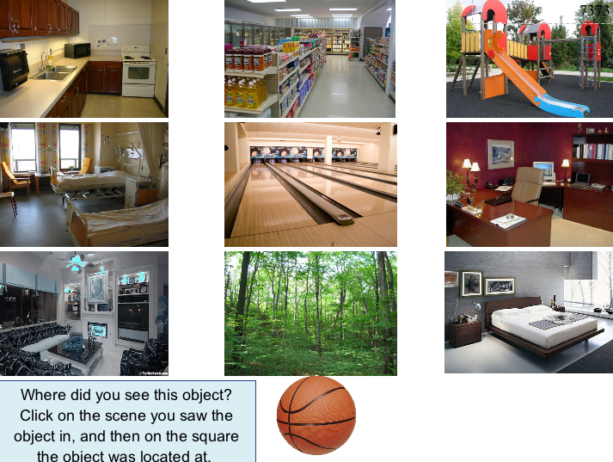
1
2
3
4
5
6
7
8
9

Slide 6
C-TOC Dev. & Parallel Studies
C-TOC v1
Cross-Cultural Advisory Panel #1
Design Specs + Recommendations
Clinical Usability Studies
C-TOC v2
Cross-Cultural Advisory Panel #2
Clinical Usability Studies
Clinical Validity Studies (Claudia)
Interruption Lab Study
(Me)
Interruption Field Study
(Charlotte)
C-TOC v3
Cross-Cultural Advisory Panel
#3
Clinical Usability Studies
C-TOC v4
Interaction Design Guidelines

Slide 7
Interruption Lab Study
How do interruptions affect older adults, as compared to younger adults?
Motivation:
C-TOC is a home-based cognitive screening test
Interruptions in the home may affect performance and validity of the screening results
An understanding of the effects of interruptions on older adults may guide the design of interruption-mitigation prompts in C-TOC, interruption-detection processes
Results may generalize to the design of other applications for older adults
i.e. do older adults differ from younger adults when making use of an interruption lag?

Slide 8
Interruption Lab Study (ii)
How do interruptions affect older adults, as compared to younger adults?
Factors:
3 age groups (BS)
multiple of 12 subjects / group
2 main tasks (adapted from 2 C-TOC tests) (WS)
Sentence Comprehension Task (verbal/memory) (SC)
Square Puzzle Task (non-verbal/spatial reasoning) (SqP)
3 levels of interruption demand (WS)
No interruption, low-demand interruption (passive image viewing), high-demand interruption (n-back task)

Slide 9
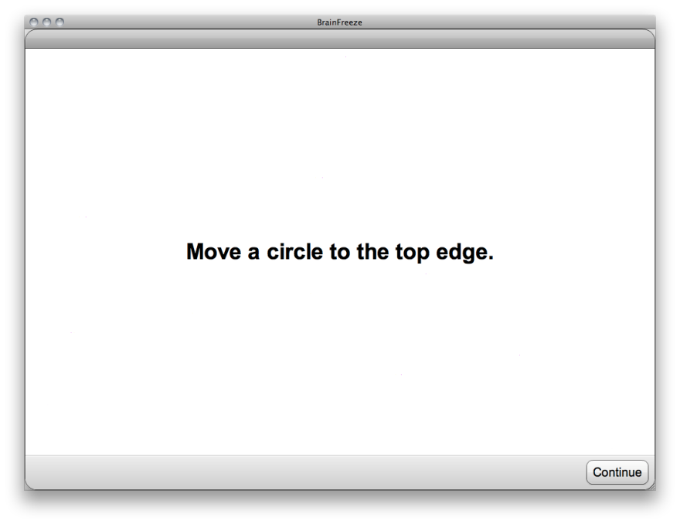
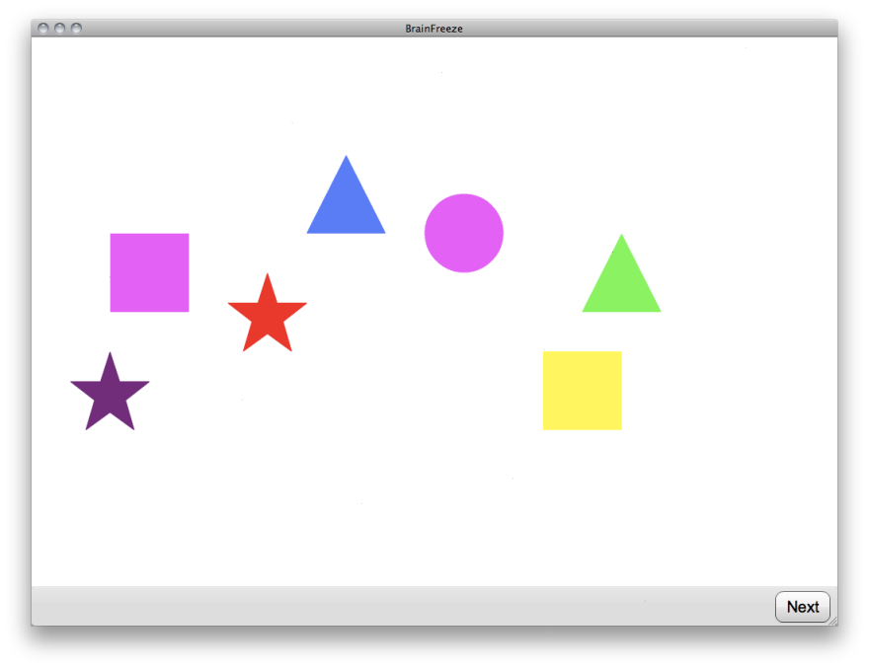
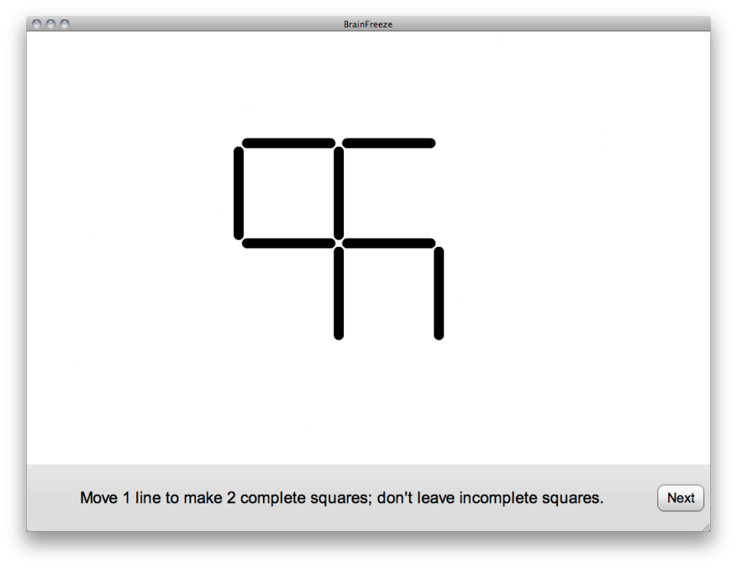
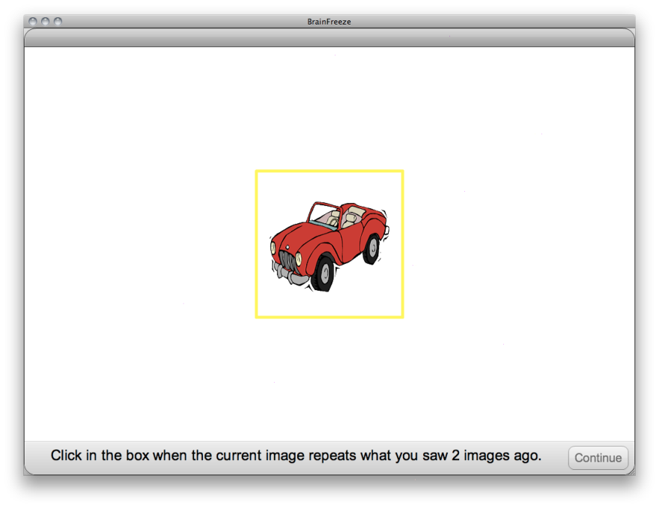
Interruption Lab Study (Demo)
1
2
3
4

Slide 10
Interruption Lab Study (iii)
How do interruptions affect older adults, as compared to younger adults?
Hypotheses:
H1: Age interaction effects for speed and accuracy
Older adults performing proportionally worse on interruption conditions
H2: High-demand interruptions will incur worse performance than low-demand interruptions
Possible age interaction or age-related compensation (attention enhancement and suppression)
H3: Performance detriments greater for verbal task (SC) than non-verbal task (SqP)
Age interaction possible
H4: Self-reports regarding disruptive effects of interruptions to reinforce H1-H3

Slide 11
Interruption Lab Study (iv)
How do interruptions affect older adults, as compared to younger adults?
Materials
10 sentence comprehension trials x 3 banks of trials
8 square puzzle trials x 3 banks of trials
Isomorphic trial banks, each increasing in difficulty, presented in random order
Main task order counterbalanced BS
Interruption conditions counterbalanced BS
For each main task, low-demand and high demand interruptions occur on the same randomly generated subset of trials in 2 of the 3 trial banks (remaining bank = control)

Slide 12
Interruption Lab Study (v)
How do interruptions affect older adults, as compared to younger adults?
Dependent measures & potential covariates
Puzzle completion accuracy
Based on predetermined scoring scheme
Completion time
Total working time, mean inter-action interval (before and after interruption), task resumption time (following interruption)
Interruption task performance (n-back task)
Time to dismiss interruption
Number of actions
Valid, invalid, aborted moves, clicks, minor adjustments
Pencil + paper cognitive screening
Self- reports and observations

Slide 13
Interruption Lab Study (vi)
How do interruptions affect older adults, as compared to younger adults?
Factors not examined in this study (future work?)
Interruption Length
Length fixed at 10 n-back trials (~15 seconds)
Interruption Frequency
Maximum of once per trial, paired between interrupt conditions
Fixed onset for SC task, based on trial difficulty
Semi-randomized onset in SqP task, following 1st/2nd move
Interruption Lag length
Interruption Modality & Similarity
Computerized interruptions occluding entire working area
Task Instruction
Speed vs. accuracy tradeoff

Slide 14
IDRG/MUX Forum
Q & A

