Slide 1
InfoVis 2017 Talk
Bridging From Goals to Tasks with Design Study Analysis Reports
Heidi Lam*, Melanie Tory*, and Tamara Munzner⁺
October 4, 2017
* Tableau Software
⁺ University of British Columbia

Slide 2
So I want to design a visualization, and my user says:
“As a flight reservation coordinator, I want to understand why there are so many failed purchase requests today.” *
How do I design a visualization for analysis questions like this?
Scenario from: Liu, Z., Stasko, J., & Sullivan, T. (2009). Selltrend: Inter-attribute visual analysis of temporal transaction data. IEEE Transactions on Visualization and Computer Graphics, 15(6), 1025-1032.

Slide 3
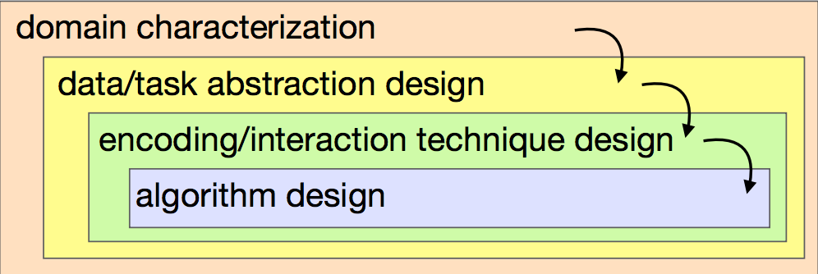
To design a visualization from domain questions...
Munzner, T. (2009). A nested model for visualization design and validation. IEEE transactions on visualization and computer graphics, 15(6).

Slide 4
So I want to design a visualization, and my user says:
“As a flight reservation coordinator, I want to understand why there are so many failed purchase requests today.”*
How do I translate domain language analysis questions to abstract tasks?
Scenario from: Liu, Z., Stasko, J., & Sullivan, T. (2009). Selltrend: Inter-attribute visual analysis of temporal transaction data. IEEE Transactions on Visualization and Computer Graphics, 15(6), 1025-1032.

Slide 5
Problem: Hard to get from domain questions to tasks
 | not a lot of guidance here | Task Classifications
Domain Question | → | Abstract Tasks | → | Encoding & Interaction
“Why are there so many failed requests today?” |  | Identify extremes [Munzner, 2014; Brehmer & Munzner 2013] Analyze outliers [Schutz et al. 2013] Find extremum [Amar et al. 2005]
Notes:
We don’t have guidance as to what to do in a field
Lots of previous work in classification and typology
Not obvious how to get there

Slide 6
Our Contribution Bridges between domain questions and task classifications
 | not a lot of guidance here | Task Classifications
Domain Question |  | Abstract Tasks | → | Encoding & Interaction
“Why are there so many failed requests today?” |  | Identify extremes [Munzner, 2014; Brehmer & Munzner 2013] Analyze outliers [Schutz et al. 2013] Find extremum [Amar et al. 2005]
Notes:
We don’t have guidance as to what to do in a field
Lots of previous work in classification and typology
Not obvious how to get there

Slide 7
Our Contribution Bridges between domain questions and task classifications
Task Classifications
Analysis Goals Framework
Domain Question
“Why are there so many failed requests today?”
Abstract Tasks
Identify extremes
Analysis Goal
Abstracted question
Typical
Analysis Steps
to achieve goal

Slide 8
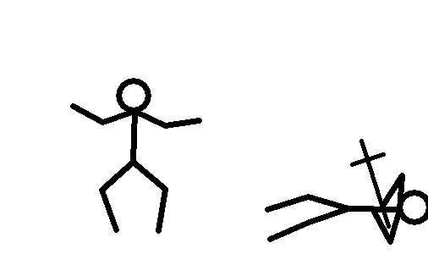
Paper Selection
Open Coding
Affinity Diagramming
287
InfoVis papers
tagged with
12
goals
discussed to define / refine..
split / merge
~12
goals
filtered to
20 design-study papers with analysis reports
a framework of
9 analysis goals arranged across
2 axes
segmented to
32
analysis reports
segmented to
many
analysis steps

Slide 9
Pros & Cons of open-coding design-study papers
Design-study papers are digested analysis reports, not raw behaviour logs
Pros: Capitalize on previous thinking about abstractions from multiple authors across multiple domains
Cons: Steps extracted are not actual analysis sequences
Only proof of existence
Incomplete (e.g., floundering typically not reported)
Ordering in analysis reports not not reliable
Coded InfoVis design-study papers from 2009-2015
Pre-2009 InfoVis papers did not contain analysis reports we need; InfoVis has the most design-study papers
Proposed framework is a thinking tool, not a model of visual analysis

Slide 10
An analysis goals framework: 9 goals + 2 axes
Specificity # Populations | Explore | Describe | Explain | Confirm
Single | Discover Observation | Describe Observation | Identify Main Cause | Collect Evidence
Multiple |  | Compare Entities | Explain Differences | Evaluate Hypothesis

Slide 11
Specificity # Populations | Explore | Describe | Explain | Confirm
Increasing specificity of the analysis outcome
Notes:
Talk through single row first (stuff at top of next slide - observation/subpopulation), then explore/describe/explain/confirm. Then introduce multiples in a subsequent slide

Slide 12
Specificity # Populations | Explore | Describe | Explain | Confirm
Single | Discover Observation | Describe Observation | Identify Main Cause | Collect Evidence
Explore the data to identify interesting trends, patterns, or anomalies |  |  | “Lots of failed requests today…”
Describe the population with a set of attributes |  |  | “Many are Class Z and R with error code 78…”
Explain an observation by finding the main contributor |  |  | “Agent DYS handled a lot of these transactions…”
Confirm beliefs about a population |  |  | “Wonder if Agent DYS was responsible for the spike…”
Notes:
Talk through single row first (stuff at top of next slide - observation/subpopulation), then explore/describe/explain/confirm. Then introduce multiples in a subsequent slide

Slide 13
Specificity # Populations | Explore | Describe | Explain | Confirm
Single | Discover Observation | Describe Observation | Identify Main Cause | Collect Evidence
Explore the data to identify interesting trends, patterns, or anomalies |  |  | “Lots of failed requests today…”
Describe the population with a set of attributes |  |  | “Many are Class Z and R with error code 78…”
Explain an observation by finding the main contributor |  |  | “Agent DYS handled a lot of these transactions…”
Confirm beliefs about a population |  |  | “Wonder if Agent DYS was responsible for the spike…”
Notes:
Talk through single row first (stuff at top of next slide - observation/subpopulation), then explore/describe/explain/confirm. Then introduce multiples in a subsequent slide

Slide 14
Specificity # Populations | Explore | Describe | Explain | Confirm
Single | Discover Observation | Describe Observation | Identify Main Cause | Collect Evidence
Explore the data to identify interesting trends, patterns, or anomalies |  |  | “Lots of failed requests today…”
Describe the population with a set of attributes |  |  | “Many are Class Z and R with error code 78…”
Explain an observation by finding the main contributor |  |  | “Agent DYS handled a lot of these requests...”
Confirm beliefs about a population |  |  | “Wonder if Agent DYS was responsible for the spike…”
Notes:
Talk through single row first (stuff at top of next slide - observation/subpopulation), then explore/describe/explain/confirm. Then introduce multiples in a subsequent slide

Slide 15
Specificity # Populations | Explore | Describe | Explain | Confirm
Single | Discover Observation | Describe Observation | Identify Main Cause | Collect Evidence
Explore the data to identify interesting trends, patterns, or anomalies |  |  | “Lots of failed requests today…”
Describe the population with a set of attributes |  |  | “Many are Class Z and R with error code 78…”
Explain an observation by finding the main contributor |  |  | “Agent DYS handled a lot of these requests...”
Confirm beliefs about a population |  |  | “Wonder if Agent DYS was responsible for the spike…”
Notes:
Talk through single row first (stuff at top of next slide - observation/subpopulation), then explore/describe/explain/confirm. Then introduce multiples in a subsequent slide

Slide 16
An analysis goals framework
Specificity # Populations | Explore | Describe | Explain | Confirm
Single | Discover Observation | Describe Observation | Identify Main Cause | Collect Evidence
Multiple |  | Compare Entities | Explain Differences | Evaluate Hypothesis

Slide 17
Specificity # Populations
Single | Single population analyses start with an observation and end with a definition for a subpopulation with that observation
Multiple
“Lots of failed requests today…”
“Failed requests with Airline A80 and flight number 4360 are all of Class Z and R,
with error code 78…”
Multiple population analyses start with population definitions and end with similarities and/or differences between populations
“Failed requests and
successful requests...”
“Both types involved
Agent DYS…”
“Agent Z7F handled more
failed requests...”

Slide 18
An analysis goals framework
Specificity # Populations | Explore | Describe | Explain | Confirm
Single | Discover Observation | Describe Observation | Identify Main Cause | Collect Evidence
Multiple |  | Compare Entities | Explain Differences | Evaluate Hypothesis

Slide 19
How to use the framework?
Task Classifications
Analysis Goals Framework
Domain Question
“Why are there so many failed requests today?”
Abstract Tasks
Identify extremes
Analysis Goal
Identify Main Cause

Slide 20
An analysis goals framework
Specificity # Populations | Explore | Describe | Explain | Confirm
Single | Discover Observation | Describe Observation | Identify Main Cause | Collect Evidence
Multiple |  | Compare Entities | Explain Differences | Evaluate Hypothesis

Slide 21
An analysis goals framework
Specificity # Populations | Explore | Describe | Explain | Confirm
Single | Discover Observation | Describe Observation | Identify Main Cause | Collect Evidence
Multiple |  | Compare Entities | Explain Differences | Evaluate Hypothesis

Slide 22
How to use the framework?
Task Classifications
Analysis Goals Framework
Domain Question
“Why are there
so many failed requests
today?”
Input
Single population with the observation
“Failed request records”
Analysis Goal
Identify Main Cause
Output
Main data slice of the
input (sub)population
“Class Z and R together, and error code 78 correspond to 100% of failed transactions associated with A80 and Flight Number 4360 … travel agent Z7F might be the right stakeholder to contact for resolution.”

Slide 23
How to use the framework?
Task Classifications
Analysis Goals Framework
Domain Question
“Why are there so many failed requests today?”
Abstract Tasks
Identify extremes
Analysis Goal
Identify Main Cause
Typical
Analysis Steps
to achieve goal

Slide 24
Goal breaks down to Steps
 | Analysis Report | Our Framework
Input | A spike in the time trend of daily failed airline transactions | A population with an observation found at the aggregate population level
Steps | (one example loop) | (iteratively)
 | Identified that Airline A80 had contributed the most failed transactions | Identify the likely dominant attribute that causes the observation
 | Confirmed that the airline’s contribution is worse than historical average | Confirm the identified attribute
 | Filtered to focus on airline A80’s failed transactions | Refine the analysis population by applying the identified dominant attribute
Output | Travel agent Z7F contributed to most of airline A80’s failed transactions | The dominant attribute that explains the observation

Slide 25
Easy to map Steps to Tasks
Analysis Report | Our Framework | Munzner Actions & Targets*
Identified that airline A80 contributed the most failed transactions | Identify the likely dominant attribute that caused the observation | Analyze>Consume>Discover Search>Locate Query>Identify | Attribute>One >Distribution >Extremes
...and many more...
*Munzner, T. (2014). Visualization analysis and design. CRC press.

Slide 26
Bridging From Goals to Tasks...
Task Classifications
Analysis Goals Framework
Domain Question
“Why are there
so many failed
requests
today?”
Abstract Tasks
Input
Single population with the observation
Analysis Step 0
Identify the likely dominant attribute that caused the observation
Task 0
Identify Extremes
Analysis Goal
Identify Main Cause
Analysis Step 1
Task 1
Analysis Step 2
Task 2
Output
Main data slice of the
input (sub)population

Slide 27
Summary: An analysis goals framework
A thinking tool to help designers map domain analysis questions, to abstract goals and steps, that can easily translate into existing tasks classifications.
Analysis goals are characterised by:
Axes of specificity (Explore, Describe, Explain, Confirm) and the number of populations (Single, Multiple)
Analysis inputs and outputs
Typical analysis steps
Framework derived empirically from open coding design-study papers
Grounded in reports of real analyses from a (relatively) diverse set of domains
Call for action: Help us improve this framework by collecting more goals from other sources!!

Slide 28
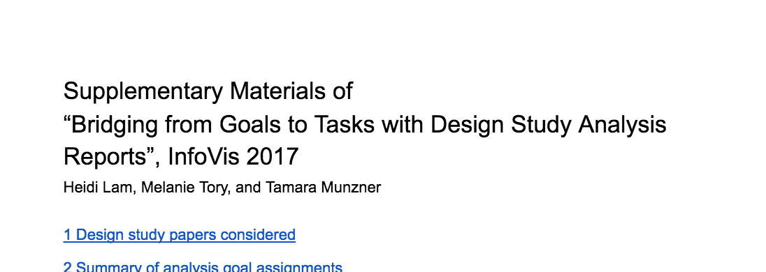
Bridging From Goals to Tasks with Design Study Analysis Reports
Heidi Lam
heidi.lam@gmail.com
http://www.cs.ubc.ca/labs/imager/tr/2017/GoalsToTasks
Melanie Tory
mtory@tableau.com
http://tinyurl.com/gt27fau
Tamara Munzner
tmm@cs.ubc.ca
@tamaramunzner

Slide 29
An analysis goals framework
Specificity # Populations | Explore | Describe | Explain | Confirm
Single | Discover Observation | Describe Observation | Identify Main Cause | Collect Evidence
Multiple |  | Compare Entities | Explain Differences | Evaluate Hypothesis
http://www.cs.ubc.ca/labs/imager/tr/2017/GoalsToTasks

Slide 30
Specificity # Populations | Explore | Describe | Explain | Confirm
Multiple |  | Compare Entities | Explain Differences | Evaluate Hypothesis
Describe two or more populations by comparing one to another |  |  | “Wonder how the failed requests compared to the successful ones?”
Explain the reason behind differences |  |  | “Failed requests are more from Agent Z7F…”
Confirm suspected similarities or differences between populations |  |  | “Wonder if requests handled by Agent Z7F are more likely to fail?”
Notes:
Talk through single row first (stuff at top of next slide - observation/subpopulation), then explore/describe/explain/confirm. Then introduce multiples in a subsequent slide

