Slide 1
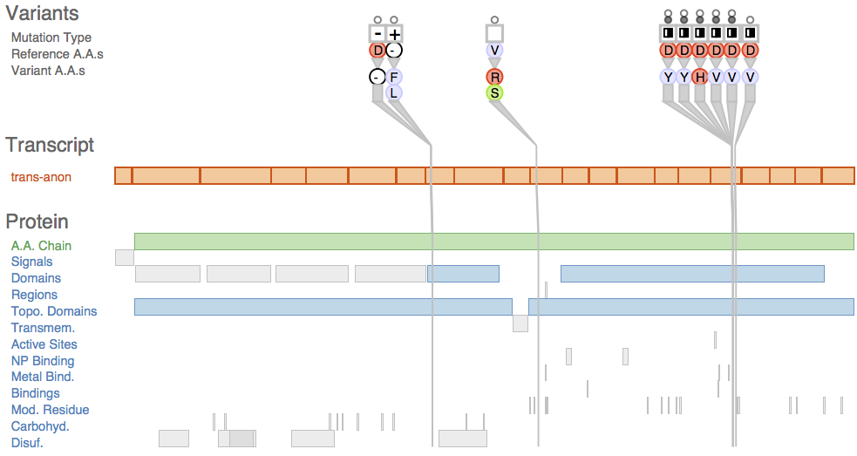
Variant View
Visualizing Sequence Variants in their Gene Context
Joel A. Ferstay^{1*}, Cydney B. Nielsen², Tamara Munzner¹
University of British Columbia¹, now at AeroInfo Systems/Boeing Canada*
BC Cancer Agency²
Notes:
Hi, my name is Joel Ferstay, and I am a recent graduate of the University of British Columbia’s Computer Science program; I am now at AeroInfo Systems / Boeing Canada. This project is titled: “Variant View: Visualizing Sequence Variants in their Gene context”; I collaborated with Dr. Cydney Nielsen from the BC Cancer Agency, and Dr. Tamara Munzner from the University of British Columbia on this project.

Slide 2

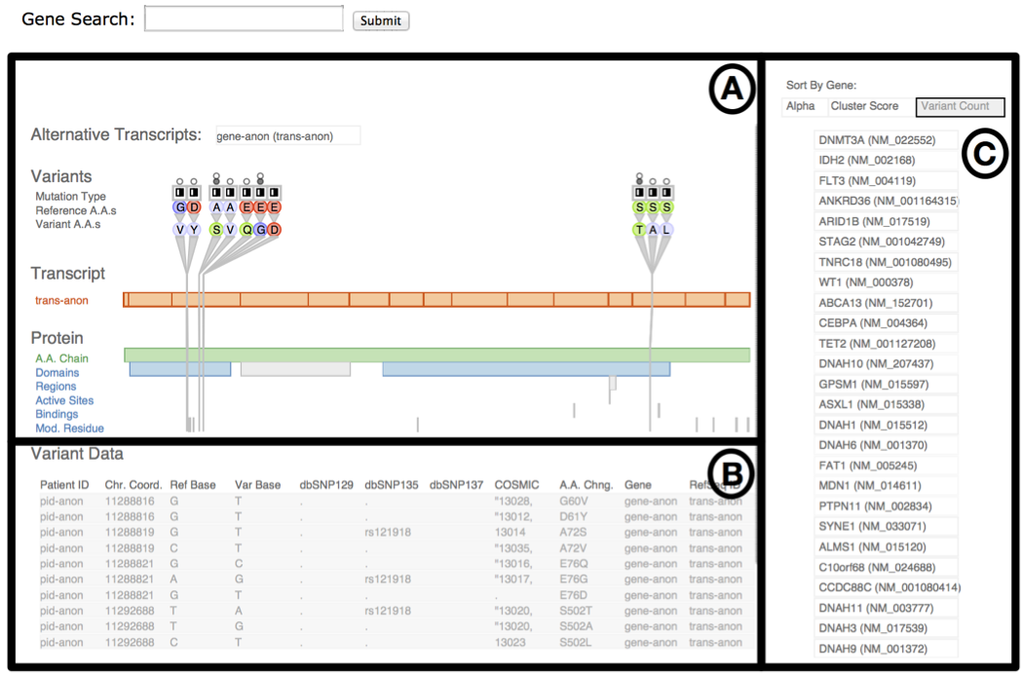
Design study
Real users, real tasks, real data
Find out what users are doing
Support with visualization tool
Reflect and present guidelines
Analyst
Tool
Notes:
Together, we performed an information visualization design study. We worked with real analysts to determine their data and tasks, and built a visualization tool to support their work. Afterward, we reflected on the lessons learned during this process, and tried to frame these in a general way to help design study practitioners in the future.

Slide 3
Design Study
The Design Process

Slide 4
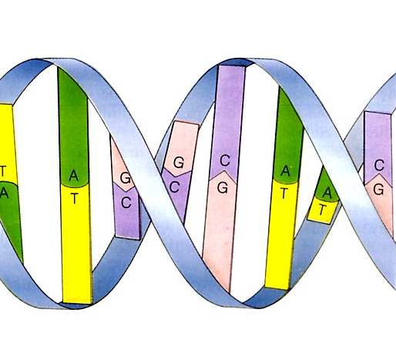
Collaborated with analysts at the Genome Sciences Centre
Study genetic basis of leukemia
Needed help interpreting their data
Major problems:
  What do we show?
  How do we show it?
Notes:
We collaborated with analysts at the BC Cancer Genome Sciences Centre in Vancouver, Canada. The analysts were studying the genetic basis of leukemia, and needed help interpreting their data. The data included multiple scales and levels, so challenges we faced were: what features in the data are significant for their problem, and, using what we know about visual encoding principles and interaction techniques, how do we show these features to them in a way that specifically supports their tasks?

Slide 5
Design cycle
Interview
Notes:
We began with semi-structured interviews to characterize their problem.

Slide 6
Design cycle
Interview
Data and Tasks
Notes:
Then created a definition of their data and tasks

Slide 7
Design cycle
Interview
Data and Tasks
Create Data Sketch
Notes:
and used this knowledge to create a data sketch

Slide 8
Design cycle
Interview
Data and Tasks
Present Data Sketch
Create Data Sketch
Notes:
We then showed the sketch to the analysts to get feedback

Slide 9
Design cycle
Interview
Data and Tasks
REPEAT
Present Data Sketch
Create Data Sketch
Notes:
We repeated this cycle until the tool met their needs

Slide 10
Data sketches
Alternative to paper prototyping
Load and show real data
Beneficial when the data is complex
[Lloyd and Dykes, InfoVis 2011]
Notes:
We used data sketches throughout the design process for prototyping. These prototypes could load and show real data.

Slide 11
Can identify features of interest in data
Emphasize some features over others
Notes:
The data sketches \helped to identify features of interest in the data – this is especially important in domains like biology where the amount of detail up front can be overwhelming. We’ll see later on in this talk that knowledge of the structure of the data and tasks can help to drastically filter the amount of information to show on screen at the overview level.

Slide 12
Can identify design dead ends early
Notes:
Using data sketches also helped us to identify design dead ends early. The design with the red strikeout shown on the right of the screen had controls for interactive filtering of the data set. However, it turned out that our analysts’ data was going to be heavily pre-filtered upstream of analysis, and they didn’t need these controls in the end.

Slide 13
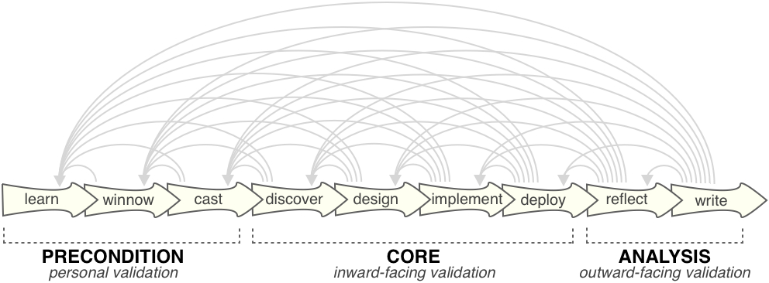
Methods and durations
Semi-structured interviews
  7 months
  Once per week
  One hour in duration
Presented data sketches
  8 deployed over 5 months
  Implemented with D3 toolkit
  [Bostock et al., InfoVis 2011 ]
Design study methodology [Sedlmair et al., 2012]
Notes:
We applied Sedlmair and colleagues design study methodology to the entire design process. We performed interviews over 7 months, about once per week, and they lasted about one hour in duration. We deployed 8 data sketches over this time. Finally we reflected on the design process and wrote a paper that summarized our work. I will begin to characterize our analysts’ problem with a discussion of their data.

Slide 14
Problem characterization:
Data

Slide 15
The data
Data are sequence variants
  Difference between reference genome and a given genome
Notes:
The data are DNA sequence variants. A variant is a difference between the reference genome for the human species and any given human genome. The reference genome is a consensus sequence of a small group of individuals, and is therefore an approximation that can’t capture all human genetic diversity.

Slide 16
The data
Data are sequence variants
  Difference between reference genome and a given genome
Reference Genome DNA: ATA TGA TCA ACA CTT
Sample 1 Genome DNA: ATA TGG TCA ATA CTT
Sample 2 Genome DNA: ATA TGA TGA ACA CCT
Notes:
There can therefore be many variants between a genome and the reference genome.

Slide 17
The data
Data are sequence variants
  Difference between reference genome and a given genome
Reference Genome DNA: ATA TGA TCA ACA CTT
Sample 1 Genome DNA: ATA TGG TCA ATA CTT
Sample 2 Genome DNA: ATA TGA TGA ACA CCT
Harmful?
Harmless?
Notes:
The task is to determine which are harmful, and which are harmless.

Slide 18
Multi-scale data
DNA of the organism
Notes:
The data contains many different scales. At the top scale, there is the genome. The genome consists of all the DNA for an organism. It is represented by a string of the four letter nucleotide alphabet ATC and G. The genome contains 3 billion nucleotide coordinates.

Slide 19
Multi-scale data
Genes are functional units
Notes:
Genes are shorter stretches of nucleotides that are sprinkled along the genome. Genes are an important unit for analysis because they are usually functional.

Slide 20
Multi-scale data
Exons code for proteins
Notes:
Genes contain exons that can code for functional products. There are regions between exons, but they can have less predictable functional significance for the cell.

Slide 21
Multi-scale data
Regions within proteins perform activities
Notes:
Protein regions are stretches of about 50 amino acids that have important functional significance: they may perform catalytic activities or provide structure for the cell.

Slide 22
Related work:
Genome scale
Notes:
There is previous work that allows analysts to visualize variant data and their biological context.

Slide 23
Ensembl genome browser
Explore genome and variant data
[Chen et al., BMC Genomics 2010]
Notes:
The genome browser is a pervasive tool for genome and variant data analysis. I’m showing a screen capture of the Ensembl genome browser, but there are others such as the UCSC genome browser. Their approaches to displaying data are similar.

Slide 24
Genome scale shown at the top
Notes:
In this representation, the genome scale is shown at the top of the display…

Slide 25
User data is stacked in horizontal tracks
Notes:
… and user data is stacked in horizontal tracks…

Slide 26
User data is stacked in horizontal tracks
Very flexible framework
Notes:
The flexibility of a genome browser comes from being able to compare multiple tracks containing different data types; this comparison is made possible by the shared genome coordinate or x-axis.

Slide 27
Problem with the genome scale
Features of interest become small
Notes:
The problem with the genome scale, however, is that features of interest in the data become small.

Slide 28
Problem with the genome scale
Features of interest become small
Variant
Notes:
Here is a variant is encoded as a thin, short, coloured line.

Slide 29
Problem with the genome scale
Features of interest become small
Variant
Exon
Notes:
And here is an exon. These features are interesting to the analyst, but at the genome scale, it’s difficult to resolve them.

Slide 30
Analysts must pan and zoom
Notes:
To see these features, the analyst must use interaction techniques such as panning and zooming to areas of interest.

Slide 31
Analysts must pan and zoom
Heavy interaction costs with zooming

Slide 32
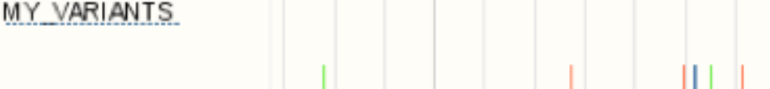
Analysts must pan and zoom
Heavy interaction costs with zooming
Variant
Must know where to look
Notes:
This can have heavy interaction costs such as cognitive load.

Slide 33
Raw variant data
(What they looked at before)

Slide 34
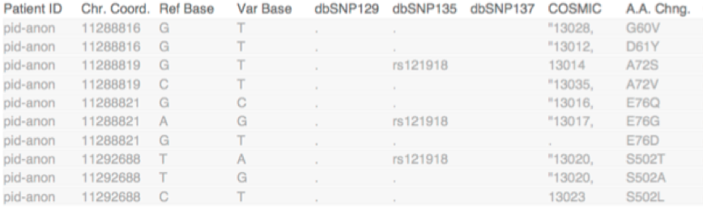
Raw data variant-centric
Tabular data format
Notes:
Originally our analysts inspected their variant data in a tabular format.

Slide 35
Raw data variant-centric
Tabular data format
Variant row 1
Notes:
Each row represents one variant which has several attributes attached to it.

Slide 36
Raw data variant-centric
Tabular data format
Variant row 2

Slide 37
Raw data variant-centric
Tabular data format
Variant row 2
Difficult to reason about variants without their biological context
Notes:
This method of display is variant-centric, but variants can have greater or lesser impact depending upon where they reside with respect to several levels of biological context. This display is limiting because it does not capture these levels.

Slide 38
Multiple biological levels/scales
What to show?

Slide 39
Many biological levels and scales
Notes:
It’s important to retain some biological levels so we can situate a variant within its context for informed analysis to take place. Based on discussions with our analysts, we were able to define the structure and features of interest within the data that were important for variant analysis.

Slide 40
Only some levels and scales are beneficial for variant analysis
Notes:
As it turned out, only some biological levels and scales of the data were beneficial for analysis.

Slide 41
Filter out whole genome; keep genes
Notes:
Reasoning about variants for our analysts required thinking about a variant’s position and attributes within genes. Since the genome contains a lot of material that does not constitute genes, we could safely eliminate it, and limit consideration of the data space to just gene coordinates.

Slide 42
Filter out non-exon regions
Notes:
Furthermore, our analysts were only concerned with performing analysis on exon regions within a gene. Exons can contribute to functional transcript and protein products, so variants affecting these regions could have a big impact on the cell.

Slide 43
Left with a filtered scope
Notes:
In the end, we were left with a heavily filtered scope that included the transcript and protein regions. For our analysts, determining a variant’s effect on the cell required reasoning about a variant’s attributes in concert with its position within the transcript and protein regions. Other tools have attempted this type of filtering, but I’ll show you why we feel they don’t go far enough.

Slide 44
Related work:
Filtered scope

Slide 45
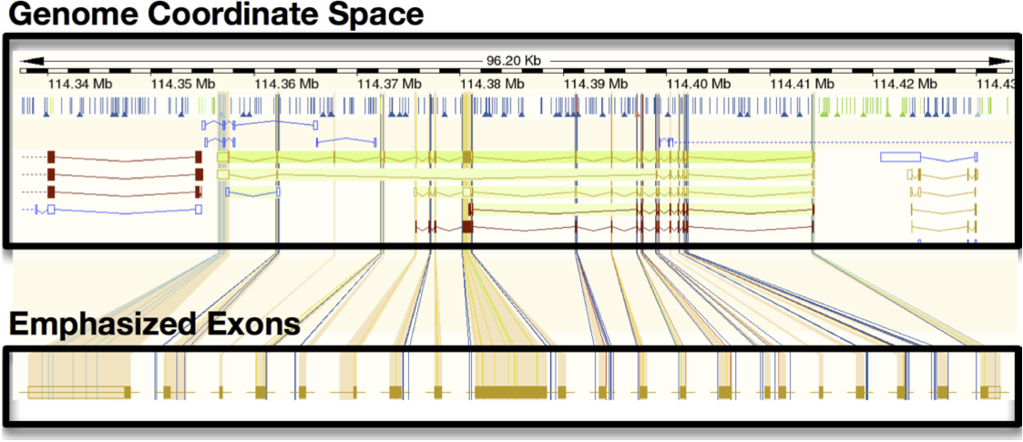
The Ensembl Variation Image
[Chen et al., BMC Genomics 2010]
Notes:
This is the top of the Ensembl Variation Image display: a tool tailored for variant analysis. This tool is available as part of the Ensembl genome browser.

Slide 46
First filtering step: per-gene view
One gene shown
[Chen et al., BMC Genomics 2010]
Notes:
This display attempts a filtered view of the data. The first filtering step was to display one gene at a time, leaving the rest of the genome out.

Slide 47
Second filtering step: partial removal inter-exon regions
Partial removal
[Chen et al., BMC Genomics 2010]
Notes:
Second, the regions between exons are partially removed to slightly exaggerate their presence. The variation image has taken some important steps toward tailoring the display for variant analysis, but problems that are common to genome browsers still remain.

Slide 48
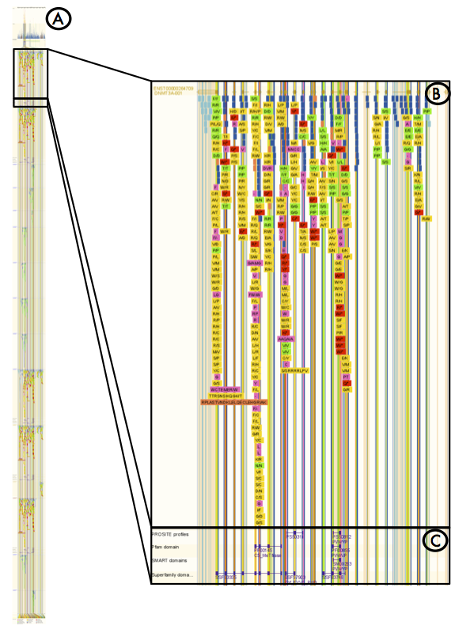
Problem: Extends multiple screens
[Chen et al., BMC Genomics 2010]
Notes:
Data on the variation image stacks to create a vertically tall display. The screen capture shown is annotated to show the region of the display that fits into a screen in B and C on the right, while the total display, shown on the left and labeled A, extends across 10 screen lengths.

Slide 49
Problem: Extends multiple screens
1st Screen
[Chen et al., BMC Genomics 2010]

Slide 50
Problem: Extends multiple screens
2nd Screen
[Chen et al., BMC Genomics 2010]
Notes:
Scrolling to reveal more data has heavy interaction costs, such as cognitive load, because the user must remember the content of previous screens to inform analysis on a current screen.

Slide 51
Problem: Features of interest small
Exon regions small
Color coding difficult to see
[Chen et al., BMC Genomics 2010]
Notes:
Finally, the scale of the data is too large, so exon regions still appear small, and variants are encoded as thin lines which are difficult to resolve. Additionally, a severe practical limitation here is that analysts can’t upload their own data. Given the limitations of the previous work, we felt there was still a gap to fill in order to address our analysts tasks.

Slide 52
Our Goal:
Show attributes necessary for variant analysis
Notes:
Our goal was to show all attributes and context necessary for variant analysis, and nothing else.

Slide 53
Use information-dense visual encoding
Notes:
We decided to create an information-dense visual encoding that is in contrast to other approaches that encode variants merely as coloured lines. In the diagram onscreen, the grey line encodes the position of the variant across several bars representing its biological context - I’ll explain the bars in just a few slides. We encode additional attribute information at the top of the variant line which I will also get to. Note that there are three variants depicted here, and they are all at the same position. If variants are collocated, the variant encodings will fan out at the top of the variant line, and a bloom-like structure will result emphasizing collocation.

Slide 54
Use information-dense visual encoding
Notes:
Whenever possible, we tried to leverage symbols biologists are familiar with. A biologist can look at the part of the encoding pointed to on the left, and see that at one of the variants at this position, the human reference genome had a Serine amino acid (the S symbol) …

Slide 55
Use information-dense visual encoding
Notes:
… and the variant amino acid at this position is Threonine (the T symbol).

Slide 56
Use information-dense visual encoding
Notes:
Amino Acids can be grouped in to 4 classes depending on their properties. A change in class means that the variant could be problematic for cell function. We encoded class with color since there are only 4, and because a change in color is highly detectable. Additionally the 4 colors are colorblind safe.

Slide 57
Use information-dense visual encoding
Notes:
Each variant has an attribute describing its type: knowing the variant type can give the analyst an idea of the kind of impact the variant might have on the cell, especially in combination with the variant’s position: for instance, knowing that a stop or truncation mutation occurs right before an important functional region lets the analyst know that this region might never be produced, which could have dire consequence for the life of the cell. We chose to encode type with icon, since there are icons we could lift from the biological literature and also because it allows us to use color for other attributes, such as amino acid class.

Slide 58
Use information-dense visual encoding
Notes:
As I mentioned earlier in the talk, variants are revealed based on comparison to a reference genome. Curated databases exist which attempt to compensate for the reference genome’s inability to fully capture human genetic diversity. Our analysts’ variant data had attributes describing whether or not a variant had been reported before in a known cancer causing or known harmless database. We encode this presence in a database with the circle marks shown at the top of the variant encoding.

Slide 59
Use information-dense visual encoding
Notes:
We wanted to show our analysts how variants are situated with respect to relevant biological levels. The transcript and protein regions are levels we determined were informative for variant analysis. We represent these levels as horizontal bars. We redundantly encode them with color and spatial position to emphasize the difference between them. Protein regions are encoded on separate lanes to avoid the overlap and occlusion that can happen if they are encoded on the same horizontal track.

Slide 60
The tool:
Variant View

Slide 61
Variant View
Notes:
I will now walk you quickly through Variant View, the variant analysis tool we created.

Slide 62
Variant View
Information-dense single gene view
Notes:
The center of the display includes the visual encoding for the transcript, protein regions, and the variants situated within them

Slide 63
Variant View
Information-dense single gene view
No need for pan and zoom
Notes:
As mentioned, we tried to heap as much information into the overview display as possible so as to reduce or completely remove the need for memory intensive pan and zoom navigation techniques.

Slide 64
Variant View
Sorting metrics guide gene navigation
Notes:
We only show one gene at a time in the main view because variant analysis takes place at the gene level. However, given a long list of genes, you might be wondering how to prioritize analysis of them. Well, with Variant View, if you know the name of the gene you’re interested in, you can simply type the gene name into the search box and Variant View will retrieve it. If not, you can also use the gene selection list at the right of the display. The gene selection list is sortable by alphabetical order of gene name, and two newly-derived metrics that capture variant impact. Details of these metrics can be found in the paper.

Slide 65
Variant View
Sorting metrics guide gene navigation
Control what shows up here
Notes:
Selecting a gene from the list at right will display the gene and its variants in the centre.

Slide 66
Variant View
Peripheral supporting data
Notes:
At the bottom of the display you’ll notice the tabular view of variants I mentioned before. This table includes additional information for each variant. Selecting a variant in the main view will highlight its entry in the table view and vice versa.

Slide 67
Related work:
Targeted for variant analysis
Notes:
There are a couple of recent representations that attempt to target depiction of variants in a single gene view like Variant View. I’ll discuss one of them.

Slide 68
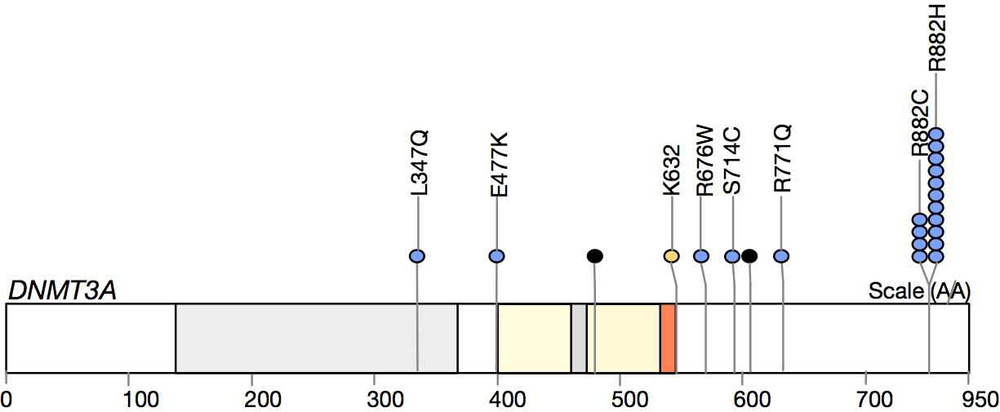
MuSiC variant visualization plot
[Dees et al., Genome Research 2012]
Notes:
MuSiC is a library that creates static plots depicting variants in a single gene view. It is not an interactive tool like Variant View, but, from a visual encoding perspective, MuSiC attempts to encode attributes that are important for variant analysis, so it is useful to compare our visual encoding to MuSiC’s. The depictions of MuSiC I show are mock-ups I created because it was not possible to plot our own variant data with MuSiC: the plotting capabilities are not currently documented.

Slide 69
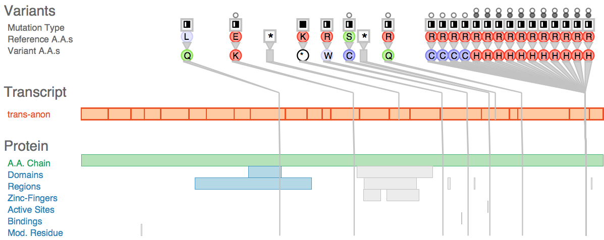
Side-by-side comparison
Notes:
I am showing the same variant data in each display. The MuSiC plot is shown at top, and the Variant View display is shown at the bottom.

Slide 70
Side-by-side comparison
Protein regions can overlap
Regions get separate lanes
Notes:
The first major advantage our encoding has over the MuSiC representation concerns the display of protein regions. The MuSiC display encodes protein regions all on the same horizontal track, so regions can overlap and occlude each other. We encode regions on separate lanes so this occlusion doesn’t happen.

Slide 71
Side-by-side comparison
Many collocated variants
Large bloom of repeated elements: more salient
Notes:
One of our biggest advantages over MuSiC is our display of variant collocation. If variants tend to occur at the same position for a particular disease, disruption of that location may be predictive of the disease. With our display, if multiple variants occur at the same location, the encoding will fan out and produce a bloom like structure. This structure is highly visually salient - more so, we would argue, than the encoding for the same number of variants in the MuSiC representation.

Slide 72
Driving biological tasks
Notes:
To give you an idea of how Variant View was used by our analysts, I’ll discuss some of the driving biological tasks it was used for.

Slide 73
Task 1: Discover genes
Tool originally designed to discover genes
with harmful variants
  Sorting metrics guide single gene navigation
  Uncover new genes affected by variants in leukemia
Want to see if Variant View exposed known genes in leukemia
Notes:
Variant View was originally designed to discover genes with harmful variants in leukemia. We wanted to see if using the derived sorting metrics to prioritize inspection of a long list of genes, along with visual inspection of genes near the top of the sorted selection list, could help identify new genes that were heavily impacted by variants. Heavily impacted genes could be candidate genes for leukemia.

Slide 74
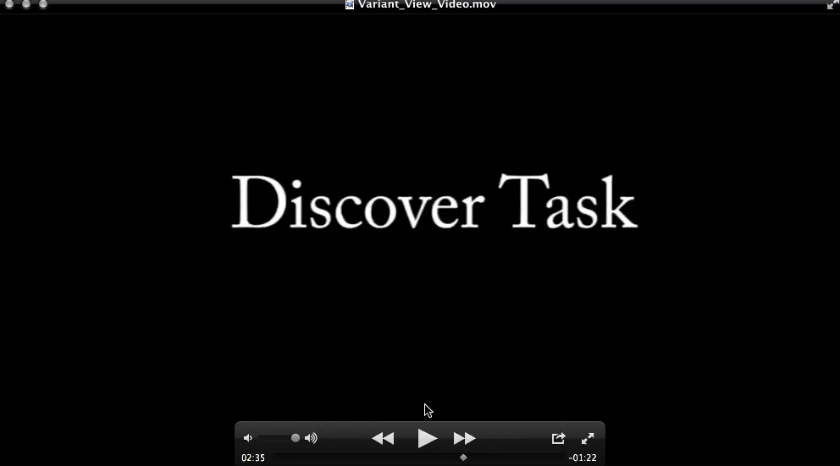
Notes:
(start at 4.72 seconds)
I’m going to show a quick video just to give you an idea of Variant View’s use and its interaction techniques.
<< Start Video >>
We are now sorting genes in order of one of the derived metrics of variant impact. Genes near the top of the list will be highly scored by the metric, and heavily impacted with variants.
The gene list is blurred out because research of some of these genes are ongoing. Genes lower on the list tend to have less interesting variant distribution patterns.
<< End Video >>

Slide 75
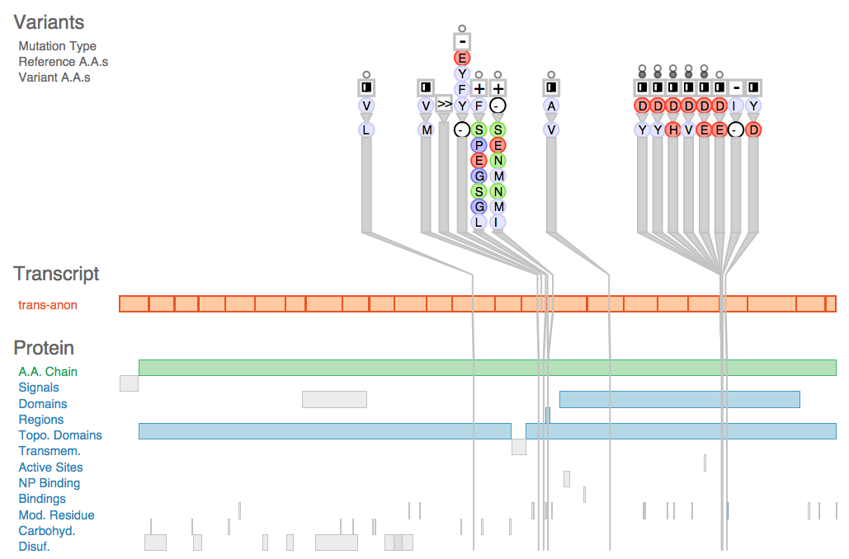
Sorting by derived metric revealed known leukemia genes
Notes:
In summary, by sorting by the derived metric, Variant View is able to reveal known leukemia genes, such as the one displayed here.

Slide 76
Highly scored gene by sorting metric
Notes:
This particular gene was highly scored by the derived metric of variant impact.

Slide 77
Visual inspection reveals collocation of variants
Notes:
Visual inspection of the gene reveals collocation of variants, as the highly visually salient bloom-like structure indicates.

Slide 78
Several functional protein regions affected
Notes:
As well, several functional protein regions are affected by variants which may disrupt the proteins’ ability to function as catalysts, or provide structure for the cell.

Slide 79
Highly scored by metric and not known
Notes:
The metrics also revealed new, previously unknown genes that might be implicated in leukemia.

Slide 80
Protein chemical class change evident
Notes:
Visual inspection of the variants reveals that a protein chemical class change is also highly evident. The change from red to blue from top to bottom tells the analyst that the variant amino acid is a completely different class from the human reference genome’s amino acid at this position. This could have a big impact on the cell.

Slide 81
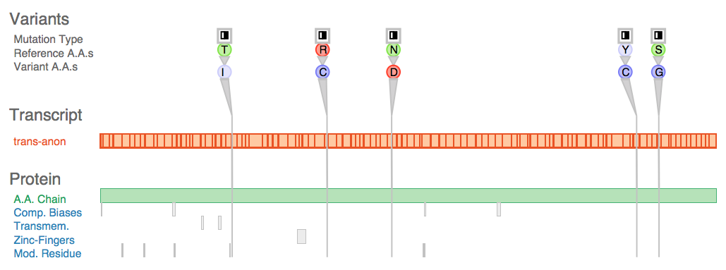
In contrast, low scoring gene
Notes:
In contrast, this gene was low scoring based on our derived sorting metrics.

Slide 82
No collocation of variants
Notes:
You’ll notice a relatively uniform distribution of variants. There is no collocation of variants.

Slide 83
Mostly unaffected protein regions
Notes:
From visual inspection, we can also tell that there are mostly unaffected protein regions.

Slide 84
Variant tasks
Started with the main task of discover gene
Shared tool with analysts
Identified two more tasks!
  Patient compare
  Debug pipeline
Notes:
We started with the task of discovering new genes that were implicated in leukemia. Later, we shared Variant View with other analysts during a meeting, and they identified two potential new tasks for the tool.

Slide 85
Task 2: Patient compare
Clinical setting application
Compare patient data to known harmful variants
The challenge
  Similarity is loosely understood rather than fully characterized
  What constitutes a match requires visual inspection
Notes:
The first new task was a clinical setting application at the BC Cancer Centre. The task was to compare incoming patient variant data to known harmful variants. If the patient has similar variants, then the patient may have the disease associated with the harmful variants. The challenge here is that similarity is loosely understood rather than fully characterized, and what constitutes a good match could require visual inspection.

Slide 86
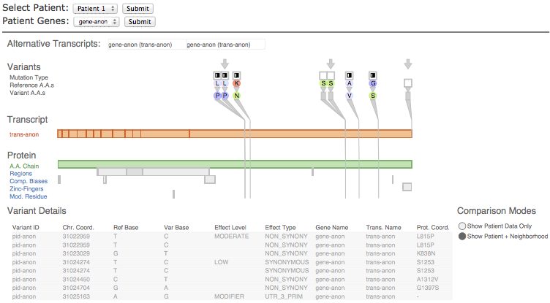
Adapted Variant View with minimal changes
Notes:
We adapted Variant View with minimal changes to support this comparison task.

Slide 87
Navigate through patient data with list
Notes:
We can select the patient and gene we’re interested in.

Slide 88
Patient data emphasized with arrows
Notes:
The patient data is emphasized with arrow icons to distinguish them from known harmful variants surrounding them.

Slide 89
Patient has same harmful L to P mutation
Notes:
In this patient, in this gene, we can see that the patient has the same L to P variant as in the harmful variant data set. It may be a good idea to follow-up with this patient.

Slide 90
These variants probably do not match
Notes:
In contrast, these two variants are dissimilar by proximity and attributes, so they probably don’t match.

Slide 91
Task 3: Debug pipeline
Debug data generation pipeline
  Remove errors from data before analysis takes place
Analysts originally did not think they needed this support
Notes:
A last new task we uncovered for Variant View was the debug pipeline task. We wanted to use Variant View to remove errors that could have crept into the data during the data generation pipeline. Our analysts originally did not think they needed this support.

Slide 92
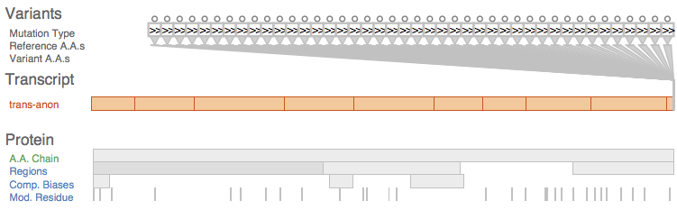
Tool revealed errors in the data
The tool exposed artifacts in the data that slid past at least two rounds of quality metric filtering … this type of problem would not have been caught by our previous, automated methods.
- Analyst 3
Notes:
Here is an example of a variant that is repeated an abnormal number of times, and a quote from one of our analysts: “The tool exposed artifacts in the data that slid past at least two rounds of quality metric filtering … this type of problem would not have been caught by our previous, automated methods.”

Slide 93
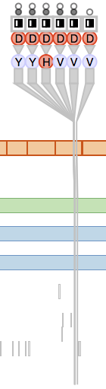
Conclusions
Designed, implemented, and deployed tool for visual variant impact assessment
Originally designed for Discover Genes task
  Adapted to two others with minimal changes
Methods
  What to show
    Filtering data scope
  How to show it
    Carefully selected visual encodings
Goals
  Navigation-free main overview at gene level
  Reveal genes of interest; accomplished by sorting by new, derived metrics
Notes:
In this design study, we designed, implemented, and deployed a tool for variant impact assessment. We originally designed Variant View for the discover genes task, but were able to adapt it to two other tasks with minimal changes. We used our knowledge of our analysts’ data and tasks to aggressively filter the scope of the data, and focus acutely on features of interest; we then carefully selected visual encodings for just those biological levels and variant attributes our analysts needed for variant analysis. Our major goals included a navigation-free main overview at the gene level, and to reveal genes of interest to the user, which we accomplished through a gene selection list sortable by new derived metrics of variant impact on a gene.

Slide 94
Acknowledgements
Our collaborators at the GSC
  Dr Aly Karsan
  Rod Docking
  Dr Linda Chang
  Dr Gerben Duns
  Simon Chang
Funding
  VIVA, AeroInfo Systems/Boeing Canada, MITACS
Notes:
Finally, we would like to thank our collaborators at the BC Genome Science Centre and our sources of funding.

Slide 95
Questions?
Joel Ferstay: joel.ferstay@gmail.com
Paper Page:
http://www.cs.ubc.ca/labs/imager/tr/2013/ VariantView/
Software Available as Open Source
Notes:
Thank you for your attention. I can now take any questions.

Slide 96
Future work: Other use contexts
Scaling up beyond the current design target
  ~50 variants at once
Possibly integrate Variant View with MedSavant
  Tool by Fiume et al., BioVis Posters 2012
  Focus on interactive filtering
Notes:
We successfully solved the problem of variant analysis for our current analysts’ data and tasks. But you could imagine tasks that require seeing more than the 50 variants we currently can display in the main view. Scaling up the number of variants which were specified by our current design target could involve integration of Variant View with tools such as MedSavant, which specifically targets interactive filtering of very large variant data sets.

