Slide 1
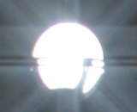
Glare encoding of high dynamic range images
Mushfiqur ‘Nasa’ Rouf Rafał Mantiuk Wolfgang Heidrich Matthew Trentacoste Cheryl Lau
Glare encoding
Reconstruction
IEEE Computer Vision and Pattern Recognition 2011
Glare encoding
Single-shot HDR
Notes:
We propose a novel method to capture HDR imagery with a single image using structured glare
Exposure saturates
Shorter exposure...
We encode saturation info in the structured glare
Decode with our algorithm

Slide 2
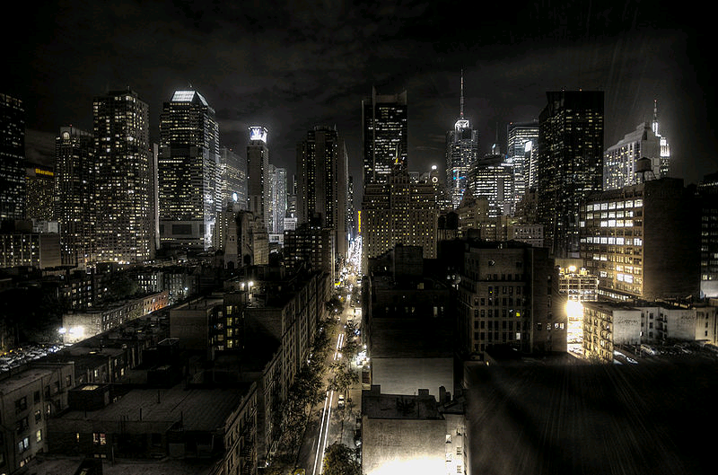
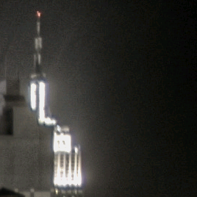
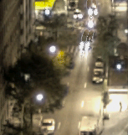
High Dynamic Range Imaging
[http://en.wikipedia.org/wiki/High_dynamic_range_imaging]
Notes:
Natural scene
SKIP Displaying issues
Broad range of values
Dynamic range = ratio

Slide 3
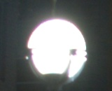
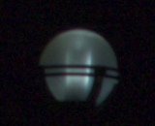
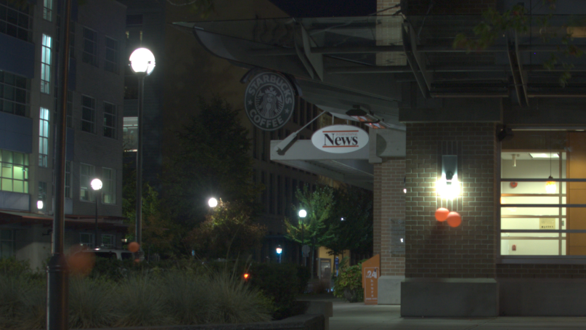
Motivation
Traditional: multiexposure | Our method: single exposure
single device
off-the-shelf
Regular exposure
Shorter exposure
Shorter exposure
Single-shot HDR
Shorter exposure
Glare encoding
Reconstruction
Shorter exposure
Clipped highlight
Scene
Notes:
Exposure saturates
Shorter exposure...
We encode saturation info in the structured glare
Decode with our algorithm

Slide 4
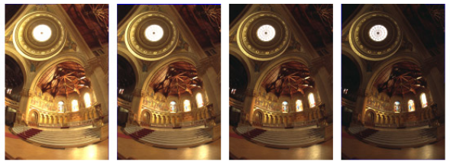
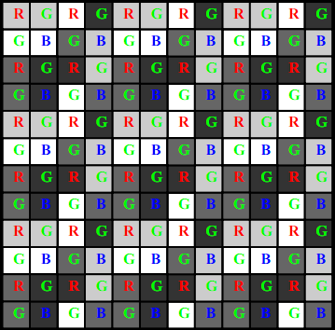
Previous work
Other methods
Our method
Multiple Exposures
[Debevec and Malik 1997]
[Mitsunaga and Nayar 2000]
[Gallo et. al]
Spatial tradeoff
Assorted pixels [Nayar and Mitsunaga 2000] [Nayar and Narasimhan 2005]
Temporal tradeoff
(A)synchronous self-reset [El Gamal 2002] [Kitchen and Bermak 2004]
Single exposure
Full spatial resolution
Single exposure
[Nayar and Narasimhan 2005]
[Debevec and Malik 1997]
Notes:
Most common
Ghosting

Slide 5
Motivation
Good quality sensor dynamic range ≈ 12 f-stops
Natural scenes mostly <12 f-stops
Except 2–5% of the brightest pixels
For only 2–5% pixels: expensive HDR sensor is impractical
Our solution: information encoding!
F-stops

Slide 6
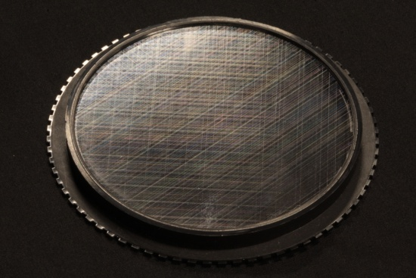
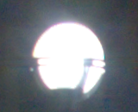
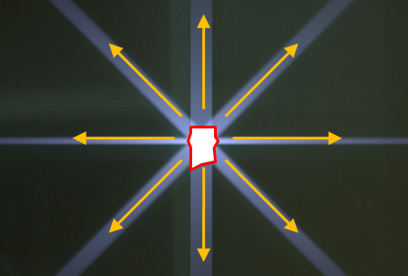
Computational photography for HDRI
Optical encoding
Glare = encode(intrinsic highlights)
Captured image = intrinsic LDR + glare
(highlights get clipped)
Computational decoding
Estimate glare using priors
Intrinsic LDR = captured image – glare
Intrinsic highlights = decode(glare)

Slide 7
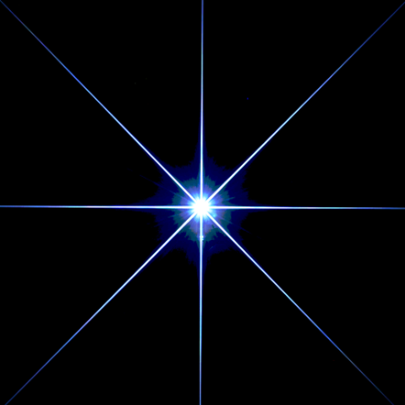
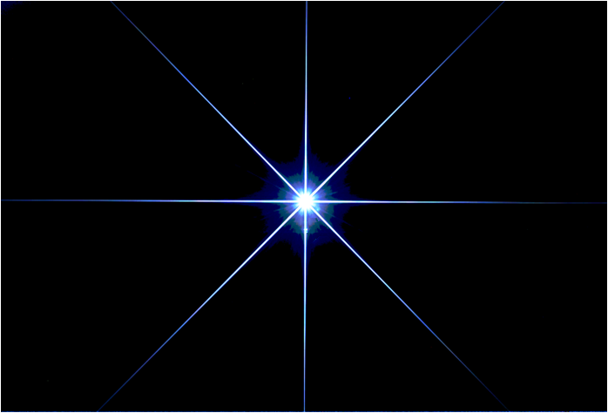
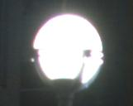
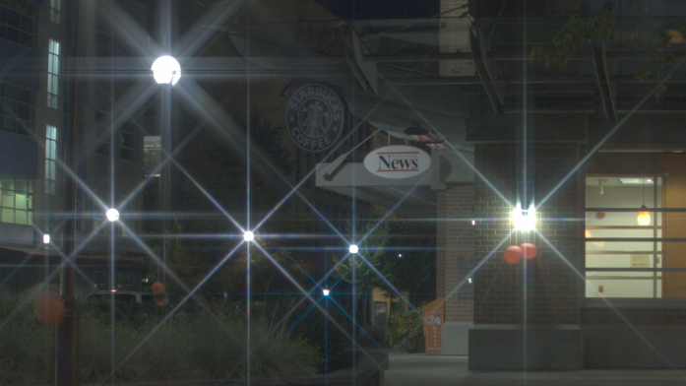
Cross-screen filter to the rescue
No camera modification
Off-the-shelf filter
Common photographic filter
Point spread function
Scene
Captured

Slide 8
Cross-screen filter to the rescue
No camera modification
Off-the-shelf filter
Blur strong yet invertible
“Easy” to deconvolve
Tomography, instead of deconvolution
Point spread function

Slide 9
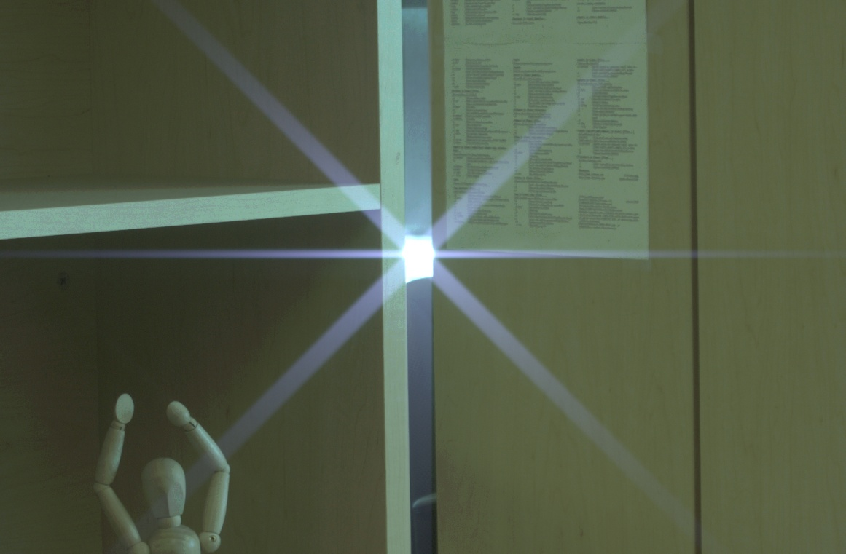
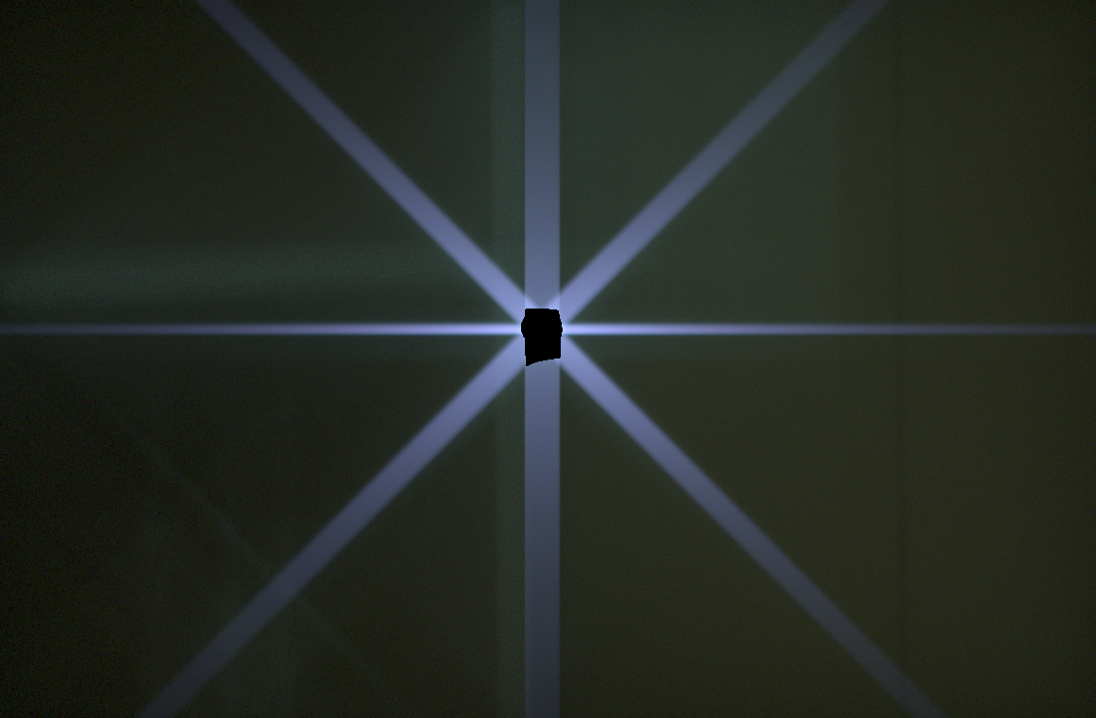
Principle of tomographic reconstruction
Assuming we have estimated the glare...
Iterative reconstruction: SART
Glare
Clipped highlight

Slide 10
Image formation model

Slide 11
Formation of star-shaped glare
Grooves on filter spread light
Sensor
Lens
Filter
Notes:
How the filter works... Focused rays...
Groove spreads... Parallel grooves...
Multiple directions...
... a convolution ...

Slide 12
Formation of star-shaped glare
Grooves on filter spread light
Glare created on a line around a point
Multiple directions of grooves on filter make the star shape
Sensor
Lens
Filter
Notes:
How the filter works... Focused rays...
Groove spreads... Parallel grooves...
Multiple directions...
... a convolution ...

Slide 13
Computational decoding
Glare estimation
Glare removal
Tomography

Slide 14
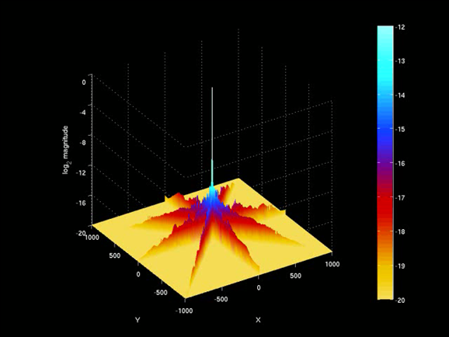
Filter point spread function
Collection of 1D filters ➔ only 1D processing
Possible to process one row at a time
Log magnitude
Sensor
Notes:
That’s the image ...
Glare pattern... Also kernel
LOG PLOT
Collection of 1D filters

Slide 15
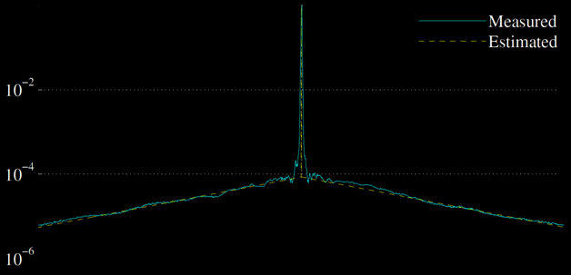
Filter point spread function – 1D
4 orders of magnitude
Log magnitude
Sensor
X
Dirac peak
Linear in log space
Dirac peak preserves spatial frequencies => invertible
Glare falloff encodes brightness
Notes:
LOG PLOT
Linear in log scale = exponential

Slide 16
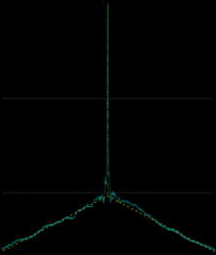
Filter point spread function – 1D
α+β
log
log
log
α
linear
=
+
+
β
X
X
X
X
Dirac peak
Linear in log space
Residual
NOT shift-invariant
(Filter)
Notes:
Split our kernel...
LOG PLOT
Convolution tends to destroy information but...

Slide 17
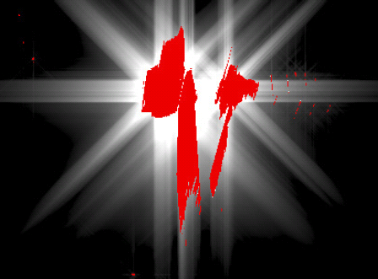
Glare estimation – formulation
Express captured image in terms of intrinsic image
Find intrinsic image by minimizing an energy function
+
=
+
+residual + noise
Glare
Captured g
Intrinsic f
Glare K *f
Clipped
Next: transform this deconvolution into tomography
Constraints on r
Gradients show a heavy-tailed distribution
[Levin et. al 2007]
Notes:
Back to the split kernel
Simulated scenario...
AUTO....
R is not a convolution per se...
Ignore noise
Need prior information...
Sparse prior

Slide 18
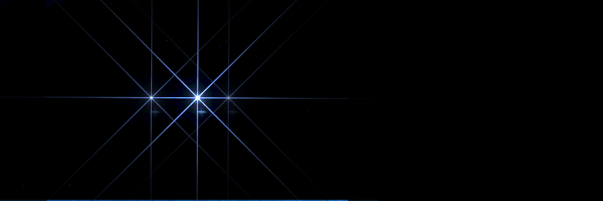
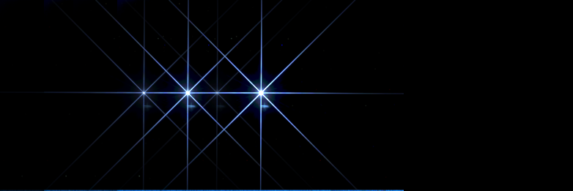
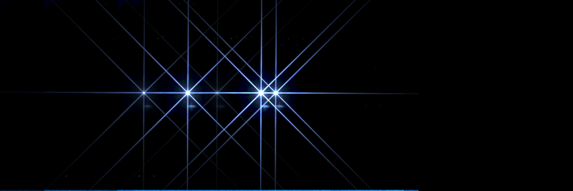
Glare estimation – line integrals
Superimposed glare
gives aggregate brightness: line integral → tomography
has the same linear-in-log-space structure:
Image prior!
Glare line: linear in log space
Log magnitude
Aggregate glare
X
Clipped highlight
Glare
Glare row
Notes:
The exponential falloff observation acts as a powerful prior...
Linear in log space

Slide 19
Glare estimation – estimating line integrals
Relating line integrals with glare
Image prior!
Log magnitude
X
Saturated pixels
u
M
Saturated pixels
Unsaturated pixels
Run: For each M, on each row, for each glare direction
completely describe total glare
Notes:
Instead of solving this equation directly, we use the exponential falloff prior here
For some set of unsaturated pixels in a row ...
(uncover the final equation term by term)

Slide 20
Computational decoding
Glare estimation
Glare removal
Tomography

Slide 21
Glare removal
Glare estimation yields:
LDR only!
Next: reconstruct clipped highlights
=
–
Intrinsic (LDR) f
Captured g
Glare βK * f + γr

Slide 22
Computational decoding
Glare estimation
Glare removal
Tomography

Slide 23
Tomography
Line integral estimates
give aggregate information about clipped pixels
SART tomography
gives the HDR reconstruction
1D projection of
2D unknown region
Glare
Clipped pixels
LDR part
HDR part

Slide 24
Results and discussion

Slide 25
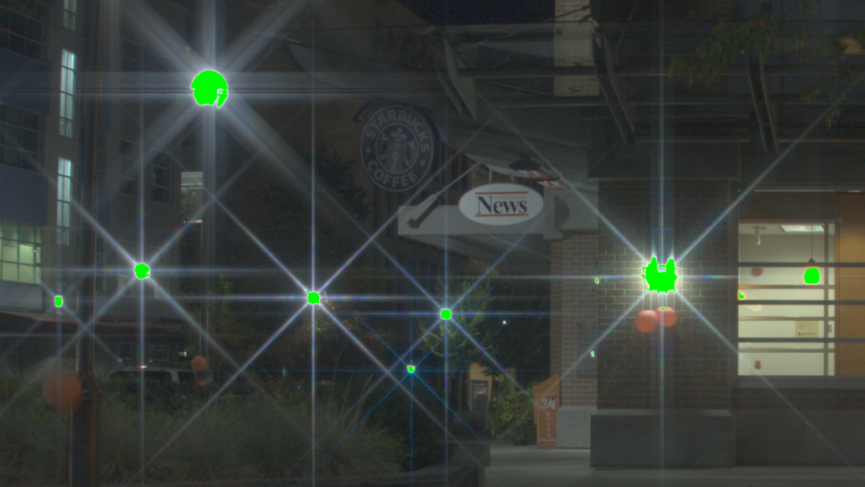
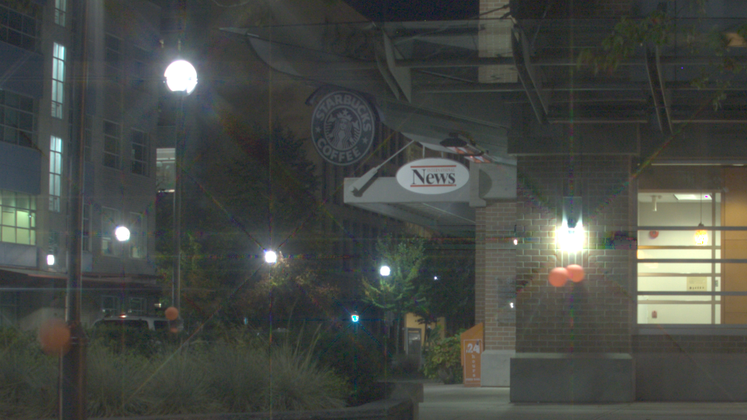
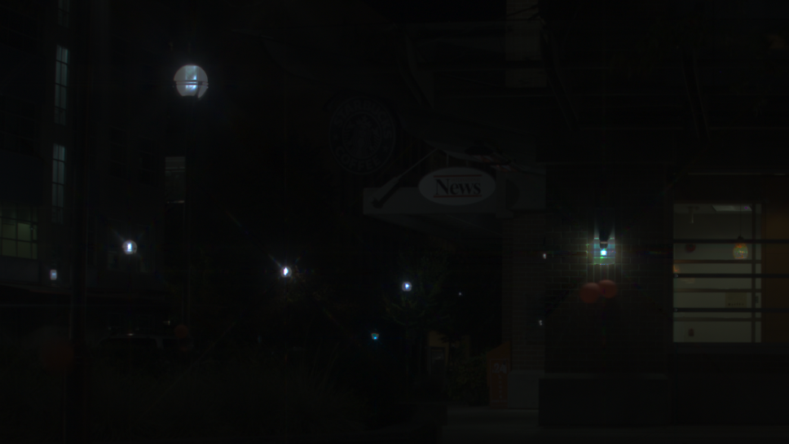
Results – starbucks
Input
Reconstruction
LDR part
HDR part | DR increase: 9.21 f-stops
Clipped
Reference

Slide 26
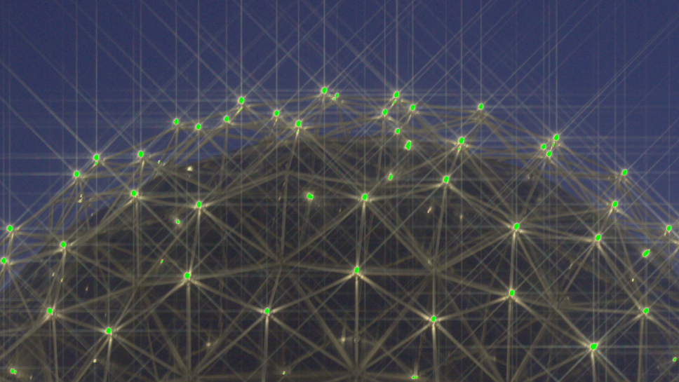
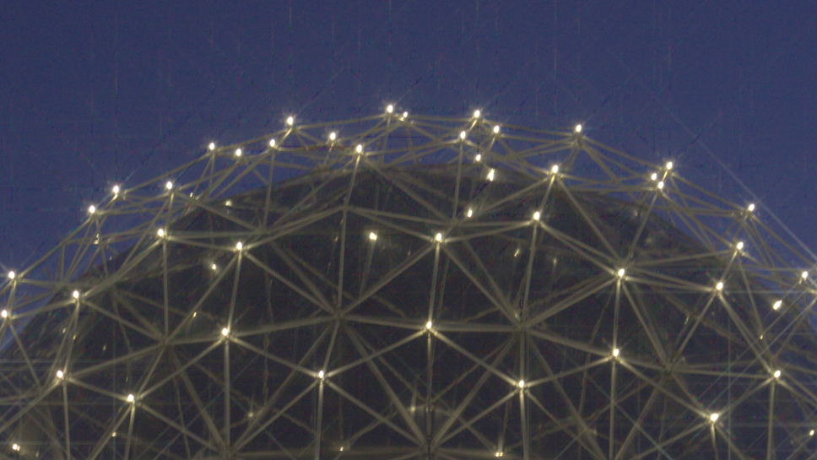
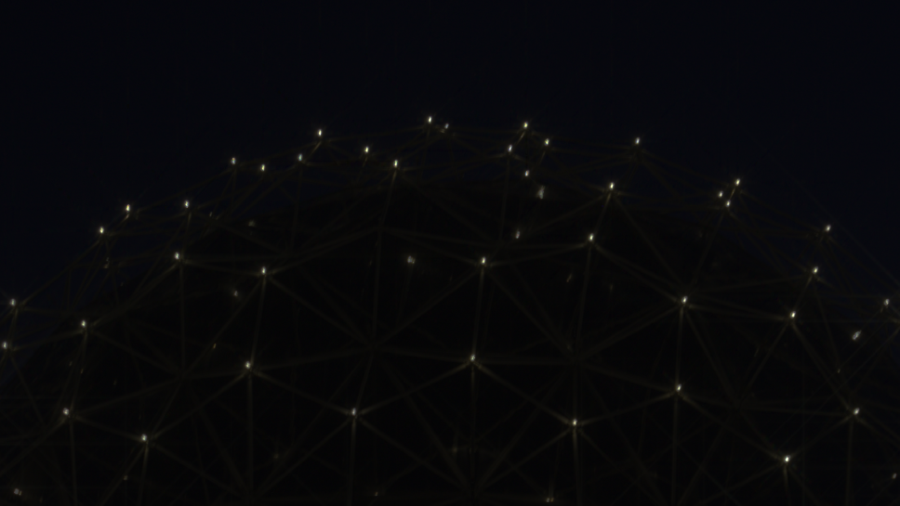
Results – science world
Input
Reconstruction
LDR part
HDR part | DR increase: 5.41 f-stops
Reference

Slide 27
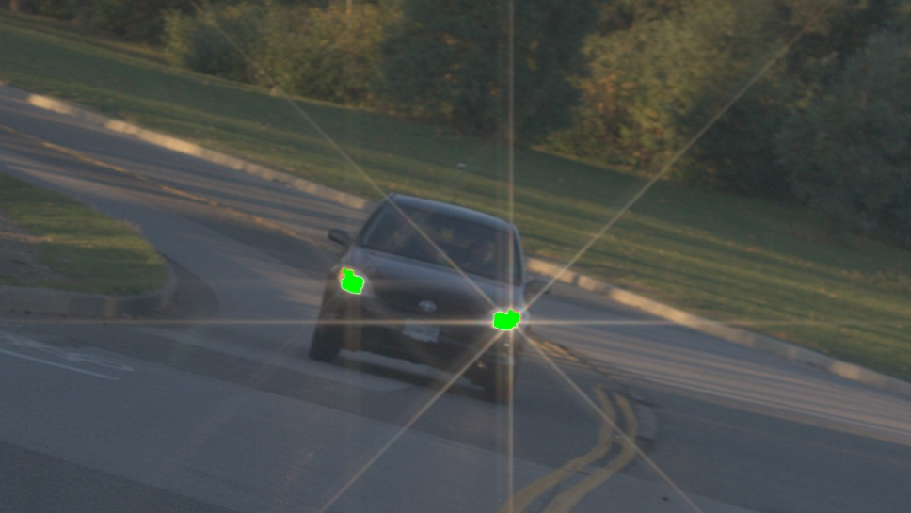
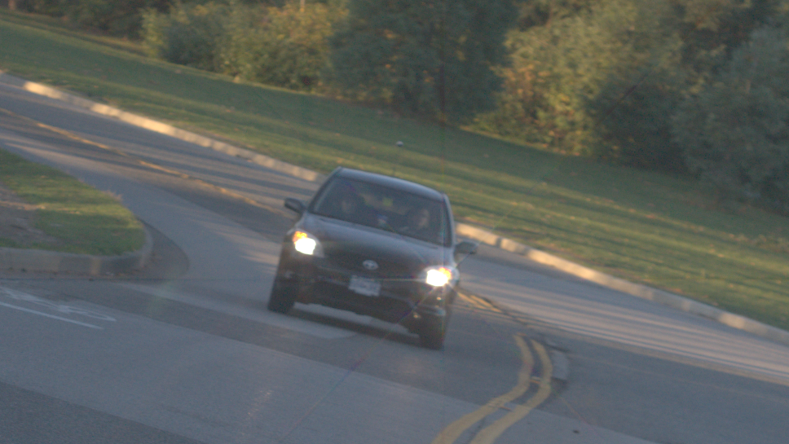
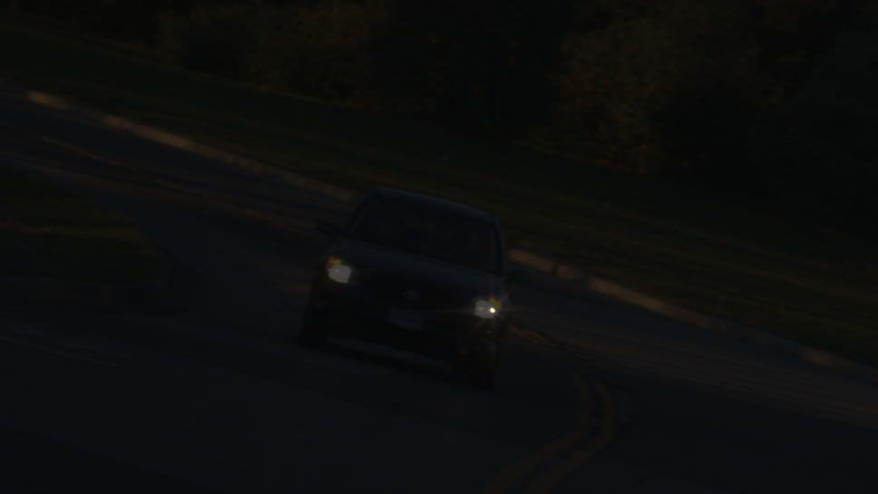
Results – car
Input
Reconstruction
LDR part
HDR part | DR increase: 6.31 f-stops

Slide 28
Discussion
Deconvolution vs. SART Tomography
Good encoding => large energy spread => large PSF
Large linear system
Control over reconstruction
Noise amplification
SART as a regularizer
Limited # of views => Small saturations
Highlights need to be sufficiently bright

Slide 29
Conclusion
Optically encode structured patterns of glare with a cross-screen filter
Preserves frequencies
Is 1D separable
Computationally decode
Image prior: log-linear glare falloff
Sparse gradient prior: L1 optimization in gradient domain
Tomography, not deconvolution!
First single-shot HDRI with off-the-shelf technology

Slide 30
Thank you
Sponsored by

Slide 31
Future work
Video
Other priors
cross channel correlation

Slide 32
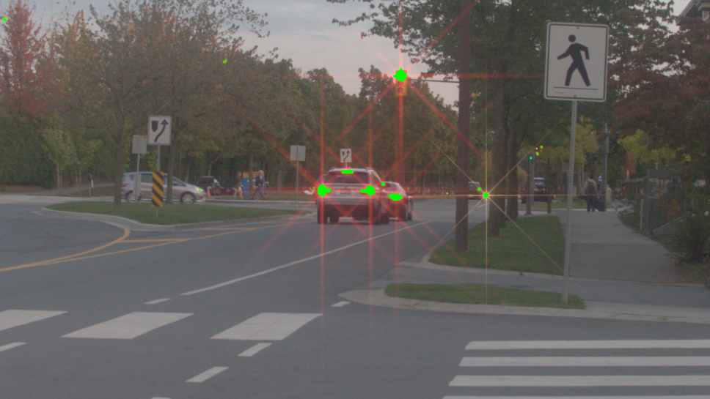
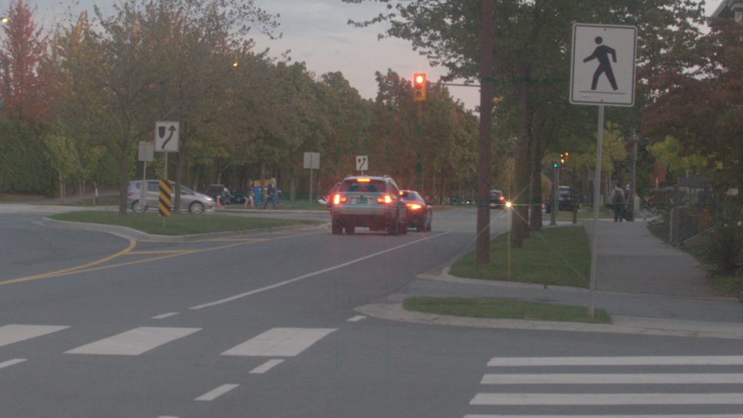
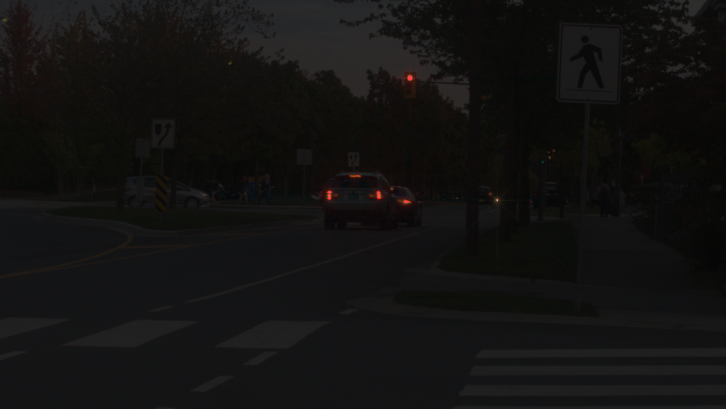
Results – street
Input
Reconstruction
LDR part
HDR part

Slide 33
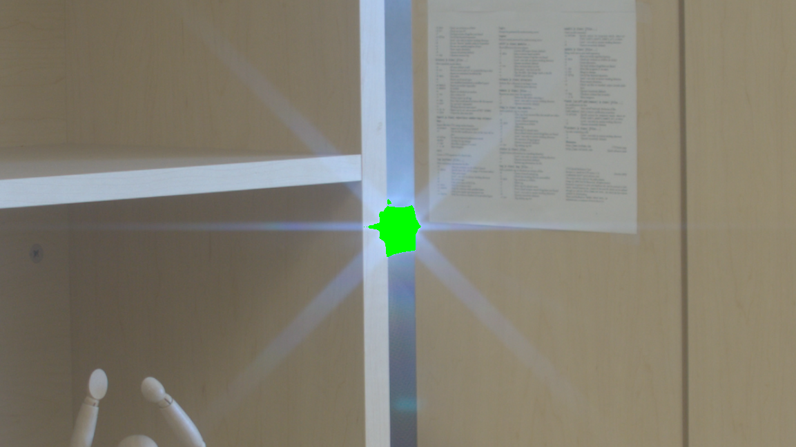
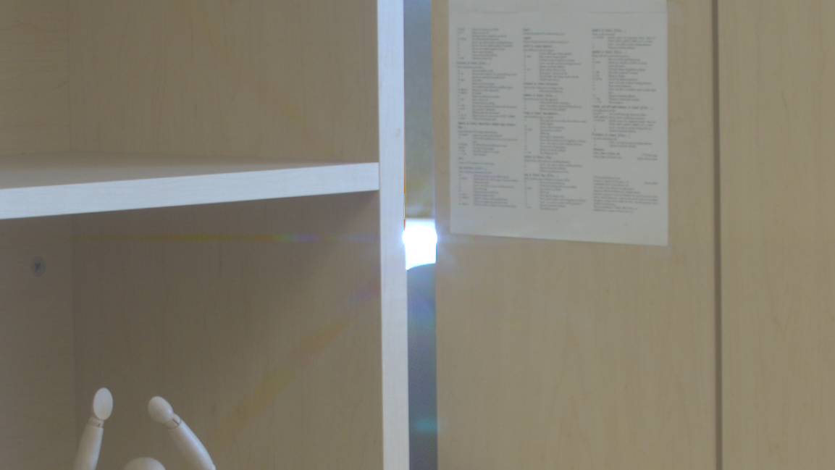
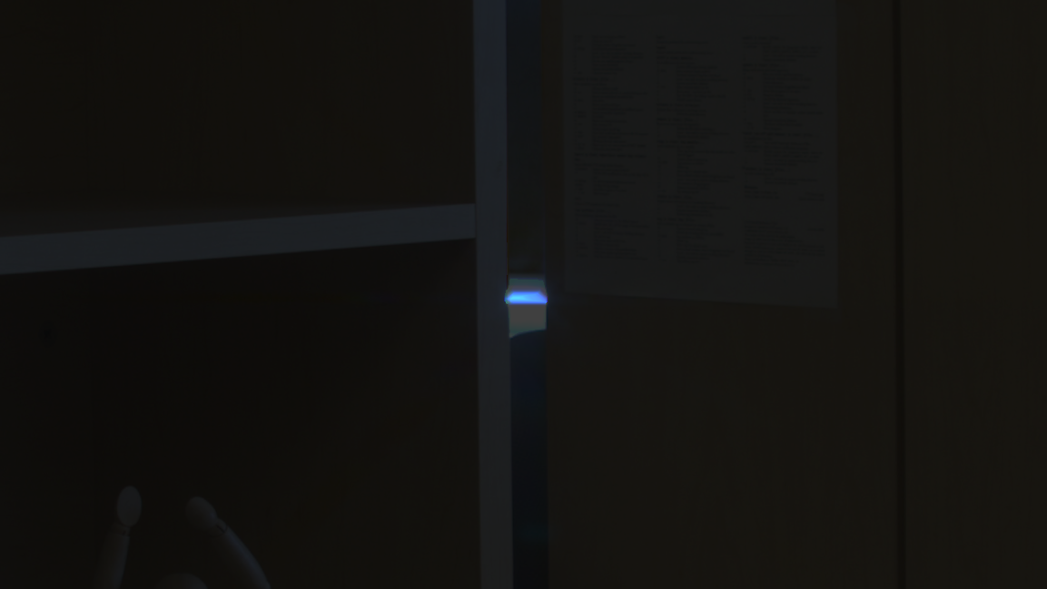
Results – desk
Input
Reconstruction
LDR part
HDR part
Reference

Slide 34
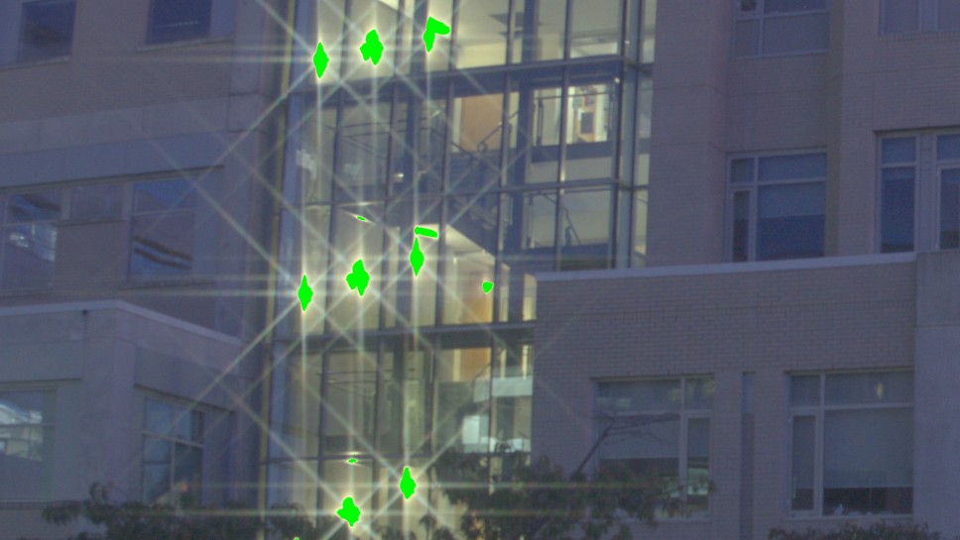
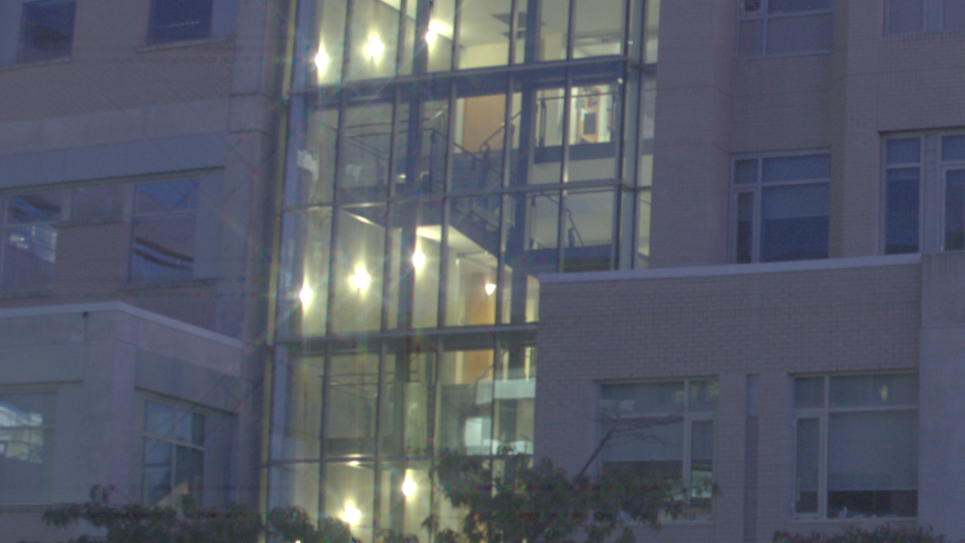
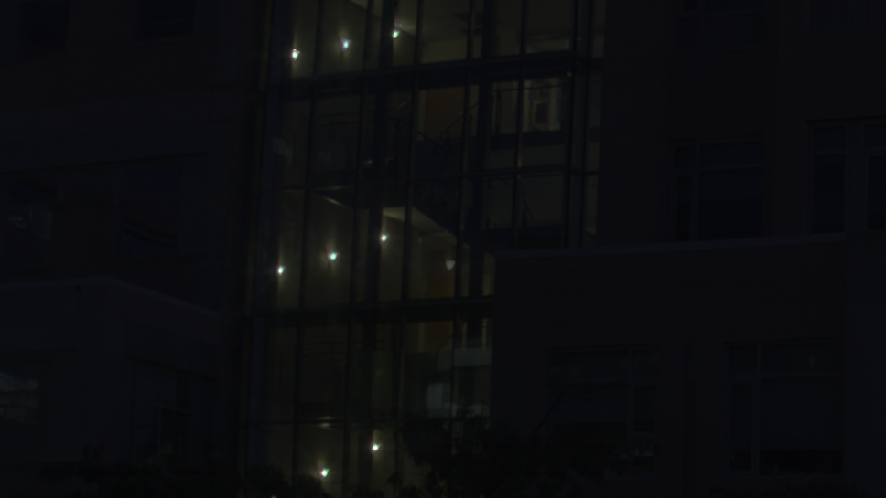
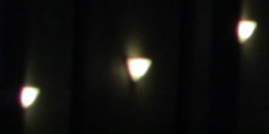
Results – building
Input
Reconstruction
LDR part
HDR part
Reference

Slide 35
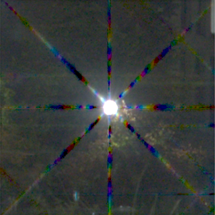
Constraints on residual glare R
Input
Reconstruction
Without R
With R

Slide 36
Extra slide on limits of brightness
Chart from suppl.

Slide 37
Something on Noise
Chart from suppl.

Slide 38
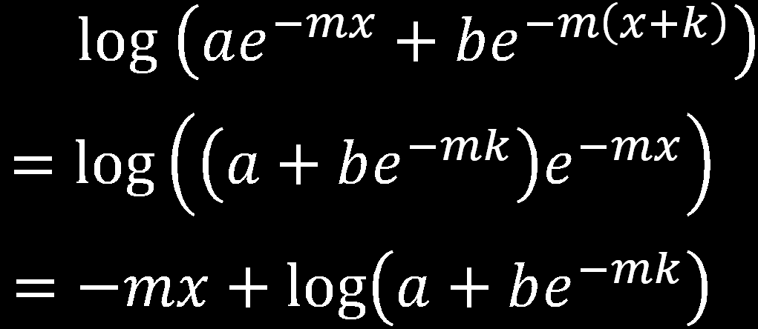
Addition in linear domain?

Slide 39
Application
HDRI
Environment maps
?
?
Add images
Notes:
(Motivate the audience here...)

Slide 40
Image formation model
log
α+β
log
α
log
linear
=
+
+
β
X
X
X
X
Dirac peak
Linear in log space
Residual
NOT shift-invariant
Notes:
Split our kernel...
LOG PLOT
Convolution tends to destroy information but...

Slide 41
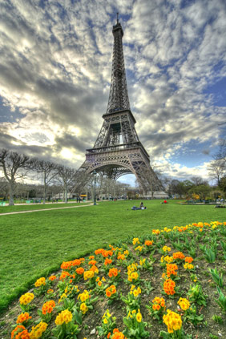
HDR Imaging : HOWTO
Multiple Exposures
Space Tradeoff
[nayar and Narasimhan 2005]
Replace
Need to add references here?
[http://www.hdrsoft.com]
Notes:
Most common
Ghosting

Slide 42
HDR Imaging : HOWTO
Multiple Exposures
Space Tradeoff
Assorted Pixels
[nayar and Narasimhan 2005]
Need to add references here?
Notes:
Camera sensor array
Besides R G B samples...
Demosaicing...
alternately size of pixel...

Slide 43
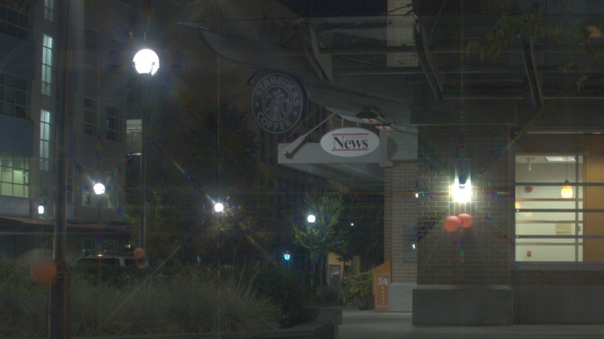
Overview
Cross-screen filter
Tomography
LDR capture Virtual low exposure
replace
Virtual low exposure
Virtual low exposure
L₁ Optimize
Glare
HDR part
LDR part
Recovered
Scene
Captured
Notes:
We use the star filter..
Our algorithm is an optimization..
Separates the glare and does tomography
(need to add a glare image here)

Slide 44
Motivation
98% Scene DR < Sensor DR = 10^{3.5} (~12 f-stops)
Can it be done with one snapshot?
Dynamic range

Slide 45
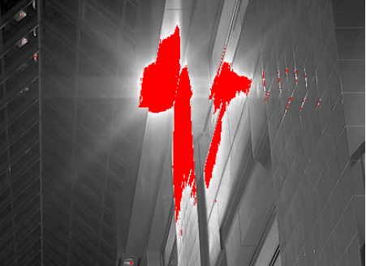
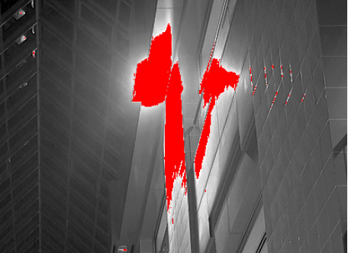
Glare estimation – complete formulation
Clipped
=
+
Glare too dim
Captured g
Original f
Glare
+residual + noise
We need priors to decode information
Natural Images have edges and smooth regions
Gradients show a heavy-tailed distribution
L₁ optimization in gradient domain
[Levin et. al 2007]
Notes:
Back to the split kernel
Simulated scenario...
AUTO....
R is not a convolution per se...
Ignore noise
Need prior information...
Sparse prior

Slide 46
Motivation
98% Scene DR < Sensor DR = 10^{3.5} (~12 f-stops)
HVS cannot capture details in highlights
Accurate reconstruction not necessary
Can it be done with one snapshot?
Encode information!
Filter Profile
CVPR 2011 | Glare Encoding of High Dynamic Range Images
Notes:
Human Visual System ....
... Such as Environment map
We want to Encode
Cheryl’s one page abstract

