Slide 1
A walk in cloud (and look for databases)
Jian Xu
DMM DB-talk, Feb 2010

Slide 2
outline
Cloud products
Architecture
Database issues
Data integration issues
Other topics

Slide 3
Cloud products
Google App Engine
http://code.google.com/appengine/
Amazon Elastic Compute Cloud (EC2)
http://aws.amazon.com/ec2/
Yahoo! Cloud Testbed / M45
http://labs.yahoo.com/cloud_computing
WestGrid
http://www.westgrid.ca/
Microsoft Azure
http://www.microsoft.com/windowsazure/

Slide 4
What’s in common ?
A cluster of centrally managed computing resources
Provide application hosting & storage
Provide API / SDK
Encourage deployment of applications that runs in parallel.
The goal : fast, scalable & cheap computing

Slide 5
Comparison to cluster/grid
Share similar hardware deployment [IBM]
Cloud hides resource specification:
Only API is exposed [google, Amazon]
User transparent to underlying resources
Cluster exposes resource configuration
“Utility” computing
Less or no service support

Slide 6
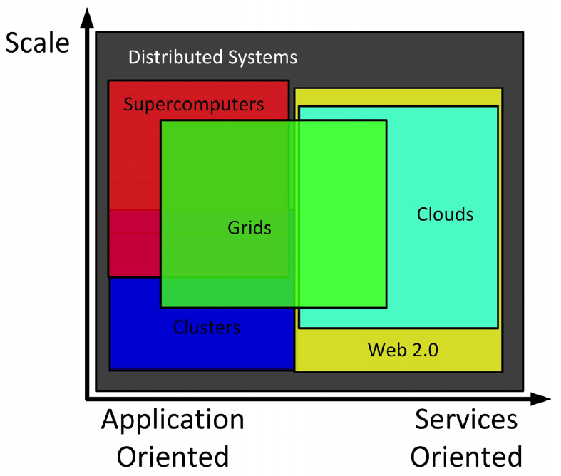
Source : [Foster 09]

Slide 7
Cloud Architecture
Cluster / Grid system as hardware platform
IBM cluster line
Virtualization [Barham03]
Amazon Machine Image
Unified storage and data access model
Google’s bigtable
Amazon’s Simple DB

Slide 8
IBM Architectural Model for Cloud Computing [Web2.0 expo]
Subscribers
Cloud Infrastructure & Application Provider
Web 2.0
Solution Tools
Service Management
End User
Requests
User Request Management/Self Service
Service Lifecycle Management
Design
& Build
Image Lifecycle Management
Provisioning
Performance Management
Availability/Backup/ Restore
Security: Identity, Access, Integrity, Isolation, Audit & Compliance
Usage Accounting
License Management
Image Library
(Store)
Virtualized Applications
Applications & Services
Content & Data
…
Deployment
Mashup
Interface
Web 2.0 Platform
(image deployment, integrated security, workload mgmt., high-availability)
Virtualized Infrastructure
Operational
Lifecycle
of Images
Service
Catalog
Virtual Resources & Aggregations
Server Virt.
Storage Virt.
Network Virt.
Standards Based Interfaces
System Resources
Virtualized Infrastructure
SMP Servers
Blades
Storage Servers
Storage
Network Hardware

Slide 9
Where is database ?
Database as a service
Above / below / crossing virtualization layer
File system v.s. Database
G’s bigtable -- (???)
A’s S3 -- SimpleDB, RDS(mysql based)
M’s Azure Table – SQL Azure

Slide 10
Handling big^big data
Is database too weak?
Map-reduce v.s. Distri. Databases [stonebraker 2010]
Database accepting map-reduce [chen 2009]
Why databases are missing in clouds
General purpose v.s. specific use
Programming model
Work-flow administration
Notes:
Find DB2’s capability, GP has transactions speci. Don’t need them.

Slide 11
Cloud is like database
Cloud
User does not know how resources are allocated
balances resource among user applications
[LINQ]
Database
User does not care how DBMS executes an SQL query
Handles large number of concurrent queries
SQL standard
Notes:
LINQ paper , programming on cloud tends to adopt an “SQL like” fashion that the users specify “requirement”, or “goal’” and system (API, compiler) helps to generate execution plan.
Distinguishing points are developers prefers to use procedure based fashion.

Slide 12
New Database Architectures?
DBMS for High-density clusters, Virtualization platform. [Ibrahim 09]
SSD & SSD-Matrix as storage / high speed cache / virtualized storage
GPU aided computing or DBMS on GPU [He 08]
Notes:
Cite DB performance on virtualization paper, find SSD? Get GPU ad. (70x higher) and Luo Qiong paper.

Slide 13
How about Data Integration?
Domain heterogeneous data sources
Need to scale
More data sources co-operate in query processing
Larger scope of schema
Data integration as a cloud service
Notes:
Add cloud part from previous slides

Slide 14
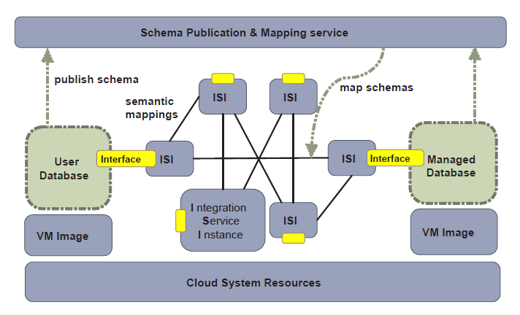
Our preliminary model

Slide 15
Opportunities with Cloud
Cloud gathers data sources into highly available clusters.
Cloud reduces the overhead of replicating data sources.
Cloud simplifies the underlay communication.
Peer-to-Peer model maintains autonomy of individual data sources and scales

Slide 16
Other topics
Security & privacy
New business model
Inter-cloud data exchange

Slide 17
References
[stonebraker 2010] Michael Stonebraker. MapReduce and Parallel DBMSs , Friends or Foes?, CACM 2010
[Ibrahim 09] Shadi Ibrahim et, al . CloudLet: Towards MapReduce Implementation on Virtual Machines. HPDC09
[chen 09] Qiming Chen et, al. Efficiently Support MapReduce-like Computation Models Inside Parallel DBMS. IDEAS 2009
[Loebman] Analyzing Massive Astrophysical Datasets: Can
Pig/Hadoop or a Relational DBMS Help?
[He08] Mars: A MapReduce Framework on Graphics Processors

Slide 18
Reference (2)
[LINQ] Michael Isard, Yuan Yu. Distributed Data-Parallel Computing Using a High-Level Programming Language. Sigmod 09
[Pavlo 09] Andrew Pavlo et, al. A Comparison of Approaches to Large-Scale Data Analysis. Sigmod 09
[Foster 09 ] Ian Foster et,al. Cloud Computing and Grid Computing 360-Degree Compared.
[Web2.0 expo] Scott Gerard. Maximize your web2.0 experience with cloud computing. (presentation on web2.0 expo 2009)
[Barham 03] Xen and Art of Virtualization , SOSP 2003

