Slide 1
IEEE VIS 2024
DeLVE into Earth’s Past: A Visualization-Based Exhibit Deployed Across Multiple Museum Contexts
www.cs.ubc.ca/group/infovis/pubs/2024/delve
Mara Solen¹, Nigar Sultana², Laura Lukes², Tamara Munzner¹
¹ Department of Computer Science
² Department of Earth, Ocean and Atmospheric Sciences

Slide 2
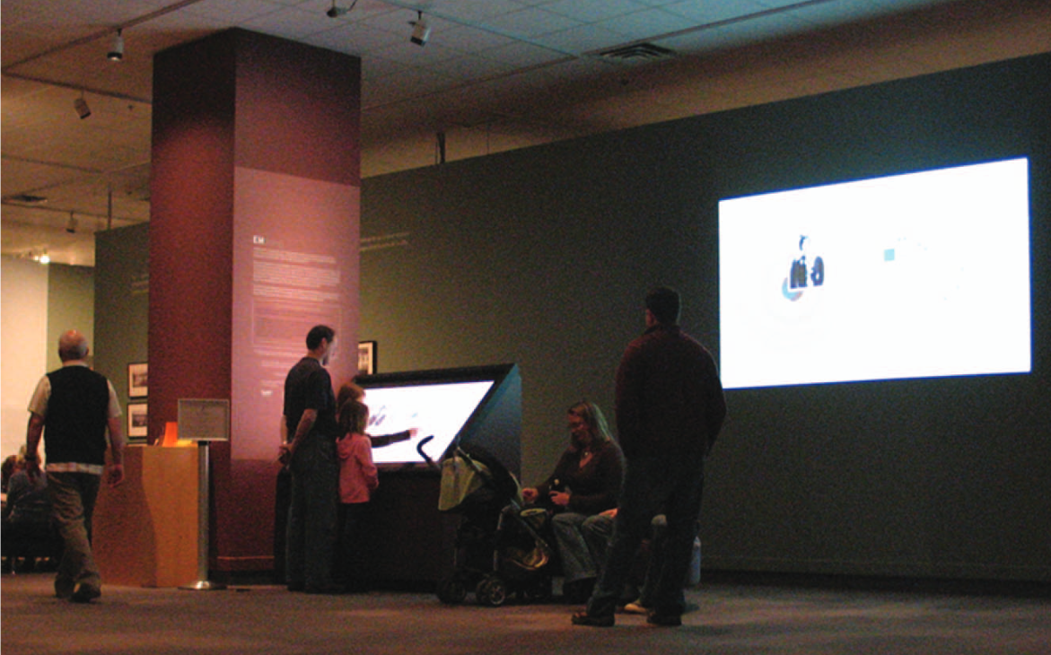
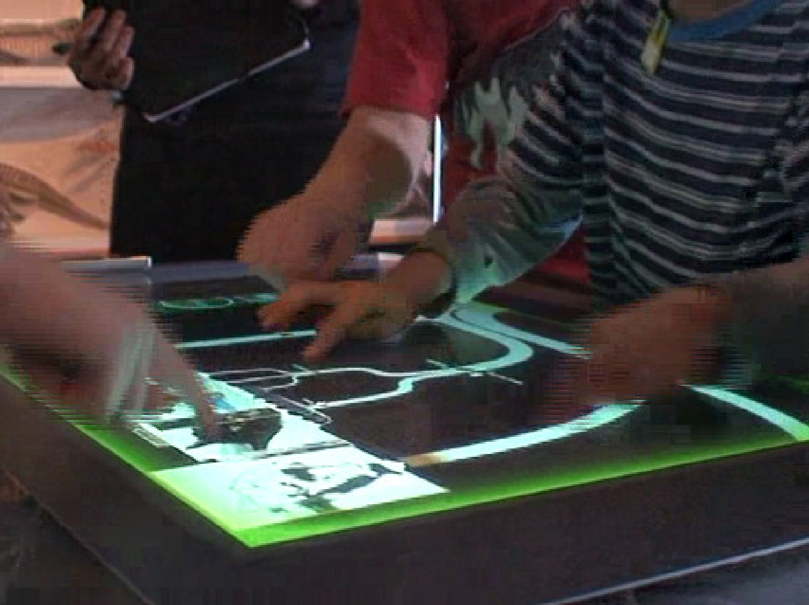
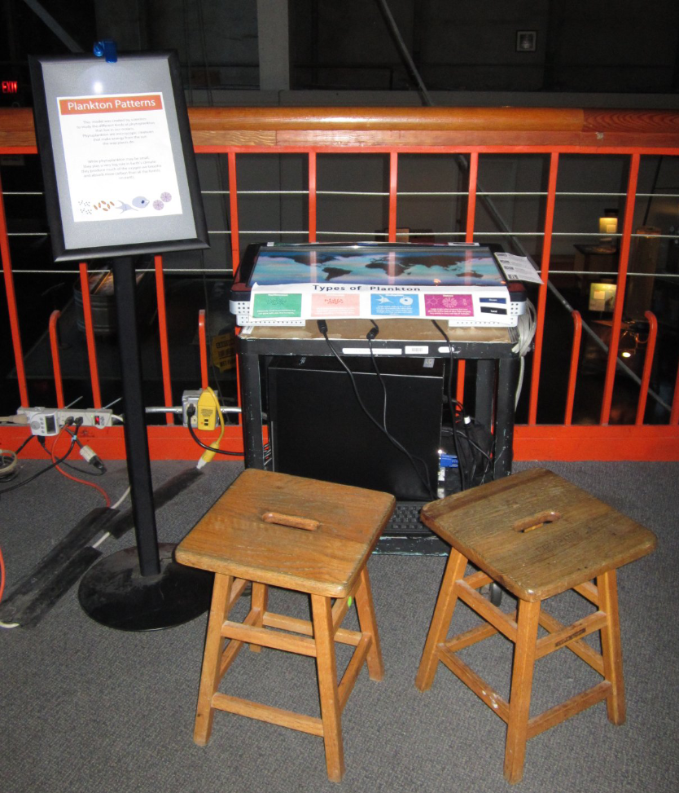
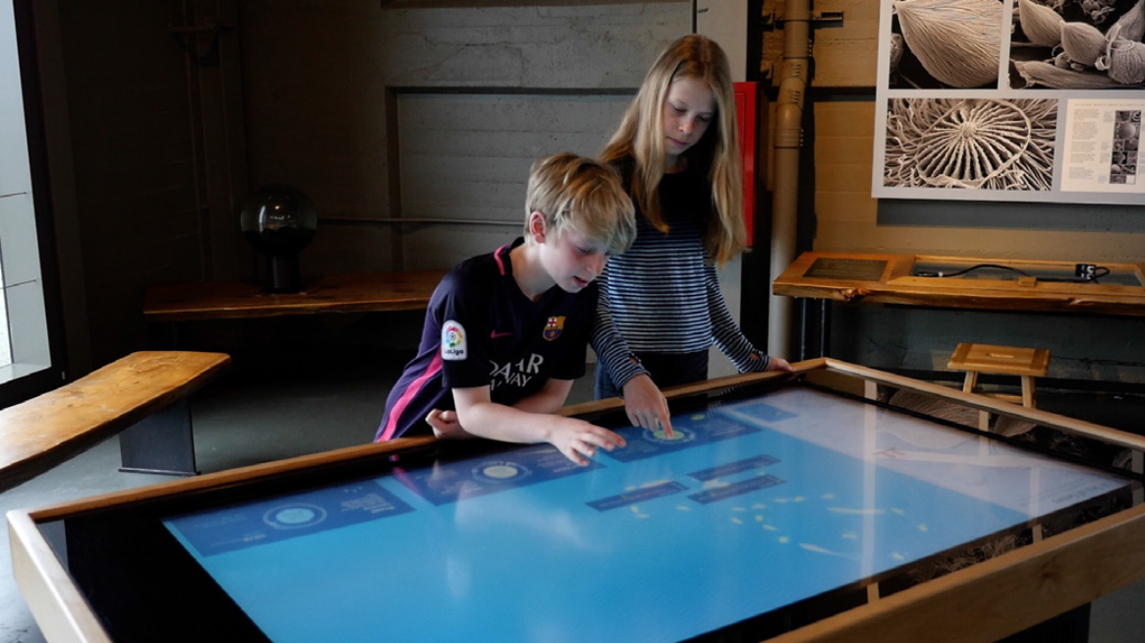
Previous Museum Vis Studies - Single Contexts!
EMDialog, Hinrichs et al., 2008
DeepTree, Block et al., 2012
Living Liquid, Ma et al., 2012
Sea of Genes, Dasu et al., 2021

Slide 3
Context?
EMDialog, Hinrichs et al., 2008

Slide 4
Context?
Room theme,
style, size
EMDialog, Hinrichs et al., 2008

Slide 5
Context?
Display type & size
Room theme,
style, size
EMDialog, Hinrichs et al., 2008

Slide 6
Context?
Display type & size
Audience
Room theme,
style, size
EMDialog, Hinrichs et al., 2008

Slide 7
Context?
Display type & size
Audience
Other exhibits
Room theme,
style, size
EMDialog, Hinrichs et al., 2008

Slide 8
Context?
Display type & size
Audience
Other exhibits
Room theme,
style, size
Intended use
EMDialog, Hinrichs et al., 2008

Slide 9
Context → Behaviour
Display type & size
Audience
Other exhibits
Room
theme,
style,
size
Intended use
EMDialog, Hinrichs et al., 2008

Slide 10
Context → Behaviour
Display type & size
Audience
Other exhibits
Behaviour
Room
theme,
style,
size
Intended use
EMDialog, Hinrichs et al., 2008

Slide 11
Different Contexts?
EMDialog, Hinrichs et al., 2008
Behaviour

Slide 12
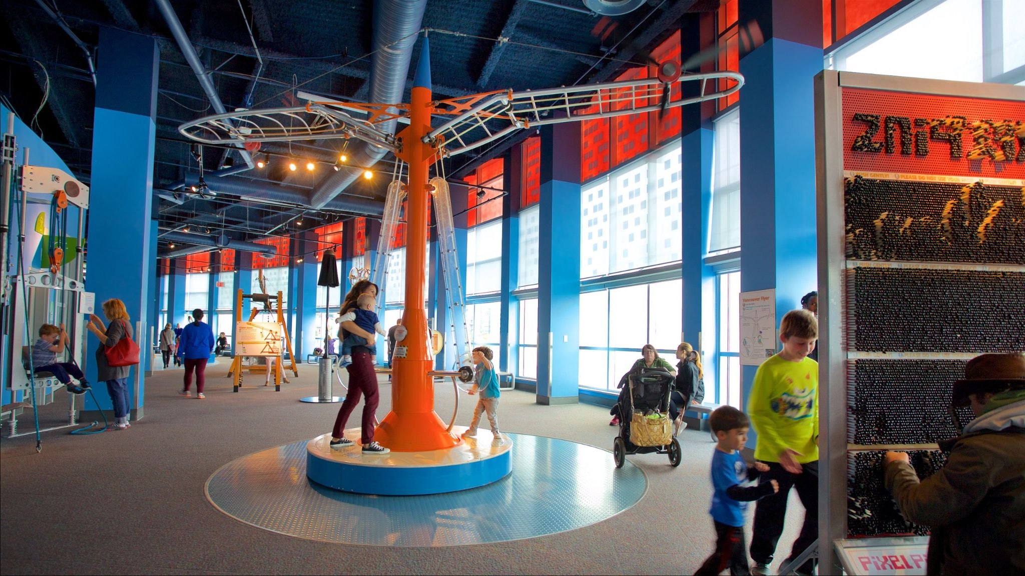
Different Contexts?
EMDialog, Hinrichs et al., 2008
Behaviour

Slide 13
Different Contexts?
EMDialog, Hinrichs et al., 2008
Behaviour
Behaviour

Slide 14
Different Contexts?
EMDialog, Hinrichs et al., 2008
???
Behaviour
Behaviour

Slide 15
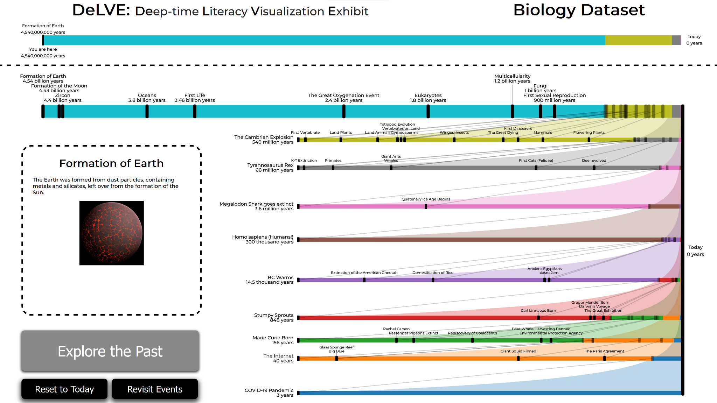
Let’s Take a Look!
DeLVE: Deep-time Literacy Visualization Exhibit
Deep time: geoscientist term for the long periods of time of geological processes
Interactive tool for exploring past events on different scales of time
Promote proportional reasoning through comparisons of scales
Deployed in four locations across three institutions

Slide 16
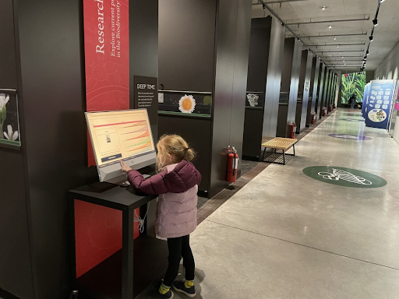
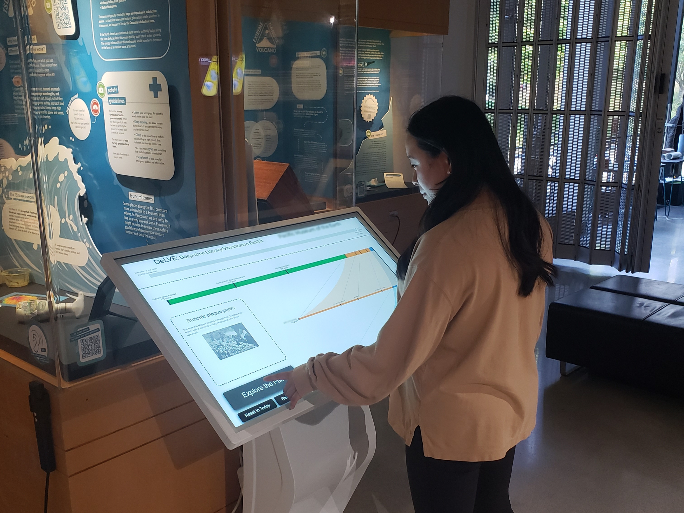
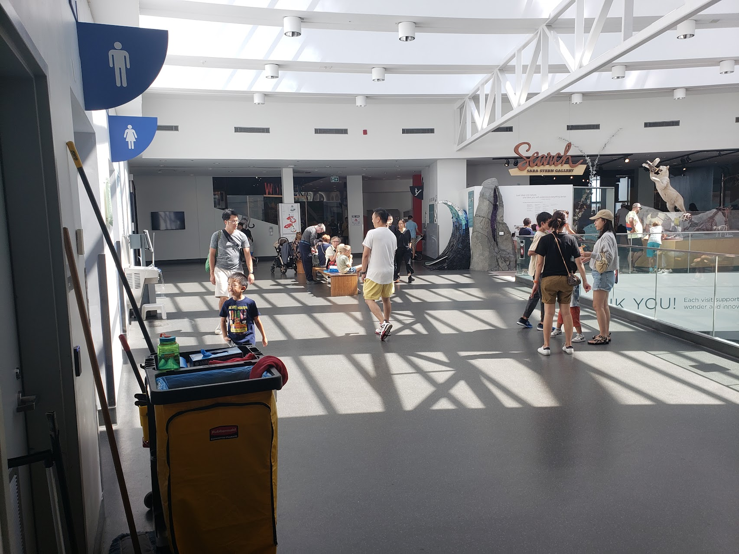
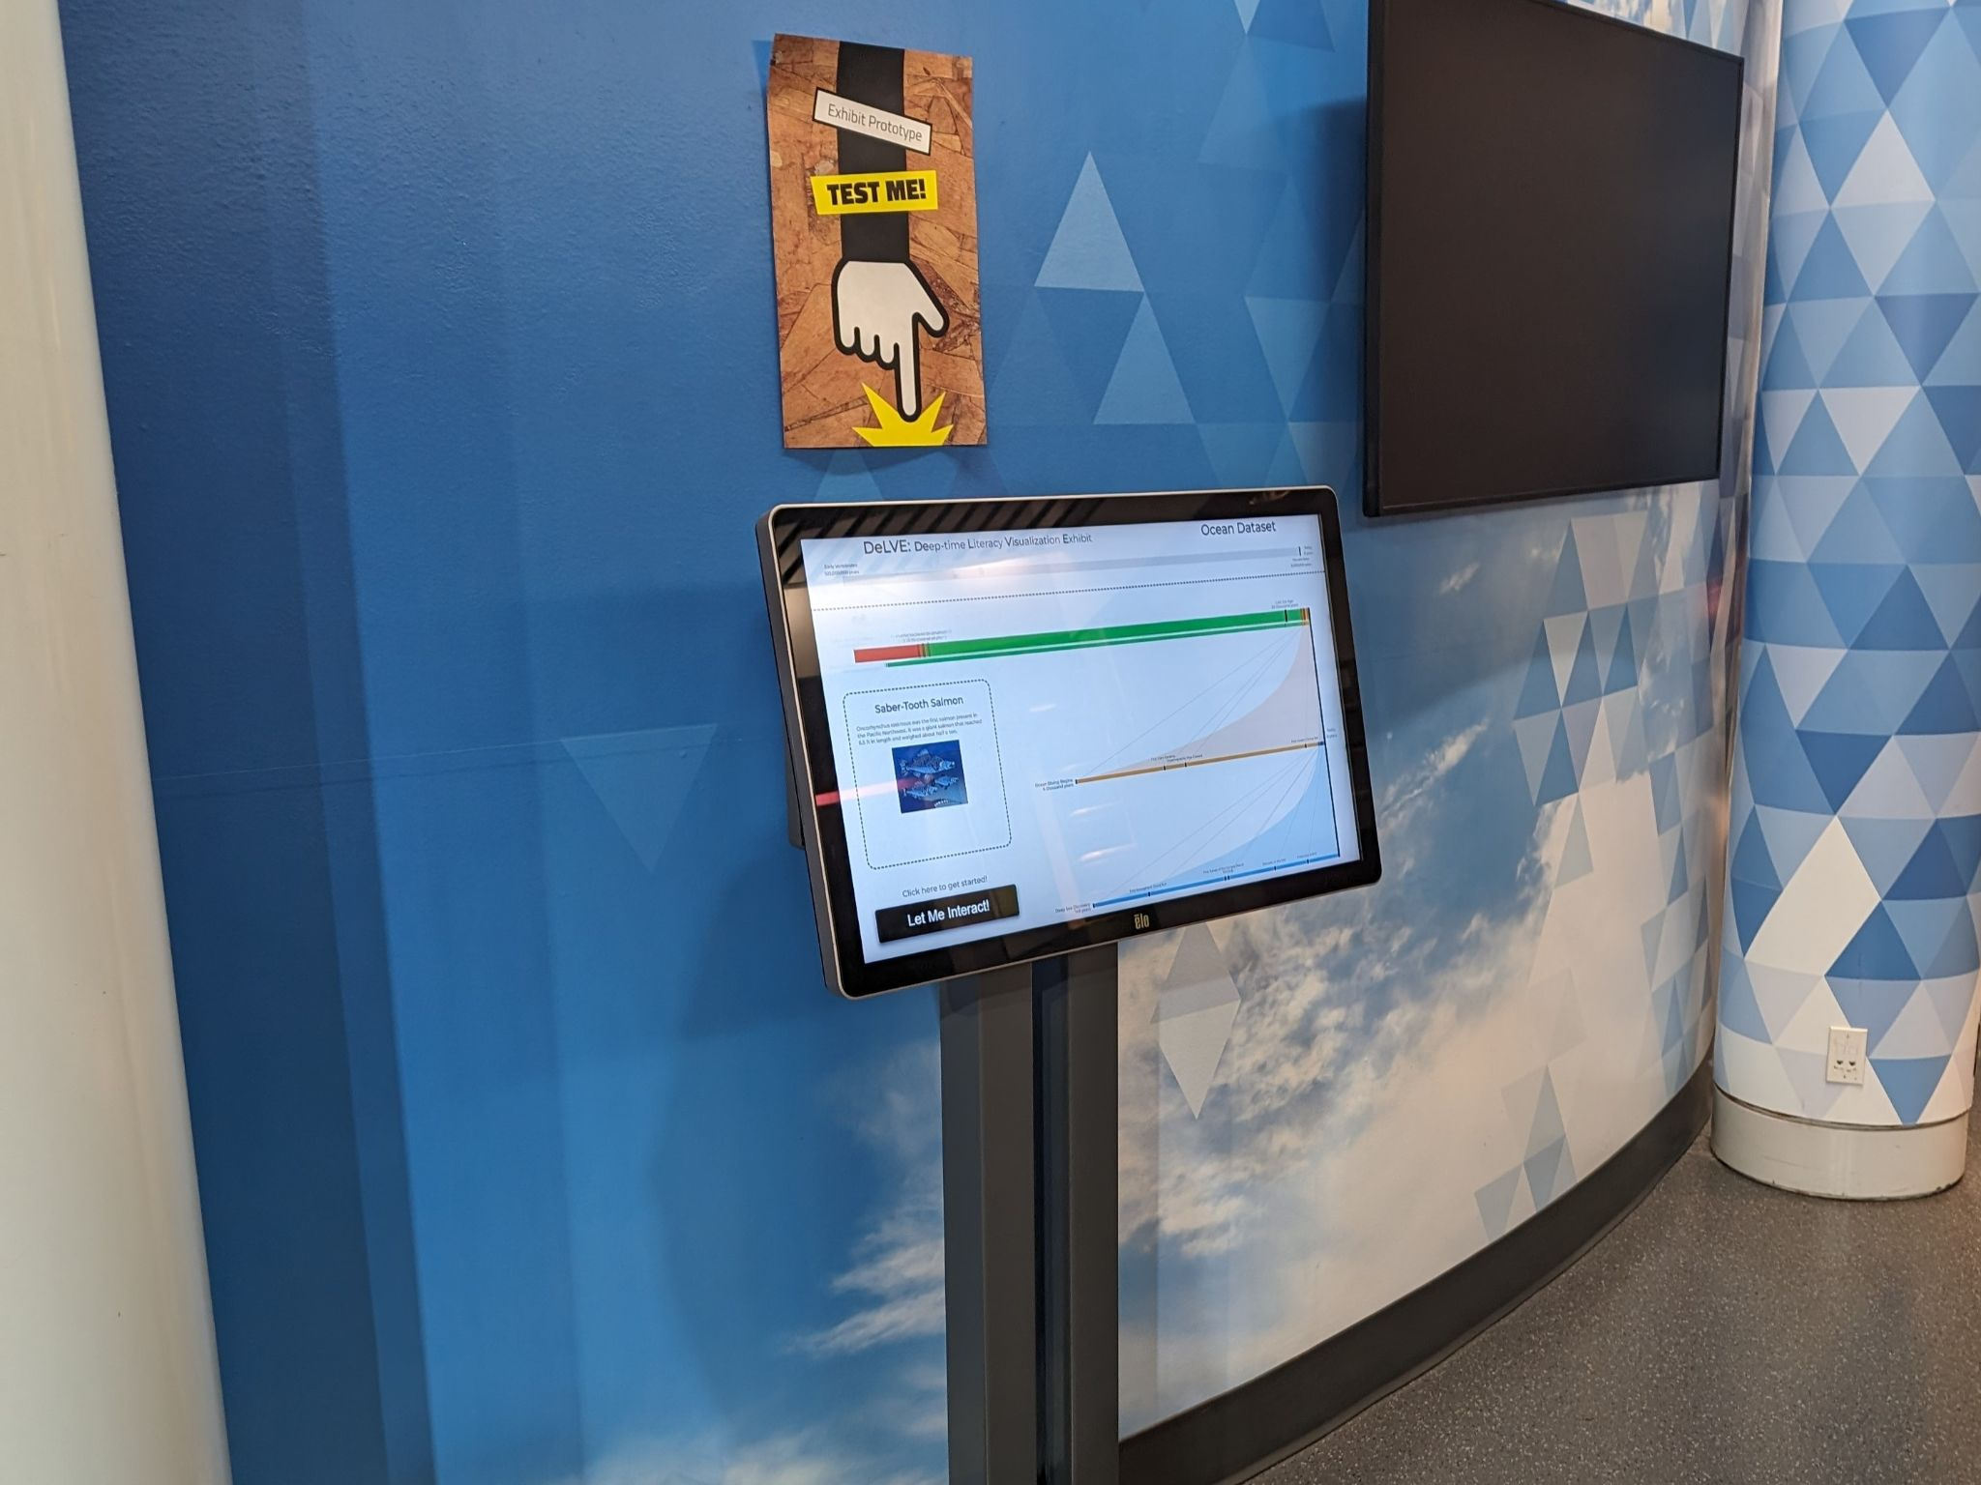
Let’s Take a Look!
DeLVE: Deep-time Literacy Visualization Exhibit
Deep time: geoscientist term for the long periods of time of geological processes
Interactive tool for exploring past events on different scales of time
Promote proportional reasoning through comparisons of scales
Deployed in four locations across three institutions

Slide 17
Visitor Behaviour Differs!
Behaviour
Behaviour
Behaviour
Behaviour
Studied visitor behaviour when interacting with DeLVE
Data suggests context does impact visitor behaviour!

Slide 18
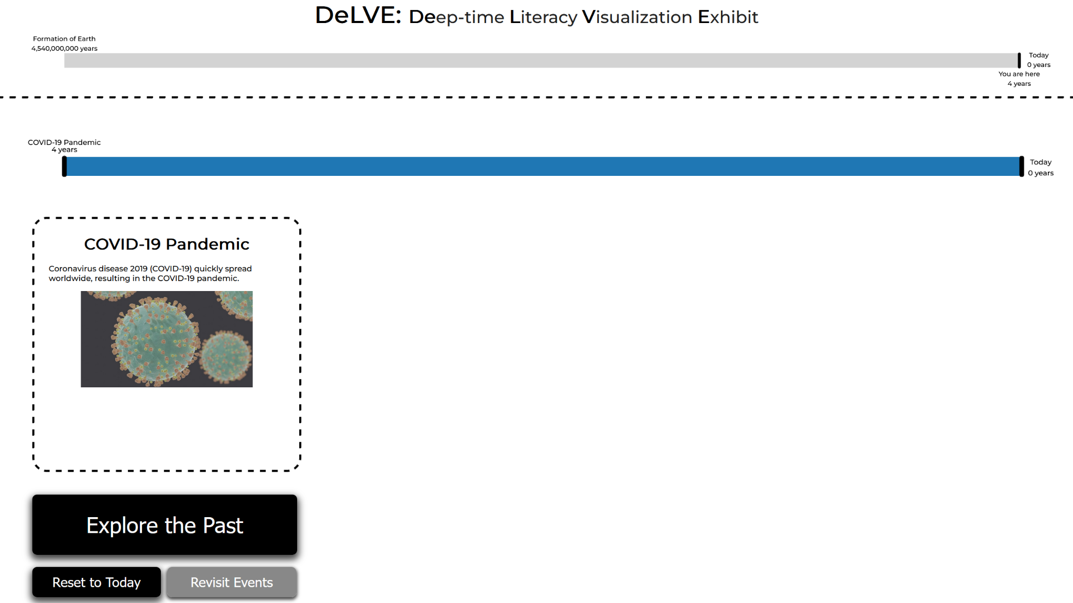
How Does DeLVE Work?

Slide 19
How Does DeLVE Work?

Slide 20
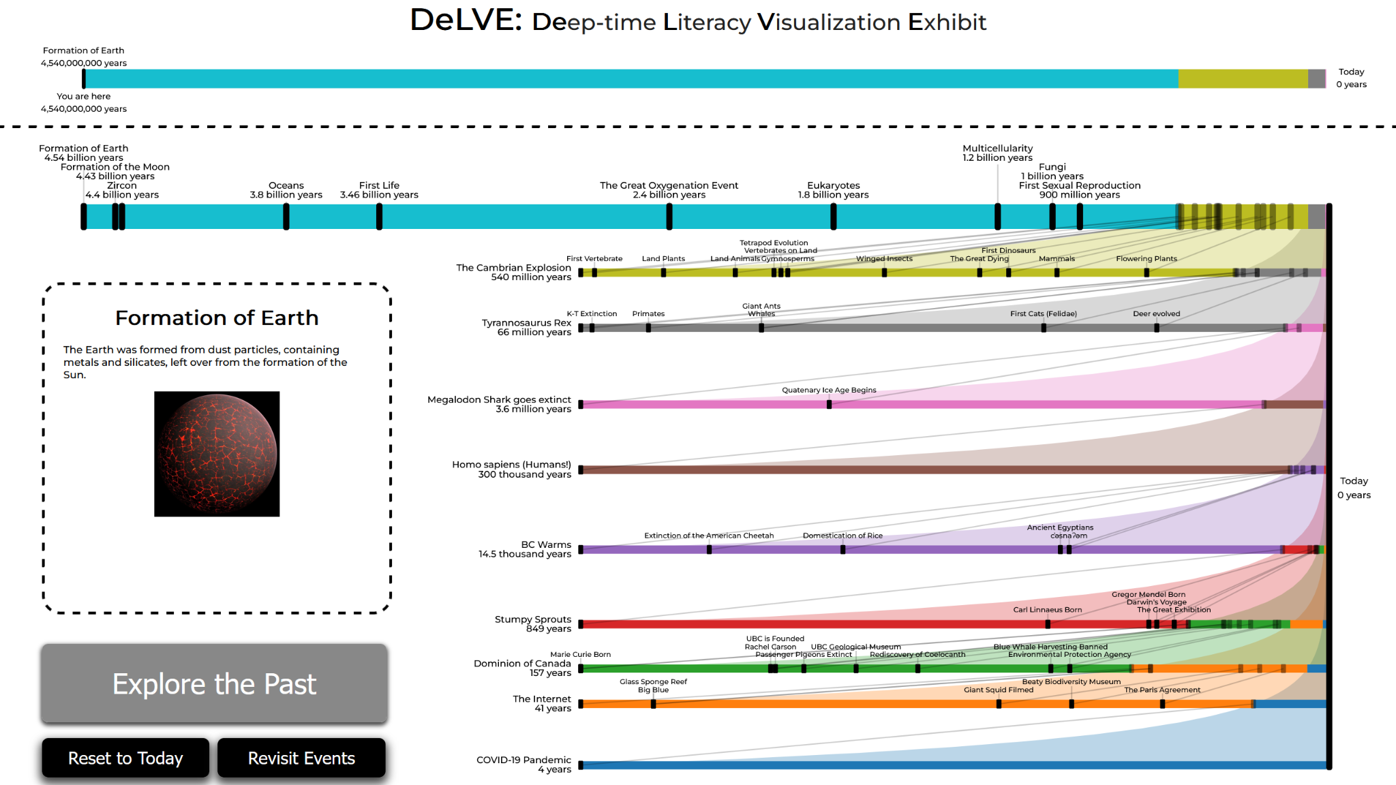
How Does DeLVE Work?

Slide 21
Project Requirements
R-Deploy: find/build collaborations that lead to deployment
R-Curate: enable non-technical museum staff to curate datasets
R-Engage: engage visitors through enjoyment or interest
R-Inspire: inspire curiosity to foster positive relationships with science
R-Compare: support our task of comparing varied-magnitude time periods
(staff-facing)
(visitor-facing)

Slide 22
Design Components

Slide 23
Design Components
New idiom: connected multi-tier ranges (CMTR)

Slide 24
Design Components
New idiom: connected multi-tier ranges (CMTR)
R-Engage
Animation
Interactivity
Pictures
Colours

Slide 25
Design Components
R-Inspire
Descriptions
Times
New idiom: connected multi-tier ranges (CMTR)
R-Engage
Animation
Interactivity
Pictures
Colours

Slide 26
Design Components
R-Inspire
Descriptions
Times
New idiom: connected multi-tier ranges (CMTR)
R-Engage
Animation
Interactivity
Pictures
Colours
R-Compare
Timelines
Connecting Lines

Slide 27
Deployment
Deployed in four locations across three institutions
Different deployment processes for each museum
Deployment-approval meetings with museum staff at each museum
26 total months of deployment between three institutions at submission
47 now!
Museum staff curated custom datasets to work with DeLVE

Slide 28
Deployment
R-Deploy ✅
Deployed in four locations across three institutions
Different deployment processes for each museum
Deployment-approval meetings with museum staff at each museum
26 total months of deployment between three institutions at submission
47 now!
Museum staff curated custom datasets to work with DeLVE

Slide 29
Deployment
R-Deploy ✅
R-Curate ✅
Deployed in four locations across three institutions
Different deployment processes for each museum
Deployment-approval meetings with museum staff at each museum
26 total months of deployment between three institutions at submission
47 now!
Museum staff curated custom datasets to work with DeLVE

Slide 30
User Studies and Analysis
Methods
Two data sources:
Observational study 🔍 of museum visitors
25 sessions, 37 hours, 95 engaged observations
Qualitatively coded for meeting requirements + behaviour differences
System trace logs 🧾 from museum visitors
~200,000 button presses logged
Logs grouped to compute statistics (interaction length, num clicks, etc)
Did we meet our visitor-facing requirements?
Yes!
R-Engage: long interaction times, many button presses, lots of reading text ✅
R-Inspire: surprised/intrigued facial expressions, discussing info with others ✅
R-Compare: gesturing between timelines, verbally discussing scales and time differences ✅

Slide 31
Context Matters Immensely!
Many differences in visitor behaviour
Amount of time spent, number of button presses, amount of text read
Mirrors O’Reilly and Inkpen white room paper [2007]
Quiet lab vs crowded corridor
Many differences in context
Specimens on display vs interactive exhibits
Bright room vs dark room
Kids/families vs college-students/adults
1: Biology Museum
2: Geoscience Mus.
3: Science Center
4: Science Center
🤓
🏃‍♀️
😴
🤔

Slide 32
Concept-First Design Study Methodology
Concept-first design study methodology
Alternative to Sedlmair et al.’s design study methodology [2012]
Project trigger: concept to visualize/communicate
Not triggered by connection with collaborators
Differences in five stages
Winnow/Cast: Connection with collabs comes late, moved to after Implement
Cast: Different project roles:
Viewer instead of Analyst
Domain Experts split into Presentation and Content Experts
Discover: Tasks come from authors/literature
Acquire (new): Acquire data later to fit design/concept, added between Cast and Deploy
Deploy: More in-depth field studies required to validate work
Sedlmair et al., 2012
learn
winnow
cast
discover
design
implement
deploy
reflect
write

Slide 33
Concept-First Design Study Methodology
Concept-first design study methodology
Alternative to Sedlmair et al.’s design study methodology [2012]
Project trigger: concept to visualize/communicate
Not triggered by connection with collaborators
Differences in five stages
Winnow/Cast: Connection with collabs comes late, moved to after Implement
Cast: Different project roles:
Viewer instead of Analyst
Domain Experts split into Presentation and Content Experts
Discover: Tasks come from authors/literature
Acquire (new): Acquire data later to fit design/concept, added between Cast and Deploy
Deploy: More in-depth field studies required to validate work
Sedlmair et al., 2012
learn
winnow
cast
discover
design
implement
deploy
reflect
write

Slide 34
Concept-First Design Study Methodology
Concept-first design study methodology
Alternative to Sedlmair et al.’s design study methodology [2012]
Project trigger: concept to visualize/communicate
Not triggered by connection with collaborators
Differences in five stages
Winnow/Cast: Connection with collabs comes late, moved to after Implement
Cast: Different project roles:
Viewer instead of Analyst
Domain Experts split into Presentation and Content Experts
Discover: Tasks come from authors/literature
Acquire (new): Acquire data later to fit design/concept, added between Cast and Deploy
Deploy: More in-depth field studies required to validate work
Sedlmair et al., 2012
learn
winnow
cast
discover
design
implement
deploy
reflect
write
Concept-first alternative
learn
discover
design
implement
winnow
cast
deploy
reflect
write

Slide 35
Concept-First Design Study Methodology
Concept-first design study methodology
Alternative to Sedlmair et al.’s design study methodology [2012]
Project trigger: concept to visualize/communicate
Not triggered by connection with collaborators
Differences in five stages
Winnow/Cast: Connection with collabs comes late, moved to after Implement
Cast: Different project roles:
Viewer instead of Analyst
Domain Experts split into Presentation and Content Experts
Discover: Tasks come from authors/literature
Acquire (new): Acquire data later to fit design/concept, added between Cast and Deploy
Deploy: More in-depth field studies required to validate work
Sedlmair et al., 2012
learn
winnow
cast
discover
design
implement
deploy
reflect
write
Concept-first alternative
learn
discover
design
implement
winnow
cast
deploy
reflect
write

Slide 36
Concept-First Design Study Methodology
Concept-first design study methodology
Alternative to Sedlmair et al.’s design study methodology [2012]
Project trigger: concept to visualize/communicate
Not triggered by connection with collaborators
Differences in five stages
Winnow/Cast: Connection with collabs comes late, moved to after Implement
Cast: Different project roles:
Viewer instead of Analyst
Domain Experts split into Presentation and Content Experts
Discover: Tasks come from authors/literature
Acquire (new): Acquire data later to fit design/concept, added between Cast and Deploy
Deploy: More in-depth field studies required to validate work
Sedlmair et al., 2012
learn
winnow
cast
discover
design
implement
deploy
reflect
write
Concept-first alternative
learn
discover
design
implement
winnow
cast
deploy
reflect
write

Slide 37
Concept-First Design Study Methodology
Concept-first design study methodology
Alternative to Sedlmair et al.’s design study methodology [2012]
Project trigger: concept to visualize/communicate
Not triggered by connection with collaborators
Differences in five stages
Winnow/Cast: Connection with collabs comes late, moved to after Implement
Cast: Different project roles:
Viewer instead of Analyst
Domain Experts split into Presentation and Content Experts
Discover: Tasks come from authors/literature
Acquire (new): Acquire data later to fit design/concept, added between Cast and Deploy
Deploy: More in-depth field studies required to validate work
Sedlmair et al., 2012
learn
winnow
cast
discover
design
implement
deploy
reflect
write
Concept-first alternative
learn
discover
design
implement
winnow
cast
acquire
deploy
reflect
write

Slide 38
Concept-First Design Study Methodology
Concept-first design study methodology
Alternative to Sedlmair et al.’s design study methodology [2012]
Project trigger: concept to visualize/communicate
Not triggered by connection with collaborators
Differences in five stages
Winnow/Cast: Connection with collabs comes late, moved to after Implement
Cast: Different project roles:
Viewer instead of Analyst
Domain Experts split into Presentation and Content Experts
Discover: Tasks come from authors/literature
Acquire (new): Acquire data later to fit design/concept, added between Cast and Deploy
Deploy: More in-depth field studies required to validate work
Sedlmair et al., 2012
learn
winnow
cast
discover
design
implement
deploy
reflect
write
Concept-first alternative
learn
discover
design
implement
winnow
cast
acquire
deploy
reflect
write

Slide 39
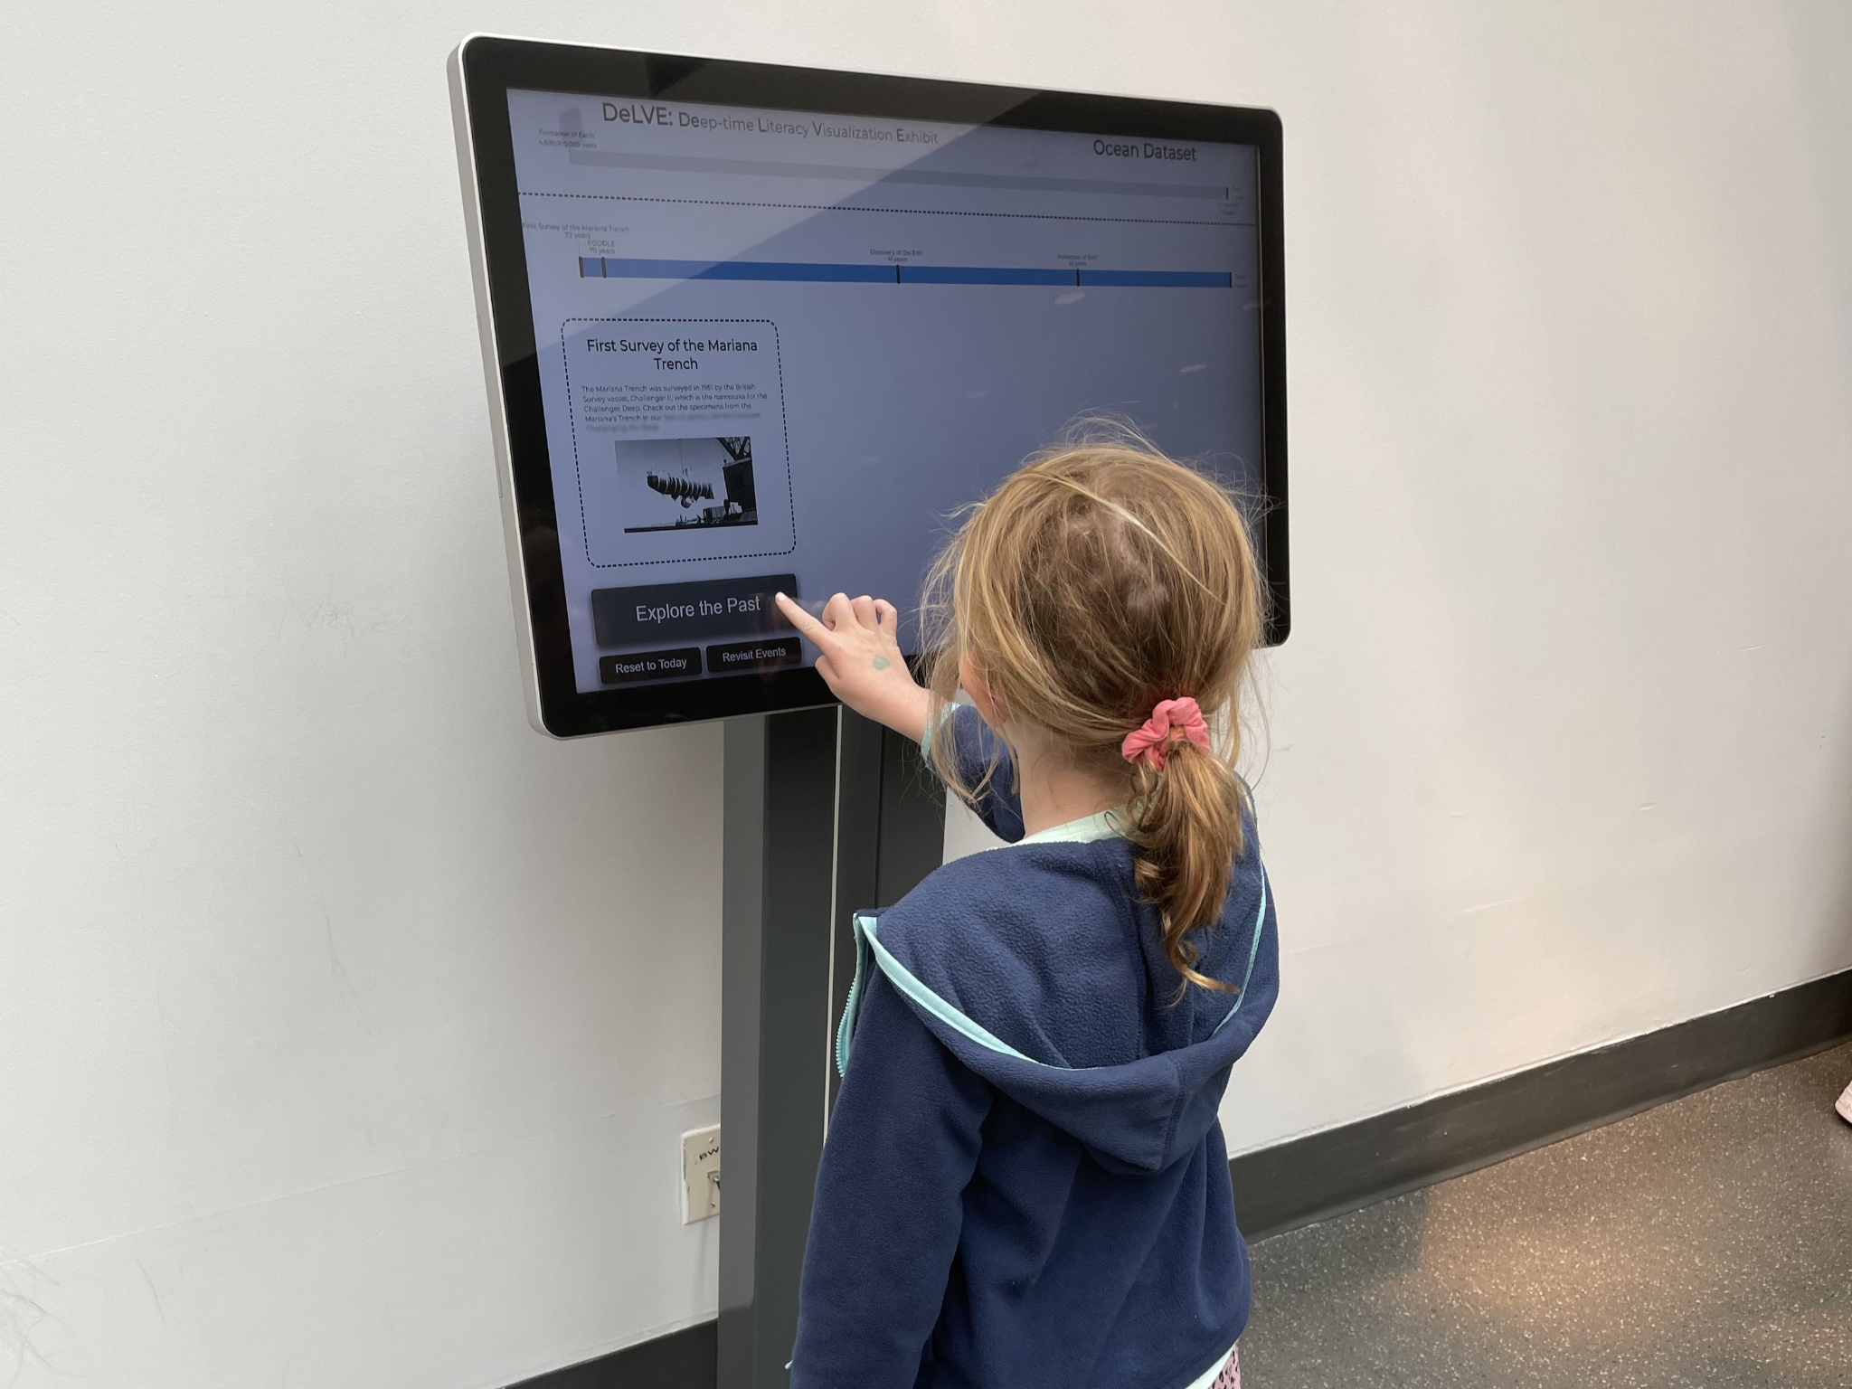
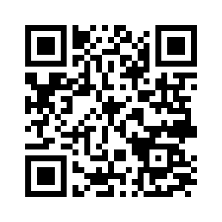
Conclusion
DeLVE into Earth’s Past: A Visualization-Based Exhibit Deployed Across Multiple Museum Contexts
Mara Solen, Nigar Sultana, Laura Lukes, Tamara Munzner
IEEE VIS 2024
www.cs.ubc.ca/group/infovis/pubs/2024/delve
Primary contributions
Task abstraction, design requirements, and data abstraction
Design and development of DeLVE
Results of and reflections from studies during deployment: Context matters immensely!
Secondary contributions
Visualization technique: Connected Multi-Tier Ranges
Concept-First Design Study Methodology

