Slide 1
Stephen Kasica
University of British Columbia Vancouver, Canada
Charles Berret
Linköping University
Norrköping, Sweden
Dirty Data in the Newsroom
Comparing Data Preparation
in Journalism and Data Science
Tamara Munzner
University of British Columbia Vancouver, Canada
ACM CHI Conference on Human Factors in Computing Systems
April 23-28, 2023, Hamburg, Germany
@tamara@vis.social
@tamaramunzner
Notes:
My name is Charles Berret, University of Linköping, Sweden
I'm presenting Dirty Data in the Newsroom: Comparing Data Preparation in Journalism and Data Science
On behalf of the first author, Stephen Kasica
Who could not attend in-person, waiting birth of second child.
This is work in collaboration with Tamara Munzner, University of British Columbia, Canada

Slide 2
Data Preparation
Getting data ready for analysis or visualization
Includes: wrangling, cleaning, munging, gathering, integrating, etc.
Time-consuming process in data science
Up to 80% of someone’s time
Image by rawpixel.com on Freepik
Notes:
Preparing data is often the most time consuming and tedious aspect of data work
Includes: wrangling, cleaning, munging, and gathering data.
Many researchers have studied this process among data scientists
Can take up to 80% of a project's overall time.

Slide 3
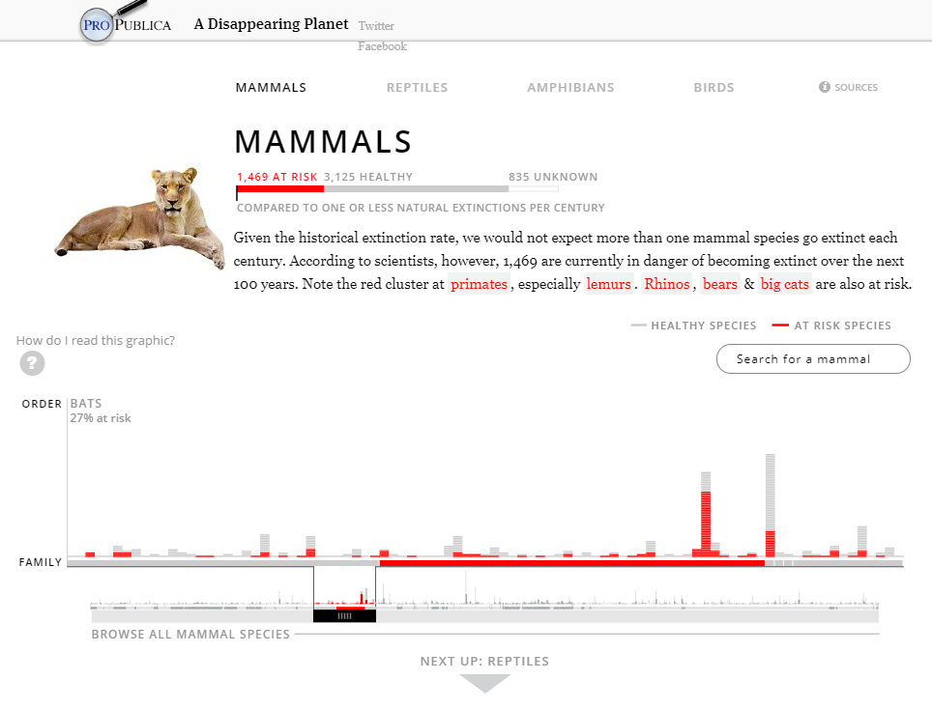
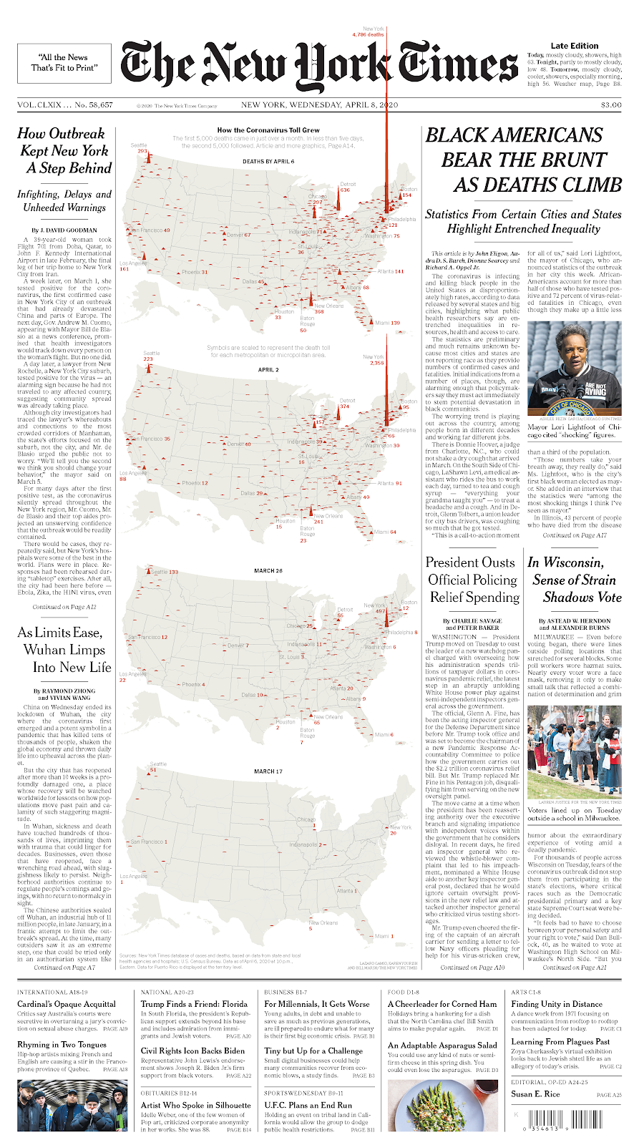
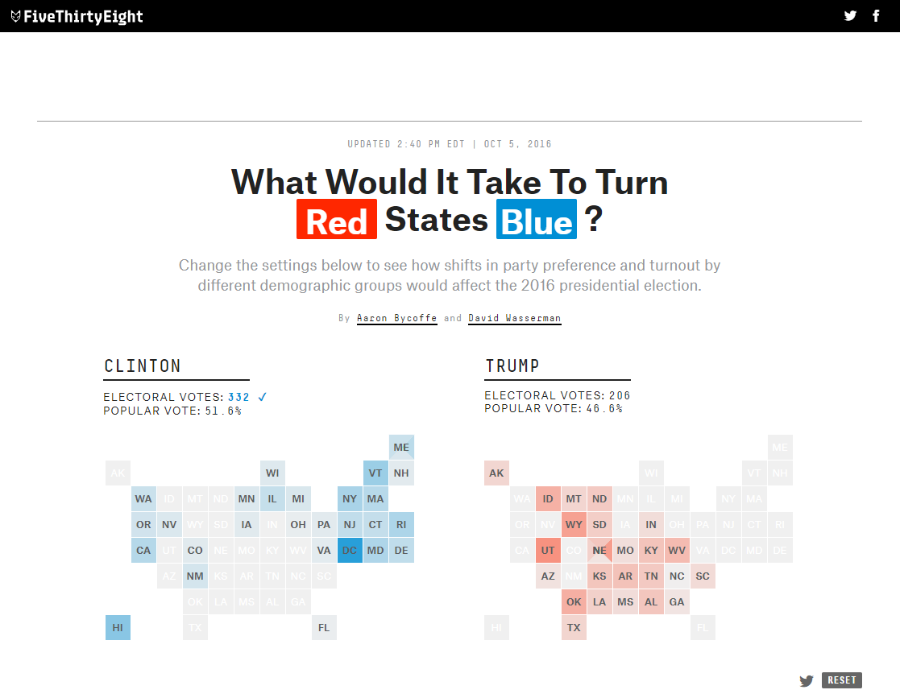
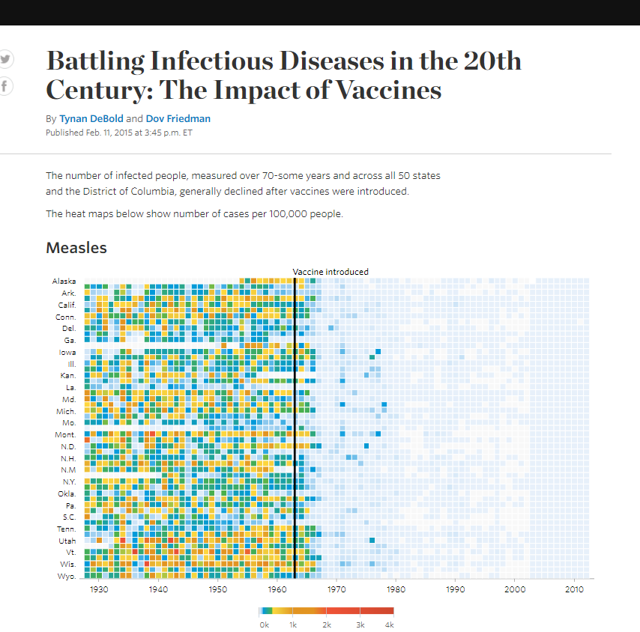
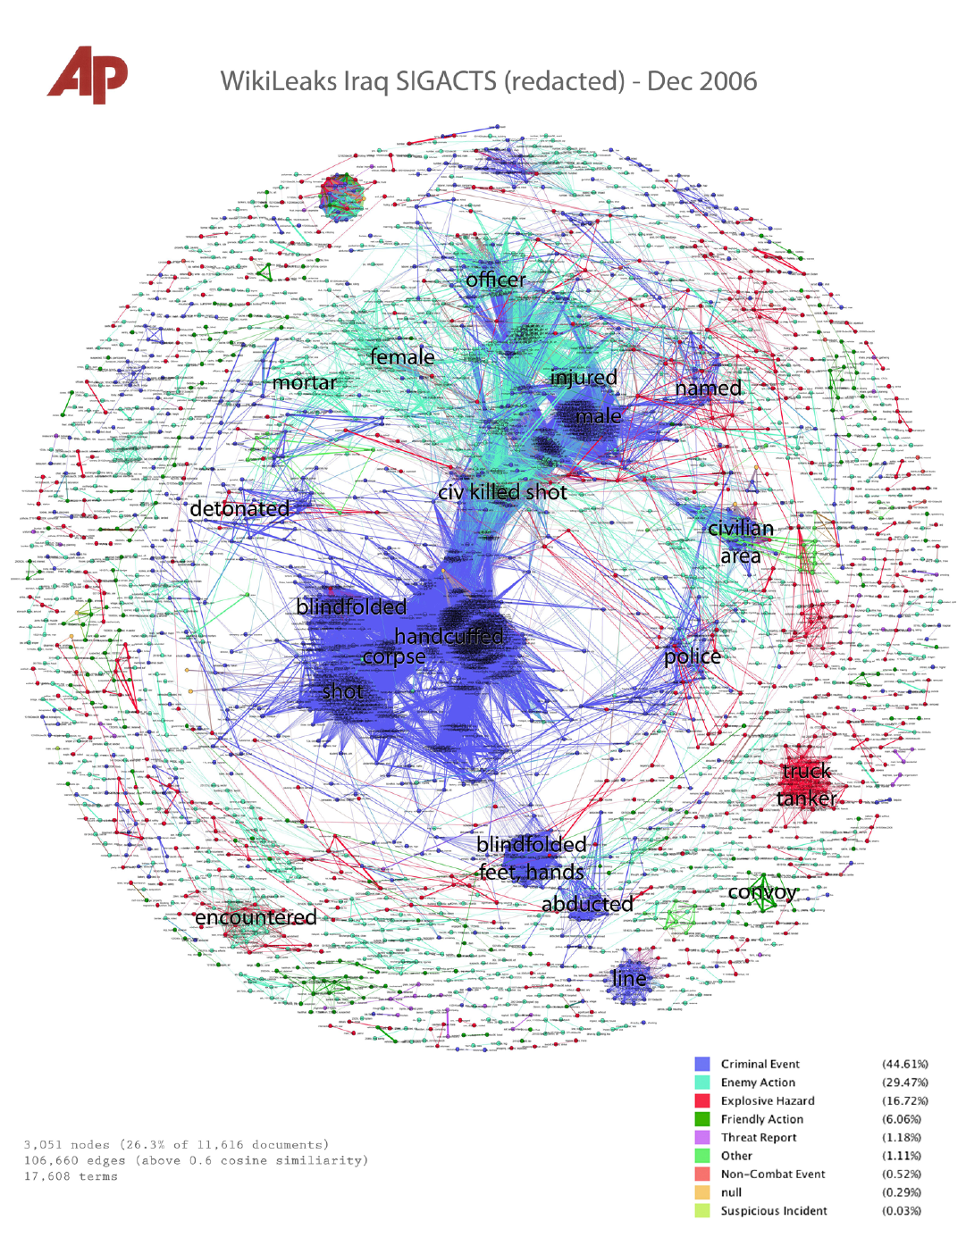
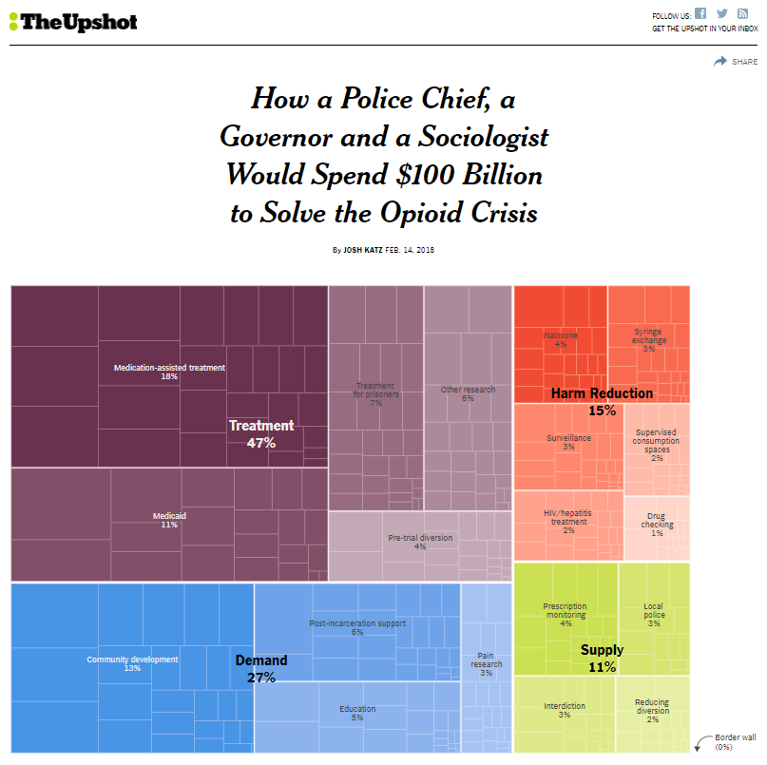
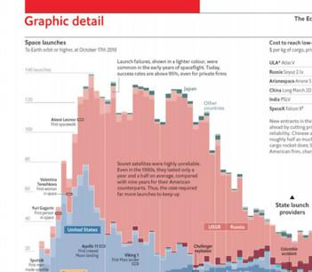
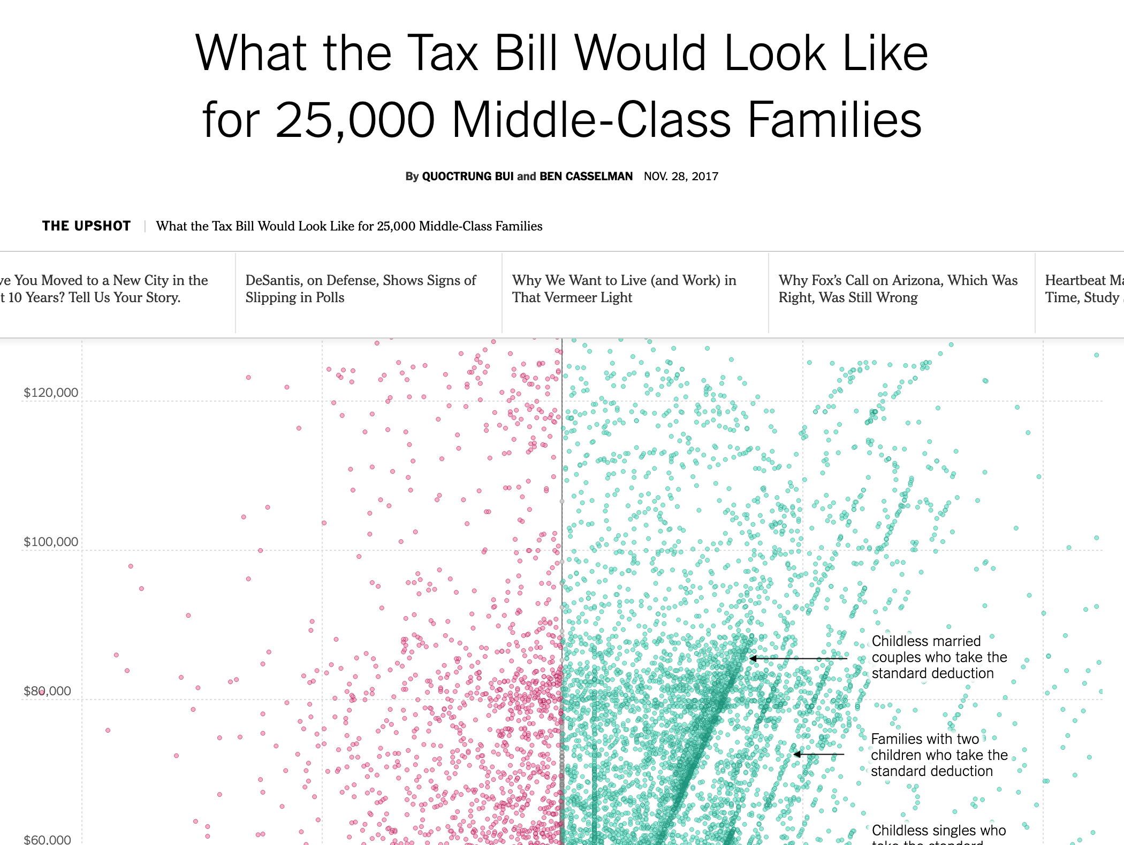
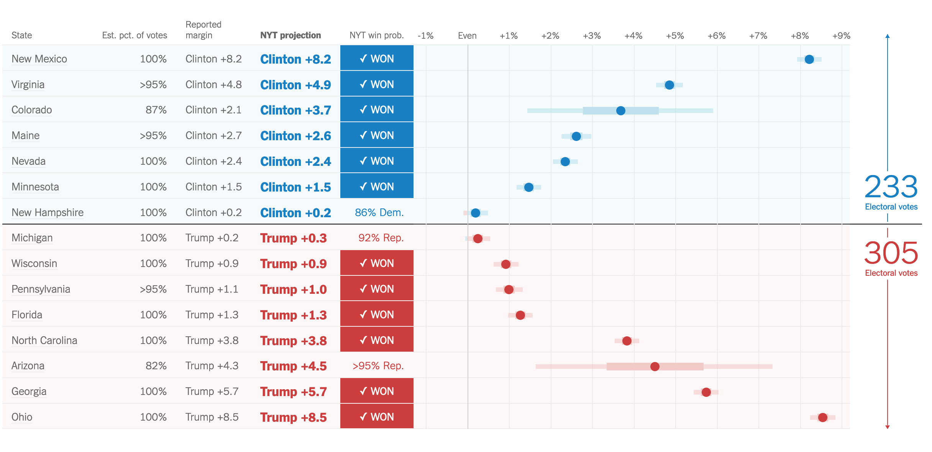
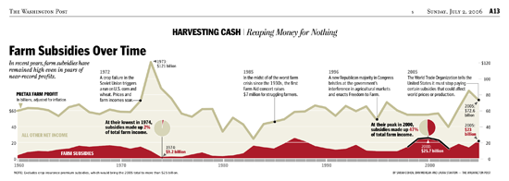
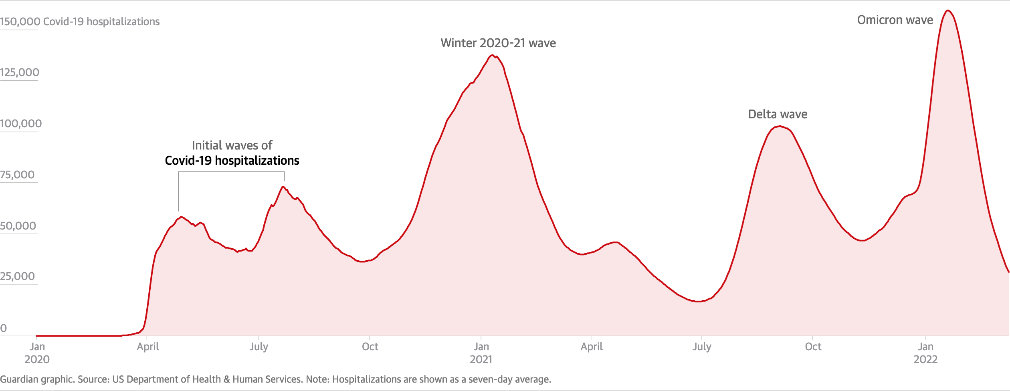
Notes:
Today, journalists are increasingly turning to data as a source to:
Deliver the day's news in a new way
Support investigations in ways that traditional news-gathering techniques cannot
The field of journalism has historically gone through many quantitative turns
The work today falls under the genre of data journalism

Slide 4
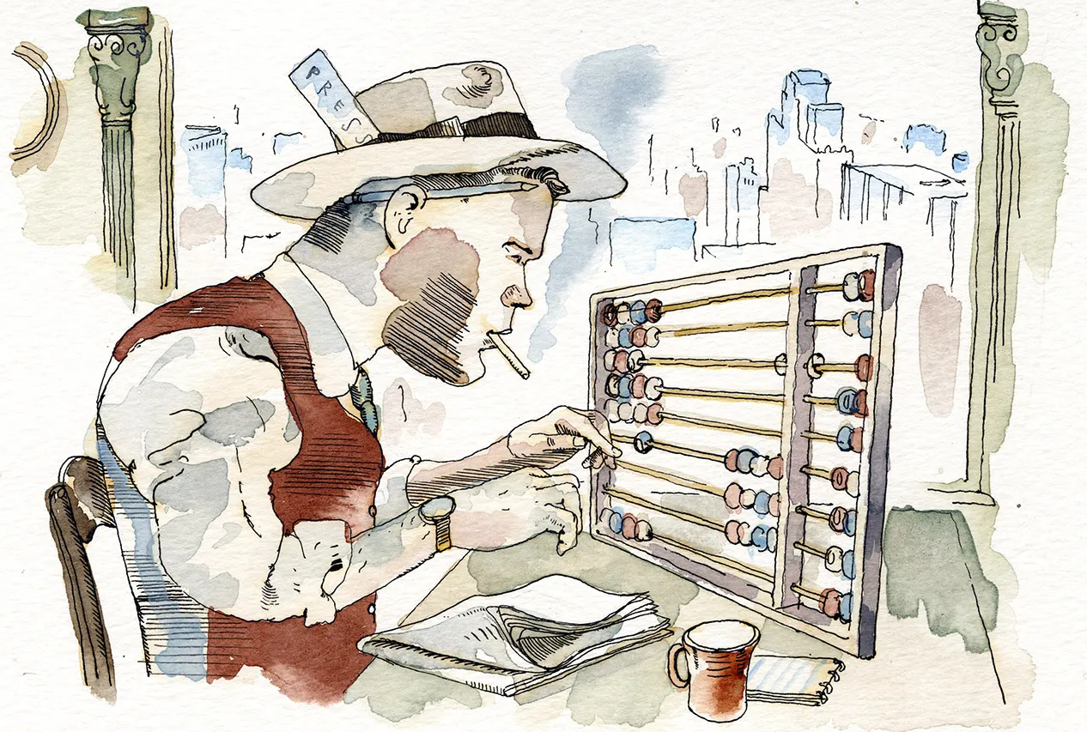
Illustration by Barry Blitt, Vanity Fair
Notes:
Compared to data scientists, not much is known about how these data journalists prepare data.
But data journalists use many of the same tools from the data science community
e.g. Python, R, Jupyter notebooks

Slide 5
Data
science
Data
journalism
How closely does research
on data scientists apply to data journalists,
with regards to data preparation?
Notes:
Our study seeks to understand how closely the abundant research on data preparation activities

Slide 6
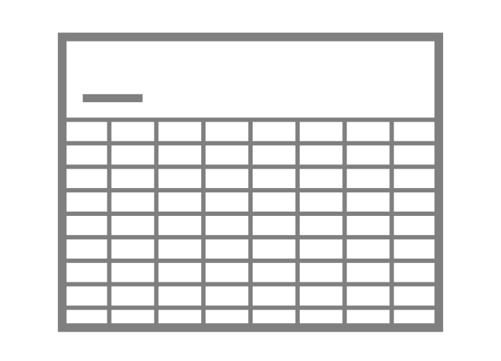
Phase 1
Phase 2
Phase 3
Phase 4
A
B
C
F
D
E
Data science
process papers (16)
Data journalist
interviews (36)
Dirty data
Taxonomies (16)
Data preparation
nightmares (63)
Issues
11
15
Data issues (60)
Activities
30
13
Model-discrepancy taxonomy of
dirty data
Four challenges in
multi-table
data integration
Augmented model of
preparation activities
From data science
From data journalism
From database research
Our contributions
Notes:
Slide 6.0 [On start]
Study = four phases
Slide 6.1 (Phase 1) [Click]
We analyze 16 research papers documenting the workflows of data science workers
These were identified in related work, a systematic literature review of this area.
Slide 6.1.1 (Phase 1) [Click]
We perform thematic analysis on these accounts of data preparation in data science w.r.t:
Underlying data issues that prohibit analysis
Activities data science workers performed to address these issues
Slide 6.2 (Phase 2) [Click]
We interview 36 data journalists about their data preparation practices
Slide 6.2.1 (Phase 2) [Click]
We perform thematic analysis on these transcripts
Coding for issues and activities
This method follows hybrid thematic analysis that combines both a deductive and inductive approaches
Apply data science (a priori) codes from phase 1 when appropriate
Generate new data journalism (a posteriori) codes from the interview data
Hybrid thematic analysis provides a way to compare and contrast these two groups
Grounded in a qualitative methodological framework
Slide 6.2.2 (Phase 2) [Click]
Our analysis of activities lead to our first contribution:
An augmented model of preparation activities
Slide 6.3 (Phase 3) [Click]
But we felt our issue analysis was incomplete
A high number of a priori codes singled the data science issues did not match up well with data journalism issues.
We consult a third source: 16 taxonomies and dirty data
Published in the research literature on databases
Slide 6.3.1 (Phase 3) [Click]
We reflect and synthesize on these issues
From data science, data journalism and data quality research
We Identify 60 distinct data issues
Slide 6.3.2 (Phase 3) [Click]
We categorize these 60 issues into our second contribution
A new model-discrepancy taxonomy of dirty data
Slide 6.4 (Phase 4) [Click]
In the fourth and final phase we review our interview transcripts at a higher level.
We asked all participants to tell us about particularly challenging data journalism studies, in detail
Challenging w.r.t data preparation
These participants told us 63 “nightmare” stories
Slide 6.4.1 (Phase 4) [Click]
We categorized these stories as our third and final contribution:
Four challenges involving multi-table data integration

Slide 7
Contributions
1
2
3
Augmented model of preparation activities
Model-discrepancy taxonomy of
dirty data
Challenges in
multi-table
data integration
Notes:
Our first contribution is an augmented model of preparation activities.

Slide 8
Augmented model of prep. activities
Crisan Model
Our analysis
Data science papers
Data journalist interviews
Prepare
Initiate
Establish goals
Make a plan
Test proof of concept
Gather
Locate existing datasets
Collect new data
Integrate multiple datasets
Parse documents
Request datasets
Create
Impute
Synthesize
Profile
Assess quality
Understand semantics
Verify transformation
Wrangle
Aggregate data
Transform data schema
Label data
Normalize values
Remove data
Standardize values
Identify items
Notes:
Slide 8 [Start]
In the first two phases, we analyzed:
Papers on data science workflow
Transcripts from our interviews with data journalists
Slide 8.1 [Click]
We identified 23 preparation activities
Using hybrid thematic analysis
Slide 8.2 [Click]
We also match our findings to a model of data science work proposed in related work by Crisan et al.
This model nicely frames data preparation in both data science and data journalism.
Slide 8.3 [Click]
Hence we call this an augmented model of data preparation activities.
Slide 8.4 [Click]
We're able to contrast and compare both groups by looking at the occurrences of codes in these two qualitative data sources.
Slide 8.5 [Click]
We note activities that were mentioned in the data science process papers that were never or rarely mentioned by data journalists.
For example: creating data by imputation or synthesize
Common in data science
Especially in the context of preparing data for predictive modelling
Rare in data journalism
Where data is often prepared for descriptive modelling.
Therefore, synthetic data means nothing.
Slide 8.7 [Click]
Likewise, we note the activities that were often reported by our data journalist participants but underreported in the data science literature

Slide 9
Contributions
1
2
3
Augmented model of preparation activities
Model-discrepancy taxonomy of
dirty data
Challenges in
multi-table
data integration
Notes:
Our second contribution is a model-discrepancy taxonomy of dirty data

Slide 10
Model-discrepancy taxonomy of dirty data
Consider data as a design artifact
Dirty data = discrepancy in mental models
Extend issue analysis to incorporate database literature
Analyze 16 taxonomies on dirty data: cluster 330 issues → 45 DB issues
Combine into synthesis set of 60 issues
Categorize into new model-discrepancy taxonomy
Data qualities axis
Existing qualities: completeness, accuracy
New qualities: form, granularity, relation, semantics
Data objects axis: table, attribute, item, value
More details in the paper
Notes:
We begin by considering data as a design artifact
Hence, dirty data = discrepancies in mental models between data workers.
We extend our issue analysis from the first two phases to incorporate issues from the database literature
Analyzing 16 taxonomies on dirty data
Clustering over 300 issues into 45 unique issues in this corpus.
We combine this with our issue analysis of data scientists and data journalists to create a synthesis set of 60 data issues.
We categorize these into a new model discrepancy taxonomy.
And these categories exist on two axes:
First axis = data qualities.
We extend existing qualities, completeness and accuracy, with new qualities:
Form granularity, relation, and semantics.
Second axis = data objects
Includes: tables, attributes, items, and values.
More details are provided in the paper.

Slide 11
Contributions
1
2
3
Augmented model of preparation activities
Model-discrepancy taxonomy of
dirty data
Challenges in
multi-table
data integration
Notes:
Our third contribution are challenges in multi table data integration.

Slide 12
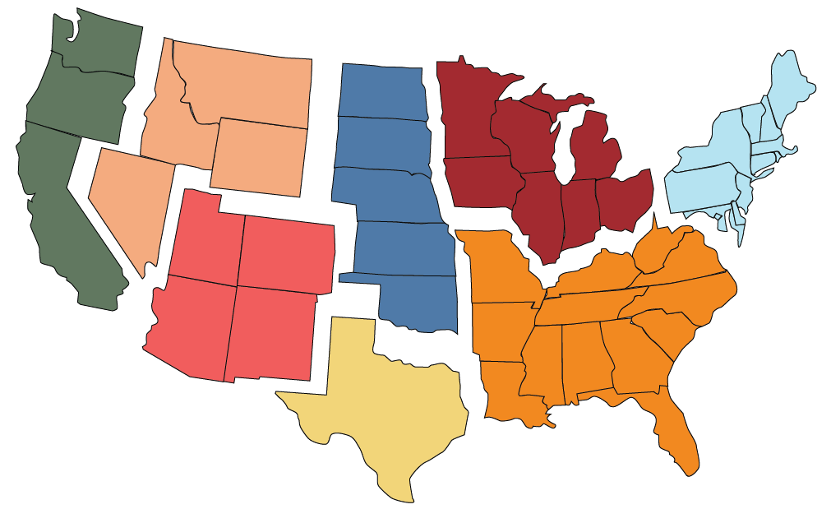
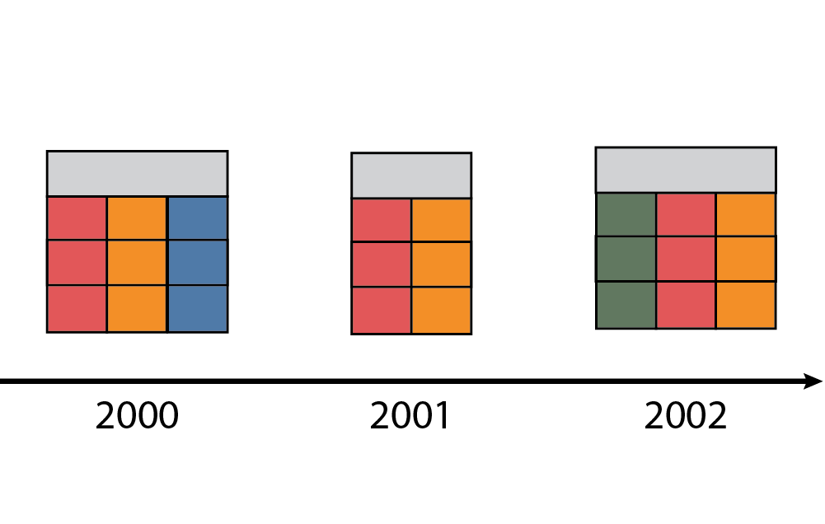
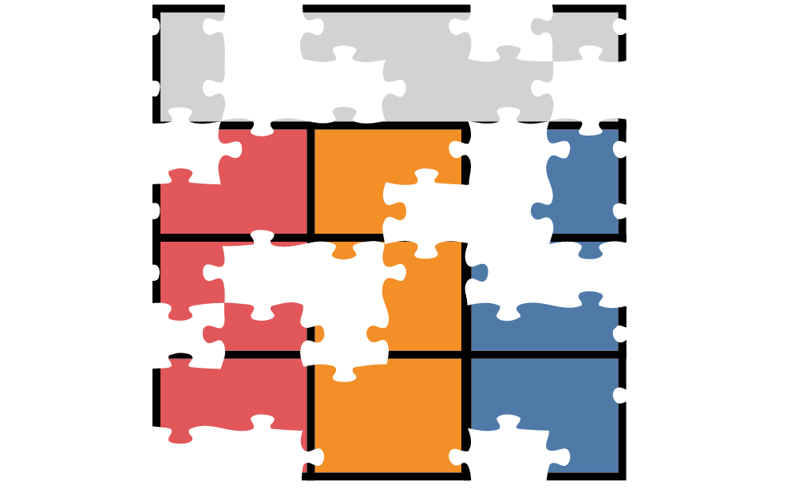
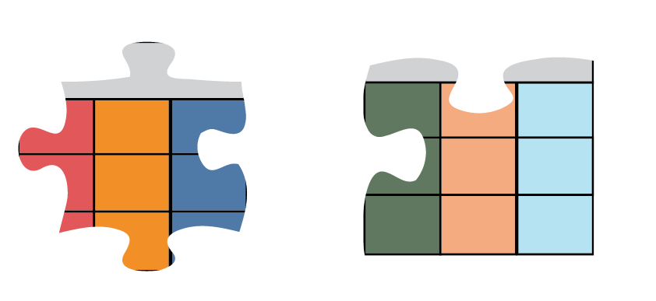
Four integration challenges
Norm: Integrate → clean
Findings: Clean → integrate
Regional
Diachronic
Fragmented
Disparate
Notes:
Slide 12 [Start]
We classify the 69 data preparation nightmare stories journalists told us into four categories
Excluding six which do not fit into one of these categories.
These categories are important with regards to data work in general because they flip the script on integration's role within the overall preparation process
Slide 12.1 [Click]
In data science integration is often viewed as a means to an end, often early in the process
These stories from data journalists treat integration as the end goal itself.

Slide 13
Regional datasets
Tables with inconsistencies due to
independent, spatially dispersed data sources
Notes:
Our first challenge is regional datasets,
Comes from independent sources, publishing data on the same phenomena.

Slide 14
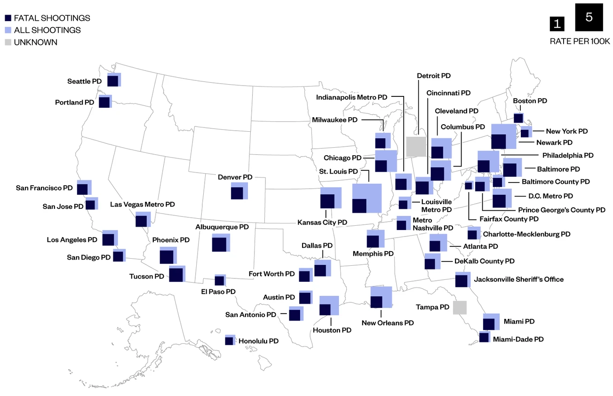
Regional: Police shootings in the United States
Graphic by Vice
Notes:
One area where this challenges turns up is in reporting of use of force incidences by police officers in the United States.
Journalists told us of analysis involving the 50 largest police departments in the United States
Data preparation: involved integrating 50 often very different datasets from these individual police departments.

Slide 15
Diachronic datasets
Tables on the same phenomena that evolve over time
Notes:
Our second category is diachronic datasets
Tables on the same phenomena that can change in subtle and significant ways over time.
Multiple journalists told us about preparing employment data from the Bureau of Labor Statistics (USA).

Slide 16
Diachronic: Economic data from Bureau of Labor Statistics
Computer
analyst
Computer
analyst
1970
1980
1990
2000
2010
2020
Photos by Boyd Belcher/US Air Force and Mimi Thain/Unsplash
Notes:
Slide 16 [Start]
One aspect of this challenge has been the value's definition changes over time.
Slide 16.1 [Click]
For example, a computer analyst in the 1980s
Slide 16.2 [Click]
Isn't the same thing as a computer analyst today.
This issue can complicate over-time analysis.

Slide 17
Fragmented datasets
Tables on a similar topic that contain different yet related items.
Notes:
Fragmented datasets are tables with different yet related items.

Slide 18
Fragmented: Unpaid mine safety violations
Mine locations
Safety violations
Mine
owners
Mine
operators
Notes:
Slide 18 [Start]
Coincidentally, multiple interviews touched on investigations of unpaid safety violations in coal mines
But linking safety violations to mine owners is not a straightforward task.
Slide 18.1 [Click]
Safety violations are often linked to data on mine locations.
Slide 18.2 [Click]
Mine locations are operated by mine operators
Slide 18.3 [Click]
Mine operators are employed by mine owners.
These data sets need to be assembled carefully to support accurate and valid analysis.
This work, in particular, is important because mine owners sometimes are prominent politicians.

Slide 19
Disparate datasets
Tables that are topically dissimilar and seemingly unrelated.
Notes:
Disparate data sets are topically dissimilar and seemingly unrelated.

Slide 20
Disparate: Opioid overdoses
Healthcare workers dying
from opioid overdoses
Death
records
Healthcare
workers
Icons by
Minh Do and
Sascha Elmers,
Noun Project
Notes:
Slide 20 [Start]
One powerful example of this challenge involves one participant covering the opioid epidemic
Slide 20.1 [Click]
By taking data that contained individual state health care workers
Slide 20.2 [Click]
And a separate data set on statewide deaths.
Slide 20.3 [Click]
This journalist was able to match entities by name
In order to identify health care workers who died of opioid overdoses.
Slide 20.4 [Click]
In this case, data work provided leads that the journalist followed up with using traditional news gathering techniques.

Slide 21
Dirty Data in the Newsroom
Stephen Kasica
Comparing Data Preparation
in Journalism and Data Science
University of British Columbia Vancouver, Canada
Charles Berret
ACM CHI Conference on Human Factors in Computing Systems
April 23-28, 2023, Hamburg, Germany
Linköping University
Norrköping, Sweden
Tamara Munzner
Contributions:
Augmented model of preparation activities
New model-discrepancy taxonomy of dirty data
Four challenges in multi-table data integration
University of British Columbia Vancouver, Canada
@tamara@vis.social
@tamaramunzner
Notes:
We compare how journalists and data scientists prepare raw data.
We have three contributions:
An augmented model of preparation activities
We find that data scientists and data journalists have a lot in common.
Hope this finding encourages future research to embrace a more pluralistic definition of data science worker by including data journalists.
A new model discrepancy taxonomy for dirty data
Which frames existing issues in a novel way that better matches how end users think about their data.
We identify four challenges in multi-table integration
which itself challenges the model for how data integration fits within the overall preparation process.

