Slide 1

Simpath: An Efficient Algorithm for Influence Maximization under Linear Threshold Model
Amit Goyal
Wei Lu
Laks V. S. Lakshmanan
University of British Columbia
http://cs.ubc.ca/~goyal

Slide 2

Influence Spread
We live in communities and interact with our friends, family and even strangers.
In the process, we influence each other.
Many applications
  Viral Marketing
  Recommender Systems
  Feed Ranking
Notes:
We live in communities and interact with our friends, family and even strangers. We share ideas and knowledge with them. In the process, we influence each other. This social influence, if modeled properly, can be leveraged in various applications like Viral Marketing, Recommender Systems, Feed Ranking etc.

Slide 3
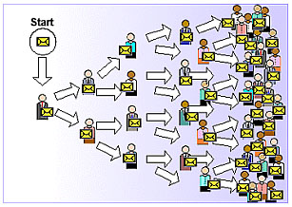
Viral Marketing
Identify influential customers
Convince them to adopt the product – Offer discount/free samples
These customers endorse the product among their friends
Notes:
One of the fundamental problems is identification of influential customers in social networks. If you convince them to adopt a product – say by offering discounts or free samples, then these customers, if they like the product will endorse it among their friends, and it will lead to large number of adoptions, driven by word-of-mouth effect.

Slide 4
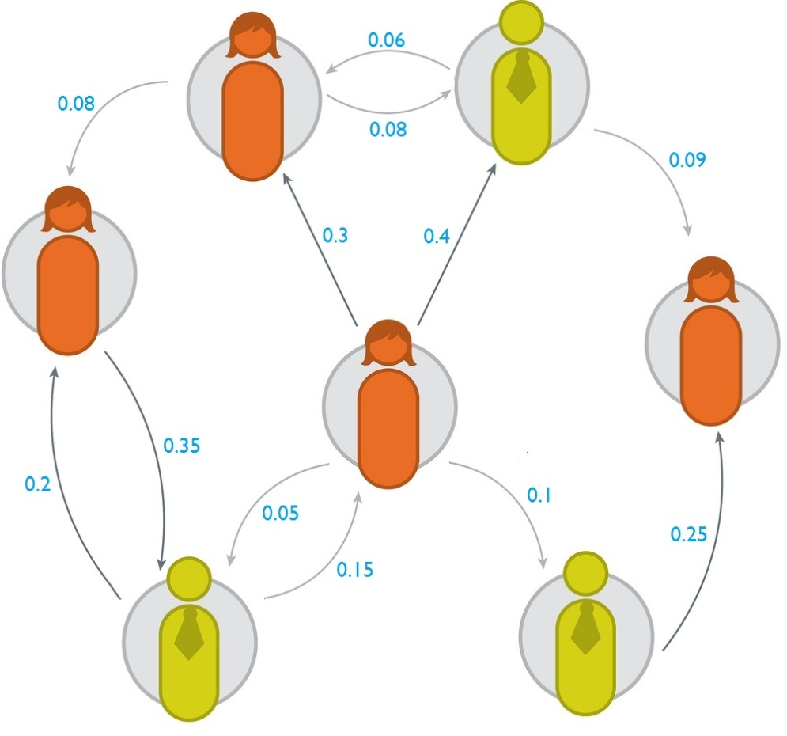


Influence Maximization
Input
Problem:
  Select k individuals such that by activating them, the expected spread of influence is maximized.
Output
Social graph with influence
probabilities of edges
Seed set of size k
Domingos et al., 2001; Kempe et al., 2003.
Notes:
The problem of influence maximization is defined as follow. Given a social graph with influence prob on edges, and a number k, the objective is to select k seed nodes .....
It has many applications like viral marketing, feed ranking, recommendation system etc.
Kempe and others in 2003

Slide 5
Two Classical Propagation Models
Linear Threshold Model
Independent Cascade Model
In this paper, we improve the current state of art
algorithm for influence maximization
under Linear Threshold Model
Notes:
In particular, the work by Kempe and others focuses on two basic propagation models ..

Slide 6
Overview
Running time
of the algorithm
Inefficient
1-1/e- ε
approximation
Simple Greedy Algorithm
(Kempe et al., 2003)
* Memory usage is high
* Spread achieved
can be improved
* Memory usage is low
* Spread achieved is better
NP-hard
LDAG Algorithm
(Chen et al., 2010)
Simpath
(Our algorithm)
Ideal
Algorithm
Fast
No approximation
guarantees
Faster
Expected spread of influence achieved
Notes:
To explain the current state of art, let me use the following plot. On X-axis, we have quality of the seed set .. in terms of final spread achieved. On Y-axis, we have running time of the algorithm. Red star denote the ideal scenario – that is, an algorithm that runs very fast and outputs a seed set whose influence spread is maximum.
The problem is NP-hard.

Slide 7
Linear Threshold (LT) Model
A user is either active (influenced) or inactive.
Influence spreads through the social graph from active users to inactive users.
Each user has an activation threshold, uniformly distributed in [0,1].
If the sum of incoming influence from neighbors is more than the activation threshold, the user becomes active.
Notes:
Now lets look at the linear threshold model.

Slide 8
Linear Threshold Model - Example
0.6
Inactive Node
Active Node
0.3
0.2
0.2
x
Activation Threshold
0.1
0.4
Incoming influence
U
0.5
0.3
0.2
Stop!
w
0.5
Spread of node v is 4
for this choice of thresholds
v
To estimate the spread of a seed set, this process is
repeated many times, and the average is taken
Through coin tosses, the activation thresholds of all the nodes are
decided in the beginning.
Say node v is the seed set.
Notes:
The process is repeated sufficiently many number of times, typically 10,000

Slide 9

Simple Greedy algorithm
Simple???? Greedy algorithm
Computing marginal gain (or spread) is #P hard
Chen et al., 2010
In each iteration, add to the seed set, the node providing the maximum marginal gain in spread.
1-1/e- ε
approximation
O(n*k) calls to spread estimation subroutine
CELF algorithm by Leskovec et al., 2007
CELF++ by Goyal et al., 2011
Notes:
Its simple, and provides an approximation .. but wait, it is not that simple. Computing marginal gain, or influence spread for sake is #P hard

Slide 10
In this paper, …
We propose Simpath (Simple Paths)
algorithm for influence maximization
under Linear Threshold Model

Slide 11
Greedy algorithm with CELF
Simpath
Vertex Cover Optimization
Look ahead optimization
Improves the efficiency
in the first iteration
Improves the efficiency
in the subsequent iterations
In lazy forward manner, in each iteration, add to the seed set, the node providing the maximum marginal gain in spread.
Simpath-Spread
Compute marginal gain by
enumerating simple paths
Notes:
To provide an overview of Simpath, let me start with Greedy algorithm with lazy forward optimization which is as follows. The lazy forward optimization add the nodes in the seed set in lazy forward manner.

Slide 12
Rest of the talk
Key ideas behind Simpath algorithm.
Results.
Conclusions.

Slide 13
Estimating Spread in SimPath (1)
We observe that the influence of a node x on node z can be computed by enumerating all simple paths starting from x and ending in z.
x
0.4
z
A simple path is a
path that doesn’t
contain any cycle
Influence of x on z
through path x → z is 0.4
Influence of x on z
through path x→y→z is
0.3 * 0.2 = 0.06
Total influence of x
on z is 0.46
0.3
0.2
0.1
0.5
y

Slide 14
Estimating Spread in SimPath (2)
Thus, the spread of a node can be computed by enumerating simple paths starting from the node.
x
0.4
z
0.3
0.2
Influence of x on z
Influence of x on y
Influence of x on x itself
Total influence of
node x is 1.96
0.1
0.5
y
Influence Spread of node x is
= 1 + (0.3 + 0.4 * 0.5) + (0.4 + 0.3 * 0.2) = 1.96

Slide 15
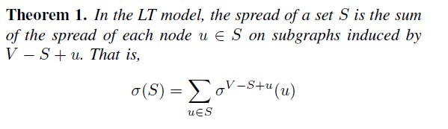
Estimating Spread in SimPath (3)
x
0.4
z
Total influence of the
seed set {x, y} is 2.6
Influence of node x in a
subgraph that does not
contain y
Influence of node y in a
subgraph that does not
contain x
0.3
0.2
0.1
0.5
y
Let the seed set S = {x,y}, then influence spread of S is

Slide 16
Estimating Spread in SimPath (4)
Enumerating all simple paths is #P hard
Thus, influence can be estimated by enumerating all simple paths starting from the seed set.
Thus, influence can be estimated by enumerating all simple paths starting from the seed set in a small neighborhood.
On slightly
different subgraphs
The majority of influence flows in a small neighborhood.

Slide 17
Estimating Spread in SimPath (5)
Through a parameter η, we can control the size of the neighborhood.
  That is, stop enumerating paths when the influence weight drops below η.
  Direct trade-off between accuracy of spread estimation and running time.
We adapt classical backtrack algorithm to enumerate simple paths smartly.

Slide 18

Simpath
Vertex Cover Optimization
Look ahead optimization
Improves the efficiency in the first iteration
Improves the efficiency in the subsequent iterations
In lazy forward manner, in each iteration, add to the seed set, the node providing the maximum marginal gain in spread.
Simpath-Spread
Compute marginal gain by enumerating simple paths

Slide 19
Look Ahead Optimization (1/2)
As the seed set grows, the time spent in estimating spread increases.
  More paths to enumerate.
A lot of paths are repeated though.
The optimization avoids this repetition intelligently.
A look ahead parameter ‘l’.

Slide 20


Look Ahead Optimization (2/2)
l = 2 here
Seed Set S_{i} after iteration i
Let y and x be
prospective seeds
from CELF queue
y
....
x
A lot of paths are enumerated repeatedly
1. Compute spread achieved by S+y
2. Compute spread achieved by S+x

Slide 21
Experiments

Slide 22
Datasets
DBLP
914K, 6.6M
Flixster
99K, 978K
Number of
edges
Last.fm
61K, 584K
NetHept
15K, 62K
Number of nodes
Influence Weights α Number of common actions users perform

Slide 23
Algorithms Compared
MC-Celf – Simple Greedy algorithm with CELF optimization (Upper bound on influence spread).
  10,000 monte carlo (MC) simulations
LDAG – By Chen et al., 2010.
SimPath – Our algorithm (Simpath-Spread + Vertex Cover Optimization + Look Ahead Optimization + CELF).
SPS-CELF++ – Simpath-Spread + Vertex Cover Optimization + CELF++.
    Look ahead optimization cannot be used with CELF++
Page Rank – Top-k nodes with highest page rank.
High Degree – Top-k nodes with highest degree.

Slide 24
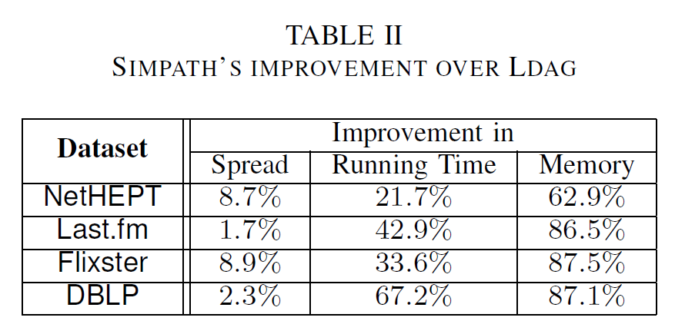
SimPath vs LDAG

Slide 25
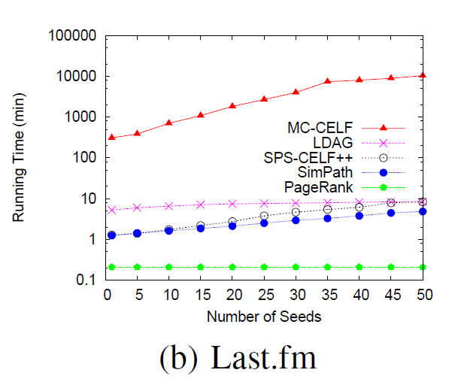
Running Time
MC-CELF takes 7 days to
finish.
Both LDAG and Simpath
takes less than 10 min.
Simpath is 42.9% faster
than LDAG.

Slide 26
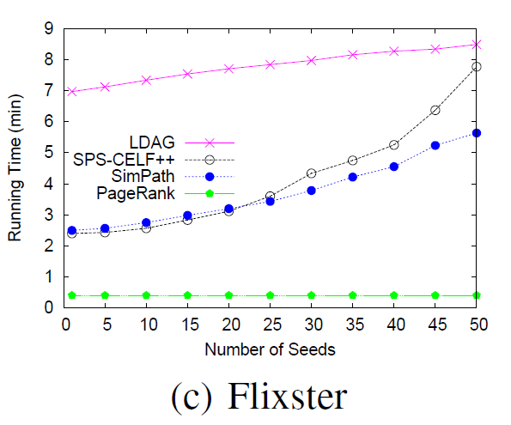
Running Time
MC-CELF is too slow to
finish.
Simpath is 33.6% faster
than LDAG.

Slide 27
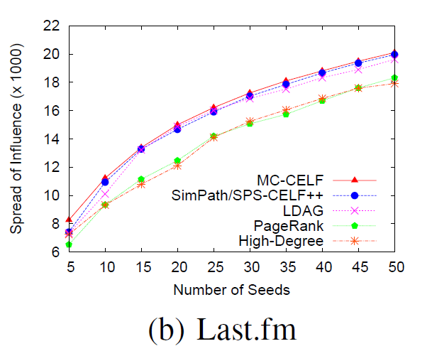
Influence Spread Achieved
1.7% better than LDAG
0.7% lower than MC-CELF,
the upper bound

Slide 28
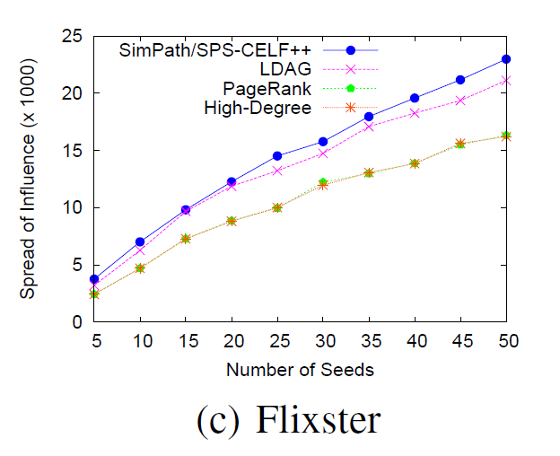
Influence Spread Achieved
8.9% better than LDAG.
MC-CELF is too slow
to finish on it

Slide 29
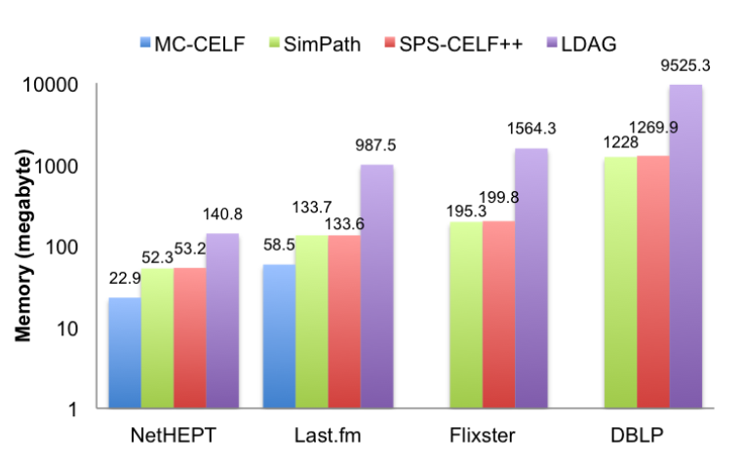
Comparison of Memory Usage
60-90%
improvement
over LDAG

Slide 30
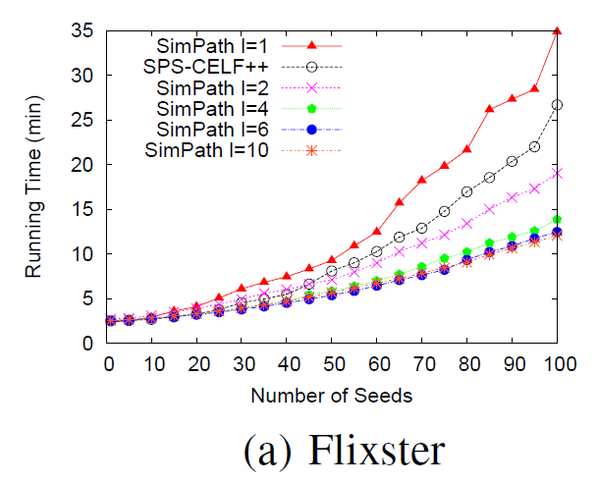
Effect of Look Ahead Optimization
l is the look ahead value.
l=1 implies no optimization.
Without the optimization,
the running time increases
sharply with the number
of iterations.

Slide 31
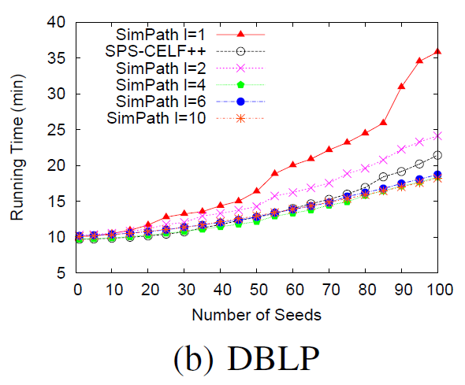
Effect of Look Ahead Optimization
Similar observation in
other datasets.

Slide 32
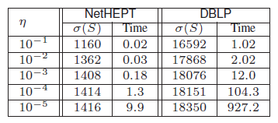
Effect of Parameter η
η decides the size of the neighborhood.
Lower the value of η, more paths to enumerate.
As we decrease the value of η, influence spread achieved
improves but the algorithm becomes inefficient.

Slide 33
Conclusions
Running time
of the algorithm
First iteration in
particular is expensive
Inefficient
Simple Greedy with
CELF Optimization
* Memory usage is high
* Spread achieved
can be improved
1-1/e- ε
approximation
* Memory usage is low
* Spread achieved is better
NP-hard
LDAG Algorithm
(Chen et al., 2010)
Simpath
(Our algorithm)
Ideal
Algorithm
Fast
No approximation
guarantees
Faster
Expected influence spread achieved

Slide 34
Conclusions
SimPath estimates influence spread by enumerating simple paths starting from the seed set.
Using the parameter , we can strike a balance between running time and desired quality.
Vertex Cover Optimization improves the running time in first iteration, thus addressing the key weakness of CELF optimization.
Look Ahead Optimization improves the efficiency in subsequent iterations.
We have released the code for Simpath and other related algorithms.

Slide 35
Other applications
Simpath can be used in other variants of Influence Maximization problem.
Minimizing seed set (also called Target Set Selection)
  Chen 2008
  Ben-Zwi et al., 2009
  Goyal et al., 2010
Minimizing Propagation time (MINTIME)
  Goyal et al., 2010

Slide 36
Thanks and Questions
Amit Goyal (Graduating in Summer 2012)
Wei Lu
Laks V. S. Lakshmanan
University of British Columbia
http://cs.ubc.ca/~goyal

Slide 37
Look Ahead Optimization
In an iteration, the optimization takes top-L elements from the CELF queue, and computes the spread of seed set S_{i} on graphs V-x for all nodes in those top-L elements.
Then, it computes spread of x on graph V-S_{i}.
Apply the formula to get the spread of S_{i} + x.
If a seed is found in these top-L elements, we are good, otherwise, next top-L elements are taken.

Slide 38
Look Ahead Optimization
L=1 implies no optimization.
High values of L are not good as well, as the overhead in computing spread of S_{i} on graphs V-x for all nodes in those top-L elements becomes large.
We study the effect of L in experiments.

Slide 39
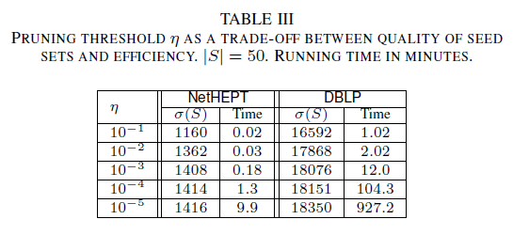
Effect of Pruning Threshold η

Slide 40
LDAG – current state of art
Computing spread in general graphs is #P hard.
  However, it can be computed in linear time on DAGs.
Majority of influence to a node flows from a small neighborhood.
For each node, construct a local DAG (LDAG) and consider the influence flow in that LDAG.
Chen et al 2010

Slide 41
Issues in LDAG algorithm
The algorithm relies heavily on finding good LDAG.
  Finding optimal LDAG is NP-hard.
  A greedy heuristic is employed. No approximation guarantees provided.
  Additional level of loss in quality.
The algorithm considers the influence flow from only one local DAG, and ignores other DAGs.
  If influence flow from other local DAGs is significant, the performance may be poor.
Because it maintains one DAG per node, memory consumption is high.

Slide 42
Vertex Cover Optimization (1/2)
We show that the spread of a node can be computed “directly” using spread of its out-neighbors.
Thus, in the first iteration, construct the vertex cover C, and compute spread for nodes in C only.
Spread for other nodes can be computed “directly”.

Slide 43
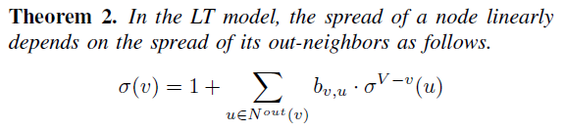
Vertex Cover Optimization (2/2)
x
0.4
z
z
0.3
0.2
0.1
0.5
y
y

Slide 44
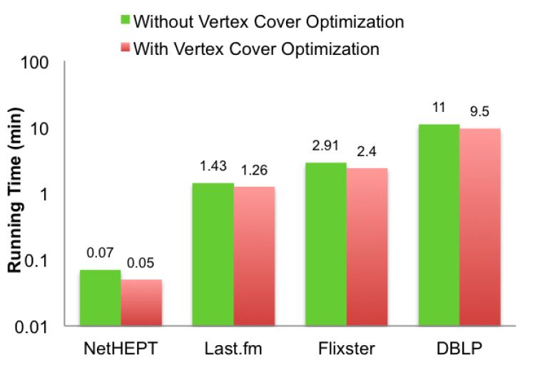
Effect of Vertex Cover Optimization

Slide 45
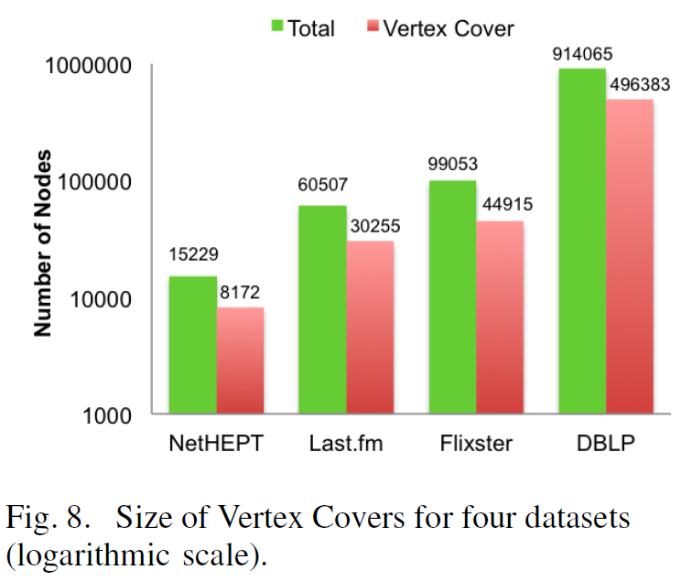
Effect of Vertex Cover Optimization

Slide 46
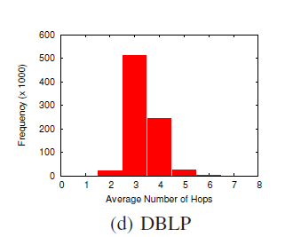
Number of hops
In maximum number of
paths, influence decays
below 0.001 in 4 hops.
Maximum hop length in
dataset is 8.

