Slide 1
Department of
Computer Science, UBC
Health and Safety Orientation
2022
If you have any questions or comments, contact Vivian Leung, Facilities and Tech Coordinator, Department of Computer Science Chair of Computer Science Local Safety Team, Emergency Director (Email: space-admin@cs.ubc.ca)

Slide 2
Building Access
Building users require their UBC ID to enter the building after building hours (5:00pm-7:30am) on weekdays and on weekends & holidays
To use the elevator
Present your token to the reader in the elevator
Press the number of your desired floor
If you have a problem with access or require additional access, send email to
grad-info@cs.ubc.ca for general use spaces
your supervisor for research lab space
Undergrad student access is based on having an active CS account
Within 24 hours of adding a course, they will have building access
Undergraduate access after hours is restricted to floors X0-X3 (X-wing) and 0 (West wing)

Slide 3
Facility Information
Showers
West Wing: room 052, 058
X Wing: room X122
Bike Room: room 004
Kitchens: 148, 211, X434, X534, X860A
Patio: 2nd floor
Copy/Print rooms: 212, X452
Grad first-year seating 108
Grad Lounge 144
Pacific Poke – UBC Food Services X165
Department lounge: X860
Skype room: 355
Notes:
Put bikes in the bike room, not in the lab.
Keep kitchens clean and tidy

Slide 4
UBC Health & Safety Program
As a new employee, a number of courses are mandatory to meet WorkSafeBC and UBC requirements. At UBC, a “worker” includes Senior Executives, Faculty, Staff, and Student workers.
https://srs.ubc.ca/training/mandatory-training-for-all-ubc-workers/
Mandatory Health & Safety Training
New Worker Safety Orientation (Part 1 only)
Preventing and Addressing Workplace Bullying and Harassment Training
Workplace Violence Prevention Training
Mandatory Privacy & Information Security Fundamentals Training
Privacy & Information Security Fundamentals Training
Mandatory for CS faculty, staff and grads
Safety Orientation Check list
Deadline is September 30th
Notes:
All of the information is online for the department. myCS.ubc.ca

Slide 5
Emergency Communication
Information Sources
The primary source for information is
www.ubc.ca
Twitter (@ubcnews)
Sign Up for UBC Alert - Students
Log into the UBC Student Service Centre
https://students.ubc.ca
Add your cell phone number to “Your Details”
Media (do not depend solely on media)
Notes:
Media - do not depend solely on media reports as your primary source because the information may not be reliable

Slide 6
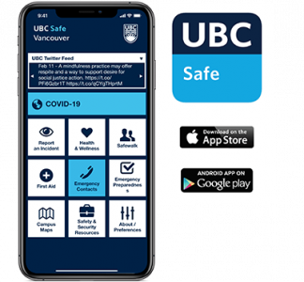
UBC Safe Vancouver app
UBC Safe is a free mobile safety app for the UBC Vancouver campus.
https://srs.ubc.ca/health-safety/ubc-safe-Vancouver-app/
This multi-function app puts direct access to campus safety resources and security tools in your hand, while on the go.
UBC Alerts
Campus resources
Critical Services
COVID-19 health assessment

Slide 7
What You can do to Prepare
Know the following numbers
Fire-Police-Ambulance 911
First Aid 604-822-4444
Campus Security 604-822-2222
AMS SafeWalk 604-822-5355
UBC Trouble Calls 604-822-2173
CS Helpdesk help@cs.ubc.ca
(604-822-1423)

Slide 8
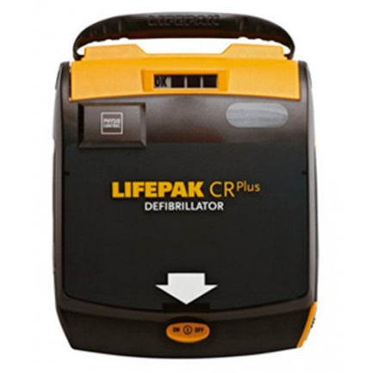
Safety Equipment
Know the location of safety equipment: closest fire extinguisher, fire alarm pull station, first aid kits, and automatic external defibrillator (AED)
First Aid kit (for minor injuries)
Available in the CS Main Office (room 201)
AED (Automatic External Defibrillator)
Available outside the CS Main Office
Anyone can use the AED
How to use the AED:
https://www.youtube.com/watch?v=R336zGS2aTE
Notes:
Walk around the building to ensure you are familiar with the exit route

Slide 9
Emergency Preparedness
https://ready.ubc.ca/
Get informed
UBC Emergency Plans
Emergency response structures and processes
UBC Alert
Get prepared
Make a plan, build a disaster kit
Take action!
React appropriately to an active threat, bomb threat, earthquake, extreme weather, fire, suspicious object … etc

Slide 10
Personal Emergency Preparedness Disaster Kit Plan for 72 hours

Slide 11
If you have an EMERGENCY
In the event of a medical emergency or if the first aid situation was caused by a crime being committed, first call 9-1-1 and then call UBC first aid.
Faculty, staff, and student-staff, should call 604.822.4444 (Dial 2.4444 on UBC landline) to contact Campus Security for first aid
Students and visitors should call 604.822.2222 (Dial 2.2222 on UBC landline) or locate an Emergency Blue Phone to contact Campus Security for first aid
Notify the front office (604-822-9289) if you have an incident
Notes:
Central First Aid System: 24 hours a day and 7 days a week.
UBC faculty, staff, paid student or practicum student – 2-4444 Every employee must be made aware of how to access first aid services.

Slide 12
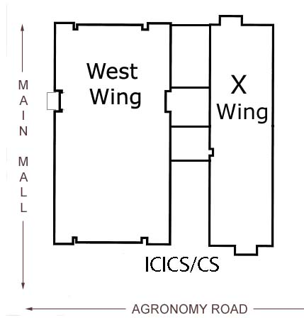
Emergency Evacuation
We may evacuate due to fire, hazardous material, bomb threat, earthquake, or drill
If you hear the fire alarm
Calmly proceed to the nearest exit
Do NOT use the elevators
Listen to the Floor Wardens
ICICS: designated assembly area is on the front lawn on Main Mall
Dempster: assemble at the main doors
Do NOT re-enter the building
Assist anyone having difficulty
Notes:
DO NOT wait for floor wardens, please evacuate when you hear fire alarm

Slide 13
Emergency Evacuation Evacuating Disabled People
Individuals who require special assistance during an evacuation.
If for some reason a person cannot make their way out of the building
Help the person to an access route
Exit the building and report the person’s location to the fire department on scene
If you need special help, you should inform your supervisor.
Notes:
If a person can not get off of the floor themselves they should have an abled bodied person assigned to help them get out.

Slide 14
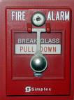
Fire Safety Plan Fire Prevention
Prevent the incidence of fire by controlling fire hazards
Good housekeeping
Do not plug too many appliances into an outlet
Keep heaters away from papers and loose clothing
In case of fire
Call 911
Pull the fire alarm
Report any problems to help@cs.ubc.ca immediately

Slide 15
Accident Prevention Hazards at ICICS/CS
ICICS/CS is a hazardous materials free building
Report any chemicals to the emergency director
If you want to use chemicals, come and talk to the Emergency Director first.
Ladders
Bookshelves
Ergonomics (largest category of injuries at UBC)
If you have any questions or concerns about safety hazards, please send email to space-admin@cs.ubc.ca

Slide 16
Accident Prevention
The Employee’s Responsibilities
Working safely is a fundamental part of your job.
You must have your supervisor’s permission before attempting any task which could be unsafe.
You must be trained before undertaking any task which could be dangerous.
You have the right to refuse to do any task which you feel is unsafe. (It’s the law.)
You are responsible for doing your best to maintain your area as a clean and safe working environment.

Slide 17
Reporting Problems
If an Accident occurs
Report to your Supervisor and the Emergency Director emergency-director@cs.ubc.ca
Call the CS office for assistance at 604-822-9289
If you need Fire-Police-Ambulance, call 9-1-1
If you are a paid employee and require First Aid, call 2-4444.
Report accidents or near-misses to your Instructor
If you observe theft, vandalism or building security issues, call UBC Campus Security at 822-2222
After building hours, if the building requires immediate attention, call UBC Campus Security at 822-2222 .

Slide 18
Reporting Problems
Report technical problems to help@cs.ubc.ca
CS account
Undergraduate teaching environment
Wireless and Data Network
Report non-emergency issue to space-admin@cs.ubc.ca
Access Control
Janitorial Services Problems
Broken doors or key cylinders, light bulb outages or damage of any kind

Slide 19
Work Alone
When possible, do not work alone at night
DO NOT let anyone into the building – everyone authorized to be in the building has a fob
Park your car or bicycle in a busy, well-lit area
Walk in busy, well-lit areas.
Use caution when stopping to give strangers information or directions, especially at night.

Slide 20
Personal Safety and Security
If you have safety concerns, use the following resources
AMS Safewalk
TransLink Shuttle bus
Blue Phones
Ensure valuables such as laptops are stored securely
Send email to help@cs.ubc.ca to get a laptop anchor attached to your desk
If you witness a crime or see a suspicious person, report it to
RCMP by calling 911 or Campus Security at 604-822-2222

Slide 21
Physical and Mental Health Resources
https://students.ubc.ca/health
Crisis support 24/7
Connect to a health professional
Self-help tools
Health topics
Notes:
A Wellness Advisor can help if these concerns or others are ongoing and affecting your academics, sleep, or motivation

Slide 22
Volunteers Liability Waiver
Who needs to fill out this form?
All incoming volunteers are required to fill out the waiver
https://my.cs.ubc.ca/system/files/docs/volunteers_liability_waiver.pdf
What do volunteers need to be aware of?
Understand the risk associated with your volunteering tasks
Take responsibility for your own safety
Protect the PI and department from liability
Notes:
Volunteers provide an important service to UBC.
Volunteers obtain valuable work and social experiences as well as acquire a sense of personal achievement and satisfaction.

Slide 23
Important Links
Safety Orientation checklist (Complete by Sept 30th)
https://ubc.ca1.qualtrics.com/jfe/form/SV_0TAnIB67wvNrSWF
Mandatory Training for All UBC Workers
https://srs.ubc.ca/training-and-general-education-courses/mandatory-training-for-all-ubc-workers/
UBC Safety App
https://srs.ubc.ca/health-safety/ubc-safe-vancouver-app/
UBC Alerts
https://ready.ubc.ca/get-informed/ubc-alert/
The primary source for information in an emergency:
www.ubc.ca , Twitter (@ubcnews)
UBC Emergency Preparedness
https://ready.ubc.ca/
Physical and Mental Resources
https://students.ubc.ca/health

Slide 24
Joining Local Safety Team
Please talk to the CSGSA or contact
space-admin@cs.ubc.ca if you would like to join the CS Local Safety Team.
We meeting monthly for an hour ☺
Thank you!
Have a safe stay at UBC!

