Slide 1
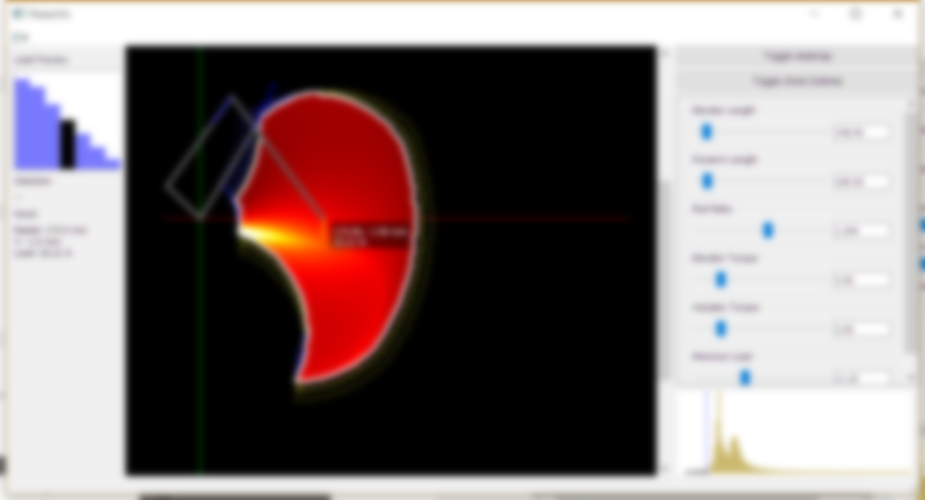
RoboVis
Alistair Wick

Slide 2
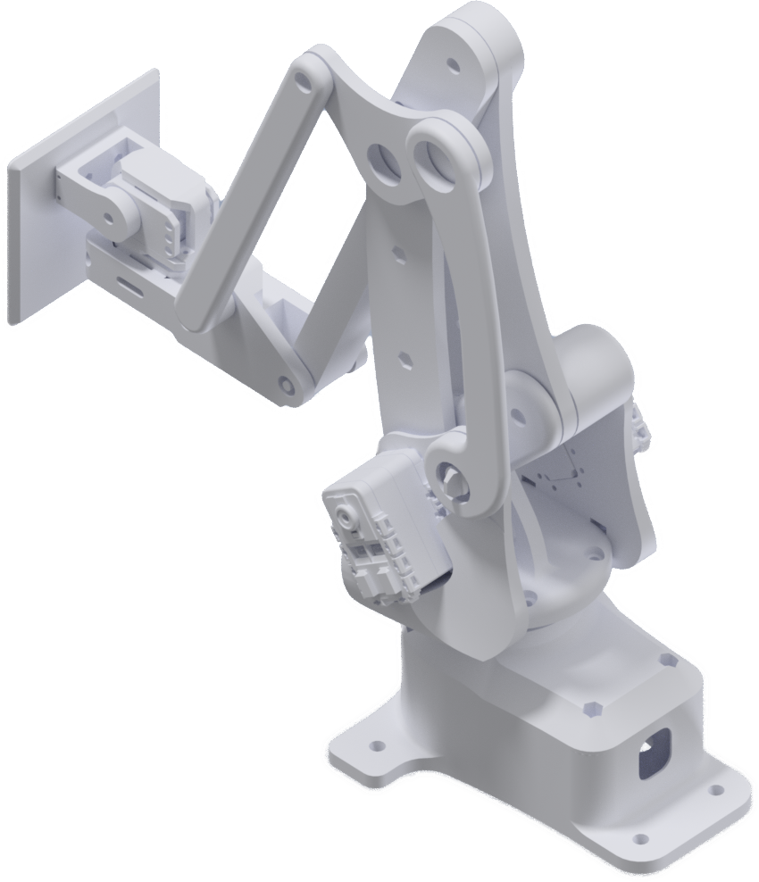
Background
Designed a small robot arm
3 degrees of freedom
3D printable
Controlled with a Python App

Slide 3
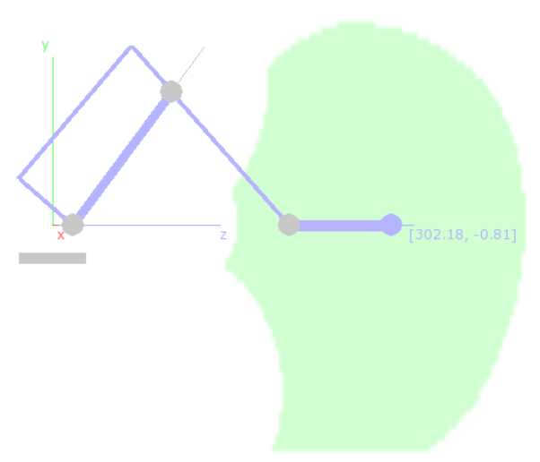
Background III
Old control app shows where the arm can reach (workspace)
Uses inverse kinematics based on the arm’s dimensions and other parameters

Slide 4
Background II
The fact it’s 3D printed is interesting
3D printing is great for small runs of custom objects
Why have a static design?
Idea: Let users design their own arm for printing

Slide 5
The Idea
Make a tool to help users design robot arms!
Should guide towards useful solutions
Tool produces ‘config’ files describing dimensions, motor power, constraints, etc.
Config can be fed into an OpenSCAD script (or similar program)
… generates 3D files for printing!
Assume users have an idea of the load and reach requirements

Slide 6
Why not use the existing app?
Painfully slow
Can’t change config in-app: alter file and restart app
10+ seconds to calculate workspace for one arm
Built as a middle-man control app, not for design
No advanced GUI
No load calculations
Notes:
So why can’t we use the existing control app? There are a couple of problems. It’s very slow – you want to quickly iterate the design in a trial and error style process, but to see the results for a new config requires you to reload the whole app. This loading also takes time: about 10 seconds to calculate the workspace. It’s also simply not designed for modifying the configuration, with limited interactive capabilities, and no support for load calculations.

Slide 7
Objectives
Essentially a configuration space exploration tool
Display workspace and load capabilities
Tool which will guide towards a good solution
User has some idea of what they need
Help them find the configuration that achieves that
Responsive – fast iteration
Ability to output config files

Slide 8
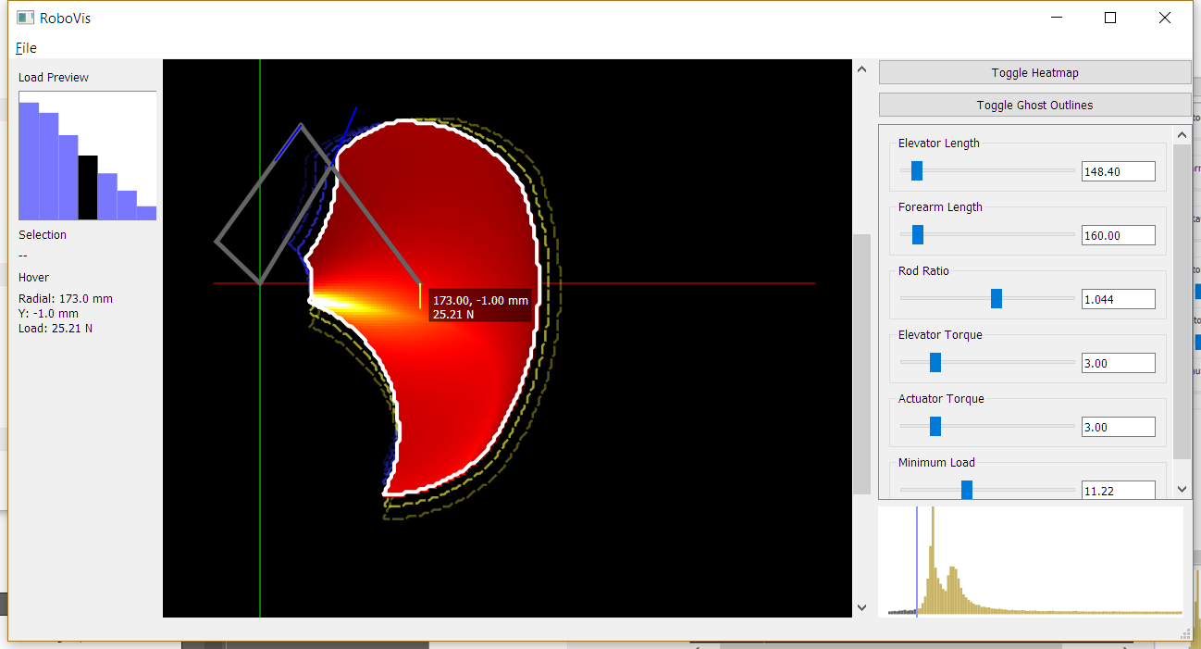
RoboVis - Overview
Notes:
So, this is what I’ve come up with. There’s a few different elements here I’ll go over in detail, but essentially, you change the configuration using the options on the right, see the results in the center view, and inspect things in extra detail with hover interactions and the pane on the left.

Slide 9
Usage
Application has a “current” configuration, and a particular parameter of interest
The main view visualizes the results for this configuration
Expected reach
Expected load capabilities
Current config adjusted using the sliders/value boxes on the right hand side
Config can also be saved to/loaded from a YAML file

Slide 10
Workspace - Outline
The space the end-effector can reach
IK run across sample grid
Contour-map around points with a valid solution

Slide 11
Load - Heatmap
Shows the distribution of maximum load for the current configuration
Max load calculated for static case with specified motor torques
Notes:
I needed a way to show how the arm’s performance varied over its workspace, and a heatmap seemed like the natural option. Essentially, brighter areas show a higher load capacity, and this is meant as a visual guide rather than a way of getting precise readings.
The actual calculations are just static mechanics – I solved for the torques given a load, then flipped those equations around to get the load for given maximum motor torques.

Slide 12
Load Histogram/Slider
Minimum load slider
Coupled with histogram of load

Slide 13
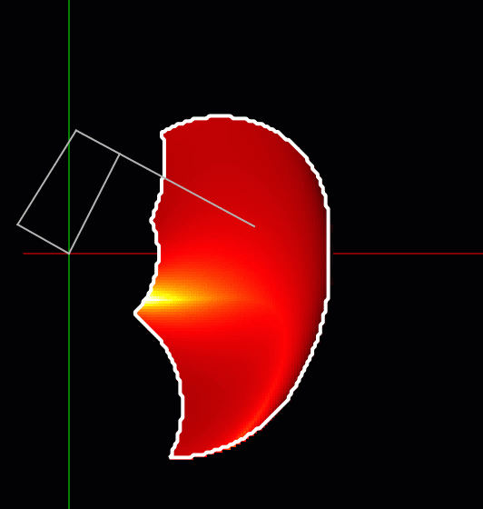
Basic Interaction
Shape and heatmap respond as the user alters parameters
Visualization of the arm can be shown for a selected point
Arm updates its dimensions and pose

Slide 14
Inspection
Hover over the vis to see coordinates in mm + max load in newtons
Click to select inspection point
Bar chart shows how load at a point will change with the current parameter

Slide 15
Parameter space
How will the results change with a particular parameter?
Current config
Parameters extend in all directions

Slide 16
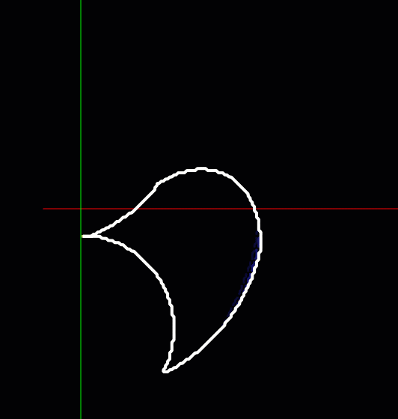
Ghosts – Preview Outlines
Extra outlines around the main one
Show how the reachable area will change for different parameters
Blue for -ve change
Yellow for +ve change

Slide 17
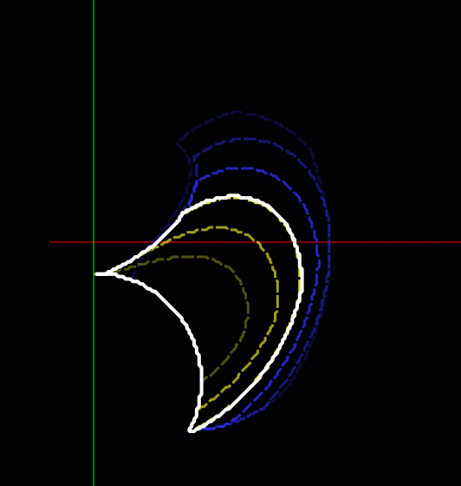
Ghosts – Preview Outlines
User can then ‘slide through’ the configurations in real time
Ghosts are updated (recalculated) on the fly
Opacity shows distance from current config

Slide 18
Ghosts – Preview Outlines
Switches between parameters are instant!
Ghosts for the other parameters are kept updated

Slide 19
Technical
Lots of work making this responsive!
NumPy is awesome
Reformulated IK code into big matrix operations
Improved IK solving performance by around 200x over naïve Python implementation
Ghost outlines are an ‘embarrassingly parallel’ problem
Calculations offloaded to pool of worker processes
Spreads work across all CPU cores
Results are presented as they become available

Slide 20
Thanks!
Questions?

Slide 21
Asynchronous Calculations
Interface
Main Process
Change config
Change triggers calculations
1 solver per parameter and ghost (dozens total)
Configuration
Solver
Solver
Solver
Poll Results
Job Queue
Results
Configuration to solve, Priority, Creator Ref
Worker Pool
Worker
Worker
Worker
Results of IK – grid of reachable cells, load distribution
…
Notes:
To actually achieve this, there’s a lot of work going on behind the scenes. When the configuration changes, these solvers, which are attached to the different ghost representations, get updated. There’s a set of solvers for every parameter (this is to keep the other ghosts updated), and they submit jobs to a queue.

