Slide 1
Beeswax
Presented at PETS'2016,
July 20th 2016
a platform for private web apps
Jean-Sébastien Légaré*, Robert Sumi and William Aiello
UBC NSS Lab
The University of British Columbia

Slide 2
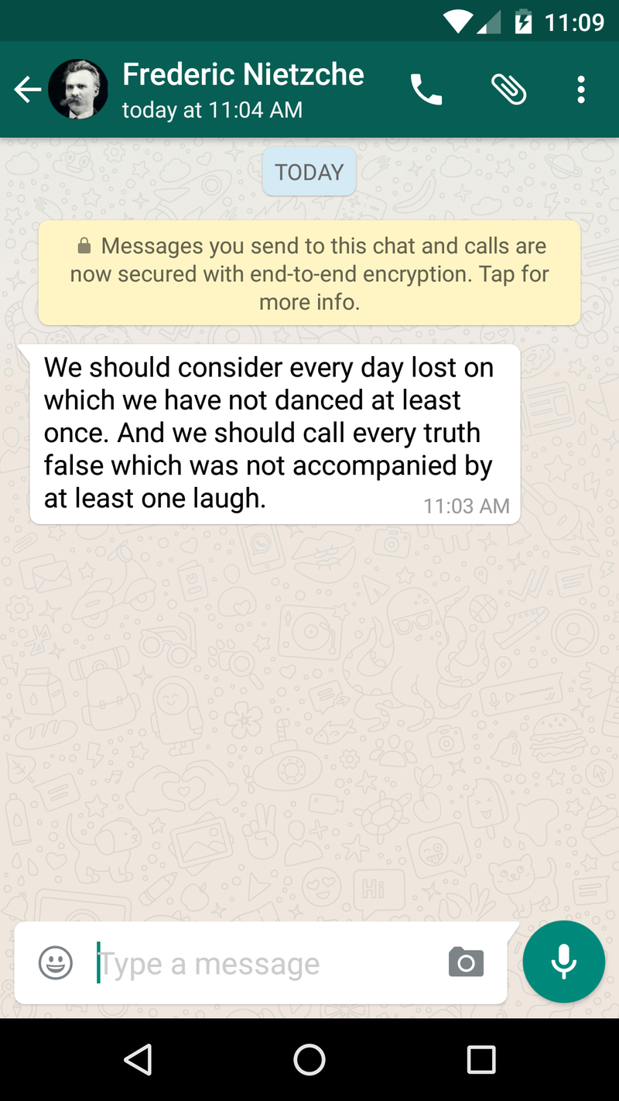
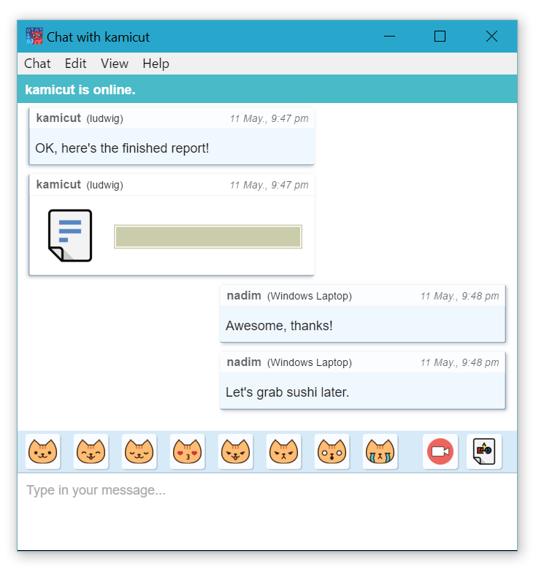
Notes:
We’re starting to see more and more end-to-end secure apps. Shown here are two examples, whatsapp and cryptocat.
This is great, because users are finally getting some data confidentiality from service providers—and ISPs, and governments,….

Slide 3
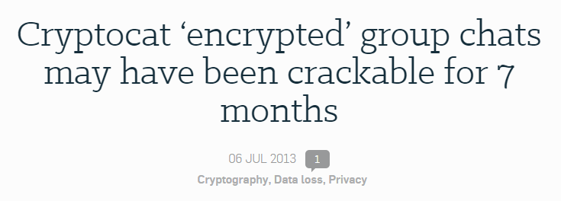
Are they secure? Is it really Private?
Notes:
How would one know that data and/or keys were not being exfiltrated by the application?
Vulnerabilities in these applications surface. Most recently, it was discovered namely that links exchanged in facebook conversations that were expected to be private were available publicly using facebook APIs
*next slide*
A google hangouts glitch was sending messages to wrong recipients.
Weaknesses in cryptocat group chat crypto could have allowed attackers to recover keys.
And more recently, links shared in facebook private messages could be recovered publicly using APIs.

Slide 4
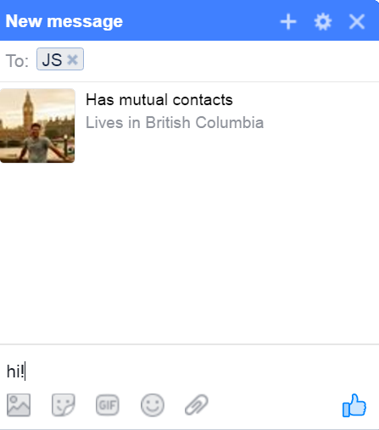
Ex: Facebook Messaging, cryptocat, google talk otr.
How could one gain assurance?
Audit the code?
Rely on conclusions of a diligent self-identified community of experts?
Do it again for every app?
Notes:
How can a user gain some assurance in the code or app?
He could audit the code him self to see if there is any offending code in the application—yeah right!
Assuming the web content delivered to the client-side is “public”, he could also rely on the conclusions of a diligent self-identified community of experts,
— on the web model this doesn’t work at all: There is no guarantee that the same code is delivered.
Even more problematic, is that if he managed to gain some trust in one application, he would need to do the same due diligence for each new private application.

Slide 5
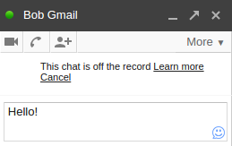
Root of the Problem
Client-Side code of private apps contains private information – The keys.
W/O containment of keys, plaintext, crypto functionality, app must be in TCB
Moreover, *every* app performing end-to-end security must be trusted
TCB of all applications
Notes:
The root of the problem is that the code on the client side of the private apps contains private information—the keys. In the absence of any disaggregation and containment of functionality, the entire application must be trusted. That is, the entire application must be considered as part of the TCB.
And, moreover, *every* application performing end to end security must be completely trusted.

Slide 6
Beeswax
A security platform to reduce the TCB of private web applications.
Disaggregation, and containment of security-critical data & functionality.
Sharing of this functionality provided in well-defined APIs.
Allows scrutiny to be focused on the platform (Instead of every app)
Implemented as a Google Chrome (v40) extension, (5K lines of code)
Deployable now and allows rich web application development
Notes:
What we proposed is a disaggregation, containment, and sharing of security-critical functionality that is critical end-to-end private _Web_ apps.
This functionality is then accessed via well defined APIs. This will reduce the TCB to this security critical functionality and APIs.
Our implementation is in Google Chrome as an extension in about 5K lines of code. We wanted it to be deployable now, and make it easy for developers to build new applications with it.
We’ll discuss issues with having a similar platform on mobile at the end of the talk

Slide 7
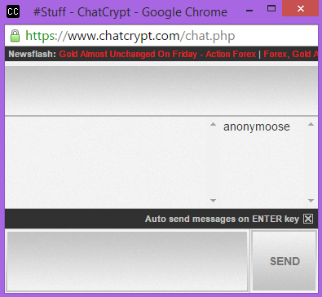
TCB Grows Larger
UI
UI
Repeats for each app.
Plaintext
Plaintext
Layout / Style
Layout / Style
Ciphertext Msgs
Ciphertext Msgs
Vulnerabilities in application code
can exfiltrate data.
App. Logic
App. Logic
Key Mgmt. / crypto
Key Mgmt. / crypto
Runtime / APIs
Runtime / APIs
Must be in TCB
Notes:
example messaging application called chatcrypt, which lets you communicate securely with many friends in a chatroom.
Decompose client side of app as follows. …
application logic, JS/HTML built on top of the browser’s runtime APIs
application performs its own client-side crypto, and exchanges ciphertext with the service provider.
It will also, naturally, provide a UI to display the confidential information that the user sends or receives.
--
Because the application does all of this work, it needs to be placed completely in the TCB.
If we take a second codebase, like browser version of cryptocat, and needs to be also be added to the TCB If the user plans on using it. This trust repeats for each application. Any weakness or vulnerability in any of the two codebase can be exploited to exfiltrate data to the provider or an attacker.
Note that the two apps have the browser APIs in common.

Slide 8
UI
UI
Protect Keys
Move them to platform
Application gets key handles
Plaintext
Plaintext
Layout / Style
Layout / Style
Ciphertext Msgs
Ciphertext Msgs
App. Logic
App. Logic
Key Mgmt. / crypto
Key Mgmt. / crypto
Key Mgmt. / crypto
Runtime / APIs
Must be in TCB
Needs no trust
Notes:
With Beeswax, we’d like to not have to trust the application. So, what’s the first thing we need to do?
A primary concern is exfiltration of keys. We therefore isolate the keying material, and crypto code in its own memory space, and add APIs to reference a secure stream.

Slide 9
UI
UI
Plaintext
Plaintext
Ciphertext
Ciphertext
Also protect plaintext
Provide opaque handles to the application
Challenges:
Keep look n feel
Maintain current dev practices.
Layout / Style
Layout / Style
Ciphertext Msgs
Ciphertext Msgs
App. Logic
App. Logic
Plaintext Viewer
Key Mgmt. / Crypto
Runtime / APIs
Must be in TCB
Needs no trust
Notes:
Hmmm. That means we need to somehow display plaintext to the user but cipher text to the application.
We repeat this principle with the plaintext. Rather than letting the application manipulate the plaintext directly, we leave the application deal with ciphertext and we provide the application a way to view and input it. Again, one of the goals is to allow the application developers to control the look and feel of their application. Otheriwse developers aren’t going to use it.

Slide 10
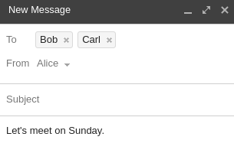
Challenge - Isolating plain text
Plaintext isolated in “private areas” taken in charge by Beeswax.
1. API call designates region of DOM to display confidential info.
2. Platform protects region of DOM from access by page JS.**
@$@#$t
3. API call to display and inputs ciphertext in/out private area.
**Isolation uses ShadowDOM [W3C], similar to ShadowCrypt [CCS2014].
**We perform JS environment changes to protect access and allow events.
Notes:
There are many things happening under the hood. We will not have the time to describe them in depth in this presentation. Beeswax isolates confidential information in regions of the DOM we call “private areas”.
We can imagine for an instant that this is an application which lets the user communicate securely with two other users. Go through bullets. Click click click
1) First, The application would call a beeswax API to display confidential information.
2) there is code in beeswax that prevents the javascript code of the application to access the contents of the PI – except for certain Beeswax API calls We use ShadowDOM, which is also used by previous work. We take a systematic approach to allow certain user events to flow in and out of private areas.
3) The Beeswax API has methods which will allow the application to r/w ciphertext in and out of the private areas.

Slide 11
UI
UI
Plaintext
Plaintext
Ciphertext
Ciphertext
Beeswax isolates keys and plaintext
Isolated data cannot be exfiltrated
Are we done?
Can we turn the app stacks blue?
Layout / Style
Layout / Style
Ciphertext Msgs
Ciphertext Msgs
App. Logic
App. Logic
Plaintext Viewer
Key Mgmt. / Crypto
Runtime / APIs
Must be in TCB
Needs no trust
Notes:
Read slide.

Slide 12
UI
UI
Plaintext
Plaintext
Ciphertext
Ciphertext
NO!
Blue means we must assume app can be malicious.
A malicious app can spoof the UI.
Layout / Style
Layout / Style
Ciphertext Msgs
Ciphertext Msgs
App. Logic
App. Logic
Plaintext Viewer
Key Mgmt. / Crypto
Runtime / APIs
Must be in TCB
Needs no trust
Notes:
Read slide.
If Beeswax api is used, then the keys and plaintext will be isolated properly. This means that an application can make some guarantees to users with regards to the safe handling of their confidential info. But there remains the issue of providing the user some assurance that the Beeswax APIs have been used properly.
An application could pretend to use Beeswax APIs. But why it would do that ?
It might try to lure users with the promise of heightened privacy and then hope to monetize private data anyway. We don’t want to have to audit the application code, so we cannot make assumptions about no UI spoofing.

Slide 13
Challenge – Defeating UI spoofing by app
Application may or may not use Beeswax APIs.
App might try to provide its own “privacy” markers
E.g. “Bob’s in the ‘To:’ field. Is this message really being sent to Bob?”
Application could show “green locks” or “green borders”, but can’t be trusted.
Beeswax could change the page to add indicators, but the app controls the window.
Notes:
The application may or may not use Beeswax APIs for different parts of the application. The application might provide its own visual indication that a given area is to be private. But we need to be careful. A malicious application could be trying to spoof privacy.
*click*
A user is likely to assume that the message that is being typed is for listed recipients. Next to the message, the application might add “green locks” or “green borders” but users shouldn’t trust that – the app controls the UI.
* click *
A secure platform might try to overlay privacy indicators in the page, but this could be spoofed too – The app controls the full UI
* Click * can’t do that.

Slide 14
Beeswax Privacy Indicator
We add an indicator of privacy in an unspoofable region of the tab
User interactions in private areas toggle the privacy indicator.
Tells if DOM region of interest is private
Content is hidden from the app
Events locked* to region
User kb + mouse
Interactions
Notes:
Our solution is to put the indicator of privacy in an unspoofable region of the browser -- As a browser action in the toolbar. Chrome does not provide a way for javascript in tab or popups to fake the browser actions next to the address bar, and no content can be overlaid outside the tab.
Once an application designates an element as a private area. The application has no control over the indications of the privacy indicator. Only beeswax can toggle that notifications there.
Whenever a user interacts with a private area, the indicator lights up. All events are locked to that area for some time. (this is covered in more detail in the paper). Clicking the action button in the toolbar provides information about the confidentiality of the element being interacted with.
This provides assurance to the user that the content is hidden from the application, and that all user events (keyboard, mouse) are locked to that particular region.

Slide 15
Keys/plaintext are unavailable to the application
P.I. indicates where events and text go.
In TCB: Beeswax YES, Apps: NO
UI
UI
Plaintext (isol.)
Plaintext (isol.)
Layout / Style
Layout / Style
Ciphertext Msgs
Ciphertext Msgs
App. Logic
App. Logic
Plaintext Viewer
Key Mgmt. / Crypto
Runtime / APIs
Must be in TCB
Needs no trust
Notes:
Coming back to this slide, then we’ve achieved the goal of not having to trust the application code.
Keys and plaintext are unavailable to the application if the application uses the APIs
Then the API gives assurance to the user that those APIs are indeed used.
So, the platform is part of the TCB, but the applications no longer have to be.

Slide 16
Split Functionality: Platform and App
When interacting with a private area, the platform allows the user to verify true recipients of a message.
Application provides functionality and takes care of sharing. Intention: “User wants to write a message to Bob+Carl”
Platform manages keys and identities.
Platform establishes secure end-to-end data streams between users. (crypto).
Notes:
Hidden slide

Slide 17
Transparent Key Management and Distribution
Beeswax has Built-in key management:
Automatic distribution of Public Keys
Key Agreement Protocol between pairs of users (“friendships”)
Symmetric key crypto API (“streams”)
Notes:
Beeswax and its API allows applications to establish end-to-end streams to communicate confidential messages between users.
We wanted to provide a complete solution, so the extension also takes care of managing and distributing keys between users.
The paper gives implementation details as to the parameters that are used for the cryptographic routines.
Beeswax provides abstractions for bidirectional signaling channels between users called friendships, and then data channels called “streams” to pass messages between groups of users.

Slide 18
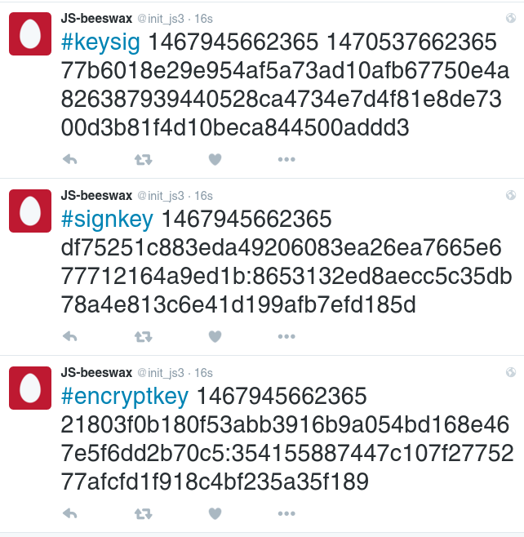
Beeswax Identities
At setup, a user’s Beeswax browser extension will generate 2 keypairs (sign, encrypt) and post a self signed cert of both to a configured twitter account..
The Beeswax background process in the extension monitors and reposts certs periodically.
*A similar process allows users to retrieve and monitor friend’s keys based on twitter IDs
Notes:
We rely on a pub/sub service to provide user identities and distribute public keys: twitter.
We use a different ECC keypair for signing and encrypting. We use Twitter in our implementation – Beeswax IDs are the account names on the pub/sub system. At setup, the user configures a twitter account in the extension.
We give user keys have an expiration, and so The extension will periodically monitor the twitter account every few days to repost the keys. This is detailed in the paper, but this good practice also works around certain twitter limitations on the availability of tweets.
Other approaches like CONIKS are also possible.
B: Here, the listener might be a little unsure what is meant by Beeswax here. Is it a service plus client-side code? I’m not sure exactly what you want to say here. Maybe something like:
At set-up, a user’s Beeswax browser extension will generate sign. and encrypt public key pairs and post self-signed certs….
The extension monitors the pub/sub account and flags if an unexpected self-signed cert is posted
* This forces a misbehaving pub/sub service to equivocate—which can be detected by gossiping
* The extension periodically reposts self-signed cert otherwise cert not searchable by other users via Twitter API

Slide 19
Beeswax Key Distribution
The application initiate friendships with other users. (Triggers the KAP).
@bob’s certs
Beeswax periodically monitors online certs against those in DB. Handles revocation.*
Fetch friend @bob’s
Beeswax @alice (background)
Notes:
Hidden slide

Slide 20
Key Agreement -- Friendship Channel
Key-Agreement-Protocol (KAP) creates secure bi-directional control channel between pairs of users, Friendship Channel. E.g. used for invitations and exchanging key information (see below).
API get_friend(@accountid) -> friendship
Establishes a set of symmetric keys used for secure communication of app signalling, such as invitations to streams.
Notes:
Just read the text on the slide.

Slide 21
Streams
Streams are media channels. Stream creators can invite other users over friendship channels.
API invite(<friendship>, <streamid>) -> invitation
Invite participants to a stream by messages over friendship channel
API accept_invite(<invitation>) -> streamid
Application receives a key handle for this stream (handle to a symmetric key).
Application relays ciphertext attached to streams.

Slide 22
Evaluation
Mechanisms fit for the development of modern web application
Transformed existing web communication application (IRC) to support encrypted messaging between groups of users
Created new encrypted photo gallery to demonstrate ability to handle richer media types
Acceptable performance

Slide 23
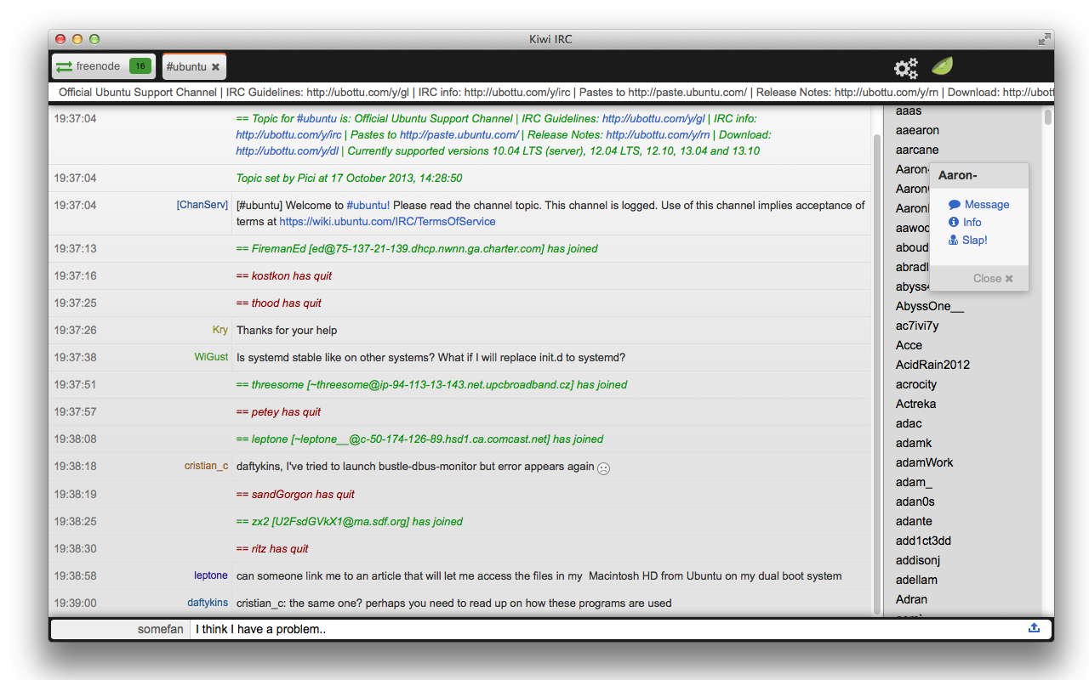
Evaluation - Encrypted IRC Client
Adding encrypted messages to an IRC client:
Beeswax users can create encrypted IRC channels
Modified KiwiIRC v0.9.0: 400 LOC added to client-side (7%)
[
Notes:
So, with beeswax, with a pretty small development effort, we converted an IRC app to one that does end to end encryption, and is just as easy to use as the non-secure version.
As long as your friends have the beeswax extension, you get end to end crypto. Really simple and easy to use.

Slide 24
Evaluation - Secure photo sharing (PicSure)
Regular tools: jquery, bootstrap, node.
Richer media type support: private areas supporting images (Beeswax photo chooser)
Notes:
Beeswax also supports richer media types than simple text. We implemented a secure photo sharing gallery, using off the shelf libraries, in which friends can share encrypted albums.
We had to be smart about how to pass the file from the computer to the application, so Beeswax also provides a special file chooser. – there are more details in the paper.

Slide 25
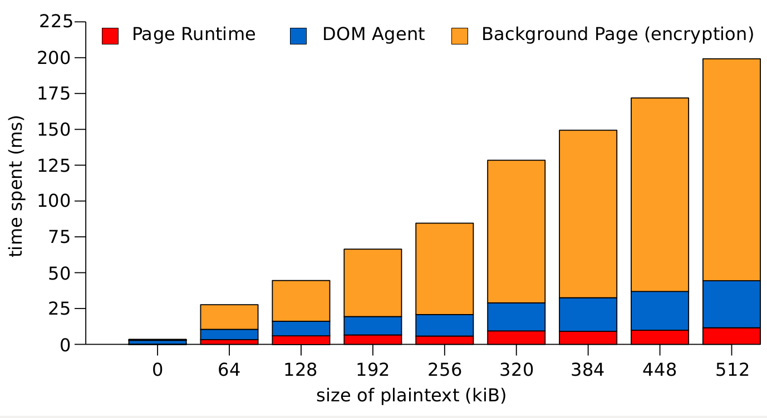
Performance - Microbenchmarks
Takeaways:
Encryption cost is predictable, linear with plaintext size.
Re: runtime
~52 ms average page load increase
2.5x slower event processing to sanitize events from confidential information in private areas
Notes:
We’ve looked into various costs of running Beeswax and ran a few microbenchmarks.
First, obviously, is measuring the cost of encryption. Which consists of passing messages from the page to the background page in the extension, and the cost of the crypto operations themselves. This cost is linear with the size of the plaintext.
Second, The beeswax extension injects modifications to the javascript runtime and has an impact on page load times (even for pages not using beeswax), on average a cost of 52ms.
Third, the Beeswax runtime has to perform sanitization on certain user events, esp those pertaining to private areas, and there is a 2.5x cost to that. In our experience however, this is not perceptible with the mouse or keyboard for regular browsing.

Slide 26
Why just the web. What about mobile?
Android OS does not have an architecture for secure modules to be loaded
No allocation for an unspoofable area of the screen (privacy indicator)

Slide 27
Discussion
Provides protection against exfiltration by the application provider
Like any platform, features can be added as platform matures
Key distribution easy and automatic, deployable now.
Focus scrutiny on platform, not apps
Platform and apps are open source, available on github:
https://web-priv.github.io/beeswax/
Notes:
Presented beeswax. Read line 1.
X: Appearance modifiers can change the look and feel of private areas. Basic highlighting, but could be extended to support markdown bbcode or other wiki-style syntax.

Slide 28
END OF RIBBON.
RESERVE SLIDES FOLLOW

Slide 29
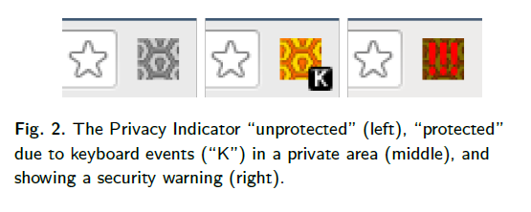
Privacy indicator states

Slide 30
Other spoofing
Talk about other ways to spoof there?
Lying about recipients
Overlaying elements
Stealing events from private areas
Locking mechanism
Refer to paper?

Slide 31
Beeswax Identity Management
Users are registered to a Pub/Sub service
Users verify binding between P/S account ID and person they want to communicate with
Only account owner can post to that account

Slide 32
