Slide 1
CPSC 503
Computational Linguistics
Lecture 11
Giuseppe Carenini

Slide 2
Plan for today Oct 19
Recap syntax
Start semantics….
Notes:
Probabilities for NP expansions do not depend on context.

Slide 3


Big Picture: Syntax & Parsing (2016…)
NEURAL APPROCHES
Bidirectional LSTM builds text span representations
MLP/FF to label each span with non-terminals
CKY for efficient global inference
The classifier is a simple MLP/FF neural network
The element of the stack / queue are vectors learned by RNNs
Notes:
Shift-reduce constituency parser
As of version 3.4 in 2014, the parser includes the code necessary to run a shift reduce parser, a much faster constituent parser with competitive accuracy. Neural-network dependency parser
In version 3.5.0 (October 2014) we released a high-performance dependency parser powered by a neural network. The parser outputs typed dependency parses for English and Chinese. The models for this parser are included in the general Stanford Parser models package.

Slide 4















Recent example of Sentiment Analyzer relying on Syntax [ABSApp EMNLP-2019]
DEMO available here: https://drive.google.om/open?id= 1BLk0xkjIOqyRhNy4UQEFQpDF_KR_NMAd
Aspect and opinion term extraction based on Dependency Parsing
illustrates the extraction of the aspect term decor based on the known opinion term nice,
illustrates the extraction of the opinion term tasty based on the known aspect term food
Extracted opinion are filtered with MLP classifier
Input features :
candidate term word embedding
mean, s-dev, max and min word-embedding cosine similarities between the candidate term and a pre-determined set of generic opinion terms.
MLP consists of a single hidden layer and is trained to distinguish manually labeled opinion terms vs. non-opinion terms (negative class)
Notes:
ABSApp: A Portable Weakly-Supervised Aspect-Based Sentiment Extraction System Oren Pereg1 , Daniel Korat1 , Moshe Wasserblat1 , Jonathan Mamou1 , Ido Dagan2 1 Intel AI Lab, Petah Tikva, Israel 2Department of Computer Science, Bar-Ilan University, Ramat Gan, Israel
1A demo video of ABSApp is available at https://drive.google.om/open?id= 1BLk0xkjIOqyRhNy4UQEFQpDF_KR_NMAd
Aspect and Opinion Term Extraction. This step is based on applying the bootstrap opinion and aspect term co-extraction using the dependency relation rules algorithm, proposed by Qiu et al. (2011). The bootstrap process is initialized with a seed lexicon of generic opinion terms. New aspect and opinion terms are extracted based on the seed lexicon and the dependency relation rules. The extracted terms are then added to the seed lexicon, and used for extracting additional terms in the next iteration. In order to initialize the bootstrap process, we used the opinion lexicon generated by Hu and Liu (2004), which contains around 6800 opinion terms along with their sentiment polarity. Table 1 shows two of the 8 rules that are used along with example sentences. The example for rule R1 illustrates the extraction o
Opinion Lexicon Scoring and Filtering. This step aims to filter the noisy candidate opinion terms extracted by the bootstrap process. It is based on using an MLP classifier for generating a score that represents the probability that a candidate is indeed an opinion term. Candidate opinion terms are qualified as opinion terms if their classification score exceeds a threshold 4 . The MLP classifier input features consists of the candidate term word embedding5 and the mean, standard-deviation, maximum and minimum word-embedding cosine similarities between the candidate term and a pre-determined set of generic opinion terms. The MLP consists of a single hidden layer and is trained once for a binary classification task using manually labeled data that consists of a set of opinion terms (positive class) and a set of non-opinion terms (negative class) from a specific domain6 . Once the model is generated it is then used for grading candidate opinion terms extracted in other domains. It is reasonable to use such model across domains, since the classification features represent semantic similarity levels that are robust across domains
f the aspect term decor based on the known opinion term nice, while the example for rule R2 illustrates the extraction of the opinion term tasty based on the known aspect term food.

Slide 5
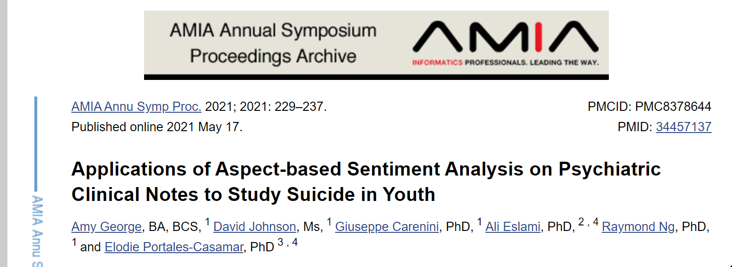
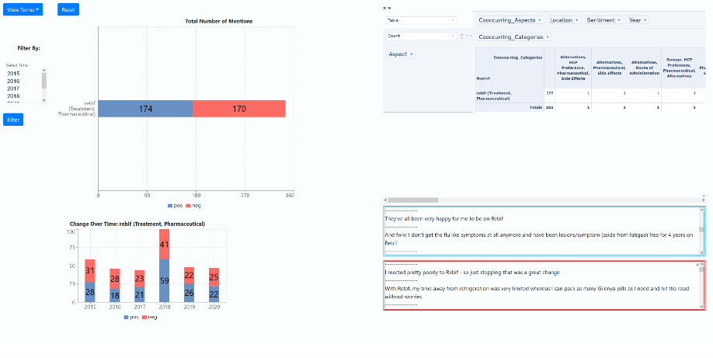
Our Ongoing Projects using ABSApp
Interpretability key in medical applications !
EXPECT-NLP Interface
EXploring patients’ Preferences and Experiences in Collected Texts using Natural Language Processing
(human in the loop)
Notes:
AMIA Abstract
Understanding and identifying the risk factors associated with suicide in youth experiencing mental health concerns is paramount to early intervention. 45% of patients are admitted annually for suicidality at BC Children's Hospital. Natural Language Processing (NLP) approaches have been applied with moderate success to psychiatric clinical notes to predict suicidality. Our objective was to explore whether machine-learning-based sentiment analysis could be informative in such a prediction task. We developed a psychiatry-relevant lexicon and identified specific categories of words, such as thought content and thought process that had significantly different polarity between suicidal and non-suicidal cases. In addition, we demonstrated that the individual words with their associated polarity can be used as features in classification models and carry informative content to differentiate between suicidal and non-suicidal cases. In conclusion, our study reveals that there is much value in applying NLP to psychiatric clinical notes and suicidal prediction.

Slide 6
Knowledge-Formalisms Map
(including probabilistic & neural formalisms)
State Machines (and prob. versions)
(Finite State Automata,Finite State Transducers, Markov Models)
Neural Models, Neural Sequence Modeling
Morphology
Machine Learning
Syntax
Rule systems (and prob. versions)
(e.g., (Prob.) Context-Free Grammars)
Semantics
Pragmatics
Discourse and Dialogue
Logical formalisms (First-Order Logics, Prob. Logics, Neural Tree Models)
AI planners (MDP Markov Decision Processes, Reinforcement learning)
Notes:
My Conceptual map - This is the master plan
Markov Models used for part-of-speech and dialog
Syntax is the study of formal relationship between words
How words are clustered into classes (that determine how they group and behave)
How they group with they neighbors into phrases

Slide 7
Next three classes
What meaning is and how to represent it
Semantic Analysis: How to map sentences into their meaning
  (syntax driven) Semantic Parsing
  “Shallow” version: Semantic Role Labeling
Inference: textual entailment
Meaning of individual words (lexical semantics)
Computational Lexical Semantics Tasks
  Word sense disambiguation
  Word Similarity
Notes:
How the meaning of a sentence depends on the meaning of its constituents
phrases and words
compositional semantics
We didn’t assume much about the meaning of words when we talked about sentence meanings
Verbs provided a template-like predicate argument structure
Nouns were practically meaningless constants
There has be more to it than that
View assuming that words by themselves do not refer to the world, cannot be
Judged to be true or false…
Information extraction: Scanning newspapers, newswires for a fixed set of events of interests
Scanning websites for products, prices, reviews,
Input: Arbitrarily complex (long) sentences
Extended discourse
Multiple writers
Output: Database-style shallow semantics (attribute-value lists)
Information retrieval: Start your own search engine company…
IR Def. Retrieving information (relevant documents) from document repositories
In ad hoc retrieval an untrained user poses a query to a system and is presented with an ordered list of
documents that are thought to be relevant to the query.
Text Categorization (Document -> Category)
Eg BusinessNews (OIL, ACQ, … )
Filtering (special case of TC, with 2 categories - relevant/non-relevant)

Slide 8
Today Oct 19
Semantics / Meaning /Meaning Representations
Linguistically relevant Concepts in FOPC/FOL
Semantic Analysis

Slide 9
Semantics
Def. Semantics: The study of the meaning of words, intermediate constituents and sentences
Def1. Meaning: a representation that links the linguistic input to knowledge of the world
Def2. Meaning: a representation that expresses the linguistic input in terms of objects, actions, events, time, space… beliefs, attitudes...relationships
Language independent
Notes:
How the meaning of a phrase is related to the meaning of its parts
The meaning of linguistic utterances can be captured in formal structures
What sorts of meaning structures and meaning relations obtain in natural language
Semantic relations among words
Link linguistic inputs to a non-linguistic representation of the world
First-Order Logics
Symbol structures that corresponds to objects and relations among objects in some world being represented
…Representation for a particular state of affairs in some world
It is important to note that these representations can be viewed from at least
two distinct perspectives in all four of these approaches: as representations of the
meaning of the particular linguistic input I have a car, and as representations of
the state of affairs in some world. It is this dual perspective that allows these representations
to be used to link linguistic inputs to the world and to our knowledge
of it.

Slide 10
Semantic Relations involving Sentences ?
Same truth conditions
Paraphrase: have the same meaning
I gave the apple to John vs. I gave John the apple
I bought a car from you vs. you sold a car to me
The thief was chased by the police vs. ……
Entailment: “implication”
The park rangers killed the bear vs. The bear is dead
Nemo is a fish vs. Nemo is an animal
Contradiction:
I am in Vancouver vs. I am in India
Notes:
If one is true the other must be true (there is no context (defines by a set of conditions) in which one is
true and the other is false)
Some linguists feel that languages do not permit two or more structures to have exactly identical meanings….
One sentence is placing emphasis on what happened to the thief the other on what the police did.

Slide 11
Meaning Structure of Language
How does language convey meaning?
  Grammaticization
  Display a basic predicate-argument structure (e.g., verb-complements)
  Display a partially compositional semantics
  Words

Slide 12
Grammaticization
Concept
Affix
Past
More than one
Again
Negation
-ed
-s
re-
in-, un-, de-
Words from Nonlexical categories
Obligation
Possibility
Definite, Specific
Indefinite, Non-specific
Disjunction
Negation
Conjunction
must
may
the
a
or
not
and
Notes:
Of the indefinitely large set of concepts expressible in human language, a relatively small set enjoys a special status
concepts that are lexicalized as affixes and nonlexical (functional / closed-class) categories in most of the world’s languages
Two kinds of category
Closed class (generally are function words)
Prepositions, articles, conjunctions, pronouns, determiners, aux, numerals
Open class
Nouns (proper/common; mass/count), verbs, adjectives, adverbs
If you run across an unknown word….??

Slide 13
Predicate-Argument Structure
Represent relationships among concepts
Some words act like arguments and some words act like predicates:
  Nouns as concepts or arguments: red(ball)
  Adj, Adv, Verbs as predicates: red(ball)
Sub-categorization frames for verbs specify number, position, and syntactic category of arguments
Examples: give NP₁ NP₂, find NP, sneeze []
Notes:
All human languages
a specific relation holds between the concepts expressed by the words or the phrases
Events, actions and relationships can be captured with representations that consist of predicates and arguments.
Languages display a division of labor where some words and constituents function as predicates and some as arguments.
One of the most important roles of the grammar is to help organize this pred-args structure

Slide 14
Semantic (Thematic) Roles
This can be extended to the realm of semantics
Semantic Roles: Participants in an event
  Agent: George hit Bill. Bill was hit by George
  Theme: George hit Bill. Bill was hit by George
Source, Goal, Instrument, Force…
Arguments in surface structure can be linked with their semantic roles
Mary gave/sent/read a book to Ming
Agent Theme Goal
Mary gave/sent/read Ming a book
Agent Goal Theme
Notes:
Force: similar to agent but lack any notion of volitionality
Predicates
Primarily Verbs, VPs, PPs, Sentences
Sometimes Nouns and NPs
Arguments
Primarily Nouns, Nominals, NPs
But also everything else; as we’ll see it depends on the context

Slide 15
Requirements for Meaning Representations?
Notes:
KB represent world knowledge in a formal / non-linguistic way
Verifiability : yes/no questions
Pharaphrases should be mapped in the same representation
Inference

Slide 16
First Order Predicate Calculus (FOPC)
FOPC provides sound computational basis for verifiability, inference, expressiveness…
  Supports determination of truth
  Supports Canonical Form (same meaning/same repres.)
  Argument-Predicate structure
  Supports compositionality of meaning
  Supports question-answering (via variables)
  Supports (tractable!) inference
More interpretable wrt distributed representations
Notes:
-Verifiability being able to compare the state of affairs described by a representation of the text with the state of affairs as described by a KB
- Canonical Form: inputs that mean the same should have the same representation
Flexible, well-understood and computationally tractable
Allows for…
The analysis of truth conditions
Allows us to answer yes/no questions
Supports the use of variables
Allows us to answer questions through the use of variable binding
Supports inference
Allows us to answer questions that go beyond what we know explicitly
FOPC reflects the semantics of natural languages because it was designed that way by human beings

Slide 17
Very recent top-quality work on FOL representations satisfying key requirements
https://www.ijcai.org/Proceedings/2019/0244.pdf
On tractability.... "Tractability in a first-order setting has been a research topic for many years, but in
most cases limitations were needed on the form of
what was believed......"
Notes:
In knowledge representation, obtaining a notion of belief which is tractable, expressive, and eventually
complete has been a somewhat elusive goal. Expressivity here means that an agent should be able
to hold arbitrary beliefs in a very expressive language like that of first-order logic, but without being
required to perform full logical reasoning on those beliefs. Eventual completeness means that
any logical consequence of what is believed will eventually come to be believed, given enough reasoning
effort. Tractability in a first-order setting has been a research topic for many years, but in
most cases limitations were needed on the form of what was believed, and eventual completeness was
so far restricted to the propositional case. In this
paper, we propose a novel logic of limited belief,
which has all three desired properties.

Slide 18
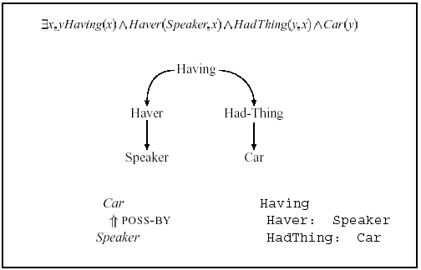
Common Meaning Representations
I have a car
FOPC
Semantic Nets
Common foundation: structures composed of symbols that correspond to objects and relationships
Frames
Notes:
They all share a common foundation: Meaning Representation consists of structures composed of sets of symbols
Symbol structures are objects and relations among objects
We’re going to take the same basic approach to meaning that we took to syntax and morphology
We’re going to create representations of linguistic inputs that capture the meanings of those inputs.
But unlike parse trees and the like these representations aren’t primarily descriptions of the structure of the inputs…

Slide 19
Today Oct 19
Semantics / Meaning /Meaning Representations
Linguistically relevant Concepts in FOPC/FOL
Semantic Analysis

Slide 20
Categories & Events
Categories:
  VegetarianRestaurant (Joe’s) - relation vs. object
  MostPopular(Joe’s,VegetarianRestaurant)
  ISA (Joe’s,VegetarianRestaurant)
  AKO (VegetarianRestaurant,Restaurant)
Reification
Events: can be described in NL with different numbers of arguments…
  I ate
  I ate a turkey sandwich
  I ate a turkey sandwich at my desk
  I ate at my desk
  I ate lunch
  I ate a turkey sandwich for lunch
  I ate a turkey sandwich for lunch at my desk
Notes:
Relation vs. object (in FOPC predicate vs. constant)
Represent all concept we want to make statements about as full-fledged objects
In this way categories are objects instead of relations
Chp 19 discusses the practical use of such relations in databases of lexical
relations, in the representation of selectional restrictions, and in word sense disambiguation.

Slide 21
Reification Again
“I ate a turkey sandwich for lunch”
∃ w: Isa(w,Eating) ∧ Eater(w,Speaker) ∧ Eaten(w,TurkeySandwich) ∧ MealEaten(w,Lunch)
“I ate a turkey sandwich and an apple”?
Reification Advantage:
  No need to specify fixed number of arguments to represent a given sentence in NL
Notes:
logical connections among closely related examples are specified
OLD
No need for meaning postulates to specify logical connections among closely related examples

Slide 22
MUC-4 Example
On October 30, 1989, one civilian was killed in a reported FMLN attack in El Salvador.
INCIDENT: DATE 30 OCT 89
INCIDENT: LOCATION EL SALVADOR
INCIDENT: TYPE ATTACK
INCIDENT: STAGE OF EXECUTION ACCOMPLISHED
INCIDENT: INSTRUMENT ID
INCIDENT: INSTRUMENT TYPE
PERP: INCIDENT CATEGORY TERRORIST ACT
PERP: INDIVIDUAL ID "TERRORIST"
PERP: ORGANIZATION ID "THE FMLN"
PERP: ORG. CONFIDENCE REPORTED: "THE FMLN"
PHYS TGT: ID
PHYS TGT: TYPE
PHYS TGT: NUMBER
PHYS TGT: FOREIGN NATION
PHYS TGT: EFFECT OF INCIDENT
PHYS TGT: TOTAL NUMBER
HUM TGT: NAME
HUM TGT: DESCRIPTION "1 CIVILIAN"
HUM TGT: TYPE CIVILIAN: "1 CIVILIAN"
HUM TGT: NUMBER 1: "1 CIVILIAN"
HUM TGT: FOREIGN NATION
HUM TGT: EFFECT OF INCIDENT DEATH: "1 CIVILIAN"
HUM TGT: TOTAL NUMBER
Notes:
Message Understanding Conference

Slide 23
Representing Time (J&M 15.4.1)
Events are associated with points or intervals in time.
We can impose an ordering on distinct events using the notion of precedes.
Temporal logic notation:
∃ e ∃ t : Isa(e,Arriving) ∧ TimeOf(e,t)
Constraints on variable t
I arrived in New York
∃ e ∃ t : Isa(e,Arriving) ∧ TimeOf(e,t) ∧ Agent(e, Speaker) ∧ Dest(e, NewYork) ∧ precedes(t,Now)
Notes:
Temporal Logics
Without reification

Slide 24
Interval Events
Need t_{start} and t_{end}
“She was driving to New York until now”
∃ t_{start},t_{end} ,e, i
ISA(e,Drive) Driver(e, She)
Dest(e, NewYork) ∧ IntervalOf(e,i)
Endpoint(i, tend) Startpoint(i, tstart)
Precedes(t_{start},Now) ∧
Equals(t_{end},Now)

Slide 25
Relation Between Tenses and Time
Relation between verb tenses and points in time is not straightforward
Present tense used like future:
  We fly from Baltimore to Boston at 10
Complex tenses:
  Flight 1902 arrived late
  Flight 1902 had arrived late
Representing them in the same way seems wrong….
Notes:
Both refer to events in the past, but representing them in the same way seems wrong
The second example seems to have another unnamed event lurking in the
background (e.g., Flight 1902 had already arrived late when something else happened).

Slide 26

Reference Point
Reichenbach (1947) introduced notion of Reference point (R), separated out from Utterance time (U) and Event time (E)
Example:
  When Mary's flight departed, I ate lunch
  When Mary's flight departed, I had eaten lunch
Departure event specifies reference point.
Notes:
In a simple temporal scheme the current moment in time is equated with the time of the utterance and it is used as a reference point for when the event occurred (before , at, or after). In Reichenbach the notion of reference point is separated from the utterance and the event points
I had eaten
_____________
| | |
E R U
I ate
_____________
| |
E ,R U

Slide 27
An action/event E will have been completed (finished or "perfected") at some point in the future.
“I will have run successfully in three marathons if I can finish this one."
"I will have spent all my money by this time next year”
Notes:
The FUTURE PERFECT TENSE indicates that an action will have been completed (finished or "perfected") at some point in the future. This tense is formed with "will" plus "have" plus the past participle of the verb (which can be either regular or irregular in form): "I will have spent all my money by this time next year. I will have run successfully in three marathons if I can finish this one."

Slide 28
Language and time…..
Much more than how past, present, and future are signaled by various English verb tenses
Languages have many other more direct and more specific ways to convey temporal information, including the use of a wide variety of temporal expressions… in the morning, somewhere around noon, throughout my life…
Course project ? (see project in 2016, Error Analysis of temporal tagger)
Textbook 17.3 – 17.4
Notes:
This discussion has focused narrowly on the broad notions of past, present, and
future and how they are signaled by various English verb tenses. Of course, languages
also have many other more direct and more specific ways to convey temporal
information, including the use of a wide variety of temporal expressions, as in the
following ATIS examples:
(14.58) I’d like to go at 6:45, in the morning.
(14.59) Somewhere around noon, please.
As we show in Chapter 17, grammars for such temporal expressions are of considerable
practical importance to information extraction and question-answering applications.

Slide 29
Today Oct 19
Semantics / Meaning /Meaning Representations
Linguistically relevant Concepts in FOPC / FOL
Semantic Analysis (aka Semantic Parsing)

Slide 30


Traditional Practical Goal for
(Syntax-driven) Semantic Analysis
  Map NL queries into FOPC so that answers can be effectively computed on a KB aka Knowledge Graph
What African countries are not on the Mediterranean Sea?
Was 2007 the first El Nino year after 2001?
Notes:
We didn’t assume much about the meaning of words when we talked about sentence meanings
Verbs provided a template-like predicate argument structure
Nouns were practically meaningless constants
There has be more to it than that
View assuming that words by themselves do not refer to the world, cannot be
Judged to be true or false…

Slide 31
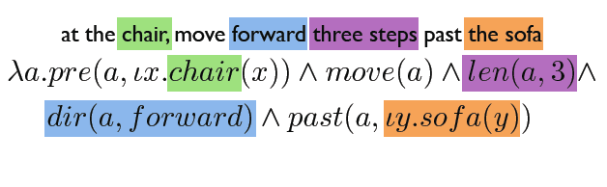

Practical Goal for (Syntax-driven) Semantic Analysis
  Referring to physical objects - Executing instructions
Notes:
Referring to physical objects - Executing instructions

Slide 32

Semantic Analysis
I am going to SFU on Tue
Meanings of grammatical structures
Sentence
The garbage truck just left
Syntax-driven
Semantic Analysis
Meanings of words
Literal Meaning
I
N
F
E
R
E
N
C
E
Common-Sense
Domain knowledge
Further
Analysis
Discourse
Structure
Intended meaning
Context
Shall we meet on Tue?
What time is it?
Notes:
Can we meet on tue?
I am going to SFU on Tue.
What time is it?
The garbage truck just left.
Context. Mutual knowledge, physical context
Has Mary left?
Semantic analysis is the process of taking in some linguistic input and assigning a meaning representation to it.
There a lot of different ways to do this that make more or less (or no) use of syntax
We’re going to start with the idea that syntax does matter
The compositional rule-to-rule approach
MOTIVATIONs
-for some applications it is enough (e.g., question answering)
- Produce input for further analysis (processing extended discourses and dialogs)

Slide 33
Compositional Analysis
Principle of Compositionality
  The meaning of a whole is derived from the meanings of the parts
What parts?
  The constituents of the syntactic parse of the input

Slide 34
Compositional Analysis: Example
AyCaramba serves meat
Notes:
A restaurant close to the Ocean serves the food I like most

Slide 35
Augmented Rules
Augment each syntactic CFG rule with a semantic formation rule
Abstractly
i.e., The semantics of A can be computed from some function applied to the semantics of its parts.
The class of actions performed by f will be quite restricted.
Notes:
We’ll accomplish this by attaching semantic formation rules to our syntactic CFG rules
This should be read as the semantics we attach to A can be computed from
some function applied to the semantics of A’s parts.
As we’ll see the class of actions performed by f in the following rule can be quite restricted.
What does it mean for a syntactic constituent to have a meaning?
• What do these meanings have to be like so that they can be composed into
larger meanings?
Parallel development in programming languages… essentially identical compositional techniques
for the design of compilers
Recent successful approach: Lambda calculus • Parsing with Combinatory Categorial Grammars

Slide 36
Simple Extension of FOL: Lambda Forms
  A FOL sentence with variables in it that are to be bound.
  Lambda-reduction: variables are bound by treating the lambda form as a function with formal arguments
Notes:
Extend syntax of FOL
The state of something satisfying the P predicate
Allow those variables to be bound by treating the lambda form as a function with formal arguments
Lambda-reduction
you can apply the lambda expression to logical terms and create new FOPC expressions in which the occurrences of the variable are bound to the argument
more than one variable: an application returns a reduced lambda exp.

Slide 37
Augmented Rules: Example
Concrete entities
assigning FOL constants
Attachments
  {AyCaramba}
  {MEAT}
  PropNoun -> AyCaramba
  MassNoun -> meat
Simple non-terminals
copying from daughters up to mothers.
Attachments
  {PropNoun.sem}
  {MassNoun.sem}
  NP -> PropNoun
  NP -> MassNoun
Notes:
Concrete entities are represented by FOPC constants
These attachments consist of assigning constants and copying from daugthers up to mothers.

Slide 38
Augmented Rules: Example
Semantics attached to one daughter is applied to semantics of the other daughter(s).
S -> NP VP
VP -> Verb NP
{VP.sem(NP.sem)}
{Verb.sem(NP.sem)
lambda-form
Verb -> serves
Notes:
These consist of taking the semantics attached to one daughter and applying
it as a function to the semantics of the other daughters.

Slide 39
Example
AC
y
y
MEAT
…….
AC
MEAT
S -> NP VP
VP -> Verb NP
Verb -> serves
NP -> PropNoun
NP -> MassNoun
PropNoun -> AyCaramba
MassNoun -> meat
{VP.sem(NP.sem)}
{Verb.sem(NP.sem)
{PropNoun.sem}
{MassNoun.sem}
{AC}
{MEAT}
Notes:
Each node in a tree corresponds to a rule in the grammar
Each grammar rule has a semantic rule associated with it that specifies how the semantics
of the RHS of that rule can be computed from the semantics of its daughters.
Strong Compositionality :The semantics of the whole is derived solely from the semantics of the parts.
(i.e. we ignore what’s going on in other parts of the tree).

Slide 40
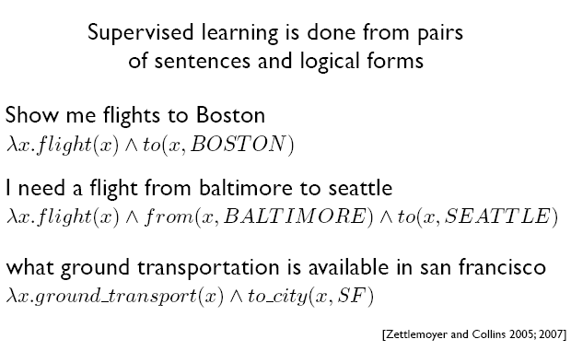
Semantic Parsing (via ML)
Notes:
Lambda calculus • Parsing with Combinatory Categorial Grammars

Slide 41
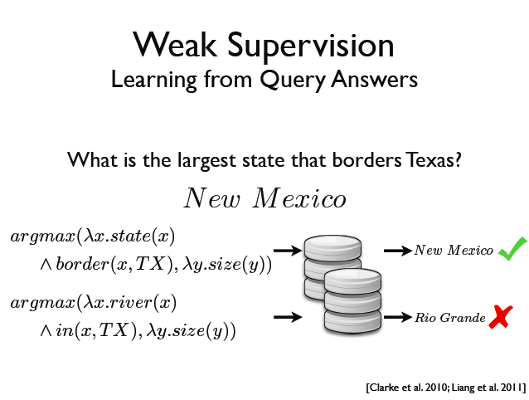

Semantic Parsing (via ML)
Notes:
Lambda calculus • Parsing with Combinatory Categorial Grammars

Slide 42
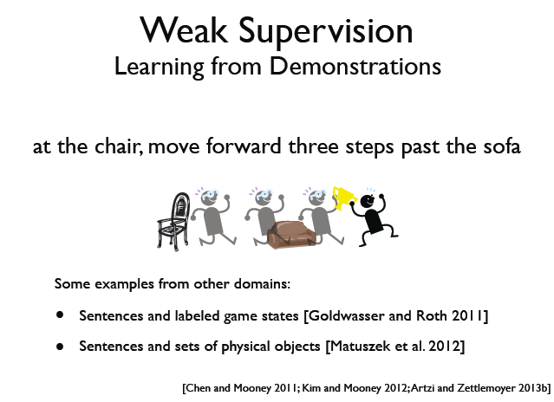

Semantic Parsing (via ML)
Notes:
Lambda calculus • Parsing with Combinatory Categorial Grammars

Slide 43


Neural Semantic Parser
Neural Semantic Parsing with Type Constraints for Semi-Structured Tables
Jayant Krishnamurthy, Pradeep Dasigi, Matt Gardner. EMNLP 2017.
Encoder Decoder Architecture in a few classes

Slide 44
References (Project?)
Text Book: Representation and Inference for Natural Language : A First Course in Computational Semantics Patrick Blackburn and Johan Bos, 2005, CSLI (pre-neural)
J. Bos (2011): A Survey of Computational Semantics: Representation, Inference and Knowledge in Wide-Coverage Text Understanding. Language and Linguistics Compass 5(6): 336–366. (pre-neural)
Semantic parsing via Machine Learning: The Cornell Semantic Parsing Framework (Cornell SPF) is an open source research software package. It includes a semantic parsing algorithm, a flexible meaning representation language and learning algorithms. http://yoavartzi.com/
The paper I just mentioned: Neural Semantic Parsing with Type Constraints for Semi-Structured Tables Jayant Krishnamurthy, Pradeep Dasigi, Matt Gardner. EMNLP 2017.
Many more papers on Semantic Parsing in more recent conferences ACL, NAACL, EMNLP, …..

Slide 45
Next Class
Computing with Word Senses: Word Sense Disambiguation WSD; WordNet; Ontologies (Lexical Semantics) Chp. 18 3rd Ed. ;
Intro to Semantic Role Labeling (Chp. 19 3rd Ed. )

Slide 46
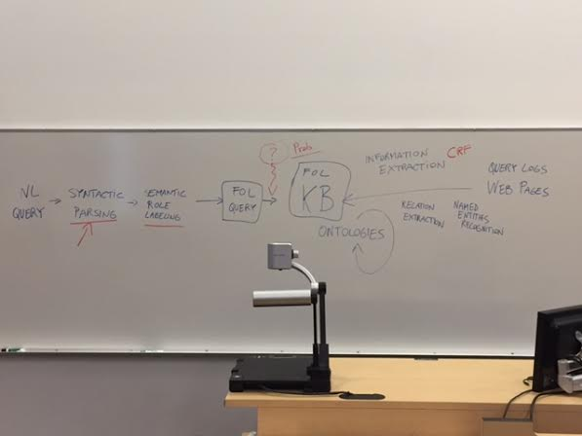
Just a sketch: to provide some context for some concepts / techniques discussed in 422

Slide 47
Non-Compositionality
Unfortunately, there are lots of examples where the meaning of a constituent can’t be derived from the meanings of the parts
  - metaphor, (e.g., corporation as person)
  metonymy, (??)
  idioms,
  irony,
  sarcasm,
  indirect requests, etc
Notes:
Corporation/Car as person. (“Google is not scared by MS”)/(“my car is thirsty”)
Metonymy (refer to an object by naming some closely related obj) “ He likes Joyce” (author for author’s work)
“The white house did not like her comment”
IRONIC implies an attempt to be amusing or provocative by saying usually the opposite of what is meant
<made the ironic observation that the government could always be trusted
SARCASTIC implies an intentional inflicting of pain by deriding, taunting, or ridiculing
<a critic famous mainly for his sarcastic remarks>.

Slide 48
English Idioms
Lots of these… constructions where the meaning of the whole is either
  Totally unrelated to the meanings of the parts (“kick the bucket”)
  Related in some opaque way (“run the show”)
“buy the farm”
“bite the bullet”
“bury the hatchet”
etc…
Notes:
Buy the farm - meaning to die
Bite the bullet - To adjust to unpleasant circumstances

Slide 49
The Tip of the Iceberg
  “Enron is the tip of the iceberg.”
  NP -> “the tip of the iceberg” {….}
  “the tip of an old iceberg”
  “the tip of a 1000-page iceberg”
  “the merest tip of the iceberg”
NP -> TipNP of IcebergNP {…}
  TipNP: NP with tip as its head
  IcebergNP NP with iceberg as its head
Notes:
Describing this particular construction
A fixed phrase with a particular meaning
A syntactically and lexically flexible phrase with a particular meaning
A syntactically and lexically flexible phrase with a partially compositional meaning
How about
That’s just the iceberg’s tip.

Slide 50
Handling Idioms
  Mixing lexical items and grammatical constituents
  Introduction of idiom-specific constituents
  Permit semantic attachments that introduce predicates unrelated with constituents
NP -> TipNP of IcebergNP
{small-part(), beginning()….}
  TipNP: NP with tip as its head
  IcebergNP NP with iceberg as its head
Notes:
Describing this particular construction
A fixed phrase with a particular meaning
A syntactically and lexically flexible phrase with a particular meaning
A syntactically and lexically flexible phrase with a partially compositional meaning
How about
That’s just the iceberg’s tip.
Syntax and semantics aren’t separable in the way that we’ve been assuming
Grammars contain form-meaning pairings that vary in the degree to which the meaning of a constituent (and what constitutes a constituent) can be computed from the meanings of the parts.

Slide 51
Attachments for a fragment of English (Sect. 18.5) old edition
Sentences
Noun-phrases
Verb-phrases
Prepositional-phrases
Based on “The core Language Engine” 1992
Notes:
The Core Language Engine
Edited by Hiyan Alshawi
The Core Language Engine presents the theoretical and engineering advances embodied in one of the most
comprehensive natural language processing systems designed to date. Recent research results from different
areas of computational linguistics are integrated into a single elegant design with potential for application to
tasks ranging from machine translation to information system interfaces.
Bridging the gap between theoretical and implementation oriented literature, The Core Language Engine
describes novel analyses and techniques developed by the contributors at SRI International's Cambridge
Computer Science Research Centre. It spans topics that include a wide-coverage unification grammar
for English syntax and semantics, context-dependent and contextually disambiguated logical form
representations, interactive translation, efficient algorithms for parsing and generation, and
mechanisms for quantifier scoping, reference resolution, and lexical acquisition.
Hiyan Alshawi is Senior Computer Scientist at SRI International, Cambridge, England.
Contents: Introduction to the CLE. Logical Forms. Categories and Rules. Unification Based Syntactic Analysis. Semantic Rules for English. Lexical Analysis. Syntactic and Semantic Processing. Quantifier Scoping. Sortal Restrictions. Resolving Quasi Logical Forms. Lexical Acquisition. The CLE in Application Development. Ellipsis, Comparatives, and Generation. Swedish-English QLF Translation.

Slide 52
Full story more complex
To deal properly with quantifiers
  Permit lambda-variables to range over predicates. E.g.,
  Introduce complex terms to remain agnostic about final scoping
Notes:
New edition
“Every restaurant closed”

Slide 53
Solution: Quantifier Scope Ambiguity
Similarly to PP attachment, number of possible interpretations exponential in the number of complex terms
Weak methods to prefer one interpretation over another:
likelihood of different orderings
Mirror surface ordering
Domain specific knowledge
Notes:
The introduction of lambda-exps and complex terms was motivated by the gap between the syntax
Of FOPC and the syntax of English

Slide 54
Integration with a Parser
Assume you’re using a dynamic-programming style parser (Earley or CKY).
Two basic approaches
  Integrate semantic analysis into the parser (assign meaning representations as constituents are completed)
  Pipeline… assign meaning representations to complete trees only after they’re completed
Notes:
As constituents are completed and entered into the table, we compute their semantics.
If they’re complete, we have their parts.
If we have their parts we have the semantics for the parts…
Therefore we can compute the semantics of the newly completed constituent.

Slide 55
Pros and Cons
Integration
  use semantic constraints to cut off parses that make no sense
  assign meaning representations to constituents that don’t take part in any correct parse
Pipeline
  assign meaning representations only to constituents that take part in a correct parse
  parser needs to generate all correct parses
Notes:
Integration semantic analysis into the parser as its running…
You can use semantic constraints to cut off parses that make no sense From BERP
From new edition
Ch. 19 describes in some detail the various ways that this notion of ill-formedness can be realized
Form old edition
I want to eat someplace near campus
The Berkeley Restaurant Project (BeRP)
Situation in where the semantic of an argument (the filler of a thematic role) is inconsistent with
A constraint imposed by on the argument by the predicate (in the example you can only eat edible thing)
So the transitive VP should fail. ?? How does it correspond to a different parse
I want to eat sushi near campus
?I need to eat my lunch in five minutes?
?I need to eat my lunch in the refrigerator?

Slide 56
How to Produce a Canonical Form
Words have different senses
  food ___
  dish ___|____one overlapping meaning sense
  fare ___|
Meaning of alternative syntactic constructions are systematically related
  server thing-being-served
  [S [NP Maharani] serves [NP vegetarian dishes]]
  thing-being-served server
  [S [NP vegetarian dishes] are served at [NP Maharani]]
Notes:
If the system has the ability to choose the shared sense…
fare
Function: noun
1 a : range of food : DIET b : material provided for use, consumption, or enjoyment
2 a : the price charged to transport a person b : a paying passenger on a public conveyance
Dish
1 a : a more or less concave vessel from which food is served b : the contents of a dish <a dish of strawberries>
2 a : food prepared in a particular way b : something one particularly enjoys : CUP OF TEA
3 a (1) : any of various shallow concave vessels; broadly : anything shallowly concave (2) : a directional receiver having a concave usually parabolic reflector; especially : one used as a microwave antenna b : the state of being concave or the degree of concavity
4 a : something that is favored <entertainment that is just his dish> b : an attractive or sexy person
Main Entry: food n
1 a : material consisting essentially of protein, carbohydrate, and fat used in the body of an organism …; also :
such food together with supplementary substances (as minerals, vitamins, and condiments) b : inorganic substances absorbed by plants in gaseous form or in water solution
2 : nutriment in solid form
3 : something that nourishes, sustains, or supplies <food for thought>
Some syntactic structure have meaning which are systematically related
Subject Object
Agent theme (active)
Theme agent (passive)

Slide 57
Non-verbal predicate-argument structures
A Spanish restaurant under the bridge
Under(SpanishRestaurant, bridge)
Selectional Restrictions
Semantic (Selectional) Restrictions: Constrain the types of arguments verbs take
  George assassinated the senator
  *The spider assassinated the fly
Notes:
Predicates
Primarily Verbs, VPs, PPs, Sentences
Sometimes Nouns and NPs
Arguments
Primarily Nouns, Nominals, NPs
But also everything else; as we’ll see it depends on the context
SELECTIONAL RESTRICTIONS
Useful in WSD
Can be implemented using Wordnet

Slide 58
Linguistically Relevant Concepts in FOPC
Categories & Events (Reification)
Representing Time
Beliefs (optional, read if relevant to your project)
Aspects (optional, read if relevant to your project)
Description Logics (optional, read if relevant to your project)
Notes:
Description logics – ontologies – semantic Web

Slide 59
Categories & Events
Categories:
  VegetarianRestaurant (Joe’s) - relation vs. object
  MostPopular(Joe’s,VegetarianRestaurant)
  ISA (Joe’s,VegetarianRestaurant)
  AKO (VegetarianRestaurant,Restaurant)
Reification
Events: can be described in NL with different numbers of arguments…
  I ate
  I ate a turkey sandwich
  I ate a turkey sandwich at my desk
  I ate at my desk
  I ate lunch
  I ate a turkey sandwich for lunch
  I ate a turkey sandwich for lunch at my desk
Notes:
Relation vs. object (in FOPC predicate vs. constant)
Represent all concept we want to make statements about as full-fledged objects
In this way categories are objects instead of relations
Chp 19 discusses the practical use of such relations in databases of lexical
relations, in the representation of selectional restrictions, and in word sense disambiguation.

Slide 60
MUC-4 Example
On October 30, 1989, one civilian was killed in a reported FMLN attack in El Salvador.
INCIDENT: DATE 30 OCT 89
INCIDENT: LOCATION EL SALVADOR
INCIDENT: TYPE ATTACK
INCIDENT: STAGE OF EXECUTION ACCOMPLISHED
INCIDENT: INSTRUMENT ID
INCIDENT: INSTRUMENT TYPE
PERP: INCIDENT CATEGORY TERRORIST ACT
PERP: INDIVIDUAL ID "TERRORIST"
PERP: ORGANIZATION ID "THE FMLN"
PERP: ORG. CONFIDENCE REPORTED: "THE FMLN"
PHYS TGT: ID
PHYS TGT: TYPE
PHYS TGT: NUMBER
PHYS TGT: FOREIGN NATION
PHYS TGT: EFFECT OF INCIDENT
PHYS TGT: TOTAL NUMBER
HUM TGT: NAME
HUM TGT: DESCRIPTION "1 CIVILIAN"
HUM TGT: TYPE CIVILIAN: "1 CIVILIAN"
HUM TGT: NUMBER 1: "1 CIVILIAN"
HUM TGT: FOREIGN NATION
HUM TGT: EFFECT OF INCIDENT DEATH: "1 CIVILIAN"
HUM TGT: TOTAL NUMBER
Notes:
Message Understanding Conference

Slide 61
Reification Again
“I ate a turkey sandwich for lunch”
∃ w: Isa(w,Eating) ∧ Eater(w,Speaker) ∧ Eaten(w,TurkeySandwich) ∧ MealEaten(w,Lunch)
Reification Advantages:
  No need to specify fixed number of arguments to represent a given sentence
  You can easily specify inference rules involving the arguments
Notes:
logical connections among closely related examples are specified
OLD
No need for meaning postulates to specify logical connections among closely related examples

Slide 62
Representing Time
Events are associated with points or intervals in time.
We can impose an ordering on distinct events using the notion of precedes.
Temporal logic notation:
(∃w,x,t) Arrive(w,x,t)
Constraints on variable t
I arrived in New York
(∃ t) Arrive(I,NewYork,t) ∧ precedes(t,Now)
Notes:
Temporal Logics
Without reification

Slide 63
Interval Events
Need t_{start} and t_{end}
“She was driving to New York until now”
∃ t_{start},t_{end} ,e, i
ISA(e,Drive) Driver(e, She)
Dest(e, NewYork) ∧ IntervalOf(e,i)
Endpoint(i, tend) Startpoint(i, tstart)
Precedes(t_{start},Now) ∧
Equals(t_{end},Now)

