Slide 1
CPSC 503
Computational Linguistics
Lecture 12
Giuseppe Carenini

Slide 2
Practical Goal for Semantic Analysis
  Map NL queries into FOPC so that answers can be effectively computed
What African countries are not on the Mediterranean Sea?
Was 2007 the first El Nino year after 2001?
Notes:
We didn’t assume much about the meaning of words when we talked about sentence meanings
Verbs provided a template-like predicate argument structure
Nouns were practically meaningless constants
There has be more to it than that
View assuming that words by themselves do not refer to the world, cannot be
Judged to be true or false…

Slide 3
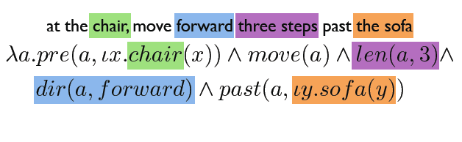

Practical Goal for Semantic Analysis
  Referring to physical objects - Executing instructions
Notes:
Referring to physical objects - Executing instructions

Slide 4
Semantic Analysis
I am going to SFU on Tue
Meanings of grammatical structures
Sentence
The garbage truck just left
Syntax-driven
Semantic Analysis
Meanings of words
Literal Meaning
I
N
F
E
R
E
N
C
E
Common-Sense
Domain knowledge
Further
Analysis
Discourse
Structure
Intended meaning
Context
Shall we meet on Tue?
What time is it?
Notes:
Can we meet on tue?
I am going to SFU on Tue.
What time is it?
The garbage truck just left.
Context. Mutual knowledge, physical context
Has Mary left?
Semantic analysis is the process of taking in some linguistic input and assigning a meaning representation to it.
There a lot of different ways to do this that make more or less (or no) use of syntax
We’re going to start with the idea that syntax does matter
The compositional rule-to-rule approach
MOTIVATIONs
-for some applications it is enough (e.g., question answering)
- Produce input for further analysis (processing extended discourses and dialogs)

Slide 5
Today 13 Feb
:
Syntax-Driven Semantic Analysis
Meaning of words
Relations among words and their meanings (Paradigmatic)
Internal structure of individual words (Syntagmatic)
Notes:
Paradigmatic: the external relational structure among words
Syntagmatic: the internal structure of words that determines how they can be combined with other words

Slide 6
Compositional Analysis
Principle of Compositionality
  The meaning of a whole is derived from the meanings of the parts
What parts?
  The constituents of the syntactic parse of the input

Slide 7
Compositional Analysis: Example
AyCaramba serves meat
Notes:
A restaurant close to the Ocean serves the food I like most

Slide 8
Augmented Rules
Augment each syntactic CFG rule with a semantic formation rule
Abstractly
i.e., The semantics of A can be computed from some function applied to the semantics of its parts.
The class of actions performed by f will be quite restricted.
Notes:
We’ll accomplish this by attaching semantic formation rules to our syntactic CFG rules
This should be read as the semantics we attach to A can be computed from
some function applied to the semantics of A’s parts.
As we’ll see the class of actions performed by f in the following rule can be quite restricted.
What does it mean for a syntactic constituent to have a meaning?
• What do these meanings have to be like so that they can be composed into
larger meanings?
Parallel development in programming languages… essentially identical compositional techniques
for the design of compilers
Recent successful approach: Lambda calculus • Parsing with Combinatory Categorial Grammars

Slide 9
Simple Extension of FOL: Lambda Forms
  A FOL sentence with variables in it that are to be bound.
  Lambda-reduction: variables are bound by treating the lambda form as a function with formal arguments
Notes:
Extend syntax of FOL
The state of something satisfying the P predicate
Allow those variables to be bound by treating the lambda form as a function with formal arguments
Lambda-reduction
you can apply the lambda expression to logical terms and create new FOPC expressions in which the occurrences of the variable are bound to the argument
more than one variable: an application returns a reduced lambda exp.

Slide 10
Augmented Rules: Example
Concrete entities
assigning FOL constants
Attachments
  {AyCaramba}
  {MEAT}
  PropNoun -> AyCaramba
  MassNoun -> meat
Simple non-terminals
copying from daughters up to mothers.
Attachments
  {PropNoun.sem}
  {MassNoun.sem}
  NP -> PropNoun
  NP -> MassNoun
Notes:
Concrete entities are represented by FOPC constants
These attachments consist of assigning constants and copying from daugthers up to mothers.

Slide 11
Augmented Rules: Example
Semantics attached to one daughter is applied to semantics of the other daughter(s).
S -> NP VP
VP -> Verb NP
{VP.sem(NP.sem)}
{Verb.sem(NP.sem)
lambda-form
Verb -> serves
Notes:
These consist of taking the semantics attached to one daughter and applying
it as a function to the semantics of the other daughters.

Slide 12
Example
AC
y
y
MEAT
…….
AC
MEAT
S -> NP VP
VP -> Verb NP
Verb -> serves
NP -> PropNoun
NP -> MassNoun
PropNoun -> AyCaramba
MassNoun -> meat
{VP.sem(NP.sem)}
{Verb.sem(NP.sem)
{PropNoun.sem}
{MassNoun.sem}
{AC}
{MEAT}
Notes:
Each node in a tree corresponds to a rule in the grammar
Each grammar rule has a semantic rule associated with it that specifies how the semantics
of the RHS of that rule can be computed from the semantics of its daughters.
Strong Compositionality :The semantics of the whole is derived solely from the semantics of the parts.
(i.e. we ignore what’s going on in other parts of the tree).

Slide 13
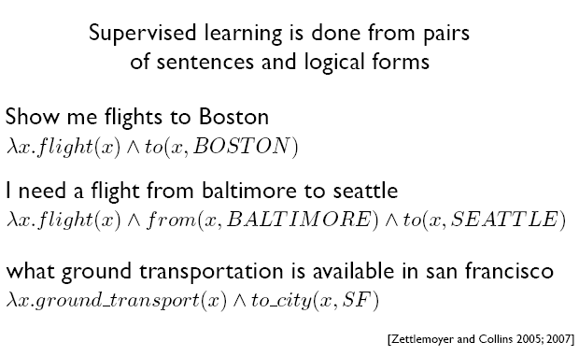
Semantic Parsing (via ML)
Notes:
Lambda calculus • Parsing with Combinatory Categorial Grammars

Slide 14
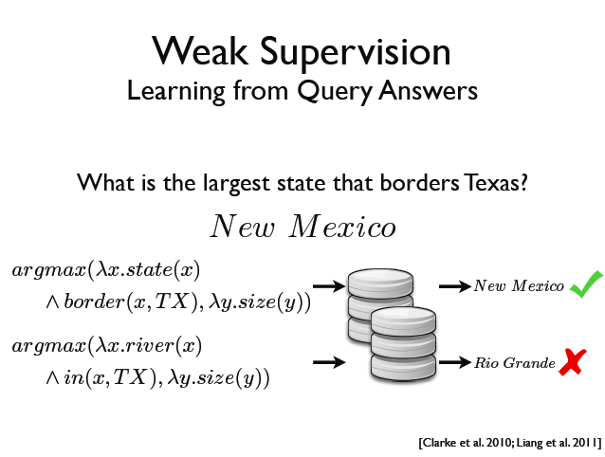
Semantic Parsing (via ML)
Notes:
Lambda calculus • Parsing with Combinatory Categorial Grammars
Requirements for weak supervision
• Know how to act given a logical form
• A validation function
• Templates for lexical induction

Slide 15
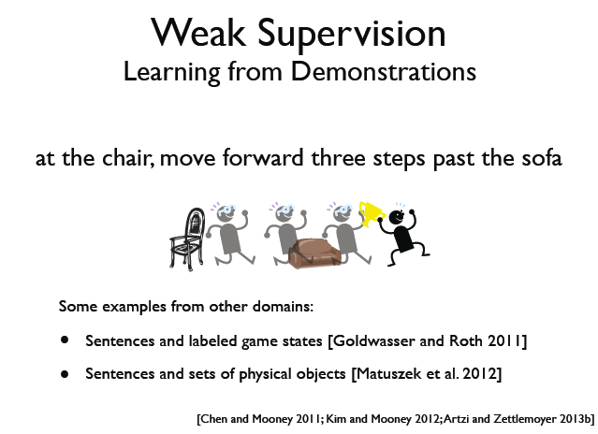
Semantic Parsing (via ML)
Notes:
Lambda calculus • Parsing with Combinatory Categorial Grammars

Slide 16
References (Project?)
Text Book: Representation and Inference for Natural Language : A First Course in Computational Semantics Patrick Blackburn and Johan Bos, 2005, CSLI
J. Bos (2011): A Survey of Computational Semantics: Representation, Inference and Knowledge in Wide-Coverage Text Understanding. Language and Linguistics Compass 5(6): 336–366.
Semantic parsing via Machine Learning: The Cornell Semantic Parsing Framework (Cornell SPF) is an open source research software package. It includes a semantic parsing algorithm, a flexible meaning representation language and learning algorithms. http://yoavartzi.com/

Slide 17
Today 13 Feb
:
Syntax-Driven Semantic Analysis
Meaning of words
Relations among words and their meanings (Paradigmatic)
Internal structure of individual words (Syntagmatic)
Notes:
Paradigmatic: the external relational structure among words
Syntagmatic: the internal structure of words that determines how they can be combined with other words

Slide 18
Word?
Stem?
  Lemma:
  Orthographic form +
  Phonological form +
  Meaning (sense)
  [Modulo inflectional morphology]
content?
celebration?
bank?
celebrate?
duck?
banks?
  Lexicon: A collection of lemmas/ lexemes
Notes:
What’s a word?
Types, tokens, stems, roots, inflected forms, etc... Ugh.
So how many entries for the “string”….
Lexeme a pairing of a particular form (ortographic and phonological) with its meaning
For the purposes of lexical semantics (dictionaries and thesauri) we represent a lexeme by a lemma
Lexicon include compound words and non-compositional phrases
Where do you
usually find this kind of information?

Slide 19
Dictionary
  Repositories of information about the meaning of words, but…..
  Most of the definitions are circular… ?? They are descriptions….
  Fortunately, there is still some useful semantic info (Lexical Relations):
  L_{1,}L₂ same O and P, different M
  L_{1,}L₂ “same” M, different O
  L_{1,}L₂ “opposite” M
  L_{1,}L₂ , M₁ subclass of M₂
  _{Etc. ……}
Homonymy
Synonymy
Antonymy
Hyponymy
Notes:
We can use them because some lexemes are grounded in the external word (perception (visual systems), ….)
Red blood
The list of relations presented here is by no means exhaustive
For computational purposes, one approach to defining a sense is to make use
of a similar approach to these dictionary definitions; defining a sense through its
relationship with other senses.

Slide 20
Ontologies: inspiration from Natural Language
(From 422)
:
How do we refer to individuals and relationship in the world in NL e.g., English?
Where do we find definitions for words?
  Most of the definitions are circular? They are descriptions.
  Fortunately, there is still some useful semantic info (Lexical Relations):
  w₁ w₂ same Form and Sound, different Meaning
  w₁ w₂ same Meaning, different Form
  w₁ w₂ “opposite” Meaning
  w₁ w₂ Meaning₁ subclass of Meaning₂
Homonymy
Synonymy
Antonymy
Hyponymy
Notes:
Meaning of words
Relations among words and their meanings (Paradigmatic)
Internal structure of individual words (Syntagmatic)
Repositories of information about the meaning of words, but…..
We can use them because some lexemes are grounded in the external word (perception (visual systems), ….)
Red blood
The list of relations presented here is by no means exhaustive

Slide 21
Homonymy
  Def. Lexemes that have the same Orthographic and Phonological forms but unrelated meanings
  Examples: Bat (wooden stick-like thing) vs. Bat (flying scary mammal thing)
    Plant (…….) vs.
    Plant (………)
Homographs
Homonyms
Homophones
content/content
wood/would
Notes:
Items taking part in such relation: homonyms
Phonological, orthographic or both
POS can help but not always
Found: past of find / found (a city)

Slide 22
Relevance to NLP Tasks
Information retrieval (homonymy):
    QUERY: ‘bat care’
Spelling correction: homophones can lead to real-word spelling errors
Text-to-Speech: homographs (which are not homophones)
……
Notes:
The problematic part of understanding homonymy isn’t with the forms, it’s the meanings.
An intuition with true homonymy is coincidence
It’s a coincidence in English that bat and bat mean what they do.
Nothing particularly important would happen to anything else in English if we used a different word for the little flying mammal things

Slide 23
Polysemy
Def. The case where we have a set of lexemes with the same form and multiple related meanings.
Consider the homonym:
bank → commercial bank₁ vs. river bank₂
Now consider: “A PCFG can be trained using derivation trees from a tree bank annotated by human experts”
Is this a new independent sense of bank?
Notes:
meanings associated with it
Most non-rare words have multiple meanings
The number of meanings is related to its frequency
Verbs tend more to polysemy
Distinguishing polysemy from homonymy isn’t always easy (or necessary)

Slide 24
Polysemy
  Lexeme (new def.):
  Orthographic form + Phonological form +
  Set of related senses
  How many distinct (but related) senses?
  They serve meat…
  He served as Dept. Head…
  She served her time….
Different subcat
Intuition (prison)
  Does AC serve vegetarian food?
  Does AC serve Rome?
  (?)Does AC serve vegetarian food and Rome?
Zeugma
Notes:
What distinct senses does it have?
How are these senses related?
How can they be reliably distinguished?
The answer to these questions can have serious consequences for how well semantic analyzers
Search engines, Generators, and Machine translation systems perform their respective tasks.
ZEUGMA:Combine two separate uses of a lexeme into a single example using a conjunction…
What is the relation among the various senses?

Slide 25
Synonyms
Def. Different lexemes with the same meaning.
Substitutability- if they can be substituted for one another in some environment without changing meaning or acceptability.
Would I be flying on a large/big plane?
?… became kind of a large/big sister to…
? You made a large/big mistake
Notes:
Synonyms clash with polysemous meanings (one sense of big is older)
Collocation: big mistake sounds more natural
There aren’t any…
Maybe not, but people think and act like there are so maybe there are…
PURCHASE / BUY
One test…
Two lexemes are synonyms if they can be successfully substituted for each other in all situations
Too strong!

Slide 26
Hyponymy
Def. Pairings where one lexeme denotes a subclass of the other
  Since dogs are canids
    Dog is a hyponym of canid and
    Canid is a hypernym of dog
  car/vehicle
  doctor/human
  ……
Notes:
A hyponymy relation can be asserted between two lexemes when the meanings of the lexemes entail a subset relation

Slide 27
Lexical Resources
Databases containing all lexical relations among all lexemes
Development:
  Mining info from dictionaries and thesauri
  Handcrafting it from scratch
WordNet: first developed with reasonable coverage and widely used [Fellbaum… 1998]
  for English (versions for other languages have been developed – see MultiWordNet)

Slide 28
WordNet 3.0
POS | Unique Strings | Synsets | Word-Sense Pairs
Noun | 117798 | 82115 | 146312
Verb | 11529 | 13767 | 25047
Adjective | 21479 | 18156 | 30002
Adverb | 4481 | 3621 | 5580
Totals | 155287 | 117659 | 206941
For each lemma/lexeme: all possible senses (no distinction between homonymy and polysemy)
For each sense: a set of synonyms (synset) and a gloss
Notes:
So bass includes fish-sense instrument-sense musical-range-sense
The noun "bass" has 8 senses in WordNet.
1. bass -- (the lowest part of the musical range)
2. bass, bass part -- (the lowest part in polyphonic music)
3. bass, basso -- (an adult male singer with the lowest voice)
4. sea bass, bass -- (the lean flesh of a saltwater fish of the family Serranidae)
5. freshwater bass, bass -- (any of various North American freshwater fish with lean flesh (especially of the genus Micropterus))
6. bass, bass voice, basso -- (the lowest adult male singing voice)
7. bass -- (the member with the lowest range of a family of musical instruments)
8. bass -- (nontechnical name for any of numerous edible marine and freshwater spiny-finned fishes)

Slide 29
WordNet: entry for “table”
The noun "table" has 6 senses in WordNet.
1. table, tabular array -- (a set of data …)
2. table -- (a piece of furniture …)
3. table -- (a piece of furniture with tableware…)
4. mesa, table -- (flat tableland …)
5. table -- (a company of people …)
6. board, table -- (food or meals …)
The verb "table" has 1 sense in WordNet.
1. postpone, prorogue, hold over, put over,
table, shelve, set back, defer, remit, put off –
(hold back to a later time; "let's postpone the exam")
Notes:
Each blue list is a synset

Slide 30

WordNet Relations (between synsets!)
fi
Notes:
Key point: synsets are related not specific words
Adjectives (synonyms, antonyms)

Slide 31
WordNet Hierarchies: “Vancouver”
WordNet: example from ver1.7.1
For the three senses of “Vancouver”
⇒(city, metropolis, urban center)
⇒ (municipality)
⇒ (urban area)
⇒ (geographical area)
⇒ (region)
⇒ (location)
⇒ (entity, physical thing)
⇒ (administrative district, territorial division)
⇒ (district, territory)
⇒ (region)
⇒ (location ⇒ (entity, physical thing)
⇒ (port)
⇒ (geographic point)
⇒ (point)
⇒ (location)
⇒ (entity, physical thing)
Notes:
Now 3.0

Slide 32
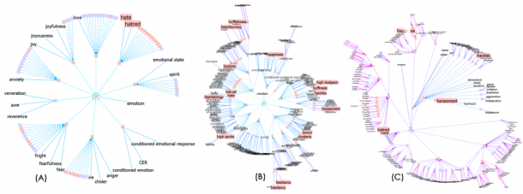
Visualizing Wordnet Relations
C. Collins, “WordNet Explorer: Applying visualization principles to lexical semantics,” University of Toronto, Technical Report kmdi 2007-2, 2007.

Slide 33
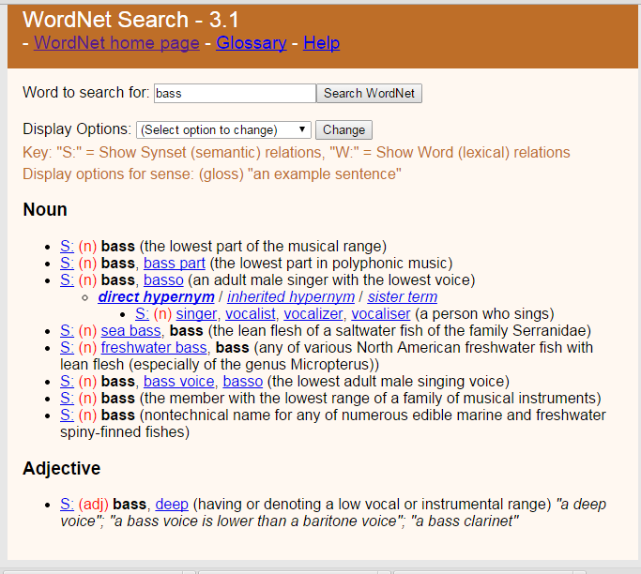
Web interface & API

Slide 34
Wordnet: NLP Tasks
Probabilistic Parsing (PP-attachments): words + word-classes extracted from the hypernym hierarchy increase accuracy from 84% to 88% [Stetina and Nagao, 1997]
… acquire a company for money
… purchase a car for money
… buy a book for a few bucks
Word sense disambiguation
Lexical Chains (topic modeling, summarization)
and many, many others !
More importantly starting point for larger Lexical Resources (aka Ontologies) !
Notes:
If you know the right attachment for “acquire a company for money”,
“purchase a car for money”
Can help you to decide the attachment for “buy books for money”
John assassinated the senator

Slide 35
YAGO2: huge semantic knowledge base
Derived from Wikipedia, WordNet and GeoNames. (started in 2007, paper in www conference)
10⁶ entities (persons, organizations, cities, etc.)
>120* 10⁶ facts about these entities.
YAGO accuracy of 95%. has been manually evaluated.
Anchored in time and space. YAGO attaches a temporal dimension and a spatial dimension to many of its facts and entities.
Notes:
YAGO2s is a huge semantic knowledge base, derived from Wikipedia WordNet and GeoNames. Currently, YAGO2s has knowledge of more than 10 million entities (like persons, organizations, cities, etc.) and contains more than 120 million facts about these entities.
YAGO is special in several ways:
The accuracy of YAGO has been manually evaluated, proving a confirmed accuracy of 95%. Every relation is annotated with its confidence value.
YAGO is an ontology that is anchored in time and space. YAGO attaches a temporal dimension and a spatial dimension to many of its facts and entities.
In addition to a taxonomy, YAGO has thematic domains such as "music" or "science" from WordNet Domains.

Slide 36
Freebase
“Collaboratively constructed database.”
Freebase contains tens of millions of topics, thousands of types, and tens of thousands of properties and over a billion of facts
Automatically extracted from a number of resources including Wikipedia, MusicBrainz, and NNDB
as well as the knowledge contributed by the human volunteers.
Each Freebase entity is assigned a set of human-readable unique keys, which are assembled of a value and a namespace.
All was available for free through the APIs or to download from weekly data dumps
Notes:
Notable Names Database (NNDB) is an online database of biographical details of over 40,000 people of note.
What is Freebase?
Freebase contains tens of millions of topics, thousands of types, and tens of thousands of properties. By comparison, English Wikipedia has over 4 million articles. Each of the topics in Freebase is linked to other related topics and annotated with important properties like movie genres and people's dates of birth. There are over a billion such facts or relations that make up the graph and they're all available for free through the APIs or to download from our weekly data dumps.
Notable Names Database (NNDB) is an online database of biographical details of over 40,000 people of note
MusicBrainz is an open music encyclopedia that collects music metadata and makes it available to the public.

Slide 37
Fast Changing Landscape.....
On 16 December 2015, Google officially announced the Knowledge Graph API, which is meant to be a replacement to the Freebase API.
Freebase.com was officially shut down on 2 May 2016.^{[6]}
Notes:
Freebase was a large collaborative knowledge base consisting of data composed mainly by its community members. It was an online collection of structured data harvested from many sources, including individual, user-submitted wiki contributions.^{[2]} Freebase aimed to create a global resource that allowed people (and machines) to access common information more effectively. It was developed by the American software company Metaweb and ran publicly since March 2007. Metaweb was acquired by Google in a private sale announced 16 July 2010.^{[3]} Google's Knowledge Graph was powered in part by Freebase.^{[4]}
Freebase data was available for commercial and non-commercial use under a Creative Commons Attribution License, and an open API, RDF endpoint, and a database dump was provided for programmers.
On 16 December 2014, Knowledge Graph announced that it would shut down Freebase over the succeeding six months and help with the move of the data from Freebase to Wikidata.^{[5]}
On 16 December 2015, Google officially announced the Knowledge Graph API, which is meant to be a replacement to the Freebase API. Freebase.com was officially shut down on 2 May 2016.^{[6]}

Slide 38
Probase (MS Research) < Sept 2016
Harnessed from billions of web pages and years worth of search logs
Extremely large concept/category space (2.7 million categories).
Probabilistic model for correctness, typicality (e.g., between concept and instance)
Notes:
Knowledge in Probase is harnessed from billions of web pages and years worth of search logs -- these are nothing more than the digitized footprints of human communication.
Probase is unique in two aspects. First, Probase has an extremely large concept/category space (2.7 million categories). As these concepts are automatically acquired from web pages authored by millions of users, it is probably true that they cover most concepts in our mental world (about worldly facts). Second, data in Probase, as knowledge in our mind, is not black or white. Probase quantifies the uncertainty. These serve as the priors and likelihoods that become the foundations of probabilistic reasoning in Probase.
Our mental world contains many concepts about worldly facts, and Probase tries to duplicate them. The core taxonomy of Probase alone contains above 2.7 million concepts. Figure 2 shows their distribution. The Y axis is the number of instances each concept contains(logarithmic scale), and on the X axis are the 2.7 million concepts ordered by their size. In contrast, existing knowledge bases have far fewer concepts (Freebase [3] contains no more than 2,000 concepts, and Cyc [7] has about 120,000 concepts), which fall short of modeling our mental world. As we can see in Figure 2, besides popular concepts such as “cities” and “musicians”, which are included by almost every general purpose taxonomy, Probase has millions of long tail concepts such as “anti-parkinson treatments”, "celebrity wedding dress designers” and “basic watercolor techniques”, which cannot be found in Freebase or Cyc. Besides concepts, Probase also has a large data space (each concept contains a set of instances or sub-concepts), a large attribute space (each concept is described by a set of attributes), and a large relationship space (e.g.,“locatedIn”, "friendOf”, "mayorOf”, as well as relationships that are not easily named, such as the relationship between apple and Newton.)
Another feature of Probase is that it is probabilistic, which means every claim in Probase is associated with some probabilities that model the claim’s correctness, typicality, ambiguity, and other characteristics. The probabilities are derived from evidences found in web data, search log data, and other existing taxonomies. For example, for typicality (between concepts and instances), Probase contains the following probabilities:
P(C=company|I=apple): How likely people will think of the concept “company” when they see the word “apple”.
P(I=steve jobs|C=ceo): How likely “steve jobs” will come into mind when people think about the concept “ceo”.
Probase also has typicality scores for concepts and attributes. Another important score in Probase is the similarity between any
two concepts y1 and y2 (e.g., celebrity and famous politicians). Thus Probase can tell that natural disasters and politicians are very different concepts,endangered species and tropical rainforest plants have certain relationships, while countries and nations are almost the same concepts.
These probabilities serve as priors and likelihoods for Bayesian reasoning on top of Probase. In addition, the probabilistic nature of Probase also enables it to incorporate data of varied quality from heterogeneous sources. Probase regards external data as evthese probabilities serve as priors and likelihoods for Bayesian reasoning on top of Probase.

Slide 39
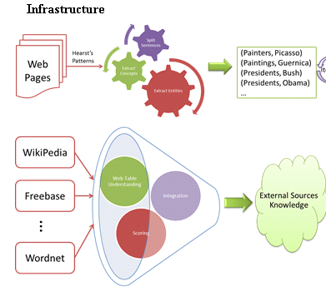

Slide 40
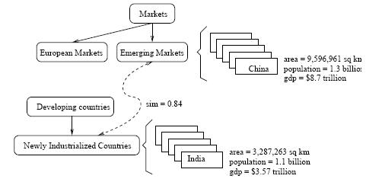
A snippet of Probase's core taxonomy
Notes:
shows what is inside Probase. The knowledgebase consists of concepts (e.g. emerging markets), instances (e.g., China), attributes and values (e.g., China's population is 1.3 billion), and relationships (e.g., emerging markets, as a concept, is closely related to newly industrialized countries), all of which are automatically derived in an unsupervised manner.

Slide 41
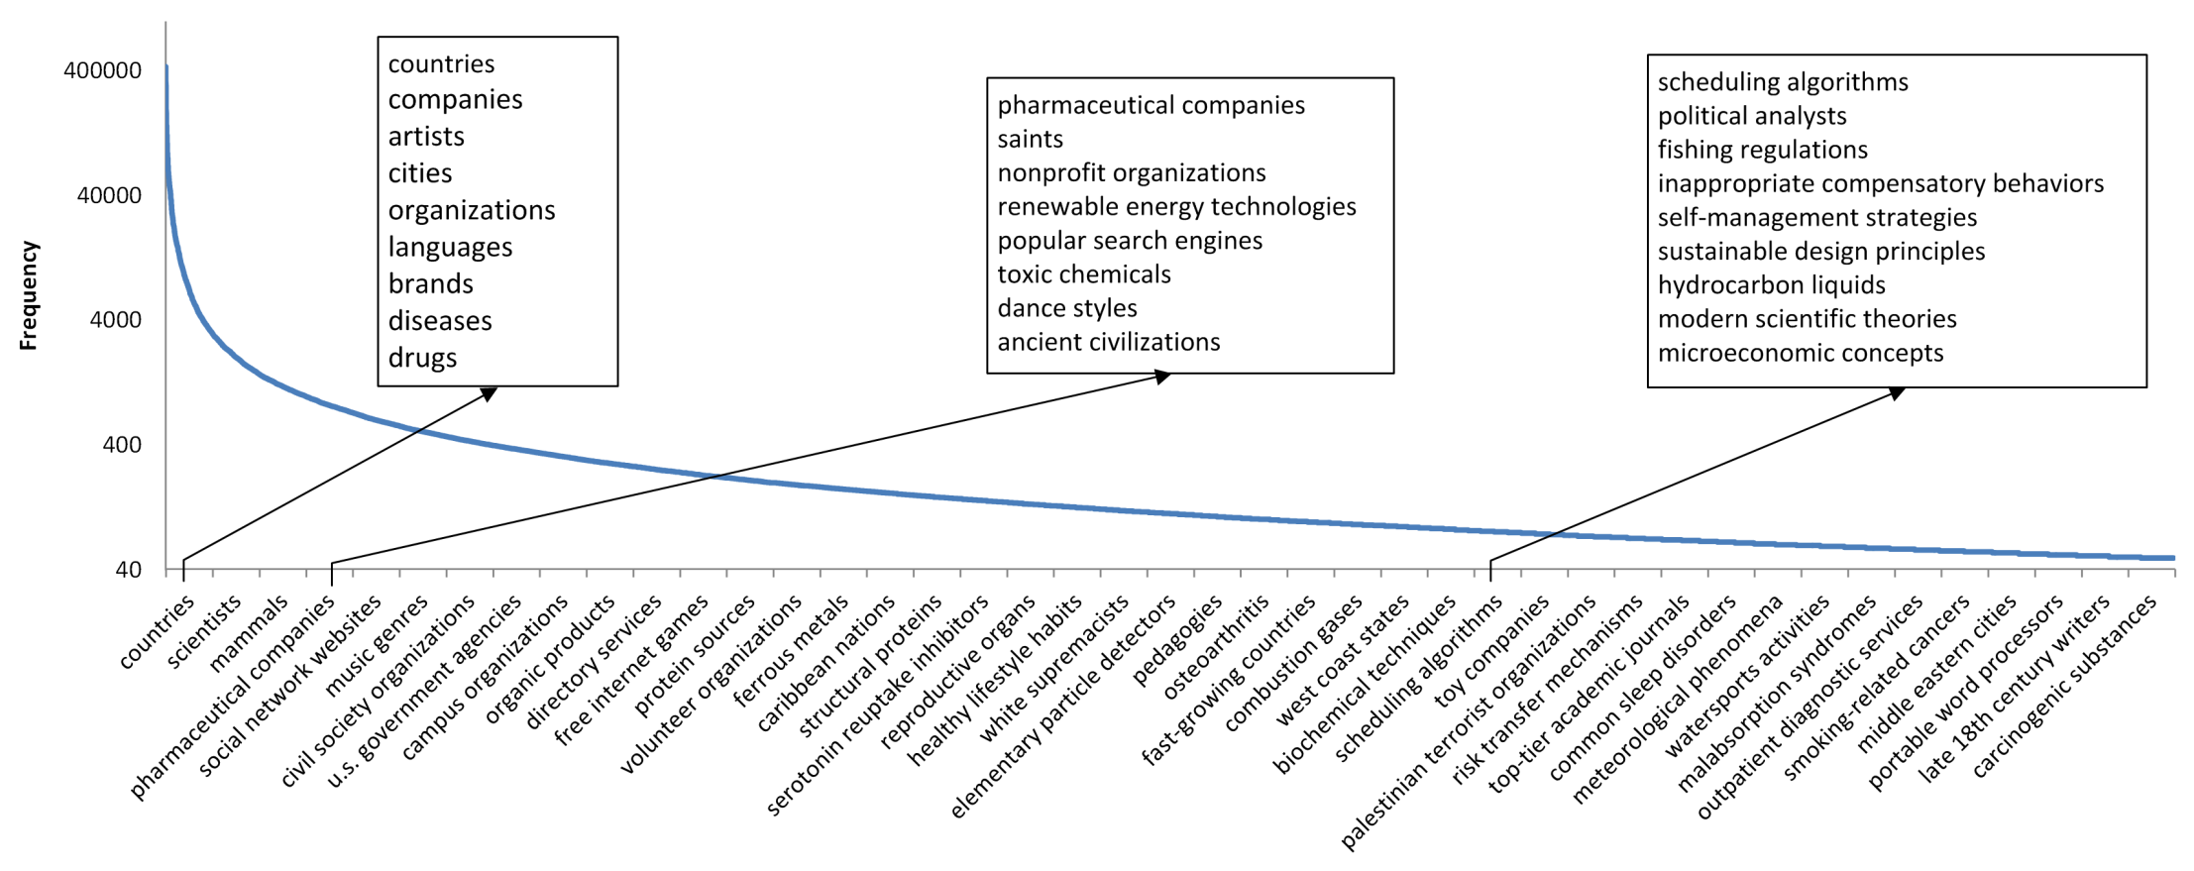
Frequency distribution of the 2.7 million concepts
The Y axis is the number of instances each concept contains(logarithmic scale), and on the X axis are the 2.7 million concepts ordered by their size.
besides popular concepts such as “cities” and “musicians”, which are included by almost every general purpose taxonomy, Probase has millions of long tail concepts such as “anti-parkinson treatments”, "celebrity wedding dress designers” and “basic watercolor techniques”,
Notes:
Figure 2 shows their distribution. The Y axis is the number of instances each concept contains(logarithmic scale), and on the X axis are the 2.7 million concepts ordered by their size. In contrast, existing knowledge bases have far fewer concepts (Freebase [3] contains no more than 2,000 concepts, and Cyc [7] has about 120,000 concepts), which fall short of modeling our mental world. As we can see in Figure 2, besides popular concepts such as “cities” and “musicians”, which are included by almost every general purpose taxonomy, Probase has millions of long tail concepts such as “anti-parkinson treatments”, "celebrity wedding dress designers” and “basic watercolor techniques”, which cannot be found in Freebase or Cyc.

Slide 42
Fast Changing Landscape...
From Probase page......
[Sept. 2016] Please visit our Microsoft Concept Graph release for up-to-date information of this project!

Slide 43
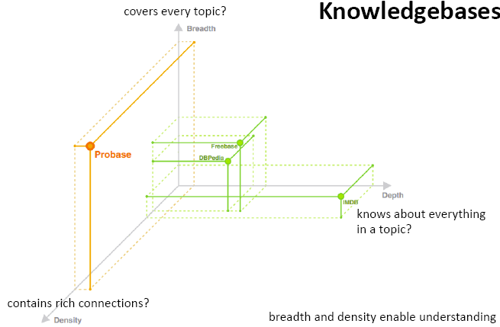
Interesting dimensions to compare Ontologies
(but form Probase so possibly biased)
Notes:
DBpedia is a crowd-sourced community effort to extract structured information from Wikipedia and make this information available on the Web. DBpedia allows you to ask sophisticated queries against Wikipedia, and to link the different data sets on the Web to Wikipedia data. We hope that this work will make it easier for the huge amount of information in Wikipedia to be used in some new interesting ways. Furthermore, it might inspire new mechanisms for navigating, linking, and improving the encyclopedia itself.

Slide 44
Domain Specific Ontologies: UMLS, MeSH
Unified Medical Language System: brings together many health and biomedical vocabularies
Enable interoperability (linking medical terms, drug names)
Develop electronic health records, classification tools
Search engines, data mining
We use it in text classification and topic modeling..
Notes:
What is the UMLS?
The UMLS, or Unified Medical Language System, is a set of files and software that brings together many health and biomedical vocabularies and standards to enable interoperability between computer systems.
You can use the UMLS to enhance or develop applications, such as electronic health records, classification tools, dictionaries and language translators.
More About the UMLS
Presentations and Publications
UMLS Reference Manual
UMLS Basics Tutorial
Source Vocabulary Information
UMLS Video Learning Resources
UMLS in Use
One powerful use of the UMLS is linking health information, medical terms, drug names, and billing codes across different computer systems. Some examples of this are:
Linking terms and codes between your doctor, your pharmacy, and your insurance company
Patient care coordination among several departments within a hospital
The UMLS has many other uses, including search engine retrieval, data mining, public health statistics reporting, and terminology research.
More Uses of the UMLS
NLM Applications
UMLS Community
Health Information Technology
Supporting Interoperability
The Three UMLS Tools
The UMLS has three tools, which we call the Knowledge Sources:
Metathesaurus: Terms and codes from many vocabularies, including CPT®, ICD-10-CM, LOINC®, MeSH®, RxNorm, and SNOMED CT®
Semantic Network: Broad categories (semantic types) and their relationships (semantic relations)
SPECIALIST Lexicon and Lexical Tools: Natural language processing tools
We use the Semantic Network and Lexical Tools to produce the Metathesaurus. Metathesaurus production involves:
Processing the terms and codes using the Lexical Tools
Grouping synonymous terms into concepts
Categorizing concepts by semantic types from the Semantic Network
Incorporating relationships and attributes provided by vocabularies
Releasing the data in a common format
Although we integrate these tools for Metathesaurus production, you can access them separately or in any combination according to your needs.

Slide 45
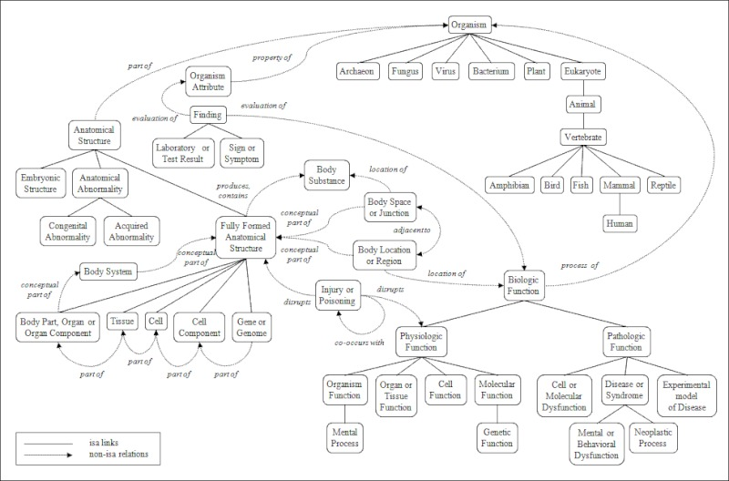
Portion of the UMLS Semantic Net
Notes:
igure 3. A Portion of the UMLS Semantic Network: Relations
The Semantic Network contains 133 semantic types and 54 relationships.

Slide 46
DBpedia is a structured twin ofWikipedia. Currently it describes more than 3.4 million entities. DBpedia resources bear the names of the Wikipedia pages, from which they have been extracted.
YAGO is an automatically created ontology, with taxonomy structure derived from WordNet, and knowledge about individuals extracted from Wikipedia. Therefore, the identifiers of resources describing individuals in YAGO are named as the corresponding Wikipedia pages. YAGO contains knowledge about more than 2 million entities and 20 million facts about them.
Freebase is a collaboratively constructed database. It contains knowledge automatically extracted from a number of resources including Wikipedia, MusicBrainz,2 and NNDB,3 as well as the knowledge contributed by the human volunteers. Freebase describes more than 12 million interconnected entities. Each Freebase entity is assigned a set of human-readable unique keys, which are assembled of a value and a namespace. One of the namespaces is the Wikipedia namespace, in which a value is the name of the Wikipedia page describing an entity.

Slide 47
Today 13 Feb
:
Syntax-Driven Semantic Analysis
Meaning of words
Relations among words and their meanings (Paradigmatic)
Internal structure of individual words (Syntagmatic)
Notes:
Paradigmatic: the external relational structure among words
Syntagmatic: the internal structure of words that determines how they can be combined with other words

Slide 48
Predicate-Argument Structure
Represent relationships among concepts, events and their participants
“I ate a turkey sandwich for lunch”
∃ w: Isa(w,Eating) ∧ Eater(w,Speaker) ∧ Eaten(w,TurkeySandwich) ∧ MealEaten(w,Lunch)
“Nam does not serve meat”
∃ w: Isa(w,Serving) ∧ Server(w, Nam) ∧ ¬Served(w,Meat)
Notes:
All human languages
a specific relation holds between the concepts expressed by the words or the phrases
Events, actions and relationships can be captured with representations that consist of predicates and arguments.
Languages display a division of labor where some words and constituents function as predicates and some as arguments.
One of the most important roles of the grammar is to help organize this pred-args structure

Slide 49
Semantic/Thematic Roles
  Def. Semantic generalizations over the specific roles that occur with specific verbs.
  I.e. eaters, servers, takers, givers, makers, doers, killers, all have something in common
  We can generalize (or try to) across other roles as well
Notes:
How does language convey meaning?

Slide 50
Thematic Roles: Usage
Sentence
Constraint
Generation
Syntax-driven
Semantic Analysis
Eg. Instrument “with”
Literal Meaning expressed with thematic roles
Eg. Subject?
Support
“more abstract”
INFERENCE
Further
Analysis
Eg. Result did not exist before
Intended meaning
Notes:
In generation.
Instrument with “with” if there is an agent
Otherwise it is the subject
Thematic hierarchy for assigning subject
Agent > Instrument > Theme

Slide 51
Thematic Role Examples
fi
fl

Slide 52
Thematic Roles
fi
fi
  Not definitive, not from a single theory!
Notes:
It is controversial whether a finite list of thematic roles exists..

Slide 53
Problem with Thematic Roles
NO agreement on what standard set should be
NO agreement on formal definition
Fragmentation problem: when you try to formally define a role you end up creating more specific sub-roles
Solutions
Generalized semantic roles
Define verb specific semantic roles
Define semantic roles for classes of verbs
Notes:
Instrument
intermediary “opened X with Y” -> “Y opened X”
enabling “ate X with Y” -> ?”Y ate X”?

Slide 54
Generalized Semantic Roles
Very abstract roles are defined heuristically as a set of conditions
The more conditions are satisfied the more likely an argument fulfills that role
Proto-Patient
  Undergoes change of state
  Incremental theme
  Causally affected by another participant
  Stationary relative to movement of another participant
  (does not exist independently of the event, or at all)
Proto-Agent
  Volitional involvement in event or state
  Sentience (and/or perception)
  Causing an event or change of state in another participant
  Movement (relative to position of another participant)
  (exists independently of event named)
Taylor ate the apricot
Notes:
OR Thematic roles should be viewed as prototypes, where there may be different degrees of membership
Sentience refers to utilization of sensory organs, the ability to feel or perceive subjectively
Incremental theme
the apricot is the incremental theme in (3) since the progress of the eating event is reflected
in the amount of apricot remaining: when the apricot is half-eaten the event is half done,
when the apricot is two-thirds eaten, the event is two-thirds done, and so on.
(3) Taylor ate the apricot.

Slide 55
Semantic Roles: Resources
Databases containing for each verb its syntactic and thematic argument structures
PropBank: sentences in the Penn Treebank annotated with semantic roles
Roles are verb-sense specific
Arg0 (PROTO-AGENT), Arg1(PROTO-PATIENT), Arg2,…….
(see also VerbNet)
Notes:
From wikipedia (and imprecise)
PropBank differs from FrameNet, the resource to which it is most frequently compared, in two major ways. The first is that it commits to annotating all verbs in its data. The second is that all arguments to a verb must be syntactic constituents.

Slide 56
PropBank Example
Increase “go up incrementally”
  Arg0: causer of increase
  Arg1: thing increasing
  Arg2: amount increase by
  Arg3: start point
  Arg4: end point
Glosses for human reader. Not formally defined
PropBank semantic role labeling would identify common aspects among these three examples
“ Y performance increased by 3% ”
“ Y performance was increased by the new X technique ”
“ The new X technique increased performance of Y”
Notes:
From wikipedia (and imprecise)
PropBank differs from FrameNet, the resource to which it is most frequently compared, in two major ways. The first is that it commits to annotating all verbs in its data. The second is that all arguments to a verb must be syntactic constituents.
Also
The VerbNet project maps PropBank verb types to their corresponding Levin classes. It is a lexical resource that incorporates both semantic and syntactic information about its contents. The lexicon can be viewed and downloaded from http://verbs.colorado.edu/verb-index
VerbNet is part of the SemLink project in development at the University of Colorado.

Slide 57
Semantic Roles: Resources
Move beyond inferences about single verbs
“ IBM hired John as a CEO ”
“ John is the new IBM hire ”
“ IBM signed John for 2M$”
FrameNet: Databases containing frames and their syntactic and semantic argument structures
(book online Version Revised November 1, 2016)
  for English (versions for other languages are under development)
Notes:
10,000 lexical units (defined below), more than 6,100 of which are fully annotated, in more than 825 hierarchically structured semantic frames, exemplified in more than 135,000 annotated sentences
John was HIRED to clean up the file system.
IBM HIRED Gates as chief janitor.
I was RETAINED at $500 an hour.
The A's SIGNED a new third baseman for $30M.

Slide 58
FrameNet Entry
Hiring
Definition: An Employer hires an Employee, promising the Employee a certain Compensation in exchange for the performance of a job. The job may be described either in terms of a Task or a Position in a Field.
Inherits From: Intentionally affect
Lexical Units: commission.n, commission.v, give job.v, hire.n, hire.v, retain.v, sign.v, take on.v
Notes:
Very specific thematic roles!

Slide 59
FrameNet Annotations
Some roles..
Employer
Employee
Task
Position
np-vpto
  In 1979 , singer Nancy Wilson HIRED him to open her nightclub act .
  ….
np-ppas
  Castro has swallowed his doubts and HIRED Valenzuela as a cook in his small restaurant .
Includes counting: How many times a role was
expressed with a particular syntactic structure…
Notes:
Shallow semantic parsing is labeling phrases of a sentence with semantic roles with respect to a target word.
For example, the sentence
“Shaw Publishing offered Mr. Smith a reimbursement last March.”
Is labeled as:
[AGENTShaw Publishing] offered [RECEPIENTMr. Smith] [THEMEa reimbursement] [TIMElast March] .
We work with a number of collaborators, beginning with Dan Gildea in his dissertation work, on automatic semantic parsing. Much of Dan Gildeas's dissertation work was written up here: Daniel Gildea and Daniel Jurafsky. 2002. Automatic Labeling of Semantic Roles. Computational Linguistics 28:3, 245-288. This work also involves close collaboration with the FrameNet and PropBank projects.
Currently, we focus on building joint probabilistic models for simultaneous assignment of labels to all nodes in a syntactic parse tree. These models are able to capture the strong correlations among decisions at different nodes.
CompensationPeripheral
EmployeeCore
EmployerCore
FieldCore
InstrumentPeripheral
MannerPeripheral
MeansPeripheral
PlacePeripheral
PositionCore
PurposeExtra-Thematic
TaskCore
TimePeripheral

Slide 60
Summary of Lexical Resources
Google Knowledge Graph
Relations among words and their meanings
Freebase
Wordnet
YAGO
Microsoft Concept Graph
Probase
Internal structure of individual words
PropBank
VerbNet
FrameNet

Slide 61
Next Time (after reading week)
Read Chp.6, Appendix C, (optional Chp16) 3rd Ed.
Computational Lexical Semantics
Vector Semantics
Word Similarity
(Maybe) Neural Semantic Role Labeling
Assignment 3: will be posted tonight. Parsing, FOL, Ontologies, WSD, Word Similarity
Projects: talk to me at least once before making a final decision on topic and papers

Slide 62
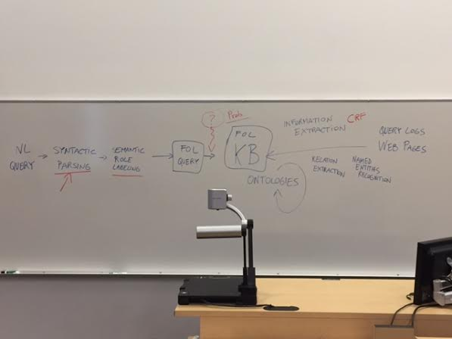
Just a sketch: to provide some context for some concepts / techniques discussed in 422

