Slide 1
CPSC 503
Computational Linguistics
Computational Lexical Semantics
(focus on word embeddings)
Lecture 12
Giuseppe Carenini
Slides Source: Jurafsky & Martin

Slide 2
Today Feb 23
Main focus: Vector Semantics
Notes:
Stand-alone with minimal assumptions on what information will be provided by other processes
IR and extremely broad field (not just text)
Today we’ll cover only a specific case in which user’s needs are expressed as words
and documents are expressed in terms of the word they contains

Slide 3
Bigger Picture
Three well-defined Semantic Task
Word Similarity
  Thesaurus and Corpus
Word Sense Disambiguation (in Assign3 and readings)
  Corpus and Thesaurus
Semantic Role Labeling (corpus)
Notes:
Stand-alone with minimal assumptions on what information will be provided by other processes
IR and extremely broad field (not just text)
Today we’ll cover only a specific case in which user’s needs are expressed as words
and documents are expressed in terms of the word they contains

Slide 4
Vector Semantics
Introduction
For word similarity and beyond (word embeddings)
Slides Source: Jurafsky & Martin

Slide 5
Why vector models of meaning?
Use these as features to represent words in many NLP tasks
Use these to compute similarity between words
“fast” is similar to “rapid”
“tall” is similar to “height”
Question answering:
Q: “How tall is Mt. Everest?”
Candidate A: “The official height of Mount Everest is 29029 feet”
Extends to sentence/paragraph similarity
Summarization: identify and eliminate redundancy, aggregate similar phrase/sentences
Notes:
Applications
Information extraction, question answering, summarization (identify and eliminate redundancy) , language modeling (by clustering words)… extends to sentence / paragraph similarity … plagiarism detection

Slide 6
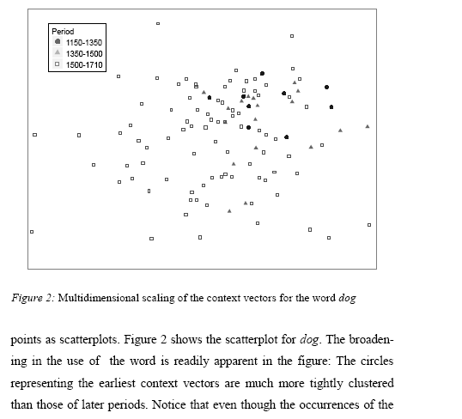
Word similarity for historical linguistics: semantic change over time
Sagi, Kaufmann Clark 2013
Notes:
Once the vector space for word types is obtained from the training corpus, new vectors can be derived for any multi-word unit of text (e.g. paragraphs, queries, or documents), regardless of whether it occurs in the original training corpus or not, as the normalized sum of the vectors associated with the words it contains.12 In this way, for each occurrence of a target word type w under investigation, we calculated a context vector from the 15 items preceding and the 15 items following that occurrence.13 Context vectors were first used in Word Sense Discrimination by Schütze (1998). Similarly to that application, we assume that these “second-order” vectors represent the aggregate meaning or topic of the segment they are associated with, and thus, following the reasoning behind LSA, are indicative of the meaning with which the target word is being used on that particular occurrence.

Slide 7
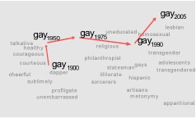
Word similarity for historical linguistics: semantic change over time
Sagi, Kaufmann Clark 2013
Kulkarni, Al-Rfou, Perozzi, Skiena 2015
Notes:
Once the vector space for word types is obtained from the training corpus, new vectors can be derived for any multi-word unit of text (e.g. paragraphs, queries, or documents), regardless of whether it occurs in the original training corpus or not, as the normalized sum of the vectors associated with the words it contains.12 In this way, for each occurrence of a target word type w under investigation, we calculated a context vector from the 15 items preceding and the 15 items following that occurrence.13 Context vectors were first used in Word Sense Discrimination by Schütze (1998). Similarly to that application, we assume that these “second-order” vectors represent the aggregate meaning or topic of the segment they are associated with, and thus, following the reasoning behind LSA, are indicative of the meaning with which the target word is being used on that particular occurrence.

Slide 8
Problems with thesaurus-based meaning
We don’t have a thesaurus for every language
We can’t have a thesaurus for every year
  For historical linguistics, we need to compare word meanings in year t to year t+1
Thesauruses have problems with recall
  Many words and phrases are missing
  Thesauri work less well for verbs, adjectives

Slide 9
Distributional models of meaning
= vector-space models of meaning
= vector semantics
Intuitions: Zellig Harris (1954):
  “oculist and eye-doctor … occur in almost the same environments”
  “If A and B have almost identical environments we say that they are synonyms.”
Firth (1957):
  “You shall know a word by the company it keeps!”

Slide 10
WS: Distributional Methods
Do not have any thesauri for target language
If you have thesaurus, still
  Missing domain-specific (e.g., technical words)
  Poor hyponym knowledge (for V) and nothing for Adj and Adv
  Difficult to compare senses from different hierarchies
Solution: extract similarity from corpora
Basic idea: two words are similar if they appear in similar contexts

Slide 11
Intuition of distributional word similarity
Nida example: Suppose I asked you what is tesgüino?
    A bottle of tesgüino is on the table
    Everybody likes tesgüino
    Tesgüino makes you drunk
    We make tesgüino out of corn.
From context words humans can guess tesgüino means
  an alcoholic beverage like beer
Intuition for algorithm:
  Two words are similar if they have similar word contexts.

Slide 12
Shared intuition: Vectors Models aka “embeddings”.
Model the meaning of a word by “embedding” in a vector space.
The meaning of a word is a vector of numbers
Four kinds of vector models
Sparse vector representations
  Mutual-information weighted word co-occurrence matrices
Dense vector representations:
  Singular value decomposition (and Latent Semantic Analysis)
  Neural-Network-inspired models (skip-grams, CBOW)
  Brown clusters

Slide 13
Vector Semantics
Words and co-occurrence vectors

Slide 14
Co-occurrence Matrices
We represent how often a word occurs in a document
  Term-document matrix
Or how often a word occurs with another
  Term-term matrix
    (or word-word co-occurrence matrix
    or word-context matrix)

Slide 15
Term-document matrix
Each cell: count of word w in a document d:
  Each document is a count vector in ℕ^{v}: a column below

Slide 16
Similarity in term-document matrices
Two documents are similar if their vectors are similar

Slide 17
The words in a term-document matrix
Each word is a count vector in ℕ^{D}: a row below

Slide 18
The words in a term-document matrix
Two words are similar if their vectors are similar

Slide 19
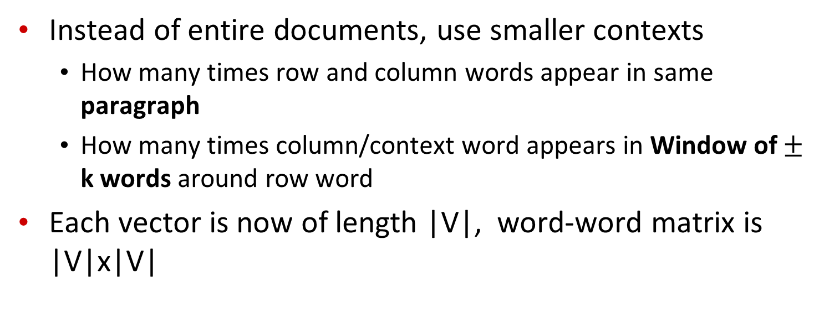
The word-word or word-context matrix
Instead of entire documents, use smaller contexts
  How many times row and column words appear in same paragraph
  How many times column/context word appears in Window of $±$ k words around row word
Each vector is now of length |V|, word-word matrix is |V|x|V|
Notes:
A word is now defined by a vector over counts of context words
Instead of each vector being of length D

Slide 20

Word-Word matrix: Sample contexts $±$ 7 words
…
…
…
Portion of matrix from the Brown corpus
…
…

Slide 21
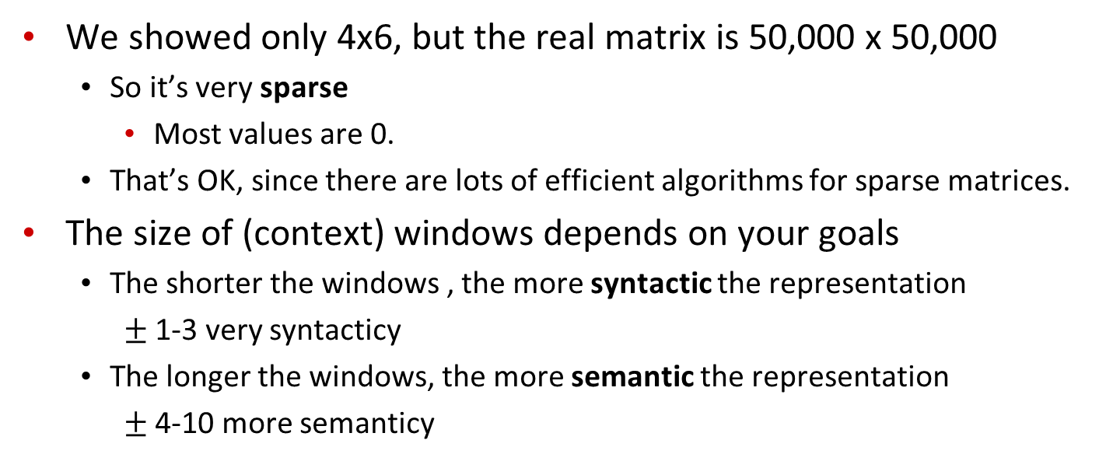
Word-word matrix
We showed only 4x6, but the real matrix is 50,000 x 50,000
  So it’s very sparse
    Most values are 0.
  That’s OK, since there are lots of efficient algorithms for sparse matrices.
The size of (context) windows depends on your goals
  The shorter the windows , the more syntactic the representation
    $±$ 1-3 very syntacticy
  The longer the windows, the more semantic the representation
    $±$ 4-10 more semanticy

Slide 22
2 kinds of co-occurrence between 2 words
(Schütze and Pedersen, 1993)
First-order co-occurrence (syntagmatic association):
  They are typically nearby each other.
  wrote is a first-order associate of book or poem.
Second-order co-occurrence (paradigmatic association):
  They have similar neighbors.
  wrote is a second- order associate of words like said or remarked.

Slide 23
Vector Semantics
Positive Pointwise Mutual Information (PPMI)

Slide 24
Problem with raw counts
Raw word frequency is not a great measure of association between words
  It’s very skewed
    “the” and “of” are very frequent, but maybe not the most discriminative
We’d rather have a measure that asks whether a context word is particularly informative about the target word.
  Positive Pointwise Mutual Information (PPMI)

Slide 25
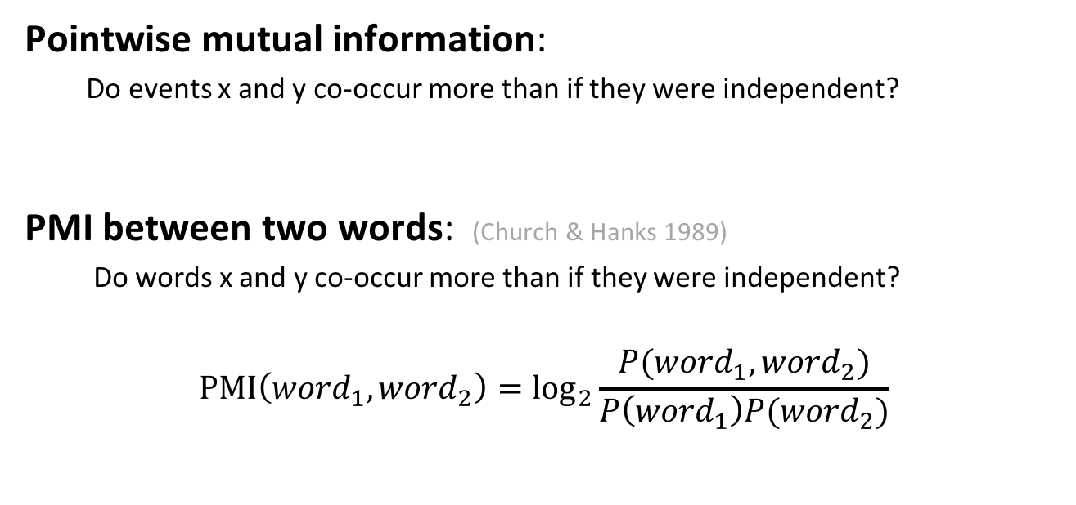
Pointwise Mutual Information
Pointwise mutual information:
  Do events x and y co-occur more than if they were independent?
  PMI between two words: (Church & Hanks 1989)
  Do words x and y co-occur more than if they were independent?
$$\text{PMI}\left({word}_{1}, {word}_{2}\right)={\text{log}}_{2}\frac{P({word}_{1}, {word}_{2})}{P\left({word}_{1}\right)P({word}_{2})}$$
Notes:
Word2 = context word

Slide 26
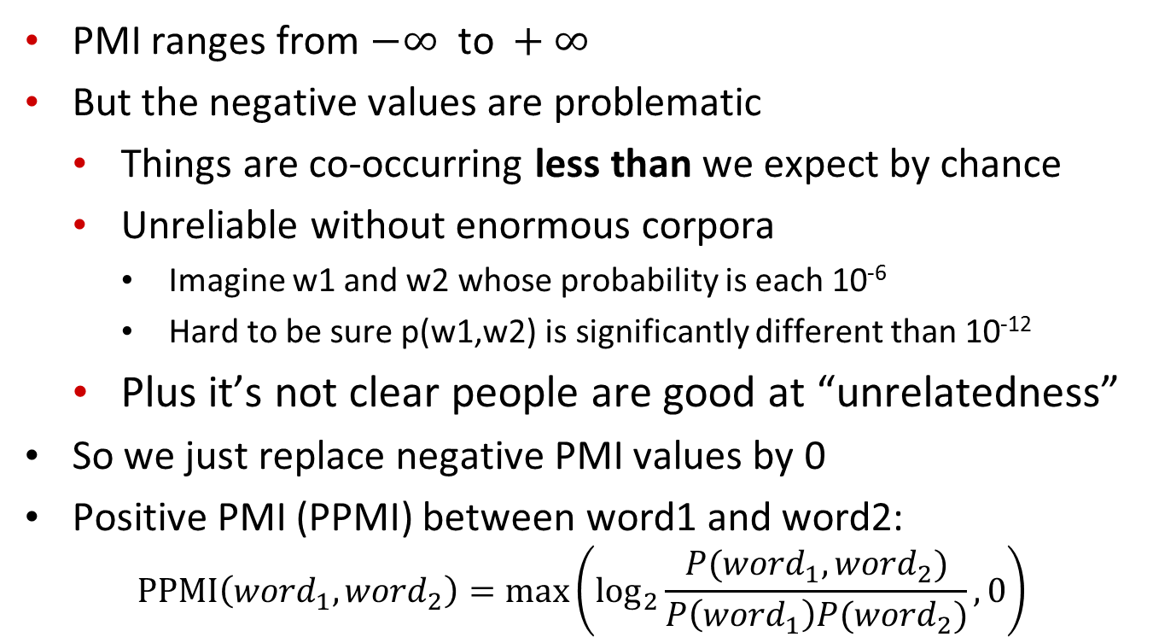
Positive Pointwise Mutual Information
  PMI ranges from $−∞ \text{to} +∞$
  But the negative values are problematic
    Things are co-occurring less than we expect by chance
    Unreliable without enormous corpora
      Imagine w1 and w2 whose probability is each 10⁻⁶
      Hard to be sure p(w1,w2) is significantly different than 10⁻¹²
    Plus it’s not clear people are good at “unrelatedness”
  So we just replace negative PMI values by 0
  Positive PMI (PPMI) between word1 and word2:
$$\text{P}\text{P}\text{MI}\left({word}_{1}, {word}_{2}\right)=\max\left({\text{log}}_{2}\frac{P({word}_{1}, {word}_{2})}{P\left({word}_{1}\right)P({word}_{2})},0\right)$$

Slide 27
Computing PPMI on a term-context matrix
Matrix F with W rows (words) and C columns (contexts)
f_{ij} is # of times c_{j} occurs in window of w_{i}
Notes:
Matrix F with W rows (words) and C columns (contexts)
f_{ij} is # of times w_{i} occurs in context c_{j}
=>
Matrix F with W rows (words) and C columns (contexts)
f_{ij} is # of times w_{i} occurs in context c_{j}

Slide 28
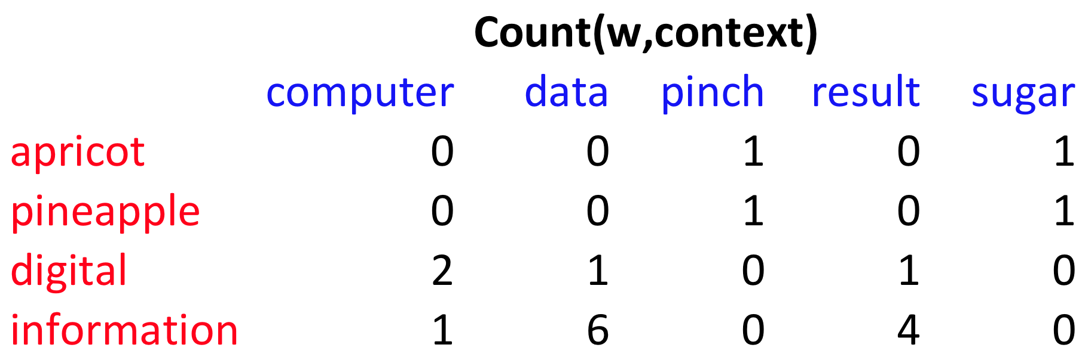
p(w=information,c=data) =
p(w=information) =
p(c=data) =
6/19
= .32
11/19
= .58
7/19
= .37

Slide 29
pmi(information,data) = log₂ (
.32 /
(.37*.58) )
= .58
(.57 using full precision)

Slide 30
Weighting PMI
PMI is biased toward infrequent events
  Very rare words have very high PMI values
Two solutions:
  Give rare words slightly higher probabilities
  Use add-one smoothing (which has a similar effect)

Slide 31
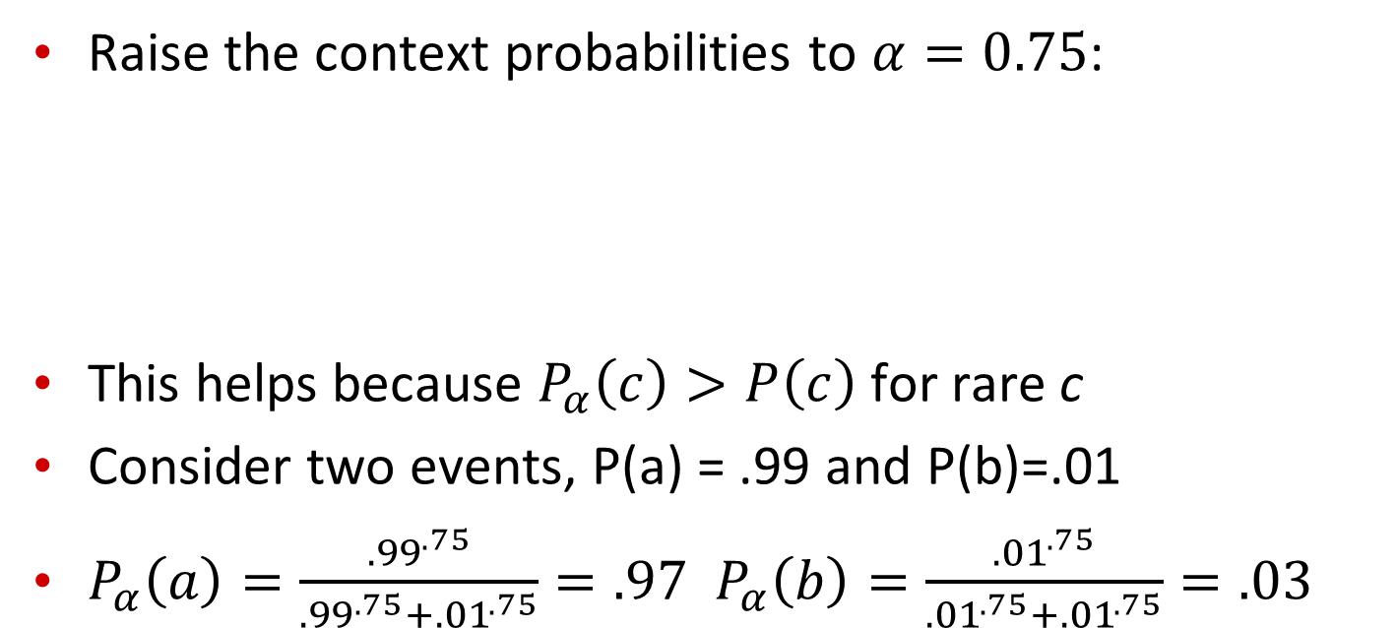
Weighting PMI: Giving rare context words slightly higher probability
Raise the context probabilities to $α=0.75$:
This helps because $P_{α}\left(c\right)>P\left(c\right)$ for rare c
Consider two events, P(a) = .99 and P(b)=.01
$P_{α}\left(a\right)=\frac{{.99}^{.75}}{{.99}^{.75}+{.01}^{.75}}=.97$ $P_{α}\left(b\right)=\frac{{.01}^{.75}}{{.01}^{.75}+{.01}^{.75}}=.03$

Slide 32
Use Laplace (add-1) smoothing

Slide 34
PPMI versus add-2 smoothed PPMI

Slide 35
Vector Semantics
Measuring similarity: the cosine

Slide 36
Measuring similarity
Given 2 target words v and w
We’ll need a way to measure their similarity.
Most measure of vectors similarity are based on the:
Dot product or inner product from linear algebra
  High when two vectors have large values in same dimensions.
  Low (in fact 0) for orthogonal vectors with zeros in complementary distribution

Slide 37
Problem with dot product
Dot product is longer if the vector is longer. Vector length:
Vectors are longer if they have higher values in each dimension
That means more frequent words will have higher dot products
That’s bad: we don’t want a similarity metric to be sensitive to word frequency

Slide 38
Solution: cosine
Just divide the dot product by the length of the two vectors!
This turns out to be the cosine of the angle between them!

Slide 39
Cosine for computing similarity
Sec. 6.3
Dot product
v_{i} is the PPMI value for word v in context i
w_{i} is the PPMI value for word w in context i.
Cos(v,w) is the cosine similarity of v and w

Slide 40
Cosine for computing similarity
Sec. 6.3
Dot product
Unit vectors
v_{i} is the PPMI value for word v in context i
w_{i} is the PPMI value for word w in context i.
Cos(v,w) is the cosine similarity of v and w

Slide 41
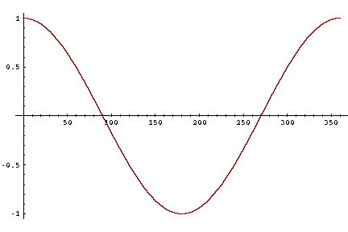
Cosine as a similarity metric
-1: vectors point in opposite directions
+1: vectors point in same directions
0: vectors are orthogonal
Raw frequency or PPMI are non-negative, so cosine range 0-1

Slide 42



 | large | data | computer
apricot | 2 | 0 | 0
digital | 0 | 1 | 2
information | 1 | 6 | 1
Which pair of words is more similar?
cosine(apricot,information) =
cosine(digital,information) =
cosine(apricot,digital) =
$$2+0+0$$
$$= \frac{2}{\sqrt{2}\sqrt{38}}= .23$$
$$\sqrt{2+0+0 }$$

Slide 43
Visualizing vectors and angles
 | large | data
apricot | 2 | 0
digital | 0 | 1
information | 1 | 6

Slide 44
Clustering vectors to visualize similarity in co-occurrence matrices
Rohde et al. (2006)

Slide 45
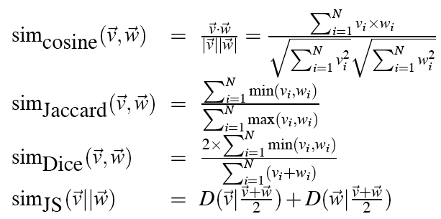
Other possible similarity measures

Slide 46
Vector Semantics
Evaluation, using syntax, alternatives to PPMI

Slide 47
Evaluating similarity
(the same as for thesaurus-based)
Intrinsic Evaluation:
  Correlation between algorithm and human word similarity ratings
Extrinsic (task-based, end-to-end) Evaluation:
  Spelling error detection, WSD, essay grading
  Taking TOEFL multiple-choice vocabulary tests
Levied is closest in meaning to which of these:
  imposed, believed, requested, correlated

Slide 48
Using syntax to define a word’s context
Zellig Harris (1968)
  “The meaning of entities, and the meaning of grammatical relations among them, is related to the restriction of combinations of these entities relative to other entities”
Two words are similar if they have similar syntactic contexts
Duty and responsibility have similar syntactic distribution:
Modified by adjectives | additional, administrative, assumed, collective, congressional, constitutional …
Objects of verbs | assert, assign, assume, attend to, avoid, become, breach..

Slide 49
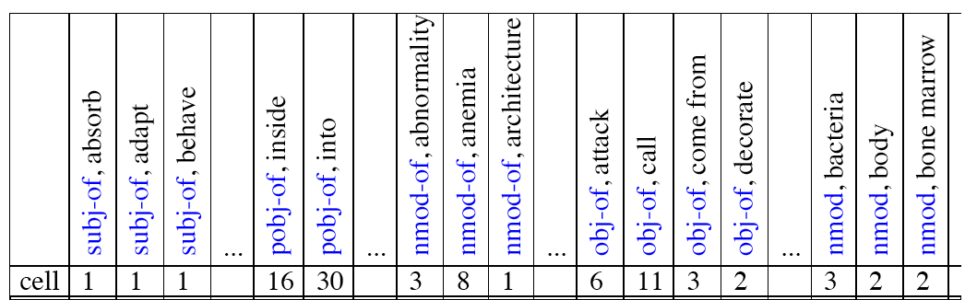
Co-occurrence vectors based on syntactic dependencies
Dekang Lin, 1998 “Automatic Retrieval and Clustering of Similar Words”
Each dimension: a context word in one of R grammatical relations
  Subject-of- “absorb”
Instead of a vector of |V| features, a vector of R|V|
Example: counts for the word cell :

Slide 50
Syntactic dependencies for dimensions
Alternative (Padó and Lapata 2007):
  Instead of having a |V| x R|V| matrix
  Have a |V| x |V| matrix
  But the co-occurrence counts aren’t just counts of words in a window
  But counts of words that occur in one of R dependencies (subject, object, etc).
  So M(“cell”,”absorb”) = count(subj(cell,absorb)) + count(obj(cell,absorb)) + count(pobj(cell,absorb)), etc.

Slide 51
PMI applied to dependency relations
Hindle, Don. 1990. Noun Classification from Predicate-Argument Structure. ACL
Object of “drink” | Count | PMI
it | 3 | 1.3
anything | 3 | 5.2
wine | 2 | 9.3
tea | 2 | 11.8
liquid | 2 | 10.5
Object of “drink” | Count | PMI
tea | 2 | 11.8
liquid | 2 | 10.5
wine | 2 | 9.3
anything | 3 | 5.2
it | 3 | 1.3
“Drink it” more common than “drink wine”
But “wine” is a better “drinkable” thing than “it”

Slide 52
Alternative to PPMI for measuring association
tf-idf (that’s a hyphen not a minus sign)
The combination of two factors
  Term frequency (Luhn 1957): frequency of the word (can be logged)
  Inverse document frequency (IDF) (Sparck Jones 1972)
    N is the total number of documents
    df_{i} = “document frequency of word i”
    = # of documents with word I
  w_{ij} = word i in document j
  w_{ij}=tf_{ij} idf_{i}

Slide 53
tf-idf not generally used for word-word similarity
But is by far the most common weighting when we are considering the relationship of words to documents

Slide 54
Vector Semantics
Dense Vectors

Slide 55
Sparse versus dense vectors
PPMI vectors are
  long (length |V|= 20,000 to 50,000)
  sparse (most elements are zero)
Alternative: learn vectors which are
  short (length 200-1000)
  dense (most elements are non-zero)

Slide 56
Sparse versus dense vectors
Why dense vectors?
  Short vectors may be easier to use as features in machine learning (less weights to tune)
  Dense vectors may generalize better than storing explicit counts
  They may do better at capturing synonymy:
    car and automobile are synonyms; but are represented as distinct dimensions; this fails to capture similarity between a word with car as a neighbor and a word with automobile as a neighbor

Slide 57
Three methods for getting short dense vectors
Singular Value Decomposition (SVD)
  A special case of this is called LSA – Latent Semantic Analysis
“Neural Language Model”-inspired predictive models
  skip-grams and CBOW
Brown clustering

Slide 58
Vector Semantics
Dense Vectors via SVD

Slide 59
Intuition
Approximate an N-dimensional dataset using fewer dimensions
By first rotating the axes into a new space
In which the highest order dimension captures the most variance in the original dataset
And the next dimension captures the next most variance, etc.
Many such (related) methods:
  PCA – principle components analysis
  Factor Analysis
  SVD

Slide 60
Dimensionality reduction
If I “forget” about the new dimension-2 I am loosing less variability / information than if I forget any of the two original dimensions
…I can use only dimension-1 and still capture much of the variation in the original data
Notes:
If I “forget” about the new dimension-2 I am loosing less variability / information than if I forget any of the two original dimensions
…I can use only dimension-1 and still capture much of the variation in the original data

Slide 61
Singular Value Decomposition
Any rectangular w x c matrix X equals the product of 3 matrices:
W: rows corresponding to original but m columns represents a dimension in a new latent space, such that
  M column vectors are orthogonal to each other
  Columns are ordered by the amount of variance in the dataset each new dimension accounts for
S: diagonal m x m matrix of singular values expressing the importance of each dimension.
C: columns corresponding to original but m rows corresponding to singular values

Slide 62
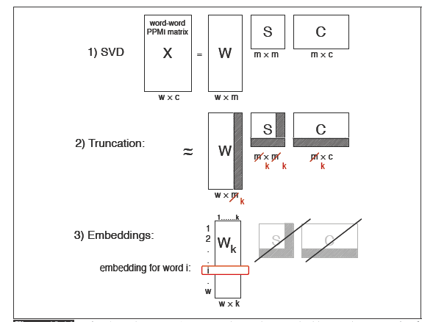
Singular Value Decomposition (SVD)
Any rectangular w x c matrix X equals the product of 3 matrices:
S: diagonal m x m matrix of singular values expressing the importance of each dimension.
Notes:
W: rows corresponding to original but m columns represents a dimension in a new latent space, such that
M column vectors are orthogonal to each other
Columns are ordered by the amount of variance in the dataset each new dimension accounts for
C: columns corresponding to original but m rows corresponding to singular values

Slide 63
SVD to produce word embeddings: applied to word-word PPMI matrix

Slide 64
Truncated SVD produces embeddings
Each row of W matrix is a k-dimensional representation of each word w
K might range from 50 to 1000
Generally we keep the top k dimensions, but some experiments suggest that getting rid of the top 1 dimension or even the top 50 dimensions is helpful (Lapesa and Evert 2014).

Slide 65
Embeddings versus sparse vectors
Dense SVD embeddings sometimes work better than sparse PPMI matrices at tasks like word similarity
  Denoising: low-order dimensions may represent unimportant information
  Truncation may help the models generalize better to unseen data.
  Having a smaller number of dimensions may make it easier for classifiers to properly weight the dimensions for the task.
  Dense models may do better at capturing higher order co-occurrence.

Slide 66
Singular Value Decomposition
Landuaer and Dumais 1997

Slide 67
SVD applied to term-document matrix:
Latent Semantic Analysis
Deerwester et al (1988)
If instead of keeping all m dimensions, we just keep the top k singular values. Let’s say 300.
The result is a least-squares approximation to the original X
But instead of multiplying, we’ll just make use of W.
Each row of W:
  A k-dimensional vector
  Representing word W
/
k
/
k
/
k
k
/

Slide 68
LSA more details
300 dimensions are commonly used
The cells are commonly weighted by a product of two weights
  Local weight: Log term frequency
  Global weight: either idf or an entropy measure

Slide 69
Let’s return to PPMI word-word matrices
Can we apply to SVD to them?

Slide 70
SVD applied to term-term matrix
(I’m simplifying here by assuming the matrix has rank |V|)

Slide 71
Truncated SVD on term-term matrix

Slide 72
Vector Semantics
Embeddings inspired by neural language models: skip-grams and CBOW

Slide 73
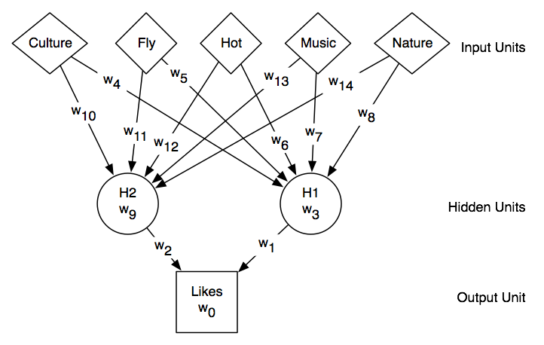
Neural nets
Specify Function: Input Unit(s) -> Output Unit(s)
Example:
Input Units: features of a City (it has/n’t Culture, you can/cannot Fly to it, etc.)
Output Unit: whether user would Like to visit that City
Notes:
The value of a unit is computed by applying “non linear” activation function to a linear combination of its input units.
In matrix notation

Slide 74

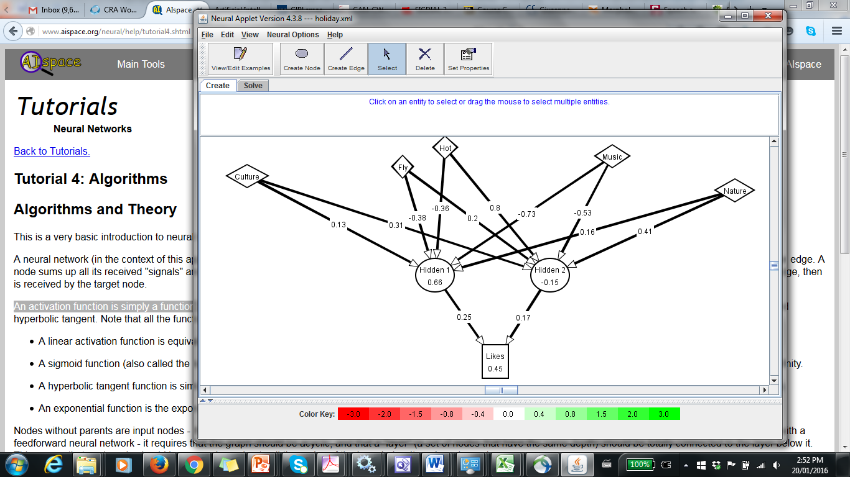
Neural Nets in one slide
Notes:
The value of a unit is computed by applying “non linear” activation function to a linear combination of its input units.
In matrix notation……
Show AI space demo for training

Slide 75
Neural Language Models
What function are we trying to learn?
n-gram: a function that takes n-1 words and returns a prob. distribution on the next word
Let’s focus on the simple 2-gram…
Take a word and return a prob. distribution on the next word

Slide 76
NN Input: Represent words as vectors
Represent each word as a different vector with no prior info on their similarity -> 1-of-K coding scheme
How to map that into a “smaller” vector of real numbers? Multiply by matrix E with dimension d<<|V|

Slide 77
NN Output: Probability distribution for next word
Output vector h of dimension |V| that we can then normalize (with soft-max)
A little simplified for the sake of simplicity

Slide 78
Connecting input and output

Slide 79
Intuition about training
Output vector h of dimension |V| that we can then normalized (with soft-max)

Slide 80
What info is stored in matrix E ?
It gives us a dense continuous vector representation for each word (called word embedding)
When this is learned in slightly different settings (e.g., to predict the probability of a word given x words on the right and x words on the left, aka continuous bag-of-words (CBoW)) => embeddings very well reflects underlying structures of words
This has become a key model for words in NLP (more later in the course)
Notes:
This approach, which was proposed in [79] as a continuous bag-of-words (CBoW)
model,20 was found to exhibit an interesting property. That is, the word embedding
matrix E learned as a part of this CBoWmodel very well reflects underlying structures
of words, and this has become one of the darling models by natural language processing
researchers in recent years. We will discuss further in the next section.
Skip-Gram and Implicit Matrix Factorization In [79], another model, called skipgram,
is proposed. The skip-gram model is built by flipping the continuous bag-ofwords
model. Instead of trying to predict the middle word given 2n surrounding words,
the skip-gram model tries to predict randomly chosen one of the 2n surrounding words
given the middle word. From this description alone, it is quite clear that this skip-gram
model is not going to be great as a language model. However, it turned out that the
word vectors obtained by training a skip-gram model were as good as those obtained by
either a continuous bag-of-words model or any other neural language model. Of course,
it is debatable which criterion be used to determine the goodness of word vectors, but in
many of the existing so-called “intrinsic” evaluations, those obtained from a skip-gram
model have been shown to excel.
The authors of [72] recently showed that training a skip-gram model with negative
sampling (see [79]) is equivalent to factorizing a positive point-wise mutual information
matrix (PPMI) into two lower-dimensional matrices. The left lower-dimensional
matrix corresponds to the input word embedding matrix E in a skip-gram model. In
other words, training a skip-gram model implicitly factorizes a PPMI matrix.
Their work drew a nice connection between the existing works on distributional
word representations from natural language processing, or even computational linguistics
and these more recent neural approaches. I will not go into any further detail in
this course, but I encourage readers to read [72].

Slide 81
Prediction-based models:
An alternative way to get dense vectors
Skip-gram (Mikolov et al. 2013a) CBOW (Mikolov et al. 2013b)
Learn embeddings as part of the process of word prediction.
Train a neural network to predict neighboring words
    Inspired by neural net language models.
    In so doing, learn dense embeddings for the words in the training corpus.
Advantages:
  Fast, easy to train (much faster than SVD)
  Available online in the word2vec package
  Including sets of pretrained embeddings!
Notes:
word2vec package implements both Skip-gram and CBOW

Slide 82
Skip-grams
Predict each neighboring word
  in a context window of 2C words
  from the current word.
So for C=2, we are given word w_{t} and predicting these 4 words:

Slide 83
Skip-grams learn 2 embeddings for each w
input embedding v, in the input matrix W
Column i of the input matrix W is the 1×d embedding v_{i} for word i in the vocabulary.
output embedding v′, in output matrix W’
Row i of the output matrix W′ is a d × 1 vector embedding v′_{i} for word i in the vocabulary.
Sorry notation inconsistent between textbook and associated slides ☹

Slide 84
Setup
Walking through corpus pointing at word w(t), whose index in the vocabulary is j, so we’ll call it w_{j} (1 < j < |V |).
Let’s predict w(t+1) , whose index in the vocabulary is k (1 < k < |V |). Hence our task is to compute P(w_{k}|w_{j}).

Slide 85
One-hot vectors
A vector of length |V|
1 for the target word and 0 for other words
So if “popsicle” is vocabulary word 5
The one-hot vector is
[0,0,0,0,1,0,0,0,0…….0]

Slide 86
Skip-gram

Slide 87
Skip-gram
h = v_{j}
o = W’h
o = W’h

Slide 88
Skip-gram
h = v_{j}
o = W’h
o_{k} = v’_{k}h
o_{k} = v’_{k}∙v_{j}

Slide 89
Turning outputs into probabilities
o_{k} = v’_{k}∙v_{j}
We use softmax to turn into probabilities

Slide 90
Embeddings from W and W’
Since we have two embeddings, v_{j} and v’_{j} for each word w_{j}
We can either:
  Just use v_{j}
  Sum them
  Concatenate them to make a double-length embedding

Slide 91
But wait; how do we learn the embeddings?

Slide 92
Relation between skipgrams and PMI!
If we multiply W^{T}W’^{T}
We get a |V|x|V| matrix M , each entry m_{ij} corresponding to some association between input word i and output word j
Levy and Goldberg (2014b) show that skip-gram reaches its optimum just when this matrix is a shifted version of PMI:
W^{T}W’^{T} =M^{PMI} −log k
So skip-gram is implicitly factoring a shifted version of the PMI matrix into the two embedding matrices.

Slide 93
CBOW (Continuous Bag of Words)
Computed by averaging the output of w_{t-1} and w_{t+1}

Slide 94
Properties of embeddings
Nearest words to some embeddings (Mikolov et al. 2013)

Slide 95
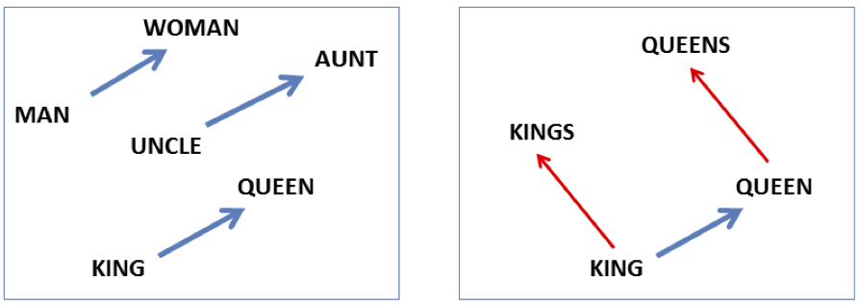

Embeddings capture relational meaning!
vector(‘king’) - vector(‘man’) + vector(‘woman’) $≈$vector(‘queen’)
vector(‘Paris’) - vector(‘France’) + vector(‘Italy’) $≈$ vector(‘Rome’)

Slide 96
Next Time
One more lecture on Thurs ….. Brief intro to pragmatics
Next Tue: project proposals . Look at project work plan. 5 mins each. May need to stay past 3:30. If you need to addend another class you can present first…
Assignment 3
(will be on Connect by tomorrow)

Slide 98
Vector Semantics
Brown clustering

Slide 99
Brown clustering
An agglomerative clustering algorithm that clusters words based on which words precede or follow them
These word clusters can be turned into a kind of vector
We’ll give a very brief sketch here.

Slide 100
Brown clustering algorithm
Each word is initially assigned to its own cluster.
We now consider consider merging each pair of clusters. Highest quality merge is chosen.
  Quality = merges two words that have similar probabilities of preceding and following words
  (More technically quality = smallest decrease in the likelihood of the corpus according to a class-based language model)
Clustering proceeds until all words are in one big cluster.

Slide 101
Brown Clusters as vectors
By tracing the order in which clusters are merged, the model builds a binary tree from bottom to top.
Each word represented by binary string = path from root to leaf
Each intermediate node is a cluster
Chairman is 0010, “months” = 01, and verbs = 1

Slide 102
Brown cluster examples

Slide 103
Class-based language model
Suppose each word was in some class c_{i:}

Slide 104
Vector Semantics
Evaluating similarity

Slide 105
Evaluating similarity
Extrinsic (task-based, end-to-end) Evaluation:
  Question Answering
  Spell Checking
  Essay grading
Intrinsic Evaluation:
  Correlation between algorithm and human word similarity ratings
    Wordsim353: 353 noun pairs rated 0-10. sim(plane,car)=5.77
  Taking TOEFL multiple-choice vocabulary tests
    Levied is closest in meaning to:
    imposed, believed, requested, correlated

Slide 106
Summary
Distributional (vector) models of meaning
  Sparse (PPMI-weighted word-word co-occurrence matrices)
  Dense:
    Word-word SVD 50-2000 dimensions
    Skip-grams and CBOW
    Brown clusters 5-20 binary dimensions.

