Slide 1
CPSC 503
Computational Linguistics
Lecture 9
Giuseppe Carenini

Slide 2
Today Feb 5
Finish PCFG and Stat. Parsing

Slide 3
Probabilistic Parsing:
  Slight modification to dynamic programming approach
  (Restricted) Task is to find the max probability tree for an input
Notes:
We will look at a solution to a restricted version of the general problem of finding all
possible parses of a sentence and their corresponding probabilities

Slide 4
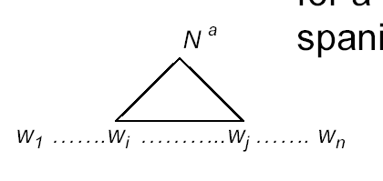
Probabilistic CYK Algorithm
Ney, 1991 Collins, 1999
CYK (Cocke-Younger-Kasami) algorithm
  A bottom-up parser using dynamic programming
  Assume the PCFG is in Chomsky normal form (CNF)
Definitions
  w₁… w_{n} an input string composed of n words
  w_{ij} a string of words from word i to word j
  µ[i, j, A] : a table entry holds the maximum probability for a constituent with non-terminal A spanning words w_{i}…w_{j}
A
Notes:
First described by Ney, but the version we are seeing here is adapted from Collins

Slide 5
CYK: Base Case
Fill out the table entries by induction: Base case
  Consider the input strings of length one (i.e., each individual word w_{i}) P(A → w_{i})
  Since the grammar is in CNF: A *⇒ w_{i} iff A → w_{i}
  So µ[i, i, A] = P(A → w_{i})
“Can₁ you₂ book₃ TWA₄ flights₅ ?”
Aux
Noun
1
.4
……
.5
5
1
5

Slide 6
CYK: Recursive Case
Recursive case
  For strings of words of length = 2,
  A *⇒ w_{ij} iff there is at least one rule A → BC
  where B derives the first k words (between i and i-1 +k ) and C derives the remaining ones (between i+k and j)
A
  µ[i, j, A] = µ [i, i-1 +k, B] *
  µ [i+k, j, C ] *
  P(A → BC)
B
C
i
i-1+k
i+k
j
  (for each non-terminal)Choose the max among all possibilities
Notes:
Compute the probability by multiplying together the probabilities of these two pieces (note that they have been calculated in the recursion)
2<= k <= j – i - 1

Slide 7
CYK: Termination
  The max prob parse will be µ [ ]
“Can₁ you₂ book₃ TWA₄ flight₅ ?”
5
S
1
1.7x10⁻⁶
5
Notes:
Any other filler for this matrix?
1,3 and 1,4 and 3,5 !

Slide 8
Acquiring Grammars and Probabilities
Manually parsed text corpora (e.g., PennTreebank)
Grammar: read it off the parse trees
Ex: if an NP contains an ART, ADJ, and NOUN then we create the rule NP -> ART ADJ NOUN.
Probabilities:
Ex: if the NP -> ART ADJ NOUN rule is used 50 times and all NP rules are used 5000 times, then the rule’s probability is …
Notes:
We can create a PCFG automatically by exploiting manually parsed text corpora, such as the Penn Treebank. We can read off them grammar found in the treebank.
Probabilities: can be assigned by counting how often each item is found in the treebank
Ex: if the NP -> ART ADJ NOUN rule is used 50 times and all NP rules are used 5000 times, then the rule’s probability is 50/5000 = .01

Slide 9
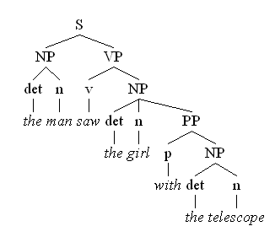
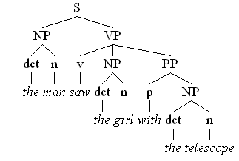
Un-supervised PCFG Learning
Take a large collection of text and parse it
If sentences were unambiguous: count rules in each parse and then normalize
But most sentences are ambiguous: weight each partial count by the prob. of the parse tree it appears in (?!)
Notes:
What if you don’t have a treebank (and can’t get one)

Slide 10
Non-supervised PCFG Learning
Start with equal rule probs and keep revising them iteratively
Parse the sentences
Compute probs of each parse
Use probs to weight the counts
Reestimate the rule probs
Inside-Outside algorithm
(generalization of forward-backward algorithm)
Notes:
What if you don’t have a treebank (and can’t get one)
Grammar Induction: even more challenging – learn rules and probabilities.

Slide 11
Problems with PCFGs
Most current PCFG models are not vanilla PCFGs
  Usually augmented in some way
Vanilla PCFGs assume independence of non-terminal expansions
But statistical analysis shows this is not a valid assumption
  Structural and lexical dependencies
Notes:
Probabilities for NP expansions do not depend on context.

Slide 12
Structural Dependencies: Problem
E.g. Syntactic subject of a sentence tends to be a pronoun
  Subject tends to realize the topic of a sentence
  Topic is usually old information
  Pronouns are usually used to refer to old information
  So subject tends to be a pronoun
  In Switchboard corpus:
Notes:
I do not get good estimates for the pro
Parent annotation technique
91% of subjects in declarative sentences are pronouns
66% of direct objects are lexical (nonpronominal)
(i.e., only 34% are pronouns)

Slide 13
Structural Dependencies: Solution
Split non-terminal. E.g., NPsubject and NPobject
Parent Annotation:
Hand-write rules for more complex struct. dependencies
Splitting problems?
  Automatic/Optimal split – Split and Merge algorithm [Petrov et al. 2006- COLING/ACL]
Notes:
I do not get good estimates for the pro
Parent annotation technique
Splitting problems
- Increase size of the grammar -> reduces amount of training data for each rule -> leads to overfitting

Slide 14
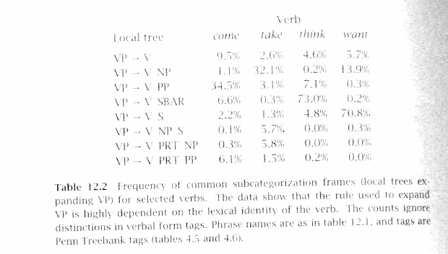
Lexical Dependencies: Problem
(b)
Notes:
The verb send subcategorises for a destination, which could be a PP headed by “into”

Slide 15
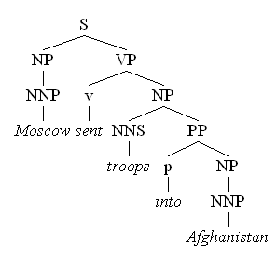
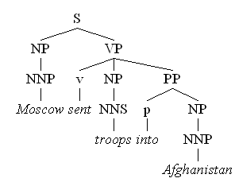
Lexical Dependencies: Problem
Two parse trees for the sentence
“Moscow sent troops into Afghanistan”
(b)
(a)
VP-attachment
NP-attachment
Typically NP-attachment more frequent than VP-attachment
Notes:
The verb send subcategorises for a destination, which could be a PP headed by “into”

Slide 16
Lexical Dependencies: Solution
Add lexical dependencies to the scheme…
  Infiltrate the influence of particular words into the probabilities in the derivation
  I.e. Condition on the actual words in the right way
All the words?
(a)
  P(VP -> V NP PP | VP = “sent troops into Afg.”)
  P(VP -> V NP | VP = “sent troops into Afg.”)
(b)
Notes:
No only the key ones

Slide 17
Heads
To do that we’re going to make use of the notion of the head of a phrase
  The head of an NP is its noun
  The head of a VP is its verb
  The head of a PP is its preposition
Notes:
(but for other phrases can be more complicated and somewhat controversial)
Should the complementizer TO or the verb be the head of an infinite VP?
Most linguistic theories of syntax of syntax generally include a component that defines heads.

Slide 18
More specific rules
We used to have rule r
  VP -> V NP PP P(r|VP)
    That’s the count of this rule divided by the number of VPs in a treebank
Now we have rule r
  VP(h(VP))-> V(h(VP)) NP(h(NP)) PP(h(PP))
  P(r|VP, h(VP), h(NP), h(PP))
Sample sentence:
“Workers dumped sacks into the bin”
  VP(dumped)-> V(dumped) NP(sacks) PP(into)
  P(r|VP, dumped is the verb, sacks is the head of the NP, into is the head of the PP)
Notes:
Also associate the head tag e.g.,
NP(sacks,NNS) where NNS is noun, plural

Slide 19
Example (right)
(Collins 1999)
Attribute grammar: each non-terminal is annotated with its lexical head… many more rules!
Notes:
Each non-terminal is annotated with a single word which is its lexical head
A CFG with a lot more rules!

Slide 20
Example (wrong)

Slide 21
Problem with more specific rules
Rule:
  VP(dumped)-> V(dumped) NP(sacks) PP(into)
  P(r|VP, dumped is the verb, sacks is the head of the NP, into is the head of the PP)
Not likely to have significant counts in any treebank!
Notes:
Count of times this rule appears in corpus divided by timed VP(dumped) is decomposed

Slide 22
Usual trick: Assume Independence
When stuck, exploit independence and collect the statistics you can…
We’ll focus on capturing two aspects:
  Verb subcategorization
    Particular verbs have affinities for particular VP expansions
  Phrase-heads affinities for their predicates (mostly their mothers and grandmothers)
    Some phrase/heads fit better with some predicates than others

Slide 23
Subcategorization
Condition particular VP rules only on their head… so
  r: VP(h(VP))-> V(h(VP)) NP(h(NP)) PP(h(PP))
  P(r|VP, h(VP), h(NP), h(PP))
  Becomes
  P(r | VP, h(VP)) x ……
  e.g., P(r | VP, dumped)
  What’s the count?
  How many times was this rule used with dumped, divided by the number of VPs that dumped appears in total
Notes:
First step
Now we have rule r
VP(h(VP))-> V(h(VP)) NP(h(NP)) PP(h(PP))
P(r|VP, h(VP), h(NP), h(PP))

Slide 24
Phrase/heads affinities for their Predicates
  r: VP -> V NP PP ; P(r|VP, h(VP), h(NP), h(PP))
  Becomes
  P(r | VP, h(VP)) x
  P(h(NP) | NP, h(VP))) x P(h(PP) | PP, h(VP)))
  E.g. P(r | VP,dumped) x
  P(sacks | NP, dumped)) x P(into | PP, dumped))
count the places where dumped is the head of a constituent that has a PP daughter with into as its head and normalize
Notes:
Normalize = divide by the count of the places where dumped is the head of a constituent that has a PP daughter

Slide 25
Example (right)
  P(VP -> V NP PP | VP, dumped) =.67
  P(into | PP, dumped)=.22
Notes:
The issue here is the attachment of the PP. So the affinities we care about are the ones between:
dumped and into
vs. sacks and into.
So count the places where dumped is the head of a constituent that has a PP daughter with into as its head and normalize
Vs. the situation where sacks is a constituent with into as the head of a PP daughter

Slide 26
Example (wrong)
  P(VP -> V NP | VP, dumped)=..
P(into | PP, sacks)=..
Notes:
Prob “dumped” without destination
Prob of “sacks” modified by into (the sacks into the bin stinks)

Slide 27
Today Feb 5
Finish PCFG and Stat. Parsing
Start Semantics

Slide 28
Next Time
Assignment-2 due!
You need to have some ideas about your project topic. Check Slides from last week. Look at the course Webepage
More Semantics
  Assuming you know First Order Logics (FOL)
  Read Chp. 17 (17.4 – 17.5)
  Read Chp. 18.1-2-3 and 18.5

