Slide 1
CPSC 503 Computational Linguistics
Lecture 6
Giuseppe Carenini

Slide 2
Knowledge-Formalisms Map
State Machines (and prob. versions)
(Finite State Automata,Finite State Transducers, Markov Models)
Morphology
Syntax
Rule systems (and prob. versions)
(e.g., (Prob.) Context-Free Grammars)
Semantics
Pragmatics
Discourse and Dialogue
Logical formalisms
(First-Order Logics)
AI planners
Markov Chains -> n-grams
Markov Models
Hidden Markov Models (HMM)
MaxEntropy Markov Models (MEMM)
Notes:
My Conceptual map - This is the master plan
Markov Models used for part-of-speech and dialog
Syntax is the study of formal relationship between words
How words are clustered into classes (that determine how they group and behave)
How they group with they neighbors into phrases

Slide 3
Today Jan 24
Part-of-speech tagging
Start Syntax…

Slide 4
Parts of Speech Tagging: What
Input
Brainpower, not physical plant, is now a firm's chief asset.
Output
Brainpower_NN ,_, not_RB physical_JJ plant_NN ,_, is_VBZ now_RB a_DT firm_NN 's_POS chief_JJ asset_NN ._.
Tag meanings
NNP (Proper N sing), RB (Adv), JJ (Adj), NN (N sing. or mass), VBZ (V 3sg pres), DT (Determiner), POS (Possessive ending), . (sentence-final punct)
Notes:
Penn Treebank part-of-speech tags (including punctuation)

Slide 5
Parts of Speech Summary
Eight basic categories…
Closed vs. Open class
POS distribution
Tagsets …..
Notes:
Most words have one part of speech of the rest, most have two
From there it’s about what you’d expect
A small number of words have lots of parts of speech
Unfortunately, the words with lots of parts of speech occur with high frequency
in: adv contrasted with out, prep eg of time ,N the ins and outs
a (det vs. letter) still ( N apparatus for making liquor, still Adv)
Most nouns can be used as verbs “to oil the pan”

Slide 6
Sets of Parts of Speech:Tagsets
Most commonly used:
45-tag Penn Treebank,
61-tag C5,
146-tag C7
The choice of tagset is based on the application (do you care about distinguishing between “to” as a prep and “to” as a infinitive marker?)
Accurate tagging can be done with even large tagsets
Notes:
There are various standard tagsets to choose from; some have a lot more tags than others
(C5 and C7 in Appendix C of textbook) (most are evolutions of the brown corpus 87-tagset 1982)
The choice of tagset is based on the application
Accurate tagging can be done with even large tagsets

Slide 7
PoS Tagging
Input text
Brainpower, not physical plant, is now a firm's chief asset. …………
Dictionary
word_{i} -> set of tags from Tagset with prob. dist
Tagger
Output
Brainpower_NN ,_, not_RB physical_JJ plant_NN ,_, is_VBZ now_RB a_DT firm_NN 's_POS chief_JJ asset_NN ._. ……….
Notes:
Def: Part of speech tagging is the process of assigning parts of speech to each word in a sentence… Assume we have
A tagset
A dictionary that gives you the possible set of tags for each entry

Slide 8
Tagger Types
Rule-based ‘95
Stochastic
HMM tagger ~ >= ’92
Transformation-based tagger (Brill) ~ >= ’95
MEMM (Maximum Entropy Markov Models)
~ >= ’97 (if interested sec. 6.6-6.8)
- More later
Notes:
Current work, using POS tagging to find phrases

Slide 9
Rule-Based (ENGTWOL ‘95)
A lexicon transducer returns for each word all possible morphological parses
A set of ~3,000 constraints is applied to rule out inappropriate PoS
Step 1: sample I/O
Sample Constraint
“Pavlov had show that salivation….”
Example: Adverbial “that” rule Given input: “that” If (+1 A/ADV/QUANT) (+2 SENT-LIM) (NOT -1 SVOC/A) Then eliminate non-ADV tags Else eliminate ADV
Pavlov N SG PROPER
had HAVE V PAST SVO
HAVE PCP2 SVO
shown SHOW PCP2 SVOO ……
that ADV
PRON DEM SG
CS
……..
…….
Notes:
PCP2 past participle
That adv: it isn’t that odd
CS = complementaized
Constraints are used to eliminate tags inconsistent with the context
Simplified version of constraint
If following word is an adj/adv/quant and it is followed by an end of sentence
And the preceding word is not a verb like consider and believe
Which allow adj as object complements like in “I consider that odd”

Slide 10
HMM Stochastic Tagging
Tags corresponds to an HMM states
Words correspond to the HMM alphabet symbols
Tagging: given a sequence of words (observations), find the most likely sequence of tags (states)
But this is…..!
We need: State transition and symbol emission probabilities
1) From hand-tagged corpus
2) No tagged corpus: parameter estimation (forward/backward aka Baum-Welch)
Notes:
Two reasons: what to do about context words that are ambiguous and, this way, since there are a lot fewer tags than words, counts are high enough to be meaningful.
EM. These taggers will start with a dictionary that lists which tags can be assigned to each word

Slide 11
Evaluating Taggers
Accuracy: percent correct (most current taggers 96-7%) *test on unseen data!*
Human Celing: agreement rate of humans on classification (96-7%)
Unigram baseline: assign each token to the class it occurred in most frequently in the training set (race -> NN). (91%)
What is causing the errors? Build a confusion matrix…
Notes:
How good is the algorithm?
What’s the maximum performance we have any reason to believe is achievable? (How well can people do?)
How good is good enough?
Is 97% good enough?
Example 1: A speech dialogue system correctly assigns a meaning to a user’s input 97% of the time.
Example 2: An OCR systems correctly determines letters 97% of the time.

Slide 12
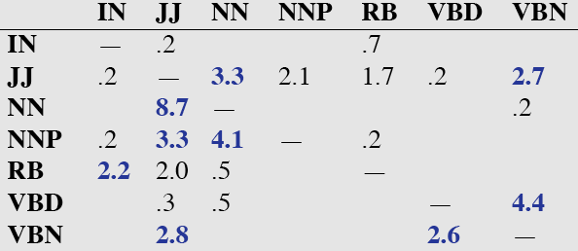
Confusion matrix
Precision ?
Recall ?

Slide 13
Error Analysis (textbook)
Look at a confusion matrix
See what errors are causing problems
Noun (NN) vs ProperNoun (NNP) vs Adj (JJ)
Past tense (VBD) vs Past Participle (VBN)

Slide 14
POS tagging state of the art + tools
Stanford Tagger: Maximum entropy cyclic dependency network – Java - 97.24%
Toutanova and Manning. 2000. Enriching the Knowledge Sources Used in a Maximum Entropy Part-of-Speech Tagger (EMNLP/VLC-2000),
Toutanova, Klein, Manning, and Singer. 2003. Feature-Rich Part-of-Speech Tagging with a Cyclic Dependency Network. HLT-NAACL 2003,
Semisup Neighbor - Python – 97.50%
Anders. 2011. Semi-supervised condensed nearest neighbor for part-of-speech tagging. (ACL-HLT).
“state of the art POS tagging “ link on course webpage
Notes:
We present a new part-of-speech tagger that
demonstrates the following ideas: (i) explicit use of both preceding and following tag contexts
via a dependency network representation, (ii) broad use of lexical features, including
jointly conditioning on multiple consecutive words, (iii) effective use of priors in conditional
loglinear models, and (iv) fine-grained modeling of unknown word features. Using these ideas together, the resulting tagger gives a 97.24%accuracy on the Penn TreebankWSJ, an error reduction of 4.4% on the best previous single automatically learned tagging result.
The labeled data points are the model. Consequently,
classification time is proportional to the
number of labeled data points. This is of course impractical.
Many algorithms have been proposed to
make memory-based learning more efficient. The
intuition behind many of them is that the set of labeled
data points can be reduced or condensed, since
many labeled data points are more or less redundant.
The algorithms try to extract a subset of the overall
training set that correctly classifies all the discarded
data points through the nearest neighbor rule. Intuitively,
the model finds good representatives of clusters
in the data or discards the data points that are far
from the decision boundaries. Such algorithms are
called training set condensation algorithms.
The need for training set condensation is particularly
important in semi-supervised learning where
we rely on a mixture of labeled and unlabeled data
points. While the number of labeled data points
is typically limited, the number of unlabeled data
points is typically high. In this paper, we introduce
a new semi-supervised learning algorithm that
combines self-training and condensation to produce
small subsets of labeled and unlabeled data points
that are highly relevant for determining good decision boundaries

Slide 15
Knowledge-Formalisms Map (next three lectures)
State Machines (and prob. versions)
(Finite State Automata,Finite State Transducers, Markov Models)
Morphology
Syntax
Rule systems (and prob. versions)
(e.g., (Prob.) Context-Free Grammars)
Semantics
Pragmatics
Discourse and Dialogue
Logical formalisms
(First-Order Logics)
AI planners
Notes:
My Conceptual map - This is the master plan
Markov Models used for part-of-speech and dialog
Syntax is the study of formal relationship between words
How words are clustered into classes (that determine how they group and behave)
How they group with they neighbors into phrases

Slide 16
Today Jan 24
POS tagging
Start Syntax
English Syntax
Context-Free Grammar for English
Rules
Trees
Recursion
Problems

Slide 17
Syntax
Def. The study of how sentences are formed by grouping and ordering words
Example:
Ming and Sue prefer morning flights
* Ming Sue flights morning and prefer
Groups behave as single unit wrt Substitution, Movement, Coordination
Notes:
Sentence formation how symbols of the language can be grouped and ordered together
Part of speech: whether a word is a noun, verb or an adjective
Based on Meaning/Inflection/Distribution
An Adjective is a word that can fill the blank in:
It’s so __________.
A Noun is a word that can be marked as plural.
A Noun is a word that can fill the blank in:
the __________ is
What is green?
It’s so green.
Both greens could work for the walls.
The green is a little much given the red rug.
Constituency: groups of words behave as a single unit or
Based on:
<Substitution Test (they, it, do so)>
<Movement Test>
<Coordination Test>
Words/phrases order (English SVO)

Slide 18
Syntax: Useful tasks
Why should you care?
Grammar checkers
Basis for semantic interpretation
Question answering
Information extraction
Summarization
Machine translation
……

Slide 19
Key Constituents – with heads (English)
(Specifier) X (Complement)
Noun phrases
Verb phrases
Prepositional phrases
Adjective phrases
Sentences
(Det) N (PP)
(Qual) V (NP)
(Deg) P (NP)
(Deg) A (PP)
(NP) (I) (VP)
Some simple specifiers
Category Typical function Examples
Determiner specifier of N the, a, this, no..
Qualifier specifier of V never, often..
Degree word specifier of A or P very, almost..
Complements?
Notes:
All group/phrases share the same structure!
Sequence of words surrounding at least one noun
They appear in similar “environments” Before a verb
Substitution for PP location :“there”
Specifiers much more complex in general
There are also Adjuncts: Adjuncts are head modifiers which may be added infinitely. For example, there is no limit on the number of adjectives which may be added to a noun: the big long red gruesome . . . limosine. The same is true of adverbs: Tweeky ran quickly, surreptitiously, . . . and unsuspectingly into Lance's arms.
The adjunct phrase is an X' node which contains an X' node. This allows for infinite recursivity, which distinguishes adjuncts from specifiers and complements.

Slide 20
Key Constituents: Examples
Noun phrases
Verb phrases
Prepositional phrases
Adjective phrases
Sentences
(Det) N (PP)
the cat on the table
(Qual) V (NP)
never eat a cat
(Deg) P (NP)
almost in the net
(Deg) A (PP)
very happy about it
(NP) (I) (VP)
a mouse -- ate it
Notes:
Sequence of words surrounding at least one noun
They appear in similar “environments” Before a verb
Substitution for PP location :“there”

Slide 21
Context Free Grammar (Example)
Start-symbol
S -> NP VP
NP -> Det NOMINAL
NOMINAL -> Noun
VP -> Verb
Det -> a
Noun -> flight
Verb -> left
Non-terminal
Terminal
Notes:
CFG are the backbone of many models of syntax
Powerful enough to express sophisticated relations among the words in a sentence
Parsing is computationally tractable
A CFG consist of a set of productions or rules
Each rule how symbol in the language can be grouped and ordered together
Terminal correspond to “words” in the language

Slide 22
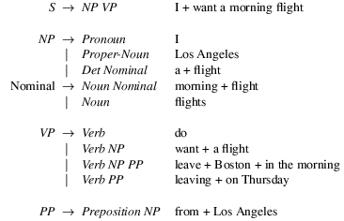
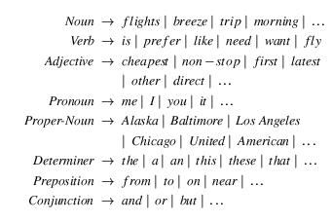
CFG more complex Example
Grammar with example phrases
Lexicon
Notes:
A CFG consist of a set of productions or rules
Each rule how symbol in the language can be grouped and ordered together
Terminal correspond to “words” in the language
S -> NP VP
says
that there are units called S, NP, and VP in this language
that an S consists of an NP followed immediately by a VP
but does not say
that that’s the only kind of S
that this is the only place that NPs and VPs occur

Slide 23
CFGs
Define a Formal Language (un/grammatical sentences)
Generative Formalism
Generate strings in the language
Reject strings not in the language
Impose structures (trees) on strings in the language
Notes:
As with FSAs and FSTs you can view these rules as either analysis or synthesis machines

Slide 24
CFG: Formal Definitions
4-tuple (non-term., term., productions, start)
(N, ∑, P, S)
P is a set of rules A→α; A∈N, α∈(∑∪N)*
A derivation is the process of rewriting α₁ into α _{m} (both strings in (∑∪N)*) by applying a sequence of rules: α₁ ⇒* α _{m}
L _{G} = W|w∈∑* and S ⇒* w

Slide 25
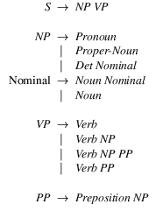
Derivations as Trees
Nominal
Nominal
flight
Context Free?
Notes:
Slight mismatch between grammar and derivation tree ☺
The notion of context in CFGs has nothing to do with the ordinary meaning of the word context in language.
All it really means is that the non-terminal on the left-hand side of a rule is out there all by itself
A -> B C
Means that I can rewrite an A as a B followed by a C regardless of the context in which A is found

Slide 26
CFG Parsing
I prefer a morning flight
Nominal
Parser
Nominal
flight
It is completely analogous to running a finite-state transducer with a tape
It’s just more powerful
Chpt. 13
Notes:
Parsing is the process of taking a sentence and a CFG and returning a (many?) parse tree(s) for that sentence

Slide 27
Other Options
Regular languages (FSA) A→ xB or A→ x
Too weak (e.g., cannot deal with recursion in a general way – no center-embedding)
CFGs A→ γ (also produce more understandable and “useful” structure)
Context-sensitive αAβ→ αγβ; γ≠ε
Can be computationally intractable
Turing equiv. α→β; α≠ε
Too powerful / Computationally intractable
Notes:
0 no restriction (but left side cannot be the empty string)
TAGs are context sensitive
A single non-terminal
α γ β any sequence of terminal and non-terminal
x any sequence of terminal
For many practical purposes a finite state approx of the underlying CFG is adequate.

Slide 28
Common Sentence-Types
Declaratives: A plane left
S -> NP VP
Imperatives: Leave!
S -> VP
Yes-No Questions: Did the plane leave?
S -> Aux NP VP
WH Questions:
Which flights serve breakfast?
S -> WH NP VP
When did the plane leave?
S -> WH Aux NP VP

Slide 29
NP: more details
NP -> Specifiers N Complements
NP -> (Predet)(Det)(Card)(Ord)(Quant) (AP) Nom
e.g., all the other cheap cars
Nom -> Nom PP (PP) (PP)
e.g., reservation on BA456 from NY to YVR
Nom -> Nom GerundVP
e.g., flight arriving on Monday
Nom -> Nom RelClause
Nom RelClause ->(who | that) VP
e.g., flight that arrives in the evening
Notes:
Quant : many, few, several

Slide 30
Conjunctive Constructions
S -> S and S
John went to NY and Mary followed him
NP -> NP and NP
John went to NY and Boston
VP -> VP and VP
John went to NY and visited MOMA
…
In fact the right rule for English is
X -> X and X

Slide 31
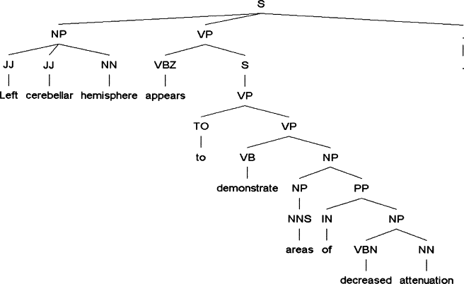
Journal of the American Medical Informatics Association, 2005, Improved Identification of Noun Phrases in Clinical Radiology Reports ….
Notes:
Journal of the American Medical Informatics Association
Volume 12, Issue 3, May–June 2005, Pages 275–285
The Practice of Informatics
Improved Identification of Noun Phrases in Clinical Radiology Reports Using a High-Performance Statistical Natural Language Parser Augmented with the UMLS Specialist Lexicon
Yang Huang, MS, ,
Henry J. Lowe, MD,
Dan Klein, PhD,
Russell J. Cucina, MD, MS
Affiliations of the authors: Stanford Medical Informatics and Stanford Center for Clinical Informatics, Stanford University School of Medicine, Stanford, CA (YH, HJL); Computer Science Division, University of California at Berkeley, Berkeley, CA (DK); Department of Medicine, University of California, San Francisco, San Francisco, CA (RJC)

Slide 32
Problems with CFGs
Agreement
Subcategorization

Slide 33
Agreement
In English,
Determiners and nouns have to agree in number
Subjects and verbs have to agree in person and number
Many languages have agreement systems that are far more complex than this (e.g., gender).

Slide 34
Agreement
This dog
Those dogs
This dog eats
You have it
Those dogs eat
*This dogs
*Those dog
*This dog eat
*You has it
*Those dogs eats
Notes:
Number
person

Slide 35
Possible CFG Solution
OLD Grammar
NEW Grammar
S -> NP VP
NP -> Det Nom
VP -> V NP
…
SgS -> SgNP SgVP
PlS -> PlNp PlVP
SgNP -> SgDet SgNom
PlNP -> PlDet PlNom
PlVP -> PlV NP
SgVP3p ->SgV3p NP
…
Sg = singular
Pl = plural

Slide 36
CFG Solution for Agreement
It works and stays within the power of CFGs
But it doesn’t scale all that well (explosion in the number of rules)

Slide 37
Subcategorization
Def. It expresses constraints that a predicate (verb here) places on the number and type of its arguments (see first table)
*John sneezed the book
*I prefer United has a flight
*Give with a flight
Notes:
It turns out that verb subcategorization facts will provide a key element for semantic analysis
(determining who did what to who in an event).

Slide 38
Subcategorization
Sneeze: John sneezed
Find: Please find [a flight to NY]_{NP}
Give: Give [me]_{NP}[a cheaper fare]_{NP}
Help: Can you help [me]_{NP}[with a flight]_{PP}
Prefer: I prefer [to leave earlier]_{TO-VP}
Told: I was told [United has a flight]_{S}
…

Slide 39
So?
So the various rules for VPs overgenerate.
They allow strings containing verbs and arguments that don’t go together
For example:
VP -> V NP therefore Sneezed the book
VP -> V S therefore go she will go there

Slide 40
Possible CFG Solution
OLD Grammar
NEW Grammar
VP -> IntransV
VP -> TransV NP
VP -> TransPP_{to} NP PP_{to}
…
TransPP_{to} -> hand,give,..
VP -> V
VP -> V NP
VP -> V NP PP
…
This solution has the same problem as the one for agreement

Slide 41
CFG for NLP: summary
CFGs cover most syntactic structure in English.
But there are problems (over-generation)
That can be dealt with adequately, although not elegantly, by staying within the CFG framework.
Many practical computational grammars simply rely on CFG
For more elegant / concise approaches see Chpt 15 “Features and Unification”
Notes:
CFGs appear to be just about what we need to account for a lot of basic syntactic structure in English.
But there are problems
That can be dealt with adequately, although not elegantly, by staying within the CFG framework.
There are simpler, more elegant, solutions that take us out of the CFG framework (beyond its formal power)
LFG, HPSG, Construction grammar, XTAG, etc.
Chapter 15 explores the unification approach in more detail

Slide 42
Dependency Grammars
Syntactic structure: binary relations between words
Links: grammatical function or very general semantic relation
Abstract away from word-order variations (simpler grammars)
Useful features in many NLP applications (for classification, summarization and NLG)

Slide 43
Next Time
Read Chapter 12 (syntax & Context Free Grammars)
Start Parsing (Chp. 13)

