Slide 1
CPSC 503 Computational Linguistics
Lecture 5
Giuseppe Carenini

Slide 2
Today Jan 22
Finish Language Model + evaluation
Markov Models
POS tagging

Slide 3
Impossible to estimate!
N-Grams Summary: final
Sample space much bigger than any realistic corpus ☹
Chain rule does not help ☹
Markov assumption ☺:
Unigram… sample space?
Bigram … sample space?
Trigram … sample space?
Sparse matrix: Smoothing techniques
Look at practical issues: sec. 4.8
Notes:
Most sentences/sequences will not appear or appear only once ☹
At least your corpus should be >> than your sample space

Slide 4
You still need a big corpus…
The biggest one is the Web!
Impractical to download every page from the Web to count the ngrams =>
Rely on page counts (which are only approximations)
Page can contain an ngram multiple times
Search Engines round-off their counts
Such “noise” is tolerable in practice ☺
Notes:
Google language model
Update (22 Sept. 2006): The LDC now has the data available in their catalog. The counts are as follows: File sizes: approx. 24 GB compressed (gzip'ed) text files Number of tokens: 1,024,908,267,229 Number of sentences: 95,119,665,584 Number of unigrams: 13,588,391 Number of bigrams: 314,843,401 Number of trigrams: 977,069,902 Number of fourgrams: 1,313,818,354

Slide 5
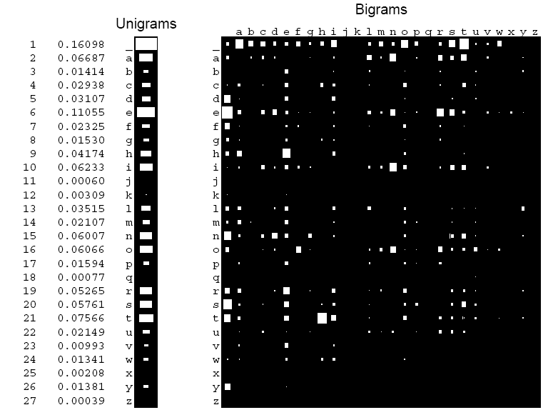
(character) Unigram and bigram counts from “the Origin of Species”
K Murphy 2011, based on (MacKay 2003)

Slide 6
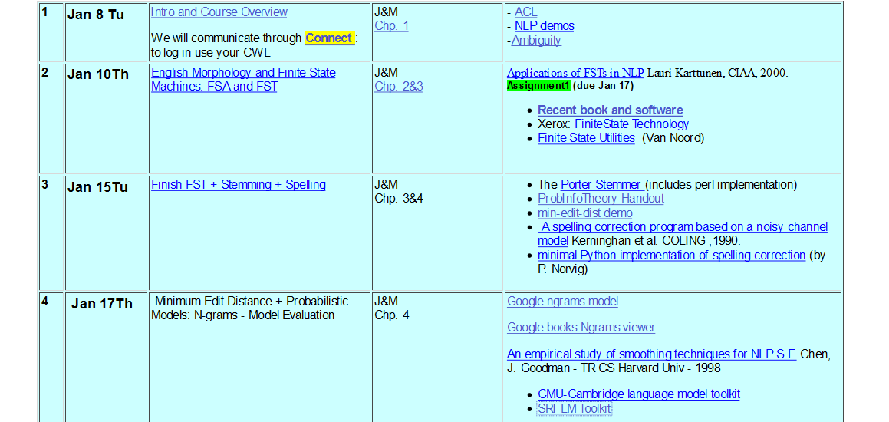

Slide 7
Model Evaluation: Goal
You may want to compare:
2-grams with 3-grams
two different smoothing techniques (given the same n-grams)
On a given corpus…
Notes:
Def. The relative entropy is a measure of how different two probability distributions (over the same event space) are.
average number of bits wasted by encoding events from a distribution p with distribution q.
I(X,Y) = D(p(x,y)||p(x)p(y))

Slide 8
Model Evaluation: Key Ideas
Corpus
A:split
Training Set
Testing set
B: train models
C:Apply models
counting
frequencies
smoothing
Compare results
Models: Q₁ and Q₂
Notes:
Def. The relative entropy is a measure of how different two probability distributions (over the same event space) are.
average number of bits wasted by encoding events from a distribution p with distribution q.
I(X,Y) = D(p(x,y)||p(x)p(y))

Slide 9
On what metric would you compare Q₁ and Q₂ ?
Notes:
Def. The relative entropy is a measure of how different two probability distributions (over the same event space) are.
average number of bits wasted by encoding events from a distribution p with distribution q.
I(X,Y) = D(p(x,y)||p(x)p(y))

Slide 10
Entropy
Def1. Measure of uncertainty
Def2. Measure of the information that we need to resolve an uncertain situation
Let p(x)=P(X=x); where x ∈ X.
H(p)= H(X)= - Σ_{x∈X} p(x)log₂p(x)
It is normally measured in bits.
Notes:
X not limited to numbers ranges over a set of basic elements
Can be words part-of-speech

Slide 11
Model Evaluation
Actual distribution
How different?
Our approximation
Relative Entropy (KL divergence) ?
D(p||q)= Σ_{x∈X} p(x)log(p(x)/q(x))
Notes:
Def. The relative entropy is a non-symmetric measure of how different two probability distributions (over the same event space) are. average number of bits wasted by encoding events from a distribution p with distribution q.
I(X,Y) = D(p(x,y)||p(x)p(y))
0*log0/q=0; p*logp/0=inf.
P ¼ ¾
Q ½ ½
Distance (¼ * log ¼ / ½) + ( ¾ * log ¾ / ½) (log 3/2 = ~0.6)
is a non-symmetric measure of the difference between two probability distributions P and Q. KL measures the expected number of extra bits required to code samples from P when using a code based on Q, rather than using a code based on P. Typically P represents the "true" distribution of data, observations, or a precise calculated theoretical distribution. The measure Q typically represents a theory, model, description, or approximation of P.

Slide 12
Entropy of
Entropy rate
Language Entropy
Shannon-McMillan-Breiman
Assumptions:
ergodic and stationary
NL?
Entropy can be computed by taking the average log probability of a looooong sample
Notes:
… without summing up over all possible sequences
Let’s try to find an alternative measure
Shannon-McMillan-Breiman theorem
Ergotic process: for each state there is a non-zero probability to end up in any other state
Stationary probability distributions on words/sequences-of-words are time invariant
(for bigram if it depends only from previous word at time t
it will depend only on previous word at any other future time)
Assumptions: language is generated by a stationary and ergodic process
NL is not stationary the probability of upcoming words can be dependent on events
that were arbitrary distant and time dependent – new expressions regularly enter the language
While other die out… but if we take a snapshot of text from a certain period it may be
a good approximation

Slide 13
Cross-Entropy
Between probability distribution P and another distribution Q (model for P)
Applied to Language
Between two models Q₁ and Q₂ the more accurate is the one with higher =>lower cross-entropy => lower
Notes:
We could not use the kl divergence (relative entropy)
But we’ll see that we can use a related measure of distance called cross-entropy
The bigger the probability Q w(n,1) the smaller the cross entropy

Slide 14
Model Evaluation: In practice
Corpus
A:split
Training Set
Testing set
B: train models
C:Apply models
counting
frequencies
smoothing
Compare cross-perplexities
Models: Q₁ and Q₂
Notes:
Def. The relative entropy is a measure of how different two probability distributions (over the same event space) are.
average number of bits wasted by encoding events from a distribution p with distribution q.
I(X,Y) = D(p(x,y)||p(x)p(y))

Slide 15
k-fold cross validation and t-test
Randomly divide the corpus in k subsets of equal size
Use each for testing (all the other for training)
In practice you do k times what we saw in previous slide
Now for each model you have k perplexities
Compare average models perplexities with t-test

Slide 16
Today Jan 22
Language Model evaluation
Markov Models
POS tagging

Slide 17
Example of a Markov Chain
.6
1
a
p
h
.4
.4
1
.3
.6
.3
e
1
t
i
.4
.6
.4
Start
Start

Slide 18
Markov-Chain
.6
1
h
a
.4
p
.4
1
.3
.3
.6
e
1
t
i
.4
.6
.4
t
i
p
a
h
e
Start
Start
Formal description:
t
0
.3
0
.3
.4
0
1
Stochastic Transition matrix A
i
.4
0
.6
0
0
0
p
0
0
1
0
0
0
a
0
0
.4
.6
0
0
h
0
0
0
0
0
1
e
1
0
0
0
0
0
2
Probability of initial states
t
.6
i
.4

Slide 19
Markov Assumptions
Let X=(X₁, .., X_{t}) be a sequence of random variables taking values in some finite set S={s₁, …, s_{n}}, the state space, the Markov properties are:
(a) Limited Horizon:
For all t, P(X_{t+1}|X₁, .., X_{t})=P(X _{t+1} | X_{t})
(b)Time Invariant:
For all t, P(X _{t+1} |X_{t})=P(X₂ | X₁)
i.e., the dependency does not change over time.
Notes:
(b) Means that the matrix does not change
If X possesses these properties, then X is said to be a Markov Chain

Slide 20
Markov-Chain
.6
1
h
a
.4
p
.4
1
.3
.3
.6
e
1
t
i
Probability of a sequence of states X₁ … X_{T}
.4
.6
.4
Start
Start
Example:

Slide 21
Knowledge-Formalisms Map
State Machines (and prob. versions)
(Finite State Automata,Finite State Transducers, Markov Models)
Morphology
Syntax
Rule systems (and prob. versions)
(e.g., (Prob.) Context-Free Grammars)
Semantics
Pragmatics
Discourse and Dialogue
Logical formalisms
(First-Order Logics)
AI planners
Markov Chains -> n-grams
Markov Models
Hidden Markov Models (HMM)
MaxEntropy Markov Models (MEMM)
Notes:
My Conceptual map - This is the master plan
Markov Models used for part-of-speech and dialog
Syntax is the study of formal relationship between words
How words are clustered into classes (that determine how they group and behave)
How they group with they neighbors into phrases

Slide 22
HMMs (and MEMM) intro
They are probabilistic sequence-classifier / sequence-lablers: assign a class/label to each unit in a sequence
Used extensively in NLP
Part of Speech Tagging e.g Brainpower_NN ,_, not_RB physical_JJ plant_NN ,_, is_VBZ now_RB a_DT firm_NN 's_POS chief_JJ asset_NN ._.
Partial parsing
[NP The HD box] that [NP you] [VP ordered] [PP from] [NP Shaw] [VP never arrived].
Named entity recognition
[John Smith PERSON] left [IBM Corp. ORG] last summer.
Notes:
-NNP (Proper N sing), RB (Adv), JJ (Adj), NN (N sing. or mass), VBZ (V 3sg pres), DT (Determiner), POS (Possessive ending), . (sentence-final punct

Slide 23
Hidden Markov Model (State Emission)
.6
1
a
.1
.5
b
b
.4
s₄
s₃
.4
.5
a
.5
i
.7
.6
.3
b
1
s₁
.1
i
s₂
.9
a
.4
.6
.4
Start
Start

Slide 24
Hidden Markov Model
.6
1
a
.1
.5
b
s₄
b
.4
.4
s₃
.5
a
i
.5
.7
.3
.6
b
1
s₁
.1
i
s₂
a
.4
.9
.6
.4
Start
Start
Formal Specification as five-tuple
Set of States
Output Alphabet
Initial State Probabilities
State Transition
Probabilities
Symbol Emission
Probabilities
Notes:
Why do they sum up to 1?

Slide 25
Three fundamental questions for HMMs
Decoding:
Finding the probability of an observation sequence
brute force or Forward/Backward-Algorithms
Finding the most likely state sequence
Viterbi-Algorithm
Training: find model parameters which best explain the observations
Manning/Schütze, 2000: 325
Notes:
- Given a model μ=(A, B, Π), how do we efficiently compute how likely a certain
observation is, that is, P(O| μ)
- Given the observation sequence O and a model μ, how do we choose a state sequence (X₁, …, X _{T+1})
that best explains the observations?
- Given an observation sequence O, and a space of possible models found by varying
the model parameters μ = (A, B, π), how do we find the model that best explains the observed data?

Slide 26
Computing the probability of an observation sequence O= o₁ ... o_{T}
.6
1
a
.1
.5
e.g., P(b,i | sample HMM )
b
s₄
b
.4
.4
s₃
.5
a
i
.5
X = all sequences of T states
.7
.3
.6
b
1
s₁
.1
i
s₂
a
.4
.9
.6
.4
Start
Start
Notes:
Example on sample arc emission HMM? On P(b,i)
This is simply the sum of the probability of the observation occurring according to each possible state sequence.
Direct evaluation of this expression, however, is extremely inefficient.

Slide 27
Decoding Example
s₁, s₁ = 0 ?
.6
1
a
.1
.5
s₁, s₂ = 1 * .1 * .6 * .3
b
s₄
b
.4
.4
s₃
.5
a
i
.5
……….
.7
.3
.6
b
1
s₁
.1
i
……….
s₂
a
.4
.9
s₁, s₄ = 1 * .5 * .6 * .7
.6
.4
Start
Start
s₂, s₄ = 0?
……….
Complexity☹
……….
Manning/Schütze, 2000: 327

Slide 28
The forward procedure
.6
1
a
.1
.5
b
s₄
b
.4
.4
s₃
.5
a
1. Initialization
.5
i
.7
.6
1
.3
.1
b
s₁
s₂
i
.9
a
.4
.6
.4
2. Induction
Start
Start
3. Total
Complexity☺
Notes:
In order to avoid this complexity, we can use dynamic programming or memoization techniques.
In particular, we use treillis algorithms.
We make a square array of states versus time and compute the probabilities of being at each
state at each time in terms of the probabilities for being in each state at the preceding time.
A treillis can record the probability of all initial subpaths of the HMM that end in a certain state at a certain time.
The probability of longer subpaths can then be worked out in terms of the shorter subpaths.
This algorithm requires 2N²T multiplications (much less than the direct method which takes (2T+1).N^{T+1}

Slide 29
Three fundamental questions for HMMs
Decoding:
Finding the probability of an observation sequence
brute force or Forward or Backward Algorithm
If interested in details of Backward algorithm and the next two questions, read (Sections 6.4 – 6.5)
Finding the most likely state sequence
Viterbi-Algorithm
Training: find model parameters which best explain the observations
Notes:
- Given a model μ=(A, B, Π), how do we efficiently compute how likely a certain
observation is, that is, P(O| μ)
- Given the observation sequence O and a model μ, how do we choose a state sequence (X₁, …, X _{T+1})
that best explains the observations?
- Given an observation sequence O, and a space of possible models found by varying
the model parameters μ = (A, B, π), how do we find the model that best explains the observed data?

Slide 30
Today Jan 22
…….
Hidden Markov Models:
definition
the three key problems (only one in detail)
Part-of-speech tagging
What it is, Why we need it…
Word classes (Tags)
Distribution
Tagsets
How to do it
Rule-based
Stochastic

Slide 31
Parts of Speech Tagging: What
Input
Brainpower, not physical plant, is now a firm's chief asset.
Output
Brainpower_NN ,_, not_RB physical_JJ plant_NN ,_, is_VBZ now_RB a_DT firm_NN 's_POS chief_JJ asset_NN ._.
Tag meanings
NNP (Proper N sing), RB (Adv), JJ (Adj), NN (N sing. or mass), VBZ (V 3sg pres), DT (Determiner), POS (Possessive ending), . (sentence-final punct)
Notes:
Penn Treebank part-of-speech tags (including punctuation)

Slide 32
Parts of Speech Tagging: Why?
Part-of-speech (word class, morph. class, syntactic category) gives a significant amount of info about the word and its neighbors
Useful in the following NLP tasks:
As a basis for (Partial) Parsing
Information Retrieval
Word-sense disambiguation
Speech synthesis
……
Notes:
Penn Treebank part-of-speech tags (including punctuation)
Quickly finding names or other phrases for information extraction
Select important words from documents (e.g., nouns)
I made her duck
Knowing PoS produce more natural pronunciations Object Content
Kind of recursive….
Class-based n-grams (J&M pag 112 do not work with POS)

Slide 33
Parts of Speech
Eight basic categories
Noun, verb, pronoun, preposition, adjective, adverb, article, conjunction
These categories are based on:
morphological properties (affixes they take)
distributional properties (what other words can occur nearby)
e.g, green It is so… , both…, The… is
Not semantics!
Notes:
Words that function similarly with respect to
the affixes they take
What other words can occur nearby
Only tendency towards semantic coherence
An Adjective is a word that can fill the blank in:
It’s so __________.
A Noun is a word that can be marked as plural.
A Noun is a word that can fill the blank in:
the __________ is
What is green?
It’s so green.
Both greens could work for the walls.
The green is a little much given the red rug.

Slide 34
Parts of Speech
Two kinds of category
Closed class (generally are function words)
Prepositions, articles, conjunctions, pronouns, determiners, aux, numerals
Open class
Nouns (proper/common; mass/count), verbs, adjectives, adverbs (degree, manner,…)
Very short, frequent and important
Objects, actions, events, properties
If you run across an unknown word….??
Notes:
Very short, occur frequently, play important grammatical role
Identify objects events actions and properties of those..
Most languages have Adjectives for color age and value
Adverbs locative/degree/manner/temporal
.. Much more likely it is a member of an open class

Slide 35
PoS Distribution
Parts of speech follow a usual behavior in Language
(unfortunately very frequent)
>2 PoS
Words
~4k
1 PoS
2 PoS
~35k
~4k
…but luckily different tags associated with a word are not equally likely
Notes:
Most words have one part of speech of the rest, most have two
From there it’s about what you’d expect
A small number of words have lots of parts of speech
Unfortunately, the words with lots of parts of speech occur with high frequency
In: adv contrasted with out, prep eg of time ,N the ins and outs
A (det vs. letter) Still ( N apparatus for making liquor, still Adv)
Most nouns can be used as verbs “to oil the pan”

Slide 36
Sets of Parts of Speech:Tagsets
Most commonly used:
45-tag Penn Treebank,
61-tag C5,
146-tag C7
The choice of tagset is based on the application (do you care about distinguishing between “to” as a prep and “to” as a infinitive marker?)
Accurate tagging can be done with even large tagsets
Notes:
There are various standard tagsets to choose from; some have a lot more tags than others
(C5 and C7 in Appendix C of textbook) (most are evolutions of the brown corpus 87-tagset 1982)
The choice of tagset is based on the application
Accurate tagging can be done with even large tagsets

Slide 37
PoS Tagging
Input text
Brainpower, not physical plant, is now a firm's chief asset. …………
Dictionary
word_{i} -> set of tags from Tagset
Tagger
Output
Brainpower_NN ,_, not_RB physical_JJ plant_NN ,_, is_VBZ now_RB a_DT firm_NN 's_POS chief_JJ asset_NN ._. ……….
Notes:
Def: Part of speech tagging is the process of assigning parts of speech to each word in a sentence… Assume we have
A tagset
A dictionary that gives you the possible set of tags for each entry

Slide 38
Tagger Types
Rule-based ‘95
Stochastic
HMM tagger ~ >= ’92
Transformation-based tagger (Brill) ~ >= ’95
MEMM (Maximum Entropy Markov Models)
~ >= ’97 (if interested sec. 6.6-6.8)
Notes:
Current work, using POS tagging to find phrases

Slide 39
Rule-Based (ENGTWOL ‘95)
A lexicon transducer returns for each word all possible morphological parses
A set of ~3,000 constraints is applied to rule out inappropriate PoS
Step 1: sample I/O
Sample Constraint
“Pavlov had show that salivation….”
Example: Adverbial “that” rule Given input: “that” If (+1 A/ADV/QUANT) (+2 SENT-LIM) (NOT -1 SVOC/A) Then eliminate non-ADV tags Else eliminate ADV
Pavlov N SG PROPER
had HAVE V PAST SVO
HAVE PCP2 SVO
shown SHOW PCP2 SVOO ……
that ADV
PRON DEM SG
CS
……..
…….
Notes:
PCP2 past participle
That adv: it isn’t that odd
CS = complementaized
Constraints are used to eliminate tags inconsistent with the context
Simplified version of constraint
If following word is an adj/adv/quant and it is followed by an end of sentence
And the preceding word is not a verb like consider and believe
Which allow adj as object complements like in “I consider that odd”

Slide 40
HMM Stochastic Tagging
Tags corresponds to an HMM states
Words correspond to the HMM alphabet symbols
Tagging: given a sequence of words (observations), find the most likely sequence of tags (states)
But this is…..!
We need: State transition and symbol emission probabilities
1) From hand-tagged corpus
2) No tagged corpus: parameter estimation (forward/backward aka Baum-Welch)
Notes:
Two reasons: what to do about context words that are ambiguous and, this way, since there are a lot fewer tags than words, counts are high enough to be meaningful.
EM. These taggers will start with a dictionary that lists which tags can be assigned to each word

Slide 41
Evaluating Taggers
Accuracy: percent correct (most current taggers 96-7%) *test on unseen data!*
Human Celing: agreement rate of humans on classification (96-7%)
Unigram baseline: assign each token to the class it occurred in most frequently in the training set (race -> NN). (91%)
What is causing the errors? Build a confusion matrix…
Notes:
How good is the algorithm?
What’s the maximum performance we have any reason to believe is achievable? (How well can people do?)
How good is good enough?
Is 97% good enough?
Example 1: A speech dialogue system correctly assigns a meaning to a user’s input 97% of the time.
Example 2: An OCR systems correctly determines letters 97% of the time.

Slide 42
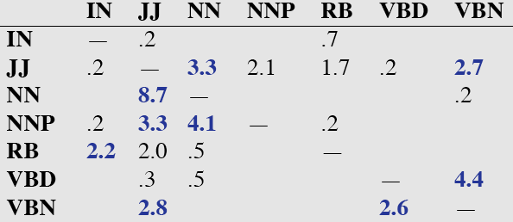
Confusion matrix
Precision ?
Recall ?

Slide 43
Error Analysis (textbook)
Look at a confusion matrix
See what errors are causing problems
Noun (NN) vs ProperNoun (NNP) vs Adj (JJ)
Past tense (VBD) vs Past Participle (VBN)

Slide 44
POS tagging state of the art + tools
Stanford Tagger: Maximum entropy cyclic dependency network - Java
Toutanova and Manning. 2000. Enriching the Knowledge Sources Used in a Maximum Entropy Part-of-Speech Tagger (EMNLP/VLC-2000),
Toutanova, Klein, Manning, and Singer. 2003. Feature-Rich Part-of-Speech Tagggging with a Cyclic Dependency Network. HLT-NAACL 2003,
Python
Anders. 2011. Semi-supervised condensed nearest neighbour for part-of-speech tagging. (ACL-HLT).
Notes:
We present a new part-of-speech tagger that
demonstrates the following ideas: (i) explicit use of both preceding and following tag contexts
via a dependency network representation, (ii) broad use of lexical features, including
jointly conditioning on multiple consecutive words, (iii) effective use of priors in conditional
loglinear models, and (iv) fine-grained modeling of unknown word features. Using these ideas together, the resulting tagger gives a 97.24%accuracy on the Penn TreebankWSJ, an error reduction of 4.4% on the best previous single automatically learned tagging result.

Slide 45
Knowledge-Formalisms Map (next two-three lectures)
State Machines (and prob. versions)
(Finite State Automata,Finite State Transducers, Markov Models)
Morphology
Syntax
Rule systems (and prob. versions)
(e.g., (Prob.) Context-Free Grammars)
Semantics
Pragmatics
Discourse and Dialogue
Logical formalisms
(First-Order Logics)
AI planners
Notes:
My Conceptual map - This is the master plan
Markov Models used for part-of-speech and dialog
Syntax is the study of formal relationship between words
How words are clustered into classes (that determine how they group and behave)
How they group with they neighbors into phrases

Slide 46
Next Time
Read Chapter 12 (syntax & Context Free Grammars)

