Slide 1
CPSC 503
Computational Linguistics
Lecture 3
Giuseppe Carenini

Slide 2
Today Jan 15
Finish: Finite State Transducers (FSTs) and Morphological Parsing
Stemming (Porter Stemmer)
Start Prob. Models
  Dealing with spelling errors
    Noisy channel model
    Bayes rule applied to Noisy channel model (single and multiple spelling errors)
  Min Edit Distance ?
Notes:
Applications: word processing, clean-up corpus, on-line hand-writing recognition
Introduce the need for (more sophisticated) probabilistic language models

Slide 3
Formalisms and associated
Algorithms
Linguistic Knowledge
State Machines (no prob.)
Finite State Automata (and Regular Expressions)
Finite State Transducers
(English)
Morphology
Syntax
Semantics
Rule systems (and prob. version)
(e.g., (Prob.) Context-Free Grammars)
Pragmatics
Discourse and Dialogue
Logical formalisms
(First-Order Logics)
AI planners

Slide 4
Computational tasks in Morphology
Recognition: recognize whether a string is an English/… word (FSA)
Parsing/Generation:
stem, class, lexical features
word
….
….
buy +V +PAST-PART
e.g.,
bought
buy +V +PAST
Stemming:
stem
word
….
Notes:
participle
Form: en+ large +ment +s
Gloss: VR1+ AJ +NR25 +PL
Cat: PREFIX ROOT SUFFIX INFL
Feat: [fromcat: AJ [lexcat: AJ [fromcat: V [fromcat: N tocat: V aform: !POS] tocat: N tocat: N finite: !-] number: !SG] number: SG reg: +]

Slide 5
Where are we?
#

Slide 6
Final Scheme: Part 1

Slide 7
Final Scheme: Part 2

Slide 8
Intersection (FST1, FST2) = FST3
States of FST1 and FST2 : Q₁ and Q₂
States of intersection: (Q₁ x Q₂)
Transitions of FST1 and FST2 : δ_{1,} δ₂
Transitions of intersection : δ₃
For all i,j,n,m,a,b δ₃((q_{1i},q_{2j}), a:b) = (q_{1n},q_{2m}) iff
  δ₁(q_{1i}, a:b) = q_{1n} AND
  δ₂(q_{2j}, a:b) = q_{2m}
a:b
q_{1i}
q_{1n}
a:b
a:b
a:b
(q_{1i},q_{2j})
(q_{1n},q_{2m})
⬄
q_{2j}
q_{2m}
Notes:
Only sequences accepted by both transducers are accepted!
Initial if both states are initial
Accept if both states are accept

Slide 9
Composition(FST1, FST2) = FST3
States of FST1 and FST2 : Q₁ and Q₂
States of composition : Q₁ x Q₂
Transitions of FST1 and FST2 : δ_{1,} δ₂
Transitions of composition : δ₃
For all i,j,n,m,a,b δ₃((q_{1i},q_{2j}), a:b) = (q_{1n},q_{2m}) iff
  There exists c such that
  δ₁(q_{1i}, a:c) = q_{1n} AND
  δ₂(q_{2j}, c:b) = q_{2m}
a:c
q_{1i}
q_{1n}
a:b
c:b
a:b
⬄
(q_{1i},q_{2j})
(q_{1n},q_{2m})
q_{2j}
q_{2m}
Notes:
Create a set of new states that correspond to each pair of states from the original machines (New states are called (x,y), where x is a state from M1, and y is a state from M2)
Create a new FST transition table for the new machine according to the following intuition…
There should be a transition between two related states in the new machine if it’s
the case that the output for a transition from a state from M1, is the same as the
input to a transition from M2 or…
Initial if Xa is initial
Accept if Yb is accept

Slide 10
FSTs in Practice
Install an FST package…… (pointers)
Describe your “formal language” (e.g, lexicon, morphotactic and rules) in a RegExp-like notation (pointer)
Your specification is compiled in a single FST
Ref: “Finite State Morphology” (Beesley and Karttunen, 2003, CSLI Publications) (pointer)
Complexity/Coverage:
FSTs for the morphology of a natural language may have 10⁵ – 10⁷ states and arcs
Spanish (1996) 46x10³ stems; 3.4 x 10⁶ word forms
Arabic (2002?) 131x10³ stems; 7.7 x 10⁶ word forms
Notes:
Run with moderate complexity if deterministic and minimal

Slide 11
Other important applications of FST in NLP
From segmenting words into morphemes to…
Tokenization:
  finding word boundaries in text (?!) …maxmatch
  Finding sentence boundaries: punctuation… but . is ambiguous look at example in Fig. 3.22
Shallow syntactic parsing: e.g., find only noun phrases
Phonological Rules…… (Chpt. 11)
Notes:
English has orthographic spaces and punctuation but languages like Chinese or Japanese don’t…
maxmatch “ the table down there”
“Theta bled own there”

Slide 12
Computational tasks in Morphology
Recognition: recognize whether a string is an English word (FSA)
Parsing/Generation:
stem, class, lexical features
word
….
….
buy +V +PAST-PART
e.g.,
bought
buy +V +PAST
Stemming:
stem
word
….
Notes:
participle
Form: en+ large +ment +s
Gloss: VR1+ AJ +NR25 +PL
Cat: PREFIX ROOT SUFFIX INFL
Feat: [fromcat: AJ [lexcat: AJ [fromcat: V [fromcat: N tocat: V aform: !POS] tocat: N tocat: N finite: !-] number: !SG] number: SG reg: +]

Slide 13
Stemmer
E.g. the Porter algorithm, which is based on a series of sets of simple cascaded rewrite rules:
(condition) S1->S2
  ATIONAL → ATE (relational → relate)
  (*v*) ING → ε if stem contains vowel (motoring → motor)
Cascade of rules applied to: computerization
  ization -> -ize computerize
  ize -> ε computer
Errors occur:
  organization → organ, university → universe
Code freely available in most languages: Python, Java,…
Notes:
For practical work, therefore, the new Snowball stemmer is recommended. The Porter stemmer is appropriate to IR research work involving stemming where the experiments need to be exactly repeatable.
Does not require a big lexicon!
The Porter algorithm consists of seven simple sets of rules. Applied in order.
In each step if more than one of the rules applies, only the one
With the longest match suffix is followed
Handles both inflectional and derivational suffixes

Slide 14
Stemming mainly used in Information Retrieval
Run a stemmer on the documents to be indexed
Run a stemmer on users queries
Compute similarity between queries and documents (based on stems they contain)
Seems to work especially well with smaller documents
Notes:
There are way less stems than words!
Works with new words

Slide 15
Porter as an FST
The original exposition of the Porter stemmer did not describe it as a transducer but…
  Each stage is a separate transducer
  The stages can be composed to get one big transducer

Slide 16
Today Jan 15
Finish: Finite State Transducers (FSTs) and Morphological Parsing
Stemming (Porter Stemmer)
Start Prob. Models
  Dealing with spelling errors
    Noisy channel model
    Bayes rule applied to Noisy channel model (single and multiple spelling errors)
  Min Edit Distance ?
Notes:
Applications: word processing, clean-up corpus, on-line hand-writing recognition
Introduce the need for (more sophisticated) probabilistic language models

Slide 17
Knowledge-Formalisms Map
(including probabilistic formalisms)
State Machines (and prob. versions)
(Finite State Automata,Finite State Transducers, Markov Models)
Morphology
Syntax
Rule systems (and prob. versions)
(e.g., (Prob.) Context-Free Grammars)
Semantics
Pragmatics
Discourse and Dialogue
Logical formalisms
(First-Order Logics)
AI planners
Notes:
Spelling: Very simple NLP task (requires morphological recognition)
Shows Need for probabilistic approaches
Move beyond single words
Probability of a sentence

Slide 18
Background knowledge
Morphological analysis
P(x) (prob. distribution)
joint P(x,y)
conditional P(x|y)
Bayes rule
Chain rule
Notes:
For convenience let’s call all of them prob distributions
Word length, word class

Slide 19
Spelling: the problem(s)
Detection
Correction
funn -> funny, fun, ...
Non-word
isolated
Find the most likely correct word
Non-word
context
…in this context
  trust funn
  a lot of funn
Real-word
isolated
?!
Is it an impossible
(or very unlikely) word in this context?
Find the most likely substitution word in this context
Real-word
context
  .. a wild dig.
Notes:
Check if it is in the lexicon
Find candidates and select the most likely
it was funne - trust fun

Slide 20
Spelling: Data
.05% -3% - 26%
80% of misspelled words, single error
  insertion (toy -> tony)
  deletion (tuna -> tua)
  substitution (tone -> tony)
  transposition (length -> legnth)
Types of errors
  Typographic (more common, user knows the correct spelling… the -> rhe)
  Cognitive (user doesn’t know…… piece -> peace)
Notes:
Very related problem: modeling pronunciation variation for automatic speech recognition and text to speech systems
(.05% carefully edited newswire) (23% in “normal” human typewritten text)
26% Web queries
OLD(Telephone directory lookup 38%)
Usually related to the keyboard: Substituting one char with the one next on the keyboard
Cognitive errors include homophones errors piece peace

Slide 21
Noisy Channel
An influential metaphor in language processing is the noisy channel model
noisy
signal
signal
signal
Special case of Bayesian classification
Notes:
Noisy channel: speech, machine translation
Bayesian classification
You’ll find in one way or another in many nlp papers after 1990
In spelling noise introduced by processes that cause people to misspell words
We want to classify the noisy word as the most likely word that generated it

Slide 22
Bayes and the Noisy Channel: Spelling Non-word isolated
Goal: Find the most likely word given some observed (misspelled) word
Notes:
Memorize this

Slide 23
Problem
P(w|O) is hard/impossible to get (why?)
P(wine|winw)=
Notes:
Refer to distribution joint and conditional
If you have a large enough corpus you could collect the pairs needed to compute
P(S|w) for all possible misspelling for each word in the lexicon.
Seems unlikely
Hoping that what we are left with can be estimated more easily

Slide 24
Solution
Apply Bayes Rule
Simplify
likelihood
prior
Notes:
Refer to distribution joint and conditional
If you have a large enough corpus you could collect the pairs needed to compute
P(S|w) for all possible misspelling for each word in the lexicon.
Seems unlikely
Hoping that what we are left with can be estimated more easily

Slide 25
Estimate of prior P(w) (Easy)
smoothing
Always verify…
Notes:
P(w) is easy. That’s just the prior probability of that word given some corpus
(that we hope is similar to the text being corrected).
We are making a simplifying assumption that P(w) is the unigram probability, but in practice this is extended to triagram or even 4grams

Slide 26
Estimate of P(O|w) is feasible
(Kernighan et. al ’90)
For one-error misspelling:
Estimate the probability of each possible error type
e.g., insert a after c, substitute f with h
P(O|w) equal to the probability of the error that generated O from w
e.g., P( cbat| cat) = P(insert b after c)
Notes:
What about P(O|w)… i.e. the probability that this string would have appeared
given that the right word was w

Slide 27
Estimate P(error type)
Large corpus compute confusion matrices
(e.g substitution: sub[x,y]) and count matrix
#Times b was incorrectly used for a
a
b
c
………
a
………
………
Count(a)= # of a in corpus
b
5
c
8
15
………
d
8
…
………
………
………
Notes:
Still have to build some tables!
b was incorrectly used instead of a
How many b in the corpus are actually a

Slide 28
Corpus: Example
… On 16 January, he sais [sub[i,y] 3] that because of astronaut safety tha [del[a,t] 4] would be no more space shuttle missions to miantain [tran[a,i] 2] and upgrade the orbiting telescope……..

Slide 29
Final Method single error
(1) Given O, collect all the w_{i} that could have generated O by one error.
E.g., O=acress => w₁ = actress (t deletion),
w₂ = across (sub o with e), … …
How to do (1): Generate all the strings that could have generated O by one error (how?). Keep the words
(2) For all the w_{i} compute:
word prior
Probability of the error generating O from w₁
(3) Sort and display top-n to user
Notes:
Apply any single transformation to O and see if it generates a word
This can be a big set. For a word of length n, there will be n deletions, n-1 transpositions, 26n alterations, and 26(n+1) insertions, for a total of 54n+25 (of which a few are typically duplicates). For example, len(edits1('something')) -- that is, the number of elements in the result of edits1('something') -- is 494.
Collect all generated words
Sort and display top-n to the user
the prior of the collected words
Multiply P(w_{i}) by the probability of the particular error that results in O (estimate of P(O|w_{i})).

Slide 30
Example: collect all the w_{i} that could have generated “acress” by one error.
a c r e s s
# of deletions
# of transpositions
# of alternations
# of insertions

Slide 31
Example: O = acress
1988 AP newswire corpus 44 million words
_
_
_
_
_
…stellar and versatile acress whose…
Notes:
Corpus size N=44 million words
Normalizing percentages
Acres -> acress two ways (1) inserting s after e (2) inserting s after s

Slide 32
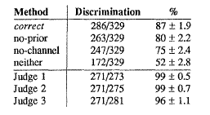

Evaluation “correct” system
0 1 2 other
Notes:
Neither was just proposing the first word that could have generated O by one error
The following table shows that correct agrees with the majority of the judges in 87% of the
329 cases of interest. In order to help calibrate this result, three inferior methods ,are also
evaluated. The no-prior method ignores the prior probability. The no-channel method
ignores the channel probability. Finally, the neither method ignores both probabilities and
selects the first candidate in "all cases”. As the following table shows, correct is significantly
better than the three inferior alternatives. Both the channel and the prior probabilities provide a
significant contribution, and the combination is significantly better than either in isolation. The
second half of the table evaluates the judges against one another and shows that they
significantly out-perform correct, indicating that there is plenty of room for further improvement. 6
All three judges found the task more difficult and time consuming than they had expected.
Each judge spent about half a day grading the 564 triples.
(6) Judges were only scored on triples for which they
selected "1" or "2," and for which the other two judges
agreed on "1" or "2”. A triple was scored "correct"
for one judge if that judge agreed with the other two and
"incorrect" if that judge disagreed with the other two.

Slide 33
Corpora: issues to remember
Spelling Corpora
  Wikipedia’s list of common misspellings
  Aspell filtered version
  Birbeck corpus
Zero counts in the corpus: Just because an event didn’t happen in the corpus doesn’t mean it won’t happen
  e.g., cress has not really zero probability
Getting a corpus that matches the actual use. e.g., Kids don’t misspell the same way that adults do

Slide 34
Multiple Spelling Errors
(BEFORE) Given O collect all the w_{i} that could have generated O by one error…….
(NOW) Given O collect all the w_{i} that could have generated O by 1..k errors
How? (for two errors): Collect all the strings that could have generated O by one error, then collect all the w_{i} that could have generated one of those strings by one error
_{Etc.}
Notes:
Distance how alike two strings are to each other

Slide 35
Final Method multiple errors
(1) Given O, for each w_{i} that can be generated from O by a sequence of edit operations EdOp_{i} ,save EdOp_{i} .
(2) For all the w_{i} compute:
word prior
Probability of the errors generating O from w_{i}
(3) Sort and display top-n to user
Notes:
Sort and display top-n to the user
the prior of the collected words
Multiply P(w_{i}) by the probability of the particular error that results in O (estimate of P(O|w_{i})).

Slide 36
Spelling: the problem(s)
Detection
Correction
funn -> funny, funnel...
Non-word
isolated
Find the most likely correct word
Non-word
context
…in this context
  trust funn
  a lot of funn
Real-word
isolated
?!
Is it an impossible
(or very unlikely) word in this context?
Find the most likely sub word in this context
Real-word
context
  .. a wild dig.
Notes:
Check if it is in the lexicon
Find candidates and select the most likely
it was funne - trust fun

Slide 37
Real Word Spelling Errors (20-40%)
Collect a set of common sets of confusions: C={C₁ .. C_{n}}
e.g.,{(Their/they’re/there), (To/too/two), (Weather/whether), (lave, have)..}
Whenever c’ ∈ C_{i} is encountered
Compute the probability of the sentence in which it appears
Substitute all c∈C_{i} (c ≠ c’) and compute the probability of the resulting sentence
Choose the highest one
Notes:
Mental confusions
Their/they’re/there To/too/two Weather/whether
Typos that result in real words Lave for Have
Similar process for non-word errors

Slide 38
More sophisticated approach
One error per sentence….

Slide 39
Want to play with Spelling Correction: minimal noisy channel model implementation
(Python)
http://www.norvig.com/spell-correct.html
By the way Peter Norvig is Director of Research at Google Inc.

Slide 40
Today Jan 15
Finish: Finite State Transducers (FSTs) and Morphological Parsing
Stemming (Porter Stemmer)
Start Prob. Models
  Dealing with spelling errors
    Noisy channel model
    Bayes rule applied to Noisy channel model (single and multiple spelling errors)
  Min Edit Distance ?
Notes:
Applications: word processing, clean-up corpus, on-line hand-writing recognition
Introduce the need for (more sophisticated) probabilistic language models

Slide 41
Minimum Edit Distance
Def. Minimum number of edit operations (insertion, deletion and substitution) needed to transform one string into another.
gumbo
gumb
gum
gam
delete o
delete b
substitute u by a
Notes:
Compute string minimum edit distance between O and each w_{i}
There are lots of applications of Levenshtein distance. It is used in biology to find similar sequences of nucleic acids in DNA or amino acids in proteins. It is used in some spell checkers to guess at which word (from a dictionary) is meant when an unknown word is encountered. Wilbert Heeringa's dialectology project uses Levenshtein distance to estimate the proximity of dialect pronunciations. And some translation assistance projects have used the alignment capability of the algorithm in order to discover (the approximate location of) good translation equivalents. This application, using potentially large texts, requires optimisations to run effectively.

Slide 42
Minimum Edit Distance Algorithm
Dynamic programming (very common technique in NLP)
High level description:
  Fills in a matrix of partial comparisons
  Value of a cell computed as “simple” function of surrounding cells
  Output: not only number of edit operations but also sequence of operations
Notes:
Compute string minimum edit distance between O and each w_{i}
There are lots of applications of Levenshtein distance. It is used in biology to find similar sequences of nucleic acids in DNA or amino acids in proteins. It is used in some spell checkers to guess at which word (from a dictionary) is meant when an unknown word is encountered. Wilbert Heeringa's dialectology project uses Levenshtein distance to estimate the proximity of dialect pronunciations. And some translation assistance projects have used the alignment capability of the algorithm in order to discover (the approximate location of) good translation equivalents. This application, using potentially large texts, requires optimizations to run effectively.

Slide 43
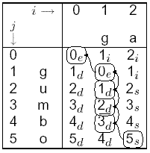
Minimum Edit Distance Algorithm Details
del-cost =1
sub-cost=2
ins-cost=1
target
ed[i,j]
j
i
ed[i,j] = min distance between first i chars of the source and first j chars of the target
source
i-1, j-1
i-1 , j
update
z
x
sub or equal
del
i , j-1
y
?
MIN(z+1,y+1, x + (2 or 0))
ins
Notes:
Book kind of confusing matrix indexes start from bottom left corner

Slide 44
Minimum Edit Distance Algorithm Details
del-cost =1
sub-cost=2
ins-cost=1
target
j
i
ed[i,j] = min distance between first i chars of the source and first j chars of the target
source
i-1, j-1
i-1 , j
update
z
x
sub or equal
del
i , j-1
y
?
MIN(z+1,y+1, x + (2 or 0))
ins
Notes:
Book kind of confusing matrix indexes start from bottom left corner

Slide 45
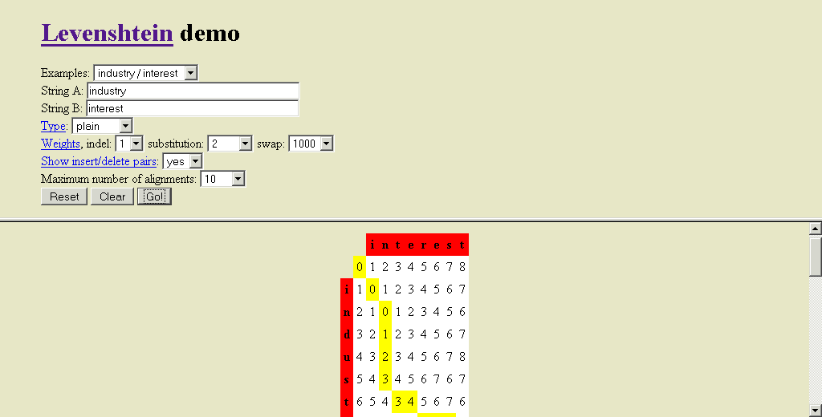
Min edit distance and alignment
See demo

Slide 46
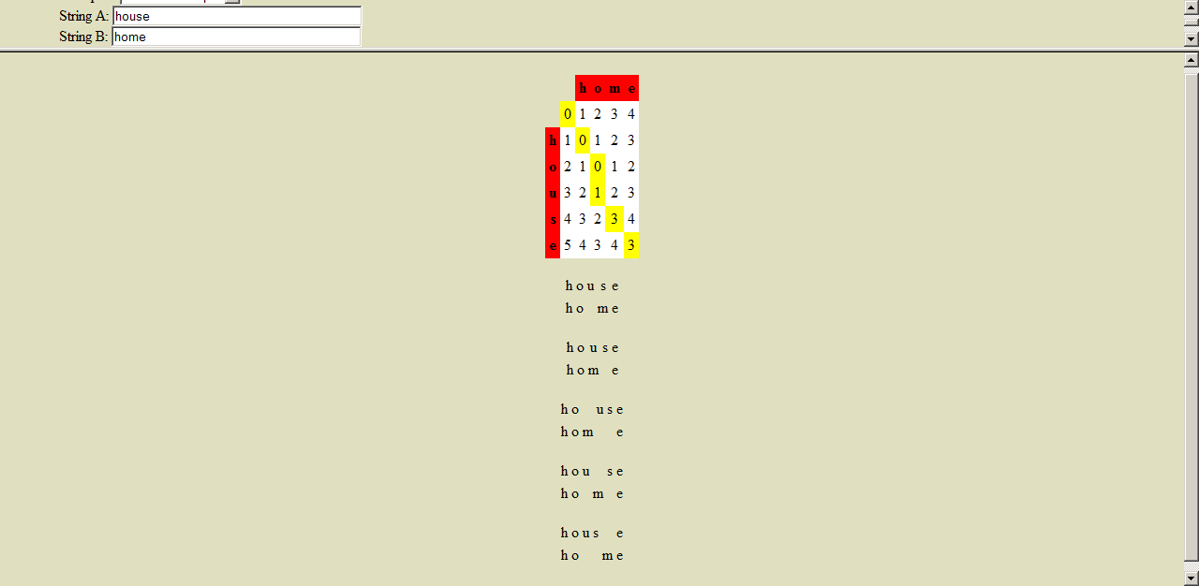
Min edit distance and alignment
See demo
On course
webpage
Notes:
Any non decreasing path from the top left corner to the bottom right corner is an alignment

Slide 47
Next Time: Key Transition
Up to this point we’ve mostly been discussing words in isolation
Now we’re switching to sequences of words
And we’re going to worry about assigning probabilities to sequences of words

Slide 48
Next Time
N-Grams (Chp. 4)
Model Evaluation (sec. 4.4)
No smoothing 4.5-4.7

