Slide 1
Introduction to
Artificial Intelligence (AI)
Computer Science cpsc502, Lecture 12
Oct, 20, 2011
Notes:
Lecture 12

Slide 2
Today Oct 20
Value of Information and value of Control
Markov Decision Processes
Formal Specification and example
Policies and Optimal Policy
Value Iteration
Rewards and Optimal Policy

Slide 3
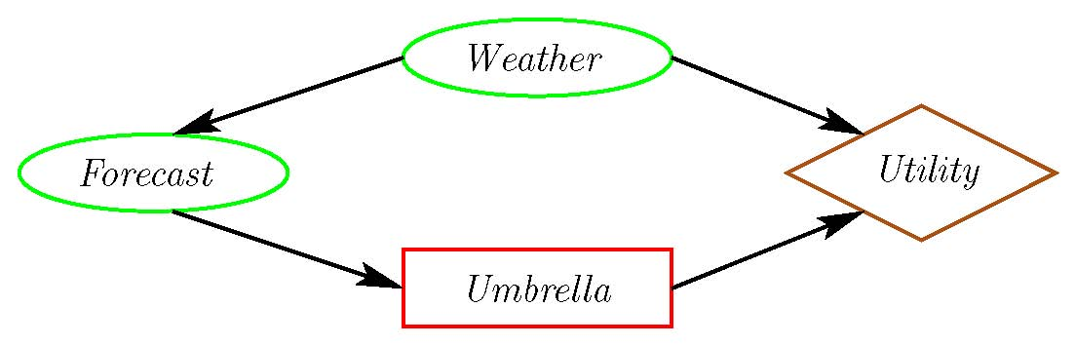
Value of
Information
What would help the agent make a better Umbrella decision?
The value of information of a random variable X for decision D is:
the utility of the network with an arc from X to D minus the utility of the network without the arc.
Intuitively:
  The value of information is always
  It is positive only if the agent changes

Slide 4
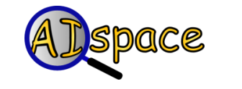
Value of Information (cont.)
The value of information provides a bound on how much you should be prepared to pay for a sensor. How much is a perfect weather forecast worth?
77
Original maximum expected utility:
Maximum expected utility when we know Weather:
Better forecast is worth at most:
91

Slide 5
Value of Information
The value of information provides a bound on how much you should be prepared to pay for a sensor. How much is a perfect fire sensor worth?
-22.6
Original maximum expected utility:
Maximum expected utility when we know Fire:
Perfect fire sensor is worth:
-2

Slide 6
Value of control
The value of control of a variable X is the utility of the network when you make X a decision variable minus the utility of the network when X is a random variable.
What if we could control the weather?
Original maximum expected utility: 77
Maximum expected utility when we control the weather: 100
Value of control of the weather: 23

Slide 7
Today Oct 20
Value of Information and value of Control
Markov Decision Processes
Formal Specification and example
Policies and Optimal Policy
Value Iteration
Rewards and Optimal Policy

Slide 8
Combining ideas for Stochastic planning
What is a key limitation of decision networks?
What is an advantage of Markov models?
Represent (and optimize) only a fixed number of decisions
The network can extend indefinitely
Goal: represent (and optimize) an indefinite sequence of decisions

Slide 9
Planning in Stochastic Environments
Environment
Deterministic
Stochastic
Problem
Arc Consistency
Search
Constraint Satisfaction
Vars +
Constraints
SLS
Static
Belief Nets
Query
Logics
Var. Elimination
Search
Markov Chains and HMMs
Sequential
Decision Nets
STRIPS
Var. Elimination
Planning
Search
Markov Decision Processes
Representation
Value Iteration
Reasoning
Technique
Notes:
R&R Sys Representation and reasoning Systems
Each cell is a R&R system
STRIPS actions preconditions and effects

Slide 10

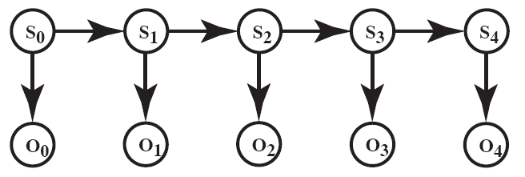
Recap: Markov Models

Slide 11
Markov Models
Markov Chains
Hidden Markov Model
Partially Observable Markov Decision Processes (POMDPs)
Markov Decision Processes (MDPs)

Slide 12
Decision Processes
Often an agent needs to go beyond a fixed set of decisions – Examples?
  Would like to have an ongoing decision process
Infinite horizon problems: process does not stop
Indefinite horizon problem: the agent does not know when the process may stop
Finite horizon: the process must end at a give time N
Notes:
Helper of a senior
Monitoring system (of a plant)
Treatment of a chronic disease

Slide 13
How can we deal with indefinite/infinite processes?
We make the same two assumptions we made for….
The action outcome depends only on the current state
Let S_{t} be the state at time t …
The process is stationary…
We also need a more flexible specification for the utility. How?
  Defined based on a reward/punishment R(s) that the agent receives in each state s
Notes:
depends on the sequence of states involved in a decision process (environment history), rather than a single final state
P(S_{t+1}|S₀, A₀,...,S_{t}, A_{t}) = P(S_{t+1}|S_{t}, A_{t})
if P(s’|s , a) is the same at each point in time, where P(s’|s , a) the probability that the agent will be in state s’ after doing action a in state s

Slide 14
MDP: formal specification
For an MDP you specify:
  set S of states and set A of actions
  the process’ dynamics (or transition model)
    P(S_{t+1}|S_{t}, A_{t})
  The reward function
      R(s, a,, s’)
  describing the reward that the agent receives when it performs action a in state s and ends up in state s’
  R(s) is used when the reward depends only on the state s and not on how the agent got there
  Absorbing/stopping/terminal state

Slide 15
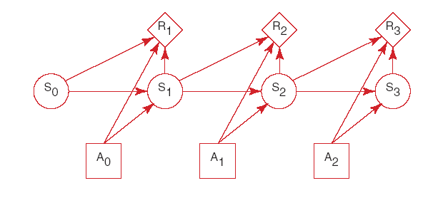
MDP graphical specification
Basically a MDP augments a Markov Chain augmented with actions and rewards/values

Slide 16
When Rewards only depend on the state

Slide 17
Decision Processes: MDPs
To manage an ongoing (indefinite… infinite) decision process, we combine….
Markovian
Stationary
Utility not just at the end
Sequence of rewards
Fully Observable
Notes:
forget the proper sequence of tasks that need to be completed
they lose track of the steps that they have already completed.
At any stage of the process
The agent decides which action to perform
The new state of the world depends on the previous state(s) as well as the action(s) performed
The agent receives rewards or punishments at various points in the process
Aim: maximize the reward received

Slide 18
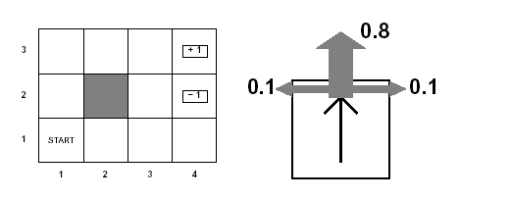
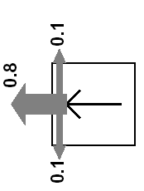
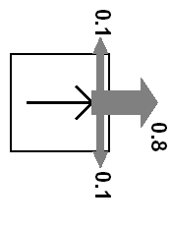
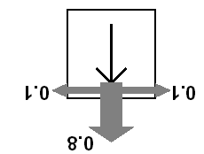
Example MDP: Scenario and Actions
Agent moves in the above grid via actions Up, Down, Left, Right
Each action has:
  0.8 probability to reach its intended effect
  0.1 probability to move at right angles of the intended direction
  If the agents bumps into a wall, it says there
How many states?
There are two terminal states (3,4) and (2,4)

Slide 19
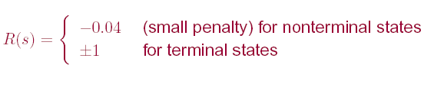
Example MDP: Rewards

Slide 20
Example MDP: Underlying info structures
Four actions Up, Down, Left, Right
Eleven States: {(1,1), (1,2)…… (3,4)}

Slide 21
Example MDP: Sequence of actions
Can the sequence [Up, Up, Right, Right, Right ] take the agent in terminal state (3,4)?
Can the sequence reach the goal in any other way?
Notes:
Yes, with probability 0.8⁵=0.3278
yes, going the other way around with prob. 0.1⁴ x 0.8

Slide 22
Today Oct 20
Value of Information and value of Control
Markov Decision Processes
Formal Specification and example
Policies and Optimal Policy
Value Iteration
Rewards and Optimal Policy

Slide 23
MDPs: Policy
The robot needs to know what to do as the decision process unfolds…
It starts in a state, selects an action, ends up in another state selects another action….
Needs to make the same decision over and over: Given the current state what should I do?
So a policy for an MDP is a single decision function π(s) that specifies what the agent should do for each state s
Notes:
So what is the best sequence of actions for our Robot?
There is no best sequence of actions!
Minimizes cost
(you do not know how the world will be when you’ll need to make the decision)

Slide 24
MDPs: Policy
So what is the best sequence of actions for our Robot?
There is no best sequence of actions!
As we saw for decision networks, our aim is to find an optimal policy: a set of δ₁ ,….., δ_{n} decision functions
But in an MDP the decision to be made is always…..
Given the current state what should I do?
So a policy for an MDP is a single decision function π(s) that specifies what the agent should do for each state s
Notes:
Minimizes cost
(you do not know how the world will be when you’ll need to make the decision)

Slide 25
How to evaluate a policy
A policy can generate a set of state sequences with different probabilities
Each state sequence has a corresponding reward. Typically the sum of the rewards for each state in the sequence
Notes:
Because of the stochastic nature of the environment,

Slide 26
MDPs: optimal policy
Because of the stochastic nature of the environment, a policy can generate a set of environment histories with different probabilities
Optimal policy maximizes expected total reward, where
  Each environment history associated with that policy has a given amount of total reward
  Total reward is a function of the rewards of its individual states
Notes:
Minimizes cost
(you do not know how the world will be when you’ll need to make the decision)

Slide 27
MDPs: optimal policy
Optimal policy maximizes expected total reward, where
  Each environment history associated with that policy has a certain probability of accuriing and a given amount of total reward
  Total reward is a function of the rewards of its individual states
For all the sequences of states generated by the policy
Notes:
Because of the stochastic nature of the environment,
Minimizes cost
(you do not know how the world will be when you’ll need to make the decision)

Slide 28
Today Oct 20
Value of Information and value of Control
Markov Decision Processes
Formal Specification and example
Policies and Optimal Policy
Value Iteration
Rewards and Optimal Policy

Slide 29
Sketch of ideas to find the optimal policy for a MDP (Value Iteration)
We first need a couple of definitions
  V ^{п}(s): the expected value of following policy π in state s
  Q ^{п}(s, a), where a is an action: expected value of performing a in s, and then following policy π.
We have, by definition
  Q ^{п}(s, a)=
reward obtained in s
states reachable
from s by doing a
Probability of getting to s’ from s via a
expected value of following policy π in s’
Discount factor

Slide 30
Value of a policy and Optimal policy
We can then compute V ^{п}(s) in terms of Q ^{п}(s, a)
action indicated by π in s
Expected value of following π in s
Expected value of performing the action indicated by π in s and following π after that
For the optimal policy π * we also have

Slide 31
Value of Optimal policy
  Q ^{п}(s, a)=
Optimal policy π * is one that gives the action that maximizes Q ^{π*} for each state

Slide 32
Value Iteration Rationale
Given N states, we can write an equation like the one below for each of them
Each equation contains N unknowns – the V values for the N states
N equations in N variables (Bellman equations): It can be shown that they have a unique solution: the values for the optimal policy
Unfortunately the N equations are non-linear, because of the max operator: Cannot be easily solved by using techniques from linear algebra
Value Iteration Algorithm: Iterative approach to find the optimal policy and corresponding values

Slide 33
Value Iteration in Practice
Let V^{(i)}(s) be the utility of state s at the i^{th} iteration of the algorithm
Start with arbitrary utilities on each state s: V⁽⁰⁾(s)
Repeat simultaneously for every s until there is “no change”
True “no change” in the values of V(s) from one iteration to the next are guaranteed only if run for infinitely long.
  In the limit, this process converges to a unique set of solutions for the Bellman equations
  They are the total expected rewards (utilities) for the optimal policy

Slide 34
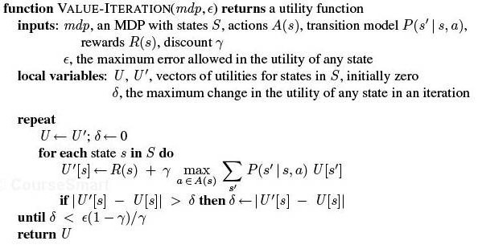
VI algorithm

Slide 35
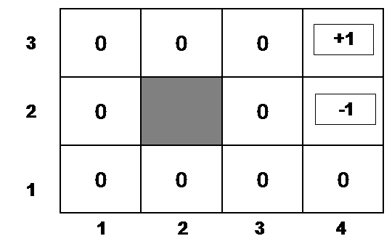
Example
Suppose, for instance, that we start with values V⁽⁰⁾(s) that are all 0
Iteration 0
Iteration 1
3
2
1
0 | 0 | 0
0 |  | 0
0 | 0 | 0 | 0
+1
-1
-0.04
1 2 3 4

Slide 36
Example (cont’d)
Let’s compute V⁽¹⁾(3,3)
Iteration 0
Iteration 1
3
2
1
0 | 0 | 0
0 |  | 0
0 | 0 | 0 | 0
0.76
+1
-1
-0.04
-0.4
1 2 3 4

Slide 37
Example (cont’d)
Let’s compute V⁽¹⁾(4,1)
Iteration 0
Iteration 1
3
2
1
0 | 0 | 0
0 |  | 0
0 | 0 | 0 | 0
.76
+1
-1
-0.04
-0.04
1 2 3 4

Slide 38
After a Full Iteration
Iteration 1
3
2
1
-.04 | -.04 | 0.76
-.04 |  | -.04
-.04 | -.04 | -.04 | -.04
+1
-1
1 2 3 4
Only the state one step away from a positive reward (3,3) has gained value, all the others are losing value because of the cost of moving

Slide 39
Some steps in the second iteration
Iteration 1
Iteration 2
3
2
1
-.04 | -.04 | 0.76
-.04 |  | -.04
-.04 | -.04 | -.04 | -.04
3
2
1
-.04 | -.04 | 0.76
-.04 |  | -.04
-.04 | -.04 | -.04 | -.04
+1
+1
-1
-1
-0.08
1 2 3 4
1 2 3 4

Slide 40
Example (cont’d)
Let’s compute V⁽¹⁾(2,3)
Steps two moves away from positive rewards start increasing their value
Iteration 2
Iteration 1
-.04 | -.04 | 0.76
-.04 |  | -.04
-.04 | -.04 | -.04 | -.04
0.56
+1
3
2
1
-.04 | -.04 | 0.76
-.04 |  | -.04
-.04 | -.04 | -.04 | -.04
+1
-1
-1
-0.08
1 2 3 4
1 2 3 4

Slide 41
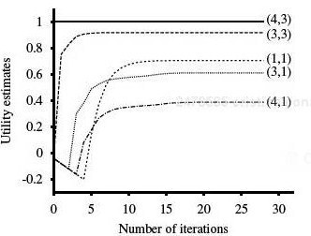
State Utilities as Function of Iteration #
Note that values of states at different distances from (4,3) accumulate negative rewards until a path to (4,3) is found

Slide 42
Value Iteration: Computational Complexity
Value iteration works by producing successive approximations of the optimal value function.
Each iteration can be performed in O(|A||S|²) steps,
or faster if there is sparsity in the transition function.
Notes:
Computational Complexity
Value iteration works by producing successive approximations of the optimal value function. Each iteration can be performed in O(|A||S|²) steps, or faster if there is sparsity in the transition function. However, the number of iterations required can grow exponentially in the discount factor [27]; as the discount factor approaches 1, the decisions must be based on results that happen farther and farther into the future. In practice, policy iteration converges in fewer iterations than value iteration, although the per-iteration costs of O(|A||S|² ⁺ |S|³ ) can be prohibitive. There is no known tight worst-case bound available for policy iteration [66]. Modified policy iteration [91] seeks a trade-off between cheap and effective iterations and is preferred by some practictioners [96].

Slide 43
Today Oct 20
Value of Information and value of Control
Markov Decision Processes
Formal Specification and example
Policies and Optimal Policy
Value Iteration
Rewards and Optimal Policy

Slide 44
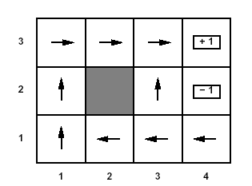
Rewards and Optimal Policy
Optimal Policy when penalty in non-terminal states is -0.04
Note that here the cost of taking steps is small compared to the cost of ending into (2,4)
  Thus, the optimal policy for state (1,3) is to take the long way around the obstacle rather then risking to fall into (2,4) by taking the shorter way that passes next to it
May the optimal policy change if the reward in the non-terminal states (let’s call it r) changes?

Slide 45
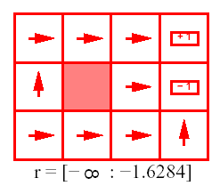
Rewards and Optimal Policy
Optimal Policy when r < -1.6284
1 2 3 4
3
2
1
Why is the agent heading straight into (2,4) from its surrounding states?
Notes:
The cost of taking a step is so high that the agent heads straight
into the nearest terminal state, even if this is (2,4) (reward -1)

Slide 46
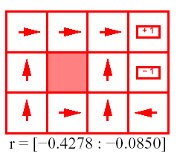
Rewards and Optimal Policy
Optimal Policy when -0.427 < r < -0.085
1 2 3 4
3
2
1
The cost of taking a step is high enough to make the agent take the shortcut to (3,4) from (1,3)

Slide 47
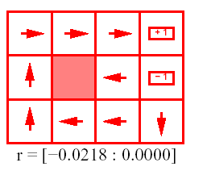
Rewards and Optimal Policy
Optimal Policy when -0.0218 < r < 0
1 2 3 4
3
2
1
Why is the agent heading straight into the obstacle from (2,3)? And into the wall in (1,4)?

Slide 48
Rewards and Optimal Policy
Optimal Policy when -0.0218 < r < 0
1 2 3 4
3
2
1
Stay longer in the grid is not penalized as much as before. The agent is willing to take longer routes to avoid (2,4)
  This is true even when it means banging against the obstacle a few times when moving from (2,3)

Slide 49

Rewards and Optimal Policy
Optimal Policy when r > 0
Which means the agent is rewarded for every step it takes
1 2 3 4
3
2
1
state where every action belong to an optimal policy
Notes:
it is basically rewarded for sticking around
The only actions that need to be specified are the ones in states that are adjacent to the terminal states: take the agent away from them

Slide 50
AI talk today: Lots of concepts covered in 502
Speaker: Thomas G. Dietterich, Professor Oregon State University
http://web.engr.oregonstate.edu/~tgd/
Title: Challenges for Machine Learning in Ecological Science and Ecosystem Management
Time: 3:30 - 4:50 p.m
Location: Hugh Dempster Pavilion (DMP)
Room 110, 6245 Agronomy Rd.
Abstract:
Just as machine learning has played a huge role in genomics, there are many problems in ecological science and ecosystem management that could be transformed by machine learning. ….. These include (a) .., (b) automated classification of images of arthropod specimens, (c) species distribution modeling …. (d) design of optimal policies for
managing wildfires and invasive species. …. combining probabilistic graphical models with non-parametric learning methods, and optimization of complex spatio-temporal Markov processes.

Slide 51
TODO for next Tue
Read Textbook 9.5
Also Do exercises 9.C
http://www.aispace.org/exercises.shtml

