Slide 1
Department of Computer Science Undergraduate Events More details @ https://my.cs.ubc.ca/students/development/events
Co-op Info Session
Thurs., Sept 17
12:30 – 1:30 pm
MCLD 202
Simba Technologies Tech Talk/Info Session
Mon., Sept 21
6 – 7 pm
DMP 310
EA Info Session
Tues., Sept 22
6 – 7 pm
DMP 310

Slide 2
Intelligent Systems (AI-2)
Computer Science cpsc422, Lecture 4
Sep, 16, 2015

Slide 3
Announcements
Assignment0 / Survey results
Discussion on Piazza (sign up piazza.com/ubc.ca/winterterm12015/cpsc422)
- More than 50% took 322 more than a year ago… so make sure you revise 322 material!
What to do with readings? In a few lectures we will discuss the first research paper. Instructions on what to do are available on the course webpage.

Slide 4
Lecture Overview
Markov Decision Processes
Some ideas and notation
Finding the Optimal Policy
Value Iteration
From Values to the Policy
Rewards and Optimal Policy

Slide 5
Sketch of ideas to find the optimal policy for a MDP (Value Iteration)
We first need a couple of definitions
V ^{п}(s): the expected value of following policy π in state s
Q ^{п}(s, a), where a is an action: expected value of performing a in s, and then following policy π.
Can we express Q ^{п}(s, a) in terms of V ^{п}(s) ?
Q ^{п}(s, a)=
A.
B.
Q ^{п}(s, a)=
Q ^{п}(s, a)=
C.
X: set of states reachable from s by doing a
D. None of the above

Slide 6
Discounted Reward Function
Suppose the agent goes through states s₁, s₂,...,s_{k} and receives rewards r₁, r₂,...,r_{k}
We will look at discounted reward to define the reward for this sequence, i.e. its utility for the agent
Notes:
In economics, γ is related to the interest rate: getting $1 now is equivalent to getting $(1+i) in one year, where i is the interest rate. You could also see the discount rate as the probability that the agent survives; γ can be seen as the probability that the agent keeps going. The rest of this book considers a discounted reward.

Slide 7
Sketch of ideas to find the optimal policy for a MDP (Value Iteration)
We first need a couple of definitions
V ^{п}(s): the expected value of following policy π in state s
Q ^{п}(s, a), where a is an action: expected value of performing a in s, and then following policy π.
We have, by definition
Q ^{п}(s, a)=
reward obtained in s
states reachable
from s by doing a
Probability of getting to s’ from s via a
expected value of following policy π in s’
Discount factor

Slide 8
Value of a policy and Optimal policy
We can also compute V ^{п}(s) in terms of Q ^{п}(s, a)
action indicated by π in s
Expected value of following π in s
Expected value of performing the action indicated by π in s and following π after that
For the optimal policy π * we also have
Notes:
This is true for any policy, so it is also true for the optimal one

Slide 9
Value of Optimal policy
Remember for any policy π
But the Optimal policy π * is the one that gives the action that maximizes the future reward for each state
So…

Slide 10
Value of Optimal policy
Remember for any policy π
But the Optimal policy π * is the one that gives the action that maximizes the future reward for each state
So…

Slide 11
Value Iteration Rationale
Given N states, we can write an equation like the one below for each of them
Each equation contains N unknowns – the V values for the N states
N equations in N variables (Bellman equations): It can be shown that they have a unique solution: the values for the optimal policy
Unfortunately the N equations are non-linear, because of the max operator: Cannot be easily solved by using techniques from linear algebra
Value Iteration Algorithm: Iterative approach to find the V values and the corresponding
optimal policy

Slide 12
Value Iteration in Practice
Let V^{(i)}(s) be the utility of state s at the i^{th} iteration of the algorithm
Start with arbitrary utilities on each state s: V⁽⁰⁾(s)
Repeat simultaneously for every s until there is “no change”
True “no change” in the values of V(s) from one iteration to the next are guaranteed only if run for infinitely long.
In the limit, this process converges to a unique set of solutions for the Bellman equations
They are the total expected rewards (utilities) for the optimal policy

Slide 13
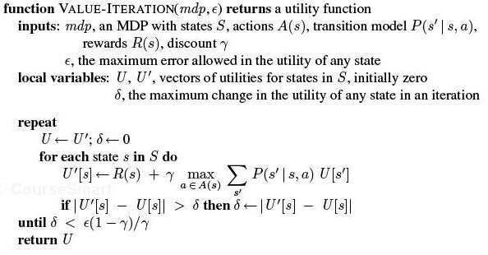
VI algorithm

Slide 14
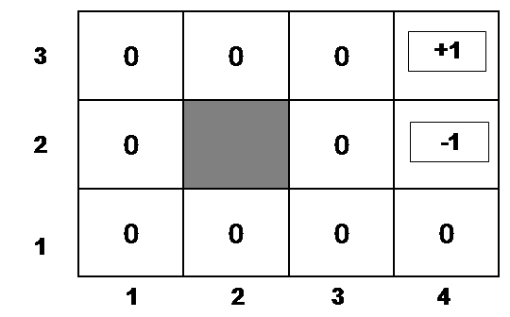
Example
Suppose, for instance, that we start with values V⁽⁰⁾(s) that are all 0
Iteration 0
Iteration 1
3
2
1
0 | 0 | 0
0 |  | 0
0 | 0 | 0 | 0
+1
-1
-0.04
1 2 3 4

Slide 15
Example (cont’d)
Let’s compute V⁽¹⁾(3,3)
Iteration 0
Iteration 1
3
2
1
0 | 0 | 0
0 |  | 0
0 | 0 | 0 | 0
0.76
+1
-1
-0.04
-0.4
1 2 3 4

Slide 16
Example (cont’d)
Let’s compute V⁽¹⁾(4,1)
Iteration 0
Iteration 1
3
2
1
0 | 0 | 0
0 |  | 0
0 | 0 | 0 | 0
.76
+1
-1
-0.04
-0.04
1 2 3 4

Slide 17
After a Full Iteration
Iteration 1
3
2
1
-.04 | -.04 | 0.76
-.04 |  | -.04
-.04 | -.04 | -.04 | -.04
+1
-1
1 2 3 4
Only the state one step away from a positive reward (3,3) has gained value, all the others are losing value
Notes:
?because of the cost of moving?
Because at best they are all one step from states with 0 value

Slide 18
Some steps in the second iteration
Iteration 1
Iteration 2
3
2
1
-.04 | -.04 | 0.76
-.04 |  | -.04
-.04 | -.04 | -.04 | -.04
3
2
1
-.04 | -.04 | 0.76
-.04 |  | -.04
-.04 | -.04 | -.04 | -.04
+1
+1
-1
-1
-0.08
1 2 3 4
1 2 3 4

Slide 19
Example (cont’d)
Let’s compute V⁽¹⁾(2,3)
Steps two moves away from positive rewards start increasing their value
Iteration 2
Iteration 1
-.04 | -.04 | 0.76
-.04 |  | -.04
-.04 | -.04 | -.04 | -.04
0.56
+1
3
2
1
-.04 | -.04 | 0.76
-.04 |  | -.04
-.04 | -.04 | -.04 | -.04
+1
-1
-1
-0.08
1 2 3 4
1 2 3 4

Slide 20
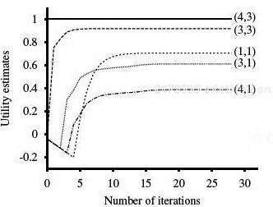
State Utilities as Function of Iteration #
 |  | (3,3) | (4,3)
 |  |  | (4,2)
(1,1) |  | (3,1) | (4,1)
Note that values of states at different distances from (4,3) accumulate negative rewards until a path to (4,3) is found

Slide 21
Value Iteration: Computational Complexity
Value iteration works by producing successive approximations of the optimal value function.
What is the complexity of each iteration?
…or faster if there is sparsity in the transition function.
A. O(|A|²|S|)
B. O(|A||S|²)
C. O(|A|²|S|²)
Notes:
Computational Complexity
Value iteration works by producing successive approximations of the optimal value function. Each iteration can be performed in O(|A||S|²) steps, or faster if there is sparsity in the transition function. However, the number of iterations required can grow exponentially in the discount factor [27]; as the discount factor approaches 1, the decisions must be based on results that happen farther and farther into the future. In practice, policy iteration converges in fewer iterations than value iteration, although the per-iteration costs of O(|A||S|² ⁺ |S|³ ) can be prohibitive. There is no known tight worst-case bound available for policy iteration [66]. Modified policy iteration [91] seeks a trade-off between cheap and effective iterations and is preferred by some practictioners [96].

Slide 22
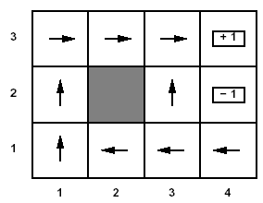
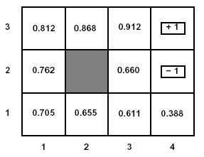
U(s) and R(s)
Note that U(s) and R(s) are quite different quantities
R(s) is the short term reward related to s
U(s) is the expected long term total reward from s onward if following л*
Example: U(s) for the optimal policy we found for the grid problem with R(s non-terminal) = -0.04 and γ =1

Slide 23
Relevance to state of the art MDPs
FROM : Planning with Markov Decision Processes: An AI Perspective Mausam (UW), Andrey Kolobov (MSResearch) Synthesis Lectures on Artificial Intelligence and Machine Learning Jun 2012
Free online through UBC
“ Value Iteration (VI) forms the basis of most of the advanced MDP algorithms that we discuss in the rest of the book. ……..”

Slide 24
Lecture Overview
Markov Decision Processes
……
Finding the Optimal Policy
Value Iteration
From Values to the Policy
Rewards and Optimal Policy

Slide 25
Value Iteration: from state values V to л*
Now the agent can chose the action that implements the MEU principle: maximize the expected utility of the subsequent state

Slide 26
Value Iteration: from state values V to л*
Now the agent can chose the action that implements the MEU principle: maximize the expected utility of the subsequent state
expected value of following policy л* in s’
states reachable
from s by doing a
Probability of getting to s’ from s via a

Slide 27
Example: from state values V to л*
To find the best action in (1,1)

Slide 28
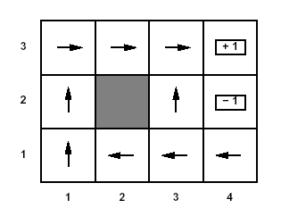
Optimal policy
This is the policy that we obtain….

Slide 29
Learning Goals for today’s class
You can:
Define/read/write/trace/debug the Value Iteration (VI) algorithm. Compute its complexity.
Compute the Optimal Policy given the output of VI
Explain influence of rewards on optimal policy

Slide 30
TODO for Fri
Read Textbook 9.5.6 Partially Observable MDPs
Also Do Practice Ex. 9.C http://www.aispace.org/exercises.shtml

