Slide 1
Intelligent Systems (AI-2)
Computer Science cpsc422, Lecture 27
Nov, 16, 2015
Notes:
Lecture 26

Slide 2
NLP: Knowledge-Formalisms Map (including probabilistic formalisms)
State Machines (and prob. versions)
(Finite State Automata,Finite State Transducers, Markov Models)
Morphology
Machine Learning
Syntax
Rule systems (and prob. versions)
(e.g., (Prob.) Context-Free Grammars)
Semantics
Pragmatics
Discourse and Dialogue
Logical formalisms (First-Order Logics, Prob. Logics)
AI planners (Task decomposition, MDP Markov Decision Processes)
Notes:
My Conceptual map - This is the master plan
Markov Models used for part-of-speech and dialog
Syntax is the study of formal relationship between words
How words are clustered into classes (that determine how they group and behave)
How they group with they neighbors into phrases

Slide 3
Lecture Overview
Recap English Syntax and Parsing
Key Problem with parsing: Ambiguity
Probabilistic Context Free Grammars (PCFG)
Treebanks and Grammar Learning

Slide 4
Key Constituents: Examples
(Specifier) X (Complement)
Noun phrases (NP)
Verb phrases (VP)
Prepositional phrases (PP)
Adjective phrases(AP)
Sentences (S)
(Det) N (PP)
the cat on the table
(Qual) V (NP)
never eat a cat
(Deg) P (NP)
almost in the net
(Deg) A (PP)
very happy about it
(NP) (-) (VP)
a mouse -- ate it
Notes:
Sequence of words surrounding at least one noun
They appear in similar “environments” Before a verb
Substitution for PP location :“there”

Slide 5
Context Free Grammar (CFG)
4-tuple (non-term., term., productions, start)
(N, ∑, P, S)
P is a set of rules A→α; A∈N, α∈(∑∪N)*

Slide 6
CFG Example
Grammar with example phrases
Lexicon
Notes:
A CFG consist of a set of productions or rules
Each rule how symbol in the language can be grouped and ordered together
Terminal correspond to “words” in the language
S -> NP VP
says
that there are units called S, NP, and VP in this language
that an S consists of an NP followed immediately by a VP
but does not say
that that’s the only kind of S
that this is the only place that NPs and VPs occur
In linguistics, the term nominal refers to a category used to group together nouns and adjectives based on shared properties. The motivation for nominal grouping is that in many languages nouns and adjectives share a number of morphological and syntactic properties.

Slide 7
Derivations as Trees
Nominal
Nominal
flight
Notes:
Slight mismatch between grammar and derivation tree ☺
The notion of context in CFGs has nothing to do with the ordinary meaning of the word context in language.
All it really means is that the non-terminal on the left-hand side of a rule is out there all by itself
A -> B C
Means that I can rewrite an A as a B followed by a C regardless of the context in which A is found

Slide 8
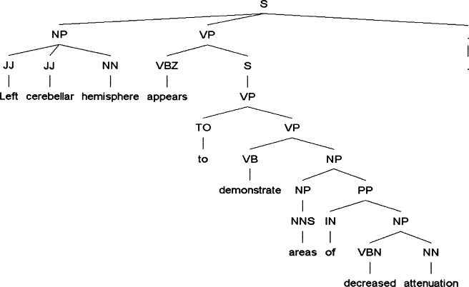
Example of relatively complex parse tree
Journal of the American Medical Informatics Association, 2005, Improved Identification of Noun Phrases in Clinical Radiology Reports Using a High-Performance Statistical Natural Language Parser Augmented with the UMLS Specialist Lexicon
Notes:
Journal of the American Medical Informatics Association
Volume 12, Issue 3, May–June 2005, Pages 275–285
The Practice of Informatics
Improved Identification of Noun Phrases in Clinical Radiology Reports Using a High-Performance Statistical Natural Language Parser Augmented with the UMLS Specialist Lexicon
Yang Huang, MS, ,
Henry J. Lowe, MD,
Dan Klein, PhD,
Russell J. Cucina, MD, MS
Affiliations of the authors: Stanford Medical Informatics and Stanford Center for Clinical Informatics, Stanford University School of Medicine, Stanford, CA (YH, HJL); Computer Science Division, University of California at Berkeley, Berkeley, CA (DK); Department of Medicine, University of California, San Francisco, San Francisco, CA (RJC)

Slide 9
Lecture Overview
Recap English Syntax and Parsing
Key Problem with parsing: Ambiguity
Probabilistic Context Free Grammars (PCFG)
Treebanks and Grammar Learning

Slide 10
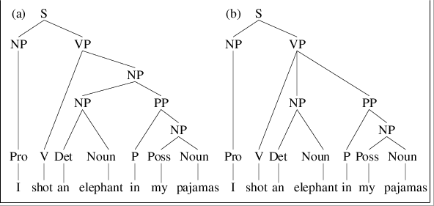
Structural Ambiguity (Ex. 1)
VP -> V NP ; NP -> NP PP
VP -> V NP PP
“I shot an elephant in my pajamas”
Notes:
What are other kinds of ambiguity?
VP -> V NP ; NP -> NP PP
VP -> V NP PP
Attachment non-PP “I saw Mary passing by cs2”
Coordination “new student and profs”
NP-bracketing “French language teacher”
In combinatorial mathematics, the Catalan numbers form a sequence of natural numbers that occur in various counting problems, often involving recursively defined objects.
Catalan numbers (2n)! / (n+1)! n!

Slide 11
Structural Ambiguity (Ex.2)
“I saw Mary passing by cs2”
“I saw Mary passing by cs2”
(ROOT
(S
(NP (PRP I))
(VP (VBD saw)
(S
(NP (NNP Mary))
(VP (VBG passing)
(PP (IN by)
(NP (NNP cs2)))))))
(ROOT
(S
(NP (PRP I))
(VP (VBD saw)
(NP (NNP Mary))
(S
(VP (VBG passing)
(PP (IN by)
(NP (NNP cs2)))))))
Notes:
What are other kinds of ambiguity?
VP -> V NP ; NP -> NP PP
VP -> V NP PP
Attachment non-PP “I saw Mary passing by cs2”
Coordination “new student and profs”
NP-bracketing “French language teacher”
In combinatorial mathematics, the Catalan numbers form a sequence of natural numbers that occur in various counting problems, often involving recursively defined objects.
Catalan numbers (2n)! / (n+1)! n!

Slide 12
Structural Ambiguity (Ex. 3)
Coordination “new student and profs”
Notes:
What are other kinds of ambiguity?
VP -> V NP ; NP -> NP PP
VP -> V NP PP
Attachment non-PP “I saw Mary passing by cs2”
Coordination “new student and profs”
NP-bracketing “French language teacher”
In combinatorial mathematics, the Catalan numbers form a sequence of natural numbers that occur in various counting problems, often involving recursively defined objects.
Catalan numbers (2n)! / (n+1)! n!

Slide 13
Structural Ambiguity (Ex. 4)
NP-bracketing “French language teacher”
Notes:
What are other kinds of ambiguity?
VP -> V NP ; NP -> NP PP
VP -> V NP PP
Attachment non-PP “I saw Mary passing by cs2”
Coordination “new student and profs”
NP-bracketing “French language teacher”
In combinatorial mathematics, the Catalan numbers form a sequence of natural numbers that occur in various counting problems, often involving recursively defined objects.
Catalan numbers (2n)! / (n+1)! n!

Slide 14
Lecture Overview
Recap English Syntax and Parsing
Key Problem with parsing: Ambiguity
Probabilistic Context Free Grammars (PCFG)
Treebanks and Grammar Learning (acquiring the probabilities)
Intro to Parsing PCFG

Slide 15
Probabilistic CFGs (PCFGs)
GOAL: assign a probability to parse trees and to sentences
Each grammar rule is augmented with a conditional probability
If these are all the rules for VP and .55 is the
VP -> Verb .55
VP -> Verb NP .40
VP -> Verb NP NP ??
A. 1
B. 0
C. .05
D. None of the above
What ?? should be ?
Notes:
P(A->beta|A)
D is a function assigning probabilities to each production/rule in P

Slide 16
Probabilistic CFGs (PCFGs)
GOAL: assign a probability to parse trees and to sentences
Each grammar rule is augmented with a conditional probability
The expansions for a given non-terminal sum to 1
VP -> Verb .55
VP -> Verb NP .40
VP -> Verb NP NP .05
Formal Def: 5-tuple (N, ∑, P, S,D)
Notes:
P(A->beta|A)
D is a function assigning probabilities to each production/rule in P

Slide 17
Sample PCFG

Slide 18
PCFGs are used to….
Estimate Prob. of parse tree
A. Sum of the probs of all the rules applied
B. Product of the probs of all the rules applied
Estimate Prob. of a sentence
A. Sum of the probs of all the parse trees
B. Product of the probs of all the parse trees
Notes:
The probability of a derivation (tree) is just the product of the probabilities of the rules in the derivation.
Product because rule applications are independent (because CFG)
integrate them with n-grams
The probability of a word sequence (sentence) is the probability of its tree in the unambiguous case.
It’s the sum of the probabilities of the trees in the ambiguous case.

Slide 19
PCFGs are used to….
Estimate Prob. of parse tree
Estimate Prob. to sentences
Notes:
The probability of a derivation (tree) is just the product of the probabilities of the rules in the derivation.
Product because rule applications are independent (because CFG)
integrate them with n-grams
The probability of a word sequence (sentence) is the probability of its tree in the unambiguous case.
It’s the sum of the probabilities of the trees in the ambiguous case.

Slide 20
Example

Slide 21
Lecture Overview
Recap English Syntax and Parsing
Key Problem with parsing: Ambiguity
Probabilistic Context Free Grammars (PCFG)
Treebanks and Grammar Learning (acquiring the probabilities)

Slide 22
Treebanks
DEF. corpora in which each sentence has been paired with a parse tree
These are generally created
Parse collection with parser
human annotators revise each parse
Requires detailed annotation guidelines
POS tagset
Grammar
instructions for how to deal with particular grammatical constructions.
Notes:
Treebanks are corpora in which each sentence has been paired with a parse tree (presumably the right one).
These are generally created
By first parsing the collection with an automatic parser
And then having human annotators correct each parse as necessary.
This generally requires detailed annotation guidelines that provide a POS tagset, a grammar and instructions for how to deal with particular grammatical constructions.

Slide 23
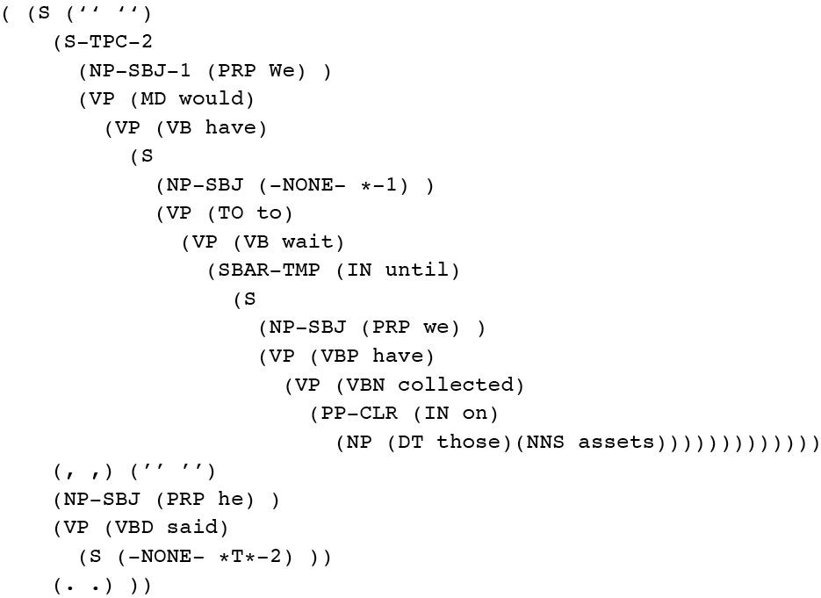
Penn Treebank
Penn TreeBank is a widely used treebank.
Most well known is the Wall Street Journal section of the Penn TreeBank.
1 M words from the 1987-1989 Wall Street Journal.
Notes:
Penn Treebank phrases annotated with grammatical function
To make recovery of predicate argument easier

Slide 24
Treebank Grammars
Treebanks implicitly define a grammar.
Simply take the local rules that make up the sub-trees in all the trees in the collection
if decent size corpus, you’ll have a grammar with decent coverage.
Notes:
Treebanks implicitly define a grammar for the language covered in the treebank.
Simply take the local rules that make up the sub-trees in all the trees in the collection and you have a grammar.
Not complete, but if you have decent size corpus, you’ll have a grammar with decent coverage.

Slide 25
Treebank Grammars
Such grammars tend to contain lots of rules….
For example, the Penn Treebank has 4500 different rules for VPs! Among them...
Notes:
Total of 17,500 rules

Slide 26
Treebank Grammars
Such grammars tend to be very flat due to the fact that they tend to avoid recursion.
To ease the annotators burden
For example, the Penn Treebank has 4500 different rules for VPs! Among them...
Notes:
Total of 17,500 rules

Slide 27
Heads in Trees
Finding heads in treebank trees is a task that arises frequently in many applications.
Particularly important in statistical parsing
We can visualize this task by annotating the nodes of a parse tree with the heads of each corresponding node.

Slide 28
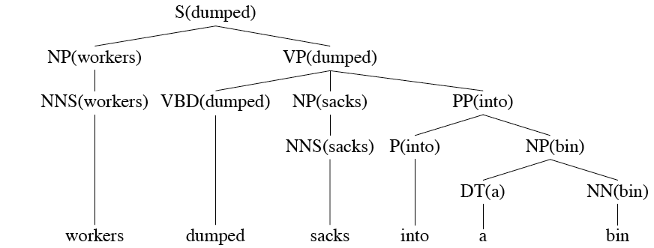
Lexically Decorated Tree

Slide 29
Head Finding
The standard way to do head finding is to use a simple set of tree traversal rules specific to each non-terminal in the grammar.
Each rule in the PCFG specifies where the head of the expanded non-terminal should be found

Slide 30
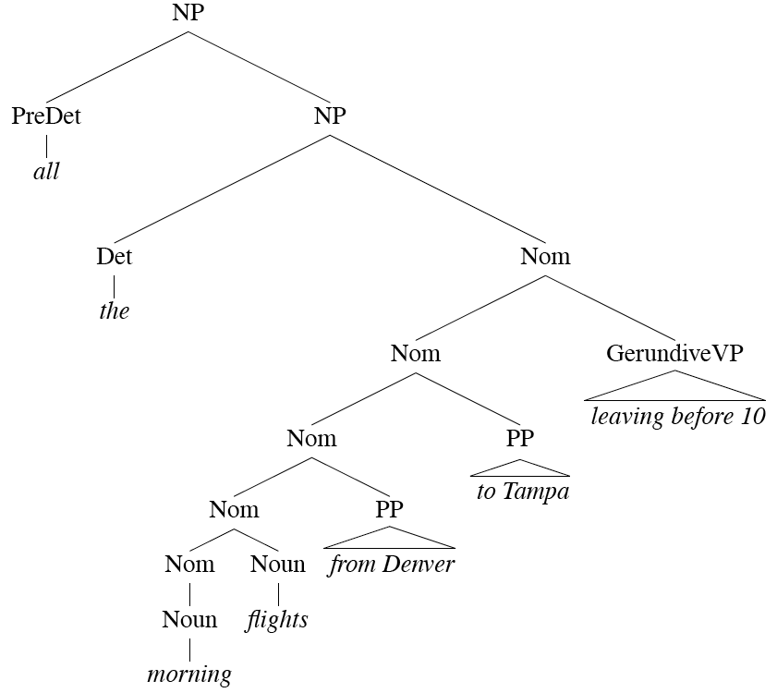
Noun Phrases
Notes:
For each phrase type Simple set of hand-written rules to find the head of such a phrase.
This rules are often called head percolation

Slide 31
Acquiring Grammars and Probabilities
Manually parsed text corpora (e.g., PennTreebank)
Grammar: read it off the parse trees
Ex: if an NP contains an ART, ADJ, and NOUN then we create the rule NP -> ART ADJ NOUN.
Probabilities:
Ex: if the NP -> ART ADJ NOUN rule is used 50 times and all NP rules are used 5000 times, then the rule’s probability is …
Notes:
We can create a PCFG automatically by exploiting manually parsed text corpora, such as the Penn Treebank. We can read off them grammar found in the treebank.
Probabilities: can be assigned by counting how often each item is found in the treebank
Ex: if the NP -> ART ADJ NOUN rule is used 50 times and all NP rules are used 5000 times, then the rule’s probability is 50/5000 = .01

Slide 33
Learning Goals for today’s class
You can:
Provide a formal definition of a PCFG
Apply a PCFG to compute the probability of a parse tree of a sentence as well as the probability of a sentence
Describe the content of a treebank
Describe the process to identify a head of a syntactic constituent
Compute the probability distribution of a PCFG from a treebank

Slide 34
Next class on Wed
Parsing Probabilistic CFG: CKY parsing
PCFG in practice: Modeling Structural and Lexical Dependencies
Assignment-3 due on Fri
Assignment-4 out same day

