Slide 1
Intelligent Systems (AI-2)
Computer Science cpsc422, Lecture 24
Nov, 6, 2015
Slide credit: Satanjeev Banerjee Ted Pedersen 2003, Jurfsky & Martin 2008
Notes:
Lecture 24

Slide 2
Lecture Overview
Semantic Similarity/Distance
Concepts: Thesaurus/Ontology Methods
Words: Distributional Methods

Slide 3
WordNet: entry for “table”
The noun "table" has 6 senses in WordNet.
1. table, tabular array -- (a set of data …)
2. table -- (a piece of furniture …)
3. table -- (a piece of furniture with tableware…)
4. mesa, table -- (flat tableland …)
5. table -- (a company of people …)
6. board, table -- (food or meals …)
The verb "table" has 1 sense in WordNet.
1. postpone, prorogue, hold over, put over,
table, shelve, set back, defer, remit, put off –
(hold back to a later time; "let's postpone the exam")
Notes:
Each blue list is a synset

Slide 4

WordNet Relations (between synsets!)
fi
Notes:
Key point: synsets are related not specific words
Adjectives (synonyms, antonyms)

Slide 5
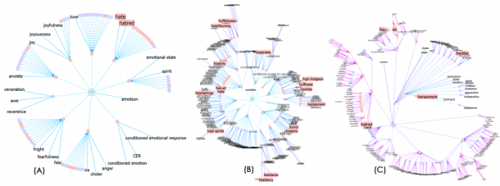
Visualizing Wordnet Relations
C. Collins, “WordNet Explorer: Applying visualization principles to lexical semantics,” University of Toronto, Technical Report kmdi 2007-2, 2007.

Slide 6
Semantic Similarity/Distance: example
(n) table -- (a piece of furniture having a smooth flat top that is usually supported by one or more vertical legs)
(n) mesa, table -- (flat tableland with steep edges)
(n) lamp (a piece of furniture holding one or more electric light bulbs)
(n) hill (a local and well-defined elevation of the land)
Notes:
Each blue list is a synset

Slide 7

Semantic Similarity/Distance
Between two concepts in an ontology, e.g., between two senses in Wordnet
What would you use to compute it ?
  A. The distance between the two concepts in the underlying hierarchies / graphs
  B. The glosses of the concepts
  C. None of the above
  D. Both of the above
Notes:
Or semantic distance
More similar if they Share more features of meaning or are near synonyms
Applications
Information extraction, question answering, summarization, language modeling (by clustering words)

Slide 8
Gloss Overlaps ≈ Relatedness
Lesk’s (1986) idea: Related word senses are (often) defined using the same words. E.g:
  bank(1): “a financial institution”
  bank(2): “sloping land beside a body of water”
  lake: “a body of water surrounded by land”
Notes:
To compare across POS: use the glosses

Slide 9
Gloss Overlaps ≈ Relatedness
Lesk’s (1986) idea: Related word senses are (often) defined using the same words. E.g:
  bank(1): “a financial institution”
  bank(2): “sloping land beside a body of water”
  lake: “a body of water surrounded by land”

Slide 10
Gloss Overlaps ≈ Relatedness
Lesk’s (1986) idea: Related word senses are (often) defined using the same words. E.g:
  bank(1): “a financial institution”
  bank(2): “sloping land beside a body of water”
  lake: “a body of water surrounded by land”
Gloss overlaps = # content words common to two glosses ≈ relatedness
  Thus, relatedness (bank(2), lake) = 3
  And, relatedness (bank(1), lake) = 0

Slide 11
Limitations of (Lesk’s)
Gloss Overlaps
Most glosses are very short.
  So not enough words to find overlaps with.
Solution?
Extended gloss overlaps
  Add glosses of synsets connected to the input synsets.

Slide 12
Extending a Gloss
sentence: “the
penalty meted out to one
adjudged guilty”
bench: “persons
who hear cases in a
court of law”
# overlapped words = 0
Notes:
Benerjee and Pedersen 2003

Slide 13
Extending a Gloss
final judgment: “a
judgment disposing of the case
before the court of law”
hypernym
sentence: “the
penalty meted out to one
adjudged guilty”
bench: “persons
who hear cases in a
court of law”
# overlapped words = 0

Slide 14
Extending a Gloss
final judgment: “a
judgment disposing of the case
before the court of law”
hypernym
sentence: “the
penalty meted out to one
adjudged guilty”
bench: “persons
who hear cases in a
court of law”
# overlapped words = 2
Notes:
S: (n) final judgment, final decision (a judgment disposing of the case before the court; after the judgment (or an appeal from it) is rendered all that remains is to enforce the judgment)
direct hyponym / full hyponym
S: (n) conviction, judgment of conviction, condemnation,sentence ((criminal law) a final judgment of guilty in a criminal case and the punishment that is imposed) "the conviction came as no surprise"
S: (n) acquittal (a judgment of not guilty)

Slide 15
Creating the Extended Gloss Overlap Measure
How to measure overlaps?
Which relations to use for gloss extension?

Slide 16
How to Score Overlaps?
Lesk simply summed up overlapped words.
But matches involving phrases – phrasal matches – are rarer, and more informative
  E.g. “court of law” “body of water”
Aim: Score of n words in a phrase > sum of scores of n words in shorter phrases
Solution: Give a phrase of n words a score of
  “court of law” gets score of 9.
  bank(2): “sloping land beside a body of water”
  lake: “a body of water surrounded by land”
Notes:
Holonymy is the opposite of meronymy.

Slide 17
Which Relations to Use?
Typically include…
Hypernyms [ “car” → “vehicle” ]
Hyponyms [ “car” → “convertible” ]
Meronyms [ “car” → “accelerator” ]
Holonym [ “car” → “train” ]
…
Notes:
Holonymy is the opposite of meronyms
S: (n) car, railcar, railway car, railroad car (a wheeled vehicle adapted to the rails of railroad) "three cars had jumped the rails"
The following pointer types are usually used to indicate lexical relations: Antonym, Pertainym, Participle, Also See, Derivationally Related. The remaining pointer types are generally used to represent semantic relations.
Also-see relation [“enter” → “move in” ]
Attribute [ “measure” → “standard” ]
derivationally related form
W: (v) standardize [Related to: standard] "The weights and measures were standardized"
W: (v) standardise [Related to: standard] "The weights and measures were standardized"
W: (adj) criterial [Related to: criterion]
W: (adj) criterional [Related to: criterion]

Slide 18
Extended Gloss Overlap Measure
Input two synsets A and B
Find phrasal gloss overlaps between A and B
For each relation, compute phrasal gloss overlaps between every synset connected to A, and
every synset connected to B
Add phrasal scores to get relatedness of A and B
A and B can be from different parts of speech!
Notes:
One possibility in which the relations pairs is
Gloss gloss
Hyper hyper
Hypo hypo
(see paper for details)

Slide 19
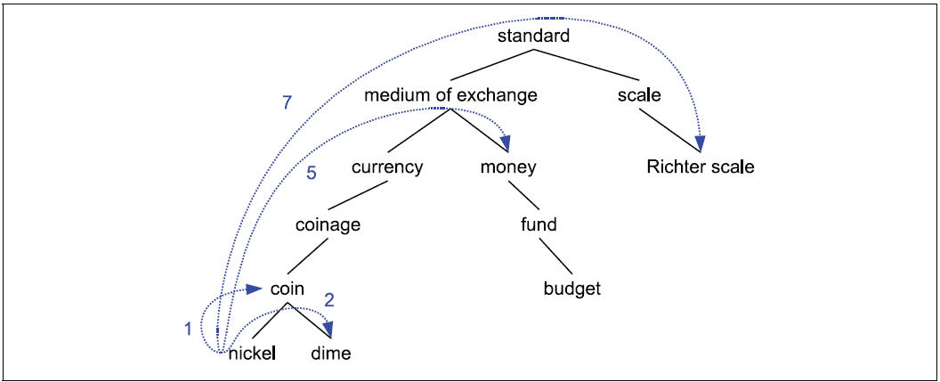
Distance: Path-length
Path-length sim based on is-a/hypernyms hierarchies
But this is assuming that all the links are the same…. Encode the same semantic distance….
Notes:
The lower the concept in the hierarchy the lower its probability
Animal
S: (n) cat, true cat (feline mammal usually having thick soft fur and no ability to roar: domestic cats; wildcats)
S: (n) guy, cat, hombre, bozo (an informal term for a youth or man) "a nice guy"; "the guy's only doing it for some doll"
S: (n) cat (a spiteful woman gossip) "what a cat she is!"
S: (n) kat, khat, qat, quat, cat, Arabian tea, African tea (the leaves of the shrub Catha edulis which are chewed like tobacco or used to make tea; has the effect of a euphoric stimulant) "in Yemen kat is used daily by 85% of adults"
S: (n) cat-o'-nine-tails, cat (a whip with nine knotted cords) "British sailors feared the cat"
S: (n) Caterpillar, cat (a large tracked vehicle that is propelled by two endless metal belts; frequently used for moving earth in construction and farm work)
S: (n) big cat, cat (any of several large cats typically able to roar and living in the wild)
S: (n) computerized tomography, computed tomography, CT, computerized axial tomography, computed axial tomography, CAT (a method of examining body organs by scanning them with X rays and using a computer to construct a series of cross-sectional scans along a single axis)

Slide 20
Probability of a concept/sense and its info content
probability
Information Content
Notes:
Or not all edges are equal….
The lower the concept in the hierarchy the lower its probability
Animal
S: (n) cat, true cat (feline mammal usually having thick soft fur and no ability to roar: domestic cats; wildcats)
S: (n) guy, cat, hombre, bozo (an informal term for a youth or man) "a nice guy"; "the guy's only doing it for some doll"
S: (n) cat (a spiteful woman gossip) "what a cat she is!"
S: (n) kat, khat, qat, quat, cat, Arabian tea, African tea (the leaves of the shrub Catha edulis which are chewed like tobacco or used to make tea; has the effect of a euphoric stimulant) "in Yemen kat is used daily by 85% of adults"
S: (n) cat-o'-nine-tails, cat (a whip with nine knotted cords) "British sailors feared the cat"
S: (n) Caterpillar, cat (a large tracked vehicle that is propelled by two endless metal belts; frequently used for moving earth in construction and farm work)
S: (n) big cat, cat (any of several large cats typically able to roar and living in the wild)
S: (n) computerized tomography, computed tomography, CT, computerized axial tomography, computed axial tomography, CAT (a method of examining body organs by scanning them with X rays and using a computer to construct a series of cross-sectional scans along a single axis)

Slide 21
Concept Distance: info content
Similarity should be proportional to the information that the two concepts share… what is that?
probability
Information
Lowest Common Subsumer
Notes:
Or not all edges are equal….
The lower the concept in the hierarchy the lower its probability
Animal
S: (n) cat, true cat (feline mammal usually having thick soft fur and no ability to roar: domestic cats; wildcats)
S: (n) guy, cat, hombre, bozo (an informal term for a youth or man) "a nice guy"; "the guy's only doing it for some doll"
S: (n) cat (a spiteful woman gossip) "what a cat she is!"
S: (n) kat, khat, qat, quat, cat, Arabian tea, African tea (the leaves of the shrub Catha edulis which are chewed like tobacco or used to make tea; has the effect of a euphoric stimulant) "in Yemen kat is used daily by 85% of adults"
S: (n) cat-o'-nine-tails, cat (a whip with nine knotted cords) "British sailors feared the cat"
S: (n) Caterpillar, cat (a large tracked vehicle that is propelled by two endless metal belts; frequently used for moving earth in construction and farm work)
S: (n) big cat, cat (any of several large cats typically able to roar and living in the wild)
S: (n) computerized tomography, computed tomography, CT, computerized axial tomography, computed axial tomography, CAT (a method of examining body organs by scanning them with X rays and using a computer to construct a series of cross-sectional scans along a single axis)

Slide 22
Given this measure of similarity
Are these two the same?
  A. Yes
  B. No
  C. Cannot tell
Is this reasonable?
  A. Yes
  B. No
  C. Cannot tell

Slide 23
Concept Distance: info content
One of best performers – Jiang-Conrath distance
How much information the two DO NOT share
Notes:
The lower the concept in the hierarchy the lower its probability
Animal
S: (n) cat, true cat (feline mammal usually having thick soft fur and no ability to roar: domestic cats; wildcats)
S: (n) guy, cat, hombre, bozo (an informal term for a youth or man) "a nice guy"; "the guy's only doing it for some doll"
S: (n) cat (a spiteful woman gossip) "what a cat she is!"
S: (n) kat, khat, qat, quat, cat, Arabian tea, African tea (the leaves of the shrub Catha edulis which are chewed like tobacco or used to make tea; has the effect of a euphoric stimulant) "in Yemen kat is used daily by 85% of adults"
S: (n) cat-o'-nine-tails, cat (a whip with nine knotted cords) "British sailors feared the cat"
S: (n) Caterpillar, cat (a large tracked vehicle that is propelled by two endless metal belts; frequently used for moving earth in construction and farm work)
S: (n) big cat, cat (any of several large cats typically able to roar and living in the wild)
S: (n) computerized tomography, computed tomography, CT, computerized axial tomography, computed axial tomography, CAT (a method of examining body organs by scanning them with X rays and using a computer to construct a series of cross-sectional scans along a single axis)

Slide 24
Concept Distance: info content
One of best performers – Jiang-Conrath distance
How much information the two DO NOT share
This is a measure of distance. Reciprocal for similarity!
Problem for measures working on hierarchies/graphs: only compare concepts associated with words of part part-of speech (typically nouns)
Notes:
The lower the concept in the hierarchy the lower its probability
Animal
S: (n) cat, true cat (feline mammal usually having thick soft fur and no ability to roar: domestic cats; wildcats)
S: (n) guy, cat, hombre, bozo (an informal term for a youth or man) "a nice guy"; "the guy's only doing it for some doll"
S: (n) cat (a spiteful woman gossip) "what a cat she is!"
S: (n) kat, khat, qat, quat, cat, Arabian tea, African tea (the leaves of the shrub Catha edulis which are chewed like tobacco or used to make tea; has the effect of a euphoric stimulant) "in Yemen kat is used daily by 85% of adults"
S: (n) cat-o'-nine-tails, cat (a whip with nine knotted cords) "British sailors feared the cat"
S: (n) Caterpillar, cat (a large tracked vehicle that is propelled by two endless metal belts; frequently used for moving earth in construction and farm work)
S: (n) big cat, cat (any of several large cats typically able to roar and living in the wild)
S: (n) computerized tomography, computed tomography, CT, computerized axial tomography, computed axial tomography, CAT (a method of examining body organs by scanning them with X rays and using a computer to construct a series of cross-sectional scans along a single axis)

Slide 25
Concept Distance: info content
One of best performers – Jiang-Conrath distance
How much information the two DO NOT share
This is a measure of distance. Reciprocal for similarity!
Problem for measures working on hierarchies/graphs: only compare concepts associated with words of part part-of speech (typically nouns)
Notes:
The lower the concept in the hierarchy the lower its probability
Animal
S: (n) cat, true cat (feline mammal usually having thick soft fur and no ability to roar: domestic cats; wildcats)
S: (n) guy, cat, hombre, bozo (an informal term for a youth or man) "a nice guy"; "the guy's only doing it for some doll"
S: (n) cat (a spiteful woman gossip) "what a cat she is!"
S: (n) kat, khat, qat, quat, cat, Arabian tea, African tea (the leaves of the shrub Catha edulis which are chewed like tobacco or used to make tea; has the effect of a euphoric stimulant) "in Yemen kat is used daily by 85% of adults"
S: (n) cat-o'-nine-tails, cat (a whip with nine knotted cords) "British sailors feared the cat"
S: (n) Caterpillar, cat (a large tracked vehicle that is propelled by two endless metal belts; frequently used for moving earth in construction and farm work)
S: (n) big cat, cat (any of several large cats typically able to roar and living in the wild)
S: (n) computerized tomography, computed tomography, CT, computerized axial tomography, computed axial tomography, CAT (a method of examining body organs by scanning them with X rays and using a computer to construct a series of cross-sectional scans along a single axis)

Slide 27
Best Performers
Jiang-Conrath
Extended Lesk
Wordnet::Similarity Package
Pedersen et al. 2004
(also in NLTK)
Notes:
The lower the concept in the hierarchy the lower its probability
Animal
S: (n) cat, true cat (feline mammal usually having thick soft fur and no ability to roar: domestic cats; wildcats)
S: (n) guy, cat, hombre, bozo (an informal term for a youth or man) "a nice guy"; "the guy's only doing it for some doll"
S: (n) cat (a spiteful woman gossip) "what a cat she is!"
S: (n) kat, khat, qat, quat, cat, Arabian tea, African tea (the leaves of the shrub Catha edulis which are chewed like tobacco or used to make tea; has the effect of a euphoric stimulant) "in Yemen kat is used daily by 85% of adults"
S: (n) cat-o'-nine-tails, cat (a whip with nine knotted cords) "British sailors feared the cat"
S: (n) Caterpillar, cat (a large tracked vehicle that is propelled by two endless metal belts; frequently used for moving earth in construction and farm work)
S: (n) big cat, cat (any of several large cats typically able to roar and living in the wild)
S: (n) computerized tomography, computed tomography, CT, computerized axial tomography, computed axial tomography, CAT (a method of examining body organs by scanning them with X rays and using a computer to construct a series of cross-sectional scans along a single axis)

Slide 28
Lecture Overview
Semantic Similarity/Distance
Concepts: Thesaurus/Ontology Methods
Words: Distributional Methods – Word Similarity (WS)

Slide 29
Word Similarity: Distributional Methods
Do not have any thesauri/ontologies for target language (e.g., Russian)
If you have thesaurus/ontology, still
  Missing domain-specific (e.g., technical words)
  Poor hyponym knowledge (for V) and nothing for Adj and Adv
  Difficult to compare senses from different hierarchies (although extended Lesk can do this)
Solution: extract similarity from corpora
Basic idea: two words are similar if they appear in similar contexts

Slide 30
WS Distributional Methods (1)
Context: feature vector
Stop list
Example: f_{i} how many times w_{i} appeared in the neighborhood of w
Notes:
Ex 64 million word corpus
Relations like
N to V (subject, object, indirect-object)
N to N (genitive, ncomp)

Slide 31
WS Distributional Methods (2)
More informative values (referred to as weights or measure of association in the literature)
Point-wise Mutual Information
t-test
Notes:
Ex 64 million word corpus

Slide 32
PMI example

Slide 33
WS Distributional Methods (3)
Similarity between vectors
v
α
w
Not sensitive to extreme values
Normalized (weighted) number of overlapping features
Notes:
Ex 64 million word corpus

Slide 34
WS Distributional Methods (4)
Best combination overall (Curan 2003)
  t-test for weights
  Jaccard (or Dice) for vector similarity
Notes:
Ex 64 million word corpus

Slide 35
Learning Goals for today’s class
You can:
Describe and Justify metrics to compute the similarity/distance of two concepts in an ontology
Describe and Justify distributional metrics to compute the similarity/distance of two words (or phrases) in a Natural Language

Slide 36
Next class Mon: Paper Discussion
Carenini G., Ng R., Zwart E., Extracting Knowledge from Evaluative Text, 3rd International Conference on Knowledge Capture (KCAP 2005). Banff, Canada. October 2-5, 2005.
Assignment-3 out – due Nov 20

Slide 37
WS: Thesaurus Methods (path-length)
Path-length sim based on isa hierarchies
If we do not have
Word Sense Disambiguation
Notes:
The lower the concept in the hierarchy the lower its probability
Animal
S: (n) cat, true cat (feline mammal usually having thick soft fur and no ability to roar: domestic cats; wildcats)
S: (n) guy, cat, hombre, bozo (an informal term for a youth or man) "a nice guy"; "the guy's only doing it for some doll"
S: (n) cat (a spiteful woman gossip) "what a cat she is!"
S: (n) kat, khat, qat, quat, cat, Arabian tea, African tea (the leaves of the shrub Catha edulis which are chewed like tobacco or used to make tea; has the effect of a euphoric stimulant) "in Yemen kat is used daily by 85% of adults"
S: (n) cat-o'-nine-tails, cat (a whip with nine knotted cords) "British sailors feared the cat"
S: (n) Caterpillar, cat (a large tracked vehicle that is propelled by two endless metal belts; frequently used for moving earth in construction and farm work)
S: (n) big cat, cat (any of several large cats typically able to roar and living in the wild)
S: (n) computerized tomography, computed tomography, CT, computerized axial tomography, computed axial tomography, CAT (a method of examining body organs by scanning them with X rays and using a computer to construct a series of cross-sectional scans along a single axis)

Slide 38
Sim/Distance: from concepts to words
If we do not have
Word Sense Disambiguation
Notes:
The lower the concept in the hierarchy the lower its probability
Animal
S: (n) cat, true cat (feline mammal usually having thick soft fur and no ability to roar: domestic cats; wildcats)
S: (n) guy, cat, hombre, bozo (an informal term for a youth or man) "a nice guy"; "the guy's only doing it for some doll"
S: (n) cat (a spiteful woman gossip) "what a cat she is!"
S: (n) kat, khat, qat, quat, cat, Arabian tea, African tea (the leaves of the shrub Catha edulis which are chewed like tobacco or used to make tea; has the effect of a euphoric stimulant) "in Yemen kat is used daily by 85% of adults"
S: (n) cat-o'-nine-tails, cat (a whip with nine knotted cords) "British sailors feared the cat"
S: (n) Caterpillar, cat (a large tracked vehicle that is propelled by two endless metal belts; frequently used for moving earth in construction and farm work)
S: (n) big cat, cat (any of several large cats typically able to roar and living in the wild)
S: (n) computerized tomography, computed tomography, CT, computerized axial tomography, computed axial tomography, CAT (a method of examining body organs by scanning them with X rays and using a computer to construct a series of cross-sectional scans along a single axis)

Slide 39
WordSim: Thesaurus Methods(Extended Lesk)
For each n-word phrase that occurs in both glosses, Extended Lesk adds in a score n²
Notes:
The lower the concept in the hierarchy the lower its probability
Animal
S: (n) cat, true cat (feline mammal usually having thick soft fur and no ability to roar: domestic cats; wildcats)
S: (n) guy, cat, hombre, bozo (an informal term for a youth or man) "a nice guy"; "the guy's only doing it for some doll"
S: (n) cat (a spiteful woman gossip) "what a cat she is!"
S: (n) kat, khat, qat, quat, cat, Arabian tea, African tea (the leaves of the shrub Catha edulis which are chewed like tobacco or used to make tea; has the effect of a euphoric stimulant) "in Yemen kat is used daily by 85% of adults"
S: (n) cat-o'-nine-tails, cat (a whip with nine knotted cords) "British sailors feared the cat"
S: (n) Caterpillar, cat (a large tracked vehicle that is propelled by two endless metal belts; frequently used for moving earth in construction and farm work)
S: (n) big cat, cat (any of several large cats typically able to roar and living in the wild)
S: (n) computerized tomography, computed tomography, CT, computerized axial tomography, computed axial tomography, CAT (a method of examining body organs by scanning them with X rays and using a computer to construct a series of cross-sectional scans along a single axis)

Slide 40
Semantic Similarity/Distance
Between two concepts in an ontology, e.g., between two senses in Wordnet
What would you use
Thesaurus methods: measure distance in online thesauri (e.g., Wordnet)
Distributional methods: finding if the two words appear in similar contexts
Notes:
Or semantic distance
More similar if they Share more features of meaning or are near synonyms
Applications
Information extraction, question answering, summarization, language modeling (by clustering words)

Slide 41
WDS: Dictionary and Thesaurus Methods
Most common: Lesk method
Choose the sense whose dictionary gloss shares most words with the target word’s neighborhood
Exclude stop-words
Def: Words in gloss for a sense is called the signature
Notes:
Extension: target signature is compared with the signature of each of the content words

Slide 42
Lesk: Example
Two SENSES for channel
S1: (n) channel (a passage for water (or other fluids) to flow through) "the fields were crossed with irrigation channels"; "gutters carried off the rain water into a series of channels under the street"
S2: (n) channel, television channel, TV channel (a television station and its programs) "a satellite TV channel"; "surfing through the channels"; "they offer more than one hundred channels"
…..
“ most streets closed to the TV station were flooded because the main channel was clogged by heavy rain .”

Slide 43
Corpus Lesk
Best performer
If a corpus with annotated senses is available
For each sense: add to the signature for that sense, words “that frequently appear” in the sentences containing that sense
CORPUS
……
“most streets closed to the TV station were flooded because the main <S1> channel </S1> was clogged by heavy rain.
…..
Notes:
Words weighted by IDF(i) log(Ndoc / nd(i))

Slide 44
Word Similarity/Semantic Distance
Actually relation between two senses
sun vs. moon – mouth vs. food – hot vs. cold
Applications?
Thesaurus methods: measure distance in online thesauri (e.g., Wordnet)
Distributional methods: finding if the two words appear in similar contexts
Notes:
Or semantic distance
More similar if they Share more features of meaning or are near synonyms
Applications
Information extraction, question answering, summarization, language modeling (by clustering words)

Slide 45
WS: Thesaurus Methods(1)
Path-length based sim on hyper/hypo hierarchies
Information content word similarity (not all edges are equal)
probability
Information
Lowest Common Subsumer
Notes:
The lower the concept in the hierarchy the lower its probability
Animal
S: (n) cat, true cat (feline mammal usually having thick soft fur and no ability to roar: domestic cats; wildcats)
S: (n) guy, cat, hombre, bozo (an informal term for a youth or man) "a nice guy"; "the guy's only doing it for some doll"
S: (n) cat (a spiteful woman gossip) "what a cat she is!"
S: (n) kat, khat, qat, quat, cat, Arabian tea, African tea (the leaves of the shrub Catha edulis which are chewed like tobacco or used to make tea; has the effect of a euphoric stimulant) "in Yemen kat is used daily by 85% of adults"
S: (n) cat-o'-nine-tails, cat (a whip with nine knotted cords) "British sailors feared the cat"
S: (n) Caterpillar, cat (a large tracked vehicle that is propelled by two endless metal belts; frequently used for moving earth in construction and farm work)
S: (n) big cat, cat (any of several large cats typically able to roar and living in the wild)
S: (n) computerized tomography, computed tomography, CT, computerized axial tomography, computed axial tomography, CAT (a method of examining body organs by scanning them with X rays and using a computer to construct a series of cross-sectional scans along a single axis)

Slide 46
Ontologies
Given a logical representation (e.g., FOL)
What individuals and relations are there and we need to model?
In AI an Ontology is a specification of what individuals and relationships are assumed to exist and what terminology is used for them
What types of individuals
What properties of the individuals
Notes:
13.2.1 Choosing Individuals and Relations
Given a logical representation language, such as the one developed in the previous chapter, and a world to reason about, the people designing knowledge bases have to choose what, in the world, to refer to. That is, they have to choose what individuals and relations there are. It may seem that they can just refer to the individuals and relations that exist in the world. However, the world does not determine what individuals there are. How the world is divided into individuals is invented by whomever is modeling the world. The modeler divides up the world up into things so that the agent can refer to parts of the world that make sense for the task at hand.
To share and communicate knowledge, it is important to be able to come up with a common vocabulary and an agreed-on meaning for that vocabulary.
A conceptualization is a mapping between symbols used in the computer (i.e., the vocabulary) and the individuals and relations in the world. It provides a particular abstraction of the world and notation for that abstraction. A conceptualization for small knowledge bases can be in the head of the designer or specified in natural language in the documentation. This informal specification of a conceptualization does not scale to larger systems where the conceptualization must be shared.
In philosophy, ontology is the study of what exists. In AI, an ontology is a specification of the meanings of the symbols in an information system. That is, it is a specification of a conceptualization. It is a specification of what individuals and relationships are assumed to exist and what terminology is used for them. Typically, it specifies what types of individuals will be modeled, specifies what properties will be used, and gives some axioms that restrict the use of that vocabulary.
13.3 Ontologies and Knowledge Sharing
Building large knowledge-based systems is complex because
Knowledge often comes from multiple sources and must be integrated. Moreover, these sources may not have the same division of the world. Often knowledge comes from different fields that have their own distinctive terminology and divide the world according to their own needs.
Systems evolve over time and it is difficult to anticipate all future distinctions that should be made.
The people involved in designing a knowledge base must choose what individuals and relationships to represent. The world is not divided into individuals; that is something done by intelligent agents to understand the world. Different people involved in a knowledge-based system should agree on this division of the world.
It is difficult to remember what your own notation means, let alone to discover what someone else's notation means. This has two aspects:
given a symbol used in the computer, determining what it means;
given a concept in someone's mind, determining what symbol they should use; that is, determining whether the concept has been used before and, if it has, discovering what notation has been used for it.
n

Slide 47
Ontologies: inspiration from Natural Language
:
How do we refer to individuals and relationship in the world in NL e.g., English?
Where do we find definitions for words?
  Most of the definitions are circular? They are descriptions.
  Fortunately, there is still some useful semantic info (Lexical Relations):
  w₁ w₂ same Form and Sound, different Meaning
  w₁ w₂ same Meaning, different Form
  w₁ w₂ “opposite” Meaning
  w₁ w₂ Meaning₁ subclass of Meaning₂
Homonymy
Synonymy
Antonymy
Hyponymy
Notes:
Meaning of words
Relations among words and their meanings (Paradigmatic)
Internal structure of individual words (Syntagmatic)
Repositories of information about the meaning of words, but…..
We can use them because some lexemes are grounded in the external word (perception (visual systems), ….)
Red blood
The list of relations presented here is by no means exhaustive

Slide 48
Polysemy
Def. The case where we have a set of words with the same form and multiple related meanings.
Consider the homonym:
bank → commercial bank₁ vs. river bank₂
Now consider: “A PCFG can be trained using derivation trees from a tree bank annotated by human experts”
Is this a new independent sense of bank?
Notes:
meanings associated with it
Most non-rare words have multiple meanings
The number of meanings is related to its frequency
Verbs tend more to polysemy
Distinguishing polysemy from homonymy isn’t always easy (or necessary)

Slide 49
Synonyms
Def. Different words with the same meaning.
Substitutability- if they can be substituted for one another in some environment without changing meaning or acceptability.
Would I be flying on a large/big plane?
?… became kind of a large/big sister to…
? You made a large/big mistake
Notes:
Synonyms clash with polysemous meanings (one sense of big is older)
Collocation: big mistake sounds more natural
There aren’t any…
Maybe not, but people think and act like there are so maybe there are…
PURCHASE / BUY
One test…
Two lexemes are synonyms if they can be successfully substituted for each other in all situations
Too strong!

Slide 50
Hyponymy
Def. Pairings where one word denotes a subclass of the other
  Since dogs are canids
    Dog is a hyponym of canid and
    Canid is a hypernym of dog
  car/vehicle
  doctor/human
  ……
Notes:
A hyponymy relation can be asserted between two lexemes when the meanings of the lexemes entail a subset relation

Slide 51
Lexical Resources
Databases containing all lexical relations among all words
Development:
  Mining info from dictionaries and thesauri
  Handcrafting it from scratch
WordNet: fist developed with reasonable coverage and widely used, started with [Fellbaum… 1998]
  for English (versions for other languages have been developed – see MultiWordNet)

Slide 52
WordNet 3.0
POS | Unique Strings | Synsets | Word-Sense Pairs
Noun | 117798 | 82115 | 146312
Verb | 11529 | 13767 | 25047
Adjective | 21479 | 18156 | 30002
Adverb | 4481 | 3621 | 5580
Totals | 155287 | 117659 | 206941
For each word: all possible senses (no distinction between homonymy and polysemy)
For each sense: a set of synonyms (synset) and a gloss
Notes:
So bass includes fish-sense instrument-sense musical-range-sense
The noun "bass" has 8 senses in WordNet.
1. bass -- (the lowest part of the musical range)
2. bass, bass part -- (the lowest part in polyphonic music)
3. bass, basso -- (an adult male singer with the lowest voice)
4. sea bass, bass -- (the lean flesh of a saltwater fish of the family Serranidae)
5. freshwater bass, bass -- (any of various North American freshwater fish with lean flesh (especially of the genus Micropterus))
6. bass, bass voice, basso -- (the lowest adult male singing voice)
7. bass -- (the member with the lowest range of a family of musical instruments)
8. bass -- (nontechnical name for any of numerous edible marine and freshwater spiny-finned fishes)

Slide 53
WordNet: entry for “table”
The noun "table" has 6 senses in WordNet.
1. table, tabular array -- (a set of data …)
2. table -- (a piece of furniture …)
3. table -- (a piece of furniture with tableware…)
4. mesa, table -- (flat tableland …)
5. table -- (a company of people …)
6. board, table -- (food or meals …)
The verb "table" has 1 sense in WordNet.
1. postpone, prorogue, hold over, put over,
table, shelve, set back, defer, remit, put off –
(hold back to a later time; "let's postpone the exam")
Notes:
Each blue list is a synset

Slide 54
WordNet Relations (between synsets!)
fi
Notes:
Key point: synsets are related not specific words
Adjectives (synonyms, antonyms)

Slide 55
WordNet Hierarchies: “Vancouver”
WordNet: example from ver1.7.1
For the three senses of “Vancouver”
⇒(city, metropolis, urban center)
⇒ (municipality)
⇒ (urban area)
⇒ (geographical area)
⇒ (region)
⇒ (location)
⇒ (entity, physical thing)
⇒ (administrative district, territorial division)
⇒ (district, territory)
⇒ (region)
⇒ (location ⇒ (entity, physical thing)
⇒ (port)
⇒ (geographic point)
⇒ (point)
⇒ (location)
⇒ (entity, physical thing)
Notes:
Now 3.0

Slide 56
Wordnet: NLP Tasks
First success in Probabilistic Parsing (PP-attachments): words + word-classes extracted from the hypernym hierarchy increase accuracy from 84% to 88% [Stetina and Nagao, 1997]
Word sense disambiguation
Lexical Chains (summarization)
…… and many others !
More importantly starting point for larger Ontologies!
Notes:
If you know the right attachment for “acquire a company for money”,
“purchase a car for money”
Can help you to decide the attachment for “buy books for money”
John assassinated the senator

Slide 57
More ideas from NLP….
Relations among words and their meanings (paradigmatic)
Internal structure of individual words (syntagmatic)

Slide 58
Predicate-Argument Structure
Represent relationships among concepts, events and their participants
“I ate a turkey sandwich for lunch”
∃ w: Isa(w,Eating) ∧ Eater(w,Speaker) ∧ Eaten(w,TurkeySandwich) ∧ MealEaten(w,Lunch)
“Nam does not serve meat”
∃ w: Isa(w,Serving) ∧ Server(w, Nam) ∧ ¬Served(w,Meat)
Notes:
All human languages
a specific relation holds between the concepts expressed by the words or the phrases
Events, actions and relationships can be captured with representations that consist of predicates and arguments.
Languages display a division of labor where some words and constituents function as predicates and some as arguments.
One of the most important roles of the grammar is to help organize this pred-args structure

Slide 59
Semantic Roles: Resources
Move beyond inferences about single verbs
“ IBM hired John as a CEO ”
“ John is the new IBM hire ”
“ IBM signed John for 2M$”
FrameNet: Databases containing frames and their syntactic and semantic argument structures
(book online Version 1.5-update Sept, 2010)
  for English (versions for other languages are under development)
Notes:
10,000 lexical units (defined below), more than 6,100 of which are fully annotated, in more than 825 hierarchically structured semantic frames, exemplified in more than 135,000 annotated sentences
John was HIRED to clean up the file system.
IBM HIRED Gates as chief janitor.
I was RETAINED at $500 an hour.
The A's SIGNED a new third baseman for $30M.

Slide 60
FrameNet Entry
Hiring
Definition: An Employer hires an Employee, promising the Employee a certain Compensation in exchange for the performance of a job. The job may be described either in terms of a Task or a Position in a Field.
Inherits From: Intentionally affect
Lexical Units: commission.n, commission.v, give job.v, hire.n, hire.v, retain.v, sign.v, take on.v
Notes:
Very specific thematic roles!

Slide 61
FrameNet Annotations
Some roles..
Employer
Employee
Task
Position
np-vpto
  In 1979 , singer Nancy Wilson HIRED him to open her nightclub act .
  ….
np-ppas
  Castro has swallowed his doubts and HIRED Valenzuela as a cook in his small restaurant .
Includes counting: How many times a role was
expressed with a particular syntactic structure…
Notes:
Shallow semantic parsing is labeling phrases of a sentence with semantic roles with respect to a target word.
For example, the sentence
“Shaw Publishing offered Mr. Smith a reimbursement last March.”
Is labeled as:
[AGENTShaw Publishing] offered [RECEPIENTMr. Smith] [THEMEa reimbursement] [TIMElast March] .
We work with a number of collaborators, beginning with Dan Gildea in his dissertation work, on automatic semantic parsing. Much of Dan Gildeas's dissertation work was written up here: Daniel Gildea and Daniel Jurafsky. 2002. Automatic Labeling of Semantic Roles. Computational Linguistics 28:3, 245-288. This work also involves close collaboration with the FrameNet and PropBank projects.
Currently, we focus on building joint probabilistic models for simultaneous assignment of labels to all nodes in a syntactic parse tree. These models are able to capture the strong correlations among decisions at different nodes.
CompensationPeripheral
EmployeeCore
EmployerCore
FieldCore
InstrumentPeripheral
MannerPeripheral
MeansPeripheral
PlacePeripheral
PositionCore
PurposeExtra-Thematic
TaskCore
TimePeripheral

Slide 62
Lecture Overview
Ontologies – what objects/individuals should we represent? what relations (unary, binary,..)?
Inspiration from Natural Language: WordNet and FrameNet
Extensions based on Wikipedia and mining the Web (YAGO, ProBase, Freebase)
Domain Specific Ontologies (e.g., Medicine: MeSH, UMLS)

Slide 63
YAGO2: huge semantic knowledge base
Derived from Wikipedia, WordNet and GeoNames. (started in 2007, paper in www conference)
10⁶ entities (persons, organizations, cities, etc.)
>120* 10⁶ facts about these entities.
YAGO accuracy of 95%. has been manually evaluated.
Anchored in time and space. YAGO attaches a temporal dimension and a spatial dimension to many of its facts and entities.
Notes:
YAGO2s is a huge semantic knowledge base, derived from Wikipedia WordNet and GeoNames. Currently, YAGO2s has knowledge of more than 10 million entities (like persons, organizations, cities, etc.) and contains more than 120 million facts about these entities.
YAGO is special in several ways:
The accuracy of YAGO has been manually evaluated, proving a confirmed accuracy of 95%. Every relation is annotated with its confidence value.
YAGO is an ontology that is anchored in time and space. YAGO attaches a temporal dimension and a spacial dimension to many of its facts and entities.
In addition to a taxonomy, YAGO has thematic domains such as "music" or "science" from WordNet Domains.

Slide 64
Probase (MS Research)
Harnessed from billions of web pages and years worth of search logs
Extremely large concept/category space (2.7 million categories).
Probabilistic model for correctness, typicality (e.g., between concept and instance)
Notes:
Knowledge in Probase is harnessed from billions of web pages and years worth of search logs -- these are nothing more than the digitized footprints of human communication.
Probase is unique in two aspects. First, Probase has an extremely large concept/category space (2.7 million categories). As these concepts are automatically acquired from web pages authored by millions of users, it is probably true that they cover most concepts in our mental world (about worldly facts). Second, data in Probase, as knowledge in our mind, is not black or white. Probase quantifies the uncertainty. These serve as the priors and likelihoods that become the foundations of probabilistic reasoning in Probase.
Our mental world contains many concepts about worldly facts, and Probase tries to duplicate them. The core taxonomy of Probase alone contains above 2.7 million concepts. Figure 2 shows their distribution. The Y axis is the number of instances each concept contains(logarithmic scale), and on the X axis are the 2.7 million concepts ordered by their size. In contrast, existing knowledge bases have far fewer concepts (Freebase [3] contains no more than 2,000 concepts, and Cyc [7] has about 120,000 concepts), which fall short of modeling our mental world. As we can see in Figure 2, besides popular concepts such as “cities” and “musicians”, which are included by almost every general purpose taxonomy, Probase has millions of long tail concepts such as “anti-parkinson treatments”, "celebrity wedding dress designers” and “basic watercolor techniques”, which cannot be found in Freebase or Cyc. Besides concepts, Probase also has a large data space (each concept contains a set of instances or sub-concepts), a large attribute space (each concept is described by a set of attributes), and a large relationship space (e.g.,“locatedIn”, "friendOf”, "mayorOf”, as well as relationships that are not easily named, such as the relationship between apple and Newton.)
Another feature of Probase is that it is probabilistic, which means every claim in Probase is associated with some probabilities that model the claim’s correctness, typicality, ambiguity, and other characteristics. The probabilities are derived from evidences found in web data, search log data, and other existing taxonomies. For example, for typicality (between concepts and instances), Probase contains the following probabilities:
P(C=company|I=apple): How likely people will think of the concept “company” when they see the word “apple”.
P(I=steve jobs|C=ceo): How likely “steve jobs” will come into mind when people think about the concept “ceo”.
Probase also has typicality scores for concepts and attributes. Another important score in Probase is the similarity between any
two concepts y1 and y2 (e.g., celebrity and famous politicians). Thus Probase can tell that natural disasters and politicians are very different concepts,endangered species and tropical rainforest plants have certain relationships, while countries and nations are almost the same concepts.
These probabilities serve as priors and likelihoods for Bayesian reasoning on top of Probase. In addition, the probabilistic nature of Probase also enables it to incorporate data of varied quality from heterogeneous sources. Probase regards external data as evthese probabilities serve as priors and likelihoods for Bayesian reasoning on top of Probase.

Slide 65
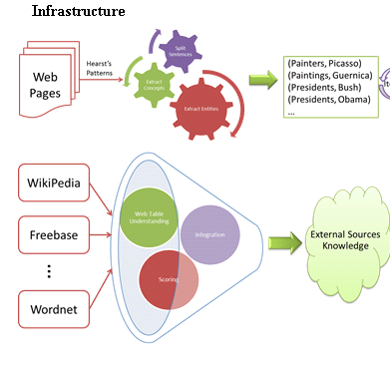

Slide 66
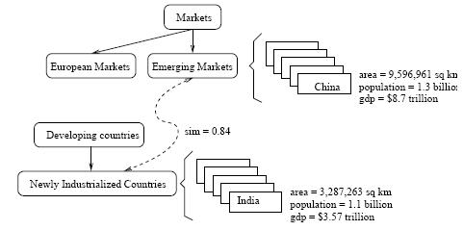
A snippet of Probase's core taxonomy
Notes:
shows what is inside Probase. The knowledgebase consists of concepts (e.g. emerging markets), instances (e.g., China), attributes and values (e.g., China's population is 1.3 billion), and relationships (e.g., emerging markets, as a concept, is closely related to newly industrialized countries), all of which are automatically derived in an unsupervised manner.

Slide 67
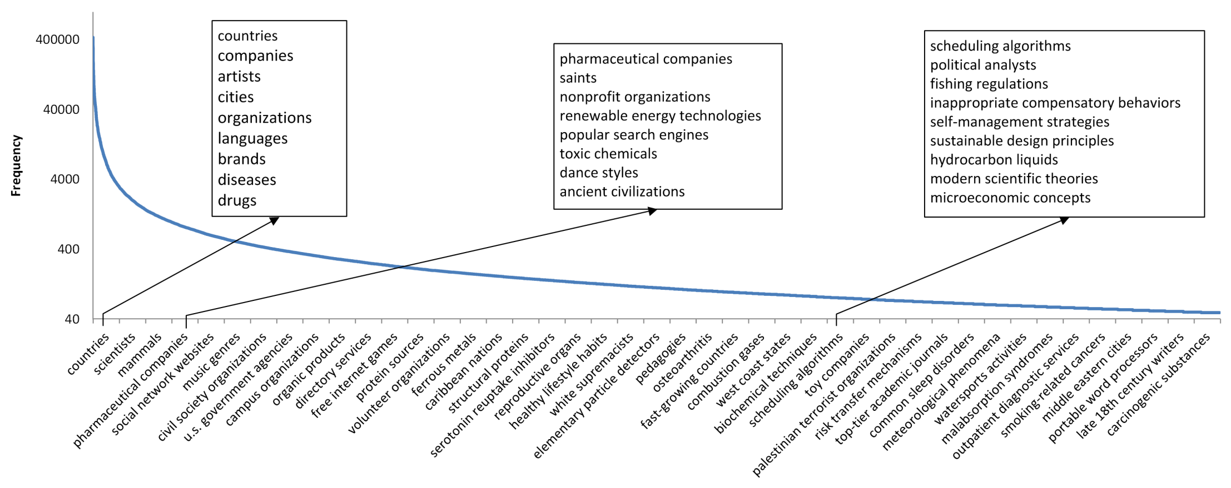
Frequency distribution of the 2.7 million concepts
Notes:
Figure 2 shows their distribution. The Y axis is the number of instances each concept contains(logarithmic scale), and on the X axis are the 2.7 million concepts ordered by their size. In contrast, existing knowledge bases have far fewer concepts (Freebase [3] contains no more than 2,000 concepts, and Cyc [7] has about 120,000 concepts), which fall short of modeling our mental world. As we can see in Figure 2, besides popular concepts such as “cities” and “musicians”, which are included by almost every general purpose taxonomy, Probase has millions of long tail concepts such as “anti-parkinson treatments”, "celebrity wedding dress designers” and “basic watercolor techniques”, which cannot be found in Freebase or Cyc.

Slide 68
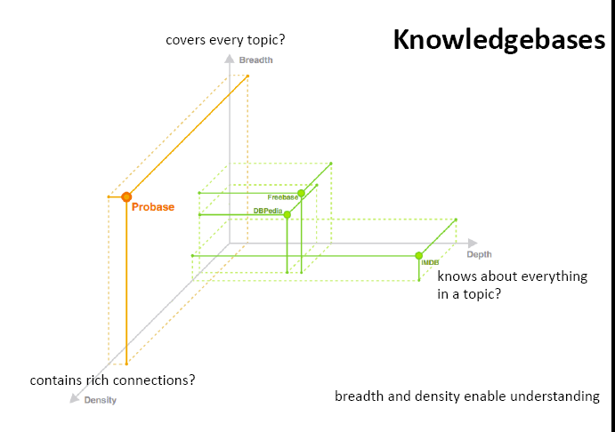
Interesting dimensions to compare Ontologies
(but form Probase so possibly biased)

Slide 69
Freebase
“Collaboratively constructed database.”
Freebase contains tens of millions of topics, thousands of types, and tens of thousands of properties and over a billion of facts
Automatically extracted from a number of resources including Wikipedia, MusicBrainz, and NNDB
as well as the knowledge contributed by the human volunteers.
Each Freebase entity is assigned a set of human-readable unique keys, which are assembled of a value and a namespace.
All available for free through the APIs or to download from our weekly data dumps
Notes:
What is Freebase?
Freebase contains tens of millions of topics, thousands of types, and tens of thousands of properties. By comparison, English Wikipedia has over 4 million articles. Each of the topics in Freebase is linked to other related topics and annotated with important properties like movie genres and people's dates of birth. There are over a billion such facts or relations that make up the graph and they're all available for free through the APIs or to download from our weekly data dumps.
Notable Names Database (NNDB) is an online database of biographical details of over 40,000 people of note
MusicBrainz is an open music encyclopedia that collects music metadata and makes it available to the public.

Slide 70
Lecture Overview
Ontologies – what objects/individuals should we represent? what relations (unary, binary,..)?
Inspiration from Natural Language: WordNet and FrameNet
Extensions based on Wikipedia and mining the Web (YAGO, ProBase, Freebase)
Domain Specific Ontologies (e.g., Medicine: MeSH, UMLS)

Slide 71
Domain Specific Ontologies: UMLS, MeSH
Unified Medical Language System: brings together many health and biomedical vocabularies
Enable interoperability (linking medical terms, drug names)
Develop electronic health records, classification tools
Search engines, data mining
Notes:
What is the UMLS?
The UMLS, or Unified Medical Language System, is a set of files and software that brings together many health and biomedical vocabularies and standards to enable interoperability between computer systems.
You can use the UMLS to enhance or develop applications, such as electronic health records, classification tools, dictionaries and language translators.
More About the UMLS
Presentations and Publications
UMLS Reference Manual
UMLS Basics Tutorial
Source Vocabulary Information
UMLS Video Learning Resources
UMLS in Use
One powerful use of the UMLS is linking health information, medical terms, drug names, and billing codes across different computer systems. Some examples of this are:
Linking terms and codes between your doctor, your pharmacy, and your insurance company
Patient care coordination among several departments within a hospital
The UMLS has many other uses, including search engine retrieval, data mining, public health statistics reporting, and terminology research.
More Uses of the UMLS
NLM Applications
UMLS Community
Health Information Technology
Supporting Interoperability
The Three UMLS Tools
The UMLS has three tools, which we call the Knowledge Sources:
Metathesaurus: Terms and codes from many vocabularies, including CPT®, ICD-10-CM, LOINC®, MeSH®, RxNorm, and SNOMED CT®
Semantic Network: Broad categories (semantic types) and their relationships (semantic relations)
SPECIALIST Lexicon and Lexical Tools: Natural language processing tools
We use the Semantic Network and Lexical Tools to produce the Metathesaurus. Metathesaurus production involves:
Processing the terms and codes using the Lexical Tools
Grouping synonymous terms into concepts
Categorizing concepts by semantic types from the Semantic Network
Incorporating relationships and attributes provided by vocabularies
Releasing the data in a common format
Although we integrate these tools for Metathesaurus production, you can access them separately or in any combination according to your needs.

Slide 72
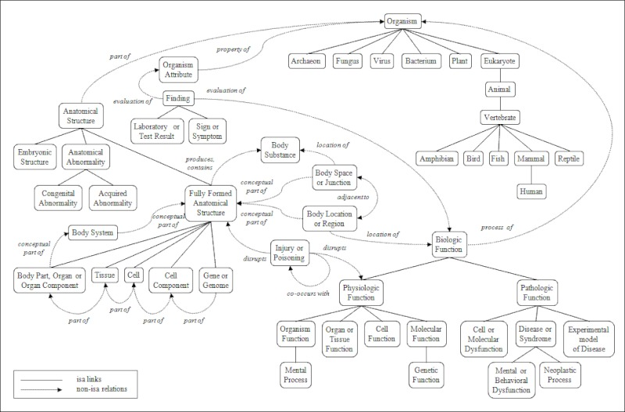
Portion of the UMLS Semantic Net
Notes:
igure 3. A Portion of the UMLS Semantic Network: Relations
The Semantic Network contains 133 semantic types and 54 relationships.

Slide 73
WSD: More Recent Trends SemEval workshops –
Cross Language Evaluation Forum (CLEF)
Better ML techniques (e.g., Combining Classifiers)
Combining ML and Lesk (Yuret,2004)
Other Languages
Building better/larger corpora
Notes:
Agirre and Edmonds 2006: a comprehensive edited volume that summarizes the state of the art in WSD

Slide 74
State-of-the-art systems and current literature
For online (certified) public systems see course web page
R. Navigli. Word Sense Disambiguation: a Survey. ACM Computing
Surveys, 41(2), ACM Press, 2009, pp. 1-69.

