Slide 1
Intelligent Systems (AI-2)
Computer Science cpsc422, Lecture 2
Jan, 7, 2015
Notes:
Lecture 2

Slide 2
Lecture Overview
Value of Information and Value of Control
Markov Decision Processes (MDPs)
Formal Specification and example
Define a policy for an MDP

Slide 3
Cpsc 322 Big Picture
Environment
Deterministic
Stochastic
Problem
Arc Consistency
Search
Constraint Satisfaction
Vars +
Constraints
SLS
Static
Belief Nets
Query
Logics
Var. Elimination
Search
Markov Chains
Sequential
STRIPS
Decision Nets
Planning
Var. Elimination
Search
Representation
Reasoning
Technique
Notes:
If you have not taken 322 last semester – go back to notes!
We will build directly on all this!

Slide 4
Simple Decision Net
Early in the morning. Shall I take my umbrella today? (I’ll have to go for a long walk at noon)
Relevant Random Variables?
Notes:
Example syntactic
Simplest <-> degenerate case
Weather Forecast Umbrella

Slide 5
Polices for Umbrella Problem
A policy specifies what an agent should do under each circumstance (for each decision, consider the parents of the decision node)
In the Umbrella case:
D₁
One possible Policy
pD₁
How many policies?

Slide 6
Value of Information
Early in the morning. I listen to the weather forecast, shall I take my umbrella today? (I’ll have to go for a long walk at noon)
What would help the agent make a better Umbrella decision?

Slide 7
Value of Information
The value of information of a random variable X for decision D is:
the utility of the network with an arc from X to D minus the utility of the network without the arc.
Intuitively:
The value of information is always
It is positive only if the agent changes
Notes:
Clickers
- First question?
– structure of the network?

Slide 8
Value of Information (cont.)
The value of information provides a bound on how much you should be prepared to pay for a sensor. How much is a perfect weather forecast worth?
77
Original maximum expected utility:
Maximum expected utility when we know Weather:
Better forecast is worth at most:
91

Slide 9
Value of Information
The value of information provides a bound on how much you should be prepared to pay for a sensor. How much is a perfect fire sensor worth?
-22.6
Original maximum expected utility:
Maximum expected utility when we know Fire:
Perfect fire sensor is worth:
-2
Notes:
Clickers
- Non forgetting link to call

Slide 10
Value of Control
What would help the agent to make an even better Umbrella decision? To maximize its utility.
Weather Umbrella | Value
Rain true Rain false noRain true noRain false | 70 0 20 100
The value of control of a variable X is :
the utility of the network when you make X a decision variable minus the utility of the network when X is a random variable.
Notes:
You need to be explicit about what information is available when you control X.
If you control X without observing, controlling X can be worse than observing X.
If you keep the parents the same, the value of control is always non-negative.

Slide 11
Value of Control
What if we could control the weather?
77
Original maximum expected utility:
Maximum expected utility when we control the weather:
Value of control of the weather:
100

Slide 12
Value of Control
What if we control Tampering?
-22.6
Original maximum expected utility:
Maximum expected utility when we control the Tampering:
Value of control of Tampering:
Let’s take a look at the policy
Conclusion: do not tamper with fire alarms!
-20.7

Slide 13
Lecture Overview
Value of Information and Value of Control
Markov Decision Processes (MDPs)
Formal Specification and example
Define a policy for an MDP

Slide 14
Combining ideas for Stochastic planning
What is a key limitation of decision networks?
What is an advantage of Markov models?
Represent (and optimize) only a fixed number of decisions
The network can extend indefinitely
Goal: represent (and optimize) an indefinite sequence of decisions

Slide 15
Decision Processes
Often an agent needs to go beyond a fixed set of decisions – Examples?
Would like to have an ongoing decision process
Infinite horizon problems: process does not stop
Indefinite horizon problem: the agent does not know when the process may stop
Finite horizon: the process must end at a give time N
Notes:
Helper of a senior
Monitoring system (of a plant)
Treatment of a chronic disease

Slide 16
Planning in Stochastic Environments
Environment
Deterministic
Stochastic
Problem
Arc Consistency
Search
Constraint Satisfaction
Vars +
Constraints
SLS
Static
Belief Nets
Query
Logics
Var. Elimination
Search
Markov Chains and HMMs
Sequential
Decision Nets
STRIPS
Var. Elimination
Planning
Search
Markov Decision Processes
Representation
Value Iteration
Reasoning
Technique
Notes:
R&R Sys Representation and reasoning Systems
Each cell is a R&R system
STRIPS actions preconditions and effects

Slide 17
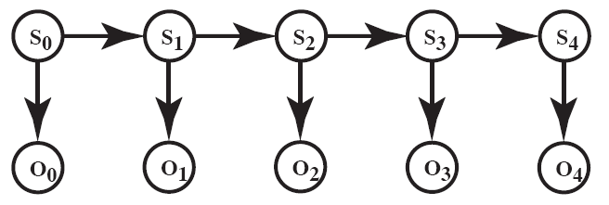
Recap: Markov Models

Slide 18
Markov Models
Markov Chains
Hidden Markov Model
Partially Observable Markov Decision Processes (POMDPs)
Markov Decision Processes (MDPs)

Slide 19
How can we deal with indefinite/infinite Decision processes?
We make the same two assumptions we made for….
The action outcome depends only on the current state
Let S_{t} be the state at time t …
The process is stationary…
We also need a more flexible specification for the utility. How?
Defined based on a reward/punishment R(s) that the agent receives in each state s
Notes:
depends on the sequence of states involved in a decision process (environment history), rather than a single final state
P(S_{t+1}|S₀, A₀,...,S_{t}, A_{t}) = P(S_{t+1}|S_{t}, A_{t})
if P(s’|s , a) is the same at each point in time, where P(s’|s , a) the probability that the agent will be in state s’ after doing action a in state s

Slide 20
MDP: formal specification
For an MDP you specify:
set S of states and set A of actions
the process’ dynamics (or transition model)
P(S_{t+1}|S_{t}, A_{t})
The reward function
R(s, a,, s’)
describing the reward that the agent receives when it performs action a in state s and ends up in state s’
R(s) is used when the reward depends only on the state s and not on how the agent got there
Absorbing/stopping/terminal state

Slide 21
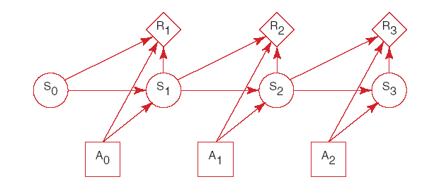
MDP graphical specification
Basically a MDP is a Markov Chain augmented with actions and rewards/values

Slide 22
When Rewards only depend on the state

Slide 23
Learning Goals for today’s class
You can:
Define and compute Value of Information and Value of Control in a decision network
Effectively represent indefinite/infinite decision processes with a Markov Decision Process (MDP)

Slide 24
For Fro:
TODO for this Fri
assignment0 – Google Form
Read textbook 9.5
9.5.1 Value of a Policy
9.5.2 Value of an Optimal Policy
9.5.3 Value Iteration

