Slide 1
Intelligent Systems (AI-2)
Computer Science cpsc422, Lecture 19
Oct, 23, 2015
Slide Sources
Raymond J. Mooney University of Texas at Austin
D. Koller, Stanford CS - Probabilistic Graphical Models
D. Page, Whitehead Institute, MIT
Several Figures from
“Probabilistic Graphical Models: Principles and Techniques” D. Koller, N. Friedman 2009

Slide 2
Lecture Overview
Recap: Naïve Markov – Logistic regression (simple CRF)
CRFs: high-level definition
CRFs Applied to sequence labeling
NLP Examples: Name Entity Recognition, joint POS tagging and NP segmentation

Slide 3
Let’s derive the probabilities we need
Y₁
…
X₁
X₂
X_{n}

Slide 4
Naïve Markov Parameters and Inference
Y₁
…
X₁
X₂
X_{n}

Slide 5
Let’s generalize ….
Assume that you always observe a set of variables X = {X₁…X_{n}} and you want to predict one or more variables Y = {Y₁…Y_{k}}
A CRF is an undirected graphical model whose nodes corresponds to X ∪ Y.
ϕ₁(D₁)… ϕ_{m}(D_{m}) represent the factors which annotate the network (but we disallow factors involving only vars in X – why?)
Notes:
Normalization constant is only difference between this and standard Markov Network definition

Slide 6
Lecture Overview
Recap: Naïve Markov – Logistic regression (simple CRF)
CRFs: high-level definition
CRFs Applied to sequence labeling
NLP Examples: Name Entity Recognition, joint POS tagging and NP segmentation

Slide 7
Sequence Labeling
..
Y₁
Y₂
Y_{T}
Linear-chain CRF
…
X₁
X₂
X_{T}

Slide 8
Increase representational Complexity: Adding Features to a CRF
Instead of a single observed variable X_{i} we can model multiple features X_{ij} of that observation.
Y₁
Y₂
…
Y_{T}
…
…
…
…
X_{1,1}
X_{1,m}
X_{2,1}
X_{2,m}
X_{T,1}
X_{T,m}

Slide 9
CRFs in Natural Language Processing
One target variable Y for each word X, encoding the possible labels for X
Each target variable is connected to a set of feature variables that capture properties relevant to the target distinction
…
Y₁
Y₂
Y_{T}
…
…
…
…
X_{1,1}
X_{1,2}
X_{1,m}
X_{2,1}
X_{2,1}
X_{2,m}
X_{T,1}
X_{T,m}
Is the word capitalized?
Does the word end in “ing”?

Slide 10
Name Entity Recognition Task
Entity often span multiple words “British Columbia”
Type of an entity may not be apparent for individual words “University of British Columbia”
Let’s assume three categories: Person, Location, Organization
BIO notation (for sequence labeling)
Notes:
BIO to allow the model to segment adjacent entities of the same type
The challenge of this problem is that many named entity strings are too rare to appear even in a large
training set, and therefore the system must identify them based only on context.

Slide 11
Linear chain CRF parameters
With two factors “types” for each word
Dependency between neighboring target vars
Dependency between target variable and its context in the word sequence, which can include also features of the words (capitalized, appear in an atlas of location names, etc.)
Factors are similar to the ones for the Naïve Markov (logistic regression)
Notes:
Draw model on the board
Discriminative models, such as CRFs, make conditional independence assumptions
among y, and assumptions about how the y can depend on x, but do
not make conditonal independence assumptions among x. This point
also be understood graphically. Suppose that we have a factor graph
representation for the joint distribution p(y,x). If we then construct a
graph for the conditional distribution p(y|x), any factors that depend
only on x vanish from the graphical structure for the conditional distribution.
They are irrelevant to the conditional because they are constant
with respect to y.

Slide 12
Features can also be
The word
Following word
Previous word
Notes:
There are no factors that depend only on X. They vanish because they are constant with respect to Y

Slide 13
More on features
Including features that are conjunctions of simple features increases accuracy
Total number of features can be 10⁵-10⁶
However features are sparse i.e. most features are 0 for most words

Slide 14
Linear-Chain Performance
Per-token/word accuracy in the high 90% range for many natural datasets
Per-field precision and recall are more often around 80-95% , depending on the dataset. Entire Named Entity Phrase must be correct

Slide 15
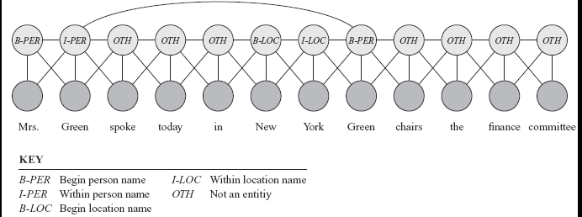
Skip-Chain CRFs
Include additional factors that connect non-adjacent target variables
E.g., When a word occur multiple times in the same documents
Graphical structure over Y can depend on the values of the Xs !
Notes:
The first occurrence has neighboring nodes that provide strong evidence that it is a PERSON’s name; however the second occurrence is much more ambiguous.
New factor “prefers” its connected variables to have the same value
Graphical structure over Y can easily depend on the values of the Xs (the factor / edge is added because the two words are the same)
Additional links make exact inference intractable, so must resort to approximate inference to try to find the most probable labeling.

Slide 16
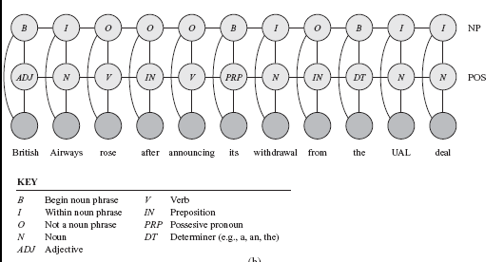
Coupled linear-chain CRFs
Linear-chain CRFs can be combined to perform multiple tasks simultaneously
Performs part-of-speech labeling and noun-phrase segmentation

Slide 17
Coupled linear-chain CRFs
Linear-chain CRFs can be combined to perform multiple tasks simultaneously
Performs part-of-speech labeling and noun-phrase segmentation

Slide 18
Inference in CRFs (just intuition)
Forward / Backward / Smoothing and Viterbi can be rewritten (not trivial!) using these factors
Then you plug in the factors of the CRFs and all the algorithms work fine with CRFs! ☺

Slide 19
CRFs Summary
Ability to relax strong independence assumptions
Ability to incorporate arbitrary overlapping local and global features
Graphical structure over Y can depend on the values of the Xs
Can perform multiple tasks simultaneously
Standard Inference algorithm for HMM can be applied
Practical Leaning algorithms exist
State-of–the-art on many labeling tasks (deep learning recently shown to be often better … ensemble them?)
See MALLET package

Slide 20
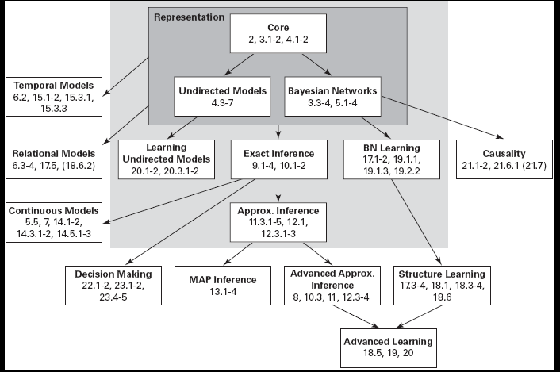
Probabilistic Graphical Models
From “Probabilistic Graphical Models: Principles and Techniques” D. Koller, N. Friedman 2009
Notes:
MAP
Most likely assignment to all of the (non-evidence) variables
Simplest is Viterbi !

Slide 21
422 big picture: Where are we?
Hybrid: Det +Sto
Prob CFG
Prob Relational Models
Markov Logics
Deterministic
Stochastic
Belief Nets
Logics
Approx. : Gibbs
First Order Logics
Markov Chains and HMMs
Ontologies
Temporal rep.
Forward, Viterbi….
Approx. : Particle Filtering
Query
Full Resolution
SAT
Undirected Graphical Models
Markov Networks
Conditional Random Fields
Markov Decision Processes and
Partially Observable MDP
Planning
Value Iteration
Approx. Inference
Reinforcement Learning
Representation
Applications of AI
Reasoning
Technique
Notes:
First Order Logics
Reinforcement Learning (not done in 340, at least in the latest offering)
Markov decision process
Set of states S, set of actions A
Transition probabilities to next states P(s’| s, a′)
Reward functions R(s, s’, a)
RL is based on MDPs, but
Transition model is not known
Reward model is not known
While for MDPs we can compute an optimal policy
RL learns an optimal policy

Slide 22
Learning Goals for today’s class
You can:
Provide general definition for CRF
Apply CRFs to sequence labeling
Describe and justify features for CRFs applied to Natural Language processing tasks
Explain benefits of CRFs

Slide 23
Next class Wed
Midterm, Mon, Oct 26,
we will start at 9am sharp
How to prepare….
Work on practice material posted on Connect
Learning Goals (look at the end of the slides for each lecture – or complete list on Connect)
Revise all the clicker questions and practice exercises
Extra Office Hours TODAY 11:00am - 12:30pm in the DLC
Start Logics
Revise Logics from 322!
CPSC 422, Lecture 19
23

Slide 24
Announcements
Midterm
Avg 73.5 Max 105 Min 30
If score below 70 need to very seriously revise all the material covered so far
You can pick up a printout of the solutions along with your midterm.
Notes:
Count 35
Minimum Value 23.00
Maximum Value 100.00
Average 76.09
Median 80.00 Standard Deviation 15.54 Variance 241.51

Slide 25
Generative vs. Discriminative Models
Generative models (like Naïve Bayes): not directly designed to maximize performance on classification. They model the joint distribution P(X,Y ).
Classification is then done using Bayesian inference
But a generative model can also be used to perform any other inference task, e.g. P(X₁ | X₂, …X_{n}, )
“Jack of all trades, master of none.”
Discriminative models (like CRFs): specifically designed and trained to maximize performance of classification. They only model the conditional distribution P(Y | X ).
By focusing on modeling the conditional distribution, they generally perform better on classification than generative models when given a reasonable amount of training data.
Notes:
Generative models (like Naïve Bayes) are not directly designed to maximize performance on classification. They model the complete joint distribution P(X,Y).
Classification is then done using Bayesian inference given the generative model of the joint distribution.
But a generative model can also be used to perform any other inference task, e.g. P(X₁ | X₂, …X_{n}, )
“Jack of all trades, master of none.”
Discriminative models (like CRFs) are specifically designed and trained to maximize performance of classification. They only model the conditional distribution P(Y | X).
By focusing on modeling the conditional distribution, they generally perform better on classification than generative models when given a reasonable amount of training data.

Slide 26
Naïve Bayes vs. Logistic Regression
Y₁
Naïve
Bayes
…
X₁
X₂
X_{n}
Generative
Discriminative
Conditional
Y₁
Logistic
Regression (Naïve Markov)
…
X₁
X₂
X_{n}
Notes:
classification

Slide 27
Sequence Labeling
..
Y₁
Y₂
Y_{T}
HMM
…
X₁
X₂
X_{T}
Generative
Discriminative
Conditional
..
Y₁
Y₂
Y_{T}
Linear-chain CRF
…
X₁
X₂
X_{T}

