Slide 1
Intelligent Systems (AI-2)
Computer Science cpsc422, Lecture 18
Oct, 21, 2015
Slide Sources
Raymond J. Mooney University of Texas at Austin
D. Koller, Stanford CS - Probabilistic Graphical Models

Slide 2
Lecture Overview
Probabilistic Graphical models
Recap Markov Networks
Applications of Markov Networks
Inference in Markov Networks (Exact and Approx.)
Conditional Random Fields

Slide 3
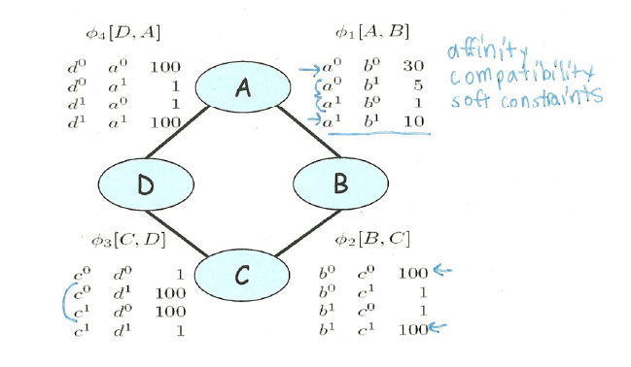
Parameterization of Markov Networks
X
X
Factors define the local interactions (like CPTs in Bnets)
What about the global model? What do you do with Bnets?
Notes:
Not conditional probabilities – capture the affinities between related variables
Also called clique potentials or just potentials
D and A and BC tend to agree. DC tend to disagree
Table values are typically nonnegative
Table values have no other restrictions
Not necessarily probabilities
Not necessarily < 1

Slide 4
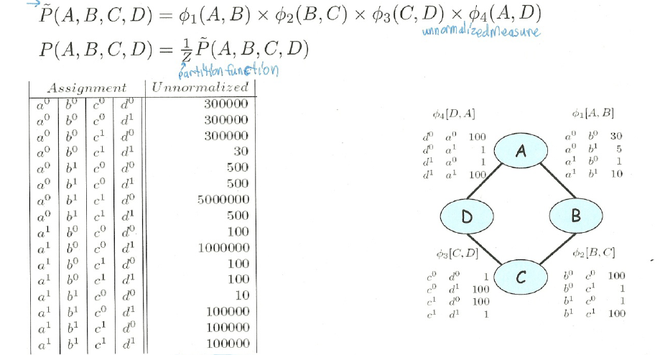
How do we combine local models?
As in BNets by multiplying them!
Notes:
This is the joint distribution from which I can compute any

Slide 5
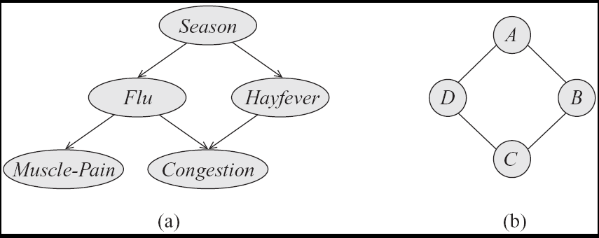
Step Back…. From structure to factors/potentials
In a Bnet the joint is factorized….
In a Markov Network you have one factor for each maximal clique
Notes:
a clique in an undirected graph is a subset of its vertices such that every two vertices in the subset are connected by an edge.

Slide 6
General definitions
Two nodes in a Markov network are independent if and only if every path between them is cut off by evidence
eg for A C
So the markov blanket of a node is…?
eg for C

Slide 7
Lecture Overview
Probabilistic Graphical models
Recap Markov Networks
Applications of Markov Networks
Inference in Markov Networks (Exact and Approx.)
Conditional Random Fields

Slide 8
Markov Networks Applications (1): Computer Vision
Called Markov Random Fields
Stereo Reconstruction
Image Segmentation
Object recognition
Typically pairwise MRF
Each vars correspond to a pixel (or superpixel )
Edges (factors) correspond to interactions between adjacent pixels in the image
  E.g., in segmentation: from generically penalize discontinuities, to road under car
Notes:
Features are extracted from the image for each pixel or superpixel
… include stats over color, texture and location
The features used in the model are then soft-cluster assignments or local classifier outputs for each superpixel
See pag 113

Slide 9
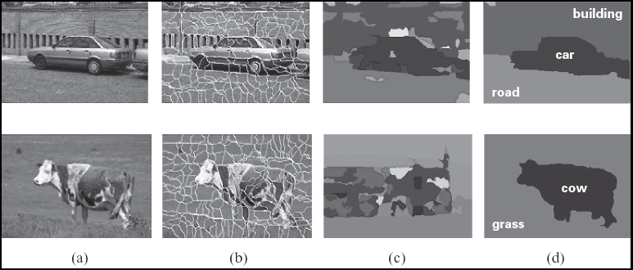
Image segmentation

Slide 10
Image segmentation

Slide 11
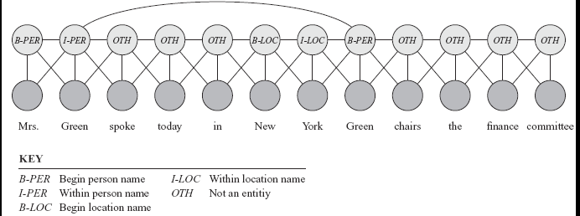
Markov Networks Applications (2): Sequence Labeling in NLP and BioInformatics
Conditional random fields
Notes:
A skip chain CRF for named entity recognition, with connection between adjacent words and long rang connection between multiple occurrences of the same word

Slide 12
Lecture Overview
Probabilistic Graphical models
Recap Markov Networks
Applications of Markov Networks
Inference in Markov Networks (Exact and Approx.)
Conditional Random Fields

Slide 13
Variable elimination algorithm for Bnets
To compute P(Z| Y₁=v₁ ,… ,Y_{j}=v_{j} ) :
Construct a factor for each conditional probability.
Set the observed variables to their observed values.
Given an elimination ordering, simplify/decompose sum of products
Perform products and sum out Z_{i}
Multiply the remaining factors Z
Normalize: divide the resulting factor f(Z) by ∑_{Z} f(Z) .
Variable elimination algorithm for Markov Networks…..
Notes:
They are all going to be only in Q

Slide 14

Gibbs sampling for Markov Networks
Example: P(D | C=0)
Resample non-evidence variables in a pre-defined order or a random order
Suppose we begin with A
  Note: never change evidence!
What do we need to sample?
  A. P(A | B=0)
  B. P(A | B=0, C=0)
  C. P( B=0, C=0| A)
A | B | C | D | E | F
1 | 0 | 0 | 1 | 1 | 0
Notes:
B and C are Markov blanket of A
Calculate P(A | B,C)
Use current Gibbs sampling value for B & C

Slide 15
Example: Gibbs sampling
Resample probability distribution of P(A|BC)
 | A=1 | A=0
C=1 | 1 | 2
C=0 | 3 | 4
 | A=1 | A=0
B=1 | 1 | 5
B=0 | 4.3 | 0.2
A | B | C | D | E | F
1 | 0 | 0 | 1 | 1 | 0
? | 0 | 0 | 1 | 1 | 0
A=1 | A=0
12.9 | 0.8
Normalized result =
A=1 | A=0
0.95 | 0.05

Slide 16
Example: Gibbs sampling
Resample probability distribution of B given A D
 | A=1 | A=0
B=1 | 1 | 5
B=0 | 4.3 | 0.2
A | B | C | D | E | F
1 | 0 | 0 | 1 | 1 | 0
1 | 0 | 0 | 1 | 1 | 0
1 | ? | 0 | 1 | 1 | 0
 | D=1 | D=0
B=1 | 1 | 2
B=0 | 2 | 1
B=1 | B=0
1 | 8.6
Normalized result =
B=1 | B=0
0.11 | 0.89

Slide 17
Lecture Overview
Probabilistic Graphical models
Recap Markov Networks
Applications of Markov Networks
Inference in Markov Networks (Exact and Approx.)
Conditional Random Fields

Slide 18
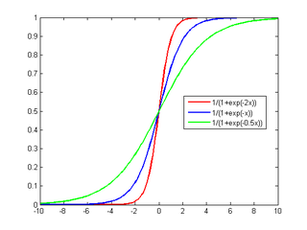
We want to model P(Y₁| X₁.. X_{n})
… where all the X_{i} are always observed
MN
BN
Y₁
Y₁
…
…
X₁
X₂
X_{n}
X₁
X₂
X_{n}
Which model is simpler, MN or BN?
Naturally aggregates the influence of different parents
Notes:
Number of param w_{i} is linear instead of exponential in the number of parents
Natural model for many real-world applications
Naturally aggregates the influence of different parents

Slide 19
  Conditional Random Fields (CRFs)
Model P(Y₁ .. Y_{k} | X₁.. X_{n})
Special case of Markov Networks where all the X_{i} are always observed
  Simple case P(Y₁| X₁…X_{n})
Notes:
To have the network structure and parametrization correspond naturally to a conditional distribution, we want to avoid representing a probabilistic model over X. We therefore disallow potentials that involve only variables in X
IT WOULD PROBABLY HAVE BEEN BETTER TO USE T and F as the two values

Slide 20
What are the Parameters?

Slide 21
Let’s derive the probabilities we need
Y₁
…
X₁
X₂
X_{n}

Slide 22
Let’s derive the probabilities we need
Y₁
…
X₁
X₂
X_{n}

Slide 23
Let’s derive the probabilities we need
Y₁
…
X₁
X₂
X_{n}
0

Slide 24
Let’s derive the probabilities we need
Y₁
…
X₁
X₂
X_{n}

Slide 25
Let’s derive the probabilities we need
Y₁
…
X₁
X₂
X_{n}

Slide 26
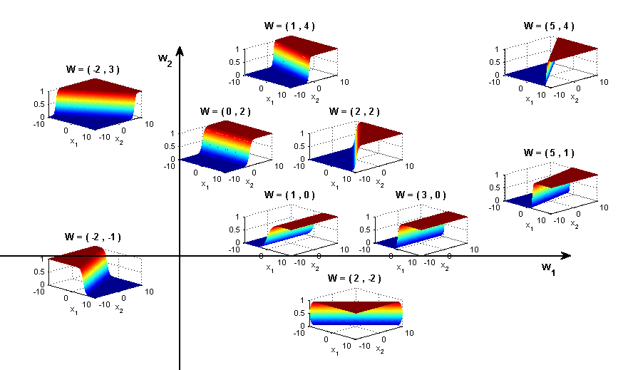
Sigmoid Function used in Logistic Regression
Y₁
Y₁
Great practical interest
Number of param w_{i} is linear instead of exponential in the number of parents
Natural model for many real-world applications
Naturally aggregates the influence of different parents
…
…
X₁
X₂
X_{n}
X₁
X₂
X_{n}

Slide 27
Logistic Regression as a Markov Net (CRF)
Logistic regression is a simple Markov Net (a CRF) aka naïve markov model
Y
…
X₁
X₂
X_{n}
But only models the conditional distribution, P(Y | X ) and not the full joint P(X,Y )

Slide 28
Naïve Bayes vs. Logistic Regression
Y
Naïve
Bayes
…
X₁
X₂
X_{n}
Generative
Discriminative
Conditional
Y
Logistic
Regression (Naïve Markov)
X₁
X₂
X_{n}
…
Notes:
classification

Slide 29
Learning Goals for today’s class
You can:
Perform Exact and Approx. Inference in Markov Networks
Describe a few applications of Markov Networks
Describe a natural parameterization for a Naïve Markov model (which is a simple CRF)
Derive how P(Y|X) can be computed for a Naïve Markov model
Explain the discriminative vs. generative distinction and its implications

Slide 30
Next class Fri
Linear-chain CRFs
To Do
Revise generative temporal models (HMM)
Midterm, Mon, Oct 26,
we will start at 9am sharp
How to prepare….
Work on practice material posted on Connect
Learning Goals (look at the end of the slides for each lecture – or complete list on Connect)
Go to Office Hours (Ted is offering and extra slot on Fri check Piazza
Revise all the clicker questions and practice exercises

Slide 31
Midterm, Mon, Oct 26,
we will start at 9am sharp
How to prepare….
Keep Working on assignment-2 !
Go to Office Hours x
Learning Goals (look at the end of the slides for each lecture – will post complete list)
Revise all the clicker questions and practice exercises
Will post more practice material today

Slide 32
Generative vs. Discriminative Models
Generative models (like Naïve Bayes): not directly designed to maximize performance on classification. They model the joint distribution P(X,Y).
Classification is then done using Bayesian inference
But a generative model can also be used to perform any other inference task, e.g. P(X₁ | X₂, …X_{n}, )
  “Jack of all trades, master of none.”
Discriminative models (like CRFs): specifically designed and trained to maximize performance of classification. They only model the conditional distribution P(Y | X ).
By focusing on modeling the conditional distribution, they generally perform better on classification than generative models when given a reasonable amount of training data.
Notes:
Generative models (like Naïve Bayes) are not directly designed to maximize performance on classification. They model the complete joint distribution P(X,Y).
Classification is then done using Bayesian inference given the generative model of the joint distribution.
But a generative model can also be used to perform any other inference task, e.g. P(X₁ | X₂, …X_{n}, )
“Jack of all trades, master of none.”
Discriminative models (like CRFs) are specifically designed and trained to maximize performance of classification. They only model the conditional distribution P(Y | X).
By focusing on modeling the conditional distribution, they generally perform better on classification than generative models when given a reasonable amount of training data.

Slide 33
On Fri: Sequence Labeling
..
Y₁
Y₂
Y_{T}
HMM
…
X₁
X₂
X_{T}
Generative
Discriminative
Conditional
..
Y₁
Y₂
Y_{T}
Linear-chain CRF
…
X₁
X₂
X_{T}

Slide 34
Lecture Overview
Indicator function
P(X,Y) vs. P(X|Y) and Naïve Bayes
Model P(Y|X) explicitly with Markov Networks
  Parameterization
  Inference
Generative vs. Discriminative models

Slide 35
P(X,Y) vs. P(Y|X)
Assume that you always observe a set of variables
X = {X₁…X_{n}}
and you want to predict one or more variables
Y = {Y₁…Y_{m}}
You can model P(X,Y) and then infer P(Y|X)
Notes:
Bnets do not need to be complex to be useful!

Slide 36
P(X,Y) vs. P(Y|X)
With a Bnet we can represent a joint as the product of Conditional Probabilities
With a Markov Network we can represent a joint a the product of Factors
We will see that Markov Network are also suitable for representing the conditional prob. P(Y|X) directly
Notes:
Bnets do not need to be complex to be useful!

Slide 37
Directed vs. Undirected
Factorization

Slide 38
Naïve Bayesian Classifier P(Y,X)
A very simple and successful Bnets that allow to classify entities in a set of classes Y₁, given a set of features (X₁…X_{n})
Example:
Determine whether an email is spam (only two classes spam=T and spam=F)
Useful attributes of an email ?
  Assumptions
  The value of each attribute depends on the classification
  (Naïve) The attributes are independent of each other given the classification
  P(“bank” | “account” , spam=T) = P(“bank” | spam=T)
Notes:
Let’s start from the simple case in which we have only one Y

Slide 39
Naïve Bayesian Classifier for Email Spam
  The corresponding Bnet represent : P(Y1, X1…Xn)
Email Spam
  What is the structure?
words
Email contains
“free”
Email contains
“money”
Email contains
“ubc”
Email contains
“midterm”
Notes:
Bnets do not need to be complex to be useful!
Number of parameters?

Slide 40
  Can we derive : P(Y₁| X₁…X_{n}) for any x₁…x_{n}
NB Classifier for Email Spam: Usage
“free money for you now”
Email Spam
Email contains
“free”
Email contains
“money”
Email contains
“ubc”
Email contains
“midterm”
But you can also perform any other inference…
e.g., P(X₁| X₃ )
Notes:
Most likely class given set of observations
Is a given Email E spam?

Slide 41
  Can we derive : P(Y₁| X₁…X_{n})
NB Classifier for Email Spam: Usage
“free money for you now”
Email Spam
Email contains
“free”
Email contains
“money”
Email contains
“ubc”
Email contains
“midterm”
But you can perform also any other inference
e.g., P(X₁| X₃ )
Notes:
Most likely class given set of observations
Is a given Email E spam?

Slide 43
How to improve this model?
Need more features– words aren’t enough!
  Have you emailed the sender before?
  Have 1K other people just gotten the same email?
  Is the sending information consistent?
  Is the email in ALL CAPS?
  Do inline URLs point where they say they point?
  Does the email address you by (your) name?
Can add these information sources as new variables in the Naïve Bayes model

