Slide 1
Intelligent Systems (AI-2)
Computer Science cpsc422, Lecture 17
Oct, 19, 2015
Slide Sources
D. Koller, Stanford CS - Probabilistic Graphical Models
D. Page, Whitehead Institute, MIT
Several Figures from
“Probabilistic Graphical Models: Principles and Techniques” D. Koller, N. Friedman 2009

Slide 2
Simple but Powerful Approach:
Particle Filtering
  Idea from Exact Filtering: should be able to compute P(X_{t+1} | e_{1:t+1}) from P( X_{t} | e_{1:t} )‏
  “.. One slice from the previous slice…”
Idea from Likelihood Weighting
  Samples should be weighted by the probability of evidence given parents
New Idea: run multiple samples simultaneously through the network

Slide 3
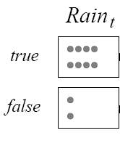
Particle Filtering
Run all N samples together through the network, one slice at a time
STEP 0: Generate a population on N initial-state samples by sampling from initial state distribution P(X₀)
N = 10
Notes:
Form of filtering, where the N samples are the forward message
Essentially use the sample themselves as an approximation of the current state distribution
No need to unroll the network, all needed is current and next slice => “constant” update per time step

Slide 4
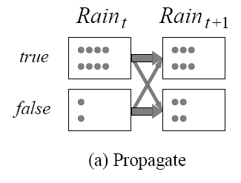
Particle Filtering
STEP 1: Propagate each sample for x_{t} forward by sampling the next state value x_{t+1} based on P(X_{t+1} |X_{t} )
R_{t} | P(R_{t+1}=t)
t f | 0.7 0.3

Slide 5
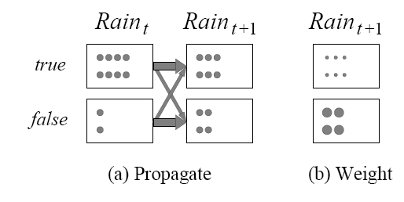
Particle Filtering
STEP 2: Weight each sample by the likelihood it assigns to the evidence
  E.g. assume we observe not umbrella at t+1
R_{t} | P(u_{t}) | P(┐u_{t})
t f | 0.9 0.2 | 0.1 0.8

Slide 6
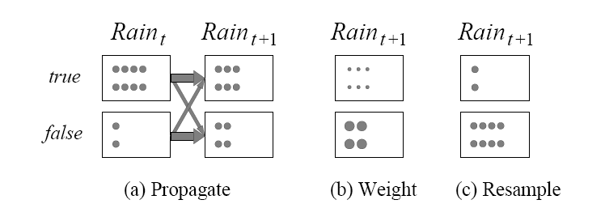
Particle Filtering
STEP 3: Create a new population from the population at X_{t+1,} i.e.
resample the population so that the probability that each sample is selected is proportional to its weight
Start the Particle Filtering cycle again from the new sample
Notes:
Weighted sample with replacement (ie “we can pick the same sample multiple times”)

Slide 7
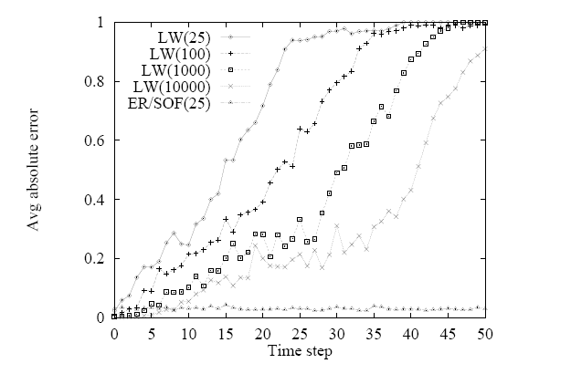
Is PF Efficient?
In practice, approximation error of particle filtering remains bounded overtime
It is also possible to prove that the approximation maintains bounded error with high probability
(with specific assumption: probs in transition and sensor models >0 and <1)
Notes:
Approximation error of particle filtering remains bounded over time, at least empirically—theoretical analysis is difficult
Probabilities in the transition and sensor models are strictly less that 1 and greater than 0
In statistics, efficiency is a term used in the comparison of various statistical procedures ……] Essentially, a more efficient estimator, experiment, or test needs fewer observations than a less efficient one to achieve a given performance.

Slide 8
422 big picture: Where are we?
Hybrid: Det +Sto
Prob CFG
Prob Relational Models
Markov Logics
Deterministic
Stochastic
Belief Nets
Logics
Approx. : Gibbs
First Order Logics
Markov Chains and HMMs
Ontologies
Temporal rep.
Forward, Viterbi….
Approx. : Particle Filtering
Query
Full Resolution
SAT
Undirected Graphical Models
Markov Networks
Conditional Random Fields
Markov Decision Processes and
Partially Observable MDP
Planning
Value Iteration
Approx. Inference
Reinforcement Learning
Representation
Applications of AI
Reasoning
Technique
Notes:
First Order Logics (will build a little on Prolog and 312)
Temporal reasoning from NLP 503 lectures
Reinforcement Learning (not done in 340, at least in the latest offering)
Markov decision process
Set of states S, set of actions A
Transition probabilities to next states P(s’| s, a′)
Reward functions R(s, s’, a)
RL is based on MDPs, but
Transition model is not known
Reward model is not known
While for MDPs we can compute an optimal policy
RL learns an optimal policy

Slide 9
Lecture Overview
Probabilistic Graphical models
Intro
Example
Markov Networks Representation (vs. Belief Networks)
Inference in Markov Networks (Exact and Approx.)
Applications of Markov Networks

Slide 10
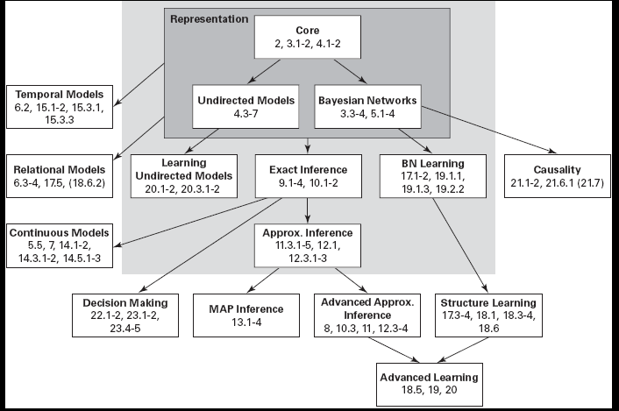
Probabilistic Graphical Models
From “Probabilistic Graphical Models: Principles and Techniques” D. Koller, N. Friedman 2009

Slide 11
Misconception Example
Four students (Alice, Bill, Debbie, Charles) get together in pairs, to work on a homework
But only in the following pairs: AB AD DC BC
Professor misspoke and might have generated misconception
A student might have figured it out later and told study partner
Notes:
Undirected graphs (cf. Bayesian networks, which are directed)
A Markov network represents the joint probability distribution over events which are represented by variables
Nodes in the network represent variables

Slide 12
Example: In/Depencencies
Are A and C independent because they never spoke?
No, because A might have figure it out and told B who then told C
But if we know the values of B and D….
And if we know the values of A and C

Slide 13

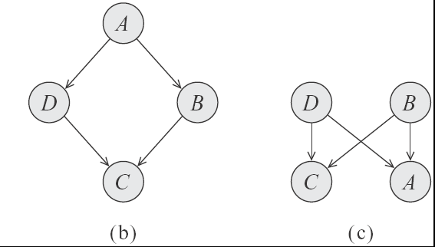
Which of these two Bnets captures the two independencies of our example?
  a.
  b.
  c. Both
  d. None
Notes:
A Bnet require that we ascribe directionality to the influence while in this case the interaction between the variables is symmetrical
A BD independent only given A
B BD marginally independent

Slide 14
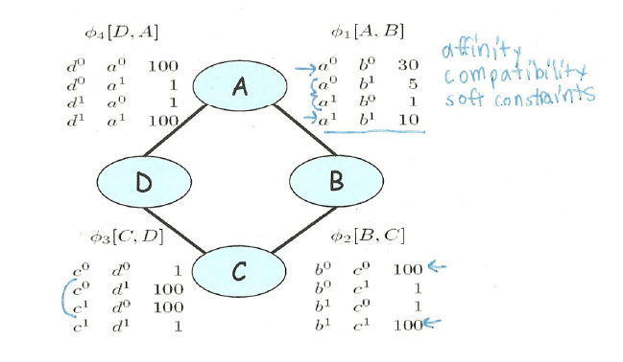
Parameterization of Markov Networks
X
X
Factors define the local interactions (like CPTs in Bnets)
What about the global model? What do you do with Bnets?
Notes:
Not conditional probabilities – capture the affinities between related variables
Also called clique potentials or just potentials
D and A and BC tend to agree. DC tend to disagree
Table values are typically nonnegative
Table values have no other restrictions
Not necessarily probabilities
Not necessarily < 1

Slide 15
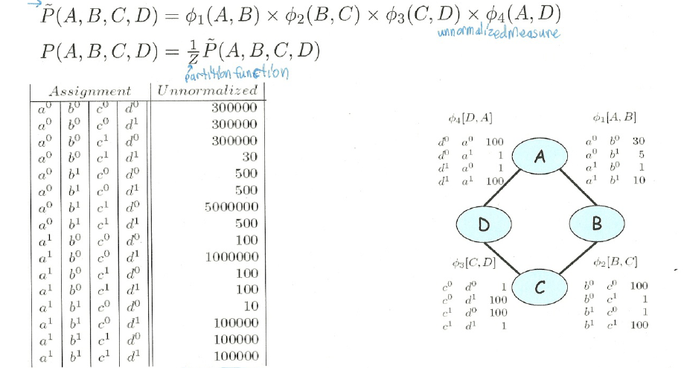
How do we combine local models?
As in BNets by multiplying them!
Notes:
This is the joint distribution from which I can compute any

Slide 16
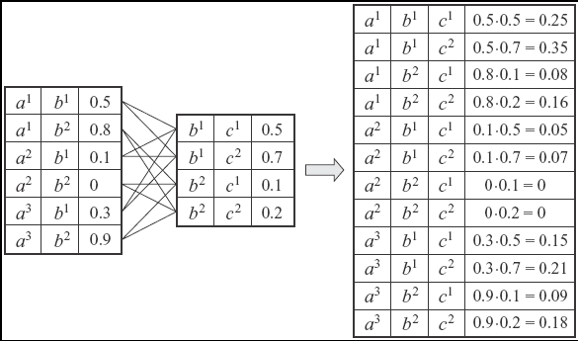
Multiplying Factors (same seen in 322 for VarElim)
Notes:
Deliberately chosen factors that do not correspond to prob or to conditional prob. To emphasize the generality of this operation
You have seen this in VarElimination

Slide 17
Factors do not represent marginal probs. !
a⁰ b⁰ | 0.13
a⁰ b¹ | 0.69
a¹ b⁰ | 0.14
a¹ b¹ | 0.04
Marginal P(A,B)
Computed from the joint
Notes:
The reason for the discrepancy is the influence of the other factors on the distribution
D and C tend to disagree but A and D AND C and B tend to agree so A and B should disagree
This is dominating the weaker agreement according to the AB factor

Slide 18
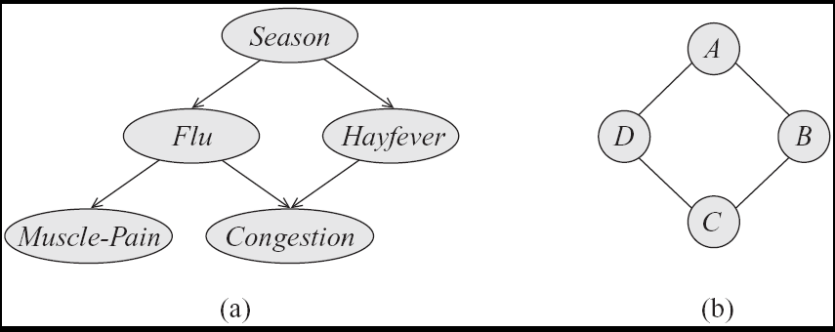
Step Back…. From structure to factors/potentials
In a Bnet the joint is factorized….
In a Markov Network you have one factor for each maximal clique
Notes:
a clique in an undirected graph is a subset of its vertices such that every two vertices in the subset are connected by an edge.

Slide 19
Directed vs. Undirected
Independencies
Factorization

Slide 20
General definitions
Two nodes in a Markov network are independent if and only if every path between them is cut off by evidence
eg for A C
So the markov blanket of a node is…?
eg for C

Slide 21
Markov Networks Applications (1): Computer Vision
Called Markov Random Fields
Stereo Reconstruction
Image Segmentation
Object recognition
Typically pairwise MRF
Each vars correspond to a pixel (or superpixel )
Edges (factors) correspond to interactions between adjacent pixels in the image
  E.g., in segmentation: from generically penalize discontinuities, to road under car

Slide 22
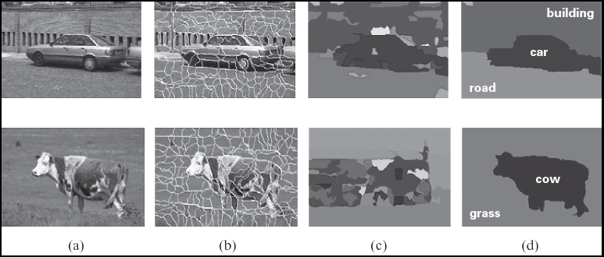
Image segmentation

Slide 23
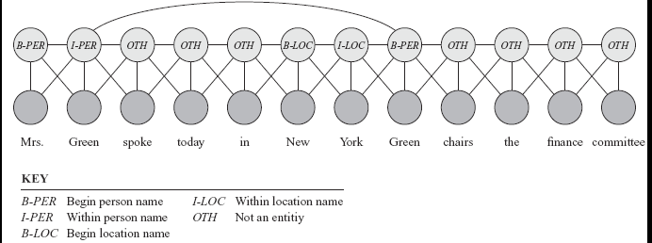
Markov Networks Applications (2): Sequence Labeling in NLP and BioInformatics
Conditional random fields (next class Wed)
Notes:
A skip chain CRF for named entity recognition, with connection between adjacent words and long rang connection between multiple occurrences of the same word

Slide 24
Learning Goals for today’s class
You can:
Justify the need for undirected graphical model (Markov Networks)
Interpret local models (factors/potentials) and combine them to express the joint
Define independencies and Markov blanket for Markov Networks
Perform Exact and Approx. Inference in Markov Networks
Describe a few applications of Markov Networks

Slide 25
Midterm, Mon, Oct 26,
we will start at 9am sharp
How to prepare….
Keep Working on assignment-2 !
Go to Office Hours x
Learning Goals (look at the end of the slides for each lecture – will post complete list)
Revise all the clicker questions and practice exercises
Will post more practice material today

Slide 26
How to acquire factors?

Slide 27
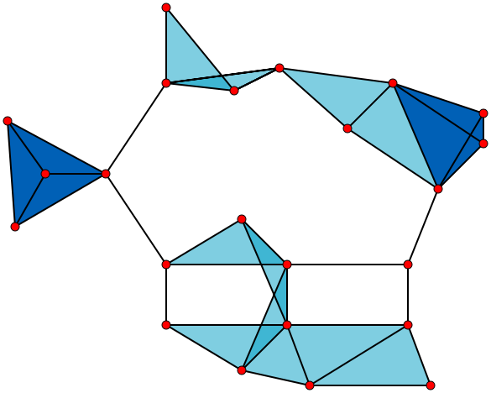
Notes:
[Source: WIKIPEDIA] A graph with 23 1-vertex cliques (its vertices), 42 2-vertex cliques (its edges), 19 3-vertex cliques (the light and dark blue triangles), and 2 4-vertex cliques (dark blue areas). The six edges not associated with any triangle and the 11 light blue triangles form maximal cliques. The two dark blue 4-cliques are both maximum and maximal, and the clique number of the graph is 4.

