Slide 1
AI Applications
Computer Science cpsc322, Lecture 3
January, 9, 2009

Slide 2
If your studentID is below we need to talk at the end of lecture
22372056
36966026
63852040

Slide 3
Lecture Overview
Office Hours
Clarifications for last lecture
AI applications…

Slide 4
Office Hours
Go to office hours (newsgroup is NOT a good substitute for this) – times below are still tentative, will be finalized next week
Giuseppe: Tue 2-3 (CICSR #129)
Jacek : Wed 2-3 (learning Center)
Gustavo: Thur 2-3 (learning Center)
Peter: Mon 2-3 (learning Center)
(Peter will start on Jan 26)
Can schedule by appointment if you can document a conflict with the official office hours

Slide 5
Explicit State or propositions
How do we model the environment?
You can enumerate the states of the world.
A state can be described in terms of features
Often it is more natural to describe states in terms of assignments of values to variables (features).
30 binary features (also called propositions) can represent 2³⁰= 1,073,741,824 states.
Mars Explorer Example
Weather
Temperature
LocX LocY

Slide 6
Explicit State or propositions or relations
Features can be described in terms of objects and relationships.
There is a proposition for each relationship on each “possible” tuple of individuals.
University Example
Registred(S,C)
Students (S) = { }
Courses (C) = { }
Textbook example: One binary relation and 10 individuals can represents 10²=100 propositions and 2¹⁰⁰ states!
Notes:
One binary rel and 2 individual
4 propositions
16 states

Slide 7
Modules we'll cover in this course: R&Rsys
Environment
Deterministic
Stochastic
Problem
Arc Consistency
Constraint Satisfaction
Vars +
Constraints
Search
Static
Belief Nets
Inference
Logics
Var. Elimination
Search
Sequential
Decision Nets
STRIPS
Var. Elimination
Planning
Search
Markov Processes
Representation
Value Iteration
Reasoning
Technique
Notes:
R&R Sys Representation and reasoning Systems
Each cell is a R&R system
STRIPS actions preconditions and effects

Slide 8
Modules we'll cover in this course: R&Rsys
Environment
Deterministic
Stochastic
Problem
Arc Consistency
Constraint Satisfaction
Vars +
Constraints
Search
Static
Belief Nets
Inference
Logics
Var. Elimination
Search
Sequential
Decision Nets
STRIPS
Var. Elimination
Planning
Search
Markov Processes
Value Iteration
Notes:
R&R Sys Representation and reasoning Systems
Each cell is a R&R system
STRIPS actions preconditions and effects

Slide 9
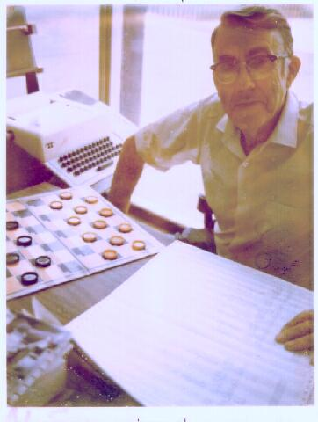
(Adversarial) Search: Checkers
Game playing was one of the first tasks undertaken in AI
Arthur Samuel at IBM wrote programs to play checkers (1950s)
initially, they played at a strong amateur level
however, they used some (simple) machine learning techniques, and soon outperformed Samuel
Source: IBM Research
Chinook’s program was declared the Man-Machine World Champion in checkers in 1994!
…and completely solved by a program in 2007!
Notes:
Chinook's program algorithm includes an opening book, a library of opening moves from games played by grandmasters; a deep search algorithm; a good move evaluation function; and an end-game database for all positions with eight pieces or fewer. The linear handcrafted evaluation function considers several features of the game board, including piece count, kings count, trapped kings, turn, runaway checkers (unimpeded path to be kinged) and other minor factors. All of Chinook's "knowledge" was programmed by its creators, rather than "learned"
Checkers was completely solved in 2007 by a computer which explored all reachable positions

Slide 10
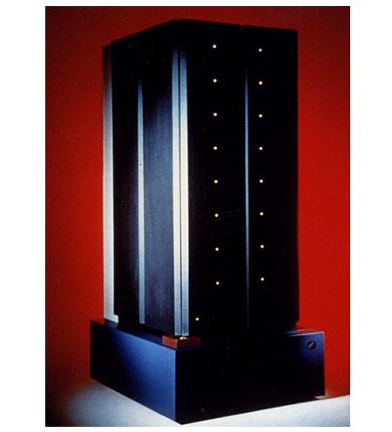
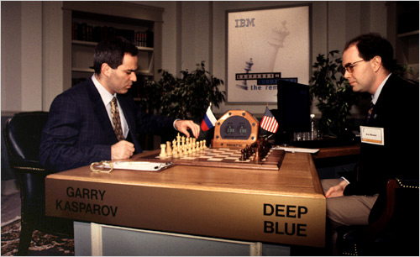
(Adversarial) Search: Chess
In 1996 and 1997, Gary Kasparov, the world chess grandmaster played two tournaments against Deep Blue, a program written by researchers at IBM
Source: IBM Research

Slide 11
(Adversarial) Search: Chess
Deep Blue’s Results in the first tournament:
won 1 game, lost 3 and tied 1
first time a reigning world champion lost to a computer
Source: CNN

Slide 12
(Adversarial) Search: Chess
Deep Blue’s Results in the second tournament:
second tournament: won 3 games, lost 2, tied 1
30 CPUs + 480 chess processors
Searched 126.000.000 nodes per sec
Generated 30 billion positions per move reaching depth 14 routinely
Notes:
Winning machine was a parallel computer (30 CPUs) + 480 VLSI chess processors
Searched 126.000.000 nodes per sec
Generated 30 billion positions per move, reaching depth 14 routinely
Standard iterative deepening alpha beta search (with transposition table)
But key to success seems to be its ability to go deeper for sufficiently interesting lines of forced/forcing moves
Evaluation functions had over 8000 features
+ opening book with 4000 positions
+ solved positions with 5 pieces and many with 6 (to extend the effective depth of the search)

Slide 13
Modules we'll cover in this course: R&Rsys
Environment
Deterministic
Stochastic
Problem
Arc Consistency
Constraint Satisfaction
Vars +
Constraints
Search
Static
Belief Nets
Inference
Logics
Var. Elimination
Search
Sequential
Decision Nets
STRIPS
Var. Elimination
Planning
Search
Markov Processes
Value Iteration
Notes:
R&R Sys Representation and reasoning Systems
Each cell is a R&R system
STRIPS actions preconditions and effects

Slide 14
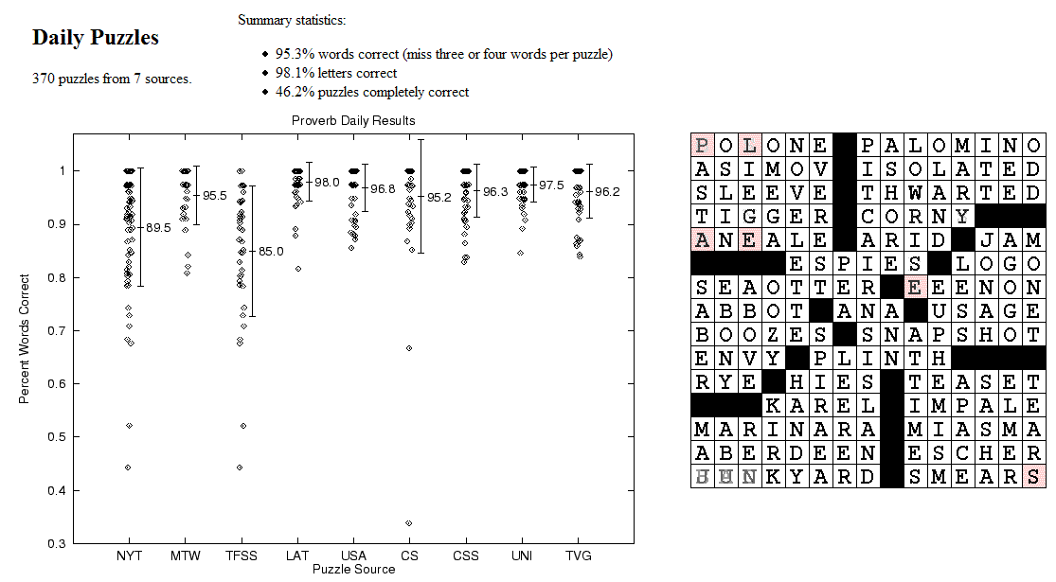
CSPs: Crossword Puzzles
Source: Michael Littman
Notes:
Variables are the places where word can go e.g. (1 across, 3 down)
Domains are words of the appropriate length (for 1 across in this example – length equals 6)
Constraints letter should be the same at the intersection
www.cs.rutgers.edu/~mlittman/papers/aaai99-solver.ps

Slide 15
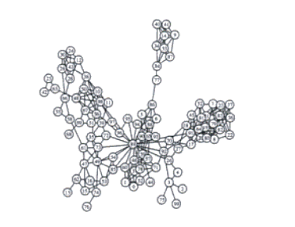
CSPs: Radio link frequency assignment
Assigning frequencies to a set of radio links defined between pairs of sites in order to avoid interferences.
Constraints on frequency depend on position of the links and on physical environment .
Source: INRIA
Sample Constraint network

Slide 16
Modules we'll cover in this course: R&Rsys
Environment
Deterministic
Stochastic
Problem
Arc Consistency
Constraint Satisfaction
Vars +
Constraints
Search
Static
Belief Nets
Inference
Logics
Var. Elimination
Search
Sequential
Decision Nets
STRIPS
Var. Elimination
Planning
Search
Markov Processes
Value Iteration
Notes:
R&R Sys Representation and reasoning Systems
Each cell is a R&R system
STRIPS actions preconditions and effects

Slide 17
Logic: Ontologies
Source: Cycorp

Slide 18
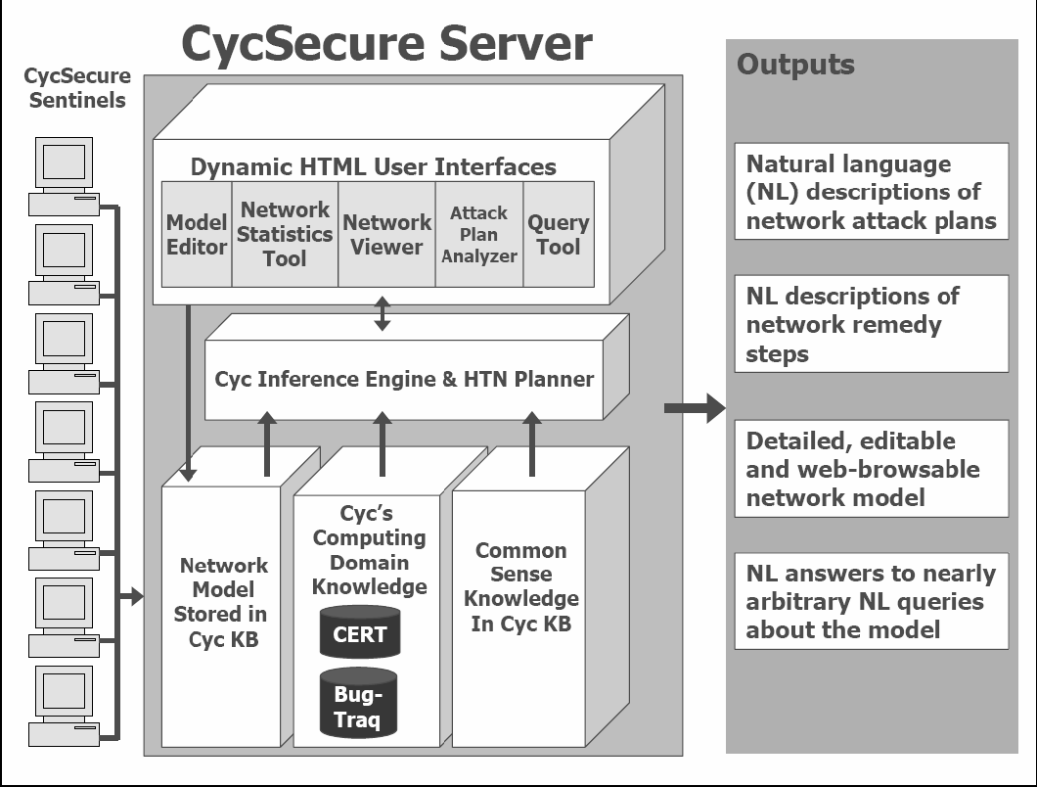
Logic: CycSecure
“scans a computer network to build a formal representation of the network, based on Cyc’s pre-existing ontology of networking, security, and computing concepts:
Excerpted from: Shepard et al., 2005
This formal representation also allows users to interact directly with the model of the network, allowing testing of proposed changes.”
Knowledge Representation
Semantic Web !
Notes:
information about what computers are on the network, what programs are installed or running on those computers, what privileges the running programs have, what users are logged into the computers, etc.

Slide 19
Modules we'll cover in this course: R&Rsys
Environment
Deterministic
Stochastic
Problem
Arc Consistency
Constraint Satisfaction
Vars +
Constraints
Search
Static
Belief Nets
Inference
Logics
Var. Elimination
Search
Sequential
Decision Nets
STRIPS
Var. Elimination
Planning
Search
Markov Processes
Value Iteration
Notes:
R&R Sys Representation and reasoning Systems
Each cell is a R&R system
STRIPS actions preconditions and effects

Slide 20
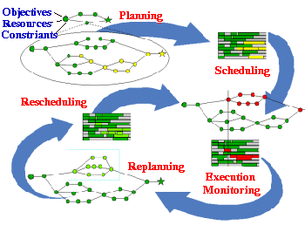
Planning & Scheduling: Logistics
Dynamic Analysis and Replanning Tool (Cross & Walker)
logistics planning and scheduling for military transport
used in the 1991 Gulf War by the US
problems had 50,000 entities (e.g., vehicles); different starting points and destinations
Same techniques can be use for non-military applications:
e.g., Emergency Evacuation
Source: DARPA
Notes:
(Re)Planning done in hours instead of in weeks
ARPA stated that this single application paid back its 30years investments in AI

Slide 21
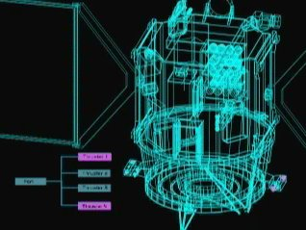
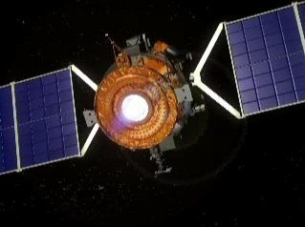
Planning: Spacecraft Control
NASA: Deep Space One spacecraft
operated autonomously for two days in May, 1999:
determined its precise position using stars and asteriods
despite a malfunctioning ultraviolet detector
planned the necessary course adjustment
fired the ion propulsion system to make this adjustment
For another space application see the Spike system for the Hubble
telescope
Source: NASA
Notes:
The Spike scheduling system, developed for scheduling astronomical observations for NASA's Hubble Space Telescope (HST), AI techniques reduced to a few hours what used to take weeks

Slide 22
Modules we'll cover in this course: R&Rsys
Environment
Deterministic
Stochastic
Problem
Arc Consistency
Constraint Satisfaction
Vars +
Constraints
Search
Static
Belief Nets
Inference
Logics
Var. Elimination
Search
Sequential
Decision Nets
STRIPS
Var. Elimination
Planning
Search
Markov Processes
Value Iteration
Notes:
R&R Sys Representation and reasoning Systems
Each cell is a R&R system
STRIPS actions preconditions and effects

Slide 23
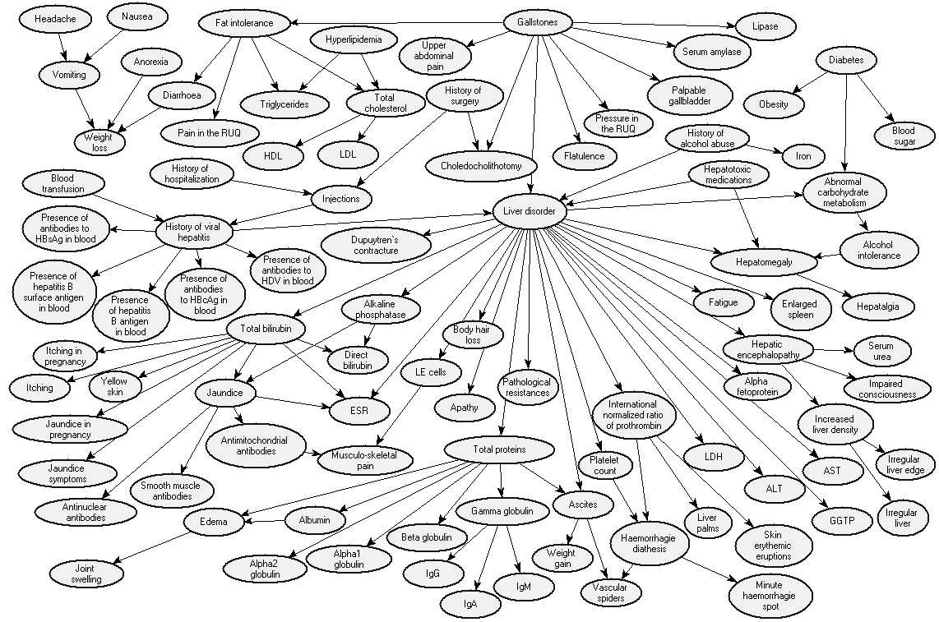
Reasoning under Uncertainty: Diagnosis
Bayes Net: to diagnose liver diseases
Source: Onisko et al., 99

Slide 24
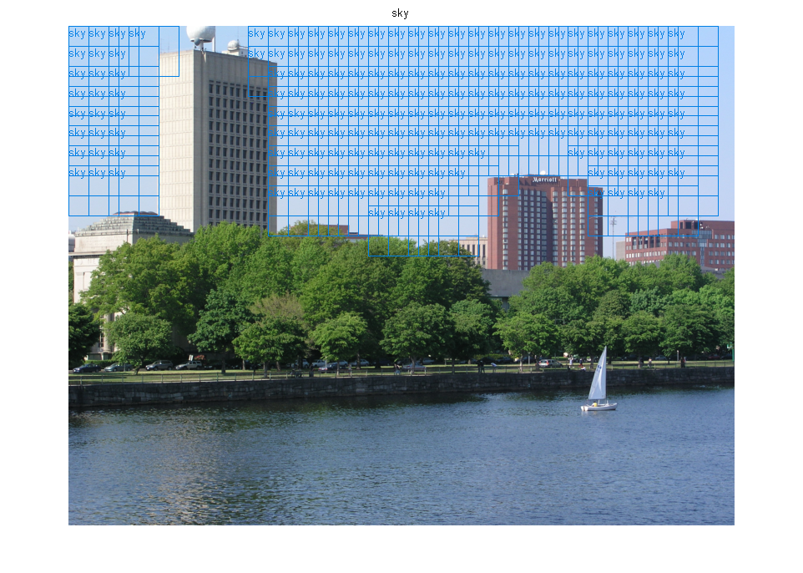
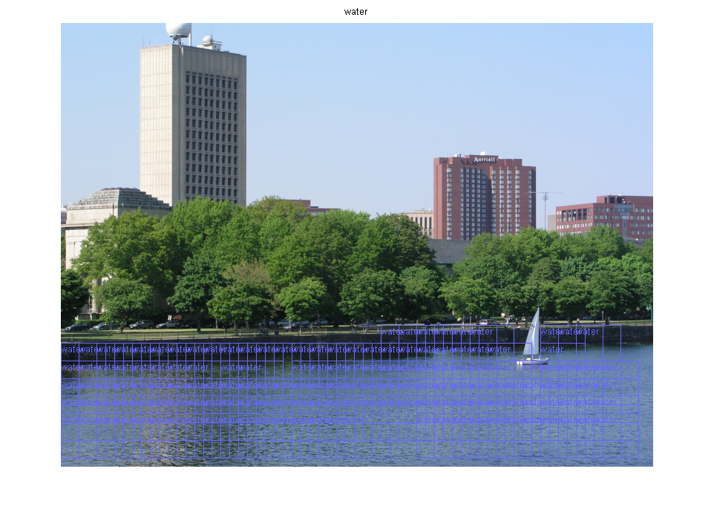
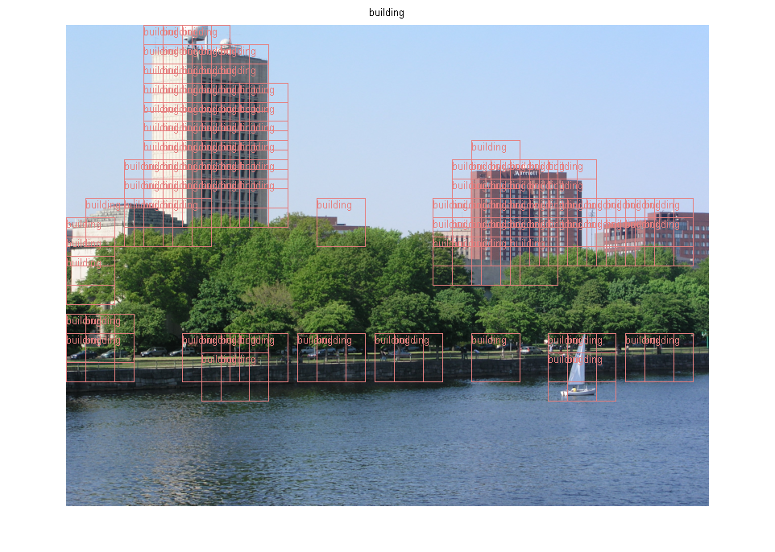
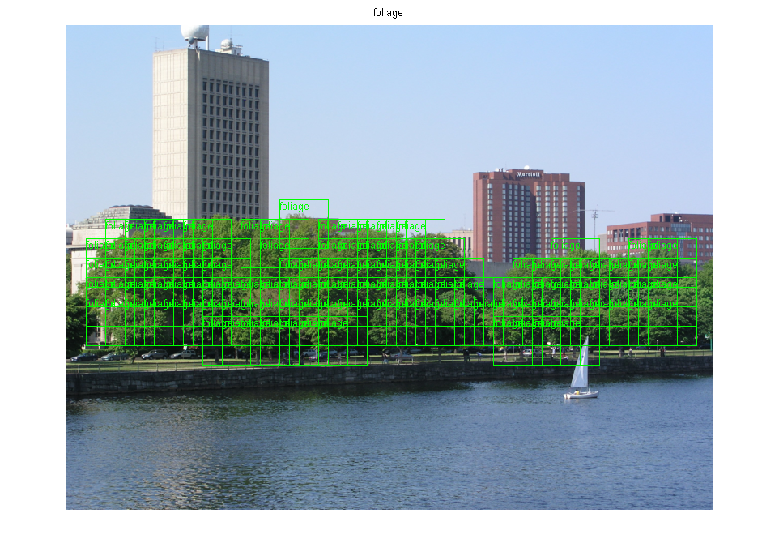
Reasoning Under Uncertainty
Texture classification using Support Vector Machines
foliage, building, sky, water
Source: Mike Cora, UBC

Slide 25
Modules we'll cover in this course: R&Rsys
Environment
Deterministic
Stochastic
Problem
Arc Consistency
Constraint Satisfaction
Vars +
Constraints
Search
Static
Belief Nets
Inference
Logics
Var. Elimination
Search
Sequential
Decision Nets
STRIPS
Var. Elimination
Planning
Search
Markov Processes
Value Iteration
Notes:
R&R Sys Representation and reasoning Systems
Each cell is a R&R system
STRIPS actions preconditions and effects

Slide 26
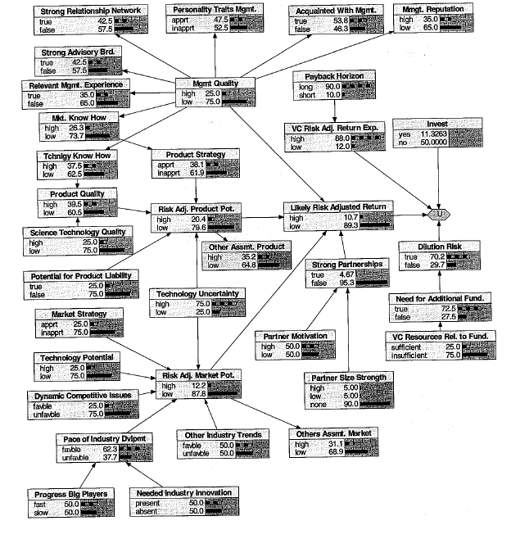
Decision Network in Finance for venture capital decision
Source: R.E. Neapolitan, 2007
Notes:
More on http://www.aaai.org/AITopics/html/applications.html (this is true in general)

Slide 27
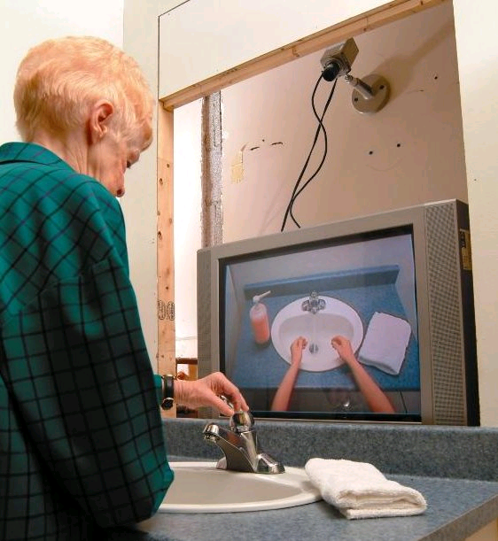
Planning Under Uncertainty
Learning and Using POMDP
models of Patient-Caregiver
Interactions During Activities
of Daily Living
Goal: Help Older adults living with
cognitive disabilities (such as Alzheimer's) when they:
forget the proper sequence of tasks that need to be completed
they lose track of the steps that they have already completed.
Source: Jesse Hoey UofT 2007
Notes:
Older adults living with cognitive disabilities (such as Alzheimer's disease or other forms of dementia) have
difficulty completing activities of daily living (ADLs). They forget the proper sequence of tasks that need
to be completed, or they lose track of the steps that they have already completed

Slide 28
Planning Under Uncertainty
Helicopter control: MDP, reinforcement learning
States: all possible positions, orientations, velocities and angular velocities
Final solution involves
Deterministic search!
Source: Andrew Ng 2004
Notes:
To our knowledge, this is the first helicopter capable of sustained
inverted flight under computer control. A video of the helicopter in inverted
autonomous flight is also at
In our problem, S is the set of states (expressed in
world coordinates) comprising all possible helicopter positions, orientations,
velocities and angular velocities;
But using the Pegasus method (Ng and
Jordan, 2000), we can turn this stochastic optimization problem into an or-
dinary deterministic problem, so that any standard search algorithm can now
be applied.

Slide 29
Dimensions of Representational Complexity in CPSC322
We've already discussed:
Deterministic versus stochastic domains
Static versus sequential domains
Some other important dimensions of complexity:
Explicit state or propositions or relations
Flat or hierarchical
Knowledge given versus knowledge learned from experience
Goals versus complex preferences
Single-agent vs. multi-agent
Notes:
begin{itemize}
% \item \alert{Key point}: ``stochastic world'' can mean that the world itself has stochastic dynamics, that the world is deterministic but imperfectly observed, or that the world has stochastic dynamics \emph{and} is imperfectly observed.
%\end{itemize}

Slide 30
Multiagent Systems: Poker
Search Space: 1.2 quintillion nodes
“In full 10-player games Poki is better than a typical low-limit casino player and wins consistently; however, not as good as most experts
New programs being developed for the 2-player game are quite a bit better, and we believe they will very soon surpass all human players”
Source: The University of Alberta GAMES Group
Notes:
Q: How large is the search space for 2-player Texas Hold'em?
A: Short answer: about 1.2 quintillion nodes. Exact answer: the imperfect information game tree for limit Hold'em (with a maximum of four bets each per round) has 1,179,000,604,565,715,751 nodes in total, including dominated sequences (ie. folding to no bet). Almost all of these (1,176,023,515,434,768,000) involve all four betting rounds. The breakdown by type of node is: 406,551,932,608,867,500 terminal (fold) nodes, 364,972,815,134,928,000 showdown nodes, 203,275,966,304,433,750 decision nodes for each player, and 923,924,213,052,751 chance nodes. Eliminating dominated sequences reduces the tree to a mere 1,097,690,218,045,566,601 nodes. (Thanks for asking! :)

Slide 31
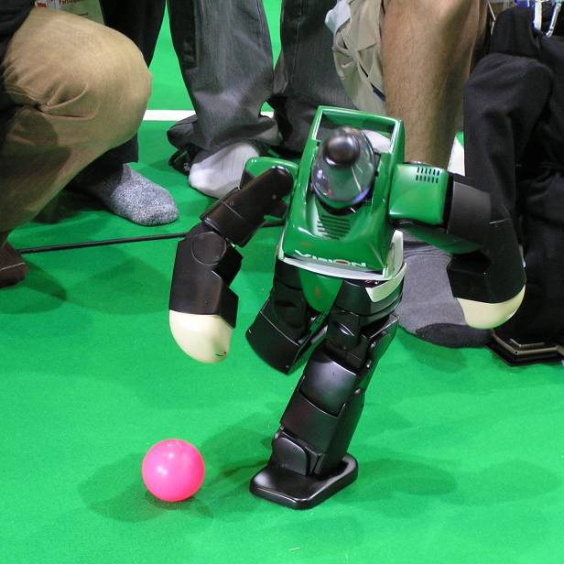
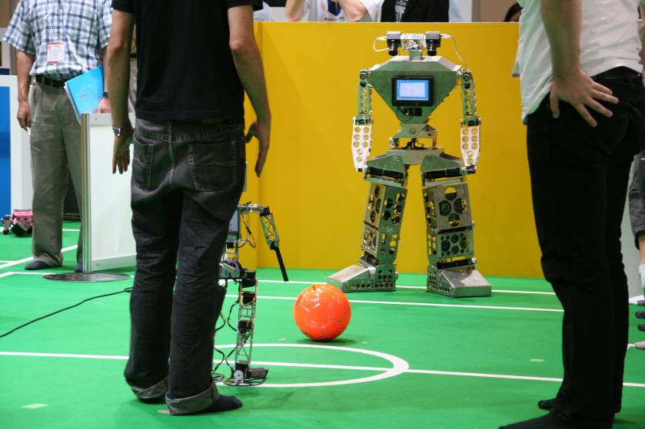
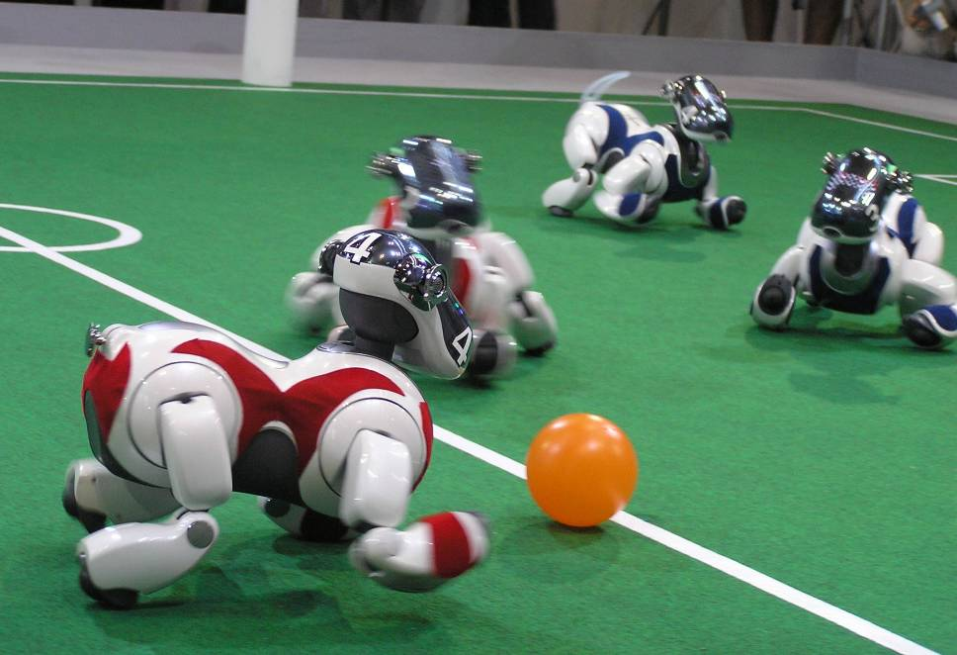
Multiagent Systems: Robot Soccer
Extremely complex
Stochastic
Sequence of actions
Multiagent
robotic soccer competition was proposed by LCI (UBC) in 1992 (which became Robocup in 1997).
Source: RoboCup web site

Slide 32
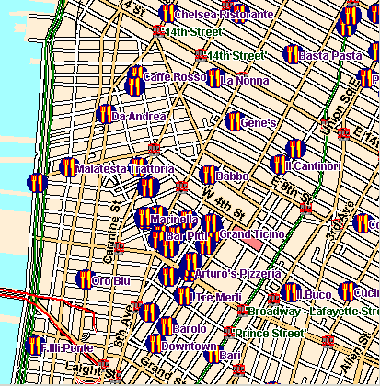
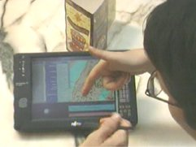
Natural Language Processing
Multimodal Access to City Help (MATCH)
Multimodal interface
Portable Fujitsu tablet
Input: Pen for deictic gestures and Speech input
Output: Text, Speech and graphics
Source: M. Walker (ex. AT&T) 2002

Slide 33
TO DO for Next class
Search: Start reading (Chpt 3 – sec 3.1 – 3.3)

Slide 34
CSPs: Radio link frequency assignment
Assigning frequencies to a set of radio links defined between pairs of sites in order to avoid interferences.
Source: INRIA
For each link two frequencies must be assigned
Notes:
Variables are the places where word can go e.g. (1 across, 3 down)
Domains are words of the appropriate length (for 1 across in this example – length equals 6)
Constraints letter should be the same at the intersection
www.cs.rutgers.edu/~mlittman/papers/aaai99-solver.ps

