Slide 1
Intelligent Systems (AI-2)
Computer Science cpsc422, Lecture 15
Feb, 12, 2021

Slide 2
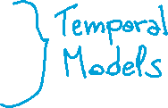
StarAI (statistical relational AI)
Hybrid: Det +Sto
422 big picture
Prob CFG
Prob Relational Models
Markov Logics
Deterministic
Stochastic
Belief Nets
Logics
Approx. : Gibbs
First Order Logics
Markov Chains and HMMs
Forward, Prediction, Smoothing, Viterbi….
Approx. : Particle Filtering
Ontologies
Query
Full Resolution
SAT
Undirected Graphical Models
Markov Networks
Conditional Random Fields
Markov Decision Processes and
Partially Observable MDP
Planning
Value Iteration
Approx. Inference
Reinforcement Learning
Representation
Applications of AI
Reasoning
Technique
Notes:
Breadth and Depth

Slide 3
Lecture Overview
Probabilistic temporal Inferences
Filtering
Prediction
Smoothing (forward-backward)
Most Likely Sequence of States (Viterbi)

Slide 4
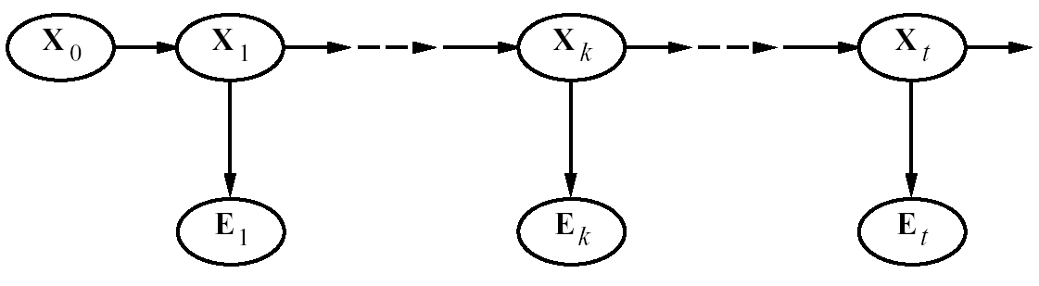


Smoothing
Smoothing: Compute the posterior distribution over a past state given all evidence to date
  P(X_{k} | e_{0:t} ) for 1 ≤ k < t
E₀
To revise your estimates in the past based on more recent evidence
Notes:
4

Slide 5

Smoothing
E₀
P(X_{k} | e_{0:t}) = P(X_{k} | e_{0:k},e_{k+1:t} ) dividing up the evidence
= α P(X_{k} | e_{0:k} ) P(e_{k+1:t} | X_{k}, e_{0:k} ) using…
= α P(X_{k} | e_{0:k} ) P(e_{k+1:t} | X_{k}) using…
  A. Bayes Rule
  B. Cond. Independence
forward message from filtering up to state k,
f _{0:k}
  C. Product Rule
backward message,
b _{k+1:t}
computed by a recursive process that runs backwards from t
Notes:
5

Slide 6

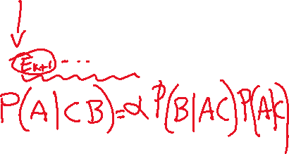
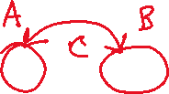
Smoothing
E₀
P(X_{k} | e_{0:t}) = P(X_{k} | e_{0:k},e_{k+1:t} ) dividing up the evidence
= α P(X_{k} | e_{0:k} ) P(e_{k+1:t} | X_{k}, e_{0:k} ) derived using Bayes Rule
= α P(X_{k} | e_{0:k} ) P(e_{k+1:t} | X_{k}) By Conditional Independence
forward message from filtering up to state k,
f _{0:k}
backward message,
b _{k+1:t}
computed by a recursive process that runs backwards from t
Notes:
6

Slide 7






Backward Message
X_{k+1}
Moving Conditioning
E₀
E_{k+1}
E_{k+2}
P(e_{k+1:t} | X_{k}) = ∑_{xk+1} P(e_{k+1:t} , x_{k+1} | X_{k}) = ∑_{xk+1} P(e_{k+1:t} |x_{k+1} , X_{k}) P( x_{k+1} | X_{k}) =
= ∑_{xk+1} P(e_{k+1:t} |x_{k+1} ) P( x_{k+1} | X_{k}) by Conditional Independence
= ∑_{xk+1} P(e_{k+1},e_{k+2:t} |x_{k+1} ) P( x_{k+1} | X_{k})
= ∑_{xk+1} P(e_{k+1}|x_{k+1} , e_{k+2:t}) P(e_{k+2:t} |x_{k+1} ) P( x_{k+1} | X_{k})
= ∑_{xk+1} P(e_{k+1}|x_{k+1} ) P(e_{k+2:t} |x_{k+1} ) P( x_{k+1} | X_{k})
Moving Conditioning
because e_{k+1} and e_{k+2:t}, are conditionally independent given x_{k+1}
sensor model
recursive call
transition model
In message notation
b_{k+1:t} = BACKWARD (b_{k+2:t}, e_{k+1})
Notes:
7
As with the forward recursion, the time and space for each backward update is independent of t

Slide 8
“moving” the conditioning

Slide 9
Proof of equivalent statements

Slide 10
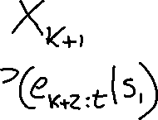









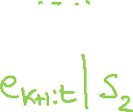





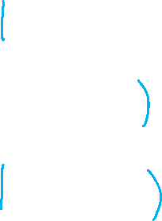





More Intuitive Interpretation (Example with three states)
X_{k+1}
E₀
E_{k+1}
E_{k+2}
P(e_{k+1:t} | X_{k}) = ∑_{xk+1} P( x_{k+1} | X_{k})P(e_{k+1}|x_{k+1} ) P(e_{k+2:t} |x_{k+1} )

Slide 11
Forward-Backward Procedure
To summarize, we showed
P(X_{k} | e_{0:t}) = α P(X_{k} | e_{0:k} ) P(e_{k+1:t} | X_{k})
Thus,
  P(X_{k} | e_{0:t}) = α f_{0:k} b_{k+1:t}
and this value can be computed by recursion through time, running forward from 0 to k and backwards from t to k+1
Notes:
11

Slide 12
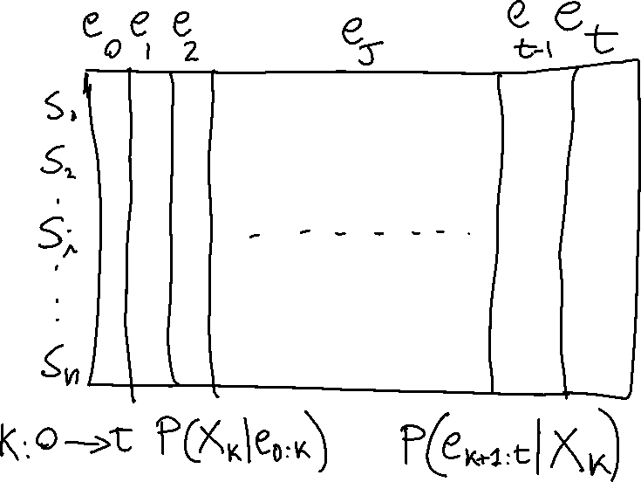
Forward-Backward Procedure fills a matrix n x t
Notes:
12

Slide 13
How is it Backward initialized?
The backwards phase is initialized with making an unspecified observation e_{t+1} at t+ 1……
b_{t+1:t} = P(e_{t+1}| X_{t} ) = P( unspecified | X_{t} ) = ?
  A. 0
  B. 0.5
  C. 1
Notes:
13

Slide 14
How is it Backward initialized?
The backwards phase is initialized with making an unspecified observation e_{t+1} at t+ 1……
b_{t+1:t} = P(e_{t+1}| X_{t} ) = P( unspecified | X_{t} ) = 1
You will observe something for sure! It is only when you put some constraints on the observations that the probability becomes less than 1
Notes:
14

Slide 15
Rain Example
Let’s compute the probability of rain at t = 1, given umbrella observations at t=1 and t =2
From P(X_{k} | e_{1:t}) = α P(X_{k} | e_{1:k} ) P(e_{k+1:t} | X_{k}) we have
  P(R₁| e_{1:2}) = P(R₁| u_{1:}u₂) = α P(R₁| u₁) P(u₂ | R₁)
P(R₁| u₁) = <0.818, 0.182> as it is the filtering to t =1 that we did in lecture 14
forward message from filtering up to state 1
backward message for propagating evidence backward from time 2
0.5
0.5
TRUE 0.5
FALSE 0.5
0.818
0.182
Rain₀
Rain₁
Rain₂
Umbrella₁
Umbrella₂
Notes:
15
.5 * .9 = .45
.5 * .2 = .01
And normalize

Slide 16




Rain Example
From P(e_{k+1:t} | X_{k}) = ∑_{xk+1} P(e_{k+1}|x_{k+1} ) P(e_{k+2:t} |x_{k+1} ) P( x_{k+1} | X_{k})
P(u₂ | R₁) = ∑ P(u₂|r ) P(|r ) P( r | R₁) =
P(u₂|r₂ ) P(|r₂ ) <P( r₂ | r₁), P( r₂ | ┐r₁) > +
P(u₂| ┐r₂ ) P(| ┐r₂ ) <P(┐r₂ | r₁), P(┐r₂ | ┐r₁)>
= (0.9 * 1 * <0.7,0.3>) + (0.2 * 1 * <0.3, 0.7>) = <0.69,0.41>
Thus
α P(R₁| u₁) P(u₂ | R₁) = α<0.818, 0.182> * <0.69, 0.41> ~ <0.883, 0.117>
Term corresponding to the Fictitious unspecified observation sequence e_{3:2}
0.5
0.5
0.818
0.182
0.69
0.41
TRUE 0.5
FALSE 0.5
0.883
0.117
Rain₀
Rain₁
Rain₂
Umbrella₁
Umbrella₂
Notes:
16

Slide 17
Lecture Overview
Probabilistic temporal Inferences
Filtering
Prediction
Smoothing (forward-backward)
Most Likely Sequence of States (Viterbi)

Slide 18
Most Likely Sequence
Suppose that in the rain example we have the following umbrella observation sequence
  [true, true, false, true, true]
Is the most likely state sequence?
  [rain, rain, no-rain, rain, rain]
In this case you may have guessed right… but if you have more states and/or more observations, with complex transition and observation models…..
Notes:
18

Slide 19



HMMs : most likely sequence (from 322)
Natural Language Processing: e.g., Speech Recognition
States: phoneme \ word
Observations: acoustic signal \ phoneme
Bioinformatics: Gene Finding
States: coding / non-coding region
Observations: DNA Sequences
For these problems the critical inference is:
find the most likely sequence of states given a sequence of observations
Notes:
ahone is a speech sound

Slide 20
Part-of-Speech (PoS) Tagging
Given a text in natural language, label (tag) each word with its syntactic category
  E.g, Noun, verb, pronoun, preposition, adjective, adverb, article, conjunction
Input
  Brainpower not physical plant is now a firm's chief asset.
Output
  Brainpower_NN not_RB physical_JJ plant_NN is_VBZ now_RB a_DT firm_NN 's_POS chief_JJ asset_NN ._.
Tag meanings
NNP (Proper Noun singular), RB (Adverb), JJ (Adjective), NN (Noun sing. or mass), VBZ (Verb, 3 person singular present), DT (Determiner), POS (Possessive ending), . (sentence-final punctuation)

Slide 21
POS Tagging is very useful
  As a basis for parsing in NL understanding
  Information Retrieval
    Quickly finding names or other phrases for information extraction
    Select important words from documents (e.g., nouns)
  Word-sense disambiguation
    …I made her duck.. (how many meanings does this sentence have)?
  Speech synthesis: Knowing PoS produce more natural pronunciations
    E.g,. Content (noun) vs. content (adjective); object (noun) vs. object (verb)

Slide 22
State of the art for sequence labeling (including POS)
Conditional Random Fields (will see these in a few weeks -Viterbi can be applied)
Recurrent Neural Networks (Slightly better performance than CRFs)
CRF and RNN can be combined (see next slide)
NOT REQUIRED FOR 422

Slide 23


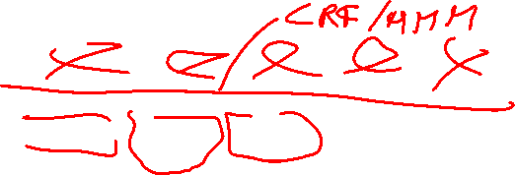
Sequence Labeling (e.g., POS): SOTA ~2018 RNN + CRF with Viterbi
Input: pre-trained embeddings
Output: softmax layer provides a probability distribution over the part-of-speech tags as output at each time step
Choosing max probability label for each item does not necessarily result in optimal (or even very good) tag sequence
Combine with Viterbi for most likely sequence, usually implemented adding CRF layer
Notes:
Part-of-speech tagging as sequence labeling with a simple RNN. Pre-trained
word embeddings serve as inputs and a softmax layer provides a probability distribution over
the part-of-speech tags as output at each time step.
The RNN block is an abstraction that represents
an unrolled simple recurrent network consisting of an input layer, hidden layer, and
output layer at each time step, as well as the sharedU, V andW weight matrices that
comprise the network. The outputs of the network at each time step represent the
distribution over the POS tagset generated by a softmax layer. To generate an actual
tag sequence as output, we can run forward inference over the input sequence and
select the most likely tag from the softmax at each step. Since we’re using a softmax
layer to generate the probability distribution over the output tagset at each timestep,
we’ll rely on the cross entropy loss introduced in Chapter 7 to train the network.
As we saw with applying logistic regression to part-of-speech tagging, choosing the
maximum probability label for each element in a sequence does not necessarily result
in an optimal (or even very good) tag sequence. In the case of IOB tagging, it
doesn’t even guarantee that the resulting sequence will be well-formed. For example,
nothing in approach described in the last section prevents an output sequence
from containing an I following an O, even though such a transition is illegal. Similarly,
when dealing with multiple classes nothing would prevent an I-LOC tag from
following a B-PER tag.
A simple solution to this problem is to use combine the sequence of probability
distributions provided by the softmax outputs with a tag-level language model as we
did with MEMMs in Chapter 8.

Slide 24
POS tagging state of the art + tools
Neural Approaches (on several languages)
Barbara Plank, Anders Søgaard, and Yoav Goldberg. Multilingual part-of-speech tagging with bidirectional long short-term memory models and auxiliary loss. ACL 2016.
Notes:
We present a new part-of-speech tagger that
demonstrates the following ideas: (i) explicit use of both preceding and following tag contexts
via a dependency network representation, (ii) broad use of lexical features, including
jointly conditioning on multiple consecutive words, (iii) effective use of priors in conditional
loglinear models, and (iv) fine-grained modeling of unknown word features. Using these ideas together, the resulting tagger gives a 97.24%accuracy on the Penn TreebankWSJ, an error reduction of 4.4% on the best previous single automatically learned tagging result.
The labeled data points are the model. Consequently,
classification time is proportional to the
number of labeled data points. This is of course impractical.
Many algorithms have been proposed to
make memory-based learning more efficient. The
intuition behind many of them is that the set of labeled
data points can be reduced or condensed, since
many labeled data points are more or less redundant.
The algorithms try to extract a subset of the overall
training set that correctly classifies all the discarded
data points through the nearest neighbor rule. Intuitively,
the model finds good representatives of clusters
in the data or discards the data points that are far
from the decision boundaries. Such algorithms are
called training set condensation algorithms.
The need for training set condensation is particularly
important in semi-supervised learning where
we rely on a mixture of labeled and unlabeled data
points. While the number of labeled data points
is typically limited, the number of unlabeled data
points is typically high. In this paper, we introduce
a new semi-supervised learning algorithm that
combines self-training and condensation to produce
small subsets of labeled and unlabeled data points
that are highly relevant for determining good decision boundaries

Slide 25
Neural Approach to Semantic Role Labeling
BIO/IOB labeling..

Slide 26








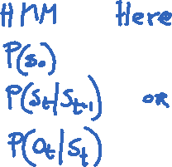


Global approach
Probably skip in class, but check textbook 18.6.2 if something similar needed for your project
Exploit global constraints between tags; e.g., a tag I-ARG0 must follow another I-ARG0 or B-ARG0.
Apply Viterbi decoding
  start with the simple softmax output (the entire probability distribution over tags for each word)
  Hard IOB constraints can act as the transition probabilities in the Viterbi decoding (Thus the transition from state I-ARG0 to I-ARG1 would have probability 0).
  Alternatively, the training data can be used to learn bigram tag transition probabilities as if doing HMM decoding.
Notes:
However, just as feature-based SRL tagging, this local approach to decoding doesn’t exploit the global constraints between tags; a tag I-ARG0, for example, must follow another I-ARG0 or B-ARG0.
As we saw for POS and NER tagging, there are many ways to take advantage of these global constraints. A CRF layer can be used instead of a softmax layer on top of the bi-LSTM output, and the Viterbi decoding algorithm can be used to decode from the CRF.
An even simpler Viterbi decoding algorithm that may perform equally well and doesn’t require adding CRF complexity to the training process is to start with the simple softmax. The softmax output (the entire probability distribution over tags)
for each word is then treated it as a lattice and we can do Viterbi decoding through the lattice. The hard IOB constraints can act as the transition probabilities in the Viterbi decoding (Thus the transition from state I-ARG0 to I-ARG1 would have probability 0). Alternatively, the training data can be used to learn bigram or trigram tag transition probabilities as if doing HMM decoding. Fig. 18.6 shows a sketch of the algorithm.

Slide 27
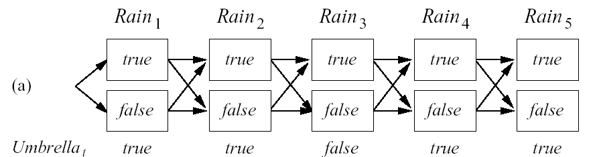
Most Likely Sequence (Explanation)
Most Likely Sequence: argmax_{x1:T} P(X_{1:T} | e_{1:T})
Idea
  find the most likely path to each state in X_{T}
  As for filtering etc. we will develop a recursive solution
Notes:
27
Different than sequence of most likely states

Slide 28
Most Likely Sequence (Explanation)
Most Likely Sequence: argmax_{x1:T} P(X_{1:T} | e_{1:T})
Idea
  find the most likely path to each state in X_{T}
  As for filtering etc. we will develop a recursive solution
Notes:
28
Different than sequence of most likely states

Slide 29
Learning Goals for today’s class
You can:
Describe the smoothing problem and derive a solution by manipulating probabilities
Describe the problem of finding the most likely sequence of states (given a sequence of observations)
Derive recursive solution (if time)

Slide 30
TODO for Mon
(not this coming week)
Keep working on Assignment-2: due Mon March 1
Midterm : Mon March 8

