Slide 1
A Brief Selection of
Shovel-Ready Disruptive Research
for Post-Silicon Observability
Alan J. Hu
Integrated Systems Design Lab
Department of Computer Science
University of British Columbia
Notes:
1

Slide 2
Audience?
Debug Engineers, Managers?
CAD Developers, Managers?
Students, Professors?
Others?
2

Slide 3
Audience?
Debug Engineers, Managers?
CAD Developers, Managers?
Students, Professors?
Others?
Familiarity with Formal Techniques (e.g. SAT, Equivalence Checking, Model Checking)?
3

Slide 4
Learning Goals
Debug Engineers, Managers
CAD Developers, Managers
Students, Professors
Others
Familiarity with Formal Techniques (e.g. SAT, Equivalence Checking, Model Checking)?
4

Slide 5
Learning Goals
Debug Engineers, Managers
  Pick up some actionable techniques to improve your debugging flow.
  See what’s on the horizon, to help communicate with CAD teams/companies.
  Improve your ability to read research results, to learn other novel results.
CAD Developers, Managers
Students, Professors
Others
Familiarity with Formal Techniques (e.g. SAT, Equivalence Checking, Model Checking)?
5

Slide 6
Learning Goals
Debug Engineers, Managers
CAD Developers, Managers
  Learn specific, ready-to-develop ideas for post-silicon validation/debug.
  See the directions from which future solutions will emerge.
  Improve your ability to read research results, to learn other novel results.
Students, Professors
Others
Familiarity with Formal Techniques (e.g. SAT, Equivalence Checking, Model Checking)?
6

Slide 7
Learning Goals
Debug Engineers, Managers
CAD Developers, Managers
Students, Professors
  Get an introduction to an exciting, important, new research area.
  See some of the major recent results.
  See examples of the style of the research being conducted in the field.
Others
Familiarity with Formal Techniques (e.g. SAT, Equivalence Checking, Model Checking)?
7

Slide 8
Learning Goals
Debug Engineers, Managers
CAD Developers, Managers
Students, Professors
Others
Gain sufficient familiarity with key formal techniques to be able to understand research results on post-silicon validation/debug.
8

Slide 9
Outline
Crash Course in Formal Techniques?
  What Is “Formal”?
  Why Formal?
  SAT and Related Automated Reasoning
  Equivalence Checking
  Model Checking
  Abstraction/Refinement
A Selection of “Shovel-Ready” Research Results:
  Signal Selection (covered already)
  Coverage/Monitors
  Virtual Observability Networks
  Capturing/Computing Traces
  Bug Localization/Diagnosis
  Automated Repair
9

Slide 10
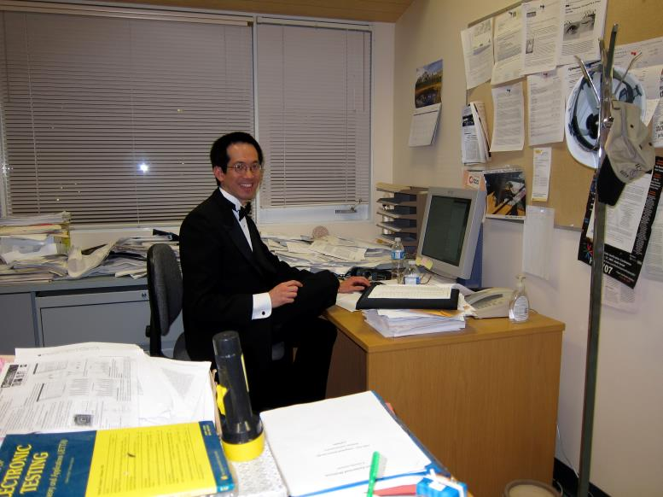
What Is “Formal”?
10

Slide 11
What Is “Formal”?
11

Slide 12
What Is “Formal”?
Precise, unambiguous specification of what you want.
Comprehensive reasoning and exploration of all possibilities.
  Results can be as strong as logical proof.
12

Slide 13
Why “Formal”?
Precise, unambiguous specification of what you want.
Comprehensive reasoning and exploration of all possibilities.
  Results can be as strong as logical proof.
allows automating
13

Slide 14
Why “Formal”?
Precise, unambiguous specification of what you want.
Comprehensive reasoning and exploration of all possibilities.
  Results can be as strong as logical proof.
allows automating
One of the main pay-offs of formality is
to enable automation of formerly
painful and labor-intensive tasks!
14

Slide 15
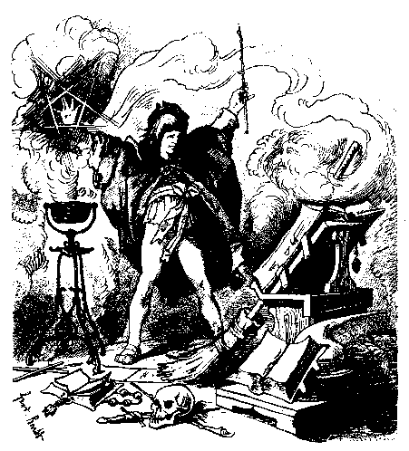
Avoiding “The Sorcerer’s Apprentice”
Der Zauberlehrling
Precise, unambiguous specification of what you want.
“Die ich rief, die Geister…”
One of the main pay-offs of formality is
to enable automation of formerly
painful and labor-intensive tasks!
Photo of etching by Ferdinand Barth, c. 1882, public domain from Wikimedia Commons.
15

Slide 16
“Formal” doesn’t imply “Painful”
Precise, unambiguous specification of what you want.
16

Slide 17
“Formal” doesn’t imply “Painful”
Precise, unambiguous specification of what you want.
  Is a C++ program “formal”?
17

Slide 18
“Formal” doesn’t imply “Painful”
Precise, unambiguous specification of what you want.
  Is a C++ program “formal”? Sure!
18

Slide 19
“Formal” doesn’t imply “Painful”
Precise, unambiguous specification of what you want.
  Is a C++ program “formal”? Sure!
  Python? Perl?
19

Slide 20
“Formal” doesn’t imply “Painful”
Precise, unambiguous specification of what you want.
  Is a C++ program “formal”? Sure!
  Python? Perl? Great!
20

Slide 21
“Formal” doesn’t imply “Painful”
Precise, unambiguous specification of what you want.
  Is a C++ program “formal”? Sure!
  Python? Perl? Great!
  “I want 100% code coverage.”?
21

Slide 22
“Formal” doesn’t imply “Painful”
Precise, unambiguous specification of what you want.
  Is a C++ program “formal”? Sure!
  Python? Perl? Great!
  “I want 100% code coverage.”?
  Did you define “code coverage”?
22

Slide 23
“Formal” doesn’t imply “Painful”
Precise, unambiguous specification of what you want.
  Is a C++ program “formal”? Sure!
  Python? Perl? Great!
  “I want 100% line and branch coverage.”?
23

Slide 24
“Formal” doesn’t imply “Painful”
Precise, unambiguous specification of what you want.
  Is a C++ program “formal”? Sure!
  Python? Perl? Great!
  “I want 100% line and branch coverage.”? Fine!
24

Slide 25
“Formal” doesn’t imply “Painful”
Precise, unambiguous specification of what you want.
  Is a C++ program “formal”? Sure!
  Python? Perl? Great!
  “I want 100% line and branch coverage, except for stupid cases.”?
25

Slide 26
“Formal” doesn’t imply “Painful”
Precise, unambiguous specification of what you want.
  Is a C++ program “formal”? Sure!
  Python? Perl? Great!
  “I want 100% line and branch coverage, except for stupid cases.”?
  Define “stupid cases”.
26

Slide 27
“Formal” doesn’t imply “Painful”
Precise, unambiguous specification of what you want.
  Is a C++ program “formal”? Sure!
  Python? Perl? Great!
  “I want 100% line and branch coverage, except for this list my friend and I came up with.”?
27

Slide 28
“Formal” doesn’t imply “Painful”
Precise, unambiguous specification of what you want.
  Is a C++ program “formal”? Sure!
  Python? Perl? Great!
  “I want 100% line and branch coverage, except for this list my friend and I came up with.”? Fine!
28

Slide 29
“Formal” doesn’t imply “Painful”
Precise, unambiguous specification of what you want.
  Is a C++ program “formal”? Sure!
  Python? Perl? Great!
  “I want 100% line and branch coverage, except for provably dead code.”
29

Slide 30
“Formal” doesn’t imply “Painful”
Precise, unambiguous specification of what you want.
  Is a C++ program “formal”? Sure!
  Python? Perl? Great!
  “I want 100% line and branch coverage, except for provably dead code.” Fine!
30

Slide 31
“Formal” doesn’t imply “Painful”
Precise, unambiguous specification of what you want.
  Is a C++ program “formal”? Sure!
  Python? Perl? Great!
  “I want 100% line and branch coverage, except for provably dead code.” Fine!
  Etc.
31

Slide 32
“Formal” doesn’t imply “Painful”
Historically, some formal methods advocates were very dogmatic about specific formalisms…
  Idealized notations made it easier to focus on fundamental research problems.
  Some notations make it easier to be precise, to say what you want.
  Some notations make is easier for automated reasoning tools.
… but don’t get distracted by issues of notation or language! As long as you are expressing what you want in a clear and precise manner, you are opening the door to formal methods and automation!
  If you can compile it, or synthesize it, or simulate it, then in principle, it is “formal” and can be analyzed using formal methods.
32

Slide 33
Outline
Crash Course in Formal Techniques?
  What Is “Formal”?
  Why Formal?
  SAT and Related Automated Reasoning
  Equivalence Checking
  Model Checking
  Abstraction/Refinement
A Selection of “Shovel-Ready” Research Results:
  Signal Selection (covered already)
  Coverage/Monitors
  Virtual Observability Networks
  Capturing/Computing Traces
  Bug Localization/Diagnosis
  Automated Repair
33

Slide 34
SAT
SAT = Boolean Satisfiability:
  Given a formula in CNF (product of sums), find a satisfying assignment, or determine that none exists.
Clause
Positive Literal
Negative Literal

Slide 35
SAT
SAT = Boolean Satisfiability:
  Given a formula in CNF (product of sums), find a satisfying assignment, or determine that none exists.
Note: Do not think of this as two-level logic.
Think of each clause as a constraint on your problem,
and you are trying to satisfy all constraints.

Slide 36
SAT
SAT = Boolean Satisfiability:
  Given a formula in CNF (product of sums), find a satisfying assignment, or determine that none exists.
For example, you can specify a (multi-level) combinational
circuit in linear space by listing the constraints imposed by
each gate:
x
z
y

Slide 37

SAT
SAT = Boolean Satisfiability:
  Given a formula in CNF (product of sums), find a satisfying assignment, or determine that none exists.
For example, you can specify a (multi-level) combinational
circuit in linear space by listing the constraints imposed by
each gate: (“Tseitin Transform”)
x
z
$$(\overline{z}+x)(\overline{z}+y)(\overline{x}+\overline{y}+z)$$
y

Slide 38
Why SAT?
SAT is the dominant Boolean reasoning engine for EDA applications.
SAT is the original NP-complete problem, so all known algorithms are worst-case exponential…

Slide 39
Why SAT?
SAT is the dominant Boolean reasoning engine for EDA applications.
SAT is the original NP-complete problem, so all known algorithms are worst-case exponential…
… but in practice, SAT solvers routinely solve practical instances with millions of variables!

Slide 40
CDCL SAT Algorithm
CDCL = “Conflict-Driven Clause Learning”
This is the breakthrough that powers all modern complete SAT solvers.
  Marques-Silva, Sakallah, “GRASP: A Search Algorithm for Propositional Satisfiability,” IEEE Trans. Computers, C-48, 1999.
  Moskewicz, Madigan, Zhao, Zhang, Malik, “Chaff: Engineering an Efficient SAT Solver,” DAC 2001.
Loop
  Choose a literal to make true. (If none left, problem is SAT.)
  Propagate implications of the choice.
  If there is a conflict, learn a clause and backtrack.
    (If nowhere left to backtrack to, problem is UNSAT.)
EndLoop
40

Slide 41
Open-Source SAT Solvers
There are many, state-of-the-art, open-source SAT solvers available.
  This is part of what has made progress so fast.
  A great starting point is MiniSAT, by Niklas Eén and Niklas Sörensseon: http://www.minisat.se
  There is also the annual SAT Competition, to follow the latest developments: http://www.satcompetition.org
  And there is the annual SAT conference: http://www.satlive.org
41

Slide 42
Variations: Incremental SAT
If solving a series of SAT problems, in which constraints are only added, the solver can re-use everything it has learned so far.
This can be a huge efficiency boost. It’s worth trying to formulate problems to take advantage of this.
42

Slide 43
Variations: ALL-SAT, #SAT
Sometimes, you want all solutions, not just a solution (ALL-SAT), or a count of the number of solutions (#SAT)
This is theoretically a much harder problem, and current solvers are not nearly as good as normal SAT solvers.
If the number of solutions is small, you can do this efficiently via incremental SAT, by adding a “blocking clause” whenever you find a solution.
43

Slide 44
Variations: MAX-SAT
MAX-SAT is the problem of finding an assignment that satisfies as many clauses as possible.
In theory, finding the optimum solution is “harder” than SAT. Current solvers do not scale to practical sizes needed for EDA applications.
In practice, it’s often possible to find heuristically useful, good-enough solution.
44

Slide 45
Variations: UNSAT Core
UNSAT Core is the similar problem of finding a small subset of the clauses that is still unsatisfiable.
As with MAX-SAT, in theory, finding the optimum solution is “harder” than SAT.
In practice, it’s often possible to find heuristically useful, good-enough solution (e.g., “minimal” vs. “minimum”). This can extracted efficiently from a normal run of a SAT solver.
45

Slide 46
Variations: Backbones
A backbone is a set of literals that are true for all satisfying assignments.
  You can also think of this as a cube that covers all satisfying assignments.
Backbones don’t always exist, but they are very useful if there’s a big backbone.
Good heuristic solutions exist, based on repeatedly calling (incremental) SAT or (approximate) UNSAT Core.
46

Slide 47
SMT (Satisfiability Modulo Theories)
A SAT solver with special superpowers ☺
Often, it’s convenient to reason about things at a more abstract level: e.g., bit vectors, integers, real numbers, arrays, etc.
An SMT solver is just a SAT solver interacting with specialized theory solvers.
Some theories are computationally much harder than Boolean SAT, but reasoning at the higher level of abstraction can be a big win.
The leading solver, Z3, is publicly available for non-commercial use: http://z3.codeplex.com
CVC is a very general, completely open-source solver: http://cvc4.cs.nyu.edu
There are several others. See the SMT Competition for more information: http://smtcomp.sourceforge.net
47

Slide 48
Outline
Crash Course in Formal Techniques?
  What Is “Formal”?
  Why Formal?
  SAT and Related Automated Reasoning
  Equivalence Checking
  Model Checking
  Abstraction/Refinement
A Selection of “Shovel-Ready” Research Results:
  Signal Selection (covered already)
  Coverage/Monitors
  Virtual Observability Networks
  Capturing/Computing Traces
  Bug Localization/Diagnosis
  Automated Repair
48

Slide 49
Combinational Equivalence

Slide 50
Combinational Equivalence
Compute functionality of each circuit.
  f = a ⊕ ((b ∧ c) ∧ d), g = a ⊕ (b ∧ (c ∧ d))
Compare expressions
Scalability: Complexity blows up for real circuits.

Slide 51
Cutpoints
Guess cutpoint and prove equivalence:
  E.g., the wire x in each circuit
Treat cutpoint as new primary input:
Prove f= a ⊕ x equivalent to g= a ⊕ x
Divide and conquer.

Slide 52
Equivalence Checking
For equivalence with identical, very similar, or slightly retimed state encoding, this is mature technology.
Commercial tools available.
52

Slide 53
Outline
Crash Course in Formal Techniques?
  What Is “Formal”?
  Why Formal?
  SAT and Related Automated Reasoning
  Equivalence Checking
  Model Checking
  Abstraction/Refinement
A Selection of “Shovel-Ready” Research Results:
  Signal Selection (covered already)
  Coverage/Monitors
  Virtual Observability Networks
  Capturing/Computing Traces
  Bug Localization/Diagnosis
  Automated Repair
53

Slide 54
ACM Turing Award 2007
Edmund M. Clarke, E. Allen Emerson, Joseph Sifakis
Model Checking:
Algorithmic Verification and Debugging
“… founded what has become the highly successful field of Model Checking. … This approach, for example, often enables engineers in the electronics industry to design complex systems with considerable assurance regarding the correctness of their initial designs. Model Checking promises to have an even greater impact on the hardware and software industries in the future.”

Slide 55
What is model checking?
Model checking is just exhaustive search!
Model checking systematically searches for a state that violates a specified property.
Example: “Every REQ is ACKed or RETRYed within 3 cycles.”
  Search through all possible executions for a state where REQ is true, and can continue for more than 3 cycles without hitting ACK or RETRY.
Search can be bounded, or to a fixpoint.

Slide 56
What is model checking?
Model checking is just exhaustive search!
Model checking systematically searches for a state that violates a specified property.
Example: “Every REQ is ACKed or RETRYed within 3 cycles.”
  Search through all possible executions for a state where REQ is true, and can continue for more than 3 cycles without hitting ACK or RETRY.
Search can be bounded, or to a fixpoint.
This won a Turing Award because there’s lots of cleverness to handle big state spaces. And it’s really useful in practice…

Slide 57
Using Model Checking
Model checking systematically searches for a state that violates a specified property.
Therefore, specify what you want, and let the model checker find it, or prove that it can’t happen.
If model checker finds it, it gives a trace leading to it.
Examples:
  To check equivalence of two state machines with very different encoding, you can run them in lockstep and ask the model checker to find a mismatch.
  To root-cause an observed buggy state, you can ask the model checker to find a path to it.

Slide 58
Verification Is Search
Target
Start

Slide 59
Model Checking
Target
Start

Slide 60
Model Checking
Target
Start

Slide 61
Model Checking
Target
Start

Slide 62
Model Checking
Target
Start

Slide 63
Model Checking
Target
Start

Slide 64
State Explosion Problem
Model checking systematically searches for a state that violates a specified property.
There are a lot of states!
This is called the “state explosion problem”. A lot of research focuses on how to manage this. Many are very intricate details, but we’ll look at a very powerful, general approach in a moment (abstraction).
Most model checkers rely on SAT solvers internally.
Good commercial model checkers are emerging.

Slide 65
Outline
Crash Course in Formal Techniques?
  What Is “Formal”?
  Why Formal?
  SAT and Related Automated Reasoning
  Equivalence Checking
  Model Checking
  Abstraction/Refinement
A Selection of “Shovel-Ready” Research Results:
  Signal Selection (covered already)
  Coverage/Monitors
  Virtual Observability Networks
  Capturing/Computing Traces
  Bug Localization/Diagnosis
  Automated Repair
65

Slide 66
Abstraction
Abstraction is a powerful paradigm for fighting state explosion (and simplifying problems in general).
Basically, abstraction just means discarding or ignoring information.
Examples:
  Cutpoints for Combinational Equivalence: When we cut out part of the circuit, we are discarding that part of the design, leaving a smaller, simpler “abstract” equivalence checking problem to solve.
  State Projection: Since you can record only a fraction of all signals in a trace buffer, the trace you see is an abstract trace, which ignores the information from the signals that weren’t recorded.

Slide 67
Abstraction
(Large) concrete state space C
(Small) abstract state space A
Abstraction function α: C->A
Abstract transitions:
If concrete trace exists, then abstract trace exists.

Slide 68
Abstraction
(Large) concrete state space C
(Small) abstract state space A
Abstraction function α: C->A
Abstract transitions:
If concrete trace exists, then abstract trace exists.
More generally, if a concrete solution exists, then an abstract solution exists (but not necessarily the other way around).

Slide 69
Abstraction
(Large) concrete state space C
(Small) abstract state space A
Abstraction function α: C->A
Abstract transitions:
You can view abstraction as grouping concrete states together into big abstract states (all states that differ only in the information that is ignored).

Slide 70
Verification Is Search
Target
Start

Slide 71
Abstraction
Target
Start

Slide 72
Explore smaller abstract state space.
Target
Start

Slide 73
Explore smaller abstract state space.
Target
Start

Slide 74
Explore smaller abstract state space.
Target
Start

Slide 75
Explore smaller abstract state space.
Target
Start

Slide 76
Explore smaller abstract state space.
Target
Start

Slide 77
Explore smaller abstract state space.
Target
Start

Slide 78
Explore smaller abstract state space.
Target
Start

Slide 79
False Solutions
The problem with abstraction is the possibility of false solutions.
Good Example: To fly from Vancouver to Dresden, I can abstract to the problem of flying from Canada to Germany, and then fill in the details (YVR->FRA, FRA->DRS)
Bad Example: To bicycle from Vancouver to Dresden, I can abstract to the problem of bicycling from Canada to Germany. It is possible to bicycle from Canada to France (from Newfoundland on a ferry to Ile St. Pierre, a small French island), and from France to Germany. But this abstract solution doesn’t correspond to any concrete solution!
Must refine the abstraction!

Slide 80
False Solutions
The problem with abstraction is the possibility of false solutions.
Good Example: To fly from Vancouver to Dresden, I can abstract to the problem of flying from Canada to Germany, and then fill in the details (YVR->FRA, FRA->DRS)
Bad Example: To bicycle from Vancouver to Dresden, I can abstract to the problem of bicycling from Canada to Germany. It is possible to bicycle from Canada to France (from Newfoundland on a ferry to Ile St. Pierre, a small French island), and from France to Germany. But this abstract solution doesn’t correspond to any concrete solution!
Must refine the abstraction!

Slide 81
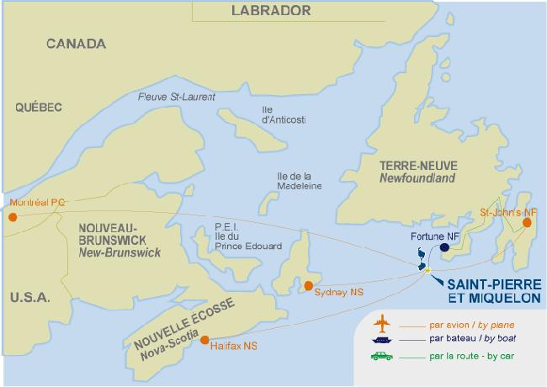
False Solutions
The problem with abstraction is the possibility of false solutions.
Good Example: To fly from Vancouver to Dresden, I can abstract to the problem of flying from Canada to Germany, and then fill in the details (YVR->FRA, FRA->DRS)
Bad Example: To bicycle from Vancouver to Dresden, I can abstract to the problem of bicycling from Canada to Germany. It is possible to bicycle from Canada to France (from Newfoundland on a ferry to Ile St. Pierre, a small French island), and from France to Germany. But this abstract solution doesn’t correspond to any concrete solution!
Must refine the abstraction!
Map is from www.tourisme-saint-pierre-et-miquelon.com, which doesn’t assert copyright on it.

Slide 82
False Solutions
The problem with abstraction is the possibility of false solutions.
Good Example: To fly from Vancouver to Dresden, I can abstract to the problem of flying from Canada to Germany, and then fill in the details (YVR->FRA, FRA->DRS)
Bad Example: To bicycle from Vancouver to Dresden, I can abstract to the problem of bicycling from Canada to Germany. It is possible to bicycle from Canada to France (from Newfoundland on a ferry to Ile St. Pierre, a small French island), and from France to Germany. But this abstract solution doesn’t correspond to any concrete solution!
Must refine the abstraction!

Slide 83
False Solutions
The problem with abstraction is the possibility of false solutions.
Good Example: To fly from Vancouver to Dresden, I can abstract to the problem of flying from Canada to Germany, and then fill in the details (YVR->FRA, FRA->DRS)
Bad Example: To bicycle from Vancouver to Dresden, I can abstract to the problem of bicycling from Canada to Germany. It is possible to bicycle from Canada to France (from Newfoundland on a ferry to Ile St. Pierre, a small French island), and from France to Germany. But this abstract solution doesn’t correspond to any concrete solution!
Must refine the abstraction!

Slide 84
Explore smaller abstract state space.
Target
Start

Slide 85
Explore smaller abstract state space.
Target
Start

Slide 86
Explore smaller abstract state space.
Target
Start

Slide 87
Explore smaller abstract state space.
Target
Start

Slide 88
Explore smaller abstract state space.
Target
Start

Slide 89
False error trace to target!
Target
Start

Slide 90
Must Refine Abstraction
Target
Start

Slide 91
CEGAR: Counterexample Guided Abstraction Refinement
This is the main paradigm for automatic abstraction refinement.
Start with a very coarse abstraction.
Solve it.
  If no solution, you have proven that the concrete problem has no solution, since the abstraction preserves solutions.
Use the solution (a “counterexample” to the theorem that you cannot reach a target) to guide finding a concrete solution.
  If you find a concrete solution, you’re done.
  If not, the failure tells you exactly where to refine.

Slide 92
Outline
Crash Course in Formal Techniques?
  What Is “Formal”?
  Why Formal?
  SAT and Related Automated Reasoning
  Equivalence Checking
  Model Checking
  Abstraction/Refinement
A Selection of “Shovel-Ready” Research Results:
  Signal Selection (covered already)
  Coverage/Monitors
  Virtual Observability Networks
  Capturing/Computing Traces
  Bug Localization/Diagnosis
  Automated Repair
92

Slide 93
Outline
Crash Course in Formal Techniques?
  What Is “Formal”?
  Why Formal?
  SAT and Related Automated Reasoning
  Equivalence Checking
  Model Checking
  Abstraction/Refinement
A Selection of “Shovel-Ready” Research Results:
  Signal Selection (covered already)
  Coverage/Monitors
  Virtual Observability Networks
  Capturing/Computing Traces
  Bug Localization/Diagnosis
  Automated Repair
93

Slide 94
Coverage and Other Monitors
The emphasis of this tutorial is on post-silicon observability – figuring out what happened on the chip.
An obvious way to improve observability is to add on-chip structures that observe – on-chip monitors.
  You can think of trace buffers, on-chip logic analyzers, etc. as instances of this.
  + On-chip structure has great bandwidth.
  -- On-chip structure takes area and power.
Coverage is one of the most fundamental questions, so let’s look at coverage monitoring first…

Slide 95
Case Study
Get an SoC that is industrial-size, but synthesizable to FPGA.
Measure coverage with pre-silicon simulation tests.
Instrument the SoC for code coverage.
Run typical post-silicon test on the “silicon”, e.g., boot Linux.
Measure and compare post-silicon coverage.
Measure overhead.
Karimibiuki, Balston, Hu, Ivanov, HLDVT 2011

Slide 96
SoC Platform at UBC
Built from Aeroflex Gaisler open-source IP
  Aeroflex Gaisler IP used in real ESA projects
Features:
  Leon3 Processor(s) -- SPARC V8, 7-stage pipeline
  IEEE-754 FPU
  SPARC V8 reference MMU
  Multiway D- and I-caches
  DDR2 SDRAM controller/interface
  DVI Display Controller
  10/100/1000 Ethernet MAC
  PS2 Keyboard and Mouse
  Compact Flash Interface
Boots and runs Linux, telnet, gcc, X11, etc.

Slide 97
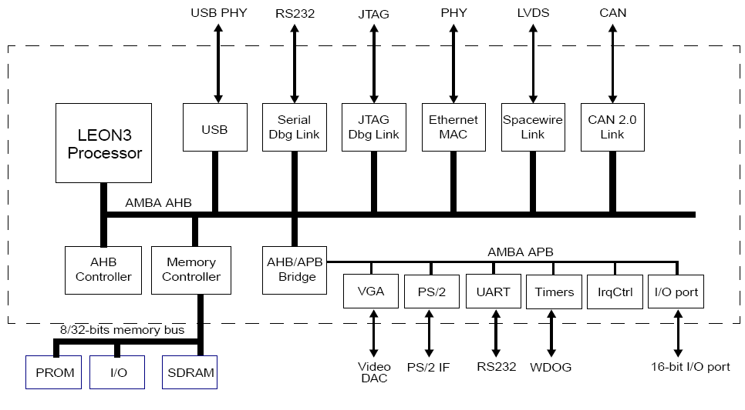
SoC Platform at UBC

Slide 98
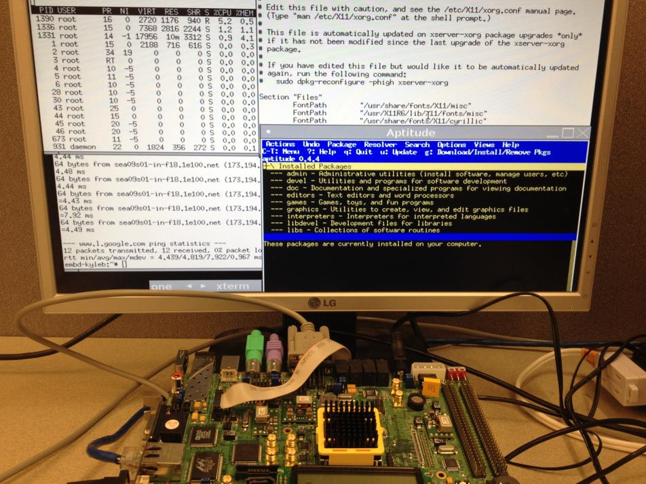
SoC Platform at UBC

Slide 99
Pre-Silicon Statement Coverage

Slide 100
Post-Silicon Statement Coverage

Slide 101
Post-Silicon Statement Coverage

Slide 102
Pre-Silicon Branch Coverage

Slide 103
Post-Silicon Branch Coverage

Slide 104
Post-Silicon Branch Coverage

Slide 105
Overhead (Percent)

Slide 106
Flip-Flop Overhead (Percent)

Slide 107
LUT Overhead (Percent)

Slide 108
LUT Overhead (Percent)

Slide 109
Coverage Monitors and Emulation
On-chip coverage monitors useful, but too expensive.
But, people are using emulation!
Put coverage monitors in the emulated design.
Evaluate quality of post-silicon tests.
Run the same tests on (un-monitored) actual silicon.

Slide 110
Coverage Monitors and Emulation
On-chip coverage monitors useful, but too expensive.
But, people are using emulation!
Put coverage monitors in the emulated design.
Evaluate quality of post-silicon tests.
Run the same tests on (un-monitored) actual silicon.
The things you are monitoring don’t even have to exist in the emulation version! As long as you can monitor whether the silicon would have covered the desired event.
Balston, Wilton, Hu, Nahir, HLDVT 2012

Slide 111
Emulation in the Design Flow
Pre-Si
Validation
Silicon Flow
Design
Chip

Slide 112
Emulation in the Design Flow
SW, etc.
Pre-Si
Validation
Silicon Flow
Design
Chip
Emulation
Flow
FPGA

Slide 113
Post-Silicon in the Design Flow
SW, etc.
Pre-Si
Validation
Silicon Flow
Design
Chip
Emulation
Flow
FPGA
Post-Si
Validation
Post-Si Test Plan,
Tests, Exercisers
Post-Si Validation Team

Slide 114
Emulation vs.
Post-Silicon Validation
Emulation runs fast. Silicon runs really fast.
Maybe emulation can help?
Emulation is implemented on FPGAs:
  LUTs, fully buffered interconnect, routing grids, etc.
Silicon is ASIC or full-custom.
Therefore, emulation only for functionality?

Slide 115
Emulation vs.
Post-Silicon Validation
Emulation runs fast. Silicon runs really fast.
Maybe emulation can help?
Emulation is implemented on FPGAs:
  LUTs, fully buffered interconnect, routing grids, etc.
Silicon is ASIC or full-custom.
Add coverage monitors to emulation version.
Measure post-silicon test quality!

Slide 116
Emulation for Post-Si Coverage
SW, etc.
Pre-Si
Validation
Silicon Flow
Design
Chip
Emulation
Flow
FPGA
Post-Si
Validation
Post-Si Test Plan,
Tests, Exercisers
Post-Si Validation Team

Slide 117
Emulation for Post-Si Coverage
SW, etc.
Pre-Si
Validation
Silicon Flow
Design
Chip
Emulation
Flow
FPGA
Instrument
for Coverage
Post-Si
Validation
Coverage
Results
Post-Si Test Plan,
Tests, Exercisers
Post-Si Validation Team

Slide 118
Emulation for Post-Si Coverage
SW, etc.
Pre-Si
Validation
Instrumentation can be for things
that don’t exist on the FPGA! –
As long as we can capture whether the
silicon would hit the coverage target.
Silicon Flow
Design
Chip
Emulation
Flow
FPGA
Instrument
for Coverage
Post-Si
Validation
Coverage
Results
Post-Si Test Plan,
Tests, Exercisers
Post-Si Validation Team

Slide 119
Example: Critical Timing Paths
These are the longest delay paths in the combinational logic of the chip.
Limits maximum clock frequency.
Important for tests to exercise these paths.

Slide 120
Coverage Monitors for Critical Timing Paths
Static timing analysis is imperfect.
Therefore, important to know what paths actually exercised on-chip.
Use STA (and/or human insight) to select important paths.
Add coverage monitors for those paths.
Evaluate coverage of test using emulation.

Slide 121
Monitoring a Path
For each selected path, compute sensitization condition (off-line)
Add hardware to detect input transition and path sensitization.
Add sticky bit to record coverage of path.
Overhead proportional to number of paths and (roughly) length of paths.

Slide 122
Overall Flow
Original (ASIC) Design
Synthesize with ASIC Tools
Convert to Emulation Version
Perform Timing Analysis
Create and Integrate Coverage Monitors
Synthesize with Emulation Tools
Run Tests and Measure Coverage

Slide 123
Instrumented 5 Cores of SoC
IP Block | Lines of RTL
DDR2 Controller | 1924
Floating Point Unit | Netlist
7-Stage Pipelined Integer Unit | 3131
Memory Management Unit | 1929
32-Bit Multiplier | 24477

Slide 124
Critical Timing Paths
For each core, we added a coverage monitor for the top 2048 most critical paths, as computed by the Xilinx Static Timing Analyzer.

Slide 125
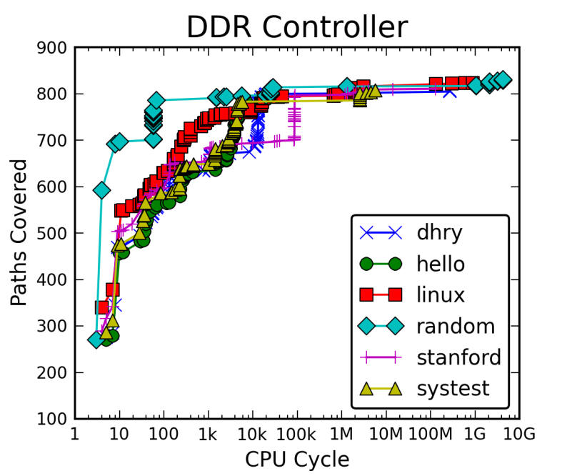

Slide 126
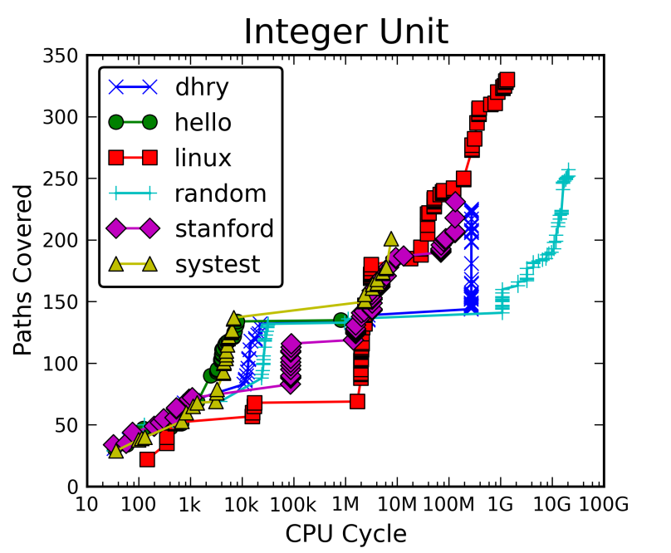

Slide 127
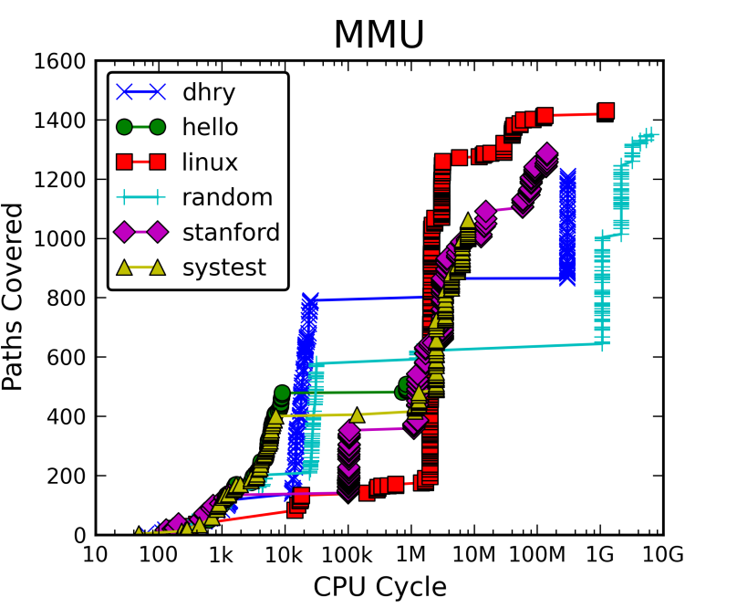

Slide 128
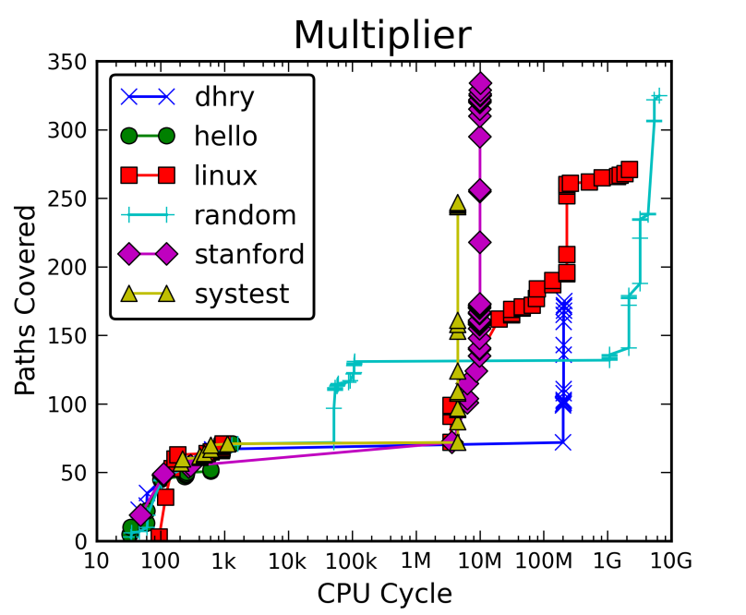

Slide 129
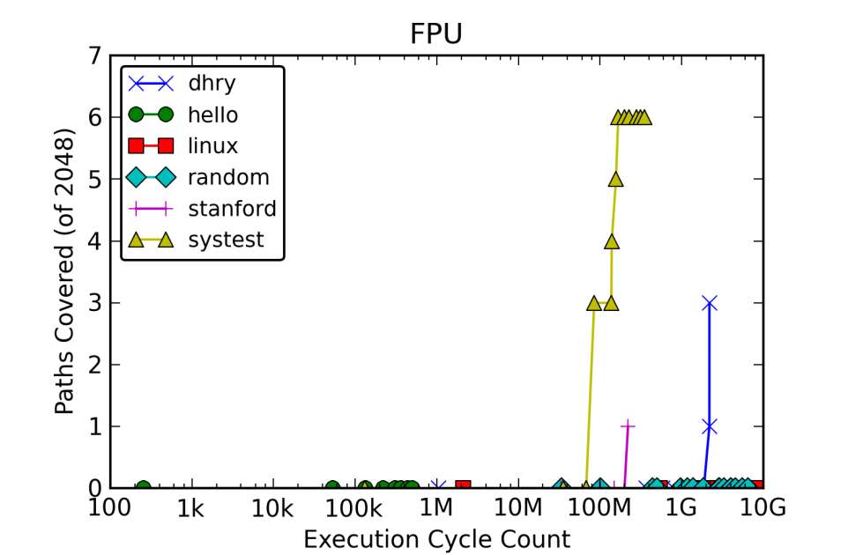

Slide 130
Detailed Coverage Example
By this test… | … but which was not achieved by this test.
 | Dhry | Hello | Linux | Random | Stanford | Systest | All Other
Dhry | 0 | 945 | 7 | 24 | 56 | 366 | 0
Hello | 24 | 0 | 2 | 1 | 9 | 110 | 0
Linux | 443 | 1359 | 0 | 185 | 263 | 594 | 101
Random | 368 | 1266 | 93 | 0 | 132 | 517 | 30
Stanford | 301 | 1175 | 72 | 33 | 0 | 458 | 10
Systest | 270 | 935 | 62 | 77 | 117 | 0 | 14
All Else | 556 | 1477 | 120 | 212 | 311 | 652

Slide 131
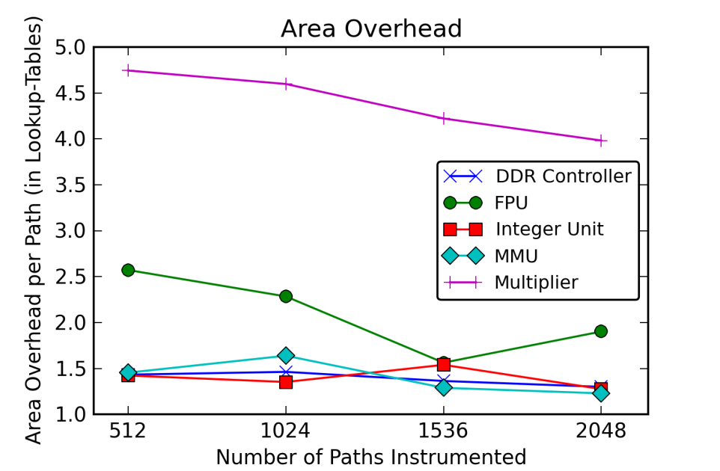

Slide 132
Coverage Monitors in Emulation:
It works!
Possible to get detailed coverage results.
Area overhead is controllable.
General methodology for using emulation to support post-silicon validation for more than just functional properties.

Slide 133
Coverage Monitors in Emulation:
More Generally?
If you are willing to add monitors to an emulation version, you can monitor much more expressive properties!
Boulé and Zilić, Generating Hardware Assertion Checkers, Springer, 2008 (and related publications) show how to generate hardware monitors for PSL and SVA assertions.

Slide 134
Coverage Monitors in Emulation:
More Generally?
If you are willing to add monitors to an emulation version, you can monitor much more expressive properties!
Boulé and Zilić, Generating Hardware Assertion Checkers, Springer, 2008 (and related publications) show how to generate hardware monitors for PSL and SVA assertions.
Ray and Hunt, “Connecting Pre-silicon and Post-silicon Verification,” FMCAD 2009, propose a methodology to decompose a pre-silicon monitor into a small on-chip portion formally combined with off-chip analysis.

Slide 135
Ray and Hunt’s Example
Memory Controller
Cache 1
Cache 2
Filtered Trace Buffer
Cache 3

Slide 136
Ray and Hunt’s Example
Memory Controller
Cache 1
Cache 2
Filtered Trace Buffer
Cache 3
Pre-Silicon Property Monitor

Slide 137
Ray and Hunt’s Example
Memory Controller
Cache 1
Cache 2
Filtered Trace Buffer
Cache 3
Pre-Silicon Property Monitor

Slide 138
Ray and Hunt’s Example
Memory Controller
Cache 1
Integrity Unit
Cache 2
Filtered Trace Buffer
Cache 3
Pre-Silicon Property Monitor
Formal Proof
via SAT Solver

Slide 139
Outline
Crash Course in Formal Techniques?
  What Is “Formal”?
  Why Formal?
  SAT and Related Automated Reasoning
  Equivalence Checking
  Model Checking
  Abstraction/Refinement
A Selection of “Shovel-Ready” Research Results:
  Signal Selection (covered already)
  Coverage/Monitors
  Virtual Observability Networks
  Capturing/Computing Traces
  Bug Localization/Diagnosis
  Automated Repair
139

Slide 140
Towards Simulator-Like Observability…
Debug engineers want to look at any signal, at any time,
with no overhead….
Key innovation: virtual overlay network
Connect any subset of user circuit signals to trace buffer pins
Hung, Wilton, “Towards simulator-like observability for FPGAs: a virtual overlay network for trace-buffers”, FPGA, 2013.

Slide 141
Virtual Overlay Network
  At Compile Time: At Debug Time:
  Insert overlay network Configure Network (seconds)
Virtual
Overlay
Network

Slide 142
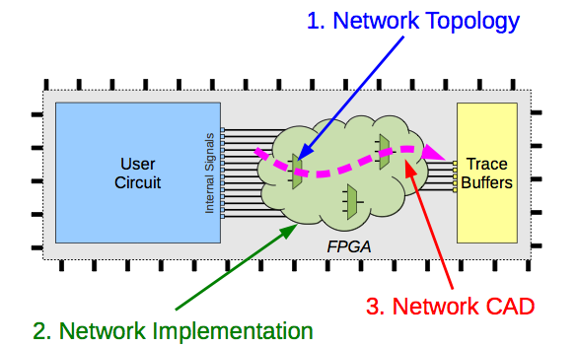
Three things to make this work:

Slide 143
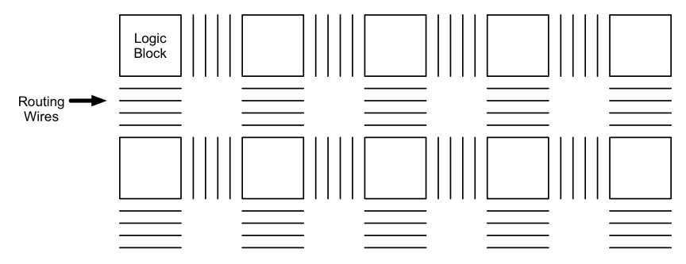
Overlay Network Implementation
Construct a network connecting all on-chip signals to trace buffers

Slide 144
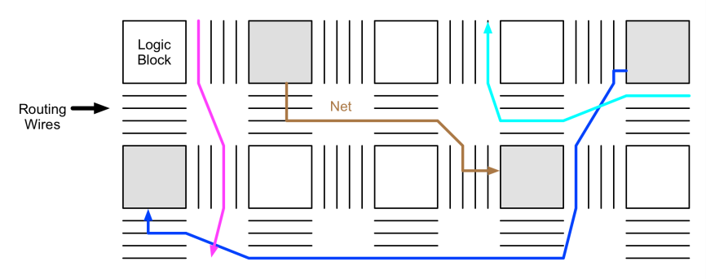
Overlay Network Implementation
Construct a network connecting all on-chip signals to trace buffers
First, compile user circuit as normal

Slide 145
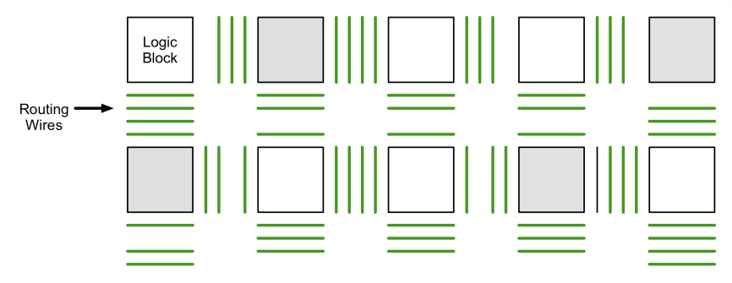
Overlay Network Implementation
Construct a network connecting all on-chip signals to trace buffers
Insert network incrementally: without affecting user circuit, utilizing
spare routing resources left behind

Slide 146
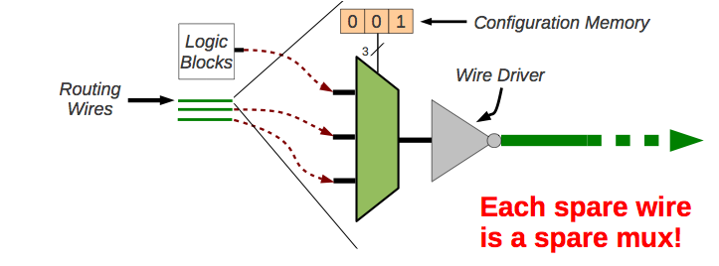
Overlay Network Implementation
Construct a network connecting all on-chip signals to trace buffers
Insert network incrementally: without affecting user circuit, utilizing
spare routing resources left behind

Slide 147
Overlay Network: Debug-time
Virtual
Overlay
Network

Slide 148
Overlay Network: Debug-time
At debug time, we set the configuration bits for each multiplexer
- No recompile
The network is a blocking network: not all network inputs can be
connected to all outputs.
Can formulate this as a bipartite graph maximum-matching problem.

Slide 149
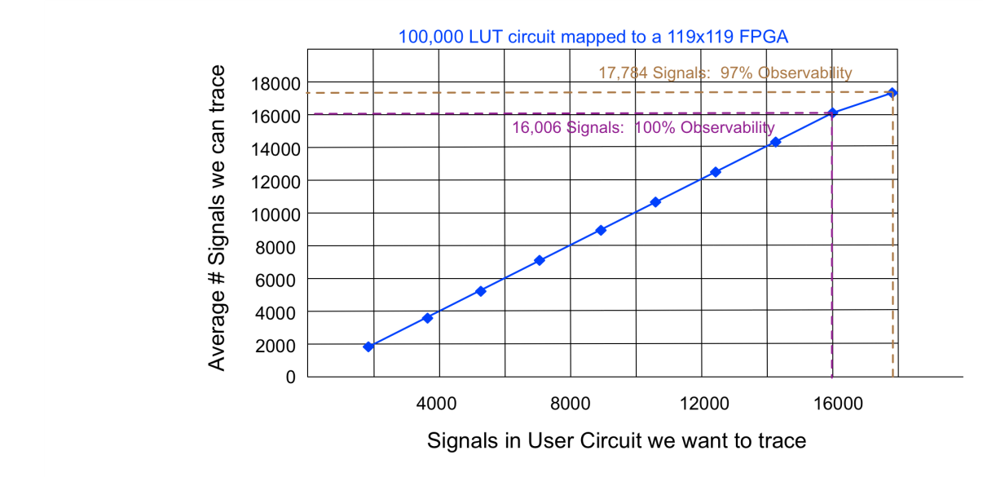

Slide 150
Summary
Can trace thousands of signals with…
- No area overhead
- No recompilation
Costs:
- A small amount of extra recompilation time

Slide 151
Outline
Crash Course in Formal Techniques?
  What Is “Formal”?
  Why Formal?
  SAT and Related Automated Reasoning
  Equivalence Checking
  Model Checking
  Abstraction/Refinement
A Selection of “Shovel-Ready” Research Results:
  Signal Selection (covered already)
  Coverage/Monitors
  Virtual Observability Networks
  Capturing/Computing Traces
  Bug Localization/Diagnosis
  Automated Repair
151

Slide 152
Existing Support for Trace Collection
Improving observability:
  Scan chains: Observe the values of a lot of state.
    Very infrequent snapshot, disturbs execution
  Trace buffers: Capture segment of full-speed execution
    Few signals, limited length, difficulty triggering
Handling nondeterminism:
  Reduce nondeterminism (e.g, disabling parts of the design)
    Requires high effort and sometimes bug is not reproducible in an “almost” deterministic environment
  Record all I/O and replay
    Requires highly specialized bring-up systems

Slide 153
Basic BackSpace: Intuition
Inputs
1. Run at-speed until hit the buggy state
Non-buggy path
De Paula, Gort, Hu, Wilton, Yang, “BackSpace: Formal Analysis for Post-Silicon Debug,” FMCAD 2008

Slide 154
Basic BackSpace: Intuition
Inputs
1. Run at-speed until hit the buggy state
Non-buggy path

Slide 155
Basic BackSpace: Intuition
Inputs
1. Run at-speed until hit the buggy state
Non-buggy path

Slide 156
Basic BackSpace: Intuition
Inputs
1. Run at-speed until hit the buggy state
Non-buggy path

Slide 157
Basic BackSpace: Intuition
Inputs
2. Scan-out buggy state and signature

Slide 158
Basic BackSpace: Intuition
Inputs
Off-Chip Formal Analysis
Formal
Engine

Slide 159
Basic BackSpace: Intuition
Inputs
Off-Chip Formal Analysis
  - Compute Pre-image
Formal
Engine

Slide 160
Basic BackSpace: Intuition
Inputs
Pick candidate state and load breakpoint circuit
Formal
Engine

Slide 161
Basic BackSpace: Intuition
Inputs
Run until hits the breakpoint
Formal
Engine

Slide 162
Basic BackSpace: Intuition
Inputs
Pick another state
Formal
Engine

Slide 163
Basic BackSpace: Intuition
Inputs
Run until hits the breakpoint
Formal
Engine

Slide 164
Basic BackSpace: Intuition
Inputs
Run until hits the breakpoint
Formal
Engine

Slide 165
Basic BackSpace: Intuition
Inputs
Computed trace of length 2

Slide 166
Basic BackSpace: Intuition
Inputs
Iterate
Formal
Engine

Slide 167
Basic BackSpace: Intuition
Inputs
BackSpace trace

Slide 168
Basic BackSpace: Theory
Theorem (Correctness of Basic BackSpace):
The trace returned by Basic BackSpace is the suffix of a valid execution of the chip leading to the crash state.

Slide 169
Basic BackSpace: Experiments
Theorem (Correctness of Basic BackSpace):
The trace returned by Basic BackSpace is the suffix of a valid execution of the chip leading to the crash state.
Experiments:
  OpenRISC in hardware emulation (small design)
  Could BackSpace hundreds of cycles
  Overhead was prohibitive.

Slide 170
TAB-BackSpace: Intution
Inputs
Run 1
Trace 1
Offline Analysis
De Paula, Nahir, Nevo, Orni, Hu, “TAB-BackSpace: unlimited-length trace buffers with zero additional on-chip overhead,” DAC 2011.

Slide 171
TAB-BackSpace: Intution
Inputs
Run 1
Trace 1

Slide 172
TAB-BackSpace: Intution
Inputs
Run 1
Run 2
Trace 1

Slide 173
TAB-BackSpace: Intution
Inputs
Run 1
Run 2
Trace 1
Trace 2

Slide 174
TAB-BackSpace: Intution
Inputs
Run 1
Run 2
Overlapping region
Trace 1
Trace 2

Slide 175
TAB-BackSpace: Intution
Inputs
Run 1
Run 2
Overlapping region
Is the overlapping region identical?
Trace 1
Trace 2
Extended Trace

Slide 176
TAB-BackSpace: Theory
Definition (l_{div} “divergence length”):
Let l_{div} be the smallest constant (if it exists) s.t.:
for all concrete traces x₁y₁z₁ and x₂y₂z₂,
with α(y₁)= α (y₂) and length(y₁)> l_{div}
x₁y₁z₂ and x₁y₂z₂ are also concrete traces.

Slide 177
TAB-BackSpace: Theory
Theorem (Correctness of TAB-BackSpace):
If the size of the overlap region between trace dumps is greater than l_{div}, then the trace returned by TAB-BackSpace is concretizable to the suffix of a valid execution of the chip leading to the crash state.

Slide 178
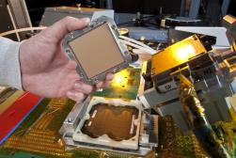
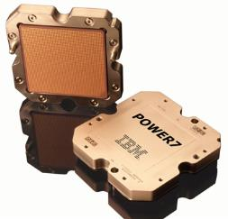
Experiments
1st Experiment (Simulation)
2nd Experiment (Silicon)
  Test case: IBM POWER7 processor
  Leveraged POWER7’s embedded debug logic
  Debugged on a bring-up lab
  Used a POWER7’s configuration to enable a real bug discovered in early stages of the POWER7 bring-up
  Applied TAB-BackSpace scheme

Slide 179
TAB-BackSpace Results Summary
Router
  Successfully achieved the goal of 20 iterations ( > 2/3 of the cases )
  For most of the 2/3 cases the total number of chip runs were in the hundreds (avg ~15 runs/iteration)
IBM-POWER7
  Successfully TAB-BackSpaced actual silicon
  Root-caused the bug
  Approximately doubled the length of the initial trace
  But, …
    worked in an environment in which nondeterminism was extensively reduced

Slide 180
nuTAB-BackSpace: Intution
Inputs
Run 1
Run 2
Overlapping region
Do Trace1 and Trace2 belong to same equivalence class?
Trace 1
Trace 2
De Paula, Hu, Nahir, “nuTAB-BackSpace:
Rewriting to Normalize Non-determinism in
Post-silicon Debug Traces,” CAV 2012.
Extended Trace

Slide 181
nuTAB-BackSpace
181
User-defined equivalence:
  Leveraging the theory of String-Rewriting Systems
  Expressive, easy-to-understand
  Powerful underlying theory

Slide 182
String Rewrite Systems in a Nutshell
Finite Set of Rewrite Rules: l -> r
  If you see l as a substring, you can replace it with r.
Two strings are equivalent if they can be rewritten to the same string.
Terminating/Noetherian: Can’t rewrite forever.
Confluent/Locally Confluent/Church-Rosser: Any time you have a choice, you can rewrite to the same final result.
Terminating+Confluent => Unique Normal Form

Slide 183
nuTAB-BackSpace: Intution
Inputs
Run 1
Run 2
Overlapping region
Do Trace1 and Trace2 canonicalize?
Trace 1
Trace 2
Extended Trace

Slide 184
nuTAB-BackSpace: Theory
Theorem (Correctness of nuTAB-BackSpace):
If the rewrite rules are terminating, confluent, and concretization preserving, and if the size of the normalized overlap region between trace dumps is greater than l_{div}, then the trace returned by nuTAB-BackSpace is concretizable to the suffix of a valid execution of the chip leading to the crash state.

Slide 185
Experiments
2nd Experiment (FPGA Emulation)
  Test case: Leon3 SOC
  Booting Linux
  “Bug” in the start_kernel routine
  Applied TAB-BackSpace scheme

Slide 186
Experiments
2nd Experiment (FPGA Emulation)
  Test case: Leon3 SOC
  Booting Linux
  “Bug” in the start_kernel routine
  Applied TAB-BackSpace scheme
    2h timeout
    207 runs = 207 breakpoints but no exact match
    ⇒ NO SUCCESS
  Applied nuTAB-BackSpace scheme
    Rewrite rules to ignore video transactions and nullified instructions

Slide 187
Experiments
2nd Experiment (FPGA Emulation)
  Test case: Leon3 SOC
  Booting Linux
  “Bug” in the start_kernel routine
  Applied TAB-BackSpace scheme
  Applied nuTAB-BackSpace scheme
    Rewrite rules to ignore video transactions and nullified instructions
    ⇒ SUCCESS! Extended effective trace buffer length by 3x, with zero overhead.

Slide 188
BackSpace Review
BackSpace, TAB-BackSpace, nuTAB-BackSpace exploit repetition and formal specification and analysis.
They are essentially automating the normally painstaking process of trying to capture a trace showing the post-silicon bug happening.
188

Slide 189
BackSpace Review
BackSpace, TAB-BackSpace, nuTAB-BackSpace exploit repetition and formal specification and analysis.
They are essentially automating the normally painstaking process of trying to capture a trace showing the post-silicon bug happening.
What if you don’t have repeatability?
189

Slide 190
Instruction Footprint Recording & Analysis
Design
Phase
Special recorders
Area cost: < 1%
Record special info.
No failure reproduction Single failure sighting
No
Failure?
Post-Silicon
Validation
Yes
Scan out recorder
Post-analyze offline
No system simulation Self-consistency
Localized Bug: (location, stimulus)
Park, Hong, Mitra, “Post-silicon bug localization in processors using instruction footprint recording and analysis (IFRA), TCAD 2009.
190

Slide 191
IFRA Hardware
FETCH
Branch Predictor
I-TLB
I-Cache
1% area cost
60KB for
Alpha 21264
Fetch Queue
ID assignment
R
R
R
R
DECODE
Decoders
R
R
R
R
Part of
scan chain
DISPATCH
Reg Map
Reg Free
Reg Rename
R
R
R
R
Post-Trigger
Generator
ISSUE
Instruction Window
Phys Regfile
R
R
R
R
Slow wire
(No at-speed
Routing)
EXECUTE
MUL
2xALU
D-Cache
2xBr
FPU
2xLSU
D-TLB
R
R
R
R
COMMIT
Reorder Buffer
Reg Map
Scan chain
191

Slide 192
IFRA Recording Example
Branch Predictor
I-TLB
I-Cache
FETCH
Fetch Queue
ID Unit
Recorder 1
Pipeline Reg
DECODE
Decoder
Recorder 2
Pipeline Reg
192

Slide 193
IFRA Recording Example
Special Rule
Branch Predictor
I-TLB
I-Cache
FETCH
Fetch Queue
ID Unit
INST1
Auxiliary Info: PC1
ID1
Recorder 1
Pipeline Reg
DECODE
Decoder
Recorder 2
Pipeline Reg
193

Slide 194
IFRA Recording Example
Branch Predictor
I-TLB
I-Cache
FETCH
Fetch Queue
ID Unit
Recorder 1
Pipeline Reg
INST1
ID1
ID1
Auxiliary Info: PC1
DECODE
Decoder
Recorder 2
Pipeline Reg
194

Slide 195
IFRA Recording Example
Special Rule
Branch Predictor
I-TLB
I-Cache
FETCH
Fetch Queue
ID Unit
INST2
Auxiliary Info: PC2
ID2
Recorder 1
Pipeline Reg
ID1
Auxiliary Info: PC1
Decoder
DECODE
INST1
ID1
Auxiliary Info: Decoded bits1
Recorder 2
Pipeline Reg
195

Slide 196
IFRA Recording Example
Branch Predictor
I-TLB
I-Cache
FETCH
Fetch Queue
ID Unit
Recorder 1
Pipeline Reg
INST2
ID2
ID2
Auxiliary Info: PC2
ID1
Auxiliary Info: PC1
DECODE
Decoder
Recorder 2
Pipeline Reg
INST1
ID1
ID1
Auxiliary Info: Decoded bits1
196

Slide 197
IFRA Recording Example
Branch Predictor
I-TLB
I-Cache
FETCH
Fetch Queue
ID Unit
Recorder 1
Pipeline Reg
ID2
Auxiliary Info: PC2
ID1
Auxiliary Info: PC1
DECODE
Decoder
Recorder 2
Pipeline Reg
INST2
ID2
ID2
Auxiliary Info: Decoded bits2
ID1
Auxiliary Info: Decoded bits1
197

Slide 198
IFRA Recorder
Memory dominated
Simple control logic
  Compact idle cycles
  Manage buffer
  Pause recording
Instruction ID + Aux. info.
Post-trigger
signal
Control Logic
Circular buffer
To slow scan chain
198

Slide 199
What to Record?
Pipeline stage | Auxiliary information |  | Number of recorders
 | Description | Bits per recorder
Fetch | Program Counter | 32 | 4
Decode | Decoding results | 4 | 4
Dispatch | Register names residue | 6 | 4
Issue | Operands residue | 6 | 4
ALU, MUL | Result residue | 3 | 4
Branch | None | 0 | 2
Load/Store | Result residue, Memory address | 35 | 2
Total storage : 60 Kbytes
8-bits ID, 1K entries per recorder
199

Slide 200
Special Instruction IDs
Simplistic schemes inadequate
  Speculation + flushes, out-of-order, loops
  Multiple clock domains
Special rule [Park TCAD 09]
  ID width: log₂4n bits
    n = 64 (max. instructions in flight)
No timestamp or global synchronization
200

Slide 201
Post-Analysis
Test program binary
Footprints from recorders
Link footprints
<Linked footprints, Test program binary>
Self-consistency
analysis
<Bug location, stimulus> pairs
201

Slide 202
Link Footprints
Test program
binary
Fetch-stage
recorder
Issue-stage
recorder
Execute-stage
recorder
PC1
PC2
PC3
PC4
PC6
old
INST1
INST2
INST3
INST4
INST6
ID: 7
ID: 5
ID: 6
ID: 7
ID: 4
ID: 5
ID: 6
ID: 7
PC5
PC3
PC4
PC5
PC0
PC1
PC2
PC3
ID: 7
ID: 6
ID: 5
ID: 7
ID: 5
ID: 4
ID: 6
ID: 7
AUX1
AUX2
AUX3
AUX5
AUX6
AUX7
AUX8
AUX10
ID: 7
ID: 5
ID: 7
ID: 6
ID: 5
ID: 4
ID: 7
ID: 6
AUX21
AUX22
AUX23
AUX24
AUX25
AUX26
AUX27
AUX28
…
…
…
…
…
ID: 0 AUX0
…
…
…
PC0 INST0
ID: 0 PC0
ID: 0 AUX20
time
ID: 0 AUX3
ID: 0 PC6
PC5 INST5
…
…
ID: 0 AUX9
ID: 0 PC4
ID: 0 AUX29
young
202

Slide 203
Link Footprints
Test program
binary
Fetch-stage
recorder
Issue-stage
recorder
Execute-stage
recorder
PC1
PC2
PC3
PC4
PC6
old
INST1
INST2
INST3
INST4
INST6
ID: 7
ID: 5
ID: 6
ID: 7
ID: 4
ID: 5
ID: 6
ID: 7
PC5
PC3
PC4
PC5
PC0
PC1
PC2
PC3
ID: 7
ID: 6
ID: 5
ID: 7
ID: 5
ID: 4
ID: 6
ID: 7
AUX1
AUX2
AUX3
AUX5
AUX6
AUX7
AUX8
AUX10
ID: 7
ID: 5
ID: 7
ID: 6
ID: 5
ID: 4
ID: 7
ID: 6
AUX21
AUX22
AUX23
AUX24
AUX25
AUX26
AUX27
AUX28
…
…
…
…
…
ID: 0 AUX0
…
…
…
PC0 INST0
ID: 0 PC0
ID: 0 AUX20
time
ID: 0 AUX3
ID: 0 PC6
PC5 INST5
…
…
ID: 0 AUX9
ID: 0 PC4
ID: 0 AUX29
young
Special instruction IDs ensure correct linking
203

Slide 204
Link Footprints
Test program
binary
Fetch-stage
recorder
Issue-stage
recorder
Execute-stage
recorder
PC1
PC2
PC3
PC4
PC6
old
INST1
INST2
INST3
INST4
INST6
ID: 7
ID: 5
ID: 6
ID: 7
ID: 4
ID: 5
ID: 6
ID: 7
PC5
PC3
PC4
PC5
PC0
PC1
PC2
PC3
ID: 7
ID: 6
ID: 5
ID: 7
ID: 5
ID: 4
ID: 6
ID: 7
AUX1
AUX2
AUX3
AUX5
AUX6
AUX7
AUX8
AUX10
ID: 7
ID: 5
ID: 7
ID: 6
ID: 5
ID: 4
ID: 7
ID: 6
AUX21
AUX22
AUX23
AUX24
AUX25
AUX26
AUX27
AUX28
…
…
…
…
…
ID: 0 AUX0
…
…
…
PC0 INST0
ID: 0 PC0
ID: 0 AUX20
time
ID: 0 AUX3
ID: 0 PC6
PC5 INST5
…
…
ID: 0 AUX9
ID: 0 PC4
ID: 0 AUX29
young
Special instruction IDs ensure correct linking
204

Slide 205
High-Level Analysis
Test program binary
Footprints from recorders
Link footprints
<Linked footprints, Test program binary>
Control-flow
Data-dependency
Decoding
Load/Store
<Initial location, initial footprint>
Low-level analysis
<Bug location, stimulus> pairs
205

Slide 206
Data Dependency Analysis
Program order
…
I₁
I₂
I₃
R0 ← R1 + R2
R0 ← R3 + R6
Producer of R0
RAW
R5 ← R0 + R6
Consumer of R0
…
Check: I₃ issued after I₂ completes
Otherwise return I₂ (time) & scheduler (location)
206

Slide 207
Low-Level Analysis
Link footprints
Microarchitecture
independent
High-level analysis
?
?
?
?
?
?
?
?
?
?
?
?
Microarchitecture
dependent
(manually
generated)
?
?
?
?
?
?
?
?
?
?
?
?
?
?
<Bug location, Bug stimulus>
207

Slide 208
Low-Level Analysis: 1
Test Program Binary
Fetch recorder
ALU recorder
Address Instruction
10 R0 ← R1 + R2
14 Jump to 20
20 R0 ← R3 + R6
64 Jump to R0
ID PC
0 10
1 14
2 20
3 24
4 64
5 00
ID Reg. value
2 5
I₂
I₁
…
…
Issue recorder
Read-After-Write
Hazard
ID Reg. values
4 0 -
…
Residues of register values match?
No simulation required
No
208

Slide 209
Low-Level Analysis: 2
Test Program Binary
Fetch recorder
Dispatch recorder
Address Instruction
10 R0 ← R1 + R2
14 Jump to 20
20 R0 ← R3 + R6
64 Jump to R0
ID PC
0 10
1 14
2 20
3 24
4 64
5 00
ID Reg. names
2 1 2 0
4 - 0 -
I₂
I₁
…
…
…
…
…
…
…
…
…
…
Read-After-Write
Hazard
…
…
…
…
…
Residues of physical register names match?
No simulation required
No
209

Slide 210
Low-Level Analysis: 3
Test Program Binary
Fetch recorder
Dispatch recorder
Address Instruction
10 R0 ← R1 + R2
14 Jump to 20
20 R0 ← R3 + R6
64 Jump to R0
ID PC
0 10
1 14
2 20
3 24
4 64
5 00
ID Reg. names
0 0 1 2
4 - 0 -
I₃
I₂
I₁
…
…
…
…
…
…
Read-After-Write
Hazard
…
…
…
…
…
Physical reg. name = previous producer?
No simulation required
Yes
210

Slide 211
Low-Level Analysis: Contd.
Link footprints
High-level analysis
N
?
N
?
?
Y
?
?
?
?
?
?
?
?
?
?
?
?
?
?
?
?
?
<Bug location, Bug stimulus>
<Bug location, Bug stimulus>
211

Slide 212
Example Localized Bug: Location
Pipeline Register
Decoder
Arch. Dest. Reg
Rest of pipeline reg.
Bug
Location
Read Circuit
Write Circuit
Rest of modules in dispatch stage
Reg. Mapping
212

Slide 213
Example Localized Bug: Stimulus
Test Program Binary
Fetch recorder
Address Instruction
10 R0 ← R1 + R2
14 Jump to 20
20 R0 ← R3 + R6
24 Jump to 64 if R3=0
64 Jump to R0
ID PC
0 10
1 14
2 20
3 24
4 64
5 00
…
…
Stimulates Bug
…
…
…
…
213

Slide 214
Simulation Methodology
Warm up for a
million cycles
Inject error
Masked/
silent error
Short error
latency?
No
Yes
No
Any failure
detected?
Post-analyze
Yes
☺
☹
☺
Complete miss
Localization with candidates
Exact localization
214

Slide 215
Localization Results: Alpha 21264
Correct localization (96%)
Exact localization (78%)
Complete miss (4%)
J
J
K
L
Avg. 6 candidates (22%)
Total candidates: 200,000+
(200 design blocks) x (1,000+ error appearance cycles)
215

Slide 216
IFRA Review
IFRA simultaneously computes an abstract trace of what happened on the chip leading to the bug, as well as localizes where an error might have happened.
  No need for repetition.
  Low on-chip overhead.
  Exploits knowledge of the test program.
  Requires intimate understanding of processor microarchitecture.
    Can we formalize this?
216

Slide 217
Bug Localization Graph
Microarchitecture
Design
Phase
Special recorders
Construct BLoG
Record special info.
No
Failure?
Post-Silicon
Validation
Yes
Scan out recorder
Link footprints, high-level analysis
Traverse BLoG
Localized Bug:
(location, stimulus)
Park, Bracy, Wang, Mitra, “BLoG: Post-Silicon Bug Localization in Processors using Bug Localization Graphs,” DAC 2010.
217

Slide 218
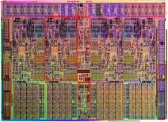

BLoG Nodes & Edges
4 Cores
$
Register
value
Register
value
Last
PC
16
16
Last
PC
MUX
μop
S
μop
P
+
Predicted
PC
Predicted
PC
Current
PC
Current
PC
=
M
Misprediction?
C
Misprediction?
REG
REG
C
218

Slide 219
BLoG Nodes: Storage
Random-access
Queue
R
Data
Q
Data
Control
Control
Address
e.g., register file
Associative
Data
A
Data
e.g., reorder buffer
Control
Tag
e.g., TLB
219

Slide 220
BLoG Nodes: Non-Storage
Modifying
M
Data 1
Connection
C
Data 1
?
Data 2
e.g., decoder
Select
Data 1
e.g., pipeline registers
S
In 1
In 2
Control
Out
e.g., forwarding path
220

Slide 221
BLoG Nodes: Non-Storage
Protected
Default
P
Data 1
D
Data in
J
Checker
Control
Data 2
Data Out
Everything else
e.g., residue
protected ALU
221

Slide 222
BLoG Edge Dependencies
Register
value
16
S
μop
Schedule Rec
Decode Rec
Last
PC
Operand
…
…
P
Predicted
PC
Fetch Rec
Current
PC
Fetch Rec
M
C
Misprediction?
C
Commit Rec
Fetch Rec
…
222

Slide 223
Example: Self-Consistency Check
Alloc
Decode
Decode
X
Y
1
C
Comb.
S
Schedule
No simulation required
Z
1
IF (Z ≠ X) AND (Z ≠ Y)
223

Slide 224
Example: Self-Consistency Check
Alloc
Decode
Decode
X
Y
2
C
Comb.
S
Schedule
No simulation required
Z
2
ELSE IF (C_{i}=C_{j} AND Z_{i}=X_{i} AND Z_{j}=Y_{j} for any i,j)
224

Slide 225
Example: Self-Consistency Check
Alloc
Decode
Decode
X
Y
C
Comb.
S
Schedule
Z
ELSE Propagate
225

Slide 226

Intel® Nehalem Microarchitecture BLoG
Default type
14%
(Custom)
Total: 160 Nodes
😐
☺
Non-default type
86%
226

Slide 227
BLoG Traversal Example
R1
ID AUX
0 23
1 24
4 43
6 88
ID AUX
6 13
1 23
4 43
7 78
R4
Queue
Mod.
R1
Queue
R2
R2
Mod.
ID AUX
1 123
3 234
4 434
6 788
R2
ID AUX
2 23
3 34
5 44
6 88
R5
R2
RAM
R2
R2
R3
R3
Mod.
R2
Select
R3
R5
R3
ID AUX
0 2
1 4
2 4
3 7
R6
ID AUX
1 128
5 247
4 345
3 783
R6
R3
Select
Mod.
R3
227

Slide 228


BLoG Simulations: Intel® Nehalem
Miss (10%)
Exact localization
L
J
(62%)
K
(38%)
Correct localization
J
(90%)
6 out of 269,000 candidates
Bug localization candidate space = 269,000+
(269 design blocks) x (1,000+ error appearance cycles)
228

Slide 229
Outline
Crash Course in Formal Techniques?
  What Is “Formal”?
  Why Formal?
  SAT and Related Automated Reasoning
  Equivalence Checking
  Model Checking
  Abstraction/Refinement
A Selection of “Shovel-Ready” Research Results:
  Signal Selection (covered already)
  Coverage/Monitors
  Virtual Observability Networks
  Capturing/Computing Traces
  Bug Localization/Diagnosis
  Automated Repair
229

Slide 230
Automatic Localization/Diagnosis
IFRA/BLoG combine both trace computation and bug localization, for processors, at a microarchitectural level.
In theory, if you have a trace, you can automate the bug localization even at the gate- or switch-level!
  Assumption of a small number of electrical bugs.
Large body of research, all working within the same general paradigm.
  I will present some of the key results.
  Progress comes in improving scalability!

Slide 231
Automatic Localization/Diagnosis:
General Paradigm
An electrical bug manifests as an inconsistency between a golden reference (e.g., the netlist) and the observed behavior of the chip (via scan, trace buffers, logic analyzers, BackSpace, IFRA, etc.)
Diagrams courtesy of Prof. Sharad Malik.

Slide 232
Automatic Localization/Diagnosis:
General Paradigm
An electrical bug manifests as an inconsistency between a golden reference (e.g., the netlist) and the observed behavior of the chip (via scan, trace buffers, logic analyzers, BackSpace, IFRA, etc.)
Diagrams courtesy of Prof. Sharad Malik.

Slide 233
Automatic Localization/Diagnosis:
General Paradigm
Formally, add CNF constraints for unrolled circuit netlist and all known information. If there is a bug (and there is enough observed information), this will be UNSAT.
Diagrams courtesy of Prof. Sharad Malik.

Slide 234
Localization Using SAT:
Ali, Veneris, Smith, Safarpour, Drechsler, Abadir, ICCAD 2004
Add MUXes to model all possible faults. Control SAT solver to find SAT solution with minimum number of faults.
Diagrams courtesy of Prof. Sharad Malik.

Slide 235
Localization Using SAT:
Ali, Veneris, Smith, Safarpour, Drechsler, Abadir, ICCAD 2004
Add MUXes to model all possible faults. Control SAT solver to find SAT solution with minimum number of faults.

Slide 236
Localization Using UNSAT Core:
Sülflow, Fey, Bloem, Drechsler,
GLSVLSI 2008
Computing UNSAT core restricts possible location of bugs.

Slide 237
Localization Using UNSAT Core:
Sülflow, Fey, Bloem, Drechsler,
GLSVLSI 2008
Computing UNSAT core restricts possible location of bugs.

Slide 238
Localization Using UNSAT Core:
Sülflow, Fey, Bloem, Drechsler,
GLSVLSI 2008
Computing UNSAT core restricts possible location of bugs.
Therefore, fewer MUXes needed for fewer possible faults.

Slide 239
Localization Using MAX-SAT:
Chen, Safarpour, Marques-Silva, Veneris,
GLSVLSI 2009
MAX-SAT directly satisfies as many clauses as possible.

Slide 240
Localization Using MAX-SAT:
Chen, Safarpour, Marques-Silva, Veneris,
GLSVLSI 2009
MAX-SAT directly satisfies as many clauses as possible.

Slide 241
Localization Using MAX-SAT:
Chen, Safarpour, Marques-Silva, Veneris,
GLSVLSI 2009
MAX-SAT directly satisfies as many clauses as possible.
Whatever is left is likely location of bug.

Slide 242
Localization Using MAX-SAT:
Chen, Safarpour, Marques-Silva, Veneris,
GLSVLSI 2009
MAX-SAT directly satisfies as many clauses as possible.
Whatever is left is likely location of bug.
5x Faster Localization

Slide 243
MAX-SAT, Backbones, and Windows:
Zhu, Weissenbacher, Malik
FMCAD 2011
MAX-SAT has limited scalability, and trace buffers are too short to encompass from root-cause to crash. (Authors were not aware of BackSpace at the time.)

Slide 244
MAX-SAT, Backbones, and Windows:
Zhu, Weissenbacher, Malik
FMCAD 2011
MAX-SAT has limited scalability, and trace buffers are too short to encompass from root-cause to crash. (Authors were not aware of BackSpace at the time.)

Slide 245
MAX-SAT, Backbones, and Windows:
Zhu, Weissenbacher, Malik
FMCAD 2011
MAX-SAT has limited scalability, and trace buffers are too short to encompass from root-cause to crash. (Authors were not aware of BackSpace at the time.)
Goal is to stitch together results from overlapping MAX-SAT runs, a la TAB-BackSpace.

Slide 246
MAX-SAT, Backbones, and Windows:
Zhu, Weissenbacher, Malik
FMCAD 2011
MAX-SAT has limited scalability, and trace buffers are too short to encompass from root-cause to crash. (Authors were not aware of BackSpace at the time.)
Goal is to stitch together results from overlapping MAX-SAT runs, a la TAB-BackSpace.

Slide 247
MAX-SAT, Backbones, and Windows:
Zhu, Weissenbacher, Malik
FMCAD 2011
MAX-SAT has limited scalability, and trace buffers are too short to encompass from root-cause to crash. (Authors were not aware of BackSpace at the time.)
Goal is to stitch together results from overlapping MAX-SAT runs, a la TAB-BackSpace.

Slide 248
MAX-SAT, Backbones, and Windows:
Zhu, Weissenbacher, Malik
FMCAD 2011
MAX-SAT has limited scalability, and trace buffers are too short to encompass from root-cause to crash. (Authors were not aware of BackSpace at the time.)
Goal is to stitch together results from overlapping MAX-SAT runs, a la TAB-BackSpace.

Slide 249
MAX-SAT, Backbones, and Windows:
Zhu, Weissenbacher, Malik
FMCAD 2011
MAX-SAT has limited scalability, and trace buffers are too short to encompass from root-cause to crash. (Authors were not aware of BackSpace at the time.)
Goal is to stitch together results from overlapping MAX-SAT runs, a la TAB-BackSpace.
Backbones allow propagating limited information from one run to the next.

Slide 250
Automatic Localization/Diagnosis:
General Paradigm
Here is work that is quite different: system-level vs. gate-level, and based on machine-learning techniques…
Li, Forin, Seshia, “Scalable Specification Mining for Verification and Diagnosis,” DAC 2010.
Diagrams courtesy of Prof. Sharad Malik.

Slide 251
Localization using Mined Assertions
Spec. Mining
Mined
Assertions C
Pre-Silicon
Analysis
Correct
Traces
Error Traces
Spec. Mining
Mined
Assertions E
Diagnosis
Distinguishing Patterns: C ⊕ E
Correct location
  eMIPS core: 1 of 278 blocks
Correct time
  CMP router: within 15 cycles
Candidate
Ranking
Bug Locations
Slide courtesy of Prof. Sanjit Seshia.
251

Slide 252
Outline
Crash Course in Formal Techniques?
  What Is “Formal”?
  Why Formal?
  SAT and Related Automated Reasoning
  Equivalence Checking
  Model Checking
  Abstraction/Refinement
A Selection of “Shovel-Ready” Research Results:
  Signal Selection (covered already)
  Coverage/Monitors
  Virtual Observability Networks
  Capturing/Computing Traces
  Bug Localization/Diagnosis
  Automated Repair
252

Slide 253
Automatic Repair
There is even some research on automatically making repairs! E.g.,
  Chang, Markov, Bertacco, “Automating Post-Silicon Debugging and Repair,” IWLS 2007.
  Requires error trace as input
  Performs minimization on error trace
    “Simbutramin” – Chang, Bertacco, Markov, ICCAD 2005.
  Simulates error trace to determine whether bug is electrical or logical.
    If logical, performs exhaustive exploration of possible circuit changes.
    If electrical, needs manual intervention.
  Perform physically aware resynthesis.
Much of this is “brute-force”, but the key is that formal specification and reasoning engines enable automation!

Slide 254
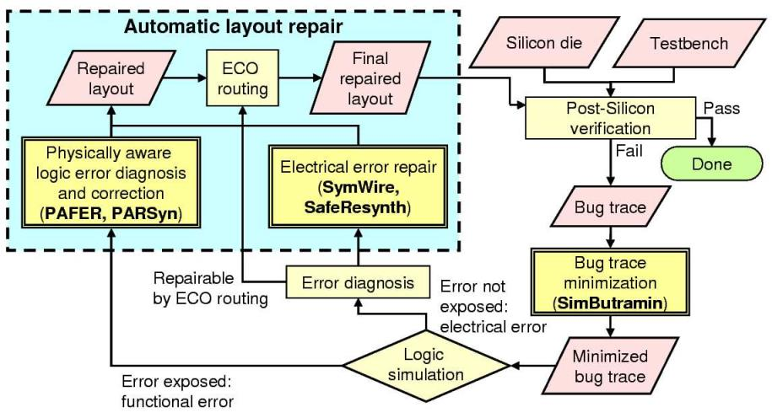
Automatic Repair:
FogClear Methodology
  Figure from Chang, Markov, Bertacco, “Automating Post-Silicon Debugging and Repair,” IWLS 2007.

Slide 255
Outline
Crash Course in Formal Techniques?
  What Is “Formal”?
  Why Formal?
  SAT and Related Automated Reasoning
  Equivalence Checking
  Model Checking
  Abstraction/Refinement
A Selection of “Shovel-Ready” Research Results:
  Signal Selection (covered already)
  Coverage/Monitors
  Virtual Observability Networks
  Capturing/Computing Traces
  Bug Localization/Diagnosis
  Automated Repair
255

Slide 256
Conclusion
I hope you found this informative and useful!
Big Message: Disruptive innovation is coming to post-silicon debug!
  You can call this “structured” or “systematic” or “formal”, but it enables automating many of the pain points in the current debug flow.

