Slide 1
Verification is the greatest intellectual challenge ever faced by humanity.
Formality is the only (known) way to achieve scalability.
Formality wins when it is less painful than the alternatives.

Slide 2
Verification is the greatest intellectual challenge ever faced by humanity.
Formality is the only (known) way to achieve scalability.
Formality wins when it is less painful than the alternatives.

Slide 3
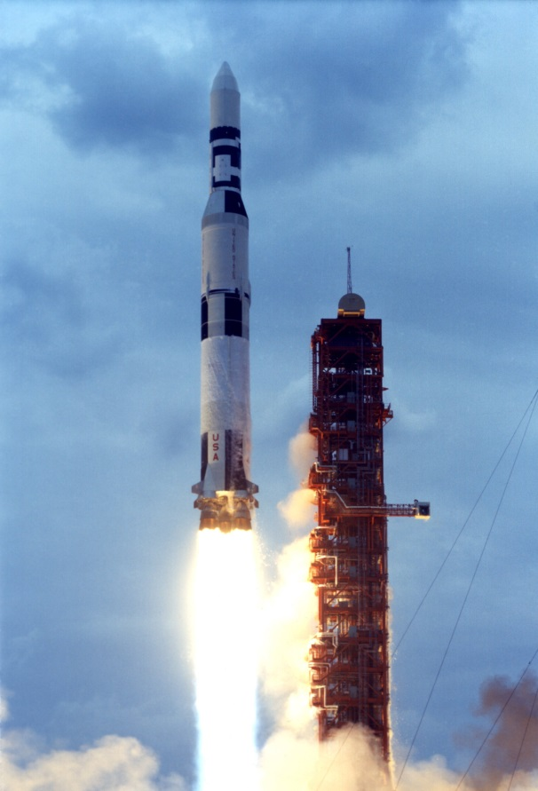
Verification is the greatest intellectual challenge ever faced by humanity.
Formality is the only (known) way to achieve scalability.
Formality wins when it is less painful than the alternatives.
Notes:
Saturn V photo is public domain, from NASA, downloaded from Wikimedia Commons.
Similar for Space Shuttle image.
Airbus A380 photo was put in public domain by author P. Loos from Wikimedia Commons.
Pentium photo by Konstantin Lanzet, under GNU Free Documentation License (therefore, I must share this talk for free.)

Slide 4
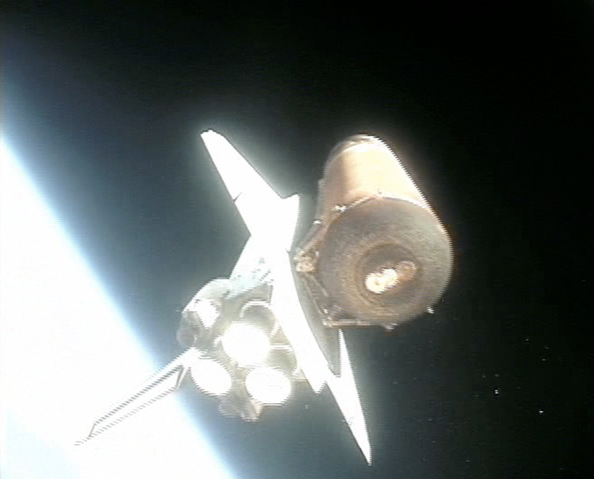
Verification is the greatest intellectual challenge ever faced by humanity.
Formality is the only (known) way to achieve scalability.
Formality wins when it is less painful than the alternatives.
Notes:
Saturn V photo is public domain, from NASA, downloaded from Wikimedia Commons.
Similar for Space Shuttle image.
Airbus A380 photo was put in public domain by author P. Loos from Wikimedia Commons.
Pentium photo by Konstantin Lanzet, under GNU Free Documentation License (therefore, I must share this talk for free.)

Slide 5
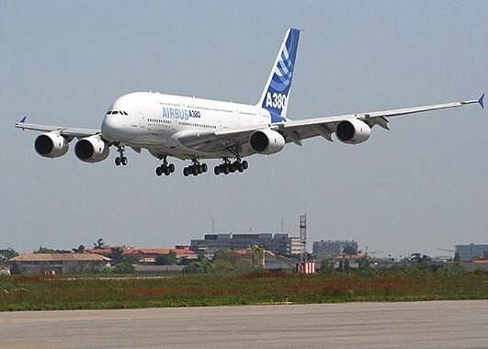
Verification is the greatest intellectual challenge ever faced by humanity.
Formality is the only (known) way to achieve scalability.
Formality wins when it is less painful than the alternatives.
Notes:
Saturn V photo is public domain, from NASA, downloaded from Wikimedia Commons.
Similar for Space Shuttle image.
Airbus A380 photo was put in public domain by author P. Loos from Wikimedia Commons.
Pentium photo by Konstantin Lanzet, under GNU Free Documentation License (therefore, I must share this talk for free.)

Slide 6
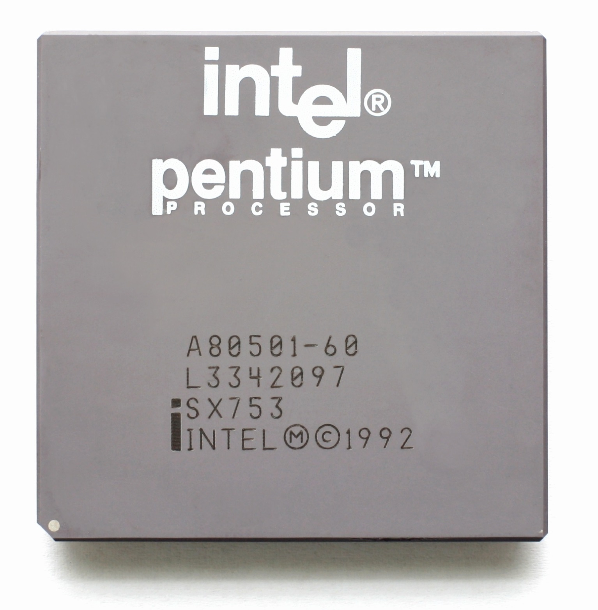
Verification is the greatest intellectual challenge ever faced by humanity.
Formality is the only (known) way to achieve scalability.
Formality wins when it is less painful than the alternatives.
Original Pentium from 1992 had
3.1 million transistors!
Pentium package photo by Konstantin Lanzet, licensed under GNU Free Documentation License.
Other images are public domain.
Notes:
Saturn V photo is public domain, from NASA, downloaded from Wikimedia Commons.
Similar for Space Shuttle image.
Airbus A380 photo was put in public domain by author P. Loos from Wikimedia Commons.
Pentium photo by Konstantin Lanzet, under GNU Free Documentation License (therefore, I must share this talk for free.)

Slide 7
Verification is the greatest intellectual challenge ever faced by humanity.
Formality is the only (known) way to achieve scalability.
Formality wins when it is less painful than the alternatives.

Slide 8
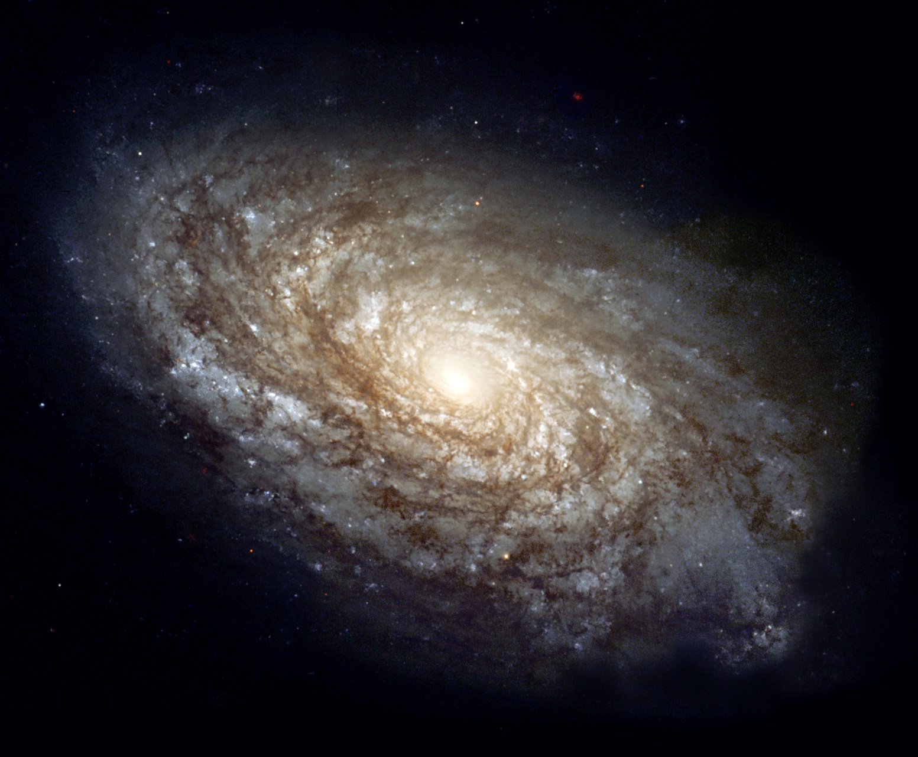
Verification is the greatest intellectual challenge ever faced by humanity.
Formality is the only (known) way to achieve scalability.
Formality wins when it is less painful than the alternatives.
About 10⁸⁰ elementary particles in the universe…
Public domain image from NASA.
Notes:
Public domain image from NASA

Slide 9
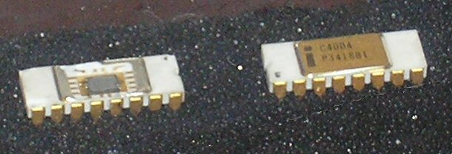
Verification is the greatest intellectual challenge ever faced by humanity.
Formality is the only (known) way to achieve scalability.
Formality wins when it is less painful than the alternatives.
About 10⁸⁰ elementary particles in the universe…
… versus at least 2²³⁰⁰ digital states of an Intel 4004!
Public domain photo by John Pilge.
Notes:
Public domain image from NASA

Slide 10
Verification is the greatest intellectual challenge ever faced by humanity.
Formality is the only (known) way to achieve scalability.
Formality wins when it is less painful than the alternatives.

Slide 11
Verification is the greatest intellectual challenge ever faced by humanity.
Formality is the only (known) way to achieve scalability.
Formality wins when it is less painful than the alternatives.

Slide 12
Verification is the greatest intellectual challenge ever faced by humanity.
Formality is the only (known) way to achieve scalability.
Formality wins when it is less painful than the alternatives.
RTL to HDL to Synthesizable RTL to Synthesis…

Slide 13
Verification is the greatest intellectual challenge ever faced by humanity.
Formality is the only (known) way to achieve scalability.
Formality wins when it is less painful than the alternatives.
RTL to HDL to Synthesizable RTL to Synthesis…
Informal Test Cases to Testbenches to
Testbench Automation to ABV to Formal Specs to
Formal Property Checking…

Slide 14
Verification is the greatest intellectual challenge ever faced by humanity.
Formality is the only (known) way to achieve scalability.
Formality wins when it is less painful than the alternatives.
RTL to HDL to Synthesizable RTL to Synthesis…
Same pattern
throughout history!
Informal Test Cases to Testbenches to
Testbench Automation to ABV to Formal Specs to
Formal Property Checking…

Slide 15
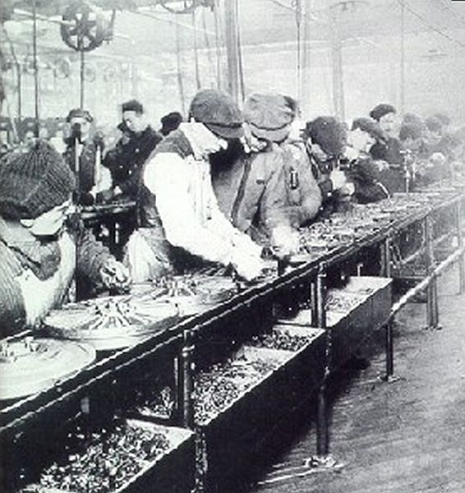
Verification is the greatest intellectual challenge ever faced by humanity.
Formality is the only (known) way to achieve scalability.
Formality wins when it is less painful than the alternatives.

Slide 16
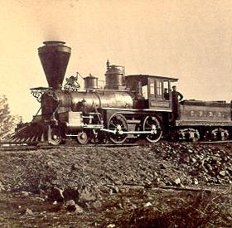
Verification is the greatest intellectual challenge ever faced by humanity.
Formality is the only (known) way to achieve scalability.
Formality wins when it is less painful than the alternatives.
Notes:
Assembly line image is public domain, from Wikimedia commons. Ford assembly line in 1913.
Steam locomotive is also public domain, due to copyright expiration, also from Wikimedia commons.

Slide 17
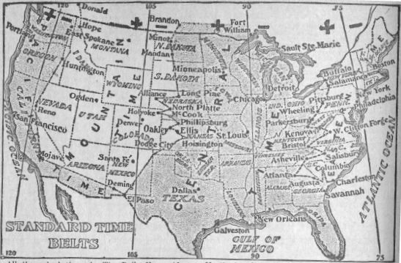
Verification is the greatest intellectual challenge ever faced by humanity.
Formality is the only (known) way to achieve scalability.
Formality wins when it is less painful than the alternatives.
Notes:
Assembly line image is public domain, from Wikimedia commons. Ford assembly line in 1913.
Steam locomotive is also public domain, due to copyright expiration, also from Wikimedia commons.
Similar for time zone image.

Slide 18
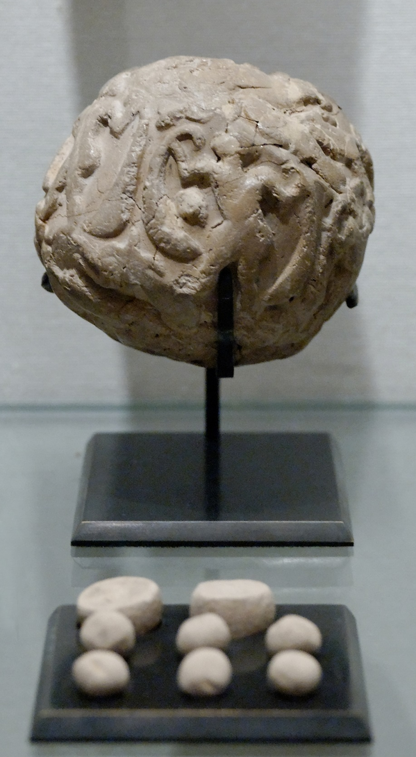
Verification is the greatest intellectual challenge ever faced by humanity.
Formality is the only (known) way to achieve scalability.
Formality wins when it is less painful than the alternatives.
Copyright Marie-Lan Nguyen / Wikimedia Commons, used under Creative Commons Attribution 2.5 Generic license.
Notes:
Assembly line image is public domain, from Wikimedia commons. Ford assembly line in 1913.
Steam locomotive is also public domain, due to copyright expiration, also from Wikimedia commons.
Similar for time zone image.

Slide 19

Verification is the greatest intellectual challenge ever faced by humanity.
Formality is the only (known) way to achieve scalability.
Formality wins when it is less painful than the alternatives.
Notes:
Assembly line image is public domain, from Wikimedia commons. Ford assembly line in 1913.
Steam locomotive is also public domain, due to copyright expiration, also from Wikimedia commons.
Similar for time zone image.

Slide 20
Verification is the greatest intellectual challenge ever faced by humanity.
Formality is the only (known) way to achieve scalability.
Formality wins when it is less painful than the alternatives.
BTW, asymmetric information also explains why
the IP industry didn’t/can’t take off until
formal verification started getting good…
Notes:
Assembly line image is public domain, from Wikimedia commons. Ford assembly line in 1913.
Steam locomotive is also public domain, due to copyright expiration, also from Wikimedia commons.
Similar for time zone image.

Slide 21
Verification is the greatest intellectual challenge ever faced by humanity.
Formality is the only (known) way to achieve scalability.
Formality wins when it is less painful than the alternatives.

Slide 22
Verification is the greatest intellectual challenge ever faced by humanity.
Formality is the only (known) way to achieve scalability.
Formality wins when it is less painful than the alternatives.

Slide 23
Verification is the greatest intellectual challenge ever faced by humanity.
Formality is the only (known) way to achieve scalability.
Formality wins when it is less painful than the alternatives.
Everyone hates lawyers and legal complexity…

Slide 24
Verification is the greatest intellectual challenge ever faced by humanity.
Formality is the only (known) way to achieve scalability.
Formality wins when it is less painful than the alternatives.
Everyone hates lawyers and legal complexity…
… but it’s better than getting burned in a deal!

Slide 25
Verification is the greatest intellectual challenge ever faced by humanity.
Formality is the only (known) way to achieve scalability.
Formality wins when it is less painful than the alternatives.
Everyone hates lawyers and legal complexity…
… but it’s better than getting burned in a deal!
Everyone hates writing specs and documentation…

Slide 26
Verification is the greatest intellectual challenge ever faced by humanity.
Formality is the only (known) way to achieve scalability.
Formality wins when it is less painful than the alternatives.
Everyone hates lawyers and legal complexity…
… but it’s better than getting burned in a deal!
Everyone hates writing specs and documentation…
… but you’re very grateful for it on a large code base!

Slide 27
Verification is the greatest intellectual challenge ever faced by humanity.
Formality is the only (known) way to achieve scalability.
Formality wins when it is less painful than the alternatives.
Everyone hates lawyers and legal complexity…
… but it’s better than getting burned in a deal!
Everyone hates writing specs and documentation…
… but you’re very grateful for it on a large code base!
Everyone hates stupid syntax errors…

Slide 28
Verification is the greatest intellectual challenge ever faced by humanity.
Formality is the only (known) way to achieve scalability.
Formality wins when it is less painful than the alternatives.
Everyone hates lawyers and legal complexity…
… but it’s better than getting burned in a deal!
Everyone hates writing specs and documentation…
… but you’re very grateful for it on a large code base!
Everyone hates stupid syntax errors…
… but precise syntax enables automation!

Slide 29
Verification is the greatest intellectual challenge ever faced by humanity.
Formality is the only (known) way to achieve scalability.
Formality wins when it is less painful than the alternatives.

Slide 30
Verification is the greatest intellectual challenge ever faced by humanity.
Formality is the only (known) way to achieve scalability.
Formality wins when it is less painful than the alternatives.

Slide 31
Verification is the greatest intellectual challenge ever faced by humanity.
Formality is the only (known) way to achieve scalability.
Formality wins when it is less painful than the alternatives.

Slide 32
Verification is the greatest intellectual challenge ever faced by humanity.
Formality is the only (known) way to achieve scalability.
Formality wins when it is less painful than the alternatives.

Slide 33
Verification is the greatest intellectual challenge ever faced by humanity.
Formality is the only (known) way to achieve scalability.
Formality wins when it is less painful than the alternatives.

Slide 34
Verification is the greatest intellectual challenge ever faced by humanity.
Formality is the only (known) way to achieve scalability.
Formality wins when it is less painful than the alternatives.
Wait! What does this
have to do with UVM???

Slide 35
Verification is the greatest intellectual challenge ever faced by humanity.
Formality is the only (known) way to achieve scalability.
Formality wins when it is less painful than the alternatives.
UVM is a step towards greater formalism:
clarity, precision, standardization,…
UVM itself may not be inevitable,
but it’s part of something bigger that is.

