Slide 1
Segmentifier: Interactive Refinement of Clickstream Data
Kimberly Dextras-Romagnino*†, Tamara Munzner*
* University of British Columbia
† Kabam
Notes:
Good afternoon,
My name is Kim…
I did this work at UBC with Tamara Munzner for my master’s, and now I work as a data scientist at Kabam, a mobile gaming studio in Vancouver.
Today I’m going to talk to you about clickstream data!

Slide 2
Introduction: E-commerce
Notes:
E-commerce has been a growing trend in the last few years People are no longer buying in stores but instead buying online, whether it be on their computer or their phone. Companies are taking note
Companies understand the of on-line shopping are investing on their online platforms
E-commerce is on the rise
Online websites is a large source of income for ecommerce companies
Trying to capitalize on this opportunity to

Slide 3
E-commerce
Build mobile apps for large e-commerce companies
Understand the importance of good websites for revenue
Notes:
We worked with a company that builds mobile apps for large e-commerce companies. They understand the importance of good websites on revenue
How Mobify tries to help companies
How do you create or improve a good website that leads to an increase in revenue and overall a succesful company
How can you improve a website for more success and revenue

Slide 4
E-commerce
Goals
Build mobile apps for large e-commerce companies
Understand the importance of good websites for revenue
Increase traffic
number of users on a site
Reduce abandonment
number of users leaving the site
Increase consumer engagement
time users spend on the site
chances that a user returns to the site
Increase conversion rate
odds a user purchases
Notes:
Some of the High level goals they focused on to improve the quality of their websites included finding ways to

Slide 5
Process
Followed Design Study Methodology [Sedlmair 2012]:
Precondition Phase (5 months) : interviews with 12 employees
Core Phase (11 months): Iterative design and implementation
Analysis Phase (3 months): Reflect and write
Notes:
We followed the design study methodology of Sedlmair et al.
We followed the design study methodology of Sedlmair et
al. [SMM12]. We began with the winnow, cast, and discover stages
over a period of 5 months. We conducted exploratory and followup
interviews with 12 employees who conducted clickstream data
analysis belonging to 3 different internal teams of an e-commerce
middleware company. Our task elicitation yielded three potential
tasks: analyzing user behavior based only on website clickstreams,
the impact of external messages sent to consumers on their web-
site behavior, and characterizing load times for the website. We
chose the former as a manageable scope after considering stake-
holder availability, data availability, and the other relevant pit-
falls [SMM12]. The iterative design and implement stages lasted 11 months, with a final
reflect
stage of 3 months.

Slide 6
Research Contributions
Thorough characterization of task and data abstraction for clickstream data analysis
High-Level Segmentifier Analysis Model abstracts iterative process
View, Refine, Record, Export, Abandon, Conclude
Segmentifier: novel analytics interface for refining data segments and viewing characteristics before downstream fine-grained analysis
Rich set of views showing both derived attributes and raw sequence details
Filtering and Partitioning through visual queries
Quantitative attributes
Custom sequences of events aggregated according to a novel three-level hierarchy
Detailed glyph based visual history of the automatically recorded refinement process showing the provenance of each segment in terms of its analysis path
Preliminary evidence of utility from:
Usage Scenario with real world data
Case Study with industry analyst
Notes:
Thorough characterization of task and data abstraction for clickstream data analysis
Clickstream Data Analysis Framework abstracts iterative process:
view, refine, record, export, abandon, and conclude
Segmentifier novel visual analytics interface for refining data segments and viewing characteristics before downstream fine-grained analysis
rich set of views showing both derived attributes characterizing segments and raw sequence details
filtering and partitioning through visual queries
Quanatative attributes
custom sequences of events, which are aggregated according
to a novel three-level hierarchy
detailed glyph-based visual history of the automatically
recorded refinement process showing the provenance of each
segment in terms of its analysis path
Prelimanary evidence of utility from
Usage scneario real world data
Case study wtih domain expert

Slide 7
What are the Data and Task Abstractions for
Clickstream Data Analysis?
Clickstream Data
Clickstream Analysis Tasks
Segmentifier Analysis Model

Slide 8
What is Clickstream Data?

Slide 9
Data: Actions
Action
Notes:
We define an action as anything a customer does on a website

Slide 10
Data: Action Attributes
Client ID
Action
Time
Action Type

Slide 11
Data: Action Types
Client ID
Action
Time
Action Type
E-commerce
Site Functionality
Pageviews
addToCart
removeFromCart
appStart
appDisplayError
pageview
search
purchase
offlineModeUsed

Slide 12
Action Hierarchy
Pageviews
pageview
Notes:
Create consistency across websites and to reduce the amount of unique page types
Manually created this abstraction because:n

Slide 13
Action Hierarchy
Pageviews
pageview
Roll-up
account_group
browse_group
cart_group
checkout_group
info_group
other_group
Mid-Level
pv_account
pv_login
pv_elitereward
pv_register
pv_home
pv_plp
pv_pdp
pv_specialoffers
pv_explore
pv_search
pv_cart
pv_checkout
pv_confirmation
pv_policy
pv_storelocator pv_other_info
pv_other
Detailed
Notes:
We map every type of page into the 17 Detailed pageviews actions at the lowest level. We then group similar ones together to form the 8 pageviews actions at the midlevel and finally and the highest level we have a single pageviews action that represents any page
So you can switch between different level depending on the level of detail of the analysis

Slide 14
Data: Sequences
appStart

Slide 15
Data: Sequences
pageview

Slide 16
Data: Client Sequences
Time
Client Sequences: all actions performed by a single user

Slide 17
Data: Session Sequences
Δ
Δ
Time
Session Sequences: all actions performed by a single user within a defined amount of time (Δ) from each other. Δ is usually 30 min.

Slide 18
Data: Session Sequences
Multiple Sequences per user
Session Sequences: all actions performed by a single user within a defined amount of time (Δ) from each other. Δ is usually 30 min.

Slide 19
Data: Sequence Attributes
Start time
End time
Duration
Action Counts
: 1
: 1
: 5
: 1
: 1

Slide 20
Data: Segments
Segment
Segment: any set of sequences

Slide 21
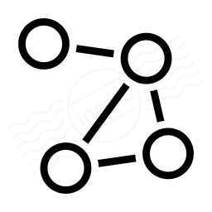
Data: Segment Attributes
Size
Counts of sequences:
Absolute, Relative
Segment
Sequence Related
Sequence Distributions:
Start Time, Duration, Action Counts
Action Related
Action Distributions:
Action Transitions: action before, action after
Notes:
At the segment level, its size, number of sequences it contains
At the sequence level, the distribution of all sequence attributes, generally represented by bar grapjs
Finally, at the action level, the counts of the number of times each action occurs before or after another represented by a node link graph
Sequence
Derived
Distributions you calculate
Action
explain better
Have node link glyph
Why these were chosen

Slide 22
Real-world Clickstream Data
Segment
Notes:
When it comes to real world clickstream data, due to the sheer number of users on the websites and different ways to navigate the site leads to segments whose

Slide 23
Real-world Clickstream Data
Segment
Scale is huge

Slide 24
Real-world Clickstream Data
Segment
Scale is huge
Variability is high

Slide 25
Real-world Clickstream Data
Segment
Scale is huge
Variability is high
Most work fails when applied to real-world data.
Notes:
Most previous work fails
This is the problem we were focusing on with our work

Slide 26
What are
Clickstream Data Analysis Tasks?

Slide 27
Tasks: Segment Behavior
Behavior: set of attribute constraints
Segment
Behavior
Viewed 4 pages
Purchased
Between 9 - 10 am
Start time
Notes:
First, we define a behavior as a set of attribute constraints. A sequence follows a behavior if it matches the attribute constraints associated with that behavior. For example, a segment follows the behavior purchased at 9 am if all its sequences contain a purchase action and have a start time at 9 am.
How does it relate to segments
A behavior is defined by a set of attribute constraints
A sequence follows a behavior if it matches the attribute constraints associated with that behavior
A segment follows a behavior if all sequences in the segment follow the behavior
An example behavior: users who purchased between 9-10am
Sequences that follow that behavior match the following attribute constraints:
Contain a purchase event
Start time and end time are between 9 -10 amz

Slide 28
Tasks: Segment Behavior
Behavior: set of attribute constraints
Expected Users add to cart before purchasing
Unexpected No purchases on a certain month
Favorable Purchased
Unfavorable Bounced
Segment
Behavior
Viewed 4 pages
Purchased
Between 9 - 10 am
Start time
Notes:
Users that view one page and then exit the site

Slide 29
Tasks: Task Abstraction
Segment
Notes:
Our main derived tasks have to do with taking these large noisy real world clickstream data segments

Slide 30
Tasks: Task Abstraction
Segment
Identify: Find some set of sequences that constitutes interesting behavior
Notes:
And identifying a set of sequences that constitutes interesting behavior such as discovering if consumers in loyalty program browse longer
T1) Identify: Find some set of sequences that constitutes interesting behavior
consumers in loyalty program browse longer

Slide 31
Tasks: Task Abstraction
Segment
Identify: Find some set of sequences that constitutes interesting behavior
Drilldown: Distinguish more specific behaviors to further partition a segment previously defined by looser constraints
Notes:
Or drilling down to distinguish more specific behaviors to further partition a segment previosuly defined by another behavior . Such as, checking if purchasers fall into natural groups by time of day
T1) Identify: Find some set of sequences that constitutes interesting behavior
consumers in loyalty program browse longer
T2) Drilldown: Distinguish more specific behaviors to further partition a segment previously defined by looser constraints
check if purchasers fall into natural groups by time of day

Slide 32
Tasks: Task Abstraction
Segment
Identify: Find some set of sequences that constitutes interesting behavior
Drilldown: Distinguish more specific behaviors to further partition a segment previously defined by looser constraints
Frequency: Determine how many sequences are in the segment defined by a behavior
Notes:
Or Frquency, Determining how many sequences are in the segment defined by a behavior, such as, checking the number of users who bounces versus those who did not
T1) Identify: Find some set of sequences that constitutes interesting behavior
consumers in loyalty program browse longer
T2) Drilldown: Distinguish more specific behaviors to further partition a segment previously defined by looser constraints
check if purchasers fall into natural groups by time of day
T3) Frequency: Determine how many sequences are in the segment defined by behavior X
check ratio of bouncers to non- bouncers

Slide 33
Tasks: Task Abstraction
Segment
Identify: Find some set of sequences that constitutes interesting behavior
Drilldown: Distinguish more specific behaviors to further partition a segment previously defined by looser constraints
Frequency: Determine how many sequences are in the segment defined by behavior
Ordering within sequence: Match if one action subsequence occurs before (or after) another action subsequence in a sequence
Notes:
Finally, Ordering within a sequence: Match if one action subsequence occurs before (or after) another action subsequence, such as, verify that all users add to cart before purchasing
T1) Identify: Find some set of sequences that constitutes interesting behavior
consumers in loyalty program browse longer
T2) Drilldown: Distinguish more specific behaviors to further partition a segment previously defined by looser constraints
check if purchasers fall into natural groups by time of day
T3) Frequency: Determine how many sequences are in the segment defined by behavior X
check ratio of bouncers to non- bouncers
T4) Ordering within sequence: Match if action subsequence X occurs before (or after) action subsequence Y in a sequence
verify that all users add to cart before purchasing

Slide 34
High-Level Segmentifier Analysis Model
Notes:
From our data and task abstractions, we derived our high level segmentifier analysis model

Slide 35
High-Level Segmentifier Analysis Model
General idea:
Combine domain knowledge with computational support to iteratively view and refine large, noisy clickstream segments into segments that lead to actionable insights or more effective downstream analysis
Refine
Record
Filter
Partition
Transform
View
Conclude
Segment
Abandon
Sequences
Actions
Export

Slide 36
High-Level Segmentifier Analysis Model
Refine
Record
Filter
Partition
View
Transform
Conclude
Segment
Abandon
Sequences
Export
Actions
Segment
View
Size
Gives Insight into underlying data of segment
Action Attributes
Sequence Attributes
Segment Attributes
Leads to:
Insights
New ways on how to refine
Whether segment should be abandoned
Whether segment should be exported
Sequence Related
Action Related
Notes:
View allows analysts to get insight into the underlying data of the segment including its action, sequence, and segment attributes
This can lead to discovering insights, new ways to refine the segment or determining if the segment should to be exported or abandoned

Slide 37
High-Level Segmentifier Analysis Model
Refine
Record
Filter
Partition
View
Transform
Conclude
Segment
Abandon
Sequences
Export
Actions
Refine
Apply operation to create new segments
Type of Refinements
Filter
Partition
Transform
Filter
Refine Operation
Partition
Transform
Notes:
Refine allows analysts to apply operations to segments to create new segments

Slide 38
High-Level Segmentifier Analysis Model
Refine
Record
Filter
Partition
View
Transform
Conclude
Segment
Abandon
Sequences
Export
Actions
Refine
Record
Record all refinement steps automatically
Keep track of questions asked and hypotheses tested
Ability to create and view multiple segments from the same segment
Refine Operation
Refine Operation
Refine Operation
Notes:
It is important to record all refinement steps in order to

Slide 39
High-Level Segmentifier Analysis Model
Refine
Record
Filter
Partition
View
Transform
Conclude
Segment
Abandon
Sequences
Export
Actions
Export
Export refined segments for further downstream analysis, to more specific tools:
Pattern mining
Clustering
Refine Operation
Refine Operation
Refine Operation
Export
Technique
Notes:
The segment can be refined into a segment that is suitable for export to a more speci0fic tool such as
These refined segments can then be suitable for export to a more specific tool

Slide 40
High-Level Segmentifier Analysis Model
Refine
Record
Filter
Partition
View
Transform
Conclude
Segment
Abandon
Sequences
Export
Actions
Conclude
Discover actionable insight by viewing segment
Refine Operation
Refine Operation
Refine Operation
Conclude
Notes:
Or it can be refined into a segment that leads to actionabole insights which can be discoved by viewing the attribute
That allows the analyst to discover actionable insightgs by viewing the attributes
Or actionable insights can be found by viewing its attributes

Slide 41
High-Level Segmentifier Analysis Model
Refine
Record
Filter
Partition
View
Transform
Conclude
Segment
Abandon
Sequences
Export
Actions
Abandon
By viewing the segment, analyst abandons if:
No actionable insights
No further ways to refine
Not suitable for export
Refine Operation
Refine Operation
Refine Operation
Abandon
Notes:
Oe finally the refined segment can be abandoned as it has not led to insights, it can't be further refined and it is not suitable for export

Slide 42
High-Level Segmentifier Analysis Model
Take a giant, noisy dataset and refine it into small, clean segments appropriate for each task
Bridge the gap between real-world data and other techniques
Encapsulates the design rationale of Segmentifier
Refine
Record
Filter
Partition
Transform
View
Conclude
Segment
Abandon
Sequences
Actions
Export
Notes:
The idea is we want to take
11 min

Slide 43
How to solve these goals with
Visual Analytics?
Visual Analytics
Other Related Work
Our Framework

Slide 44
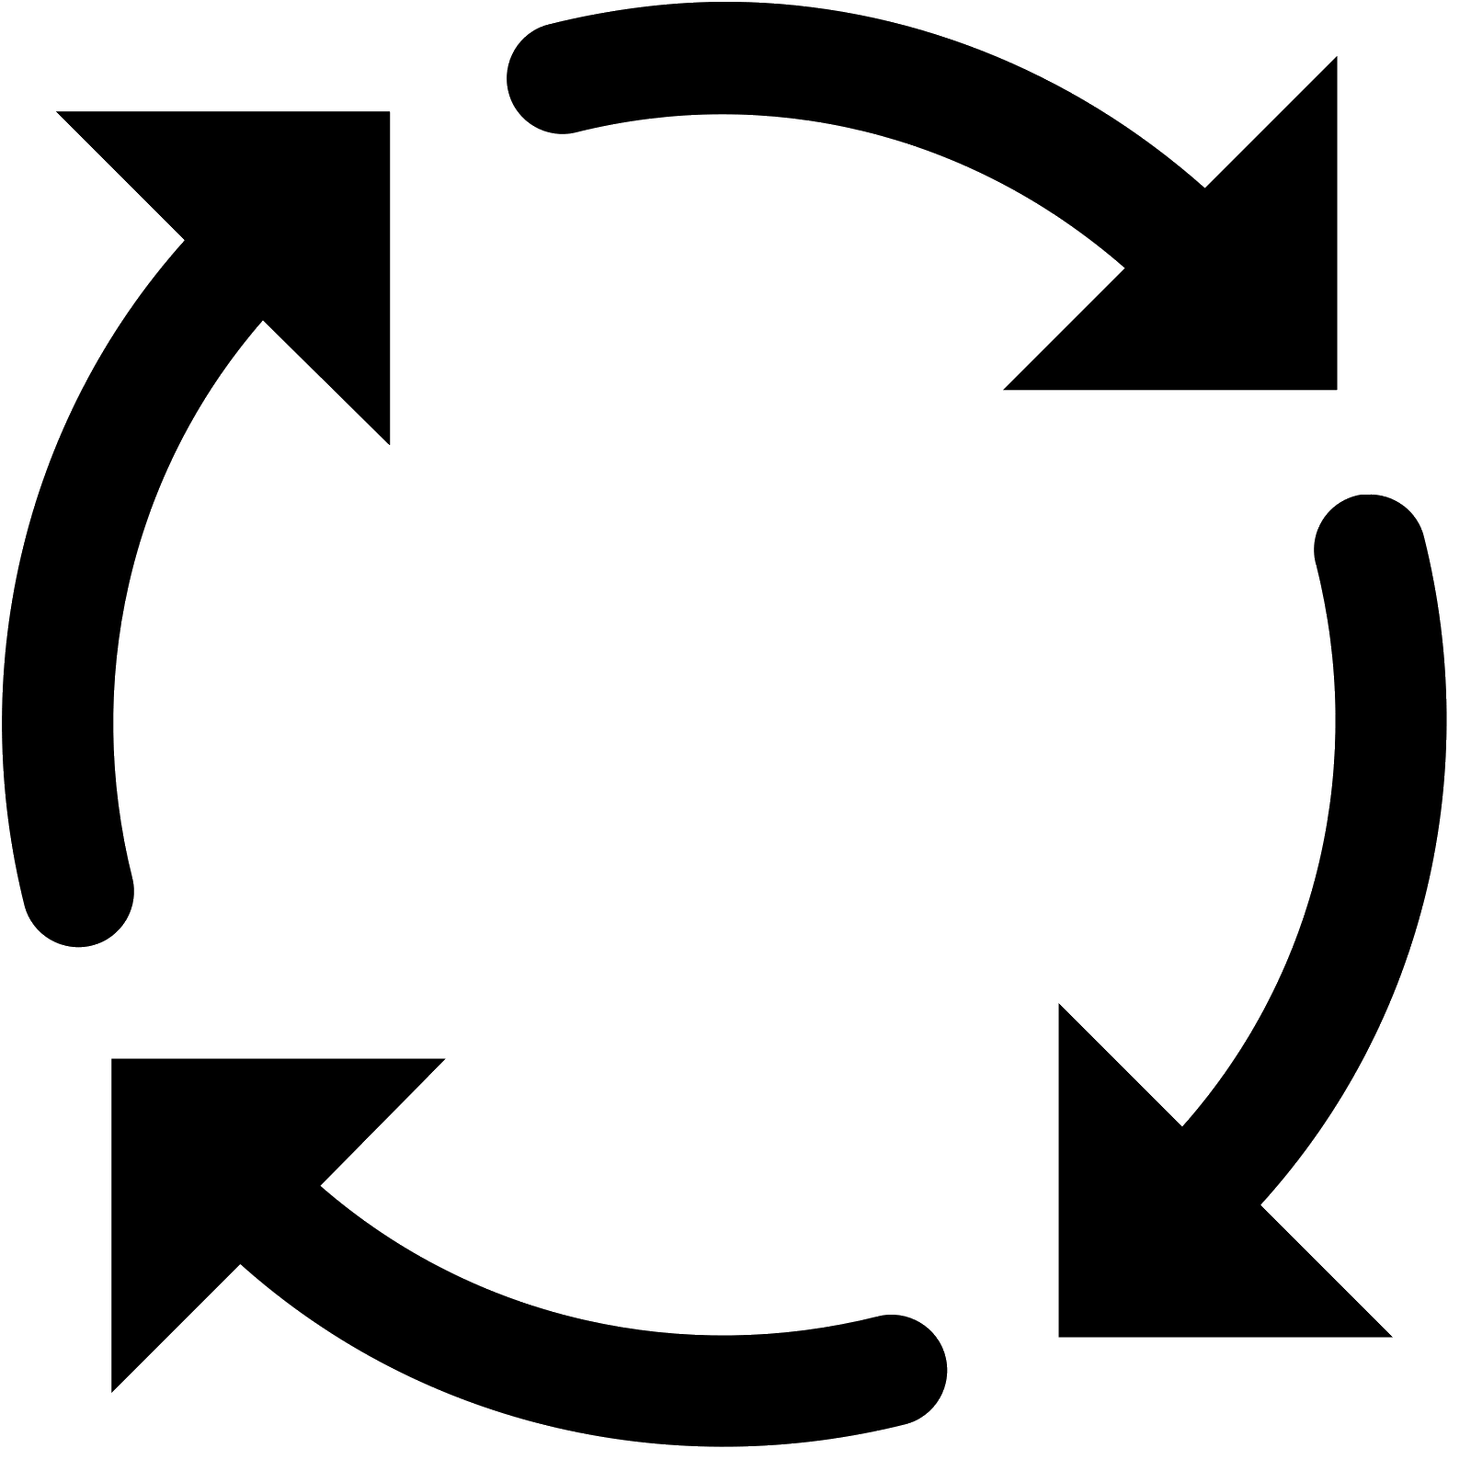
Why Visual Analytics?
Automation would be nice...
Put data in, actionable results appear
… but it is not realistic
Many possible questions, data-driven interplay between finding answers and generating new questions
Human-in-the-loop visual data analysis
Integrate computing power of machine with intuition of domain experts
Notes:
Leverage human and machine capbilities

Slide 45
What Visual Analytics Systems
exist for Clickstream Data Analysis?

Slide 46
Related Work
Refine
Record
Filter
Partition
View
Transform
Conclude
Segment
Abandon
Sequences
Export
Actions

Slide 47
Related Work
Refine
Record
Filter
Partition
View
Transform
Conclude
Segment
Abandon
Sequences
Export
 | Post-Export: Specific Techniques - Clustering: [Wei 2012]. Pattern Mining: CoreFlow [Liu 2017], Frequence [Perer 2014] - Require small, clean datasets
 | View Sequences: Event Sequence Visual Overviews - CareFlow [Perer 2013] - Limited ability to refine segments or view segment attributes
 | Refine: Visual Query Systems - COQUITO [Krause 16], (s|qu)eries [Zgraggen 2015] - No ability to view attributes
 | Record: Graphical Histories - Graphical histories help remember analysis path [Heer 2008]
Actions
Export
View
Refine
Record
Notes:
Alot of the previous work tends to focus mainly on only one aspect of the model.
There is the work that focuses on very specific techniques such as pattern mining of clustering and require small clean datasets to work effectively . This type if work thatthe segmentifier segments would be exported to. would be ideal for post-export tools that focus
Some work focuses mostly on viewing the sequences but lacks the ability to refine segments making it difficult to answer questions
On the other hand, some work such as visual query system focus maining on refining segments but without the ability to view many of the attributes makes it difficult to make decisions on how to refine
Finally, alot of precious work emphasizes the importance of recording your analysis steps though graphical histories when conducting exploratory analysis

Slide 48
Related Work
Refine
Record
Filter
Partition
View
Transform
Conclude
Segment
Abandon
Sequences
Export
Actions
 | View and Refine: Filtering Sequences To Segments SessionViewer [Lam 2007], EventFlow [Munroe 2013] , EventPad [Cappers 2018] Lack of segment attributes Lack of ability to record analysis path Focus is on looking at the level of detail of the sequences which is unscalable
View
Refine
Notes:
The work that is the most similar to ours is ones that encapsulate this view and refine loop such as EventFlow and EventPad.
This issue they have is that they focus mainly on the individual sequences. Without the ability to view many high level attributes and record all analysis steps to refine segments,it makes it difficult to deal with real world click stream data
Makes it unscalable for real world click stream data

Slide 49
Our Solution

Slide 50
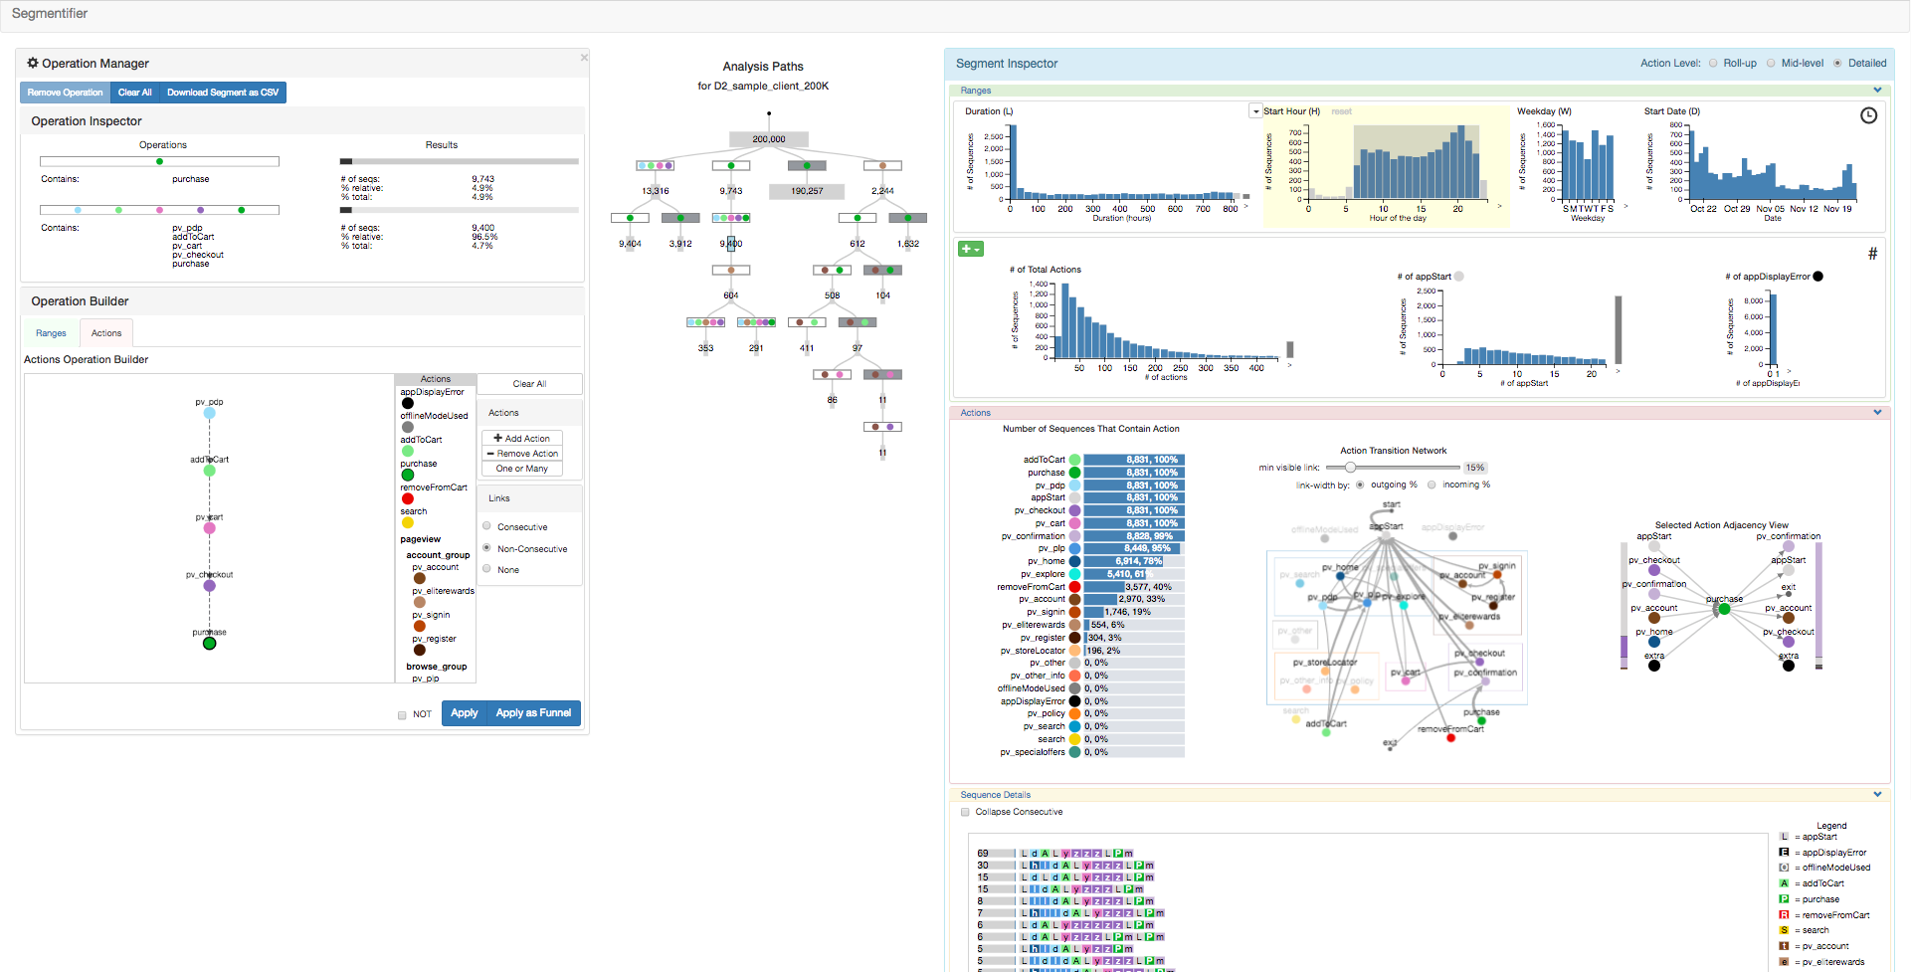
The Segmentifier Interface
Notes:
Segmentifier is a novel visual analytics interface
That encapsulates our High level Analysis model
that supports clickstream domain experts in the iterative process of refining data segments and viewing their characteristics in order to discover actionable insights and improve the effectiveness of more fine-grained downstream analysis.

Slide 51
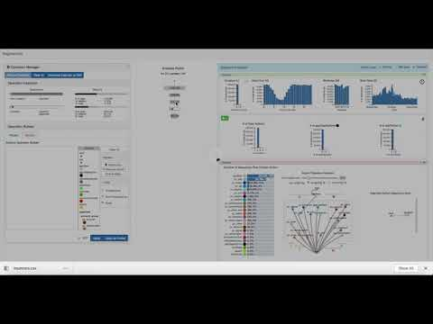
The Segmentifier Interface
https://www.youtube.com/watch?v=TobYDFeISOg&t=20s

Slide 52
Results

Slide 53
Case Study #1
2 hour chauffeured analysis
With industry data analyst
Purpose:
One month post launch report
Discover actionable insights and improvements for customer
Data
Session sequences
200K sequences

Slide 54
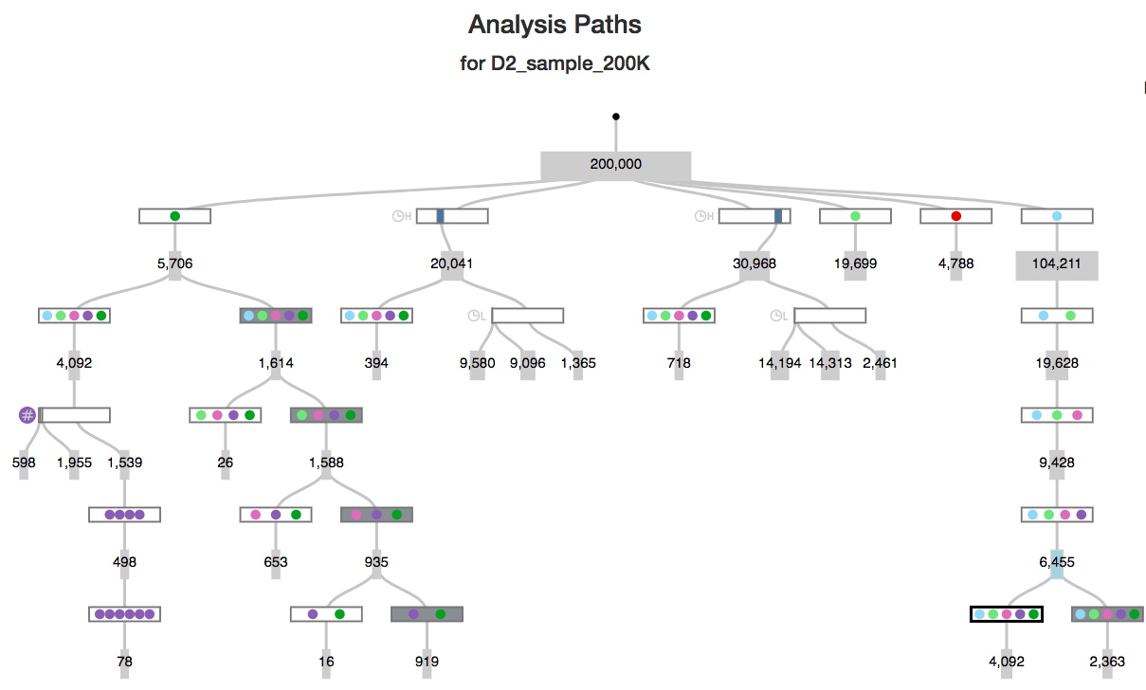
Case Study #1

Slide 55
Case Study #1: Analysis A
A | Analyze Purchasing Behavior
12% of sessions contain more checkout pages than necessary 30% of users actually exit the site and return later to complete their purchase
A

Slide 56
Case Study #1: Analysis B
B | Compare Morning vs Night
No significant difference for percentage of sessions that contain full purchasing funnel No significant difference for number of actions
A
B

Slide 57
Case Study #1: Analysis C
C | Analyze add and remove from cart behavior
No insight for add to cart behavior 30% of users who removed from cart exited the session and most likely did not come back
A
C
B

Slide 58
Case Study #1: Analysis D
D | Analyze purchasing funnel
20% of people who get to checkout will not end up purchasing
A
C
B
D

Slide 59
Case Study #2
2 hour chauffeured analysis
With industry data analyst
Purpose:
Revisit some questions from last analysis using client sequences
Data
Client sequences
Much longer
Capture longitudinal behavior
200K sequences

Slide 60
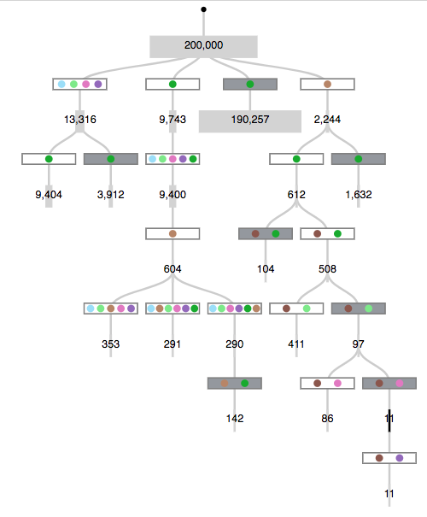
Case Study #2
Summary of Insights
25% who remove from cart at checkout stage, exit and never purchase appStart action triggered before cart page Awards page analysis: 1% signed up 27% purchased Longer sequences
Notes:
Indicating more dedicated customers

Slide 61
Discussion

Slide 62
Discussion
Segment
Goal is Scalability
Initial iterative visual refinement of large segments into useful ones
Attributes that align with analyst’s intuitions about interesting behavior
Quick forming and testing of hypotheses
Result: more effective fine-grained downstream analysis
Notes:
Goal is Scalability
Real world data is large and noisy
Previous work requires small clean datasets
Allows for initial iterative visual refinement into useful segments
Computes attributes that revealpatterns, distributions, and outliers that align with analyst’s intuitions about interesting behavior
Allows to quickly form and test hypotheses connecting consumer behavior to attribute constraints
Result: more effective fine-grained downstream analysisn for each specific task
The goal of the Segmentifier model is scalability. It provides a framework for the interactive visual refinement of extremely large clickstream datasets with an enormous level of variance between sequences into more useful lower-variance segments. These can either be successfully handed off to previously proposed approaches for further processing, or may directly show analysts what they need to know within Segmentifier itself. It is designed to allow analysts with considerable domain knowledge but limited time and statistical expertise to quickly form and test hypotheses connecting logged consumer behavior to constraints on attributes. They find actionable and interpretable insights from understanding how specific choices of filtering and partitioning change the attribute distributions within segments, sequences, and actions. The ideas of supporting interactive filtering and partitioning, of showing the statistics of attribute distributions visually, and of combining viewing and refining are of course well established in previous work. The main technical novelty in Segmentifier lies in the integration of all aspects of our high-level model: the interlocking details of how to define informative segment, sequence, and action attributes and create tightly coupled views that allow fluid and understandable interactive refinement.
The difficult visual analytics design problem is how to connect the internal and implicit mental model that clickstream data analysts have about interesting consumer behaviors to viewable characteristics of segments, sequences, and actions. Our goal is to compute evocative derived attributes of the base data that reveal patterns, distributions, and outliers that align with their informal intuitions about interesting behavior, so that a series of constraints on these attributes would serve to define a satisfactory segment.

Slide 63
Conclusions
Thorough characterization of task and data abstraction for clickstream data analysis
Refine
Record
Filter
Partition
Transform
View
Conclude
Segment
Abandon
Sequences
Actions
Export
Notes:
Thorough characterization of task and data abstraction for clickstream data analysis
Clickstream Data Analysis Framework abstracts iterative process
View, Refine, Record, Export, Abandon, Conclude\
Our task and data abstraction connects the mental model of clickstream analysts about interesting behavior to viewable characteristics of segments

Slide 64
Conclusions
Thorough characterization of task and data abstraction for clickstream data analysis
Segmentifier: novel analytics interface for refining data segments and viewing characteristics before downstream fine-grained analysis
Notes:
Segmentifier: novel analytics interface for refining data segments and viewing characteristics before downstream fine-grained analysis
Rich set of views showing both derived attributes and raw sequence details
Filtering and Partitioning through visual queries
Quantitative attributes
Custom sequences of events aggregated according to a novel three-level hierarchy
Detailed glyph based visual history of the automatically recorded refinement process showing the provenance of each segment in terms of its analysis path

Slide 65
Conclusions
Thorough characterization of task and data abstraction for clickstream data analysis
Segmentifier: novel analytics interface for refining data segments and viewing characteristics before downstream fine-grained analysis
Preliminary evidence of utility
A
C
B
D
Notes:
Preliminary evidence of utility from:
Usage scenario with real world data
Case Study with industry analyst
Understandable results are found quickly by analysts with limited time and skills

Slide 66
Segmentifier: Interactive Refinement of Clickstream Data
Kimberly Dextras-Romagnino, k.dextras.romagnino@gmail.com Tamara Munzner, tmm@cs.ubc.ca, @tamaramunzner
More info: http://www.cs.ubc.ca/labs/imager/tr/2019/segmentifier/
Affiliations
Special Thanks

Slide 67
Segmentifier: Interactive Refinement of Clickstream Data
Kimberly Dextras-Romagnino, k.dextras.romagnino@gmail.com Tamara Munzner, tmm@cs.ubc.ca, @tamaramunzner
More info: http://www.cs.ubc.ca/labs/imager/tr/2019/segmentifier/

Slide 68
Backup Slides

Slide 70
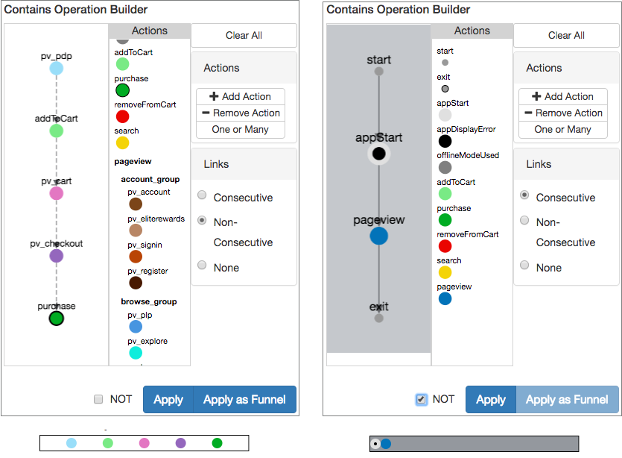
Discussion
Trade-off between power and simplicity for this application context
Actions Operation Builder: regex with glyphs
Previous work:
Full support of regex
Difficult for non-programmers
Our design: deliberately less powerful so usable by non-technical analysts
Notes:
We carefully considered the tradeoff between power and simplicity
for this application context. Many previous systems provide full support
for regular expressions [9, 24], which are notoriously difficult for nonprogrammers
to handle even when presented through a visual language,
so we deliberately kept the scope of the Actions Operation Builder
limited. Despite the request for more functionality from the domain
expert, we still suspect that adding too much additional complexity
on this front would make the system unusable for the untrained and
extremely time-crunched analysts who we are targeting.

Slide 71
Tasks: Actionable Results
Actionable Result: result or insight found through analysis that can be acted on
Result ⇒ Action
Actionable Results
Identify successful trends | ⇒ | Optimize
Identify problems | ⇒ | Fix/Improve
Identify groups of common behavior | ⇒ | Personalize experience
Identify site metrics/benchmarks | ⇒ | Keep track of state of website
Notes:
At the highest level, what results are we looking for ?
Keeping our inital goals in mind , What type of actonable results were even possible with clickstream data
Clickstream data analysis is intended to provide insight into consumer
behavior by allowing analysts to achieve the following goals:

Slide 72
Tasks: Actionable Results
Actionable Result: result or insight found through analysis that can be acted on
Result ⇒ Action
Actionable Results
Domain-Specific Questions
How many users purchase? What path did they choose?
Identify successful trends | ⇒ | Optimize
Identify problems | ⇒ | Fix/Improve
Identify groups of common behavior | ⇒ | Personalize experience
Identify site metrics/benchmarks | ⇒ | Keep track of state of website

Slide 73
Tasks: Actionable Results
Actionable Result: result or insight found through analysis that can be acted on
Result ⇒ Action
Actionable Results
Domain-Specific Questions
How many bounce (exit after viewing one page)?
Identify successful trends | ⇒ | Optimize
Identify problems | ⇒ | Fix/Improve
Identify groups of common behavior | ⇒ | Personalize experience
Identify site metrics/benchmarks | ⇒ | Keep track of state of website

Slide 74
Tasks: Actionable Results
Actionable Result: result or insight found through analysis that can be acted on
Result ⇒ Action
Actionable Results
Domain-Specific Questions
Can you classify different types of buying behaviors?
Identify successful trends | ⇒ | Optimize
Identify problems | ⇒ | Fix/Improve
Identify groups of common behavior | ⇒ | Personalize experience
Identify site metrics/benchmarks | ⇒ | Keep track of state of website

Slide 75
Tasks: Actionable Results
Actionable Result: result or insight found through analysis that can be acted on
Result ⇒ Action
Actionable Results
Domain-Specific Questions
What is the average number of sessions in a month? Was this month abnormal?
Identify successful trends | ⇒ | Optimize
Identify problems | ⇒ | Fix/Improve
Identify groups of common behavior | ⇒ | Personalize experience
Identify site metrics/benchmarks | ⇒ | Keep track of state of website

Slide 76
Discussion + Future Work
Focus on agile and iterative development of design
Modest engineering effort to achieve base level of usability to test design concept
Loading times
Processing time
Goal:
Proof of concept that design works for target tasks
Not (premature) engineering optimization
Future work:
Engineering optimization for this final design
Notes:
Our primary focus was the agile and iterative development of Segmentifier’s
design, with only modest engineering effort to improve
loading and processing times to achieve a base level of usability. A few
months of data collection can yield many millions of sequences, but our
implementation strains at one million and has better responsiveness at
200K sequences. We randomly sample from the full datasets in hopes
of capturing sequence variability over the time ranges of interest to
the domain experts, rather than simply targeting shorter time periods.
We conjecture that our fundamental design would scale to datasets
larger than our current engineering accommodates, and we have some
evidence for this optimism. The case studies with the domain expert
were run using a sample of 200,000 sequences from the CUST2 dataset
in order to ensure that Segmentifier interaction would be completely
fluid with no hindrances in the analysis loop. We later replicated the
first analysis ourselves with a larger sample of 1 million session sequences
from CUST2, up to the limit of what Segmentifier can load.
Although the processing time was frequently slower, the same patterns
were visible. Improving the capacity and speed of our approach using
computational infrastructure such as Hadoop and MapReduce [37]
would be very interesting future work, to find the boundary between
engineering and design issues.

Slide 77
Extra Slides

Slide 78
The Segmentifier Interface
https://www.youtube.com/watch?v=TobYDFeISOg&t=24s

Slide 79
Research Method: Mobify
Pre-condition Phase
Period of 5 months
Met with 12 employees
Core Phase
Data and Task Abstraction
Design interface
Implement interface
Analysis Phase
Formulate Framework
Write Paper/Thesis
Notes:
This was complex long , hard work Not easy to fidn them

Slide 80
Real-world Clickstream Data
Segment
Scale is huge

Slide 81
Real-world Clickstream Data
Segment
Scale is huge
Variability is high

Slide 82
Real-world Clickstream Data
Segment
Scale is huge
Variability is high
Most work fails when applied to real-world data.
Technique
Most techniques have data requirements to work effectively
Exploratory
Most focus on analyzing sequences. Too many to view at once.

Slide 83
Related Work: Problems
Technique
Exploratory
Evaluated using small, clean datasets
Segment
Notes:
Apply to small clean datasets

Slide 84
Related Work
Refine
Record
Filter
Partition
View
Transform
Conclude
Segment
Abandon
Sequences
Export
 | Post-Export: Specific Techniques - Clustering [Wei et al.], Pattern Mining (CoreFlow [Liu et al.], Frequence [Perer et al.] - Require small, clean datasets
 | View Sequences: Event Sequence Visual Overviews - CareFlow [Perer et al.] - Can’t refine segments or view segment attributes
 | Refine: Visual Query Systems - i.e. COQUITO [KPS16], (s|qu)eries [ZDFD15], DecisionFlow [GS14], PatternFinder [FKSS06], and SparqlFilterFlow [HLBE14]
 | Record: Graphical Histories i.e.
Actions
Export
View
Refine
Record
Notes:
Falls into two major categories

Slide 85
Tasks: Task Abstraction
T1) Identify: Find some set of sequences that constitutes interesting behavior
consumers in loyalty program browse longer
T2) Drilldown: Distinguish more specific behaviors to further partition a segment previously defined by looser constraints
check if purchasers fall into natural groups by time of day
T3) Frequency: Determine how many sequences are in the segment defined by behavior X
check ratio of bouncers to non- bouncers
T4) Ordering within sequence: Match if action subsequence X occurs before (or after) action subsequence Y in a sequence
verify that all users add to cart before purchasing

Slide 86
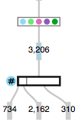
Discussion + Future Work
Understandable segments:
Each possible refinement operation corresponds to one attribute constraint
In contrast to clustering, pattern mining that have uninterpretable results for this scale of noisy data
Segmentifier explicitly supports refinement through both filtering and partitioning.
Encourages subsequent analysis
Allows comparison
Future comparison work
Notes:
A key aspect of the Segmentifier design is that each possible refinement
operation corresponds to one attribute constraint. Thus, a path through
the recorded analysis tree from root to leaf provides a crisp way to understand
the provenance of a segment as a sequential series of attribute
constraints. We saw the need for this kind of understandability after
initial experiments using existing techniques such as clustering and
pattern matching on the full dataset, which yielded incomprehensible
results because of the high variability between sequences.
Clustering:
If you cluster this data, you’ll get a lot of
It doesn’t work on this type of data
Can not interpret results on this kind of data
Super fine grained clusters
Aggregate rool up insight
Segmentifier explicitly supports refinement through both filtering
and partitioning. Although in theory partitioning could be achieved by
the workaround of filtering multiple times, the utility of partitioning is
that the analysis tree explicitly shows the split into multiple segments in a way that is a better match for a clickstream analyst’s mental model
and encourages subsequent analysis of the different cases. It is possible
to compare segment sizes quickly using the Analysis Paths view, but
support for direct comparison between segments in detail is left for
future work. An additional form of refinement is to transform segments
by altering their sequences. In Segmentifier, transform operations occur
implicitly through two choices: by switching between levels of the
action hierarchy to change the action aggregation level and by selecting
the Compress Consecutive option in the Sequence Details view to
collapse consecutive, identical actions into one. Supporting further
transformations explicitly would also be interesting future work.

Slide 87
Related Work
Refine
Record
Filter
Partition
View
Transform
Conclude
Segment
Abandon
Sequences
Export
Actions
 | View and Refine: Filtering Sequences To Segments SessionViewer [Lam 2007], EventFlow [Munroe 2013] , EventPad [Cappers 2018] Lack of segment attributes Lack of ability to record analysis path
View
Segment
Sequences
Actions
Refine
Filter
Partition
Transform
Notes:
Falls into two major categories

