Slide 1
Aggregated Dendrograms for Visual Comparison Between Many Phylogenetic Trees
Zipeng Liu Computer Science
Shing Hei Zhan Biodiversity Centre
Tamara Munzner Computer Science
University of British Columbia
( @tamaramunzner)
Download slides at http://www.cs.ubc.ca/labs/imager/tr/2019/adview/2019-10-24-infovis-talk.pptx

Slide 2
Phylogenetic tree
Evolutionary relationships of organisms
Human
Chimpanzee
Macaque
Genetic information
Computational workflow
Phylogenetic tree

Slide 3
Many phylogenetic trees
Understand relationships between genes and species trees
Explore trees generated with different methods and data
Human
Chimpanzee
Macaque
Genetic information
Computational workflow
Phylogenetic tree

Slide 4
Scalability of Existing Tree Comparison Systems
#Trees: how many trees to compare
Level of detail (LoD):
how much details are visible

Slide 5
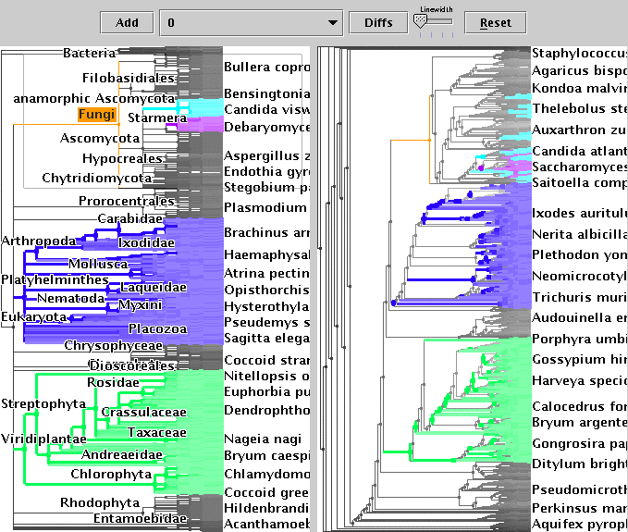
Scalability of Existing Tree Comparison Systems
#Trees: how many trees to compare
TreeJuxtaposer.
Munzner, Guimbretière, Zhang, Zhou.
SIGGRAPH 2003
Pairs
Few in full
Simplified structure
Full topology
Level of detail (LoD):
how much details are visible

Slide 6
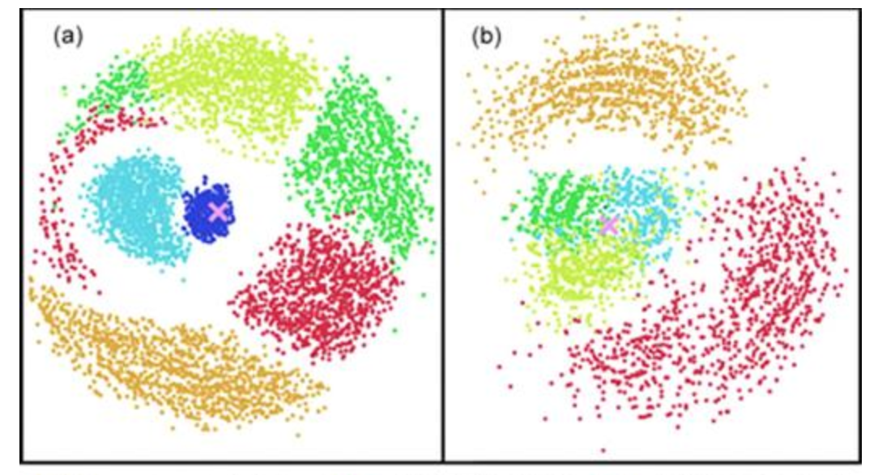
Scalability of Existing Tree Comparison Systems
#Trees: how many trees to compare
Many as points
Thousands
Hundreds
Tree space.
Hillis, Health, John.
Systematic Biology 2005.
Dozens
Pairs
Few in full
Single point
Simplified structure
Full topology
Level of detail (LoD):
how much details are visible

Slide 7
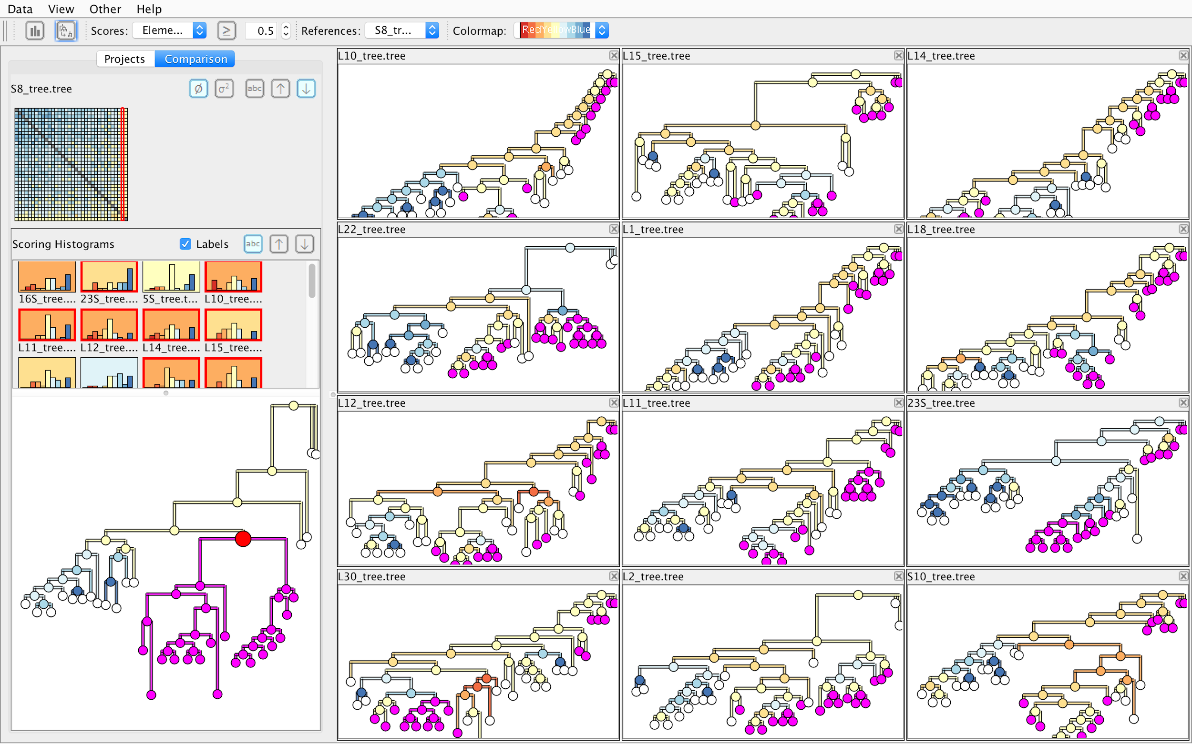
Scalability of Existing Tree Comparison Systems
#Trees: how many trees to compare
Many as points
Thousands
Hundreds
Dozens at multi-scale
Dozens
Interactive visual comparison of multiple trees.
Bremm, Landesberger, Heß, Schreck, Weil, Hamacher.
VAST 2011.
Pairs
Few in full
Single point
Simplified structure
Full topology
Level of detail (LoD):
how much details are visible

Slide 8
Comparing many phylogenetic trees
#Trees: how many trees to compare
Many as points
Hundreds / thousands at multi-scale?
Thousands
Hundreds
Dozens at multi-scale
Dozens
Pairs
Few in full
Single point
Simplified structure
Full topology
Level of detail (LoD):
how much details are visible

Slide 9
Main contributions
Data and task abstractions for comparison of phylogenetic trees

Slide 10
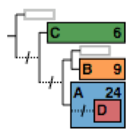
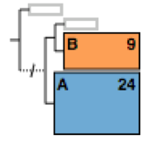
Main contributions
Data and task abstractions for comparison of phylogenetic trees
A new visual encoding: Aggregated Dendrogram
Compact tree representation that focuses on selected subtrees
Adapts to available screen space

Slide 11
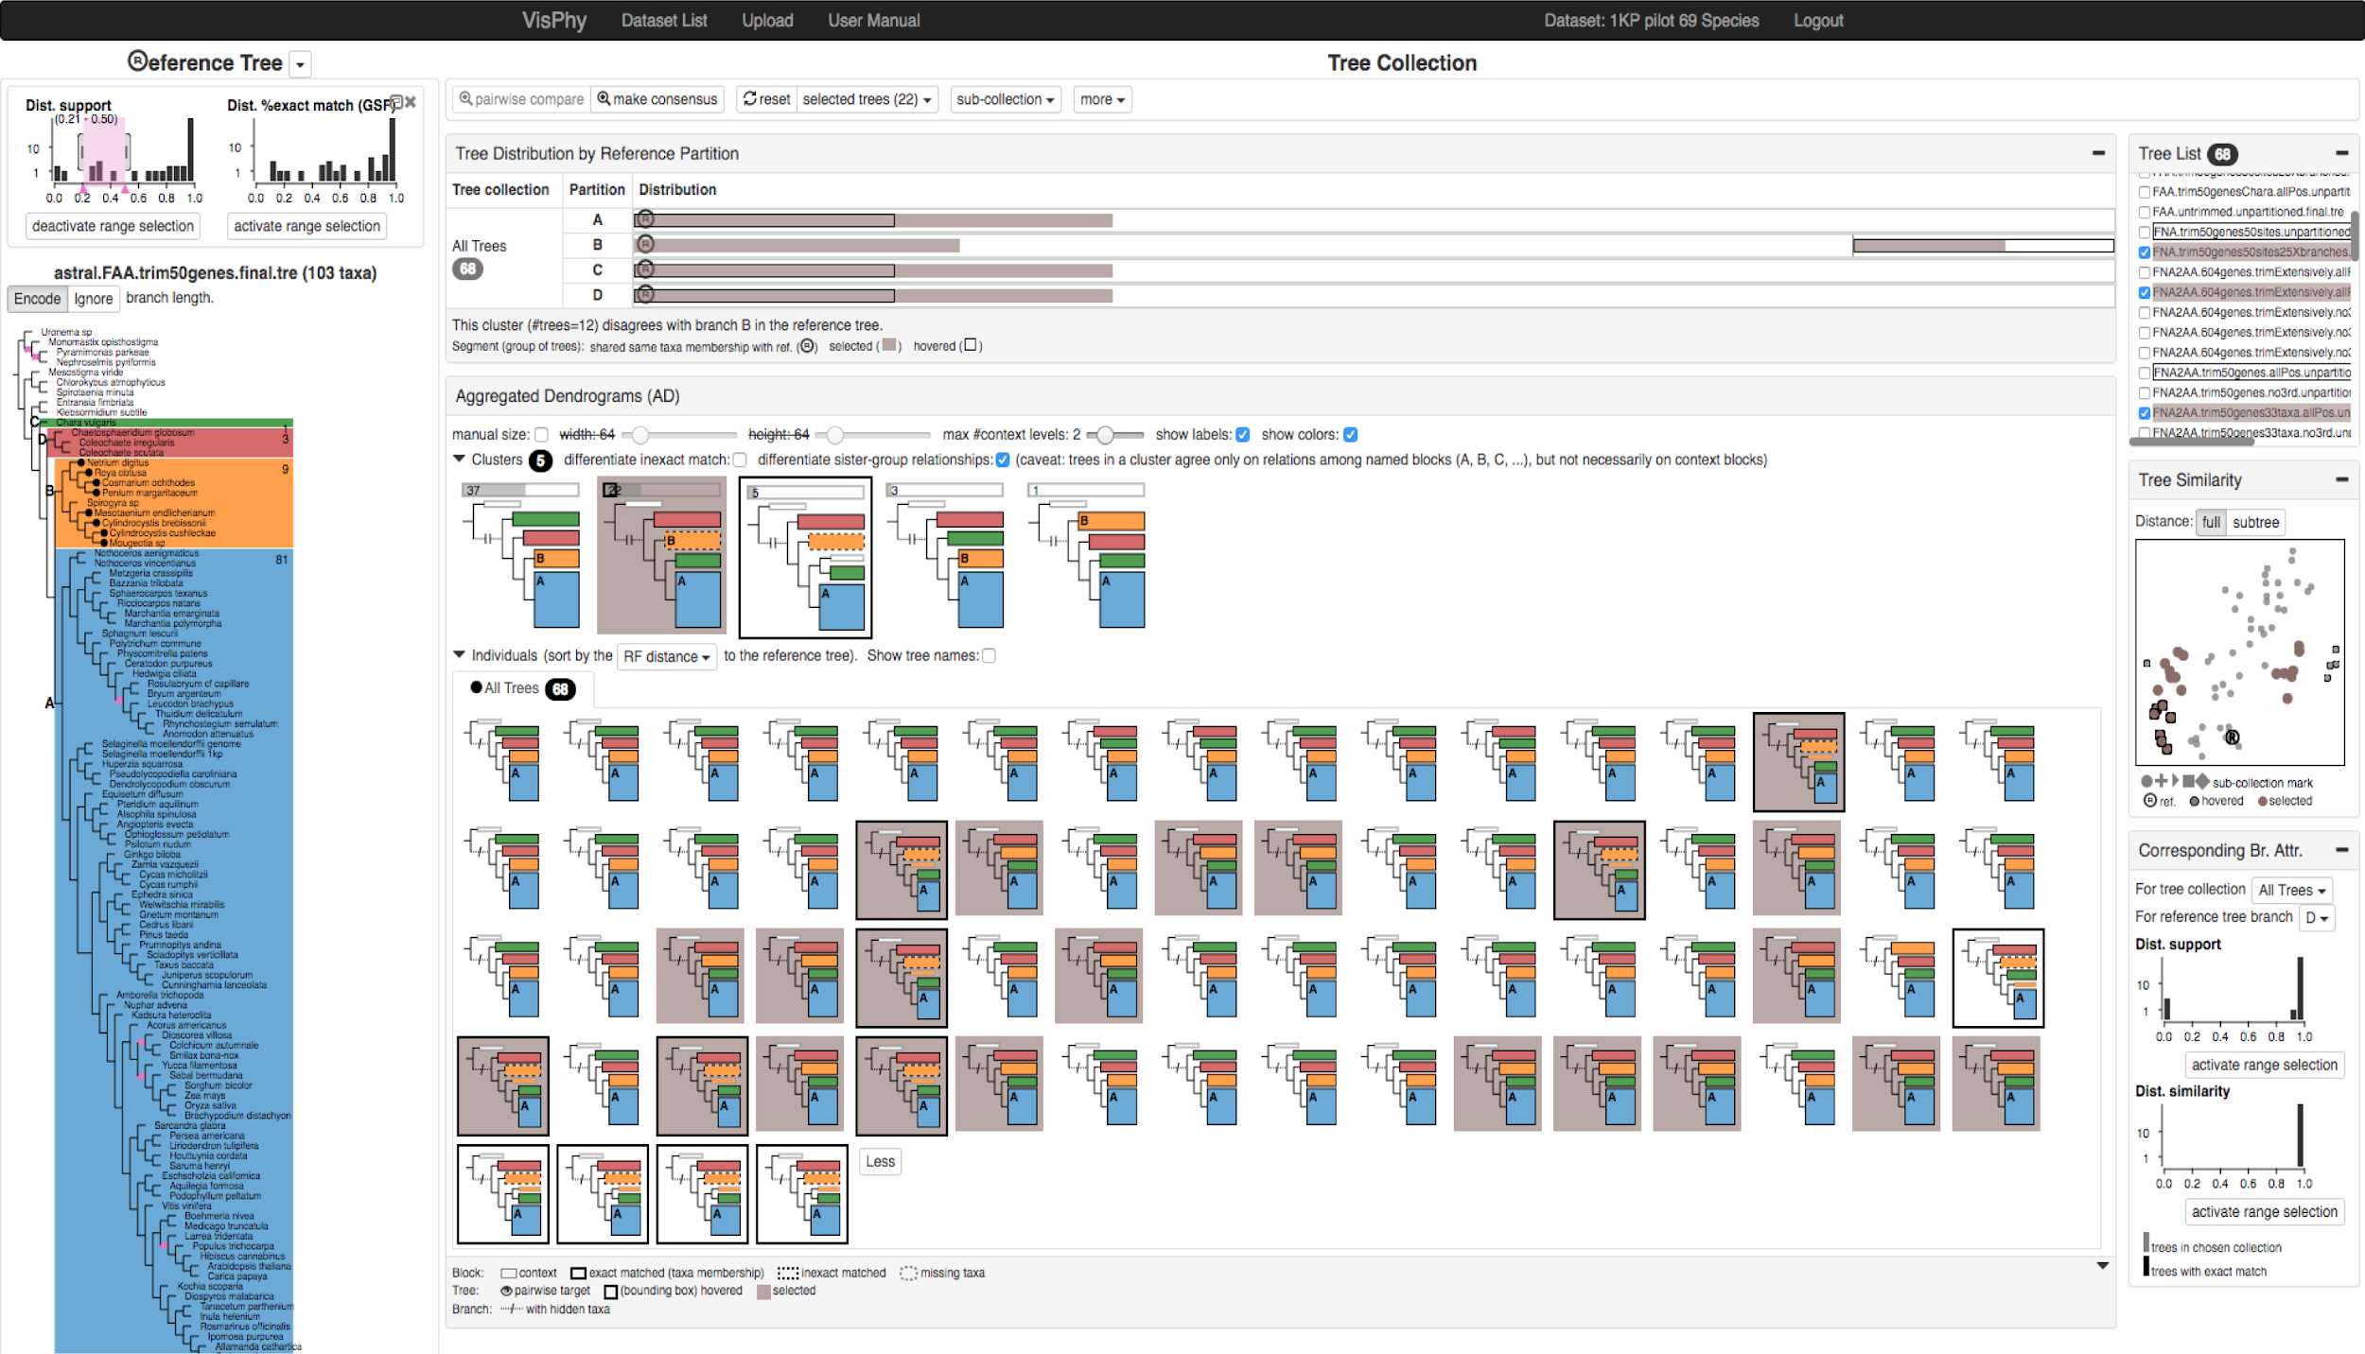
Main contributions
Data and task abstractions for comparison of phylogenetic trees
A new visual encoding: Aggregated Dendrogram
Compact tree representation that focuses on selected subtrees
Adapts to available screen space
A multi-view interactive tool: ADView
Covers multiple levels of details for tree comparison

Slide 12
Introduction
Data & Tasks
Tree data
Two crucial tasks
Derived data
Aggregated Dendrogram (AD)
ADView
Summary

Slide 13
Tree data
Reference tree vs. Tree collection

Slide 14
Two crucial tasks
Topological relationships between subtrees / leaf nodes

Slide 15
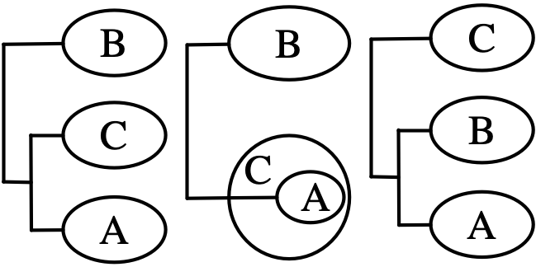
Two crucial tasks
Topological relationships between subtrees / leaf nodes
Separated Nested

Slide 16
Two crucial tasks
Topological relationships between subtrees / leaf nodes
Topological distance
Leaf node memberships compared to reference tree
Separated Nested

Slide 17
Two crucial tasks
Topological relationships between subtrees / leaf nodes
Topological distance
Leaf node memberships compared to reference tree
Separated Nested
Exact match

Slide 18
Two crucial tasks
Topological relationships between subtrees / leaf nodes
Topological distance
Leaf node memberships compared to reference tree
Separated Nested
Exact match
Partial match

Slide 19
Derived data
Topological relationships between subtrees / leaf nodes
Leaf node memberships compared to reference tree
Finding correspondences between reference tree and other trees
Derive
corresponding branch / subtree
The most similar subtree in one tree given a subtree in the reference tree

Slide 20
Introduction
Data & Tasks
Aggregated Dendrogram (AD)
Intuition
Visual design
Cluster AD
ADView
Summary

Slide 21
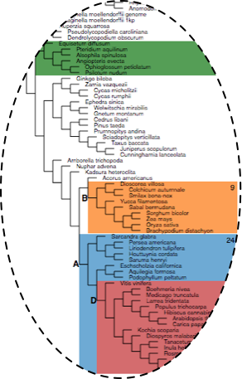
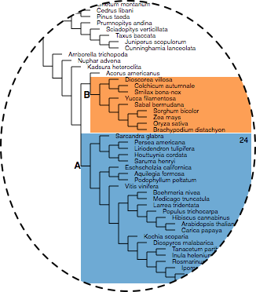
Intuition
Use glyphs to compress a tree according to user selections

Slide 22
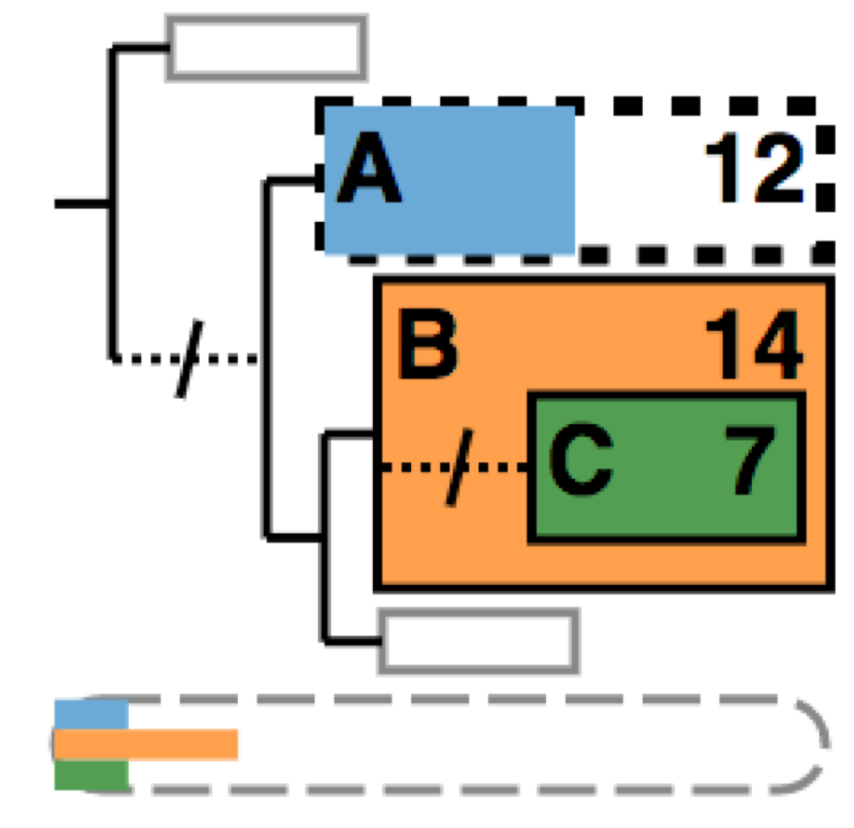
Visual design: focus + context

Slide 23
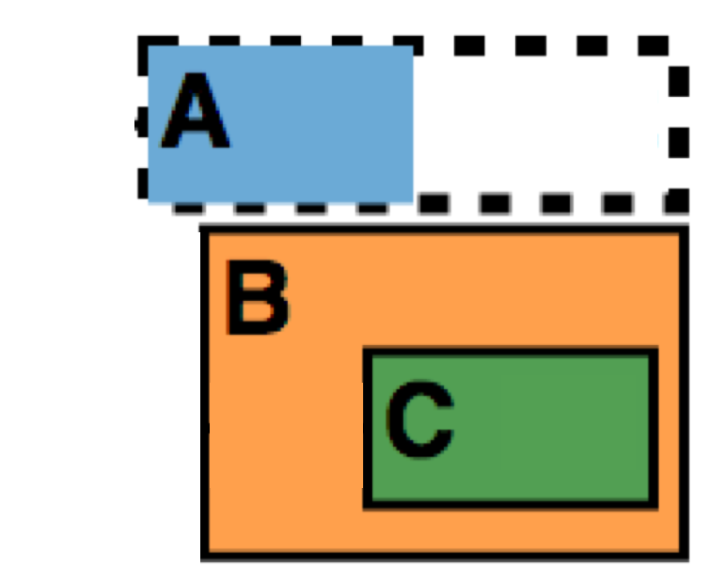
Visual design: focus + context
Focus
Selected subtrees
Hide inner structures and leaf nodes
Partial match of leaf set
(Leaf task)
Exact match of leaf set

Slide 24
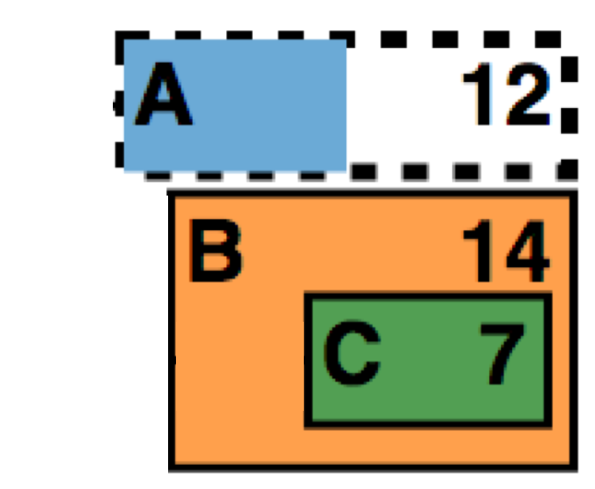
Visual design: focus + context
Focus
Selected subtrees
Proportion of matching leaves
(Leaf task)
# leaf nodes

Slide 25
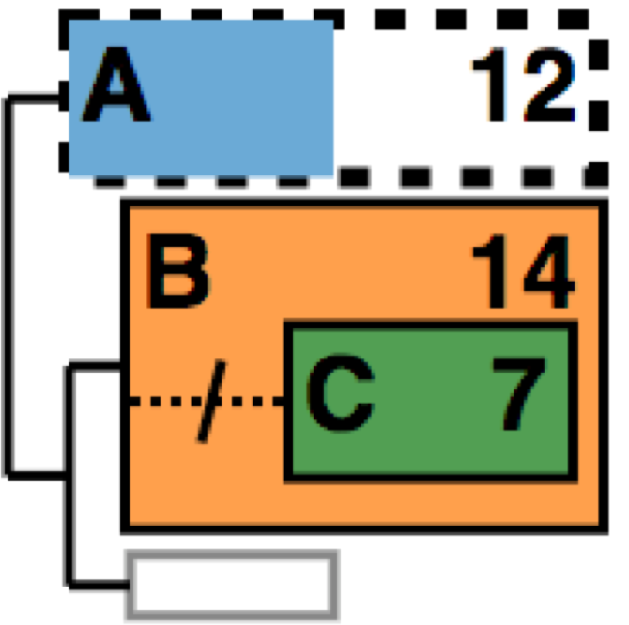
Visual design: focus + context
Focus
Selected subtrees
Topological relationships between them
(Topology task)

Slide 26
Visual design: focus + context
Focus
Selected subtrees
Topological relationships between them
Elided topology
(Topology task)

Slide 27
Visual design: focus + context
Focus
Selected subtrees
Topological relationships between them
Context
Neighboring subtrees

Slide 28
Visual design: focus + context
Focus
Selected subtrees
Topological relationships between them
Context
Neighboring subtrees
Upstream topology and root

Slide 29
Visual design: focus + context
Focus
Selected subtrees
Topological relationships between them
Context
Neighboring subtrees
Upstream topology and root
Missing leaf nodes

Slide 30
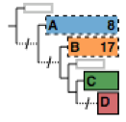
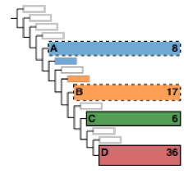
Visual design: algorithm adapts to space
Show more info when space permitted
Labels
#leaf nodes
Neighboring blocks
40x40 px
80x80 px
160x160 px

Slide 31
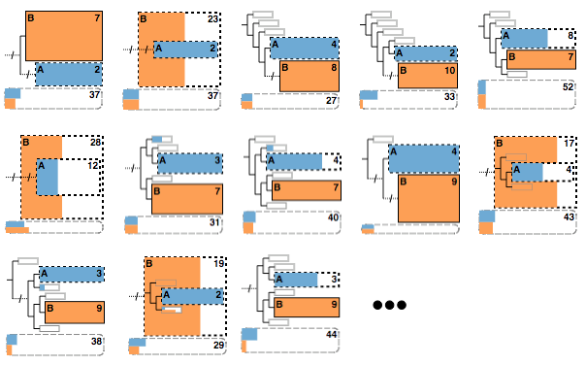
Cluster AD: summary of multiple ADs
Problem: still many individual ADs

Slide 32
Cluster AD: summary of multiple ADs
Problem: still many individual ADs
Solution: cluster by topological relationships

Slide 33
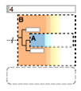
Cluster AD: summary of multiple ADs
Problem: still many individual ADs
Solution: cluster by topological relationships
Cluster

Slide 34
Cluster AD: summary of multiple ADs
Problem: still many individual ADs
Solution: cluster by topological relationships
Cluster

Slide 35
Introduction
Data & Tasks
Aggregated Dendrogram (AD)
ADView
Demo
Multi-level structure across views
Summary

Slide 36
Video demo

Slide 37
Multi-level structure across views

Slide 38
Multi-level structure across views
Branch
Individual tree subtree
branch and leaf

Slide 39
Interface walkthrough: tree collection main views
Tree collection
Subset of trees
Tree collection
Subset of trees
Individual tree
Subtree

Slide 40
Interface walkthrough: tree collection aux. views
Individual tree
Tree collection
branch

Slide 41
Validation with many biologists
Work closely with a biology PhD student (second author)
Demos, interviews and discussions
10 biologists at different times throughout project

Slide 42
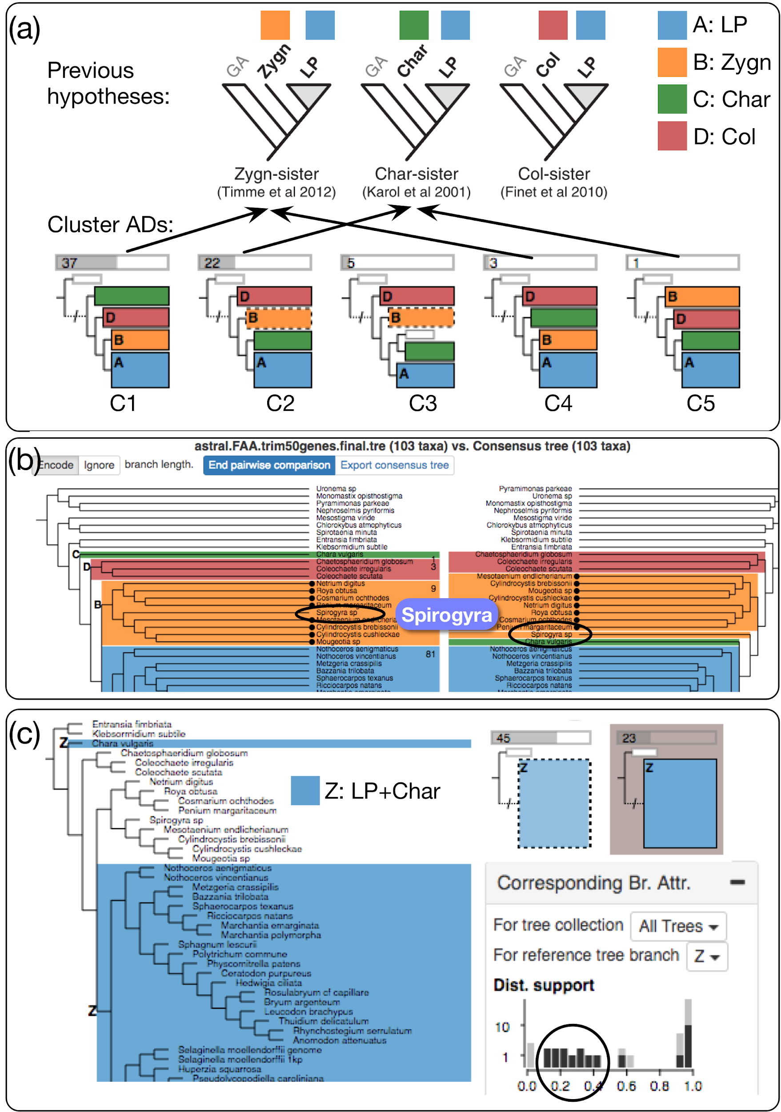
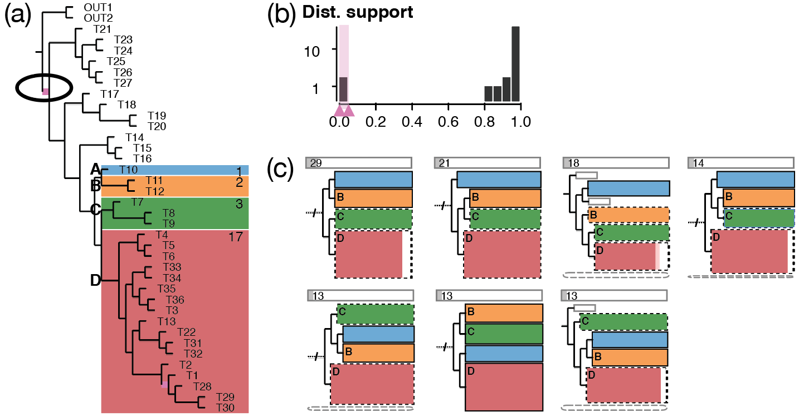
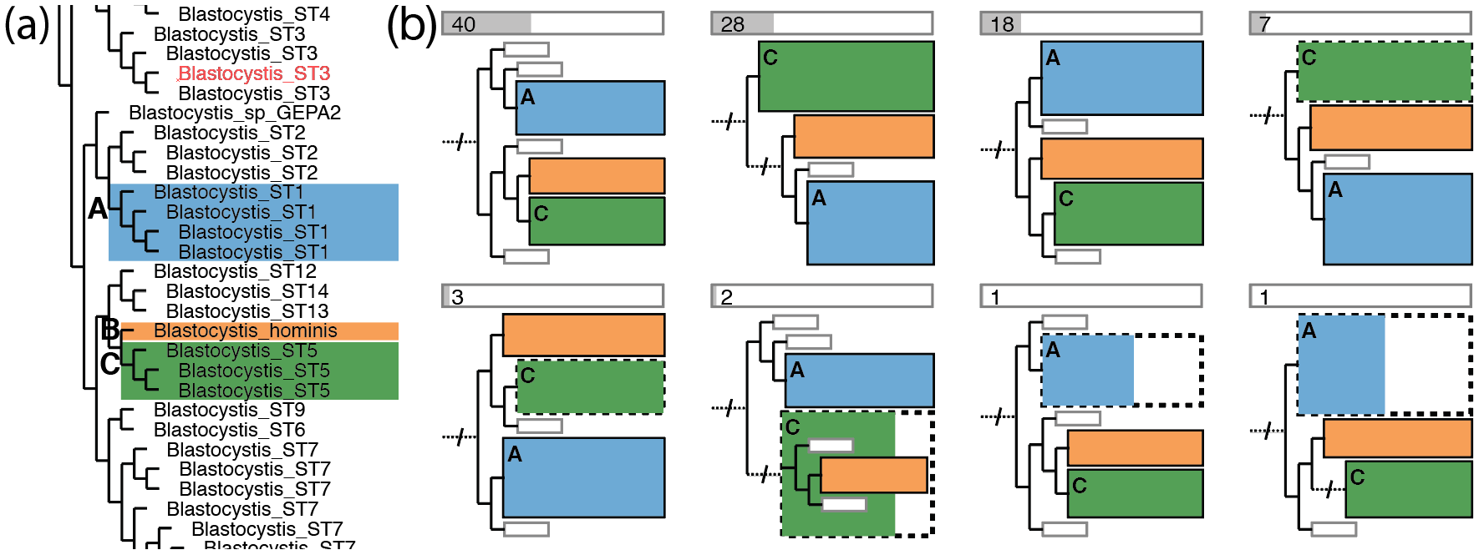
Validation with many biologists
Work closely with a biology PhD student (second author)
Demos, interviews and discussions
10 biologists at different times throughout project
User study sessions
5 biologists
Using their own datasets

Slide 43
Validation with many biologists
Work closely with a biology PhD student (second author)
Demos, interviews and discussions
10 biologists at different times throughout project
User study sessions
5 biologists
Using their own datasets
Biologists confirmed
Validity of data and task abstractions
Utility of ADView

Slide 44
Conclusion
Data and task abstractions for comparing many phylogenetic trees

Slide 45
Conclusion
Data and task abstractions for comparing many phylogenetic trees
Aggregated dendrogram (AD)
Compress a full dendrogram to a compact glyph

Slide 46
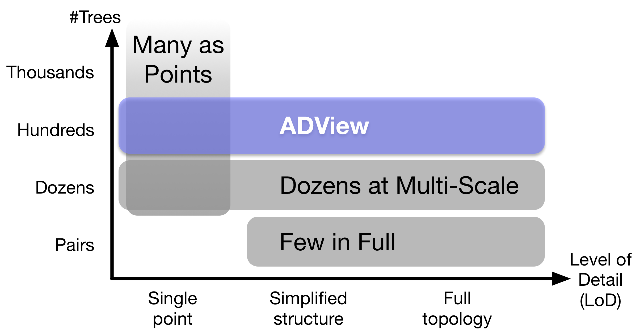
Conclusion
Data and task abstractions for comparing many phylogenetic trees
Aggregated dendrogram (AD)
Compress a full dendrogram to a compact glyph
ADView
Compare hundreds of trees at multiple scales

Slide 47
Conclusion
Data and task abstractions for comparing many phylogenetic trees
Aggregated dendrogram (AD)
Compress a full dendrogram to a compact glyph
ADView
Compare hundreds of trees at multiple scales
Future work
Thousands at multi-scale
Generalize to other domains

Slide 48
Aggregated Dendrograms for Visual Comparison Between Many Phylogenetic Trees
Zipeng Liu (zipeng@cs.ubc.ca), Shing Hei Zhan (shing.zhan@gmail.com), Tamara Munzner ( @tamaramunzner)
Project page: http://www.cs.ubc.ca/labs/imager/tr/2019/adview/
Paper, supplemental materials, videos, talk slides
Biology use cases with real-world data
Open-source code: https://github.com/zipengliu/adview
Live demo: http://visphy.cs.ubc.ca

Slide 50
Backup slides

Slide 51
Tree data
1 vs N: reference tree vs. tree collection
Genetic information
Method / run 1
Method / run 2
Method / run 3
Method / run N
Many intermediate trees (e.g. gene trees)
Reference tree
Tree collection
Species tree 1
Species tree 2
Species tree 3
Species tree N

Slide 52
Multi-level structure across views
Reference branch attributes
C
D
B
Reference dendrogram (LoD: individual tree & subtree
& branch and leaf)
A
Selected subtrees

Slide 53
Agenda -- not for presenting
Introduction
Motivation
Visual tree comparison problem (+previous work)
Domain needs
Contribution
Data and task
Aggregated dendrogram
ADView interface and video demo
Conclusion
15 min incl. Q&A. Presentation should be done in 13 ~ 13.5 min (<20 slides)
Presentation time: THURSDAY, OCTOBER 24 4:10-5:40PM
TODO: breadcrumbs at the bottom

Slide 54
Scalability of ADView
#Trees
A few hundred (with cluster AD)
Level of detail
Tree collection
Subset of trees
Individual tree
Subtree
Branch and leaf node
#leaf nodes per tree
~100 if need to show all in one screen
Scale up by hiding parts of tree

