Slide 1


Real-time Dynamic Wrinkling of Coarse Animated Cloth
Russell Gillette Craig Peters Nicholas Vining Essex Edwards Alla Sheffer
University of British Columbia
Notes:
Thank you very much for the introduction. We are presenting a method today, for the addition of real-time dynamic wrinkling to coarse animated cloth.

Slide 2

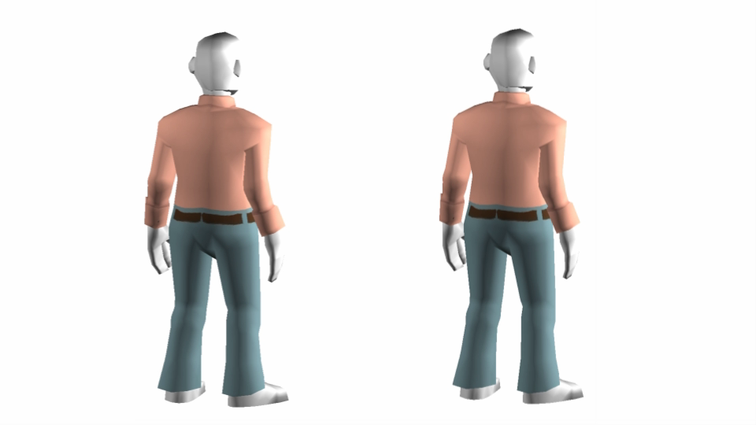
Real-Time Wrinkling of Game-style Cloth
Wrinkles are important for
believable garment animation
Notes:
Wrinkles add necessary detail for believable cloth animation. Here we observe a comparison between a traditional coarse game animation with and without wrinkles. The impact on wrinkles have on our impression of the garments is apparent.
2

Slide 3
Real-Time Wrinkling of Game-style Cloth
Wrinkles are important for
believable garment animation
Games present unique
challenges:
  Need for real-time performance
  Wrinkling needs to work in
  conjunction with game-level
  animation
Notes:
We have designed our method to be applied to games, which present a unique set of constraints; namely that our method must have real time performance, and must work in conjunction with character animation methods employed in modern game setups. Before we get into any details, lets begin by discussing previous work relating to cloth animation.
3

Slide 4
Related Work
Direct Simulation [Bridson02, Tang13]
  Not fast enough for real time/low end hardware
  Not compatible with game engines
Notes:
There have been two main strategies in the literature for tackling this problem.
The first is Physical Simulation, which animates cloth to fit a computed physical configuration. These techniques are too expensive for real time, and are incompatible with typical game engines.
4

Slide 5
Related Work
Direct Simulation [Bridson02, Tang13]
  Not fast enough for real time/low end hardware
  Not compatible with game engines
Augmentation: Add wrinkles on top of low-frequency animation
  The general framework we adopt
  Combine with low-frequency game-engine generated animation
Notes:
The second approach is Augmentation, where wrinkles are added on top of a coarse cloth animation that captures the low-frequency motion of the fabric.
5

Slide 6
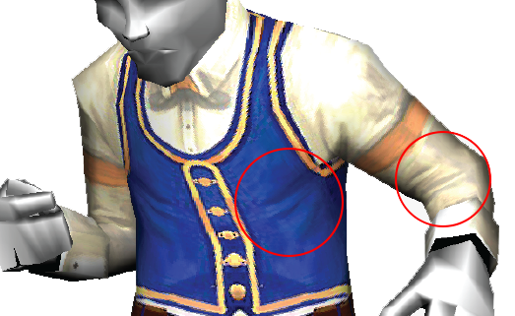
Related Work: Augmentation Methods
Manually Painted [Hadap99, Loviscach06, Oat07]
  Current approach
  Limited to fixed set of motions
Clockwork Empires
(Gaslamp Games)
Notes:
A common approach used in games is to manually paint wrinkles for a set of cloth poses, and interpolate them for intermediate poses. This method is limited to animations that closely resemble the initial set of cloth poses, and requires extra authoring resources to construct the manually painted poses.
6

Slide 7
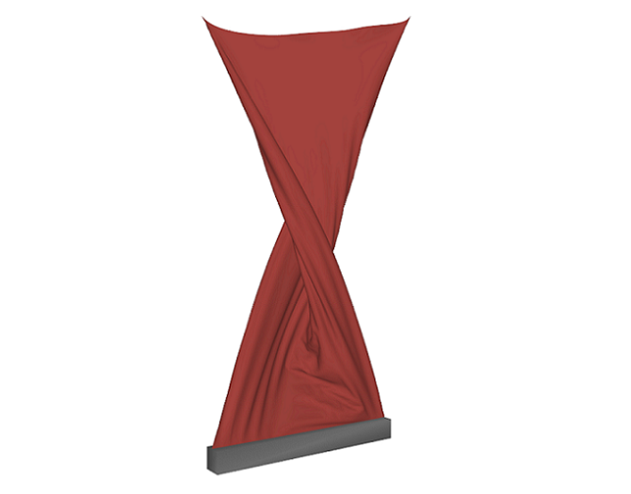
Related Work: Augmentation Methods
Manually Painted [Hadap99, Loviscach06, Oat07]
  Current approach
  Limited to fixed set of motions
Data Driven [Hahn14, Wang10, Zurdo13]
  Requires training data similar to input animation
    How to create for typical game data?
  Largely limited to tight-fitting clothing
Clockwork Empires
(Gaslamp Games)
(Zurdo13)
Notes:
Others have pursued the Data Driven approach, employing learning algorithms on an offline training data set. This technique is largely limited to tight-fitting clothing, and requires accurate training data that closely resembles the run-time inputs
7

Slide 8
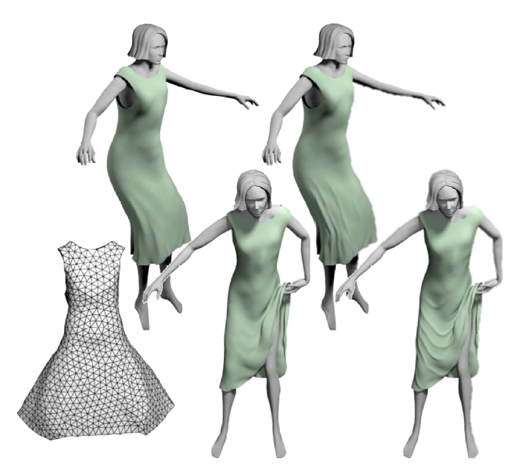
Related Work: Augmentation Methods
Physics-based [Rohmer10, Muller10, Remillard13]:
  Cloth is nearly incompressible
Rohmer
Notes:
Physics based augmentation approaches operate on the observation that cloth is nearly incompressible.

Slide 9
Related Work: Augmentation Methods
Physics-based [Rohmer10, Muller10, Remillard13]:
  Cloth is nearly incompressible
  In low-frequency physical animation, compression with respect to a reference (rest) shape indicates the presence of high-frequency wrinkles
Rohmer
Notes:
Where detailed physical animation would produce details such as wrinkles, accurate, but low-frequency
animations instead exhibit compression, which can be measured with respect to the reference, or rest shape, employed by the
underlying low-frequency animation.

Slide 10
Related Work: Augmentation Methods
Physics-based [Rohmer10, Muller10, Remillard13]:
  Cloth is nearly incompressible
  In low-frequency physical animation, compression with respect to a reference (rest) shape indicates the presence of high-frequency wrinkles
  Place wrinkles in areas of high compression
Rohmer
Notes:
These methods subsequently create believable wrinkles by placing them in areas where the animated surface is compressed with respect
to the reference shape.

Slide 11
Related Work: Augmentation Methods
Physics-based [Rohmer10, Muller10, Remillard13]:
  Cloth is nearly incompressible
  In low-frequency physical animation, compression with respect to a reference (rest) shape indicates the presence of high-frequency wrinkles
  Place wrinkles in areas of high compression
  Operate on medium size meshes (5K-10K)
Rohmer
Notes:
They typically operate on meshes with several thousand triangles, and can achieve near-interactive speeds.

Slide 12
Related Work: Augmentation Methods
Physics-based [Rohmer10, Muller10, Remillard13]:
  Cloth is nearly incompressible
  In low-frequency physical animation, compression with respect to a reference (rest) shape indicates the presence of high-frequency wrinkles
  Place wrinkles in areas of high compression
  Operate on medium size meshes (5K-10K)
Unsuitable for game data
Rohmer
Notes:
While these approaches are appealing, the assumptions they make do not hold for the input game-engine animations we operate on.

Slide 13
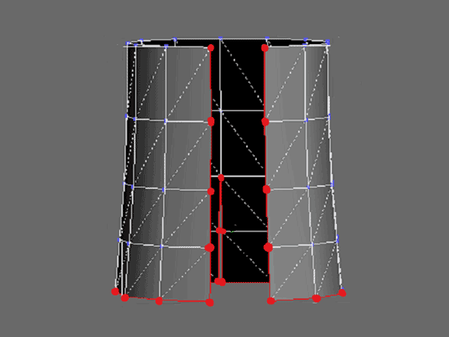
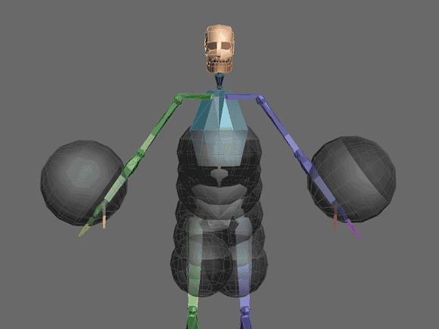
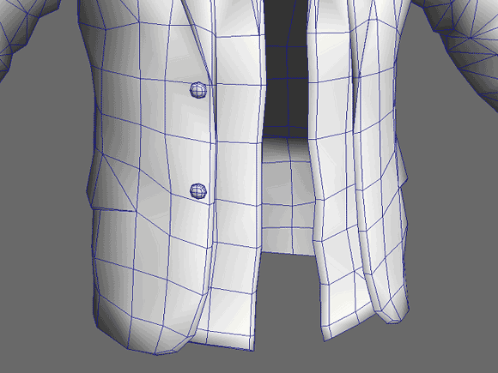
Our approach: Wrinkling Game Animated Cloth
Augment game-engine generated cloth animation with real-time wrinkles
Challenges:
Enqvist10
Very Coarse
(600-800 vertices)
Non-Physical:
Mix of coarse simulation,
Mocap/Artist Animation, IK;
No Reference Shape
Notes:
Typical assumptions include the animation being smooth, consistent, physically accurate, having a reference shape and a smooth tensor field constructed from it.
Game-engine animations are rarely physically accurate and are constructed using a mix of techniques,
which rarely utilize a reference shape as a starting point. Moreover, game geometry is very coarse violating many of the additional assumptions made
by these approaches.
Our method uses an augmentation approach inspired by these physics based methods, but designed to accommodate
Typical game-engine generated animations.
13

Slide 14
Key Insights
Absent physically meaningful animation, do not aim for “correctness”
Focus on believability
Notes:
Since our inputs do not lend themselves well to traditional approaches we aim for believability rather than correctness.

Slide 15
Key Insights
Absent physically meaningful animation, do not aim for “correctness”
Focus on believability
Humans rely on local movement when predicting wrinkle formation:
  They expect wrinkles to show up when the surface visually contracts … and to disappear when it subsequently stretches
Notes:
We observe that people look at local trends in motions to predict the formation of wrinkles.
As a surface contracts, we expect it to buckle in the formation of a wrinkle. We expect this wrinkle to dissipate as the material stretches.

Slide 16
Key Insights
Absent physically meaningful animation, do not aim for “correctness”
Focus on believability
Humans rely on local movement when predicting wrinkle formation:
  They expect wrinkles to show up when the surface visually contracts … and to disappear when it subsequently stretches
Real-life wrinkles are spatially and temporally coherent
  Neighboring wrinkles are aligned in common directions
  Wrinkles appear, move, and disappear gradually
Notes:
We also observe that real-life wrinkles are coherent in both space and time. Wrinkles must be aligned locally, and gradually appear, move, and disappear

Slide 17
Key Ideas
Idea: Use local intrinsic surface deformation (compression/stretch) to guide wrinkle formation
Notes:
Following these observations, we propose to use local surface deformation as a guide for wrinkle formation.

Slide 18
Key Ideas
Idea: Use local intrinsic surface deformation (compression/stretch) to guide wrinkle formation
Problem: Since animation is non-physical, intrinsic local motion is often not coherent spatially or temporally
Notes:
However, this intrinsic deformation is often discontinuous in time and space when computed on game quality animations and geometry.

Slide 19
Key Ideas
Idea: Use local intrinsic surface deformation (compression/stretch) to guide wrinkle formation
Problem: Since animation is non-physical, intrinsic local motion is often not coherent spatially or temporally
Solution:
  Use a classification scheme for local surface motion, which enforces spatial and temporal coherence
  Use temporally coherent wrinkle path update mechanism
Notes:
To generate coherent wrinkles from this data we first employ a classification scheme to extract smooth and reliable trends in the deformation.
We also propose a novel wrinkle update mechanism that smoothly updates wrinkles on game-quality inputs

Slide 20
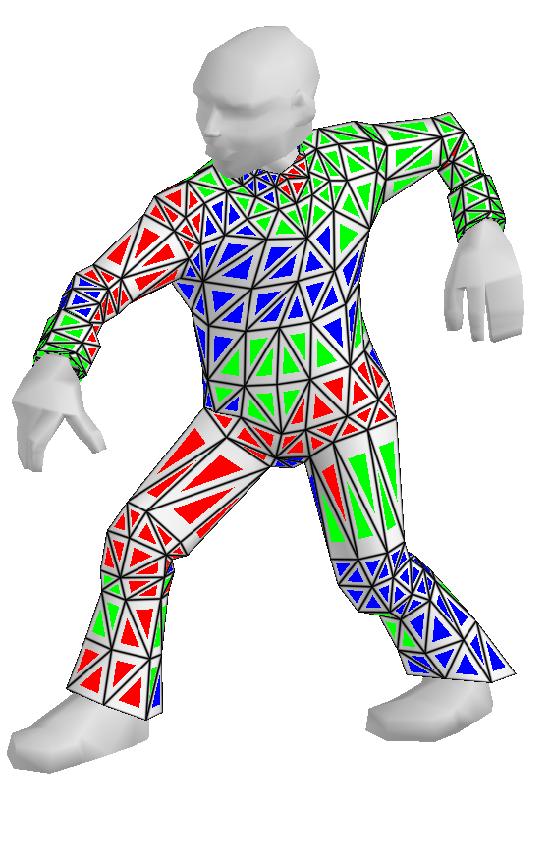
Algorithm Overview
Classification
Notes:
Our algorithm consists of four stages.
We first generate a per-triangle reference shape with respect to the previous frame and adjacent triangles

Slide 21
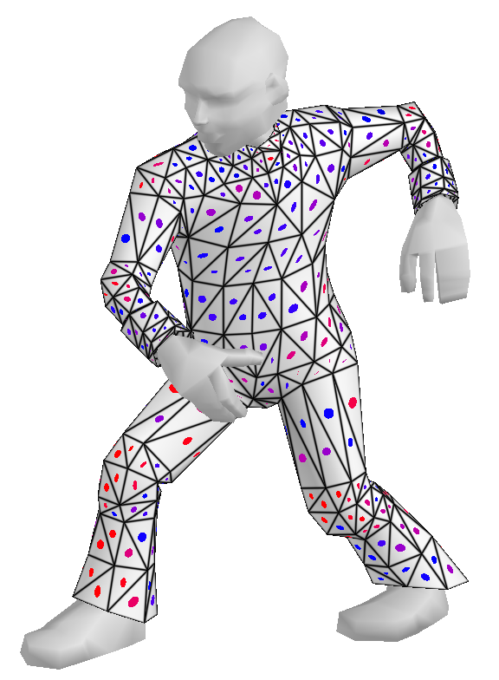
Algorithm Overview
Classification
Local Stretch Tensor
Notes:
We then generate a stretch tensor field by comparing this reference shape to the current mesh pose.

Slide 22
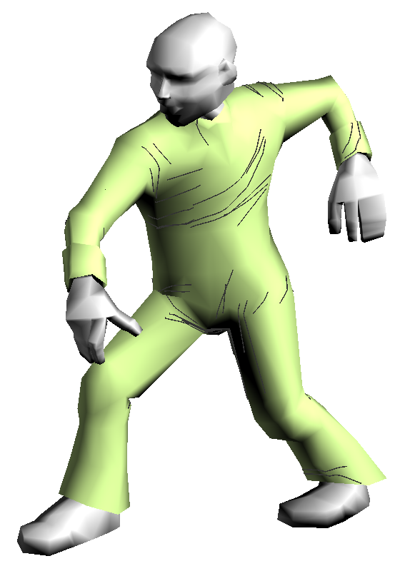
Algorithm Overview
Classification
Local Stretch Tensor
Trace Temporally Coherent
Wrinkle Paths
Notes:
We trace wrinkles through the tensor field along regions of high compression orthogonal to the direction of compression

Slide 23
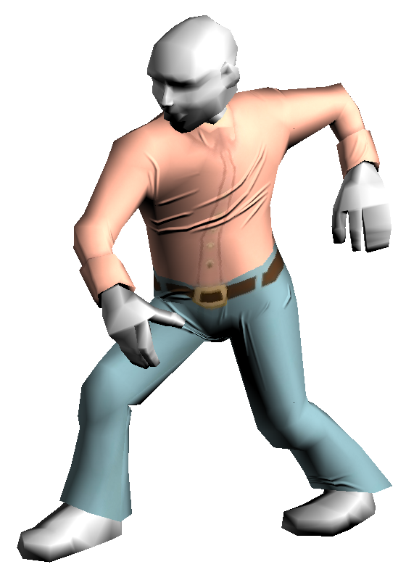
Algorithm Overview
Classification
Local Stretch Tensor
Trace Temporally Coherent
Wrinkle Paths
Compute wrinkle geometry
on GPU
Notes:
And then generate geometry along those paths using the GPU.

Slide 24
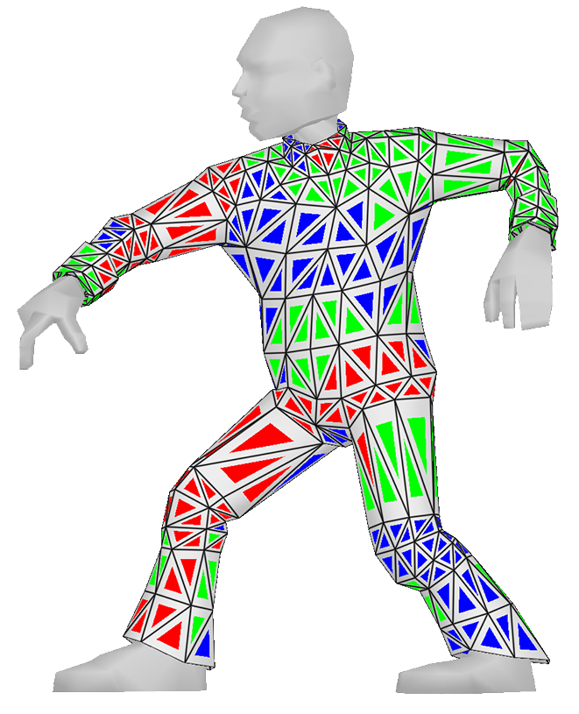
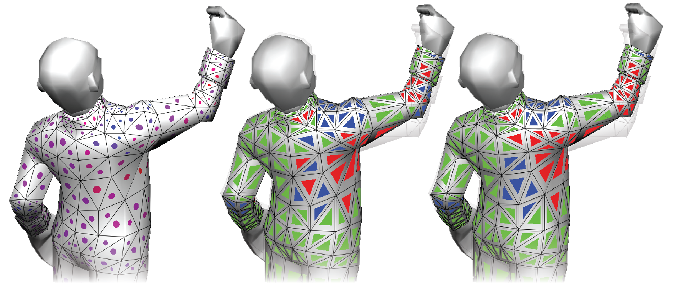
Classification
Compute raw stretch tensor w.r.t. previous frame
Compression
Stretch
Rest
Raw Tensor Field
Without Graph-Cut
With Graph-Cut
Notes:
We observe that a person's expectations of the behaviour of wrinkles are based on temporally and spatially local trends, as indicated by the surface deformation between frames.
In real-time animation, the surface behaviour between frames is too noisy to measure these trends reliably.

Slide 25
Classification
Compute raw stretch tensor w.r.t. previous frame
Classify per-triangle motion into compression, stretch or rest
Compression
Stretch
Rest
Raw Tensor Field
Without Graph-Cut
With Graph-Cut
Notes:
To extract this information, we locally classify each triangle's animation as “compressed”, “stretched”, or “at rest” using a principled labelling process.
An example labeling is shown in the upper right figure, where our character is undergoing a twisting, throwing motion. This motion creates a band of compression across his chest, indicated by blue, and stretch along his leg and arm as they extend forwards, indicated by red.

Slide 26
Classification
Compute raw stretch tensor w.r.t. previous frame
Classify per-triangle motion into compression, stretch or rest
To balance measured stretch against spatiotemporal coherence use graph-cut formulation to perform the classification
Compression
Stretch
Rest
Raw Tensor Field
Without Graph-Cut
With Graph-Cut
Notes:
As you can see, the labeling is smooth and consistent, which we accomplish by formulating the labeling problem as a graph-cut problem. This balances measured deformation with perceptual preference for spatiotemporally continuous labels
In the lower figure, you can see the input tensors to the graph-cut labeling problem, a labeling computed naively from the tensors with no consideration for smoothness, and our labeling computed with graph-cut. Without graph-cut, the labels can become noisily interspersed, while our approach chooses labels that form coherent regions

Slide 27
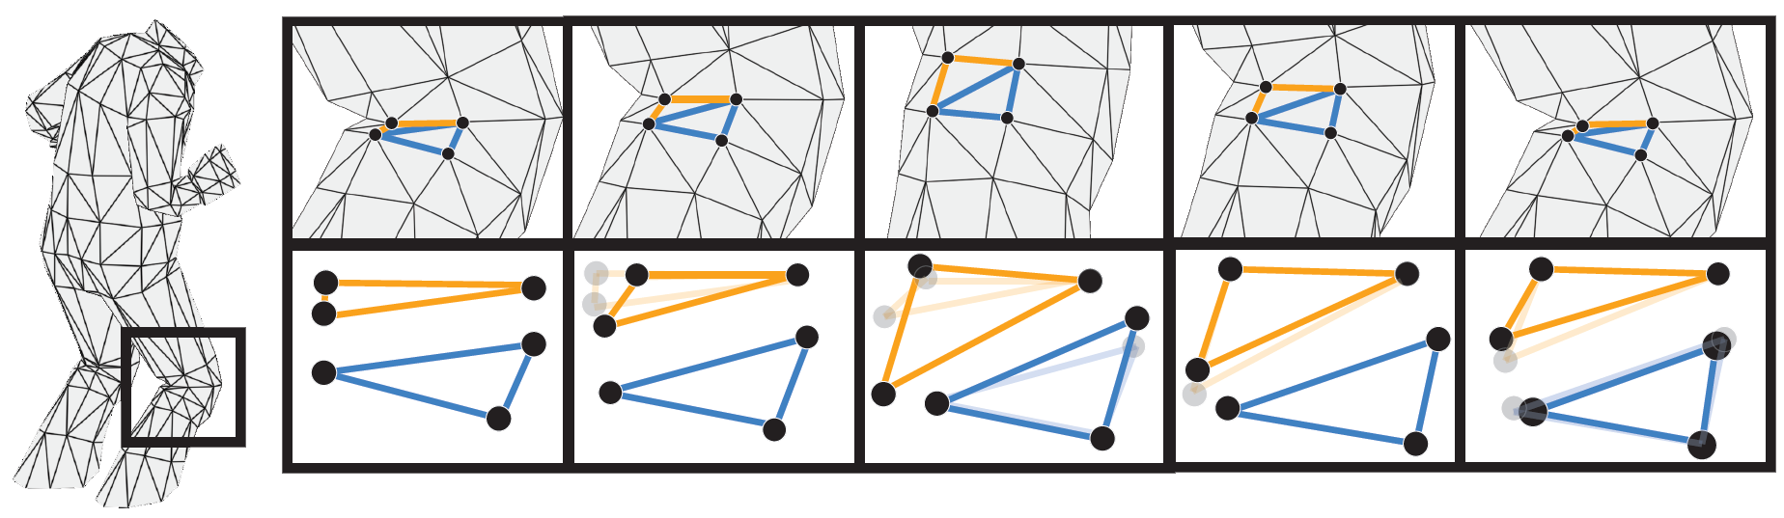
Deferred Reference Shape Update
Use classification to compute temporally smooth reference shape (RS)
  Update per-triangle RS based on current label and stretch tensor w.r.t. previous RS
Notes:
In order to obtain a spatially and temporally consistent tensor field to trace wrinkles, we need a reference shape that adapts smoothly over time. For other augmentation techniques, the reference shape is given as input and is static, thus trivially providing a consistent field. In our setup, we must construct a reference shape throughout the animation such that compression computed against it indicates believable wrinkles. The naïve approach would be to simply select the largest triangle yet seen as the reference shape. However, game animations are often authored by artists, or made to match non-physical constraints required by the game engine. This causes the naïve approach to suffer from outliers and other noise. Instead, we use the labeling as extra information to update the reference shape gradually, providing a consistent, stable reference shape while still reflecting local animation trends. The figure above illustrates this gradual update behaviour. For more detail, please refer to the paper

Slide 28
Wrinkle Path Tracing
Compute per-triangle stretch tensor w.r.t. computed reference shape
Notes:
Now that we have a reference shape, we can compute a stretch tensor field whose field lines indicate plausible wrinkle paths.
28

Slide 29
Wrinkle Path Tracing
Compute per-triangle stretch tensor w.r.t. computed reference shape
Use standard field tracing in first frame
  Seed paths in areas of high compression
  Trace orthogonally to maximal compression direction
Notes:
We trace new wrinkles along these paths in areas of high compression.
This figure illustrates this process – notice that the tensors are both well aligned locally and provide believable wrinkle paths
29

Slide 30
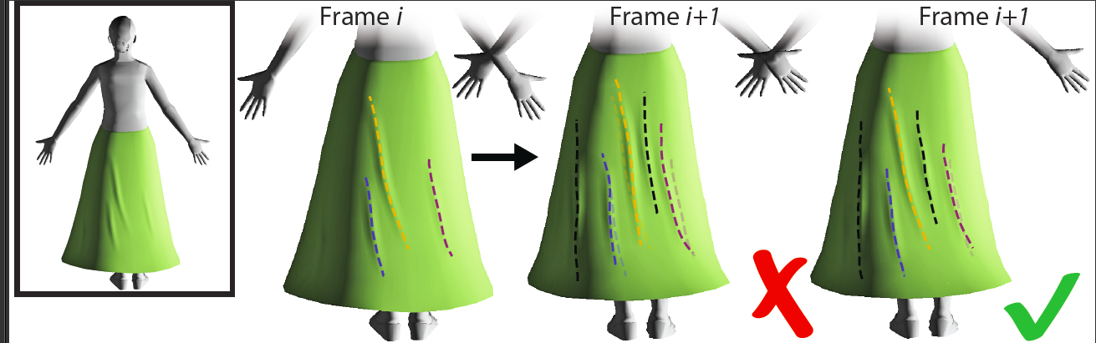
Updating Wrinkle Paths
As our tensor field is piecewise constant, we update, rather then regenerate, seeded wrinkles
Notes:
To account for temporal coherence, we must smoothly modify previously existing wrinkles.
Simple approaches for this problem, such as those used by Rohmer et al, retrace the wrinkles through the current frame’s tensor field. This depends greatly on the smoothness of the tensor field.
30

Slide 31
Updating Wrinkle Paths
As our tensor field is piecewise constant, we update, rather then regenerate, seeded wrinkles
Formulate path update as least-squares optimization balancing wrinkle coherence vs adherence to new stretch field directions
Notes:
Given the coarseness of our geometry, smoothing loses important details in the piecewise constant field, and thus these approaches do not apply.
Instead, we employ an optimization scheme to balance smoothness with adherence to the field.
The figure here shows how three wrinkle shapes adjust drastically from Frame i to i+1 when using the simple approach. Our approach, given on the right, provides the necessary consistency. For more details, please refer to the paper.
31

Slide 32

Creating Wrinkle Geometry
Model per-frame wrinkles on the fly using GPU
  Use tessellation shader to refine coarse mesh in wrinkle path vicinity
Notes:
Lastly, we utilize the tessellation unit of the GPU to refine the mesh only in regions surrounding the wrinkle paths, providing sufficient mesh resolution to represent the wrinkle geometry.

Slide 33
Creating Wrinkle Geometry
Model per-frame wrinkles on the fly using GPU
  Use tessellation shader to refine coarse mesh in wrinkle path vicinity
  Generate & blend wrinkle surfaces + normals in tessellation & fragment shaders
Notes:
We then deform this geometry to form the wrinkles, blending their normals per pixel to provide smooth and natural wrinkle merging. Here you can see an example of how we merge wrinkles. Without blending, there are clear creases and seams, while our approach creates a natural merge

Slide 34
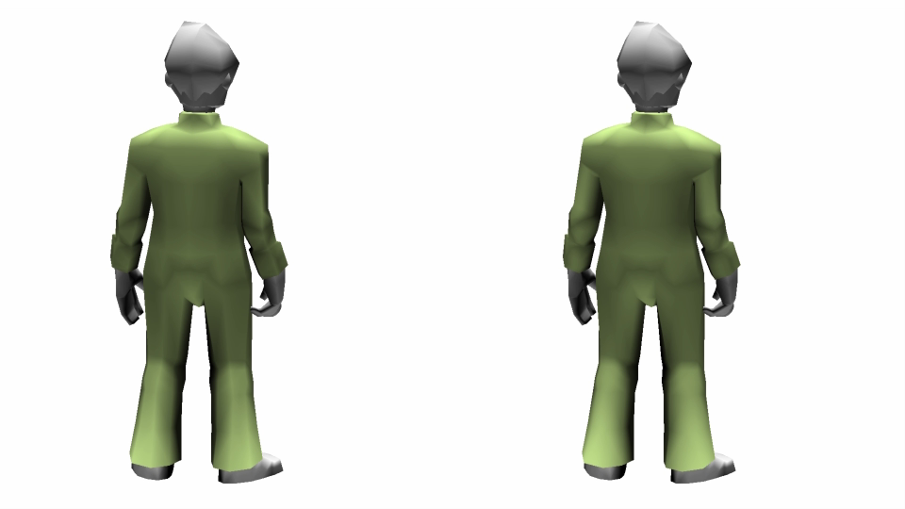
Results: Chop
Notes:
Here we show winkles formed from a twisting motion

Slide 35
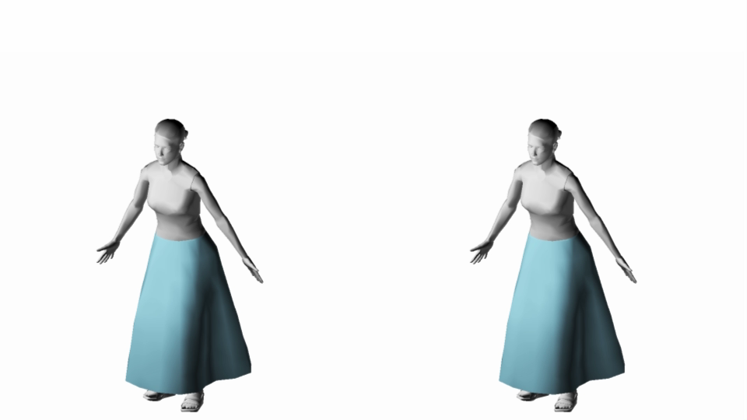
Results: Jump Jack
Notes:
This example shows our algorithm on loose flowing garments which are not skinned or authored, but rather generated by a coarse simulation

Slide 36
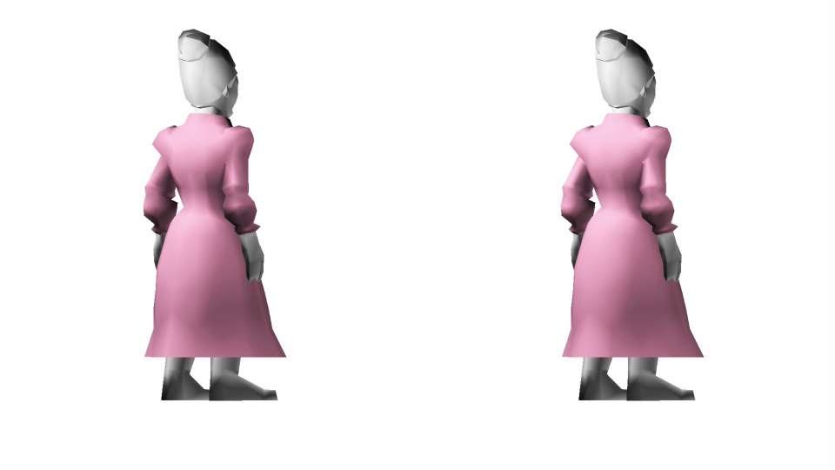
Results: Cheer
Notes:
This example highlights wrinkles along her back and provides a better view of the wrinkles under her arms and over her shoulder

Slide 37
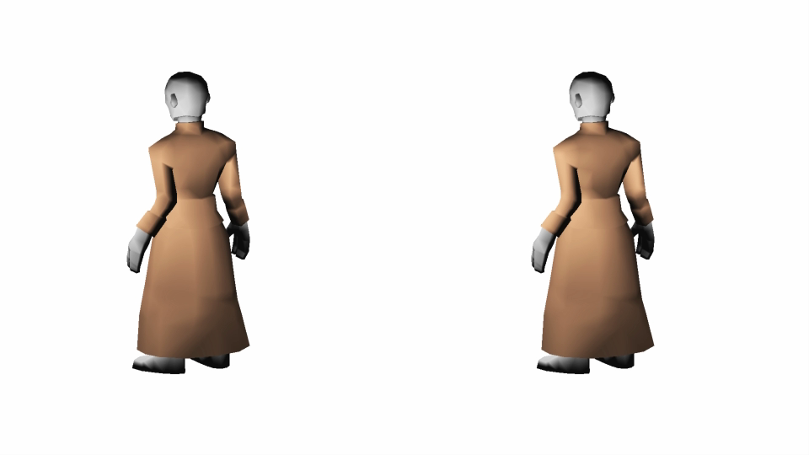
Results: Stretch
Notes:
Here the cloth captures the bunching effect of the wrinkles over her shoulder as she stretches

Slide 38
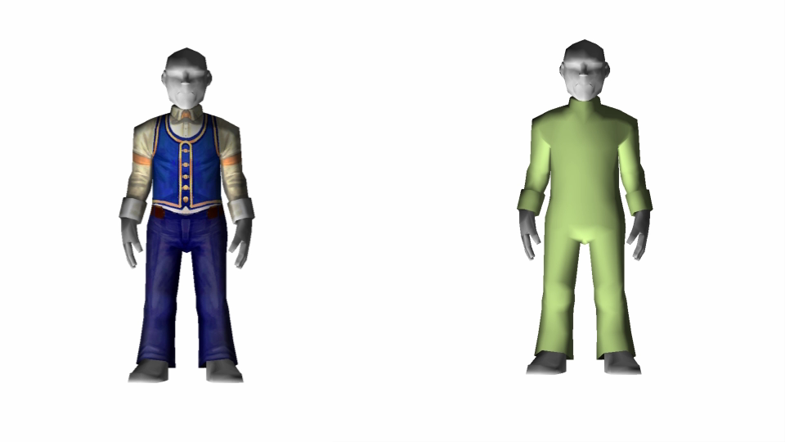
Results: Comparison
Notes:
This last clip shows a comparison of our approach with an animation using painted wrinkles. The painted texture represents wrinkles well in the armpits and elbows, but does not capture the dynamics the way our method does.

Slide 39
Performance
Notes:
Here is a table of performance values. Notice how our number of triangles is between 350 and 750, and our total frame times average around 10 ms.

Slide 40
Conclusion
First wrinkling method designed for augmenting game quality cloth animation
  Can operate on non-physical animation & extremely coarse meshes
  Does not require a reference shape
Produces believable dynamic wrinkles in real time
Notes:
We have presented a novel technique for adding dynamic wrinkles to game quality animations. This approach operates on coarse and non-physical inputs without a reference shape and is able to produce believable wrinkles in real time.

Slide 41
Thank You
Questions?
Notes:
Thank You.

