Slide 1
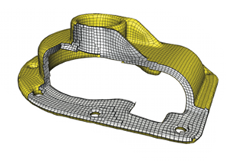
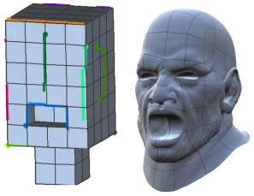
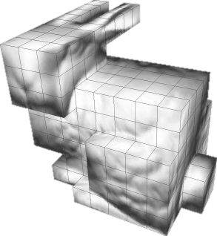
PolyCubes are useful…
Hex Meshing
Texturing
GPU Subdivision Surfaces
Notes:
POLYCUBES ARE USEFUL 3D STRUCTURES FOR SEVERAL APPLICATIONS LIKE HEX MESHING GPU SUBDIVISION SURFACES AND TEXTURE MAPPING

Slide 2
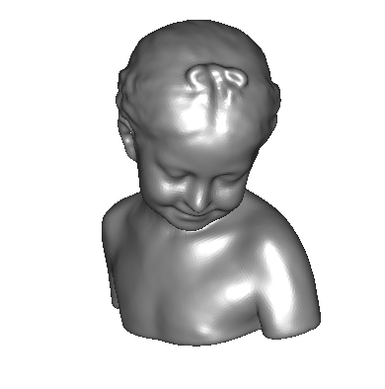
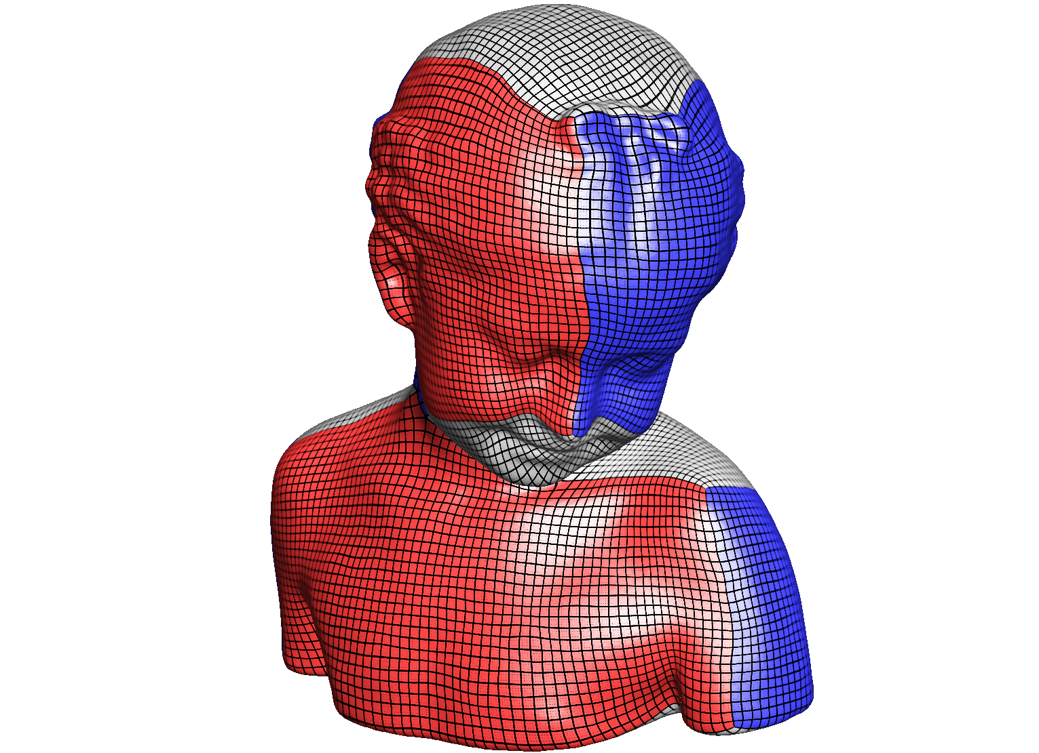
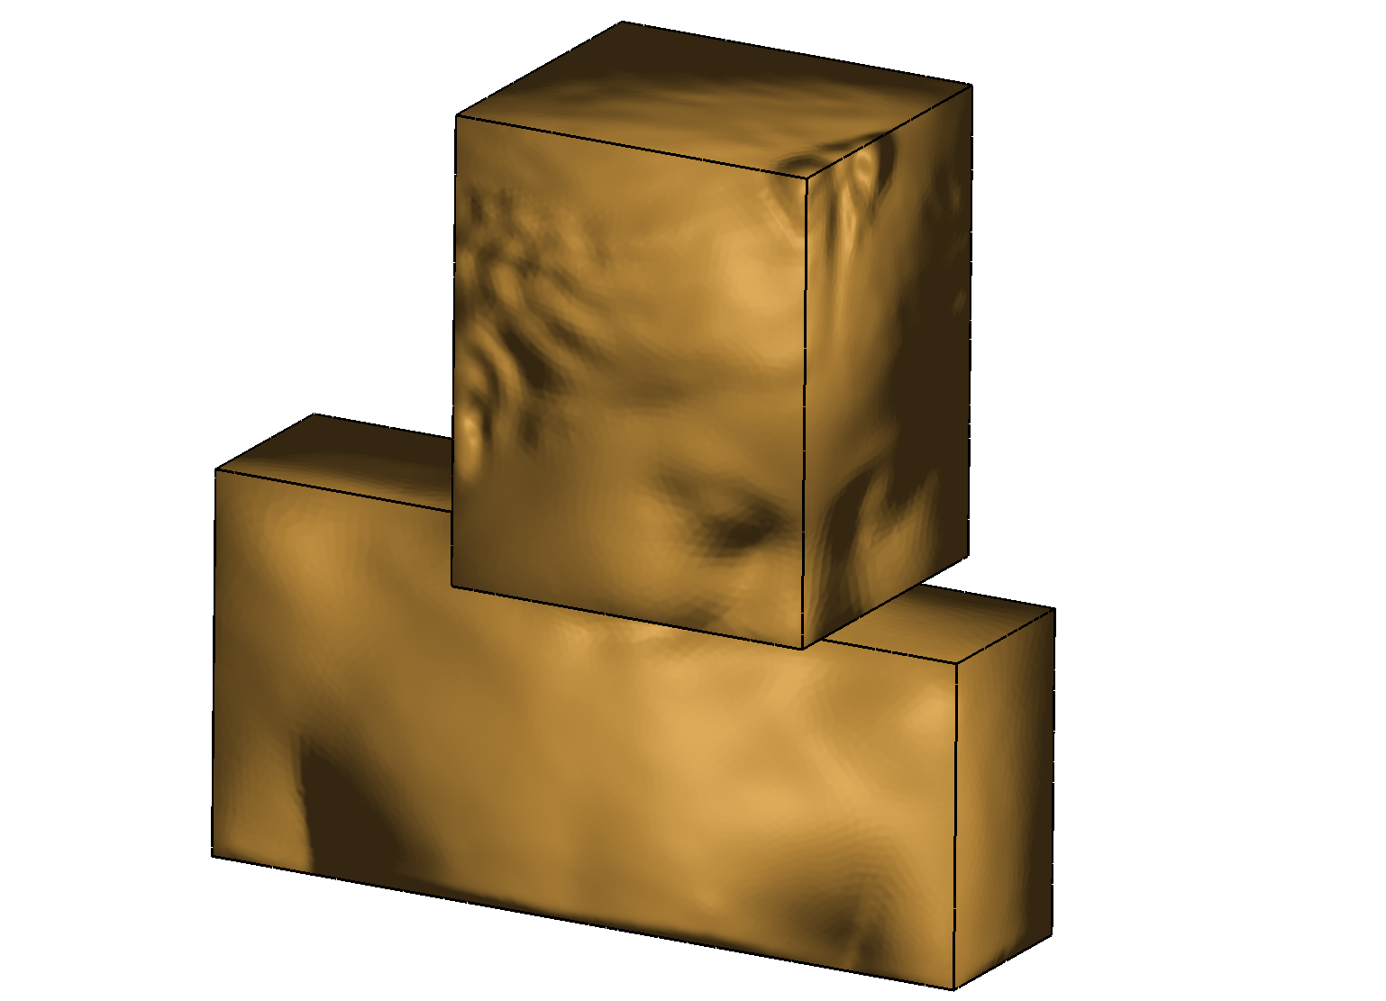
The Challenge: Creating PolyCubes Automatically
???
Notes:
HOWEVER, GIVEN A GENERAL 3D SHAPE, THE AUTOMATIC GENERATION OF A POLYCUBE HAS ALWAYS BEEN A CHALLENGE

Slide 3
The Challenge: Creating PolyCubes Automatically
Until Now!
Notes:
UNTIL NOW! WE’LL BE INTRODUCING POLYCUT, A NEW ALGORITHM FOR THE AUTOMATIC COMPUTATION OF POLYCUBES. WITH OUR ALGORITHM CREATING GOOD POLYCUBES OUT OF GENERAL 3D MODELS WON’T BE A PROBLEM ANY MORE.

Slide 4
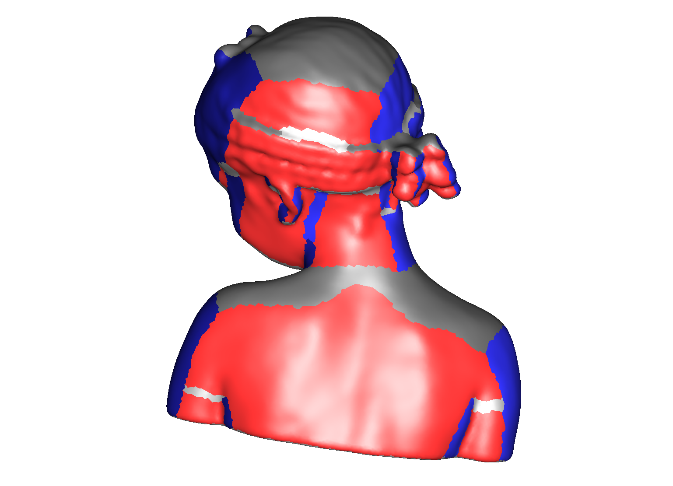
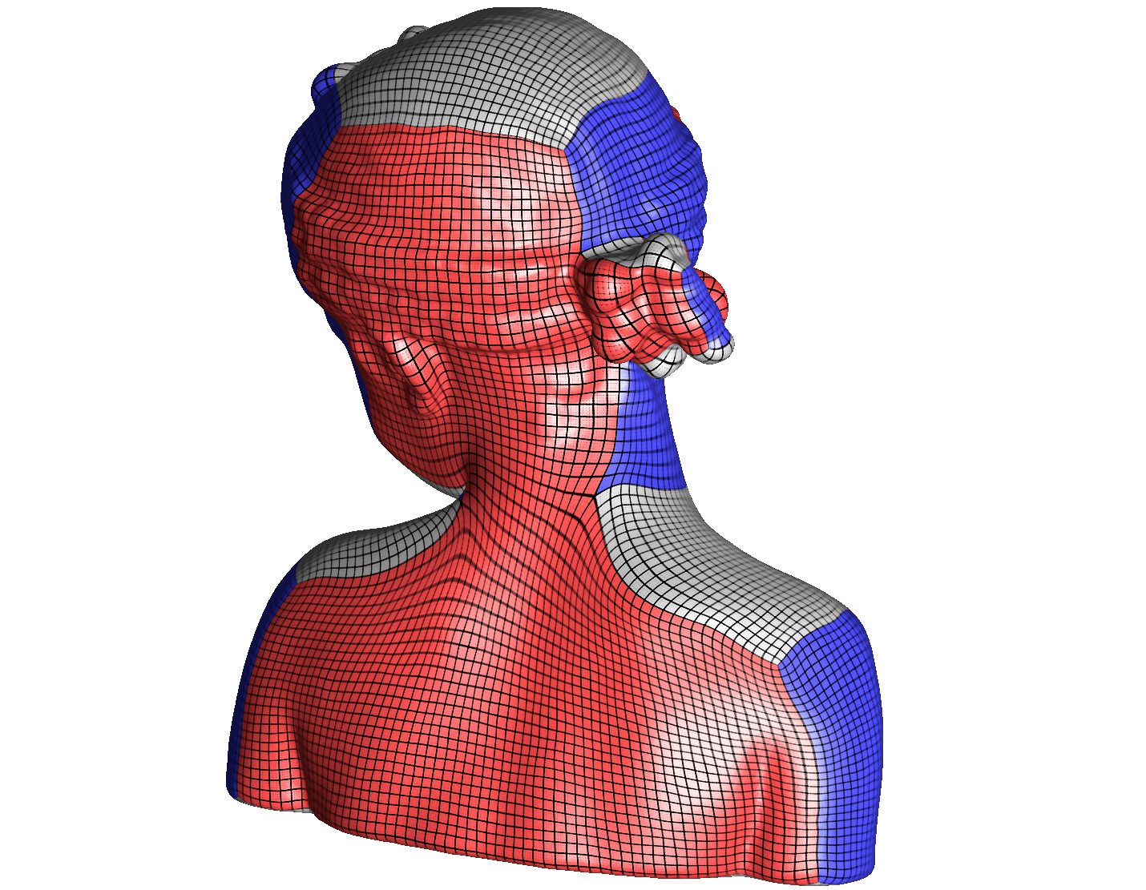
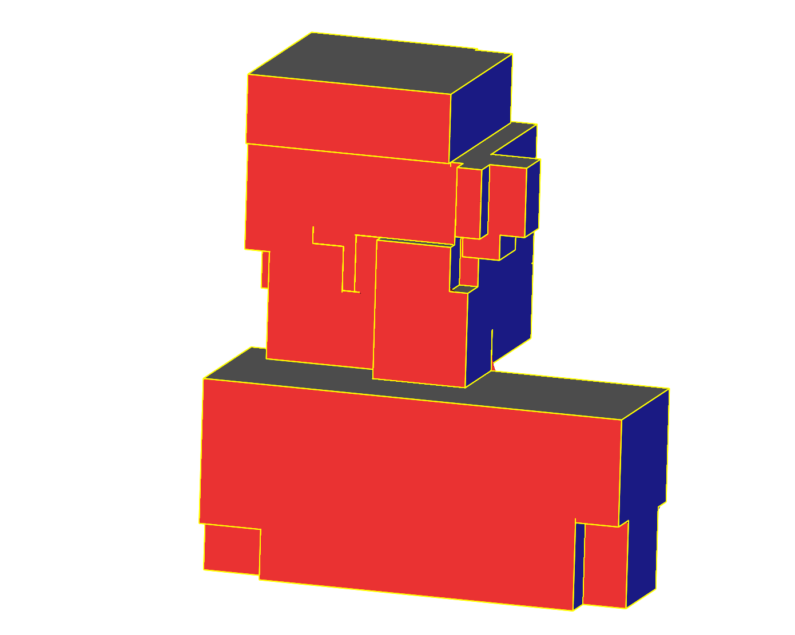
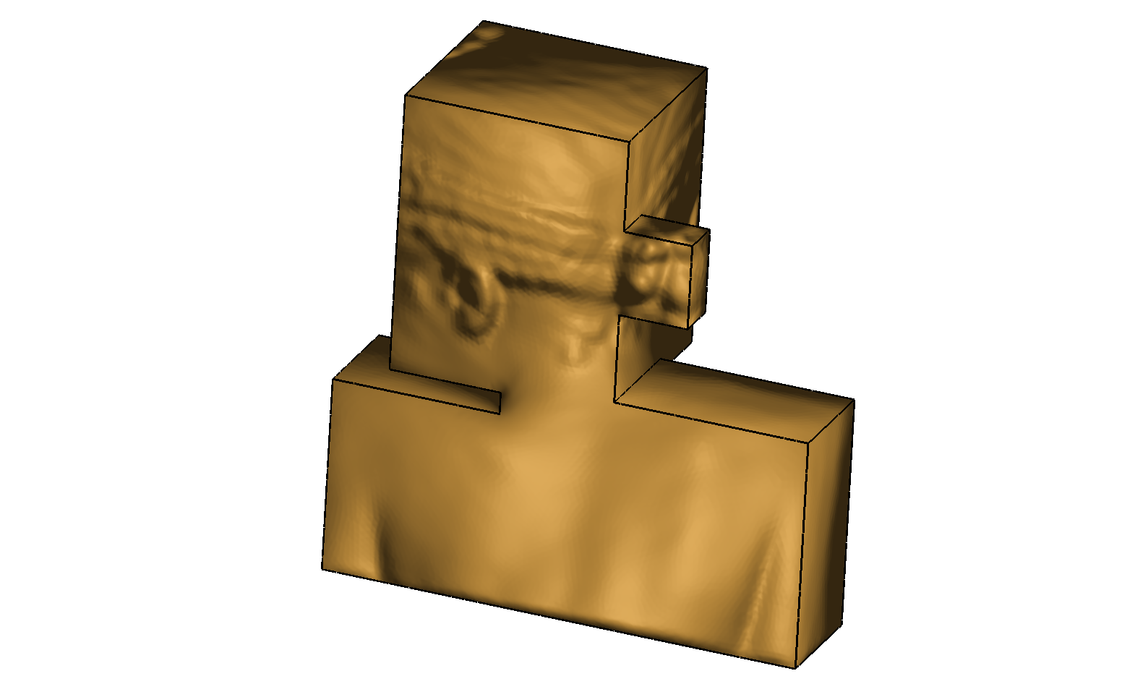
Dramatic Improvement on State-of-the-Art
Gregson 2011
Our Work
Notes:
WE COMPARED WITH THE STATE OF THE ART IN POLYCUBE GENRATION, SHOWING AN IMPROVEMENT BOTH IN THE COMPACTNESS OF THE POLYCUBE GEOMETRY AND IN THE QUALITY OF THE MAPPING
DON’T MISS OUR TALK, THANK YOU

