Slide 1

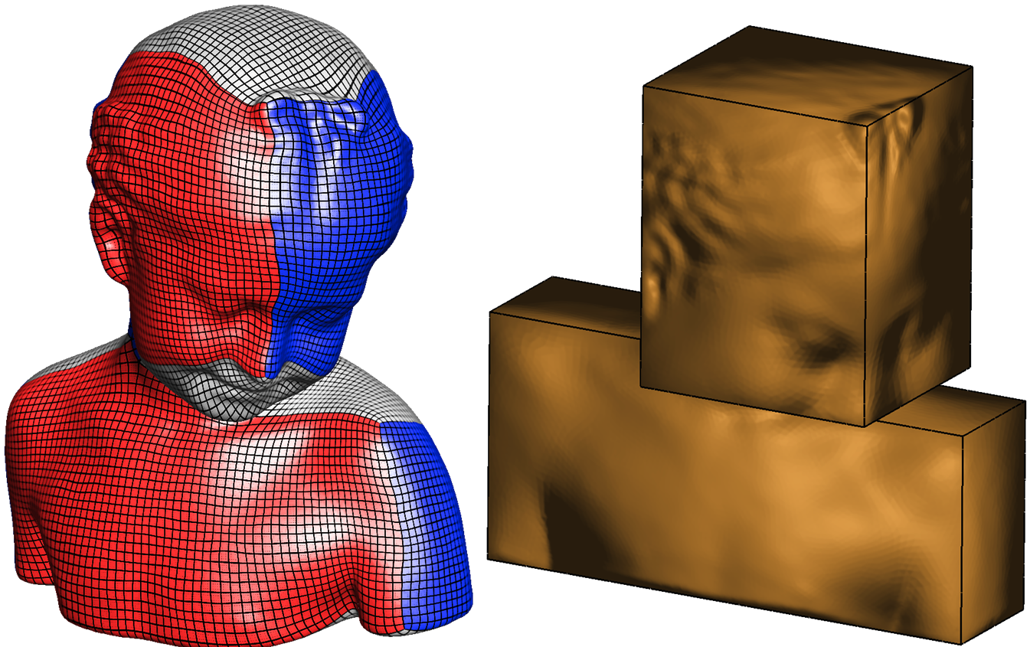


PolyCut
Monotone Graph-Cuts for
Polycube Base-Complex Construction
M. Livesu, N. Vining, A. Sheffer, J. Gregson, R. Scateni

Slide 2
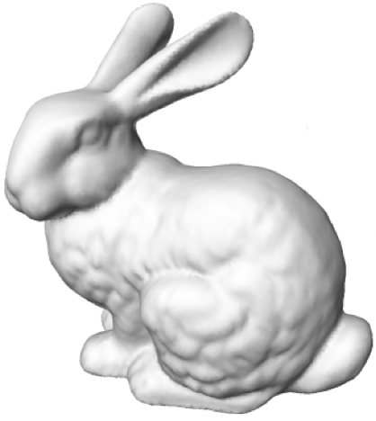
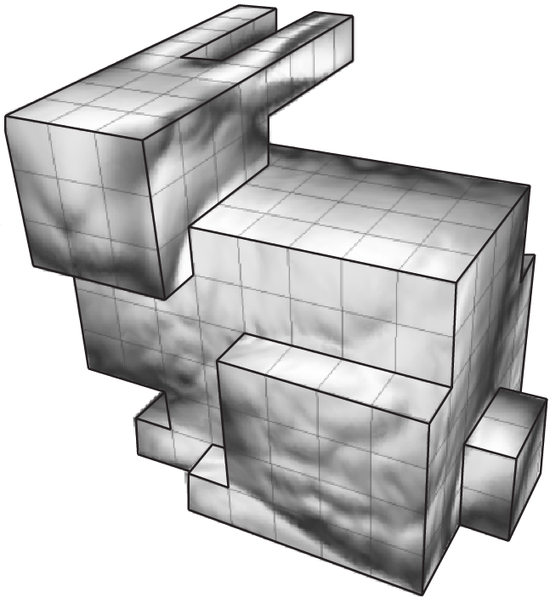
PolyCubes
straight edges
planar facets
orthogonal angles
[Tarini et al, 2004]

Slide 3
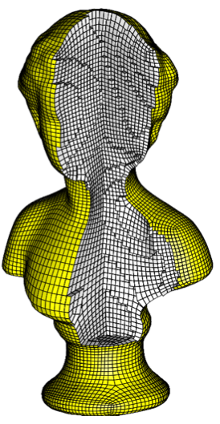
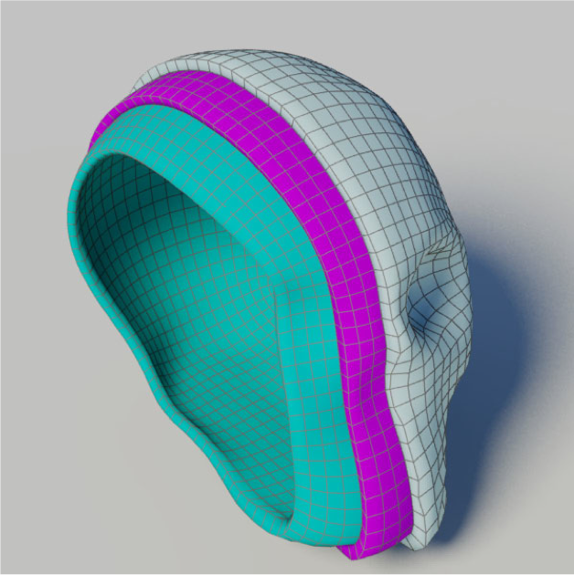
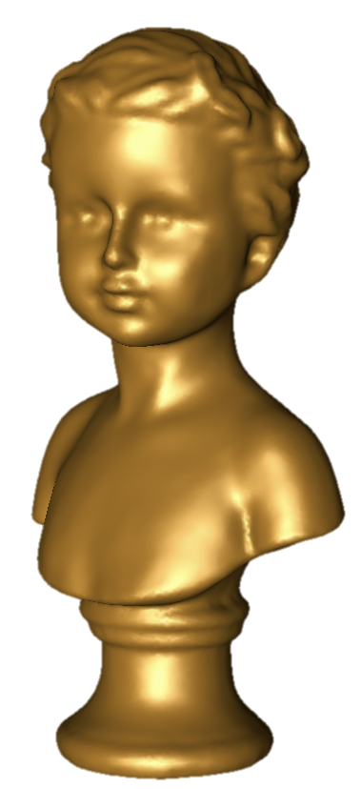
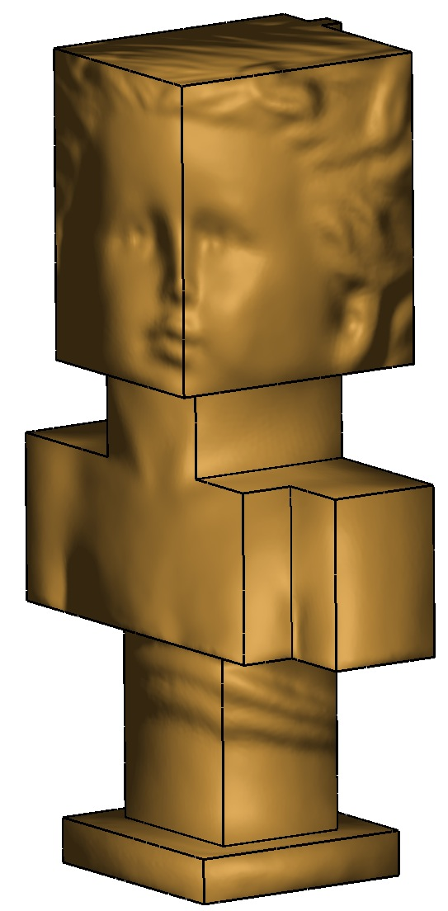
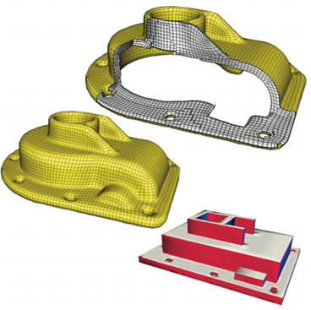
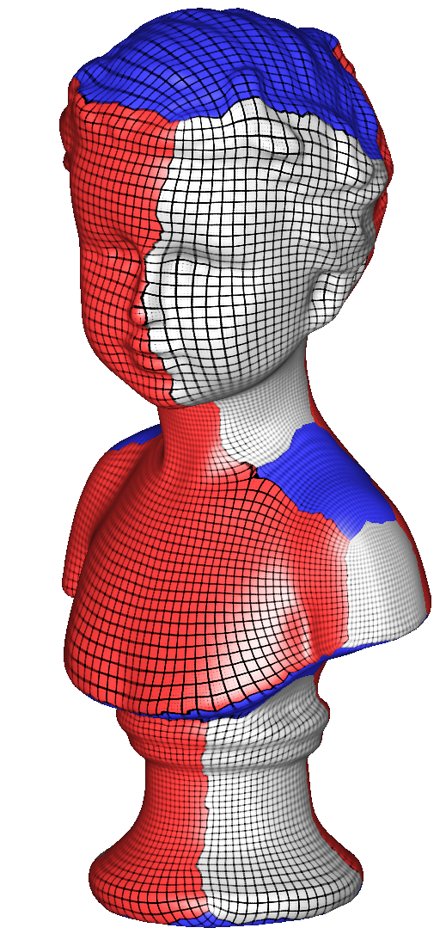
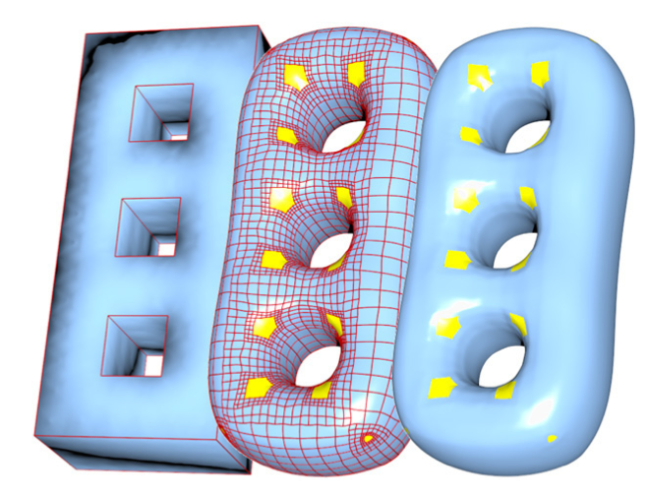
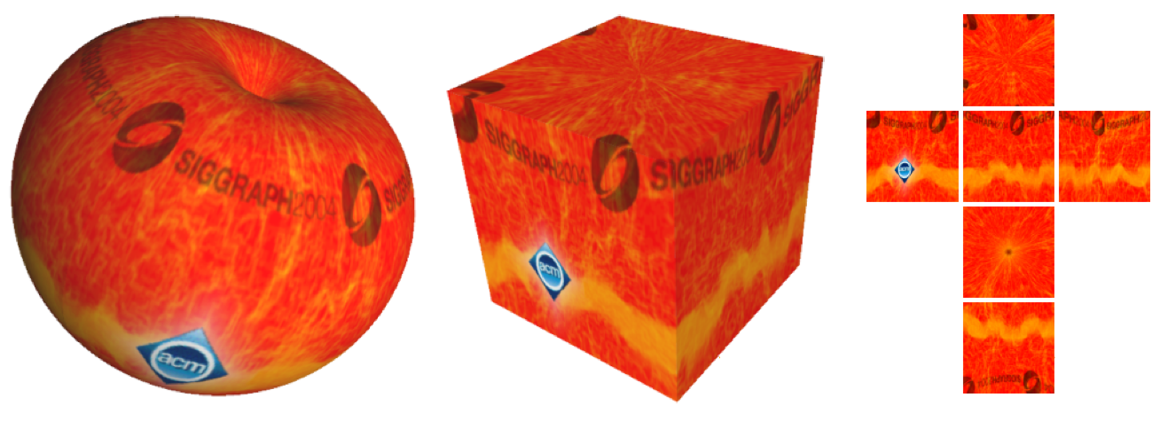
PolyCube Mappings
volume
[Han et al, 2010]
…
[Gregson et al, 2011]
surface
[Wang et al, 2008]
…
[Tarini et al, 2004]

Slide 4
Mapping Quality
PolyCube suitability for these applications depends on mapping quality
High compactness
+
Low distortion

Slide 5
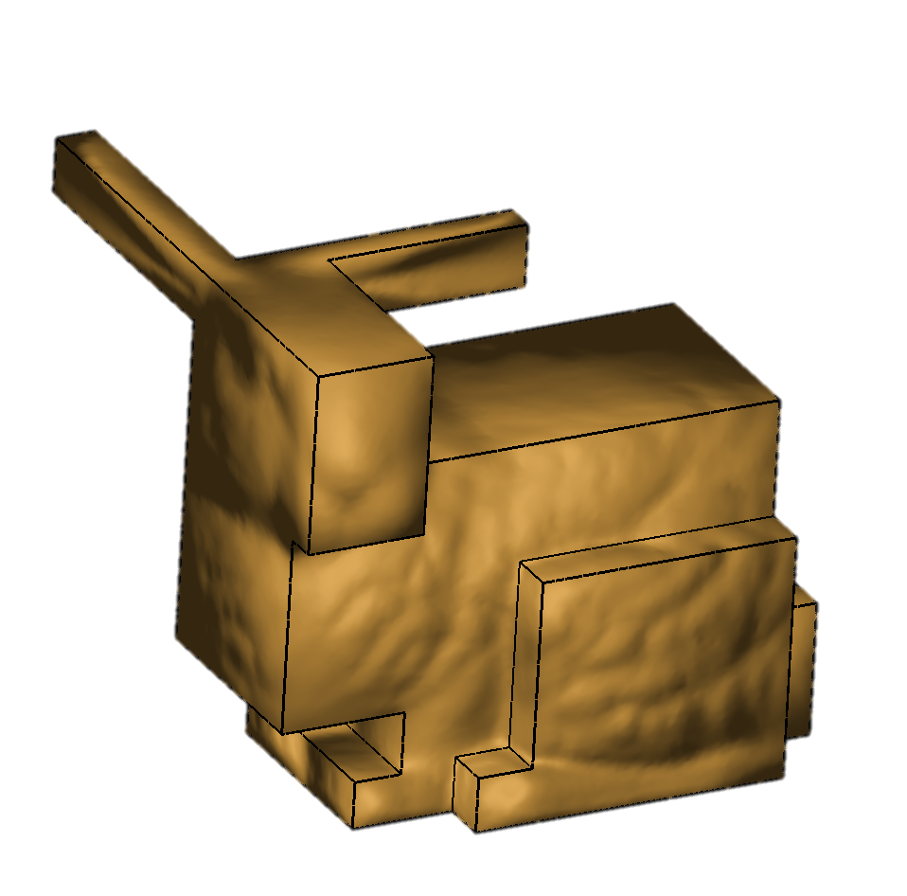
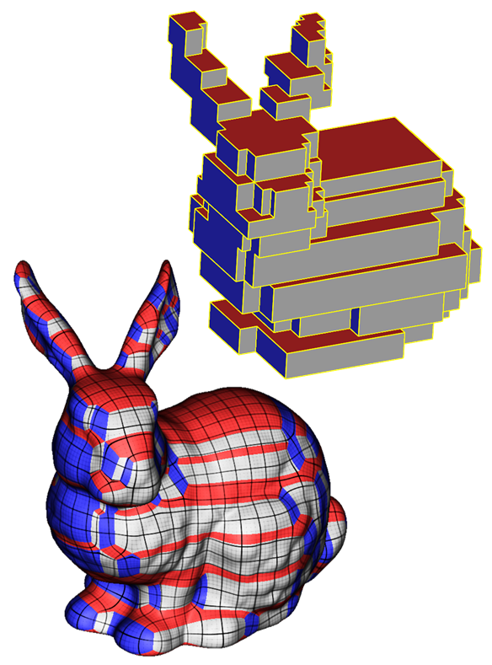
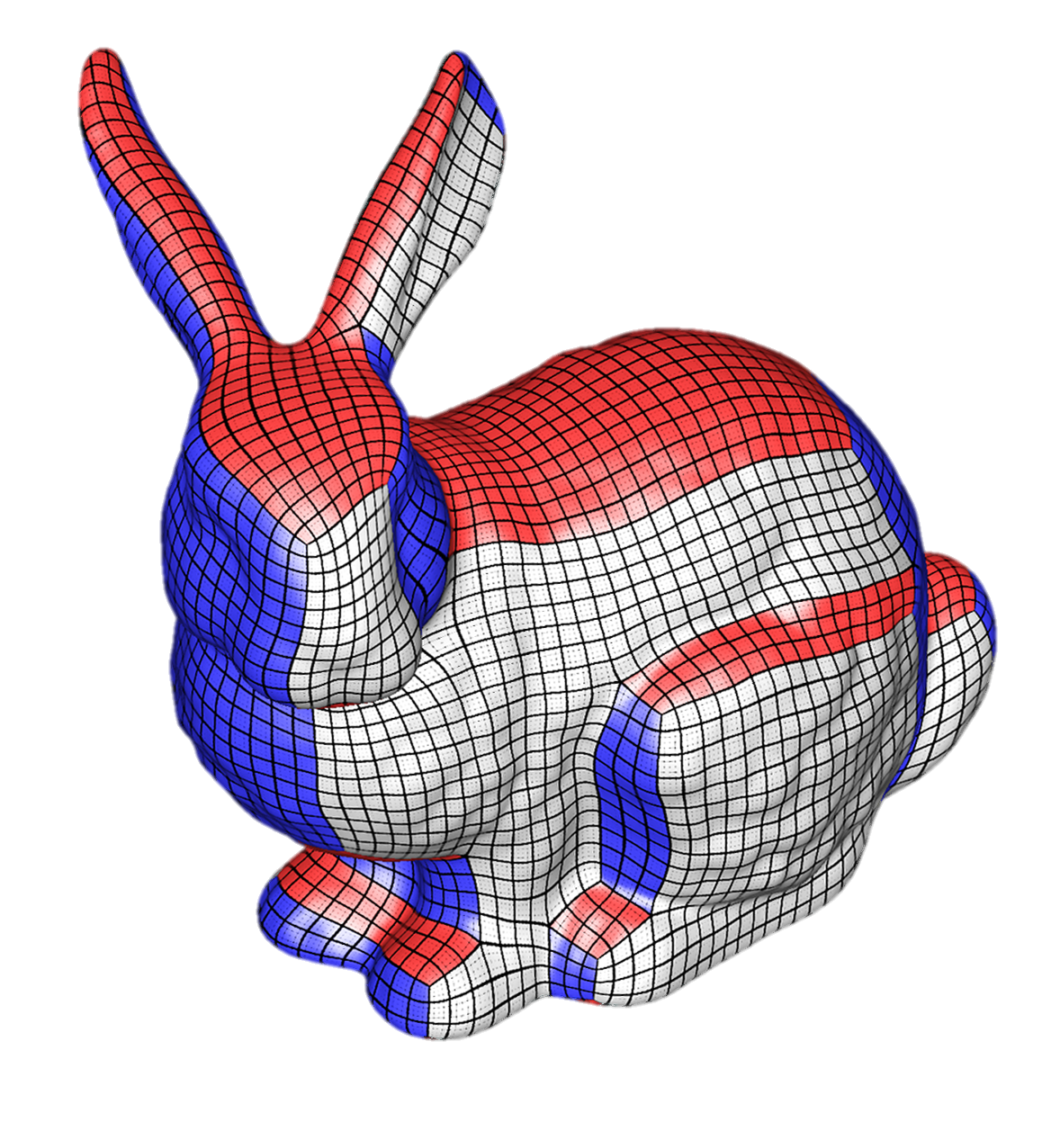
Mapping Quality: compactness
✗
✓
[He et al, 2009]
High Chart/Corner Count
Low chart/corner count

Slide 6
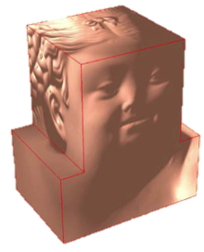
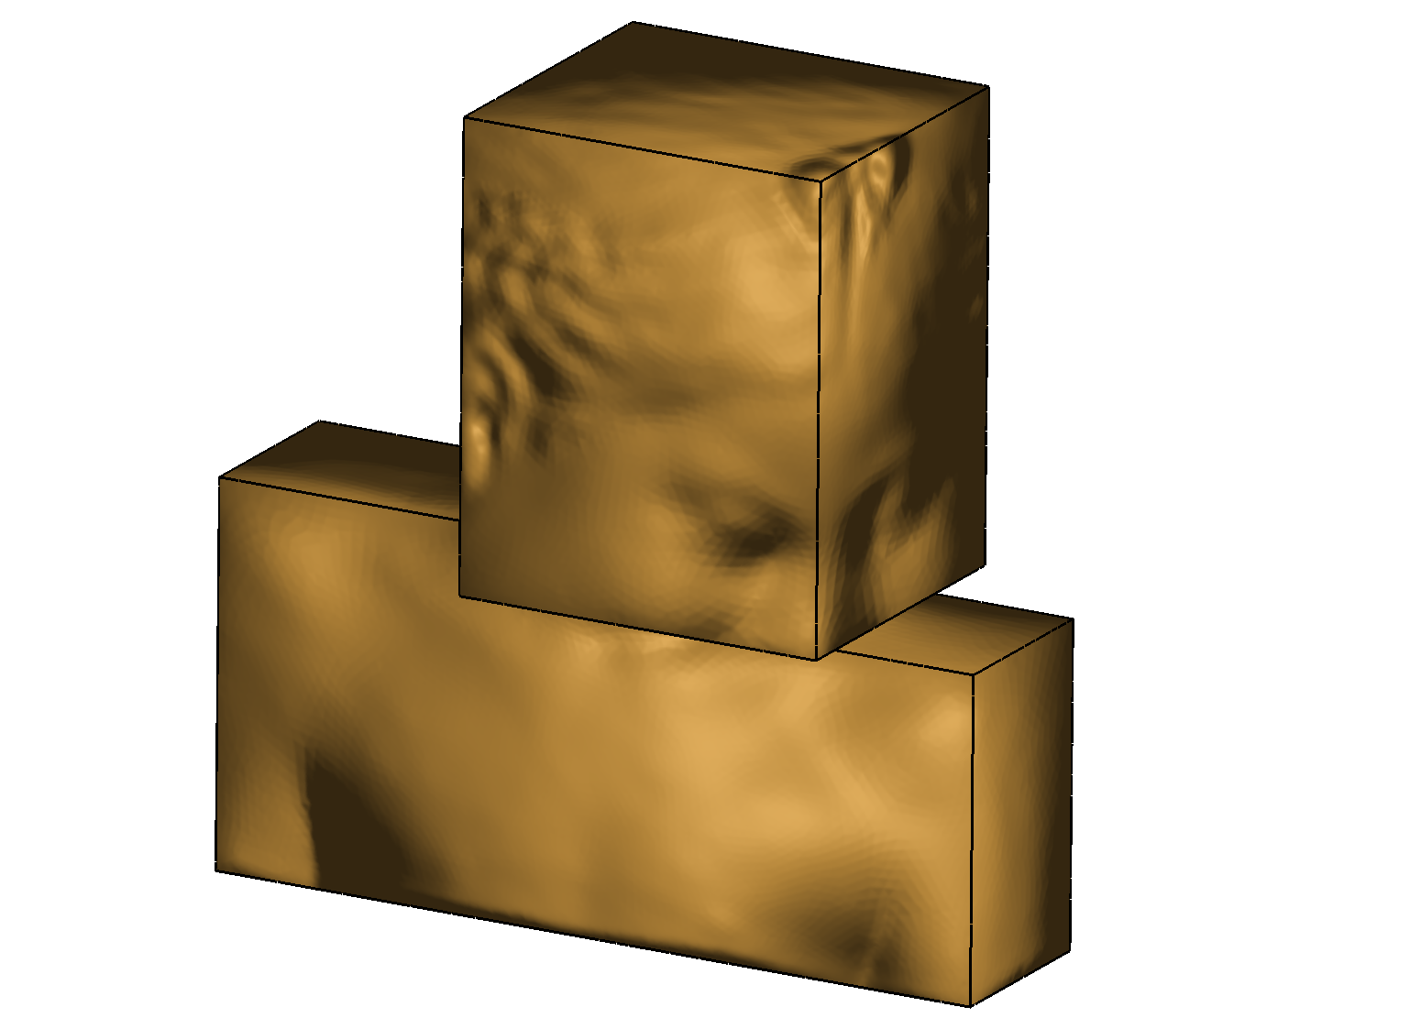
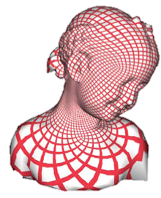
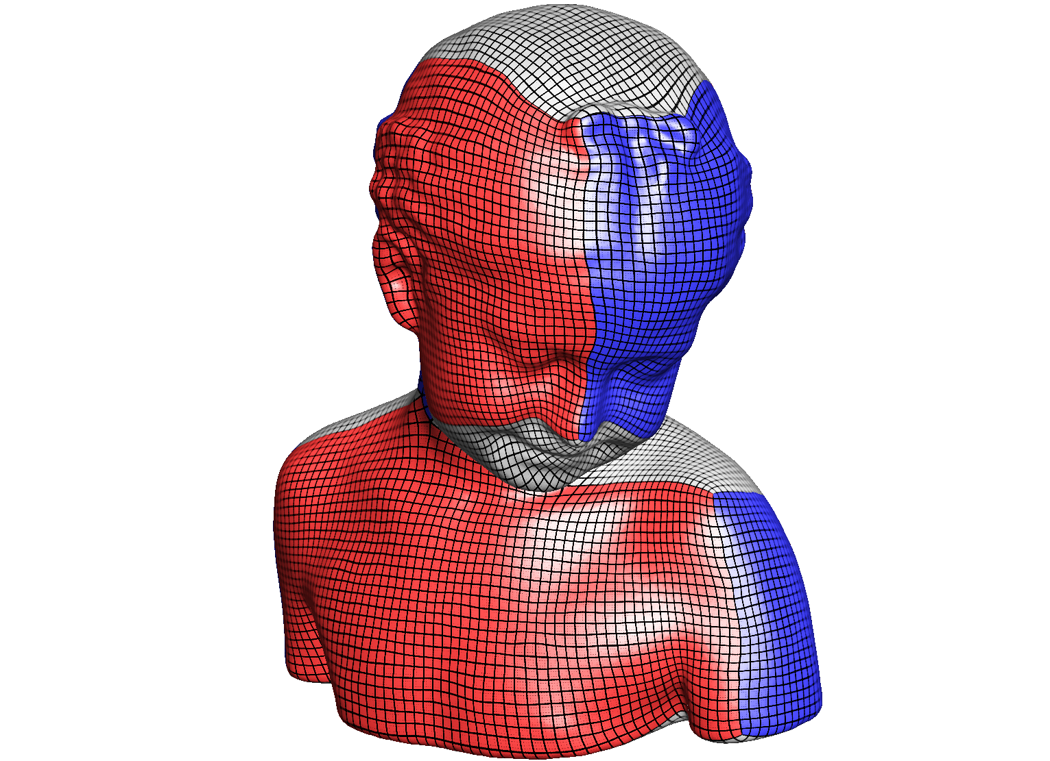
Mapping Quality: distortion
✗
✓
[Wang et al, 2007]
High distortion
Low distortion

Slide 7
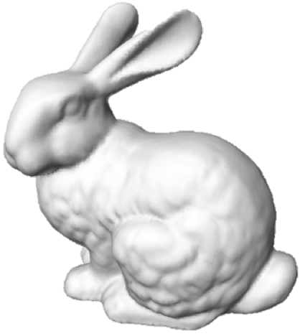
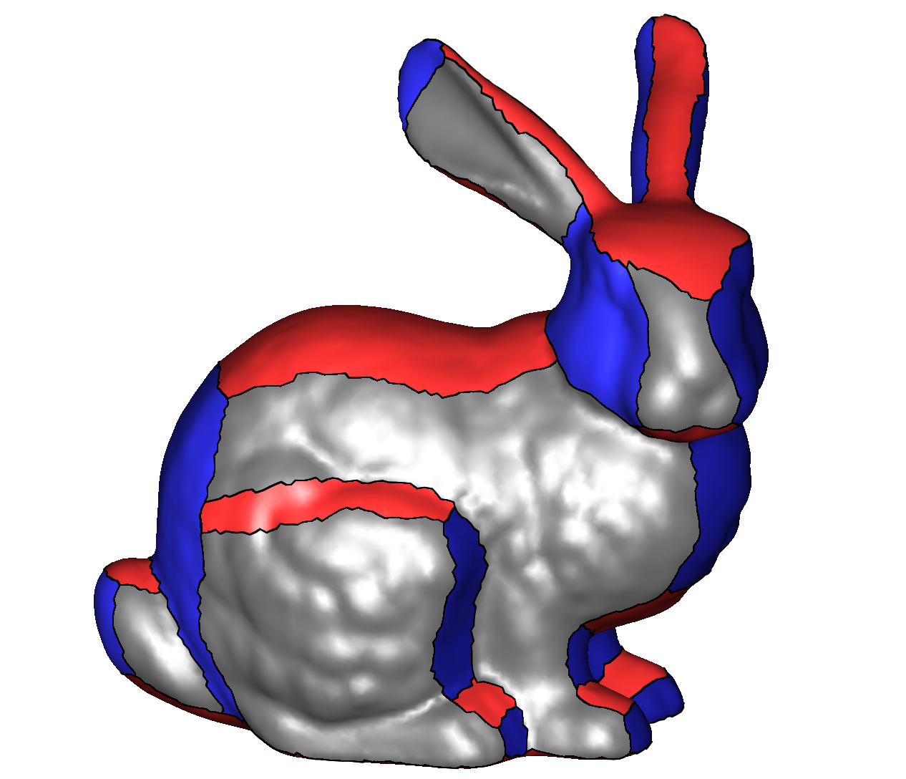
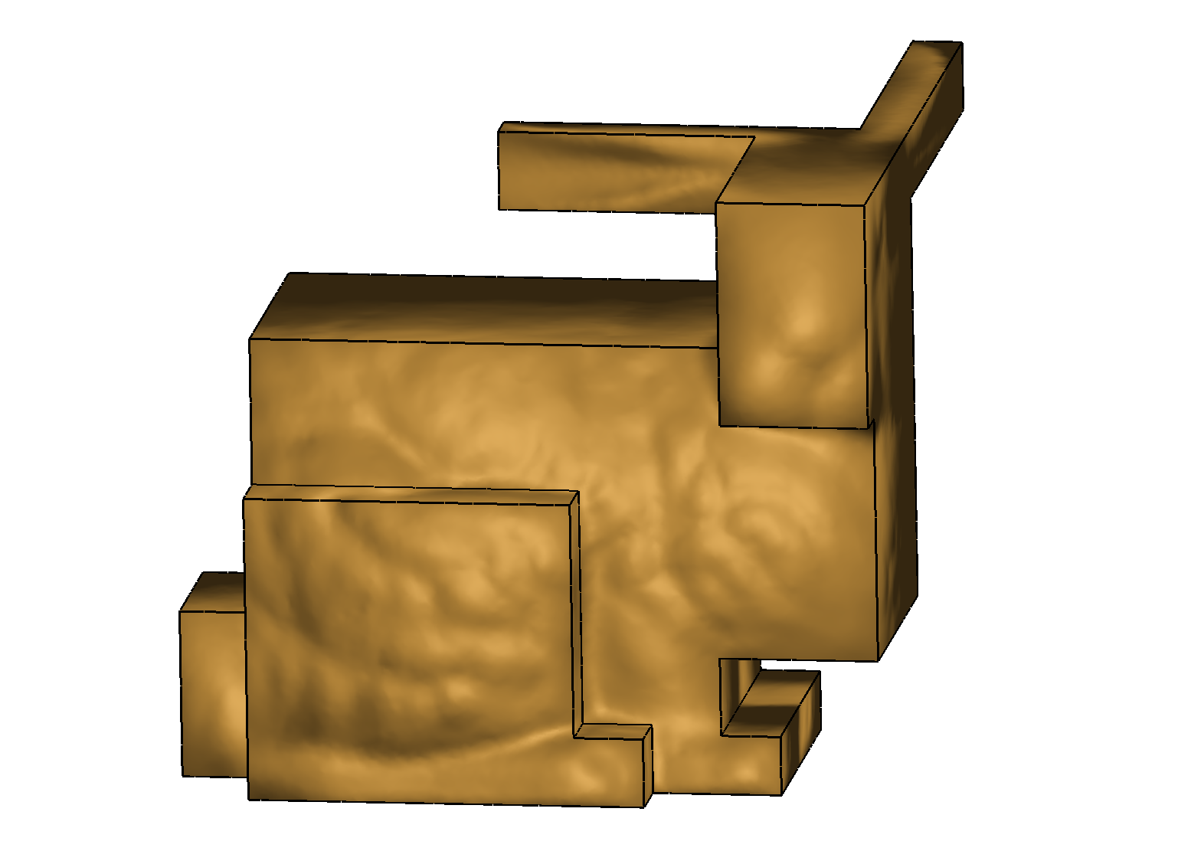
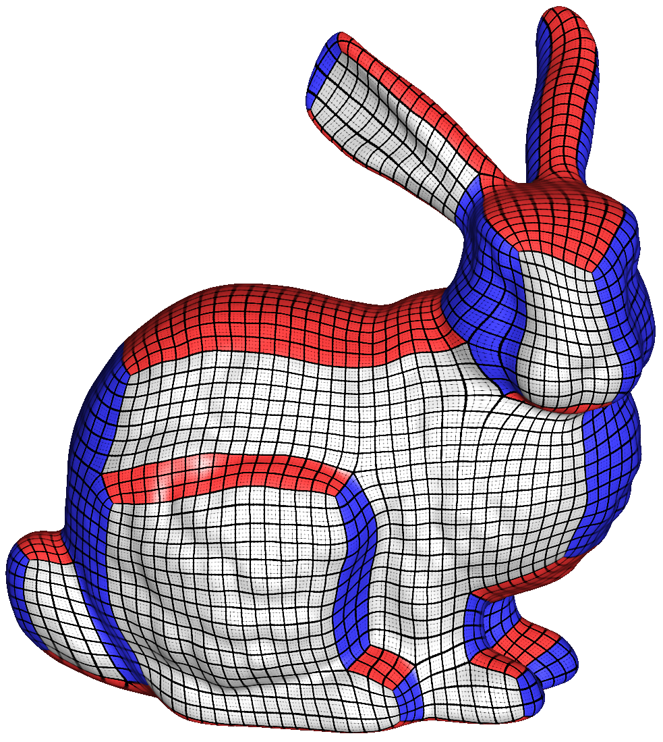
Generating Quality PolyCubes
  PolyCube Segmentation/Base Complex Construction
  PolyCube Parameterization
a. Input Model
b. Segmentation
c. PolyCube
d. Parameterization

Slide 8
Generating Quality PolyCubes
  PolyCube Segmentation/Base Complex Construction => OPEN PROBLEM!
  PolyCube Parameterization
    Multiple good methods
a. Input Model
b. Segmentation
c. PolyCube
d. Parameterization

Slide 9
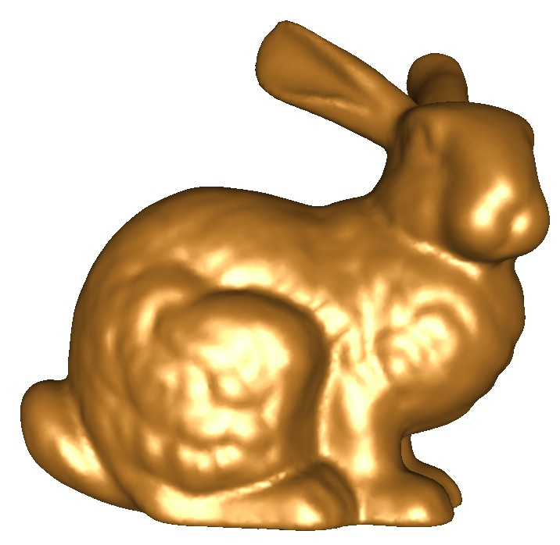
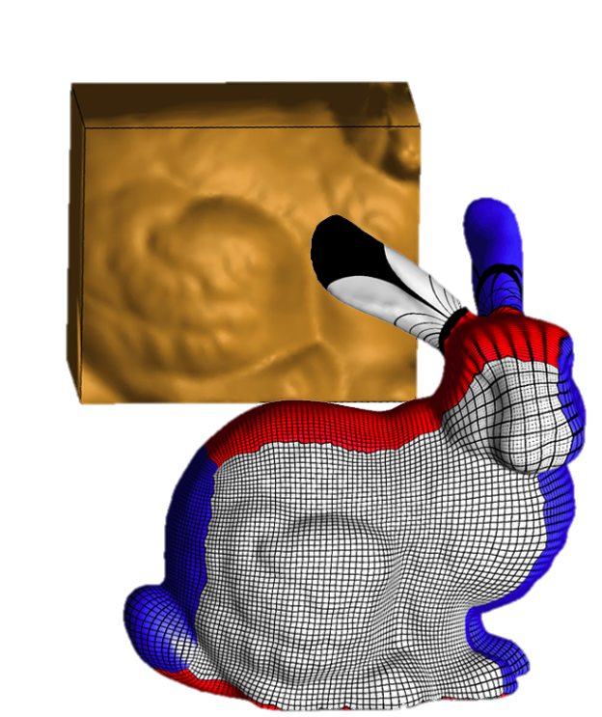
Defining the structure
GOAL: high quality PolyCube Mappings
  THE STRUCTURE OF THE POLYCUBE
  COUNTS!
  We need a proxy to predict distortion.…

Slide 10
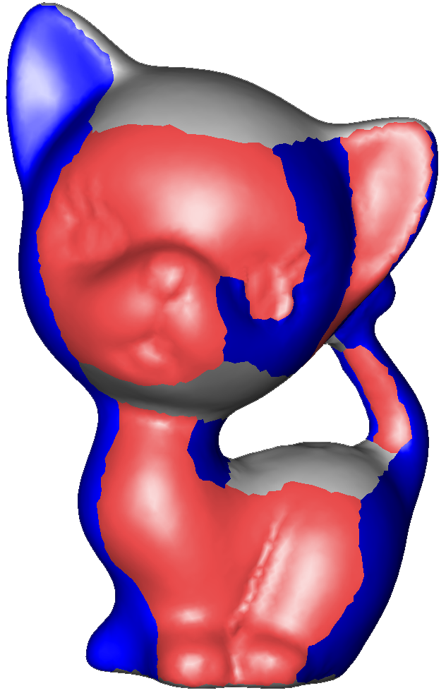
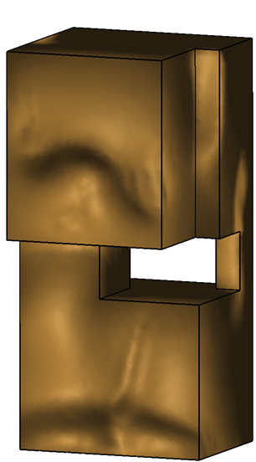
Distortion Prediction
FIDELITY
  The lower the angular distance, the lower the distortion

Slide 11
Distortion Prediction
FIDELITY
NOT
ENOUGH!

Slide 12
Distortion Prediction
FIDELITY
NOT
ENOUGH!
NON
MONOTONE!

Slide 13
Distortion Prediction
FIDELITY
NOT
ENOUGH!

Slide 14
Distortion Prediction
FIDELITY
NOT
ENOUGH!
TURNING
POINTS

Slide 15
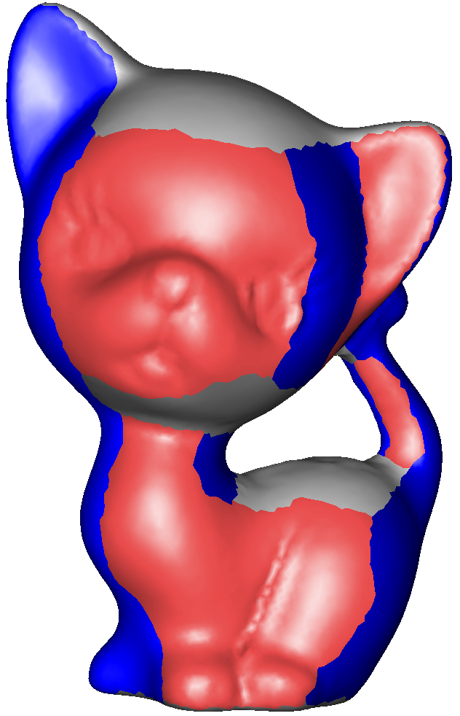
Distortion Prediction
FIDELITY
+
MONOTONICITY

Slide 16
Distortion Prediction
FIDELITY
+
MONOTONICITY
  Can be evaluated without having an explicit mapping!

Slide 17
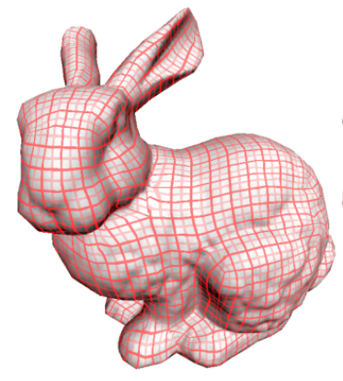
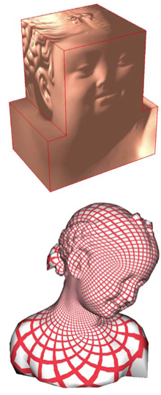
Previous Work
[Tarini et al, 2004]
[Wang et al, 2007]
[He et al, 2009]
Manually
Constructed
High Mapping
Distortion
High Singularity
Count

Slide 18
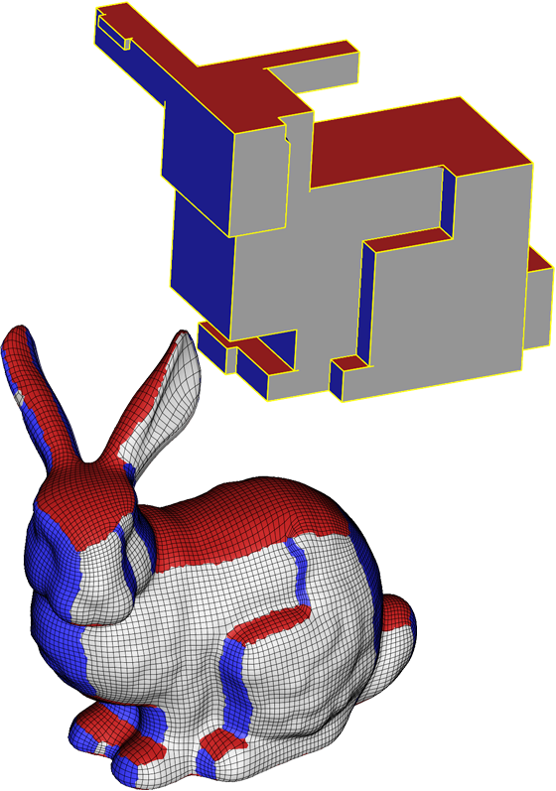
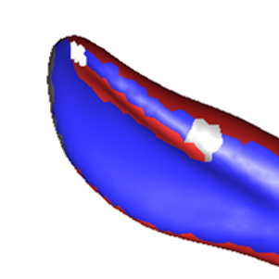
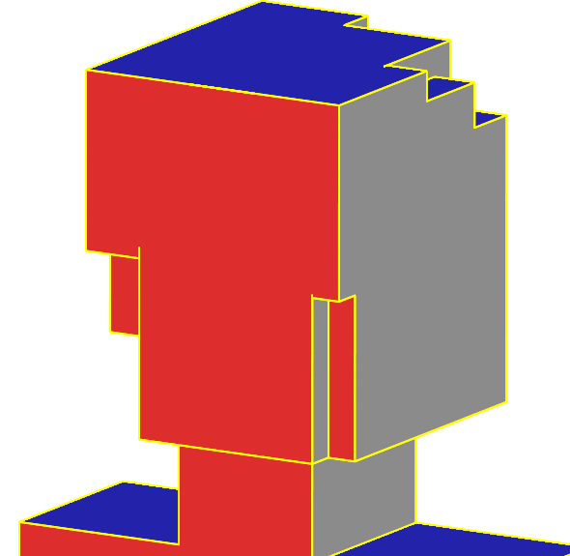
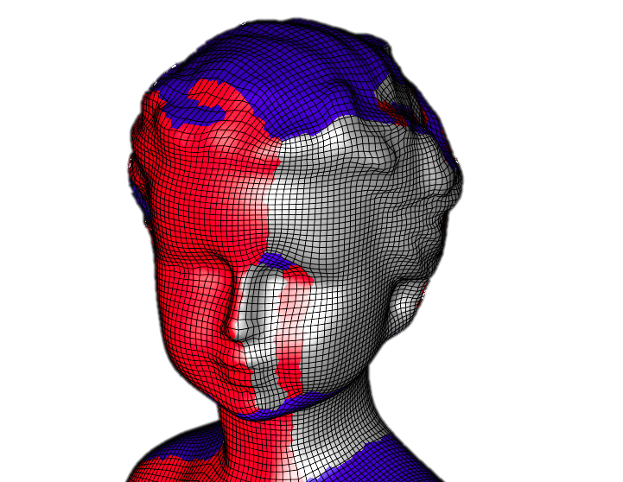
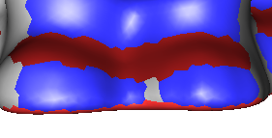
Previous Work
[Gregson et al, 2011]

Slide 19
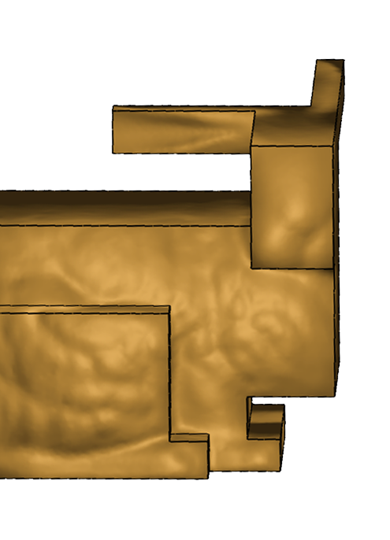
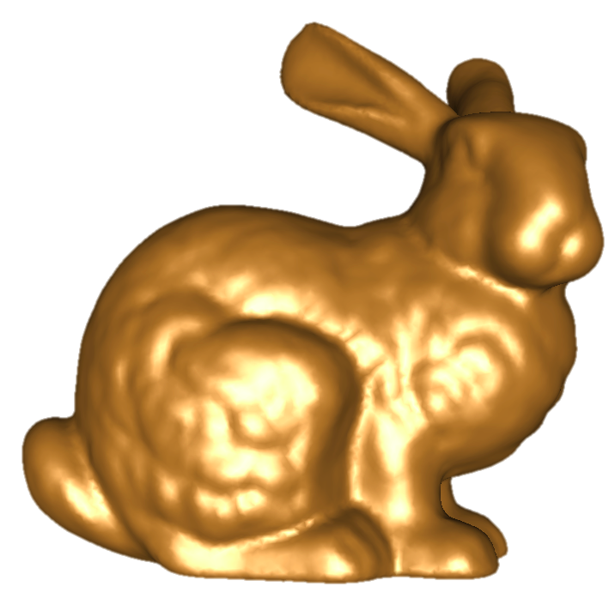
Our idea
PolyCube segmentation is a labeling problem
Six labels:

Slide 20
Graph-Cut Labeling Formulation
Fidelity
Compactness

Slide 21
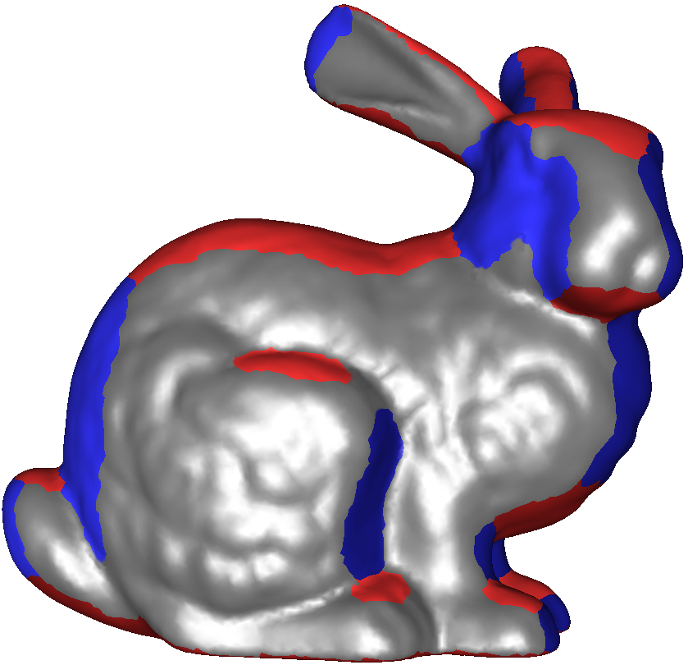
But What About Monotonicity?
Monotonicity requires global constraints that we cannot plug into our energy term…
… but we can adjust it!

Slide 22
But What About Monotonicity?
Monotonicity requires global constraints that we cannot plug into our energy term…
… but we can adjust it!

Slide 23
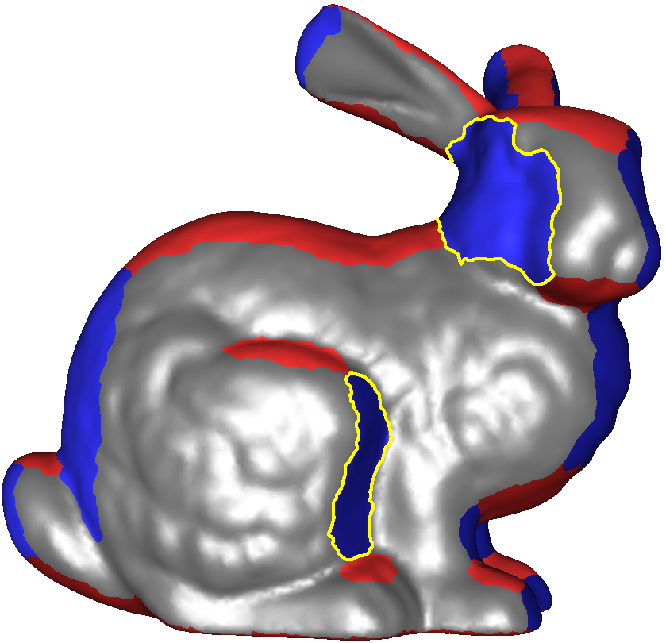
Exploring the space of segmentations…
MORE

Slide 24
Exploring the space of segmentations…
MORE

Slide 25
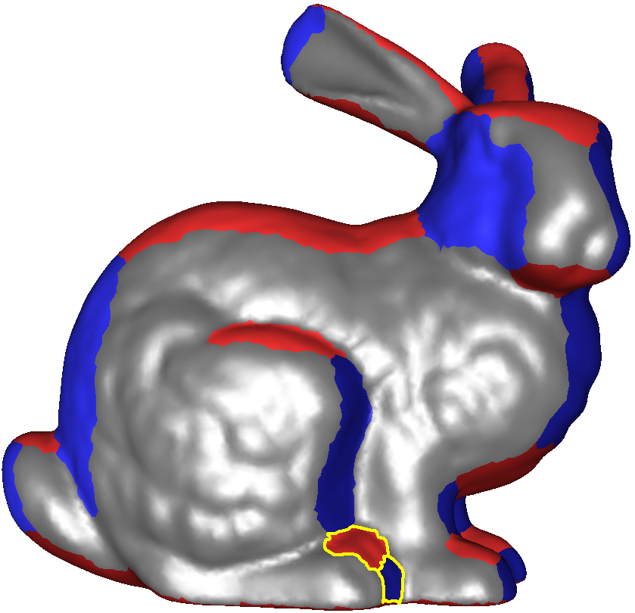
Exploring the space of segmentations…
MORE
LESS
Explore the space of segmentations to find the closest fully monotone labeling…
… this is a search problem!

Slide 26
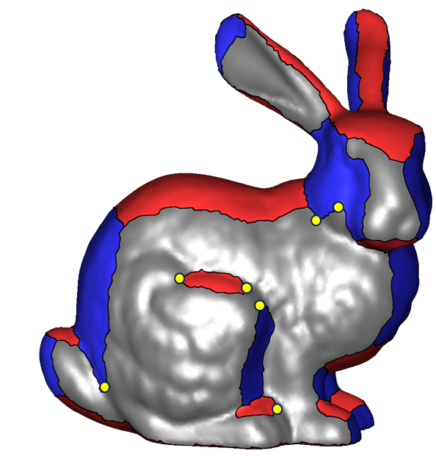
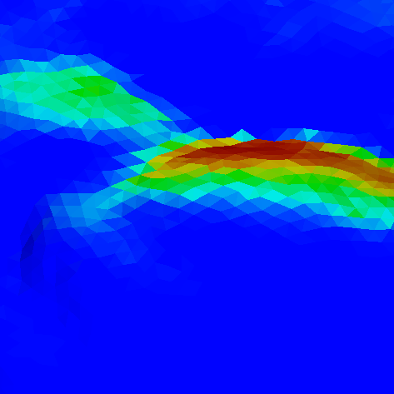


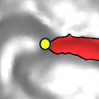

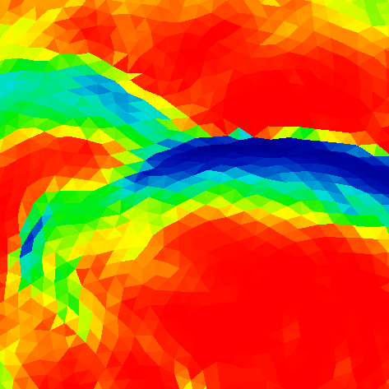

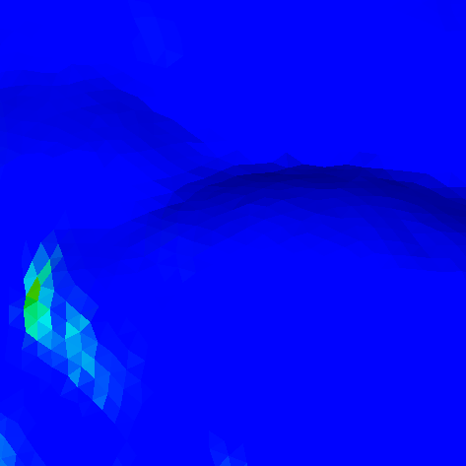

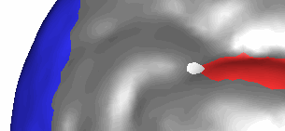
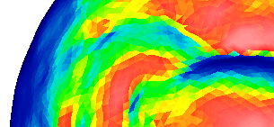
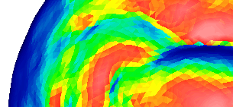
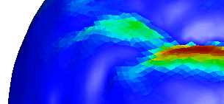
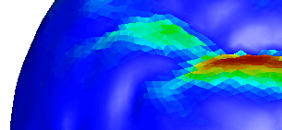
Hill Climbing
FIDELITY TERMS
MAX
0
LESS
MORE
LESS
MORE

Slide 27
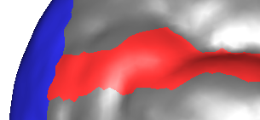

Hill Climbing
FIDELITY TERMS
MAX
0
LESS
MORE
LESS
MORE

Slide 28

Hill Climbing

Slide 29

Hill Climbing
MORE

Slide 30

Hill Climbing
MORE
MORE

Slide 31
Hill Climbing
MORE
MORE
LESS

Slide 32

Hill Climbing
MORE
MORE
LESS
MORE

Slide 33

Hill Climbing
MORE
MORE
LESS
MORE
LESS

Slide 34


Hill Climbing
Before
Hill Climbing
After
Hill Climbing

Slide 35






Hill Climbing
Before
Hill Climbing
After
Hill Climbing

Slide 36




PolyCube deformation
Initial Deformation
Gradual Deformation
Final PolyCube

Slide 37
Results

Slide 38



Rocker Arm
Initial Labeling
Final Labeling
PolyCube
(6 turning points)
CORNERS
CHARTS
STRETCH
(the OPTIMAL value for STRETCH is 1)

Slide 39



Kiss Statue
Initial Labeling
Final Labeling
PolyCube
(19 turning points)
CORNERS
CHARTS
STRETCH
(the OPTIMAL value for STRETCH is 1)

Slide 40




Compactness control
CORNERS
CHARTS
STRETCH
CORNERS
CHARTS
STRETCH
CORNERS
CHARTS
STRETCH
CORNERS
CHARTS
STRETCH
(the OPTIMAL value for STRETCH is 1)

Slide 41
Comparisons

Slide 42


Comparisons vs. He et al. (2009)
FOUR TIMES
LESS CHARTS!
[He et al, 2009]
PolyCut
CORNERS
CHARTS
STRETCH
CORNERS
CHARTS
STRETCH
(the OPTIMAL value for STRETCH is 1)

Slide 43




Comparisons vs. Gregson et al. (2011)
THREE TIMES
LESS CORNERS!
[Gregson et al, 2011]
PolyCut
CORNERS
CHARTS
STRETCH
CORNERS
CHARTS
STRETCH
(the OPTIMAL value for STRETCH is 1)

Slide 44




Comparison vs. Tarini et al. (2004)
MANUAL!
[Tarini et al, 2004]
PolyCut
CORNERS
CHARTS
STRETCH
CORNERS
CHARTS
STRETCH
(the OPTIMAL value for STRETCH is 1)
Notes:
TURN IT INTO POSITIVE!!!
The original PolyCube paper by Tarini et al. Presented a manually constructed PolyCube of an armadillo. Even on this very challenging model, we can produce an automatic PolyCube.

Slide 45



Hex Meshing Comparisons
+30%
[Gregson et al, 2011]
PolyCut
AVG SCALED JACOBIAN
AVG SCALED JACOBIAN
MIN SCALED JACOBIAN
MIN SCALED JACOBIAN
(the OPTIMAL value for SC is 1)

Slide 46




Conclusions
PolyCut
Local search framework (Hill Climbing)
High quality PolyCube mappings
    low distortion
    low singularity count

Slide 47


Questions?

