Slide 1
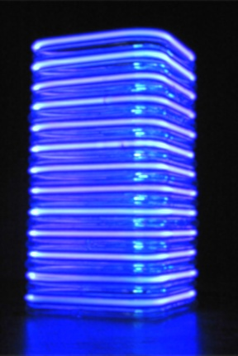
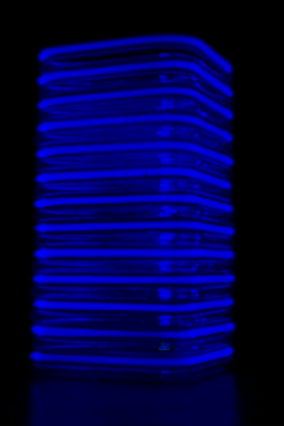
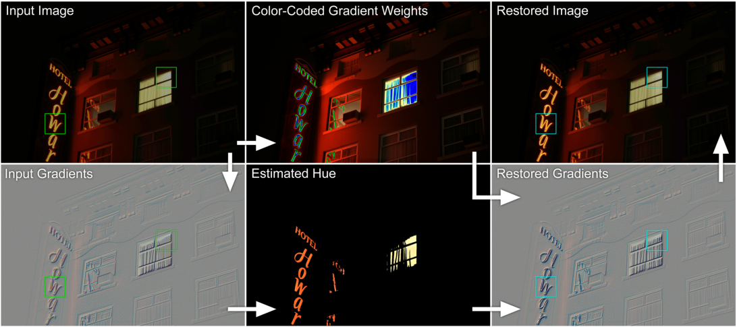
Gradient Domain Color Restoration of Clipped Highlights
Mushfiqur ‘Nasa’ Rouf Cheryl Lau Wolfgang Heidrich
University of British Columbia
International Workshop on Projector-Camera Systems 2012
Notes:
This is a joint work at UBC with my colleagues..
We propose a new method for color restoration of desaturated images.
In this work, we focus on colored light sources or specularities, which are quite common in modern environment.
But sensor clipping destroys the hue of such highlights.
We apply cross-channel correlations in the gradient domain to restore partially clipped pixels.

Slide 2
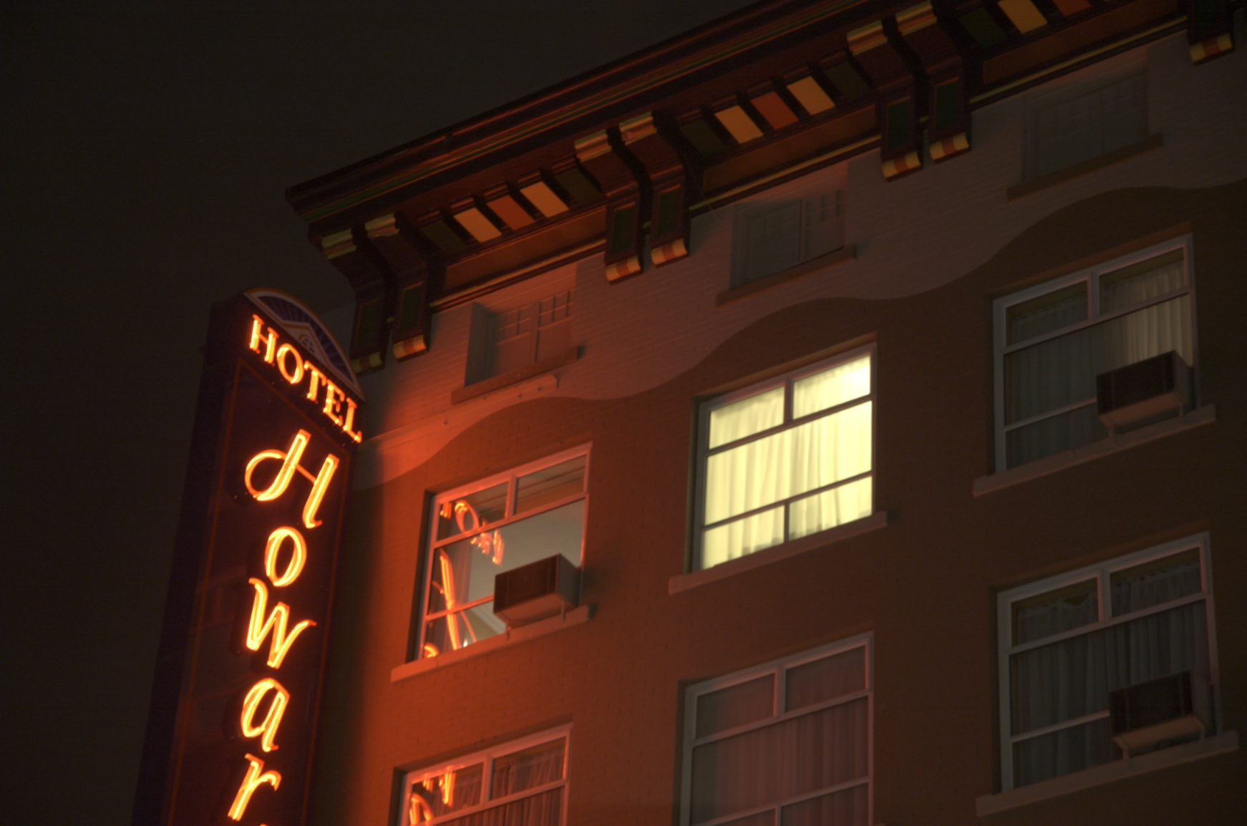
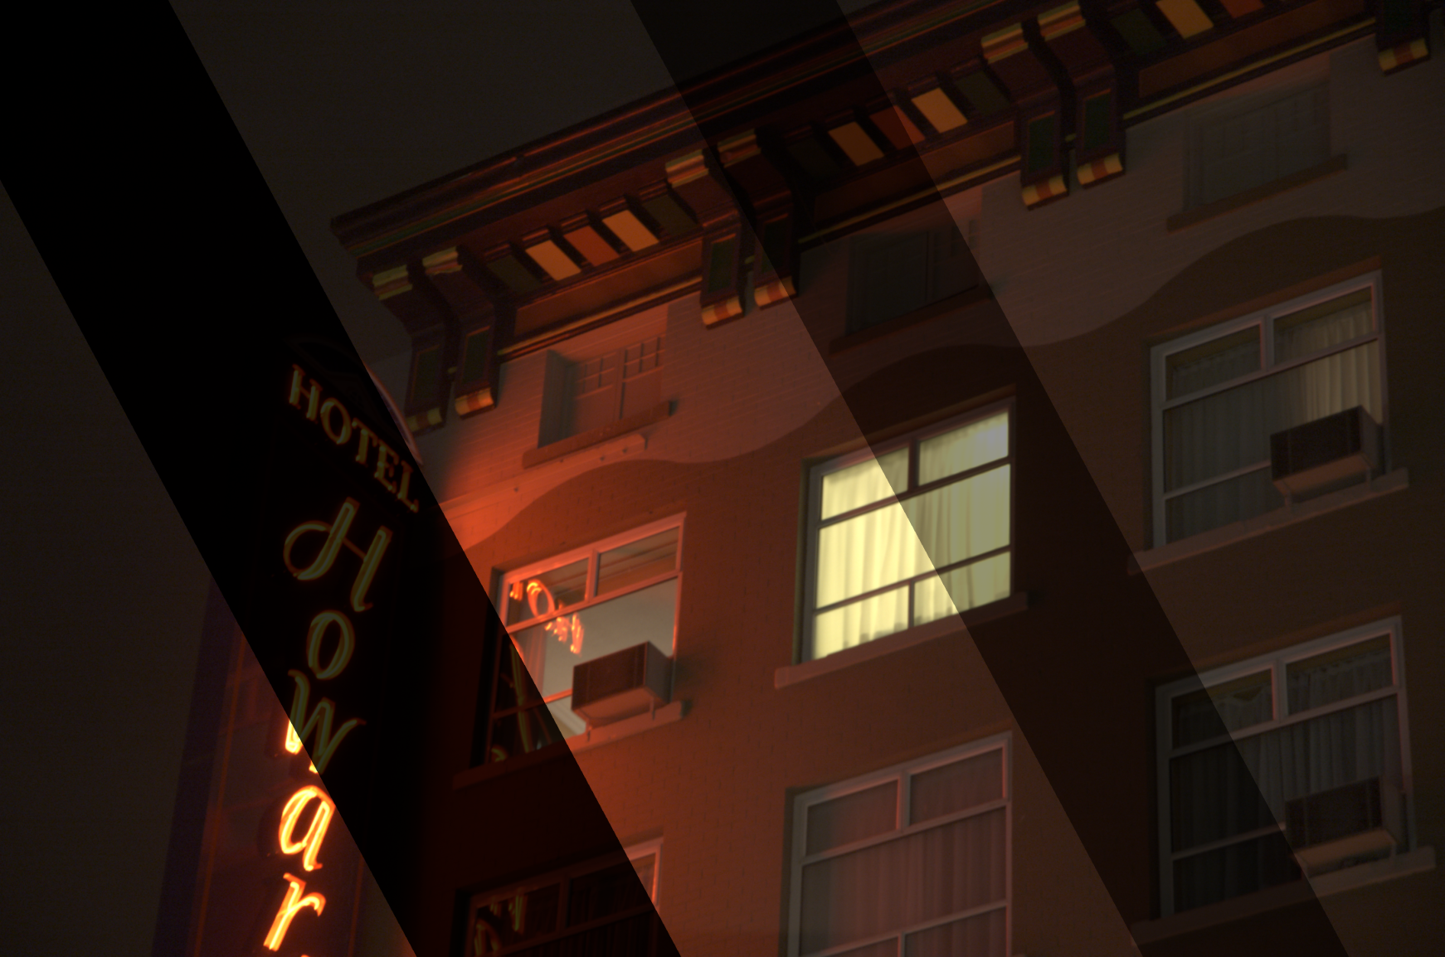
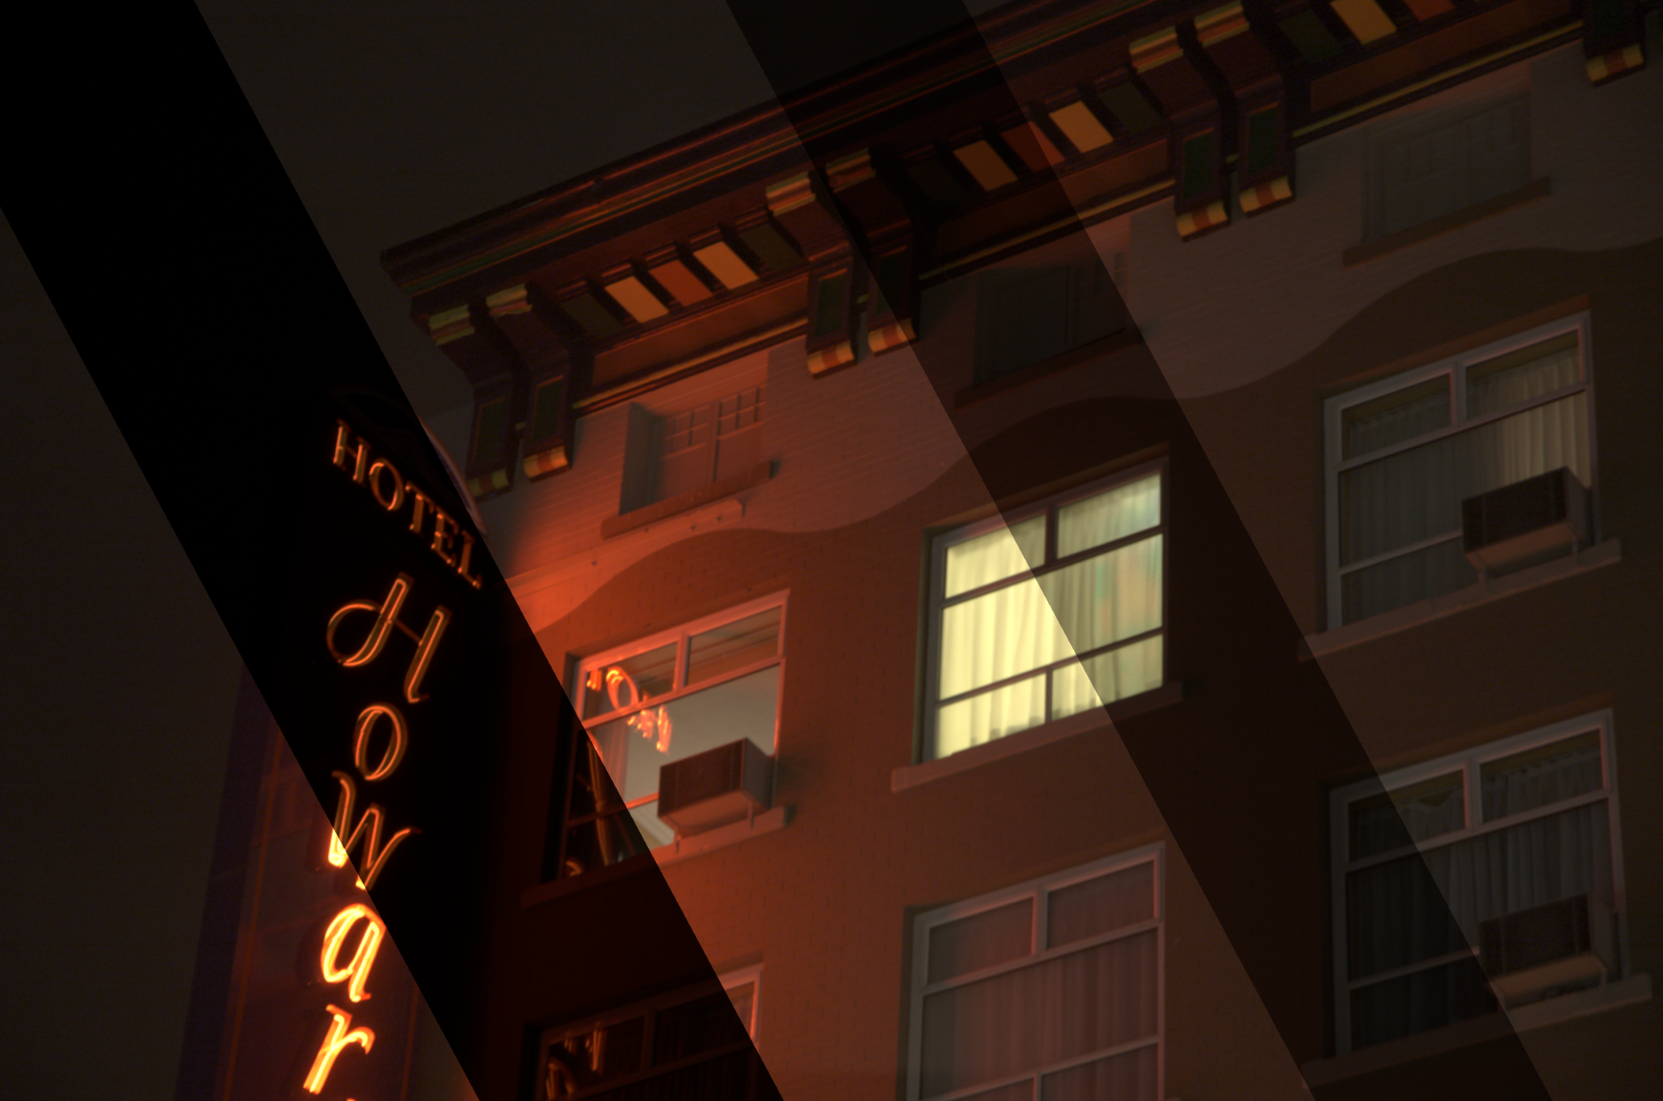


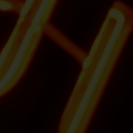
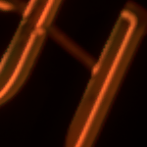
Color restoration
Notes:
Here is an example capture
Note how the red neon light gets clipped and looks yellow
Also note that the curtain has lost details and looks flat
A simulated low exposure shows the artifact better. If you hold an ND filter like that, the light source definitely should not look yellow.
Here are the close ups.
Our algorithm restores details on the neon sign and the curtain.

Slide 3






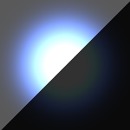

Motivation
Chromatic light sources are very common
  Neon signs etc
They saturate sensor
channels differently
  Spectral overlap of
  sensor channels
  Wide band light sources
  Color artifacts
  Gives us additional info
  we can use for restoration
  with
  Cross-channel correlation
Virtual low exposure
Regular exposure
Saturation mask: BLUE
Saturation mask: GREEN
Saturation mask: RED
Saturation mask
Split exposure Input
Split exposure Output
Hue is off here
Bluish glare
Saturation masks
Notes:
How do we attack this problem?
Let’s look at a synthetic example.
We observe that colored light sources get clipped differently on different channels.
The blue, green, and red saturations masks.
And this is exactly why the hue changes.
One of the channel values get clipped at 1, here the blue channel, and the other channels still have headroom for the values to increase.
Clearly red and green channels have more scene detail than the blue channel in this case.
And we can transfer this detail back to the blue channel.
Because in natural images, hue or color is approximately locally constant. We use this prior in this image to transfer detail from the red and green channel to the blue channel.
From the input, which is shown in a split exposure here,
We get the restored image, where the light source appears blue.

Slide 4
Previous Work
Zhang and Brainard pixels modeled as a 3D Gaussian
  No local control
Guo et al. propagation of information
Masood et al. approach is similar to ours
  Spatial domain
Notes:
Similar approaches have been explored by others before.
Zhang and Brainard modeled pixel RGB values as a 3D Gaussian distribution. Their method lacks local control.
Guo et al. and Masood et al. utilized similar ideas but in the spatial domain, which can suffer from severe discontinuity artifacts, which we will show later.

Slide 5
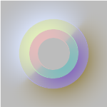
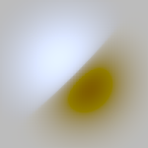
Overview
Split exposure
Split exposure
Input
Output
Full exposure
Full exposure
Flat
Detail
Gradient space computations
Input gradients
Restored gradients
Notes:
Instead we solve this problem in the gradient domain.
We restore the gradients instead of the actual pixel values.
Now we go into the details of the algorithm.

Slide 6
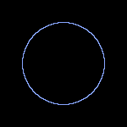



Step 0: What is the hue?
Identify the clipping boundary
  Smooth out: bilateral filter. Even Gaussian is ok.
Inpaint
  More sophisticated (edge-aware?)
  method possible
Input
Input
Mask
Clip boundary
“hue”
“hue” RGB
Notes:
First, we estimate the hue or the color of the saturated regions.
We take the saturation boundary, we assume that hue is locally constant or smoothly varying, and therefore we simply inpaint the region with a Poisson solver.
The hue is not the hue in the traditional color space sense. Hue in our case basically gives the ratios of intensities between channels. Because color approximately locally constant, hue expresses the ratio beween gradients as well
We can now use this hue information to restore the gradients.

Slide 7

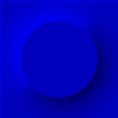

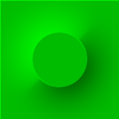


Step 1: Gradient infilling
Compute gradients
Blue
Green
Input
Red
Notes:
From each channel, we can compute the image gradients.

Slide 8

Step 1: Gradient infilling
Compute gradients
Smooth “Gaussian” infilling of the gradients
Blue
Green
Input
Red
Red
Notes:
If a region is clipped in all three channels, we fill in those gradients with a Gaussian blob. This is an optional step.

Slide 9

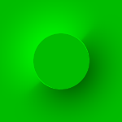

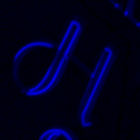

Step 2: Gradient-space restoration
Compute gradients
Merge gradients
multiply with “hue”:
“Hue”
Green
Green
Input
Red
Red to Green estimate
Notes:
Now we apply the estimated hue.
Here we see how the green channel gradients will be fixed.
The red channel has details.

Slide 10

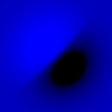

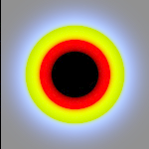

Step 2: Gradient-space restoration
Compute gradients
Merge gradients
multiply with “hue”
Linearly combine multiple channels → weights!!
Confidence
in terms of expected noise
Smooth function
Blue
Blue
Green
Green to blue estimate
Input
Weights
Red
Red to blue estimate

Slide 11
Step 2: Gradient-space restoration
Compute gradients
Merge gradients
multiply with “hue”
Linearly combine multiple channels → weights!!
Poisson solve
  Given a gradient field
  reconstruct the values
Blue
Reconstructed gradients
Green
Final result
Red = infilled gradients

Slide 12
Summary
“Hue”
Weights
Blue
Blue
Input gradients
Reconstructed gradients
Green
Green
Input
Final result
Red
Red

Slide 13
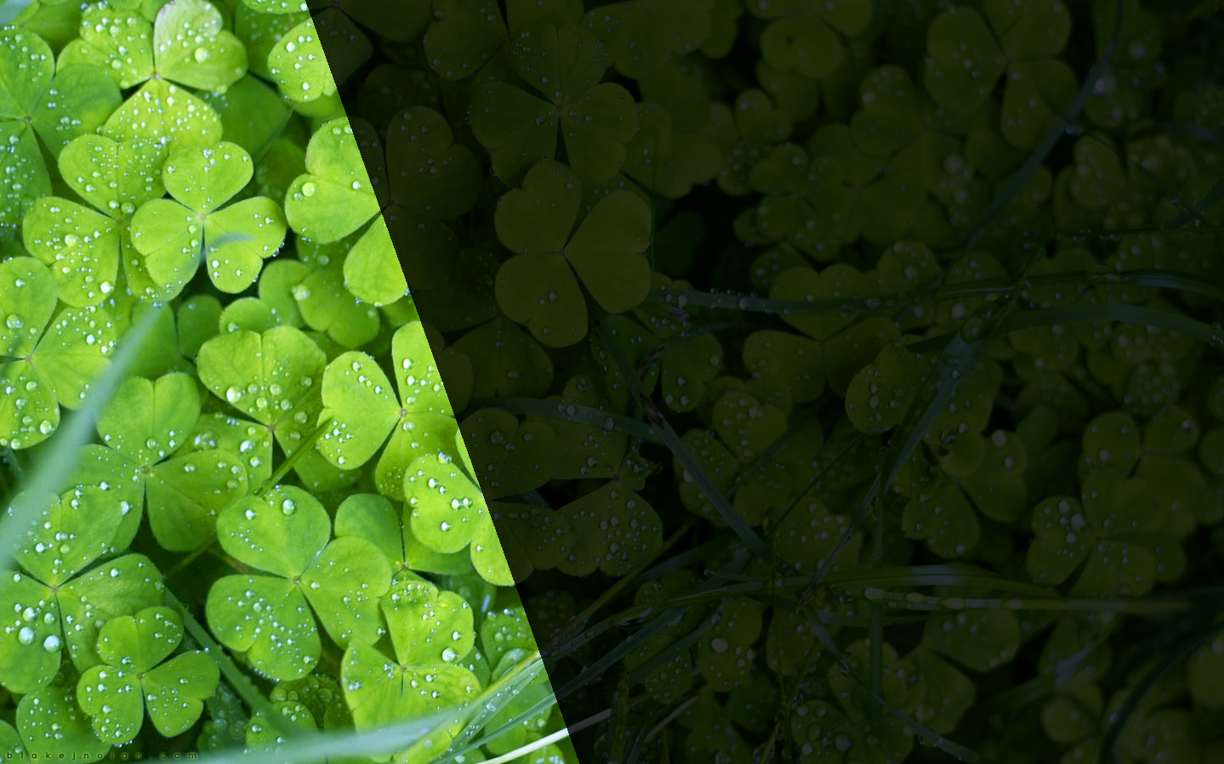

Results
Input

Slide 14


Results
Output

Slide 15

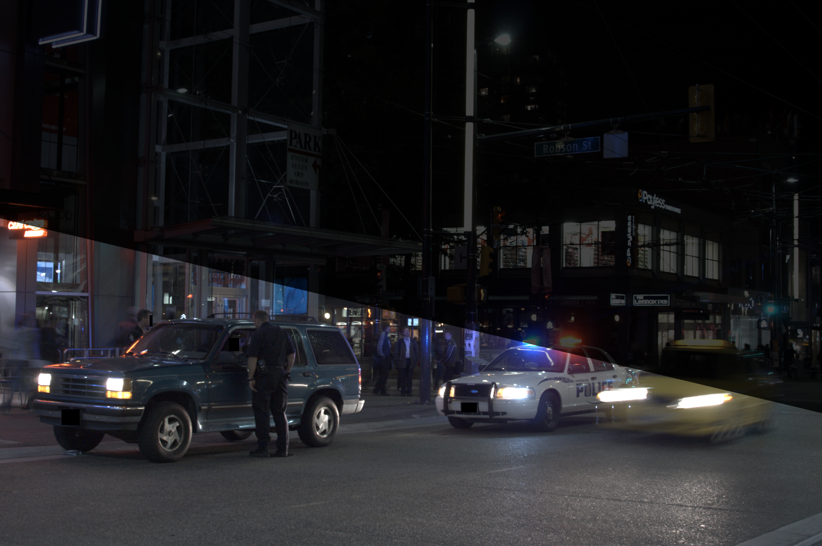
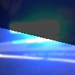
Results
Input

Slide 16
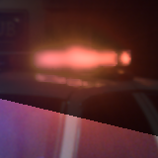
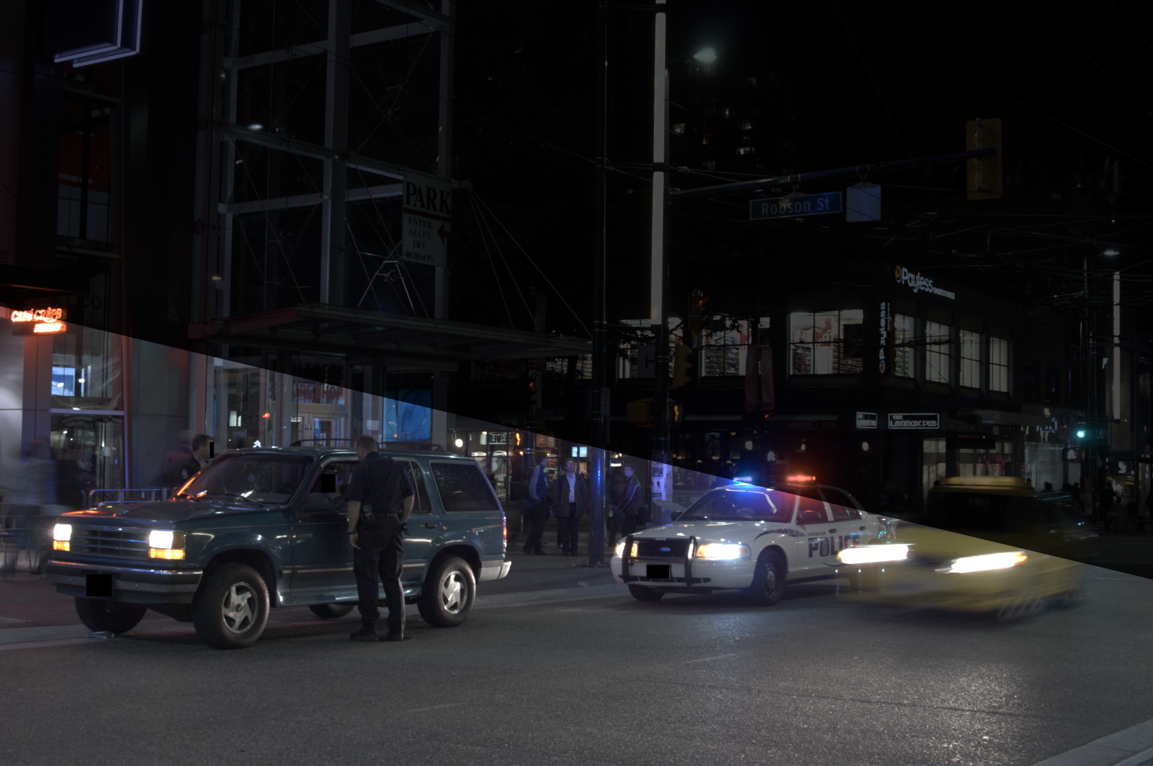

Results
Output

Slide 17
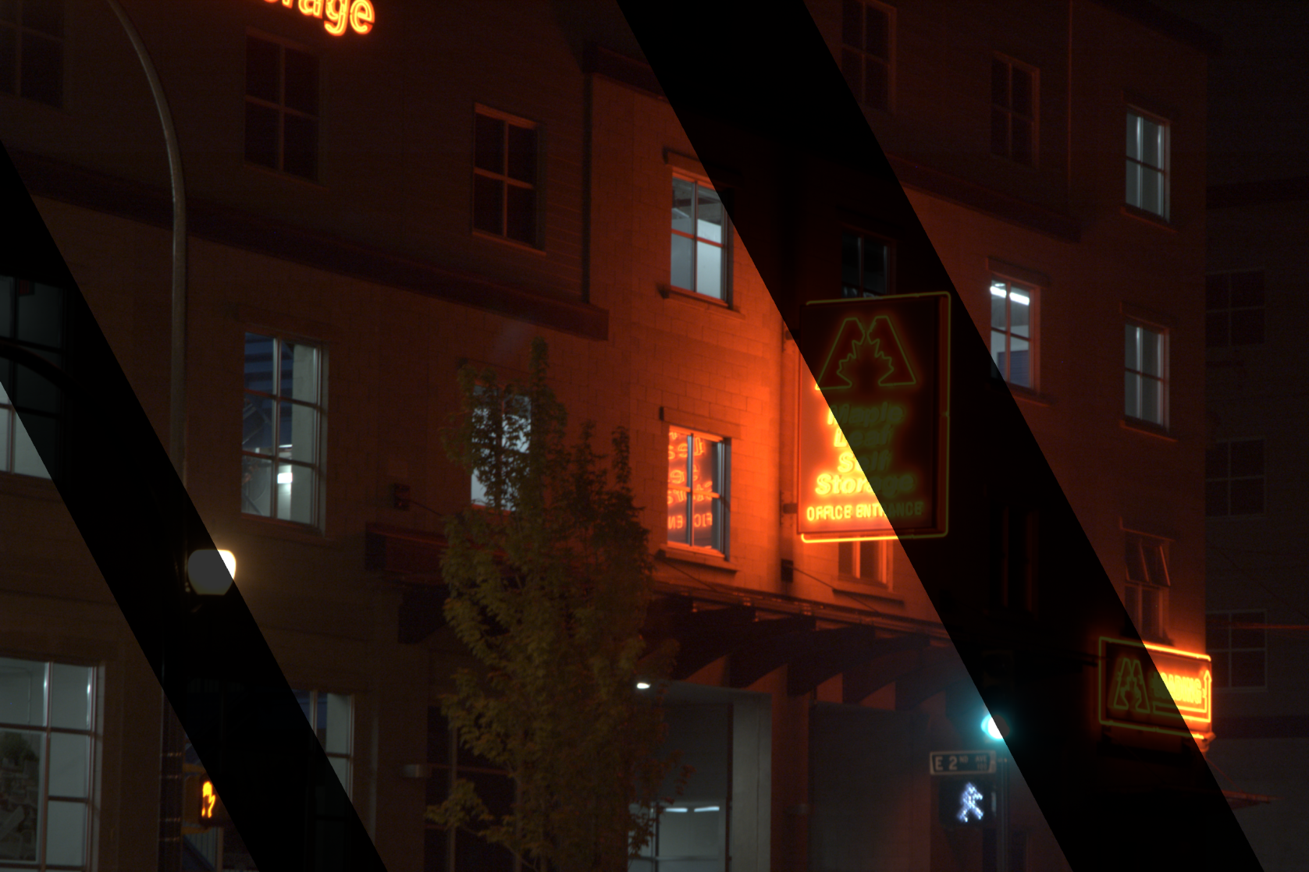

Results
Input

Slide 18
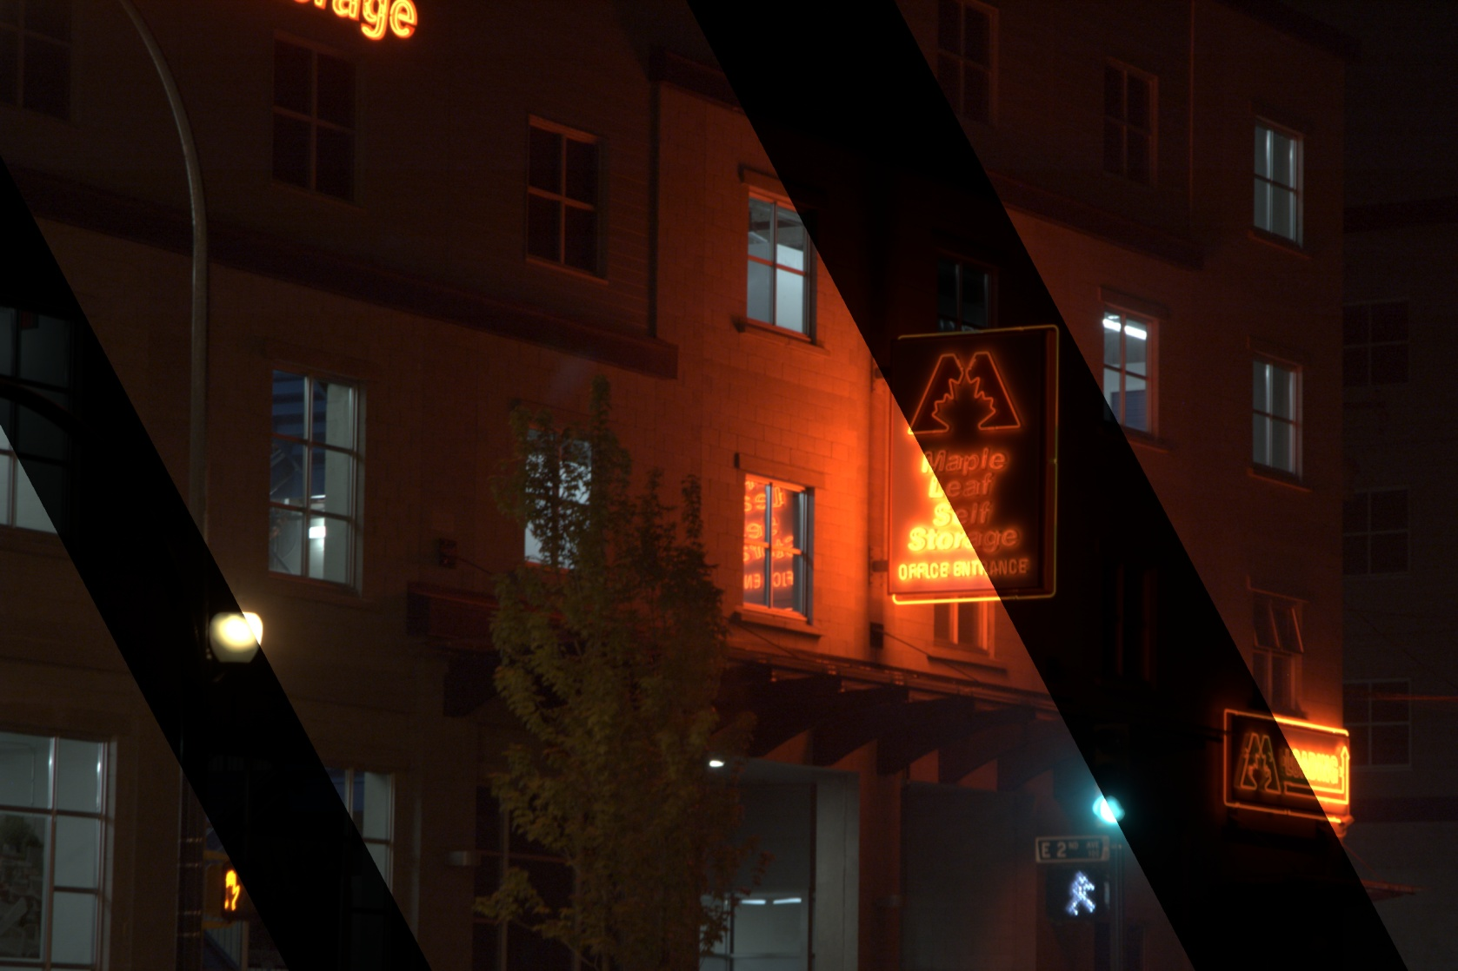

Results
Output

Slide 19
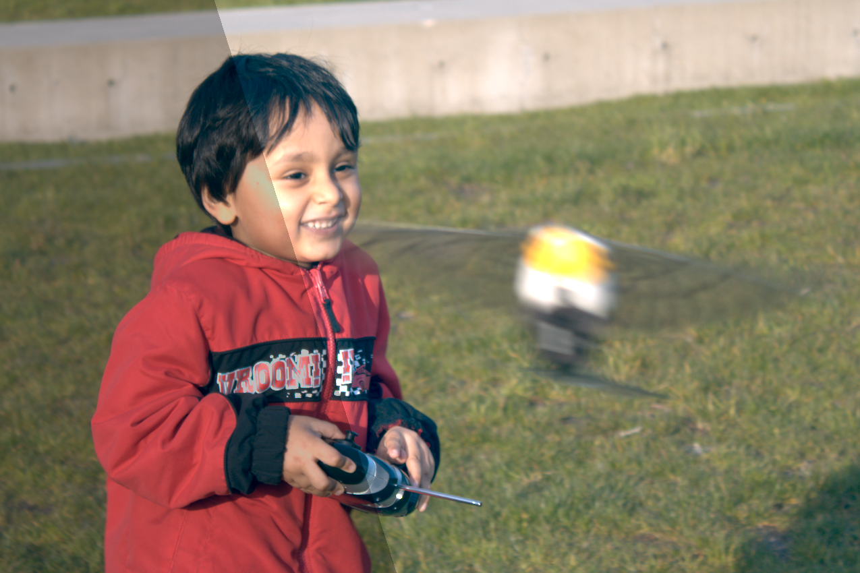

Results
Input

Slide 20
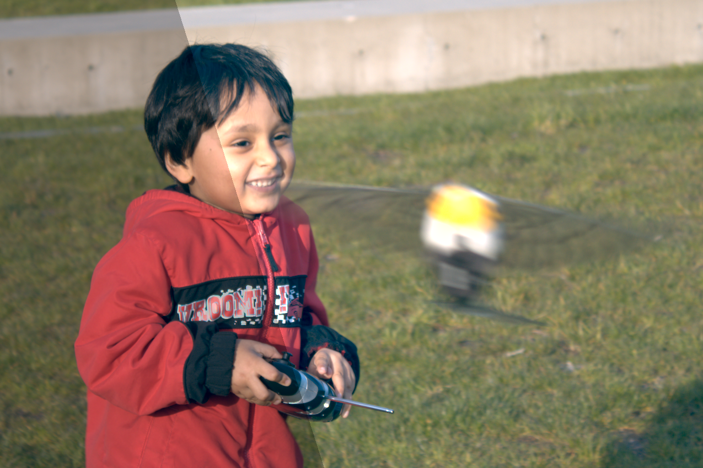

Results
Output

Slide 21
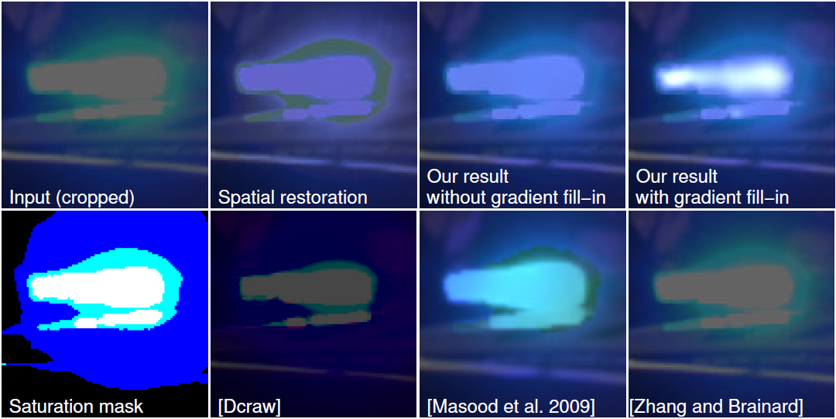
Why gradients?
Standard tools such as a Poisson solver
Local control
Robust reconstruction

Slide 22
Conclusion
We “replicate” known gradients
to estimate the unknown
Gradient-space, robust computation
Acknowledgement:
  Dolby Canada Research Chair

Slide 23
Thanks!
Acknowledgements:
  Dolby Canada Research Chair

Slide 24
Thanks!
Acknowledgements:
  Dolby Canada Research Chair

Slide 25


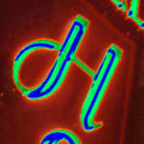
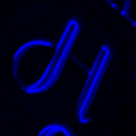
Linear combination Weights
Dictated by “some” noise model
  Smaller values → higher noise → lower confidence/weight
Smooth function to avoid
discontinuities like Mach band

Slide 26
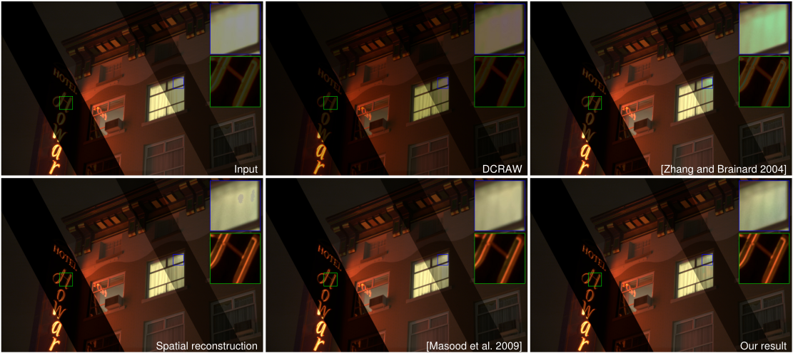
Comparison - 1

Slide 27
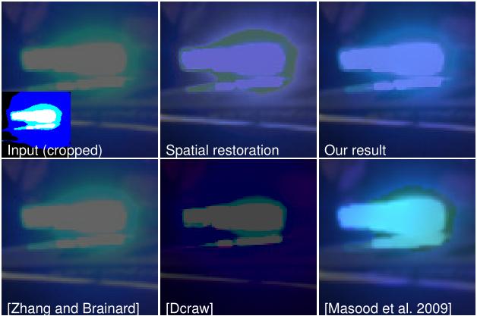
Comparison - 2

Slide 28
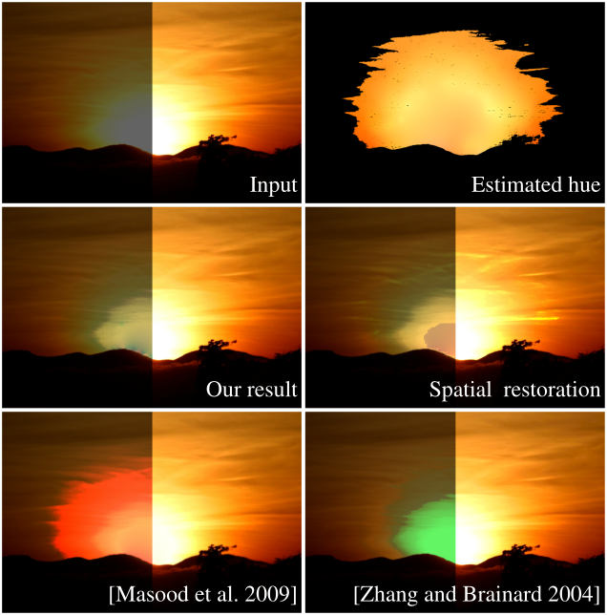
Failure

Slide 29
Conclusion
Acknowledgements
  Dolby Canada research chair

