Slide 1
Probabilistic Inverse Dynamics for Nonlinear Blood Pattern Reconstruction
Benjamin Cecchetto, Wolfgang Heidrich
University of British Columbia
Notes:
1

Slide 2
Problem Scenario

Slide 3
Problem Assumptions
Particles travel under ballistic motion with or without drag
Have noisy measurements of each particle after some distance that help with the reconstruction
Want to reconstruct the region of origin at the moment the particles separate
Notes:
3

Slide 4
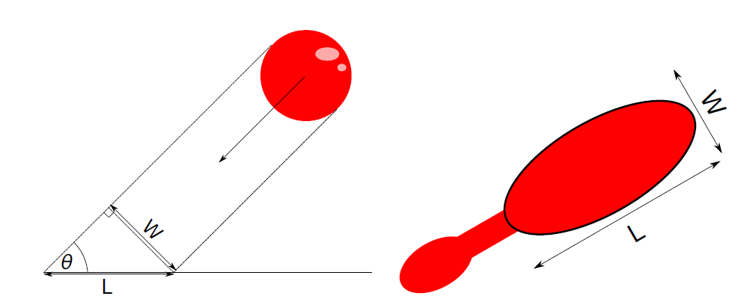
Specific Case: Blood Pattern Reconstruction
Blood drops obey ballistic motion
Directions can be estimated from blood stains
Used in forensics to reconstruct the region where someone was shot/stabbed

Slide 5
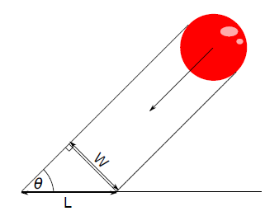
Overview
Region of origin reconstruction given impact parameters
Trajectory review
2D PDF formulation
3D PDF formulation
Bloodstain Parameter estimation
Obtain impact angles
Obtain speeds
Obtain mass and drag coefficients
Notes:
5

Slide 6
Overview
Region of origin reconstruction given impact parameters
Trajectory review
2D PDF formulation
3D PDF formulation
Bloodstain Parameter estimation
Obtain impact angles
Obtain speeds
Obtain mass and drag coefficients
Notes:
6

Slide 7
Previous Work
Linear Region of Origin Estimation/Tangent Method
Backtrack Software http://www.physics.carleton.ca/carter/
AL Carter et. al ,Validation of the Back-Track Suite of Programs for Bloodstain Pattern Analysis. 2006.
MB Illes et. Al, Use of the Backtrack Computer Program for Bloodstain Pattern Analysis of Stains From Downward-Moving Drops. 2005.
Linear Estimate
Actual
Notes:
7

Slide 8
Previous Work - Limitations
Assumes particles travel in straight lines
No error estimate
Linear Estimate
Actual
Notes:
8

Slide 9
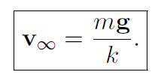
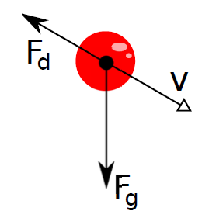
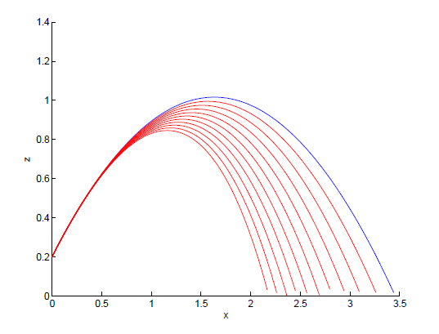
Trajectory Review
Motion with Drag
Notes:
9

Slide 10
Trajectory Reconstruction
Needed parameters
Having all parameters fix the trajectory
Notes:
10

Slide 11
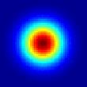
2D PDF formulation
Doesn't take into account noisy error in measured velocity
Introduce a new final velocity by adding the measurement error
Use to generate new trajectories
Each trajectory has a probability associated with it
Assume normally distributed noise in measurements
Speed Error
=(0,0)
Angle Error
Notes:
11

Slide 12
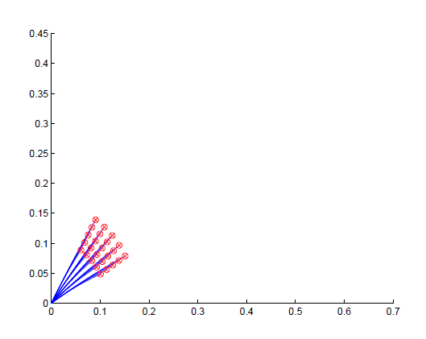
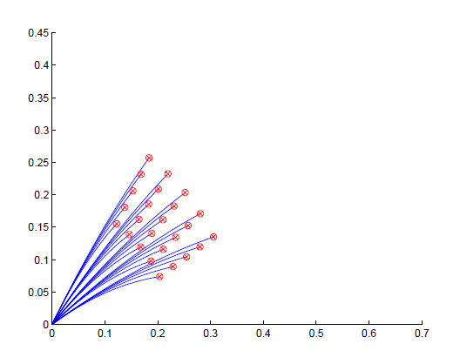
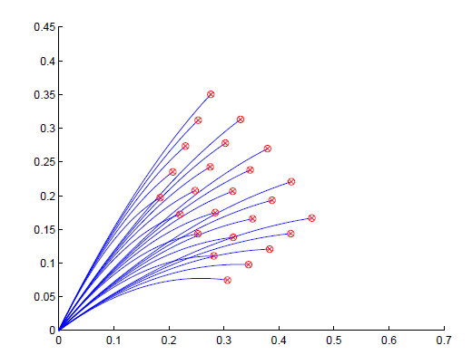
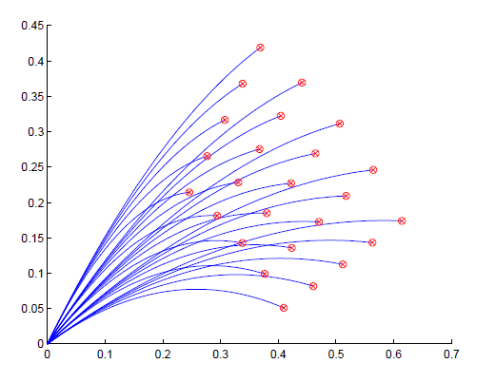
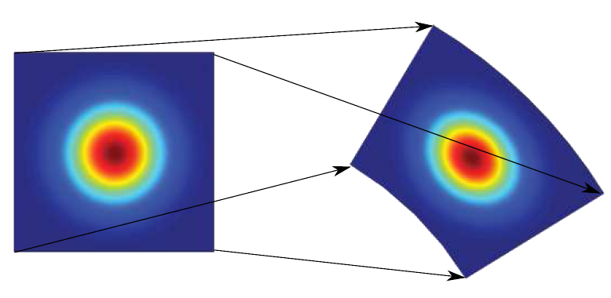
2D PDF formulation
Look at neighbouring trajectories with different final speed, angle
Approximate with non-warped Gaussian
Vary
speed
Vary angle
Notes:
12

Slide 13
2D PDF formulation
Probability region gets more uncertain the further backwards in time the estimate
Scale:
Notes:
13

Slide 14
2D PDF formulation
Integrate over all times to obtain a PDF of where a single particle is likely to have been
Notes:
14

Slide 15
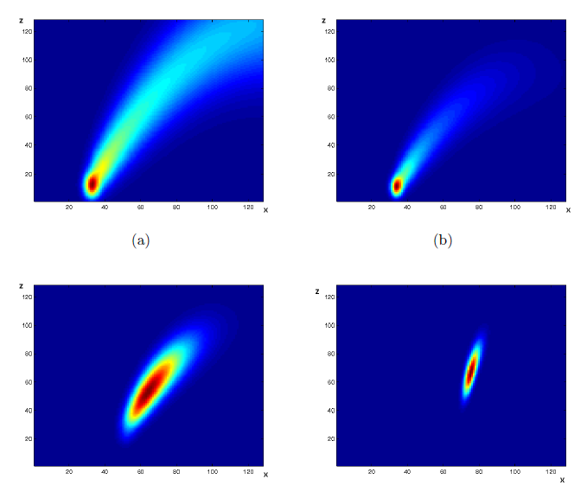
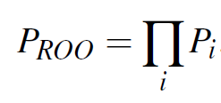
Using PDFs to Estimate Area of Origin
Multiply PDFs for different particles to obtian PDF of where all particles likely to have been
Notes:
15

Slide 16
Without Given Impact Speed
Prior that speeds at region of origin are similar
Vary the speed over some interval, integrate the PDFs
Notes:
16

Slide 17
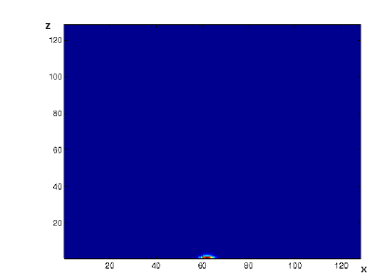
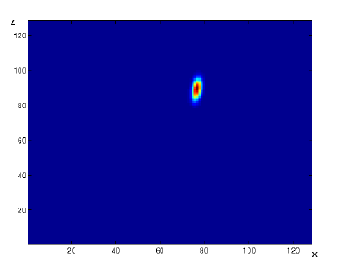
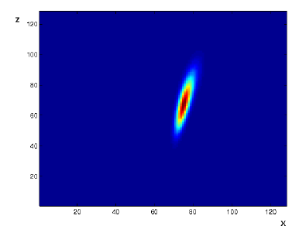
Without Given Impact Speed
Notes:
17

Slide 18
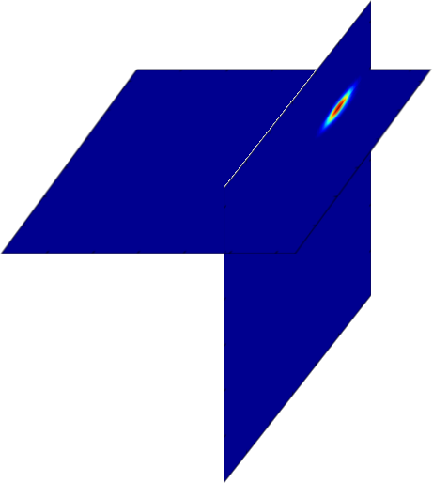
Obtaining 3D Area of Origin
Trajectory equations are separable in xz and yz planes
Construct a 3D PDF by element multiplying 2D PDFs
Notes:
18

Slide 19
Overview
Region of origin reconstruction given impact parameters
Trajectory review
2D PDF formulation
3D PDF formulation
Bloodstain Parameter estimation
Obtain impact angles
Obtain speeds
Obtain mass and drag coefficients
Notes:
19

Slide 20
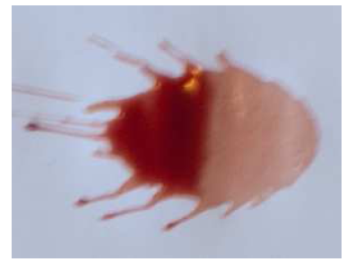
Bloodstain Parameter Estimation
Notes:
20

Slide 21
Bloodstain Direction Estimation
Fitting an ellipse gets us position and angle
K. Boonkhong et. Al, Impact angle analysis of bloodstains using a simple image processing technique. 2010.
Manually fit ellipses in BackTrack
Notes:
21

Slide 22
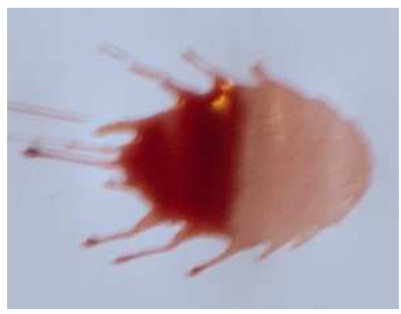
Bloodstain Direction Estimation
Stain properties
Need to fit ellipse to main stain
Satellite
Stains
Main
Stain
Notes:
22

Slide 23
Bloodstain Direction Estimation
Get rid of satellite stains
Exploit visibility property of convex regions
X
Notes:
23

Slide 24
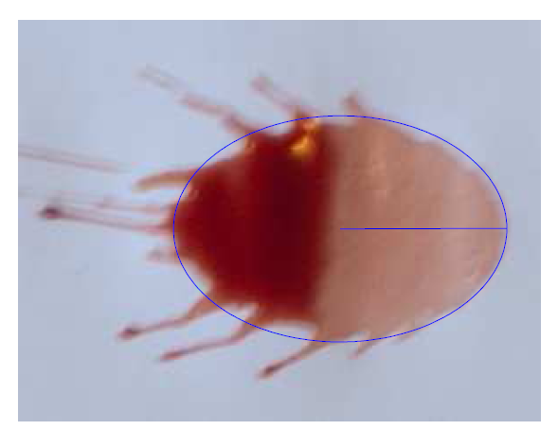
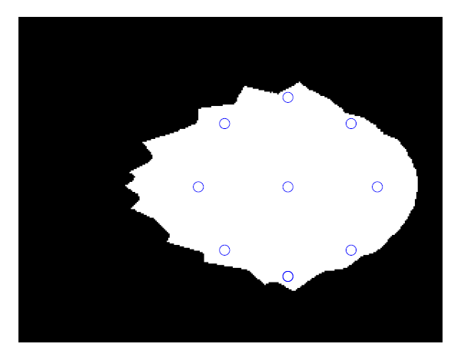
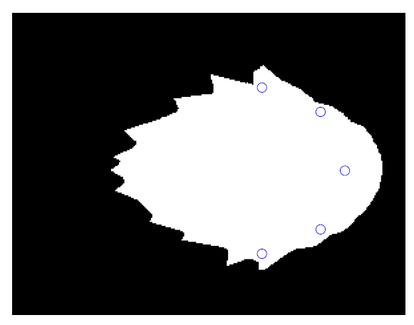
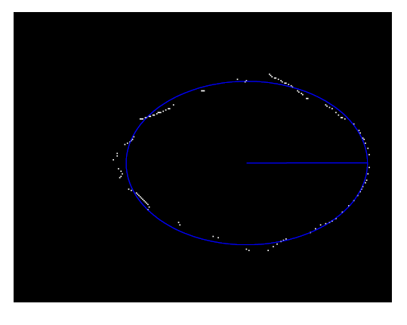
Bloodstain Direction Estimation
Perform visibility tests on mask
Assume main stain is where the largest inscribed circle is
Notes:
24

Slide 25
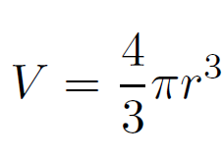
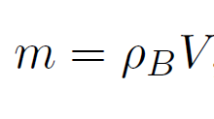
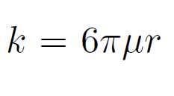
Bloodstain Mass and Drag Coefficient Estimation
Want to know the mass and drag coefficient
Know ellipse fit, half of minor axis is radius
Can estimate sphere volume
Notes:
25
Mu = dynamic viscocity for air

Slide 26
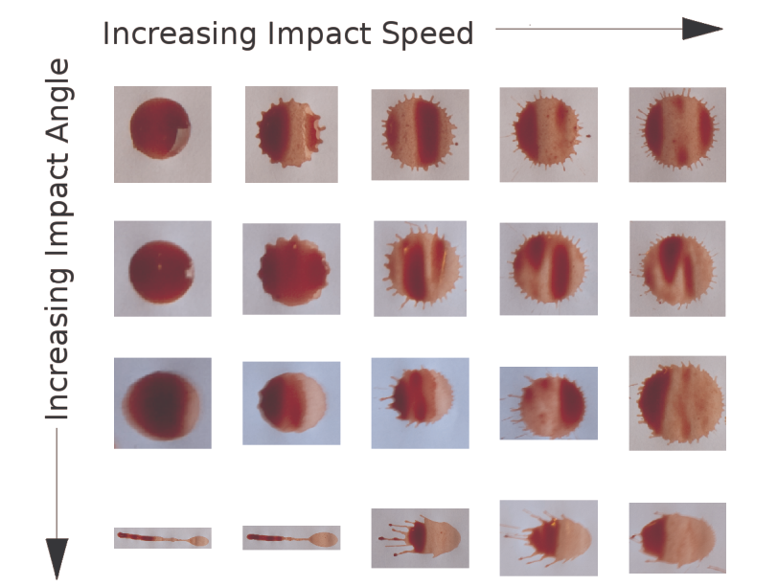
Bloodstain Speed Estimation
Projected blood drop image density is a function of
Impact angle
Speed of impact
Can invert and solve for speed
Notes:
26

Slide 27
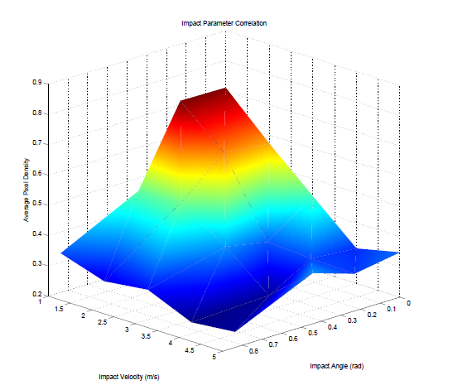
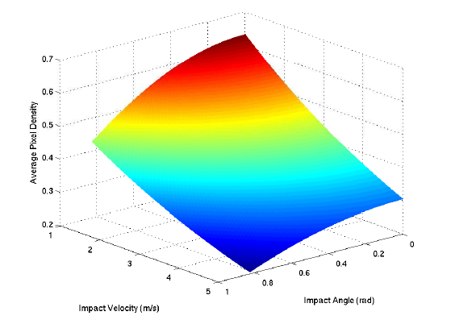
Experimental Results – Speed Estimation
Physical Experiment Data
Fit to Model
Notes:
27

Slide 28
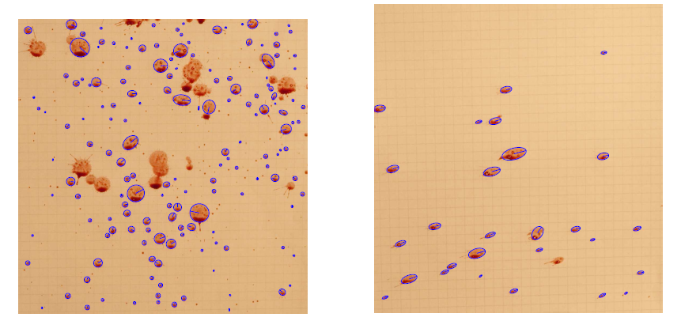
Experimental Results – Ellipse Fits
Notes:
28

Slide 29
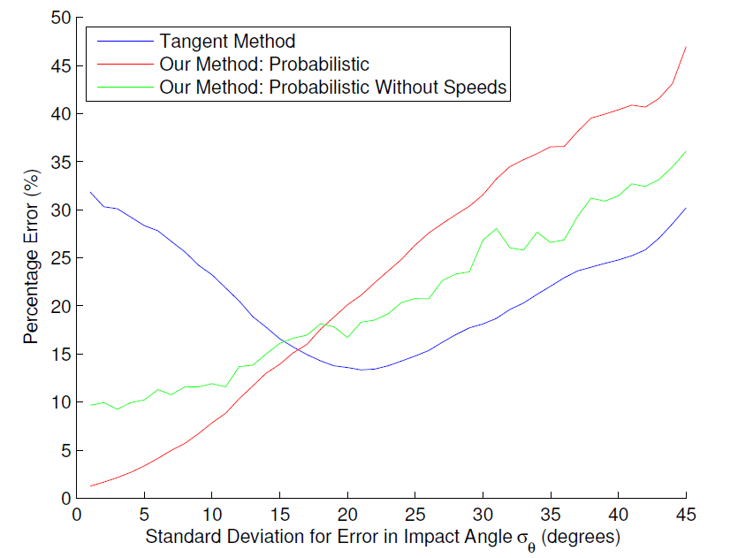
Synthetic Experiments – Error in Reconstruction

Slide 30
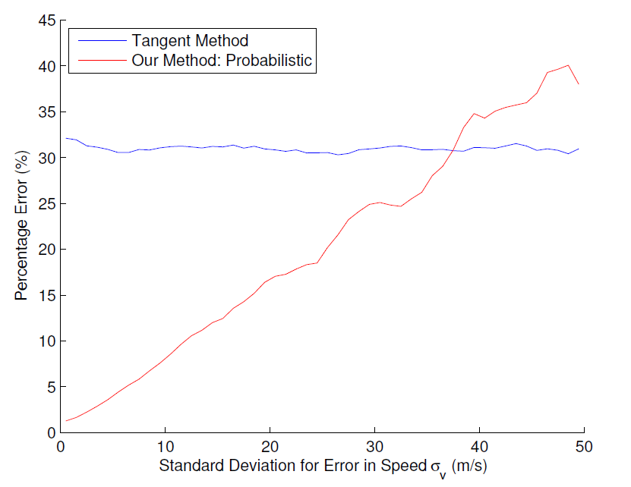
Synthetic Experiments – Error in Reconstruction

Slide 31
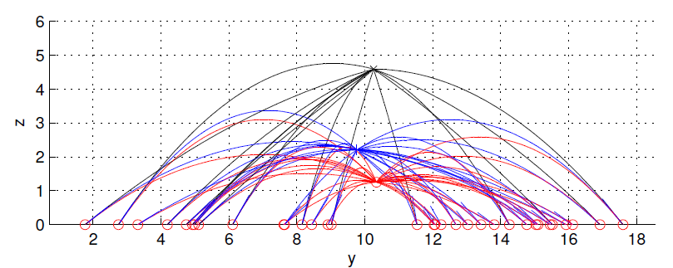
Experimental Results – Parabolic Reconstruction
Notes:
31

Slide 32
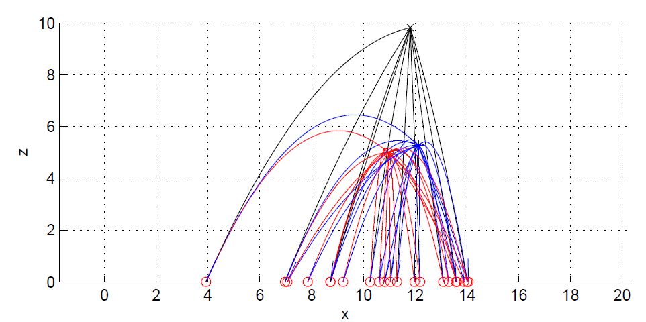
Experimental Results – Parabolic Reconstruction
Notes:
32

Slide 33
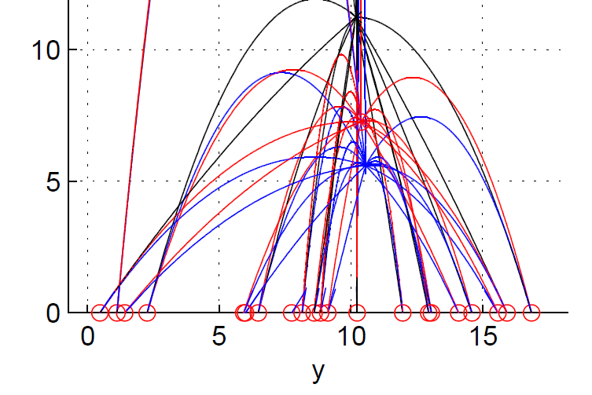
Experimental Results – Parabolic Reconstruction
Notes:
33

Slide 34
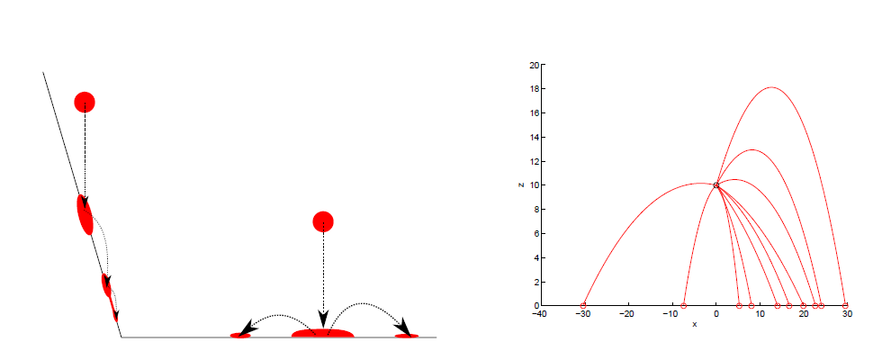
Limitations/Future Work
Volume Loss
Similar speed prior
Only handles one area of origin
Only support error in velocity estimate
Notes:
34

Slide 35
Conclusion
Accurate, modular new method to estimate area of origin from directions, positions which may or may not be used with more parameter estimates
New robust stain processing method to help with obtaining ellipses
New model to estimate speeds from stains
Notes:
35

Slide 36
Thank you!
Questions?

Slide 37
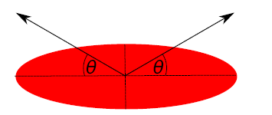
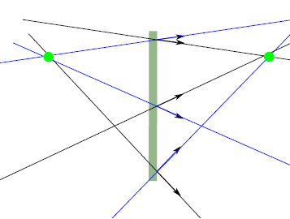
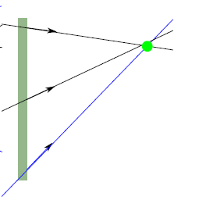
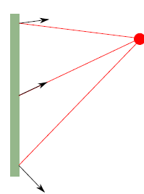
Directional Ambiguity
Notes:
37

Slide 38
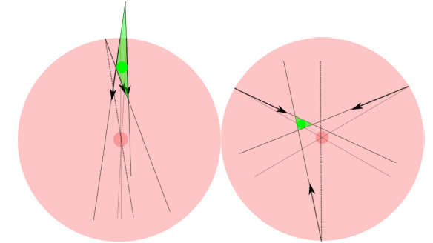
Error Bound
Notes:
38

Slide 39
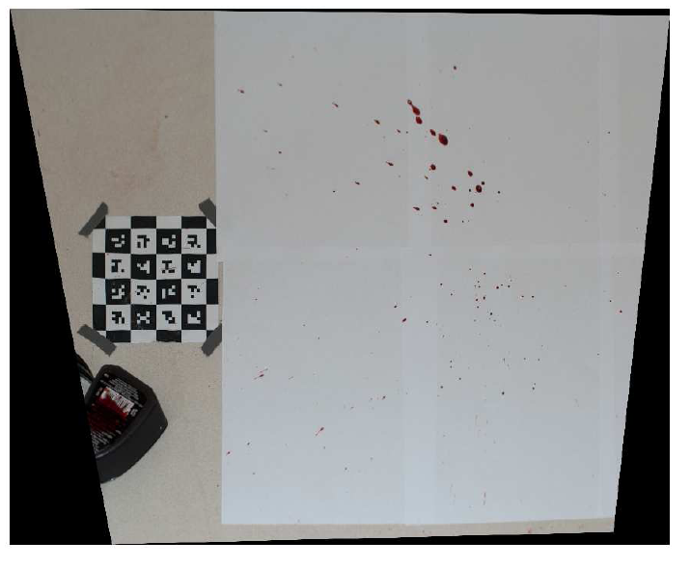
Experimental Results - Calibration
Notes:
39

