Slide 1
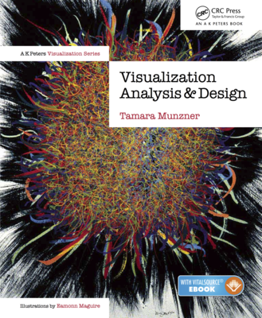
Visualization Analysis & Design
Full-Day Tutorial
Tamara Munzner
Department of Computer Science
University of British Columbia
ACT
August 2016, Iowa City IA
http://www.cs.ubc.ca/~tmm/talks.html#vad16act
@tamaramunzner

Slide 2
Outline
Session 1 8:30-10:00am Visualization Analysis Framework
Introduction: Definitions
Analysis: What, Why, How
Marks and Channels
Session 2 10:30am-12:00pm Spatial Layout
Arrange Tables
Arrange Spatial Data
Arrange Networks and Trees
Session 3 1:00-2:30pm Color & Interaction
Map Color
Manipulate: Change, Select, Navigate
Facet: Juxtapose, Partition, Superimpose
Session 4 3:00-4:30pm Guidelines and Examples
Reduce: Filter, Aggregate
Rules of Thumb
Q&A
http://www.cs.ubc.ca/~tmm/talks.html#vad16act
@tamaramunzner

Slide 3
Defining visualization (vis)
Computer-based visualization systems provide visual representations of datasets designed to help people carry out tasks more effectively.
Why?...

Slide 4
Why have a human in the loop?
Computer-based visualization systems provide visual representations of datasets designed to help people carry out tasks more effectively.
Visualization is suitable when there is a need to augment human capabilities rather than replace people with computational decision-making methods.
don’t need vis when fully automatic solution exists and is trusted
many analysis problems ill-specified
don’t know exactly what questions to ask in advance
possibilities
long-term use for end users (e.g. exploratory analysis of scientific data)
presentation of known results
stepping stone to better understanding of requirements before developing models
help developers of automatic solution refine/debug, determine parameters
help end users of automatic solutions verify, build trust

Slide 5
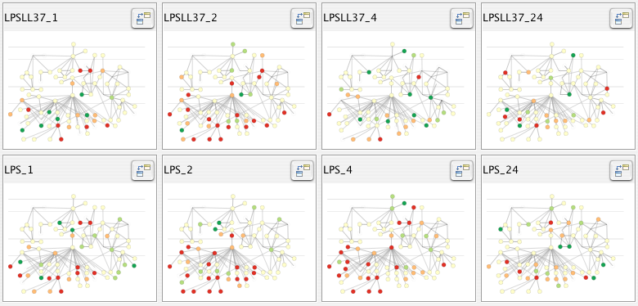
Why use an external representation?
Computer-based visualization systems provide visual representations of datasets designed to help people carry out tasks more effectively.
external representation: replace cognition with perception
[Cerebral: Visualizing Multiple Experimental Conditions on a Graph with Biological Context. Barsky, Munzner, Gardy, and Kincaid. IEEE TVCG (Proc. InfoVis) 14(6):1253-1260, 2008.]

Slide 6
Why depend on vision?
Computer-based visualization systems provide visual representations of datasets designed to help people carry out tasks more effectively.
human visual system is high-bandwidth channel to brain
overview possible due to background processing
subjective experience of seeing everything simultaneously
significant processing occurs in parallel and pre-attentively
sound: lower bandwidth and different semantics
overview not supported
subjective experience of sequential stream
touch/haptics: impoverished record/replay capacity
only very low-bandwidth communication thus far
taste, smell: no viable record/replay devices

Slide 7
Why represent all the data?
Computer-based visualization systems provide visual representations of datasets designed to help people carry out tasks more effectively.
summaries lose information, details matter
confirm expected and find unexpected patterns
assess validity of statistical model
Anscombe’s Quartet
Identical statistics
x mean | 9
x variance | 10
y mean | 7.5
y variance | 3.75
x/y correlation | 0.816

Slide 8
Why focus on tasks and effectiveness?
Computer-based visualization systems provide visual representations of datasets designed to help people carry out tasks more effectively.
tasks serve as constraint on design (as does data)
idioms do not serve all tasks equally!
challenge: recast tasks from domain-specific vocabulary to abstract forms
most possibilities ineffective
validation is necessary, but tricky
increases chance of finding good solutions if you understand full space of possibilities
what counts as effective?
novel: enable entirely new kinds of analysis
faster: speed up existing workflows

Slide 9
What resource limitations are we faced with?
Vis designers must take into account three very different kinds of resource limitations: those of computers, of humans, and of displays.
computational limits
processing time
system memory
human limits
human attention and memory
display limits
pixels are precious resource, the most constrained resource
information density: ratio of space used to encode info vs unused whitespace
tradeoff between clutter and wasting space, find sweet spot between dense and sparse

Slide 10
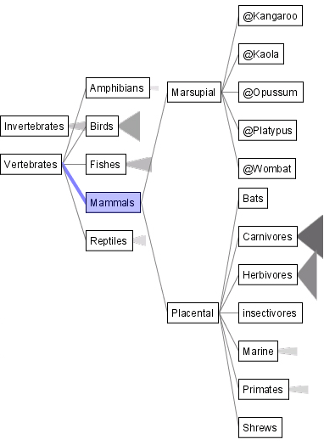
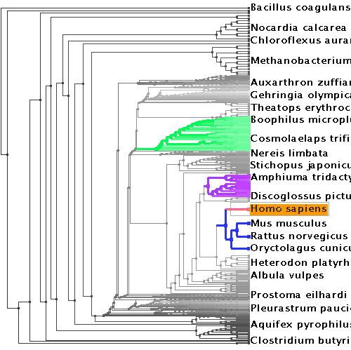
Why analyze?
SpaceTree
TreeJuxtaposer
imposes structure on huge design space
scaffold to help you think systematically about choices
analyzing existing as stepping stone to designing new
most possibilities ineffective for particular task/data combination
[SpaceTree: Supporting Exploration in Large Node Link Tree, Design Evolution and Empirical Evaluation. Grosjean, Plaisant, and Bederson. Proc. InfoVis 2002, p 57–64.]
[TreeJuxtaposer: Scalable Tree Comparison Using Focus+Context With Guaranteed Visibility. ACM Trans. on Graphics (Proc. SIGGRAPH) 22:453– 462, 2003.]

Slide 11
Further reading
Visualization Analysis and Design. Munzner. AK Peters Visualization Series, CRC Press, 2014.
Chap 1: What’s Vis, and Why Do It?

Slide 12
Outline
Session 1 8:30-10:00am Visualization Analysis Framework
Introduction: Definitions
Analysis: What, Why, How
Marks and Channels
Session 2 10:30am-12:00pm Spatial Layout
Arrange Tables
Arrange Spatial Data
Arrange Networks and Trees
Session 3 1:00-2:30pm Color & Interaction
Map Color
Manipulate: Change, Select, Navigate
Facet: Juxtapose, Partition, Superimpose
Session 4 3:00-4:30pm Guidelines and Examples
Reduce: Filter, Aggregate
Rules of Thumb
Q&A
http://www.cs.ubc.ca/~tmm/talks.html#vad16act
@tamaramunzner

Slide 13
Analysis framework: Four levels, three questions
domain
domain situation
who are the target users?
abstraction
translate from specifics of domain to vocabulary of vis
what is shown? data abstraction
often don’t just draw what you’re given: transform to new form
why is the user looking at it? task abstraction
idiom
how is it shown?
visual encoding idiom: how to draw
interaction idiom: how to manipulate
algorithm
efficient computation
abstraction
idiom
algorithm
[A Nested Model of Visualization Design and Validation.
Munzner. IEEE TVCG 15(6):921-928, 2009 (Proc. InfoVis 2009). ]
domain
abstraction
idiom
algorithm
[A Multi-Level Typology of Abstract Visualization Tasks
Brehmer and Munzner. IEEE TVCG 19(12):2376-2385, 2013 (Proc. InfoVis 2013). ]

Slide 14
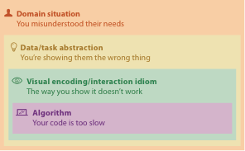
Why is validation difficult?
different ways to get it wrong at each level

Slide 15
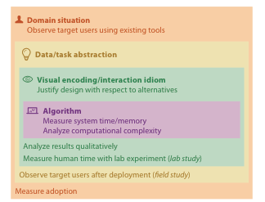
Why is validation difficult?
solution: use methods from different fields at each level
problem-driven work
anthropology/ ethnography
design
computer science
technique-driven work
cognitive psychology
anthropology/ ethnography
[A Nested Model of Visualization Design and Validation. Munzner. IEEE TVCG 15(6):921-928, 2009 (Proc. InfoVis 2009). ]

Slide 16
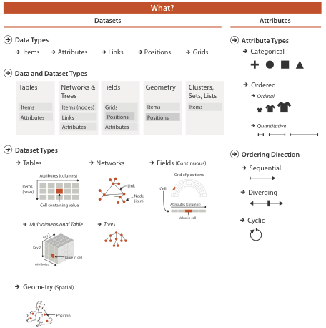

Slide 17
Three major datatypes
Spatial
visualization vs computer graphics
geometry is design decision

Slide 18
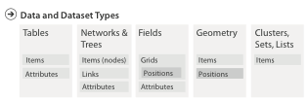
Dataset and data types

Slide 19
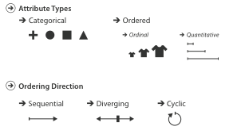
Attribute types

Slide 20
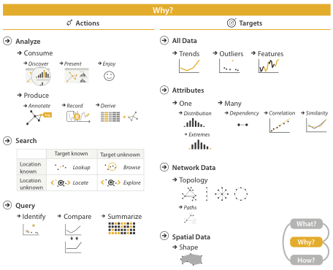
{action, target} pairs
discover distribution
compare trends
locate outliers
browse topology

Slide 21
Actions: Analyze
consume
discover vs present
classic split
aka explore vs explain
enjoy
newcomer
aka casual, social
produce
annotate, record
derive
crucial design choice

Slide 22
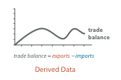
Derive
don’t just draw what you’re given!
decide what the right thing to show is
create it with a series of transformations from the original dataset
draw that
one of the four major strategies for handling complexity

Slide 23
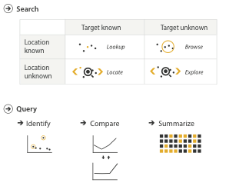
Actions: Search, query
what does user know?
target, location
how much of the data matters?
one, some, all
independent choices for each of these three levels
analyze, search, query
mix and match

Slide 24
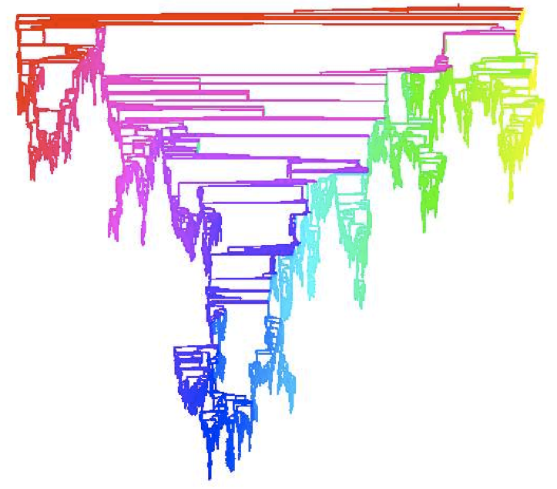
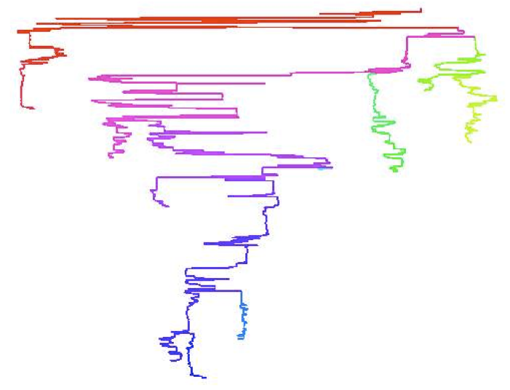
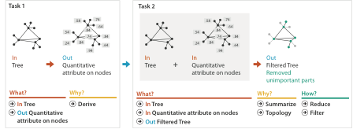
Analysis example: Derive one attribute
Strahler number
centrality metric for trees/networks
derived quantitative attribute
draw top 5K of 500K for good skeleton
[Using Strahler numbers for real time visual exploration of huge graphs. Auber. Proc. Intl. Conf. Computer Vision and Graphics, pp. 56–69, 2002.]

Slide 25
Why: Targets

Slide 27
Further reading
Visualization Analysis and Design. Munzner. AK Peters Visualization Series, CRC Press, 2014.
Chap 2: What: Data Abstraction
Chap 3: Why: Task Abstraction
A Multi-Level Typology of Abstract Visualization Tasks. Brehmer and Munzner. IEEE Trans. Visualization and Computer Graphics (Proc. InfoVis) 19:12 (2013), 2376–2385.
Low-Level Components of Analytic Activity in Information Visualization. Amar, Eagan, and Stasko. Proc. IEEE InfoVis 2005, p 111–117.
A taxonomy of tools that support the fluent and flexible use of visualizations. Heer and Shneiderman. Communications of the ACM 55:4 (2012), 45–54.
Rethinking Visualization: A High-Level Taxonomy. Tory and Möller. Proc. IEEE InfoVis 2004, p 151–158.
Visualization of Time-Oriented Data. Aigner, Miksch, Schumann, and Tominski. Springer, 2011.

Slide 28
Outline
Session 1 8:30-10:00am Visualization Analysis Framework
Introduction: Definitions
Analysis: What, Why, How
Marks and Channels
Session 2 10:30am-12:00pm Spatial Layout
Arrange Tables
Arrange Spatial Data
Arrange Networks and Trees
Session 3 1:00-2:30pm Color & Interaction
Map Color
Manipulate: Change, Select, Navigate
Facet: Juxtapose, Partition, Superimpose
Session 4 3:00-4:30pm Guidelines and Examples
Reduce: Filter, Aggregate
Rules of Thumb
Q&A
http://www.cs.ubc.ca/~tmm/talks.html#vad16act
@tamaramunzner

Slide 29
Visual encoding
analyze idiom structure
Notes:
How did we decide to use those particular visual channels? How many more visual channels are there? What kinds of information and how much information can each channel encode? Are some channels better than others? Can all of the channels be used independently or do they interfere with each other?

Slide 30
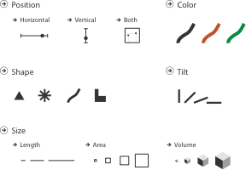
Definitions: Marks and channels
marks
geometric primitives
channels
control appearance of marks
can redundantly code with multiple channels

Slide 31
Visual encoding
analyze idiom structure
as combination of marks and channels
1: vertical position
2: vertical position
horizontal position
3: vertical position
horizontal position
color hue
4: vertical position
horizontal position
color hue
size (area)
mark: line
mark: point
mark: point
mark: point

Slide 32
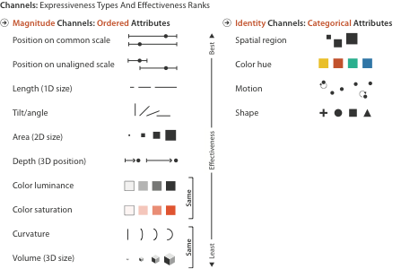
Channels: Expressiveness types and effectiveness rankings

Slide 33
Channels: Matching Types
expressiveness principle
match channel and data characteristics

Slide 34
Channels: Rankings
expressiveness principle
match channel and data characteristics
effectiveness principle
encode most important attributes with highest ranked channels

Slide 35
Channels: Expressiveness types and effectiveness rankings
expressiveness principle
match channel and data characteristics
effectiveness principle
encode most important attributes with highest ranked channels
spatial position ranks high for both

Slide 36
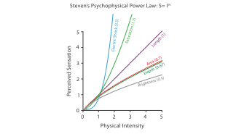
Accuracy: Fundamental Theory

Slide 37
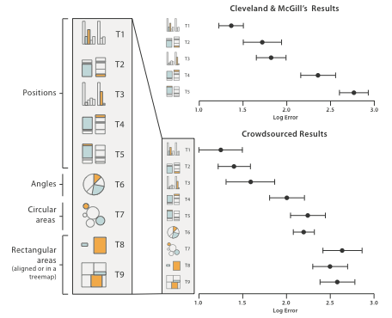
Accuracy: Vis experiments
[Crowdsourcing Graphical Perception: Using Mechanical Turk to Assess Visualization Design. Heer and Bostock. Proc ACM Conf. Human Factors in Computing Systems (CHI) 2010, p. 203–212.]
after Michael McGuffin course slides, http://profs.etsmtl.ca/mmcguffin/

Slide 38
Discriminability: How many usable steps?
must be sufficient for number of attribute levels to show
linewidth: few bins
[mappa.mundi.net/maps/maps 014/telegeography.html]

Slide 39
Separability vs. Integrality
2 groups each
2 groups each
3 groups total:
integral area
4 groups total:
integral hue

Slide 40
Popout
find the red dot
how long does it take?
parallel processing on many individual channels
speed independent of distractor count
speed depends on channel and amount of difference from distractors
serial search for (almost all) combinations
speed depends on number of distractors

Slide 41
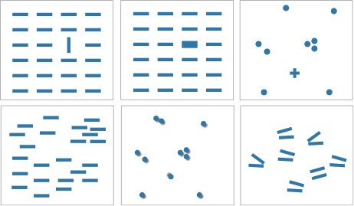
Popout
many channels: tilt, size, shape, proximity, shadow direction, ...
but not all! parallel line pairs do not pop out from tilted pairs
Notes:
Fig 5.12

Slide 42
Grouping
containment
connection
proximity
same spatial region
similarity
same values as other categorical channels

Slide 43
Relative vs. absolute judgements
perceptual system mostly operates with relative judgements, not absolute
that’s why accuracy increases with common frame/scale and alignment
Weber’s Law: ratio of increment to background is constant
filled rectangles differ in length by 1:9, difficult judgement
white rectangles differ in length by 1:2, easy judgement
length
position along unaligned common scale
position along aligned scale
after [Graphical Perception: Theory, Experimentation, and Application to the Development of Graphical Methods. Cleveland and McGill. Journ. American Statistical Association 79:387 (1984), 531–554.]
length
position along unaligned common scale
position along aligned scale

Slide 44
Relative luminance judgements
perception of luminance is contextual based on contrast with surroundings
http://persci.mit.edu/gallery/checkershadow

Slide 45
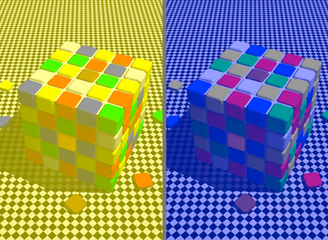
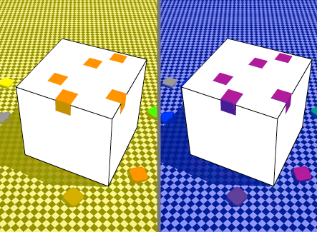
Relative color judgements
color constancy across broad range of illumination conditions
http://www.purveslab.net/seeforyourself/

Slide 46
Further reading
Visualization Analysis and Design. Munzner. AK Peters Visualization Series, CRC Press, 2014.
Chap 5: Marks and Channels
On the Theory of Scales of Measurement. Stevens. Science 103:2684 (1946), 677–680.
Psychophysics: Introduction to its Perceptual, Neural, and Social Prospects. Stevens. Wiley, 1975.
Graphical Perception: Theory, Experimentation, and Application to the Development of Graphical Methods. Cleveland and McGill. Journ. American Statistical Association 79:387 (1984), 531–554.
Perception in Vision. Healey. http://www.csc.ncsu.edu/faculty/healey/PP
Visual Thinking for Design. Ware. Morgan Kaufmann, 2008.
Information Visualization: Perception for Design, 3rd edition. Ware. Morgan Kaufmann /Academic Press, 2004.

Slide 47
Outline
Session 1 8:30-10:00am Visualization Analysis Framework
Introduction: Definitions
Analysis: What, Why, How
Marks and Channels
Session 2 10:30am-12:00pm Spatial Layout
Arrange Tables
Arrange Spatial Data
Arrange Networks and Trees
Session 3 1:00-2:30pm Color & Interaction
Map Color
Manipulate: Change, Select, Navigate
Facet: Juxtapose, Partition, Superimpose
Session 4 3:00-4:30pm Guidelines and Examples
Reduce: Filter, Aggregate
Rules of Thumb
Q&A
http://www.cs.ubc.ca/~tmm/talks.html#vad16act
@tamaramunzner

Slide 49
Encode tables: Arrange space

Slide 50
Arrange tables

Slide 51
Keys and values
key
independent attribute
used as unique index to look up items
simple tables: 1 key
multidimensional tables: multiple keys
value
dependent attribute, value of cell
classify arrangements by key count
0, 1, 2, many...
Notes:
Figs 7.1, 2.2
same small font problem as above

Slide 52
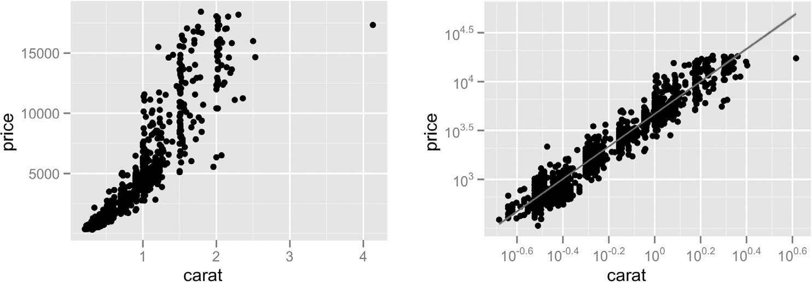
Idiom: scatterplot
express values
quantitative attributes
no keys, only values
data
2 quant attribs
mark: points
channels
horiz + vert position
tasks
find trends, outliers, distribution, correlation, clusters
scalability
hundreds of items
[A layered grammar of graphics. Wickham. Journ. Computational and Graphical Statistics 19:1 (2010), 3–28.]

Slide 53
Some keys: Categorical regions
regions: contiguous bounded areas distinct from each other
using space to separate (proximity)
following expressiveness principle for categorical attributes
use ordered attribute to order and align regions

Slide 54
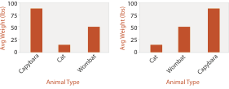
Idiom: bar chart
one key, one value
data
1 categ attrib, 1 quant attrib
mark: lines
channels
length to express quant value
spatial regions: one per mark
separated horizontally, aligned vertically
ordered by quant attrib
by label (alphabetical), by length attrib (data-driven)
task
compare, lookup values
scalability
dozens to hundreds of levels for key attrib

Slide 55
Idiom: line chart
one key, one value
data
2 quant attribs
mark: points
line connection marks between them
channels
aligned lengths to express quant value
separated and ordered by key attrib into horizontal regions
task
find trend
connection marks emphasize ordering of items along key axis by explicitly showing relationship between one item and the next

Slide 56
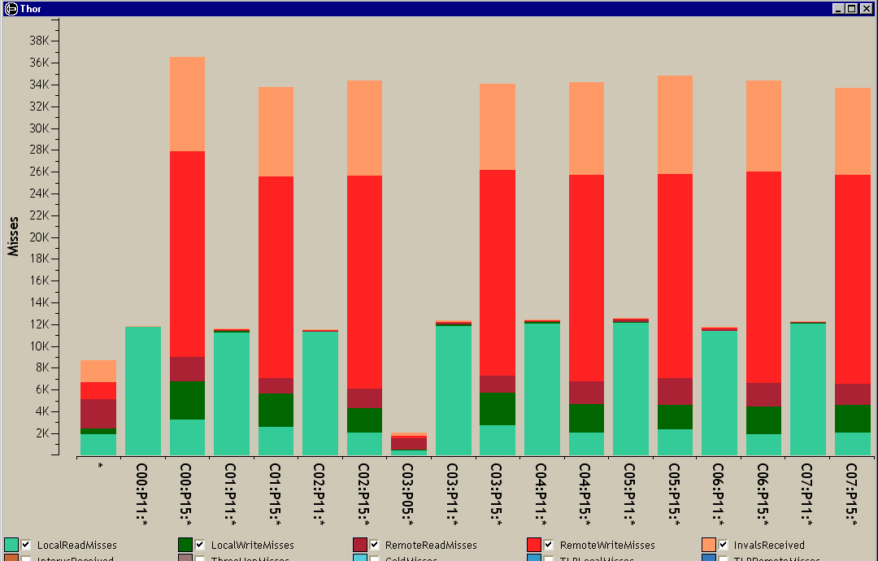
Idiom: stacked bar chart
one more key
data
2 categ attrib, 1 quant attrib
mark: vertical stack of line marks
glyph: composite object, internal structure from multiple marks
channels
length and color hue
spatial regions: one per glyph
aligned: full glyph, lowest bar component
unaligned: other bar components
task
part-to-whole relationship
scalability
several to one dozen levels for stacked attrib
[Using Visualization to Understand the Behavior of Computer Systems. Bosch. Ph.D. thesis, Stanford Computer Science, 2001.]
Notes:
Thor computer memory profiler. The key used to distribute composite bars along the axis is the combination of a processor and a procedure. The key used to stack and color the glyph subcomponents is the type of cache miss; the height of each full bar encodes all cache misses for each processor-procedure combination.

Slide 57
Idiom: streamgraph
generalized stacked graph
emphasizing horizontal continuity
vs vertical items
data
1 categ key attrib (artist)
1 ordered key attrib (time)
1 quant value attrib (counts)
derived data
geometry: layers, where height encodes counts
1 quant attrib (layer ordering)
scalability
hundreds of time keys
dozens to hundreds of artist keys
more than stacked bars, since most layers don’t extend across whole chart
[Stacked Graphs Geometry & Aesthetics. Byron and Wattenberg. IEEE Trans. Visualization and Computer Graphics (Proc. InfoVis 2008) 14(6): 1245–1252, (2008).]

Slide 58
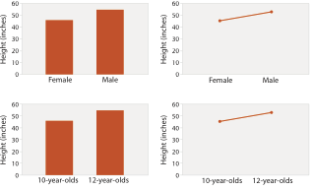
Choosing bar vs line charts
depends on type of key attrib
bar charts if categorical
line charts if ordered
do not use line charts for categorical key attribs
violates expressiveness principle
implication of trend so strong that it overrides semantics!
“The more male a person is, the taller he/she is”
after [Bars and Lines: A Study of Graphic Communication. Zacks and Tversky. Memory and Cognition 27:6 (1999), 1073–1079.]
Notes:
good: height increases with age, 12 year olds are taller than 10 year olds
bad: the more male a person is, the taller he or she is

Slide 59
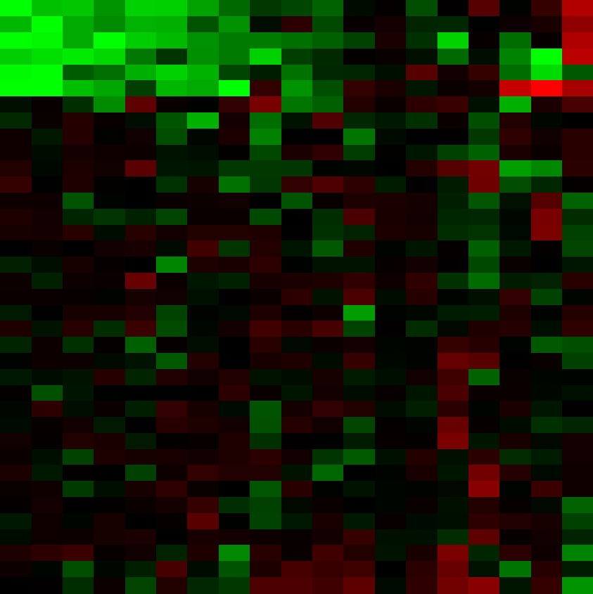
Idiom: heatmap
two keys, one value
data
2 categ attribs (gene, experimental condition)
1 quant attrib (expression levels)
marks: area
separate and align in 2D matrix
indexed by 2 categorical attributes
channels
color by quant attrib
(ordered diverging colormap)
task
find clusters, outliers
scalability
1M items, 100s of categ levels, ~10 quant attrib levels

Slide 61
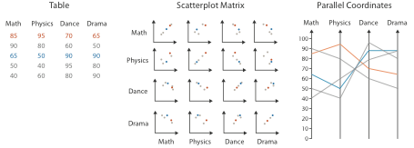
Idioms: scatterplot matrix, parallel coordinates
scatterplot matrix (SPLOM)
rectilinear axes, point mark
all possible pairs of axes
scalability
one dozen attribs
dozens to hundreds of items
parallel coordinates
parallel axes, jagged line representing item
rectilinear axes, item as point
axis ordering is major challenge
scalability
dozens of attribs
hundreds of items
after [Visualization Course Figures. McGuffin, 2014. http://www.michaelmcguffin.com/courses/vis/]

Slide 62
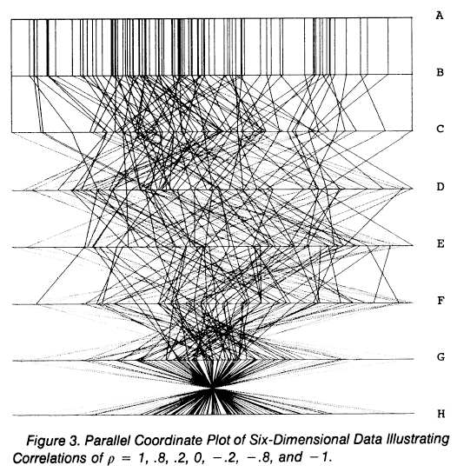
Task: Correlation
scatterplot matrix
positive correlation
diagonal low-to-high
negative correlation
diagonal high-to-low
uncorrelated
parallel coordinates
positive correlation
parallel line segments
negative correlation
all segments cross at halfway point
uncorrelated
scattered crossings
[A layered grammar of graphics. Wickham. Journ. Computational and Graphical Statistics 19:1 (2010), 3–28.]
[Hyperdimensional Data Analysis Using Parallel Coordinates. Wegman. Journ. American Statistical Association 85:411 (1990), 664–675.]

Slide 63
Idioms: radial bar chart, star plot
radial bar chart
radial axes meet at central ring, line mark
star plot
radial axes, meet at central point, line mark
bar chart
rectilinear axes, aligned vertically
accuracy
length unaligned with radial
less accurate than aligned with rectilinear
[Vismon: Facilitating Risk Assessment and Decision Making In Fisheries Management. Booshehrian, Möller, Peterman, and Munzner. Technical Report TR 2011-04, Simon Fraser University, School of Computing Science, 2011.]

Slide 64
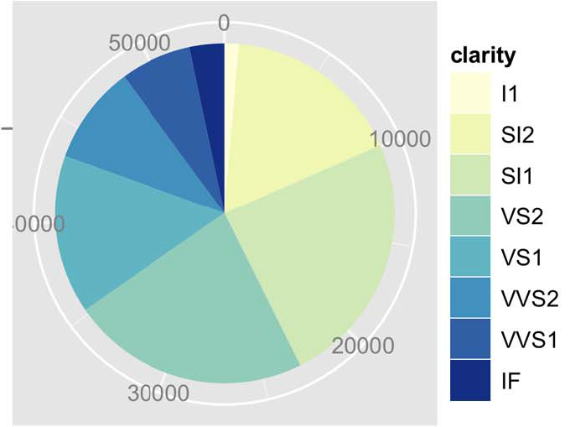
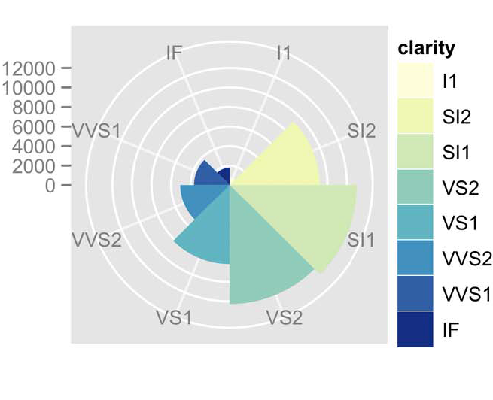
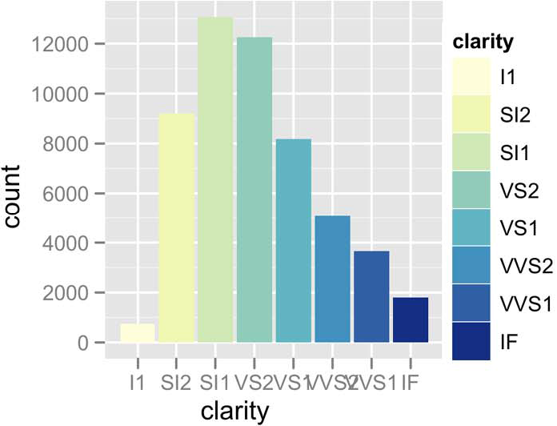
Idioms: pie chart, polar area chart
pie chart
area marks with angle channel
accuracy: angle/area less accurate than line length
arclength also less accurate than line length
polar area chart
area marks with length channel
more direct analog to bar charts
data
1 categ key attrib, 1 quant value attrib
task
part-to-whole judgements
[A layered grammar of graphics. Wickham. Journ. Computational and Graphical Statistics 19:1 (2010), 3–28.]

Slide 65
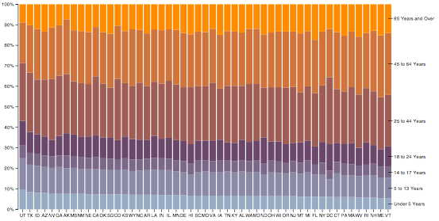
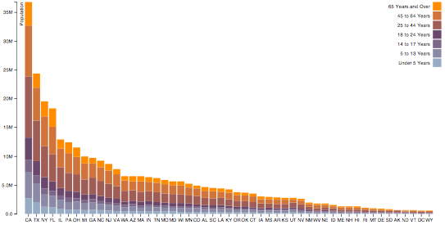
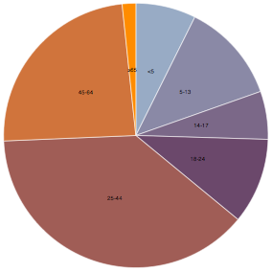
Idioms: normalized stacked bar chart
task
part-to-whole judgements
normalized stacked bar chart
stacked bar chart, normalized to full vert height
single stacked bar equivalent to full pie
high information density: requires narrow rectangle
pie chart
information density: requires large circle
http://bl.ocks.org/mbostock/3887235,
http://bl.ocks.org/mbostock/3886208,
http://bl.ocks.org/mbostock/3886394.

Slide 66
Idiom: glyphmaps
rectilinear good for linear vs nonlinear trends
radial good for cyclic patterns
[Glyph-maps for Visually Exploring Temporal Patterns in Climate Data and Models. Wickham, Hofmann, Wickham, and Cook. Environmetrics 23:5 (2012), 382–393.]

Slide 67
Orientation limitations
rectilinear: scalability wrt #axes
2 axes best
3 problematic
more in afternoon
4+ impossible
parallel: unfamiliarity, training time
radial: perceptual limits
angles lower precision than lengths
asymmetry between angle and length
can be exploited!
[Uncovering Strengths and Weaknesses of Radial Visualizations - an Empirical Approach. Diehl, Beck and Burch. IEEE TVCG (Proc. InfoVis) 16(6):935--942, 2010.]

Slide 68
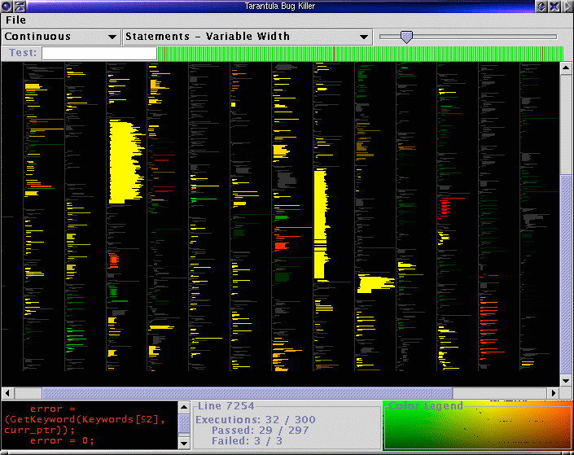
dense software overviews
[Visualization of test information to assist fault localization. Jones, Harrold, Stasko. Proc. ICSE 2002, p 467-477.]

Slide 69
Further reading
Visualization Analysis and Design. Munzner. AK Peters Visualization Series, CRC Press, 2014.
Chap 7: Arrange Tables
Visualizing Data. Cleveland. Hobart Press, 1993.
A Brief History of Data Visualization. Friendly. 2008. http://www.datavis.ca/milestones

Slide 70
Outline
Session 1 8:30-10:00am Visualization Analysis Framework
Introduction: Definitions
Analysis: What, Why, How
Marks and Channels
Session 2 10:30am-12:00pm Spatial Layout
Arrange Tables
Arrange Spatial Data
Arrange Networks and Trees
Session 3 1:00-2:30pm Color & Interaction
Map Color
Manipulate: Change, Select, Navigate
Facet: Juxtapose, Partition, Superimpose
Session 4 3:00-4:30pm Guidelines and Examples
Reduce: Filter, Aggregate
Rules of Thumb
Q&A
http://www.cs.ubc.ca/~tmm/talks.html#vad16act
@tamaramunzner

Slide 71
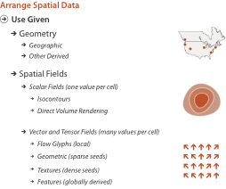
Arrange spatial data

Slide 72
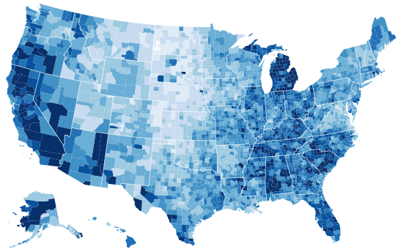
Idiom: choropleth map
use given spatial data
when central task is understanding spatial relationships
data
geographic geometry
table with 1 quant attribute per region
encoding
use given geometry for area mark boundaries
sequential segmented colormap [more later]
http://bl.ocks.org/mbostock/4060606

Slide 73
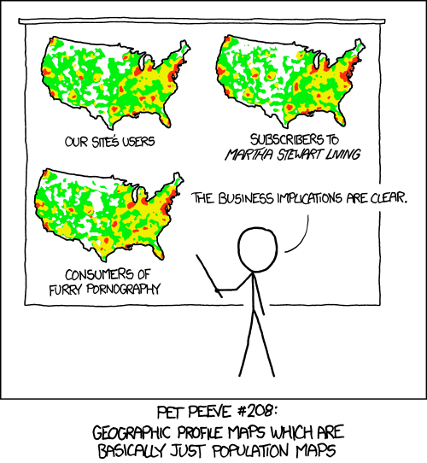
Beware: Population maps trickiness!
[ https://xkcd.com/1138 ]

Slide 74
Idiom: topographic map
data
geographic geometry
scalar spatial field
1 quant attribute per grid cell
derived data
isoline geometry
isocontours computed for specific levels of scalar values
Land Information New Zealand Data Service

Slide 75
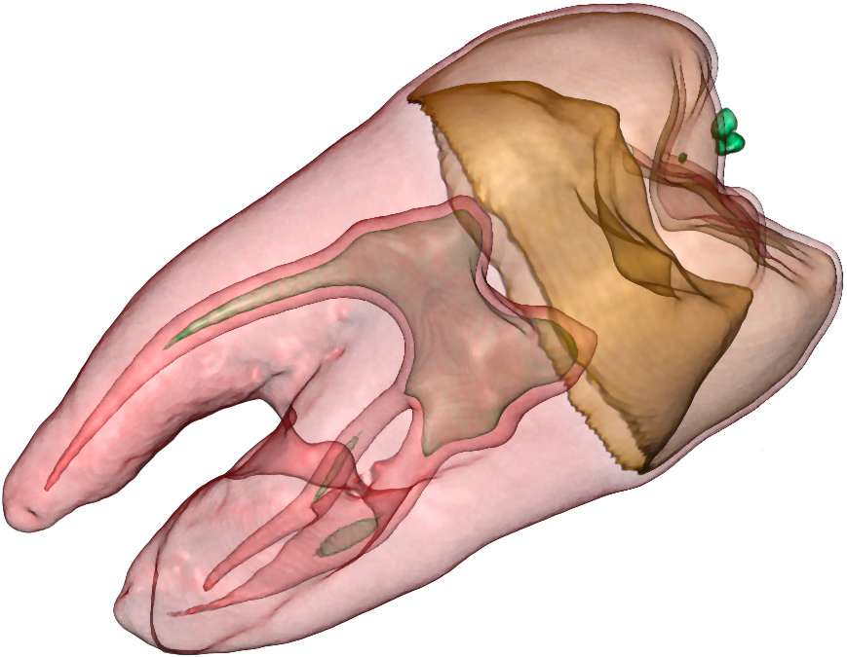
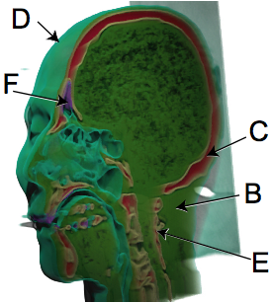
Idioms: isosurfaces, direct volume rendering
data
scalar spatial field
1 quant attribute per grid cell
task
shape understanding, spatial relationships
isosurface
derived data: isocontours computed for specific levels of scalar values
direct volume rendering
transfer function maps scalar values to color, opacity
no derived geometry
[Interactive Volume Rendering Techniques. Kniss. Master’s thesis, University of Utah Computer Science, 2002.]
[Multidimensional Transfer Functions for Volume Rendering. Kniss, Kindlmann, and Hansen. In The Visualization Handbook, edited by Charles Hansen and Christopher Johnson, pp. 189–210. Elsevier, 2005.]

Slide 76
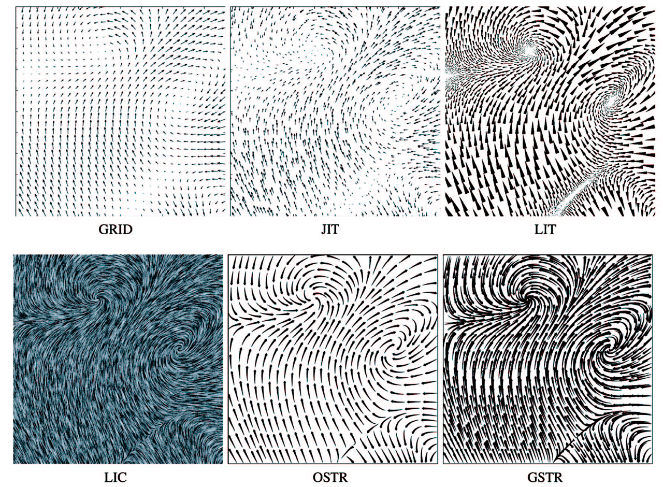
Vector and tensor fields
data
many attribs per cell
idiom families
flow glyphs
purely local
geometric flow
derived data from tracing particle trajectories
sparse set of seed points
texture flow
derived data, dense seeds
feature flow
global computation to detect features
encoded with one of methods above
[Comparing 2D vector field visualization methods: A user study. Laidlaw et al. IEEE Trans. Visualization and Computer Graphics (TVCG) 11:1 (2005), 59–70.]
[Topology tracking for the visualization of time-dependent two-dimensional flows. Tricoche, Wischgoll, Scheuermann, and Hagen. Computers & Graphics 26:2 (2002), 249–257.]
Notes:
three local glyph idioms, one dense texture idiom, and two geometric idioms using streamlines.
a) GRID: arrow glyphs on a regular grid. b) JIT: arrow glyphs on a jittered grid. c) LIT: triangular wedge glyphs inspired by oil painting strokes. d) LIC: dense texture-based idiom. e) OSTR: curved arrow glyphs with image-guided streamline seeding. f) GSTR: curved arrow glyphs with regular grid streamline seeding. From [Laidlaw et al. 05], Fig- ure 1.

Slide 77
Vector fields
empirical study tasks
finding critical points, identifying their types
identifying what type of critical point is at a specific location
predicting where a particle starting at a specified point will end up (advection)
[Comparing 2D vector field visualization methods: A user study. Laidlaw et al. IEEE Trans. Visualization and Computer Graphics (TVCG) 11:1 (2005), 59–70.]
[Topology tracking for the visualization of time-dependent two-dimensional flows. Tricoche, Wischgoll, Scheuermann, and Hagen. Computers & Graphics 26:2 (2002), 249–257.]
Notes:
three local glyph idioms, one dense texture idiom, and two geometric idioms using streamlines.
a) GRID: arrow glyphs on a regular grid. b) JIT: arrow glyphs on a jittered grid. c) LIT: triangular wedge glyphs inspired by oil painting strokes. d) LIC: dense texture-based idiom. e) OSTR: curved arrow glyphs with image-guided streamline seeding. f) GSTR: curved arrow glyphs with regular grid streamline seeding. From [Laidlaw et al. 05], Fig- ure 1.

Slide 78
Idiom: similarity-clustered streamlines
data
3D vector field
derived data (from field)
streamlines: trajectory particle will follow
derived data (per streamline)
curvature, torsion, tortuosity
signature: complex weighted combination
compute cluster hierarchy across all signatures
encode: color and opacity by cluster
tasks
find features, query shape
scalability
millions of samples, hundreds of streamlines
[Similarity Measures for Enhancing Interactive Streamline Seeding. McLoughlin,. Jones, Laramee, Malki, Masters, and. Hansen. IEEE Trans. Visualization and Computer Graphics 19:8 (2013), 1342–1353.]
Notes:
curvature, namely the curve’s deviation from a straight line; torsion, namely how much the curve bends, out of its plane; and tortuosity, namely how twisted the curve is.

Slide 79
Further reading
Visualization Analysis and Design. Munzner. AK Peters Visualization Series, CRC Press, 2014.
Chap 8: Arrange Spatial Data
How Maps Work: Representation, Visualization, and Design. MacEachren. Guilford Press, 1995.
Overview of visualization. Schroeder and. Martin. In The Visualization Handbook, edited by Charles Hansen and Christopher Johnson, pp. 3–39. Elsevier, 2005.
Real-Time Volume Graphics. Engel, Hadwiger, Kniss, Reza-Salama, and Weiskopf. AK Peters, 2006.
Overview of flow visualization. Weiskopf and Erlebacher. In The Visualization Handbook, edited by Charles Hansen and Christopher Johnson, pp. 261–278. Elsevier, 2005.

Slide 80
Outline
Session 1 8:30-10:00am Visualization Analysis Framework
Introduction: Definitions
Analysis: What, Why, How
Marks and Channels
Session 2 10:30am-12:00pm Spatial Layout
Arrange Tables
Arrange Spatial Data
Arrange Networks and Trees
Session 3 1:00-2:30pm Color & Interaction
Map Color
Manipulate: Change, Select, Navigate
Facet: Juxtapose, Partition, Superimpose
Session 4 3:00-4:30pm Guidelines and Examples
Reduce: Filter, Aggregate
Rules of Thumb
Q&A
http://www.cs.ubc.ca/~tmm/talks.html#vad16act
@tamaramunzner

Slide 81
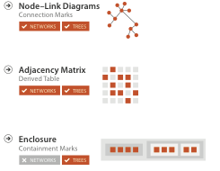
Arrange networks and trees

Slide 82
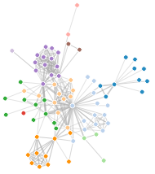
Idiom: force-directed placement
visual encoding
link connection marks, node point marks
considerations
spatial position: no meaning directly encoded
left free to minimize crossings
proximity semantics?
sometimes meaningful
sometimes arbitrary, artifact of layout algorithm
tension with length
long edges more visually salient than short
tasks
explore topology; locate paths, clusters
scalability
node/edge density E < 4N
http://mbostock.github.com/d3/ex/force.html

Slide 83
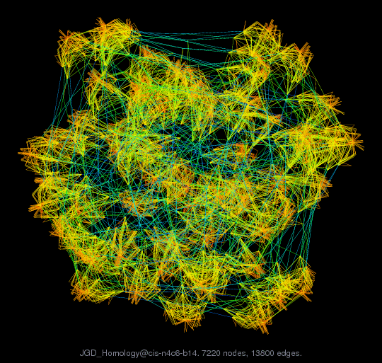
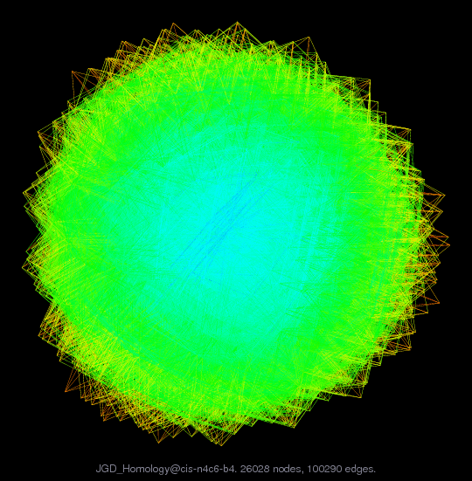
Idiom: sfdp (multi-level force-directed placement)
data
original: network
derived: cluster hierarchy atop it
considerations
better algorithm for same encoding technique
same: fundamental use of space
hierarchy used for algorithm speed/quality but not shown explicitly
(more on algorithm vs encoding in afternoon)
scalability
nodes, edges: 1K-10K
hairball problem eventually hits
[Efficient and high quality force-directed graph drawing. Hu. The Mathematica Journal 10:37–71, 2005.]
http://www.research.att.com/yifanhu/GALLERY/GRAPHS/index1.html
Notes:
hairball: 26K nodes, 100K edges

Slide 84
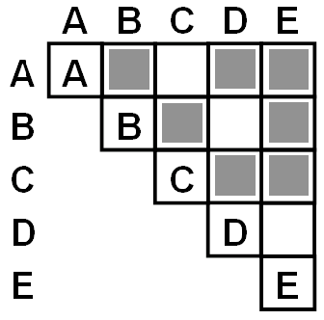
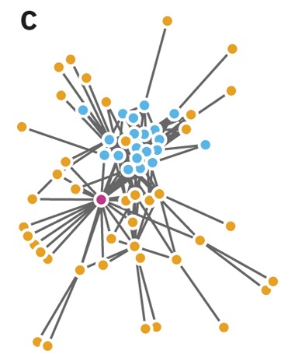
Idiom: adjacency matrix view
data: network
transform into same data/encoding as heatmap
derived data: table from network
1 quant attrib
weighted edge between nodes
2 categ attribs: node list x 2
visual encoding
cell shows presence/absence of edge
scalability
1K nodes, 1M edges
[NodeTrix: a Hybrid Visualization of Social Networks. Henry, Fekete, and McGuffin. IEEE TVCG (Proc. InfoVis) 13(6):1302-1309, 2007.]
[Points of view: Networks. Gehlenborg and Wong. Nature Methods 9:115.]

Slide 85
Connection vs. adjacency comparison
adjacency matrix strengths
predictability, scalability, supports reordering
some topology tasks trainable
node-link diagram strengths
topology understanding, path tracing
intuitive, no training needed
empirical study
node-link best for small networks
matrix best for large networks
if tasks don’t involve topological structure!
http://www.michaelmcguffin.com/courses/vis/patternsInAdjacencyMatrix.png
[On the readability of graphs using node-link and matrix-based representations: a controlled experiment and statistical analysis. Ghoniem, Fekete, and Castagliola. Information Visualization 4:2 (2005), 114–135.]

Slide 86
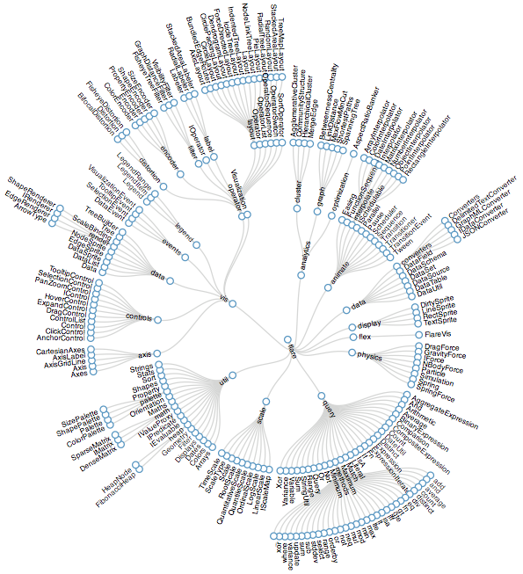
Idiom: radial node-link tree
data
tree
encoding
link connection marks
point node marks
radial axis orientation
angular proximity: siblings
distance from center: depth in tree
tasks
understanding topology, following paths
scalability
1K - 10K nodes
http://mbostock.github.com/d3/ex/tree.html

Slide 87
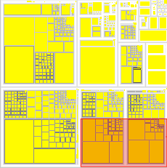
Idiom: treemap
data
tree
1 quant attrib at leaf nodes
encoding
area containment marks for hierarchical structure
rectilinear orientation
size encodes quant attrib
tasks
query attribute at leaf nodes
scalability
1M leaf nodes
http://tulip.labri.fr/Documentation/3_7/userHandbook/html/ch06.html

Slide 88
Link marks: Connection and containment
marks as links (vs. nodes)
common case in network drawing
1D case: connection
ex: all node-link diagrams
emphasizes topology, path tracing
networks and trees
2D case: containment
ex: all treemap variants
emphasizes attribute values at leaves (size coding)
only trees
[Elastic Hierarchies: Combining Treemaps and Node-Link Diagrams. Dong, McGuffin, and Chignell. Proc. InfoVis 2005, p. 57-64.]
Notes:
many techniques using each method

Slide 89
Tree drawing idioms comparison
data shown
link relationships
tree depth
sibling order
design choices
connection vs containment link marks
rectilinear vs radial layout
spatial position channels
considerations
redundant? arbitrary?
information density?
avoid wasting space
[Quantifying the Space-Efficiency of 2D Graphical Representations of Trees. McGuffin and Robert. Information Visualization 9:2 (2010), 115–140.]

Slide 90
Further reading
Visualization Analysis and Design. Munzner. AK Peters Visualization Series, CRC Press, 2014.
Chap 9: Arrange Networks and Trees
Visual Analysis of Large Graphs: State-of-the-Art and Future Research Challenges. von Landesberger et al. Computer Graphics Forum 30:6 (2011), 1719–1749.
Simple Algorithms for Network Visualization: A Tutorial. McGuffin. Tsinghua Science and Technology (Special Issue on Visualization and Computer Graphics) 17:4 (2012), 383–398.
Drawing on Physical Analogies. Brandes. In Drawing Graphs: Methods and Models, LNCS Tutorial, 2025, edited by M. Kaufmann and D. Wagner, LNCS Tutorial, 2025, pp. 71–86. Springer-Verlag, 2001.
http://www.treevis.net Treevis.net: A Tree Visualization Reference. Schulz. IEEE Computer Graphics and Applications 31:6 (2011), 11–15.
Perceptual Guidelines for Creating Rectangular Treemaps. Kong, Heer, and Agrawala. IEEE Trans. Visualization and Computer Graphics (Proc. InfoVis) 16:6 (2010), 990–998.

Slide 91
Outline
Session 1 8:30-10:00am Visualization Analysis Framework
Introduction: Definitions
Analysis: What, Why, How
Marks and Channels
Session 2 10:30am-12:00pm Spatial Layout
Arrange Tables
Arrange Spatial Data
Arrange Networks and Trees
Session 3 1:00-2:30pm Color & Interaction
Map Color
Manipulate: Change, Select, Navigate
Facet: Juxtapose, Partition, Superimpose
Session 4 3:00-4:30pm Guidelines and Examples
Reduce: Filter, Aggregate
Rules of Thumb
Q&A
http://www.cs.ubc.ca/~tmm/talks.html#vad16act
@tamaramunzner

Slide 92
Idiom design choices: Encode

Slide 93
Categorical vs ordered color
[Seriously Colorful: Advanced Color Principles & Practices. Stone.Tableau Customer Conference 2014.]

Slide 94
Color: Luminance, saturation, hue
3 channels
identity for categorical
hue
magnitude for ordered
luminance
saturation
RGB: poor for encoding
HSL: better, but beware
lightness ≠ luminance

Slide 95
Spectral sensitivity

Slide 96
Opponent color and color deficiency
perceptual processing before optic nerve
one achromatic luminance channel L
edge detection through luminance contrast
two chroma channels, R-G and Y-B axis
“color blind” if one axis has degraded acuity
8% of men are red/green color deficient
blue/yellow is rare
Lightness information
Color information
[Seriously Colorful: Advanced Color Principles & Practices. Stone.Tableau Customer Conference 2014.]

Slide 97
Designing for color deficiency: Check with simulator
Normal vision
Deuteranope
Protanope
Tritanope
http://rehue.net
[Seriously Colorful: Advanced Color Principles & Practices. Stone.Tableau Customer Conference 2014.]

Slide 98
Designing for color deficiency: Avoid encoding by hue alone
redundantly encode
vary luminance
change shape
Deuteranope simulation
Change the shape
Vary luminance
[Seriously Colorful: Advanced Color Principles & Practices. Stone.Tableau Customer Conference 2014.]
Notes:
Focus and annotate

Slide 99
Color deficiency: Reduces color to 2 dimensions
Normal
Protanope
Deuteranope
Tritanope
[Seriously Colorful: Advanced Color Principles & Practices. Stone.Tableau Customer Conference 2014.]
Notes:
Discuss what part of the hue space is missing. Note the darkening caused by protan. Note the loss of distinction between yellow, orange, red, green. Blue-purple, and also gray-brown. Could show the Tableau colors here.

Slide 100
Designing for color deficiency: Blue-Orange is safe
[Seriously Colorful: Advanced Color Principles & Practices. Stone.Tableau Customer Conference 2014.]

Slide 101
Bezold Effect: Outlines matter
color constancy: simultaneous contrast effect
[Seriously Colorful: Advanced Color Principles & Practices. Stone.Tableau Customer Conference 2014.]

Slide 102
Color/Lightness constancy: Illumination conditions
Image courtesy of John McCann

Slide 103
Color/Lightness constancy: Illumination conditions
Image courtesy of John McCann

Slide 104
Colormaps
after [Color Use Guidelines for Mapping and Visualization. Brewer, 1994. http://www.personal.psu.edu/faculty/c/a/cab38/ColorSch/Schemes.html]
Notes:
fix still needed: categorial for qualitative

Slide 105
Colormaps
after [Color Use Guidelines for Mapping and Visualization. Brewer, 1994. http://www.personal.psu.edu/faculty/c/a/cab38/ColorSch/Schemes.html]
Notes:
fix still needed: categorial for qualitative

Slide 106
Colormaps
use with care!
after [Color Use Guidelines for Mapping and Visualization. Brewer, 1994. http://www.personal.psu.edu/faculty/c/a/cab38/ColorSch/Schemes.html]
Notes:
fix still needed: categorial for qualitative

Slide 107
Colormaps
color channel interactions
size heavily affects salience
small regions need high saturation
large need low saturation
saturation & luminance: 3-4 bins max
also not separable from transparency
after [Color Use Guidelines for Mapping and Visualization. Brewer, 1994. http://www.personal.psu.edu/faculty/c/a/cab38/ColorSch/Schemes.html]
Notes:
fix still needed: categorial for qualitative

Slide 108
Categorical color: Discriminability constraints
noncontiguous small regions of color: only 6-12 bins
[Cinteny: flexible analysis and visualization of synteny and genome rearrangements in multiple organisms. Sinha and Meller. BMC Bioinformatics, 8:82, 2007.]
Notes:
emphasize: greens/blues can't tell apart

Slide 109
ColorBrewer
http://www.colorbrewer2.org
saturation and area example: size affects salience!

Slide 110
Ordered color: Rainbow is poor default
problems
perceptually unordered
perceptually nonlinear
benefits
fine-grained structure visible and nameable
[A Rule-based Tool for Assisting Colormap Selection. Bergman,. Rogowitz, and. Treinish. Proc. IEEE Visualization (Vis), pp. 118–125, 1995.]
[Why Should Engineers Be Worried About Color? Treinish and Rogowitz 1998. http://www.research.ibm.com/people/l/lloydt/color/color.HTM]
[Transfer Functions in Direct Volume Rendering: Design, Interface, Interaction. Kindlmann. SIGGRAPH 2002 Course Notes]

Slide 111
Ordered color: Rainbow is poor default
problems
perceptually unordered
perceptually nonlinear
benefits
fine-grained structure visible and nameable
alternatives
large-scale structure: fewer hues
[A Rule-based Tool for Assisting Colormap Selection. Bergman,. Rogowitz, and. Treinish. Proc. IEEE Visualization (Vis), pp. 118–125, 1995.]
[Why Should Engineers Be Worried About Color? Treinish and Rogowitz 1998. http://www.research.ibm.com/people/l/lloydt/color/color.HTM]
[Transfer Functions in Direct Volume Rendering: Design, Interface, Interaction. Kindlmann. SIGGRAPH 2002 Course Notes]

Slide 112
Ordered color: Rainbow is poor default
problems
perceptually unordered
perceptually nonlinear
benefits
fine-grained structure visible and nameable
alternatives
large-scale structure: fewer hues
fine structure: multiple hues with monotonically increasing luminance [eg viridis R/python]
[A Rule-based Tool for Assisting Colormap Selection. Bergman,. Rogowitz, and. Treinish. Proc. IEEE Visualization (Vis), pp. 118–125, 1995.]
[Why Should Engineers Be Worried About Color? Treinish and Rogowitz 1998. http://www.research.ibm.com/people/l/lloydt/color/color.HTM]
[Transfer Functions in Direct Volume Rendering: Design, Interface, Interaction. Kindlmann. SIGGRAPH 2002 Course Notes]

Slide 113
Ordered color: Rainbow is poor default
problems
perceptually unordered
perceptually nonlinear
benefits
fine-grained structure visible and nameable
alternatives
large-scale structure: fewer hues
fine structure: multiple hues with monotonically increasing luminance [eg viridis R/python]
segmented rainbows for binned
or categorical
[A Rule-based Tool for Assisting Colormap Selection. Bergman,. Rogowitz, and. Treinish. Proc. IEEE Visualization (Vis), pp. 118–125, 1995.]
[Why Should Engineers Be Worried About Color? Treinish and Rogowitz 1998. http://www.research.ibm.com/people/l/lloydt/color/color.HTM]
[Transfer Functions in Direct Volume Rendering: Design, Interface, Interaction. Kindlmann. SIGGRAPH 2002 Course Notes]

Slide 114
Viridis
colorful, perceptually uniform, colorblind-safe, monotonically increasing luminance
https://cran.r-project.org/web/packages/viridis/vignettes/intro-to-viridis.html

Slide 115
Map other channels
size
length accurate, 2D area ok, 3D volume poor
angle
nonlinear accuracy
horizontal, vertical, exact diagonal
shape
complex combination of lower-level primitives
many bins
motion
highly separable against static
binary: great for highlighting
use with care to avoid irritation
Notes:
standin for now: needs to change

Slide 116
Angle
Notes:
swap with new linebreak figure if done in time

Slide 117
Further reading
Visualization Analysis and Design. Munzner. AK Peters Visualization Series, CRC Press, 2014
Chap 10: Map Color and Other Channels
ColorBrewer, Brewer.
http://www.colorbrewer2.org
Color In Information Display. Stone. IEEE Vis Course Notes, 2006.
http://www.stonesc.com/Vis06
A Field Guide to Digital Color. Stone. AK Peters, 2003.
Rainbow Color Map (Still) Considered Harmful. Borland and Taylor. IEEE Computer Graphics and Applications 27:2 (2007), 14–17.
Visual Thinking for Design. Ware. Morgan Kaufmann, 2008.
Information Visualization: Perception for Design, 3rd edition. Ware. Morgan Kaufmann /Academic Press, 2004.
https://cran.r-project.org/web/packages/viridis/vignettes/intro-to-viridis.html

Slide 118
Outline
Session 1 8:30-10:00am Visualization Analysis Framework
Introduction: Definitions
Analysis: What, Why, How
Marks and Channels
Session 2 10:30am-12:00pm Spatial Layout
Arrange Tables
Arrange Spatial Data
Arrange Networks and Trees
Session 3 1:00-2:30pm Color & Interaction
Map Color
Manipulate: Change, Select, Navigate
Facet: Juxtapose, Partition, Superimpose
Session 4 3:00-4:30pm Guidelines and Examples
Reduce: Filter, Aggregate
Rules of Thumb
Q&A
http://www.cs.ubc.ca/~tmm/talks.html#vad16act
@tamaramunzner

Slide 120
How to handle complexity: 1 previous strategy + 3 more
derive new data to show within view
change view over time
facet across multiple views
reduce items/attributes within single view

Slide 121
Manipulate
Notes:
change any of the other choices
encoding itself
parameters
arrange: rearrange, reorder
aggregation level, what is filtered...
most obvious, powerful, flexible
interaction entails change

Slide 122
Change over time
change any of the other choices
encoding itself
parameters
arrange: rearrange, reorder
aggregation level, what is filtered...
interaction entails change

Slide 123
Idiom: Re-encode
System: Tableau
made using Tableau, http://tableausoftware.com

Slide 124
Idiom: Reorder
System: LineUp
data: tables with many attributes
task: compare rankings
[LineUp: Visual Analysis of Multi-Attribute Rankings. Gratzl, Lex, Gehlenborg, Pfister, and Streit. IEEE Trans. Visualization and Computer Graphics (Proc. InfoVis 2013) 19:12 (2013), 2277–2286.]

Slide 125
Idiom: Realign
System: LineUp
stacked bars
easy to compare
first segment
total bar
align to different segment
supports flexible comparison
[LineUp: Visual Analysis of Multi-Attribute Rankings.Gratzl, Lex, Gehlenborg, Pfister, and Streit. IEEE Trans. Visualization and Computer Graphics (Proc. InfoVis 2013) 19:12 (2013), 2277–2286.]
Notes:
video: 1:06 to 1:10 fisheye
1:31 reorder, 2:04 sort, 2:34 end of reordering

Slide 126
Idiom: Animated transitions
smooth transition from one state to another
alternative to jump cuts
support for item tracking when amount of change is limited
example: multilevel matrix views
example: animated transitions in statistical data graphics
https://vimeo.com/19278444
[Using Multilevel Call Matrices in Large Software Projects. van Ham. Proc. IEEE Symp. Information Visualization (InfoVis), pp. 227–232, 2003.]

Slide 127
Select and highlight
selection: basic operation for most interaction
design choices
how many selection types?
click vs hover: heavyweight, lightweight
primary vs secondary: semantics (eg source/target)
highlight: change visual encoding for selection targets
color
limitation: existing color coding hidden
other channels (eg motion)
add explicit connection marks between items
Notes:
jump back 3 slides to show grey selected row

Slide 128
Navigate: Changing item visibility
change viewpoint
changes which items are visible within view
camera metaphor
zoom
geometric zoom: familiar semantics
semantic zoom: adapt object representation based on available pixels
dramatic change, or more subtle one
pan/translate
rotate
especially in 3D
constrained navigation
often with animated transitions
often based on selection set
Notes:
jump back 3 slides to show grey selected row

Slide 129
Idiom: Semantic zooming
System: LiveRAC
visual encoding change
colored box
sparkline
simple line chart
full chart: axes and tickmarks
[LiveRAC - Interactive Visual Exploration of System Management Time-Series Data. McLachlan, Munzner, Koutsofios, and North. Proc. ACM Conf. Human Factors in Computing Systems (CHI), pp. 1483–1492, 2008.]

Slide 130
Navigate: Reducing attributes
continuation of camera metaphor
slice
show only items matching specific value for given attribute: slicing plane
axis aligned, or arbitrary alignment
cut
show only items on far slide of plane from camera
project
change mathematics of image creation
orthographic
perspective
many others: Mercator, cabinet, ...
[Interactive Visualization of Multimodal Volume Data for Neurosurgical Tumor Treatment. Rieder, Ritter, Raspe, and Peitgen. Computer Graphics Forum (Proc. EuroVis 2008) 27:3 (2008), 1055–1062.]
Notes:
jump back 3 slides to show grey selected row

Slide 131
Further reading
Visualization Analysis and Design. Munzner. AK Peters Visualization Series, CRC Press, 2014.
Chap 11: Manipulate View
Animated Transitions in Statistical Data Graphics. Heer and Robertson. IEEE Trans. on Visualization and Computer Graphics (Proc. InfoVis07) 13:6 (2007), 1240– 1247.
Selection: 524,288 Ways to Say “This is Interesting”. Wills. Proc. IEEE Symp. Information Visualization (InfoVis), pp. 54–61, 1996.
Smooth and efficient zooming and panning. van Wijk and Nuij. Proc. IEEE Symp. Information Visualization (InfoVis), pp. 15–22, 2003.
Starting Simple - adding value to static visualisation through simple interaction. Dix and Ellis. Proc. Advanced Visual Interfaces (AVI), pp. 124–134, 1998.

Slide 132
Outline
Session 1 8:30-10:00am Visualization Analysis Framework
Introduction: Definitions
Analysis: What, Why, How
Marks and Channels
Session 2 10:30am-12:00pm Spatial Layout
Arrange Tables
Arrange Spatial Data
Arrange Networks and Trees
Session 3 1:00-2:30pm Color & Interaction
Map Color
Manipulate: Change, Select, Navigate
Facet: Juxtapose, Partition, Superimpose
Session 4 3:00-4:30pm Color & Interaction
Reduce: Filter, Aggregate
Rules of Thumb
Q&A
http://www.cs.ubc.ca/~tmm/talks.html#vad16act
@tamaramunzner

Slide 133
Facet

Slide 134
Juxtapose and coordinate views

Slide 135
Idiom: Linked highlighting
System: EDV
see how regions contiguous in one view are distributed within another
powerful and pervasive interaction idiom
encoding: different
multiform
data: all shared
[Visual Exploration of Large Structured Datasets. Wills. Proc. New Techniques and Trends in Statistics (NTTS), pp. 237–246. IOS Press, 1995.]
Notes:
Linked highlighting between views shows how regions that are contiguous in one view are distributed within another. (a) Selecting the high salaries in the upper right window shows different distributions in the other views. (b) Selecting the bottom group in the Assists-Putouts window shows that the clump corresponds to specific positions played.

Slide 136
Idiom: bird’s-eye maps
System: Google Maps
encoding: same
data: subset shared
navigation: shared
bidirectional linking
differences
viewpoint
(size)
overview-detail
[A Review of Overview+Detail, Zooming, and Focus+Context Interfaces. Cockburn, Karlson, and Bederson. ACM Computing Surveys 41:1 (2008), 1–31.]

Slide 137
Idiom: Small multiples
System: Cerebral
encoding: same
data: none shared
different attributes for node colors
(same network layout)
navigation: shared
[Cerebral: Visualizing Multiple Experimental Conditions on a Graph with Biological Context. Barsky, Munzner, Gardy, and Kincaid. IEEE Trans. Visualization and Computer Graphics (Proc. InfoVis 2008) 14:6 (2008), 1253–1260.]

Slide 138
Coordinate views: Design choice interaction
why juxtapose views?
benefits: eyes vs memory
lower cognitive load to move eyes between 2 views than remembering previous state with single changing view
costs: display area, 2 views side by side each have only half the area of one view

Slide 139
Why not animation?
disparate frames and regions: comparison difficult
vs contiguous frames
vs small region
vs coherent motion of group
safe special case
animated transitions

Slide 140
System: Improvise
investigate power of multiple views
pushing limits on view count, interaction complexity
how many is ok?
open research question
reorderable lists
easy lookup
useful when linked to other encodings
[Building Highly-Coordinated Visualizations In Improvise. Weaver. Proc. IEEE Symp. Information Visualization (InfoVis), pp. 159–166, 2004.]
Notes:
geographic and multidimensional table (census data): 1 key attrib (county), many quantitative attribs (demographic information) views: scatterplot matrix, parallel coordinates, choropleth map with size-coded city points, birdseye map overview, scatterplot, reorderable text lists, text matrix. bivariate sequential-sequential colormap partition: small-multiple, multiform, overview-detail views; linked highlighting

Slide 141
Partition into views
how to divide data between views
split into regions by attributes
encodes association between items using spatial proximity
order of splits has major implications for what patterns are visible
no strict dividing line
view: big/detailed
contiguous region in which visually encoded data is shown on the display
glyph: small/iconic
object with internal structure that arises from multiple marks
Notes:
Partioning and grouping are inverse terms; the term partitioning is natural when considering starting from the top and gradually refining; the term grouping is more natural when considering a bottom-up process of gradually consolidating. Conditioning is a synonym for partitioning that is used heavily in the statistics literature.

Slide 142
Partitioning: List alignment
single bar chart with grouped bars
split by state into regions
complex glyph within each region showing all ages
compare: easy within state, hard across ages
small-multiple bar charts
split by age into regions
one chart per region
compare: easy within age, harder across states

Slide 143
Partitioning: Recursive subdivision
System: HIVE
split by neighborhood
then by type
then time
years as rows
months as columns
color by price
neighborhood patterns
where it’s expensive
where you pay much more for detached type
[Configuring Hierarchical Layouts to Address Research Questions. Slingsby, Dykes, and Wood. IEEE Transactions on Visualization and Computer Graphics (Proc. InfoVis 2009) 15:6 (2009), 977–984.]

Slide 144
Partitioning: Recursive subdivision
System: HIVE
switch order of splits
type then neighborhood
switch color
by price variation
type patterns
within specific type, which neighborhoods inconsistent
[Configuring Hierarchical Layouts to Address Research Questions. Slingsby, Dykes, and Wood. IEEE Transactions on Visualization and Computer Graphics (Proc. InfoVis 2009) 15:6 (2009), 977–984.]

Slide 145
Partitioning: Recursive subdivision
System: HIVE
different encoding for second-level regions
choropleth maps
[Configuring Hierarchical Layouts to Address Research Questions. Slingsby, Dykes, and Wood. IEEE Transactions on Visualization and Computer Graphics (Proc. InfoVis 2009) 15:6 (2009), 977–984.]

Slide 146
Partitioning: Recursive subdivision
System: HIVE
size regions by sale counts
not uniformly
result: treemap
[Configuring Hierarchical Layouts to Address Research Questions. Slingsby, Dykes, and Wood. IEEE Transactions on Visualization and Computer Graphics (Proc. InfoVis 2009) 15:6 (2009), 977–984.]

Slide 147
Superimpose layers
layer: set of objects spread out over region
each set is visually distinguishable group
extent: whole view
design choices
how many layers, how to distinguish?
encode with different, nonoverlapping channels
two layers achieveable, three with careful design
small static set, or dynamic from many possible?

Slide 148
Static visual layering
foreground layer: roads
hue, size distinguishing main from minor
high luminance contrast from background
background layer: regions
desaturated colors for water, parks, land areas
user can selectively focus attention
“get it right in black and white”
check luminance contrast with greyscale view
[Get it right in black and white. Stone. 2010. http://www.stonesc.com/wordpress/2010/03/get-it-right-in-black-and-white]

Slide 149
Superimposing limits
few layers, but many lines
up to a few dozen
but not hundreds
superimpose vs juxtapose: empirical study
superimposed for local, multiple for global
tasks
local: maximum, global: slope, discrimination
same screen space for all multiples vs single superimposed
[Graphical Perception of Multiple Time Series. Javed, McDonnel, and Elmqvist. IEEE Transactions on Visualization and Computer Graphics (Proc. IEEE InfoVis 2010) 16:6 (2010), 927–934.]
Notes:
local maximum task of finding the time series with the highest value at a specific point in time, global slope task of finding the time series with the highest increase during the entire time period, and the global discrimination task to check whether values were higher at different time points across the series.

Slide 150
Dynamic visual layering
System: Cerebral
interactive, from selection
lightweight: click
very lightweight: hover
ex: 1-hop neighbors
[Cerebral: a Cytoscape plugin for layout of and interaction with biological networks using subcellular localization annotation. Barsky, Gardy, Hancock, and Munzner. Bioinformatics 23:8 (2007), 1040–1042.]

Slide 151
Further reading
Visualization Analysis and Design. Munzner. AK Peters Visualization Series, CRC Press, 2014.
Chap 12: Facet Into Multiple Views
A Review of Overview+Detail, Zooming, and Focus+Context Interfaces. Cockburn, Karlson, and Bederson. ACM Computing Surveys 41:1 (2008), 1–31.
A Guide to Visual Multi-Level Interface Design From Synthesis of Empirical Study Evidence. Lam and Munzner. Synthesis Lectures on Visualization Series, Morgan Claypool, 2010.
Zooming versus multiple window interfaces: Cognitive costs of visual comparisons. Plumlee and Ware. ACM Trans. on Computer-Human Interaction (ToCHI) 13:2 (2006), 179–209.
Exploring the Design Space of Composite Visualization. Javed and Elmqvist. Proc. Pacific Visualization Symp. (PacificVis), pp. 1–9, 2012.
Visual Comparison for Information Visualization. Gleicher, Albers, Walker, Jusufi, Hansen, and Roberts. Information Visualization 10:4 (2011), 289–309.
Guidelines for Using Multiple Views in Information Visualizations. Baldonado, Woodruff, and Kuchinsky. In Proc. ACM Advanced Visual Interfaces (AVI), pp. 110–119, 2000.
Cross-Filtered Views for Multidimensional Visual Analysis. Weaver. IEEE Trans. Visualization and Computer Graphics 16:2 (Proc. InfoVis 2010), 192–204, 2010.
Linked Data Views. Wills. In Handbook of Data Visualization, Computational Statistics, edited by Unwin, Chen, and Härdle, pp. 216–241. Springer-Verlag, 2008.
Glyph-based Visualization: Foundations, Design Guidelines, Techniques and Applications. Borgo, Kehrer, Chung, Maguire, Laramee, Hauser, Ward, and Chen. In Eurographics State of the Art Reports, pp. 39–63, 2013.

Slide 152
Outline
Session 1 8:30-10:00am Visualization Analysis Framework
Introduction: Definitions
Analysis: What, Why, How
Marks and Channels
Session 2 10:30am-12:00pm Spatial Layout
Arrange Tables
Arrange Spatial Data
Arrange Networks and Trees
Session 3 1:00-2:30pm Color & Interaction
Map Color
Manipulate: Change, Select, Navigate
Facet: Juxtapose, Partition, Superimpose
Session 4 3:00-4:30pm Guidelines and Examples
Reduce: Filter, Aggregate
Rules of Thumb
Q&A
http://www.cs.ubc.ca/~tmm/talks.html#vad16act
@tamaramunzner

Slide 153
Reduce items and attributes
reduce/increase: inverses
filter
pro: straightforward and intuitive
to understand and compute
con: out of sight, out of mind
aggregation
pro: inform about whole set
con: difficult to avoid losing signal
not mutually exclusive
combine filter, aggregate
combine reduce, change, facet

Slide 154
Idiom: dynamic filtering
System: FilmFinder
item filtering
browse through tightly coupled interaction
alternative to queries that might return far too many or too few
[Visual information seeking: Tight coupling of dynamic query filters with starfield displays. Ahlberg and Shneiderman. Proc. ACM Conf. on Human Factors in Computing Systems (CHI), pp. 313–317, 1994.]

Slide 155
Idiom: DOSFA
attribute filtering
encoding: star glyphs
[Interactive Hierarchical Dimension Ordering, Spacing and Filtering for Exploration Of High Dimensional Datasets. Yang, Peng,Ward, and. Rundensteiner. Proc. IEEE Symp. Information Visualization (InfoVis), pp. 105–112, 2003.]
Notes:
215 attributes representing word counts and 298 points representing documents in a collection of medical abstracts.
plots after the dimensions are ordered by similarity and filtered by both similarity and importance thresholds. The filtered display does show clear visual patterns.

Slide 156
Idiom: histogram
static item aggregation
task: find distribution
data: table
derived data
new table: keys are bins, values are counts
bin size crucial
pattern can change dramatically depending on discretization
opportunity for interaction: control bin size on the fly

Slide 157
Continuous scatterplot
static item aggregation
data: table
derived data: table
key attribs x,y for pixels
quant attrib: overplot density
dense space-filling 2D matrix
color: sequential categorical hue + ordered luminance colormap
[Continuous Scatterplots. Bachthaler and Weiskopf. IEEE TVCG (Proc. Vis 08) 14:6 (2008), 1428–1435. 2008. ]

Slide 158
Idiom: scented widgets
augment widgets for filtering to show information scent
cues to show whether value in drilling down further vs looking elsewhere
concise, in part of screen normally considered control panel
[Scented Widgets: Improving Navigation Cues with Embedded Visualizations. Willett, Heer, and Agrawala. IEEE Trans. Visualization and Computer Graphics (Proc. InfoVis 2007) 13:6 (2007), 1129–1136.]

Slide 159
Idiom: boxplot
static item aggregation
task: find distribution
data: table
derived data
5 quant attribs
median: central line
lower and upper quartile: boxes
lower upper fences: whiskers
values beyond which items are outliers
outliers beyond fence cutoffs explicitly shown
[40 years of boxplots. Wickham and Stryjewski. 2012. had.co.nz]

Slide 160
Idiom: Hierarchical parallel coordinates
dynamic item aggregation
derived data: hierarchical clustering
encoding:
cluster band with variable transparency, line at mean, width by min/max values
color by proximity in hierarchy
[Hierarchical Parallel Coordinates for Exploration of Large Datasets. Fua, Ward, and Rundensteiner. Proc. IEEE Visualization Conference (Vis ’99), pp. 43– 50, 1999.]
Notes:
8 attribs, 230K items

Slide 161
Spatial aggregation
MAUP: Modifiable Areal Unit Problem
gerrymandering (manipulating voting district boundaries) is one example!
[http://www.e-education.psu/edu/geog486/l4_p7.html, Fig 4.cg.6]

Slide 162
Dimensionality reduction
attribute aggregation
derive low-dimensional target space from high-dimensional measured space
use when you can’t directly measure what you care about
true dimensionality of dataset conjectured to be smaller than dimensionality of measurements
latent factors, hidden variables
Malignant
Benign
Tumor
Measurement Data
DR
data: 9D measured space
derived data: 2D target space
46

Slide 163
Idiom: Dimensionality reduction for documents

Slide 164
Further reading
Visualization Analysis and Design. Munzner. AK Peters Visualization Series, CRC Press, 2014.
Chap 13: Reduce Items and Attributes
Hierarchical Aggregation for Information Visualization: Overview, Techniques and Design Guidelines. Elmqvist and Fekete. IEEE Transactions on Visualization and Computer Graphics 16:3 (2010), 439–454.
A Review of Overview+Detail, Zooming, and Focus+Context Interfaces. Cockburn, Karlson, and Bederson. ACM Computing Surveys 41:1 (2008), 1–31.
A Guide to Visual Multi-Level Interface Design From Synthesis of Empirical Study Evidence. Lam and Munzner. Synthesis Lectures on Visualization Series, Morgan Claypool, 2010.

Slide 165
Outline
Session 1 8:30-10:00am Visualization Analysis Framework
Introduction: Definitions
Analysis: What, Why, How
Marks and Channels
Session 2 10:30am-12:00pm Spatial Layout
Arrange Tables
Arrange Spatial Data
Arrange Networks and Trees
Session 3 1:00-2:30pm Color & Interaction
Map Color
Manipulate: Change, Select, Navigate
Facet: Juxtapose, Partition, Superimpose
Session 4 3:00-4:30pm Guidelines and Examples
Reduce: Filter, Aggregate
Rules of Thumb
Q&A
http://www.cs.ubc.ca/~tmm/talks.html#vad16act
@tamaramunzner

Slide 166
Rules of Thumb
No unjustified 3D
Power of the plane
Disparity of depth
Occlusion hides information
Perspective distortion dangers
Tilted text isn’t legible
No unjustified 2D
Eyes beat memory
Resolution over immersion
Overview first, zoom and filter, details on demand
Responsiveness is required
Function first, form next

Slide 167
No unjustified 3D: Power of the plane
high-ranked spatial position channels: planar spatial position
not depth!

Slide 168
No unjustified 3D: Danger of depth
we don’t really live in 3D: we see in 2.05D
acquire more info on image plane quickly from eye movements
acquire more info for depth slower, from head/body motion
Notes:
up/down and sideways: image plane: acquire more info quickly from eye movements
away: depth into scene: only acquire more info from head/body motion

Slide 169
Occlusion hides information
occlusion
interaction complexity
[Distortion Viewing Techniques for 3D Data. Carpendale et al. InfoVis1996.]

Slide 170
Perspective distortion loses information
perspective distortion
interferes with all size channel encodings
power of the plane is lost!
[Visualizing the Results of Multimedia Web Search Engines.
Mukherjea, Hirata, and Hara. InfoVis 96]

Slide 171
3D vs 2D bar charts
3D bars never a good idea!
[http://perceptualedge.com/files/GraphDesignIQ.html]

Slide 172
Tilted text isn’t legible
text legibility
far worse when tilted from image plane
further reading [Exploring and Reducing the Effects of Orientation on Text Readability in Volumetric Displays. Grossman et al. CHI 2007]
[Visualizing the World-Wide Web with the Navigational View Builder.
Mukherjea and Foley. Computer Networks and ISDN Systems, 1995.]
]

Slide 173
No unjustified 3D example: Time-series data
extruded curves: detailed comparisons impossible
[Cluster and Calendar based Visualization of Time Series Data. van Wijk and van Selow, Proc. InfoVis 99.]
Notes:
start with axes explain: power, time of day, day of year
then explain problems

Slide 174
No unjustified 3D example: Transform for new data abstraction
derived data: cluster hierarchy
juxtapose multiple views: calendar, superimposed 2D curves
[Cluster and Calendar based Visualization of Time Series Data. van Wijk and van Selow, Proc. InfoVis 99.]

Slide 175
Justified 3D: shape perception
benefits outweigh costs when task is shape perception for 3D spatial data
interactive navigation supports synthesis across many viewpoints
[Image-Based Streamline Generation and Rendering. Li and Shen. IEEE Trans. Visualization and Computer Graphics (TVCG) 13:3 (2007), 630–640.]

Slide 176
Justified 3D: Economic growth curve
http://www.nytimes.com/interactive/2015/03/19/upshot/3d-yield-curve-economic-growth.html

Slide 177
No unjustified 3D
3D legitimate for true 3D spatial data
3D needs very careful justification for abstract data
enthusiasm in 1990s, but now skepticism
be especially careful with 3D for point clouds or networks
[WEBPATH-a three dimensional Web history. Frecon and Smith. Proc. InfoVis 1999]

Slide 178
No unjustified 2D
consider whether network data requires 2D spatial layout
especially if reading text is central to task!
arranging as network means lower information density and harder label lookup compared to text lists
benefits outweigh costs when topological structure/context important for task
be especially careful for search results, document collections, ontologies

Slide 179
Eyes beat memory
principle: external cognition vs. internal memory
easy to compare by moving eyes between side-by-side views
harder to compare visible item to memory of what you saw
implications for animation
great for choreographed storytelling
great for transitions between two states
poor for many states with changes everywhere
consider small multiples instead
literal
abstract
animation
small multiples
show time with time
show time with space

Slide 180
Eyes beat memory example: Cerebral
small multiples: one graph instance per experimental condition
same spatial layout
color differently, by condition
[Cerebral: Visualizing Multiple Experimental Conditions on a Graph with Biological Context. Barsky, Munzner, Gardy, and Kincaid. IEEE Trans. Visualization and Computer Graphics (Proc. InfoVis 2008) 14:6 (2008), 1253–1260.]

Slide 181
Why not animation?
disparate frames and regions: comparison difficult
vs contiguous frames
vs small region
vs coherent motion of group
safe special case
animated transitions

Slide 182
Change blindness
if attention is directed elsewhere, even drastic changes not noticeable
door experiment
change blindness demos
mask in between images

Slide 183
Resolution beats immersion
immersion typically not helpful for abstract data
do not need sense of presence or stereoscopic 3D
resolution much more important
pixels are the scarcest resource
desktop also better for workflow integration
virtual reality for abstract data very difficult to justify
[Development of an information visualization tool using virtual reality. Kirner and Martins. Proc. Symp. Applied Computing 2000]

Slide 184
Overview first, zoom and filter, details on demand
influential mantra from Shneiderman
overview = summary
microcosm of full vis design problem
[The Eyes Have It: A Task by Data Type Taxonomy for Information Visualizations. Shneiderman. Proc. IEEE Visual Languages, pp. 336–343, 1996.]

Slide 185
Responsiveness is required
three major categories
0.1 seconds: perceptual processing
1 second: immediate response
10 seconds: brief tasks
importance of visual feedback

Slide 186
Function first, form next
start with focus on functionality
straightforward to improve aesthetics later on, as refinement
if no expertise in-house, find good graphic designer to work with
dangerous to start with aesthetics
usually impossible to add function retroactively

Slide 187
Further reading
Visualization Analysis and Design. Tamara Munzner. CRC Press, 2014.
Chap 6: Rules of Thumb
Designing with the Mind in Mind: Simple Guide to Understanding User Interface Design Rules. Jeff Johnson. Morgan Kaufmann, 2010.
Chap 12: We Have Time Requirements

Slide 188
More Information
@tamaramunzner
this talk http://www.cs.ubc.ca/~tmm/talks.html#vad16act
book page (including tutorial lecture slides) http://www.cs.ubc.ca/~tmm/vadbook
20% promo code for book+ebook combo: HVN17
http://www.crcpress.com/product/isbn/9781466508910
illustrations: Eamonn Maguire
papers, videos, software, talks, courses http://www.cs.ubc.ca/group/infovis http://www.cs.ubc.ca/~tmm
Visualization Analysis and Design.
Munzner. A K Peters Visualization Series, CRC Press, Visualization Series, 2014.

