Slide 1
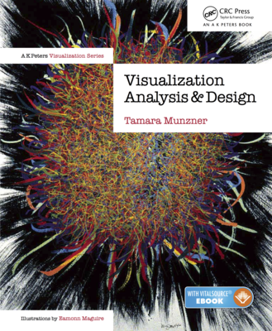
Visualization Analysis & Design
Half-Day Tutorial
Tamara Munzner
Department of Computer Science
University of British Columbia
IEEE VIS 2020 Tutorial
October 2020, Salt Lake City UT (online)
@tamaramunzner
http://www.cs.ubc.ca/~tmm/talks.html#halfdaycourse20

Slide 2
Visualization Analysis & Design, Half-Day Tutorial
Session 1
Analysis: What, Why, How
Marks and Channels
Arrange Tables
Arrange Spatial Data
Session 2
Arrange Networks and Trees
Map Color and Other Channels
Manipulate: Change, Select, Navigate
Facet: Juxtapose, Partition, Superimpose
Reduce: Filter, Aggregate
@tamaramunzner
http://www.cs.ubc.ca/~tmm/talks.html#halfdaycourse20

Slide 3
Defining visualization (vis)
Computer-based visualization systems provide visual representations of datasets designed to help people carry out tasks more effectively.

Slide 4
Defining visualization (vis)
Computer-based visualization systems provide visual representations of datasets designed to help people carry out tasks more effectively.
Why?...

Slide 5
Why have a human in the loop?
Computer-based visualization systems provide visual representations of datasets designed to help people carry out tasks more effectively.

Slide 6
Why have a human in the loop?
Computer-based visualization systems provide visual representations of datasets designed to help people carry out tasks more effectively.
Visualization is suitable when there is a need to augment human capabilities rather than replace people with computational decision-making methods.

Slide 7
Why have a human in the loop?
Computer-based visualization systems provide visual representations of datasets designed to help people carry out tasks more effectively.
Visualization is suitable when there is a need to augment human capabilities rather than replace people with computational decision-making methods.
don’t need vis when fully automatic solution exists and is trusted
many analysis problems ill-specified
don’t know exactly what questions to ask in advance
possibilities
long-term use for end users (ex: exploratory analysis of scientific data)
presentation of known results (ex: New York Times Upshot)
stepping stone to assess requirements before developing models
help automatic solution developers refine & determine parameters
help end users of automatic solutions verify, build trust

Slide 8
Why use an external representation?
Computer-based visualization systems provide visual representations of datasets designed to help people carry out tasks more effectively.
external representation: replace cognition with perception
[Cerebral: Visualizing Multiple Experimental Conditions on a Graph with Biological Context. Barsky, Munzner, Gardy, and Kincaid. IEEE TVCG (Proc. InfoVis) 14(6):1253-1260, 2008.]

Slide 9
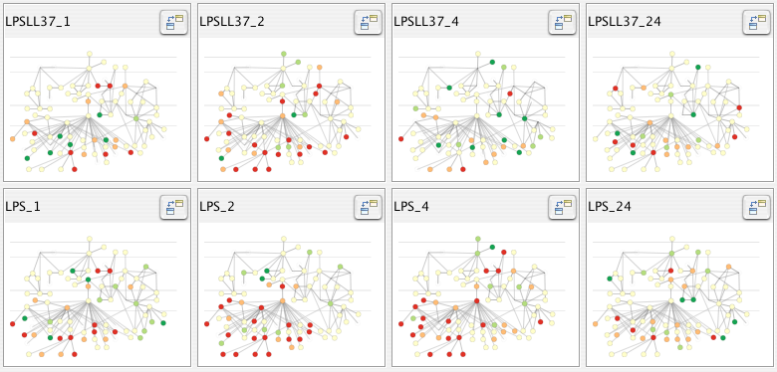
Why use an external representation?
Computer-based visualization systems provide visual representations of datasets designed to help people carry out tasks more effectively.
external representation: replace cognition with perception
[Cerebral: Visualizing Multiple Experimental Conditions on a Graph with Biological Context. Barsky, Munzner, Gardy, and Kincaid. IEEE TVCG (Proc. InfoVis) 14(6):1253-1260, 2008.]

Slide 10
Why represent all the data?
Computer-based visualization systems provide visual representations of datasets designed to help people carry out tasks more effectively.
summaries lose information, details matter
confirm expected and find unexpected patterns
assess validity of statistical model
Anscombe’s Quartet
Identical statistics
x mean | 9
x variance | 10
y mean | 7.5
y variance | 3.75
x/y correlation | 0.816

Slide 11
Why represent all the data?
Computer-based visualization systems provide visual representations of datasets designed to help people carry out tasks more effectively.
summaries lose information, details matter
confirm expected and find unexpected patterns
assess validity of statistical model
Anscombe’s Quartet
Identical statistics
x mean | 9
x variance | 10
y mean | 7.5
y variance | 3.75
x/y correlation | 0.816

Slide 12
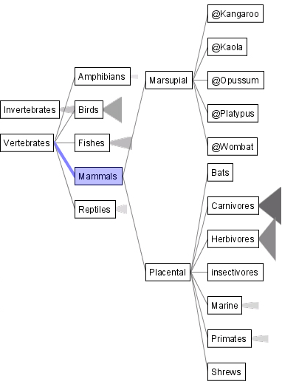
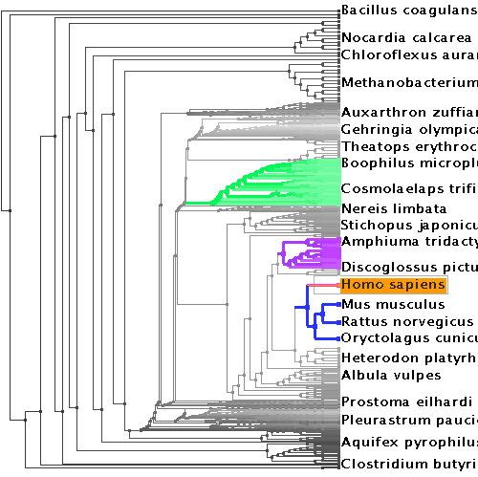
Why analyze?
SpaceTree
TreeJuxtaposer
imposes structure on huge design space
scaffold to help you think systematically about choices
analyzing existing as stepping stone to designing new
most possibilities ineffective for particular task/data combination
[SpaceTree: Supporting Exploration in Large Node Link Tree, Design Evolution and Empirical Evaluation. Grosjean, Plaisant, and Bederson. Proc. InfoVis 2002, p 57–64.]
[TreeJuxtaposer: Scalable Tree Comparison Using Focus+Context With Guaranteed Visibility. ACM Trans. on Graphics (Proc. SIGGRAPH) 22:453– 462, 2003.]

Slide 13
Analysis framework: Four levels, three questions
domain situation
who are the target users?

Slide 14
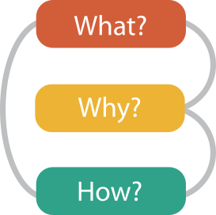
Analysis framework: Four levels, three questions
domain situation
who are the target users?
abstraction
translate from specifics of domain to vocabulary of vis
what is shown? data abstraction
why is the user looking at it? task abstraction
[A Nested Model of Visualization Design and Validation.
Munzner. IEEE TVCG 15(6):921-928, 2009 (Proc. InfoVis 2009). ]
domain
abstraction
idiom
algorithm
[A Multi-Level Typology of Abstract Visualization Tasks
Brehmer and Munzner. IEEE TVCG 19(12):2376-2385, 2013 (Proc. InfoVis 2013). ]

Slide 15
Analysis framework: Four levels, three questions
domain situation
who are the target users?
abstraction
translate from specifics of domain to vocabulary of vis
what is shown? data abstraction
why is the user looking at it? task abstraction
idiom
how is it shown?
visual encoding idiom: how to draw
interaction idiom: how to manipulate
[A Nested Model of Visualization Design and Validation.
Munzner. IEEE TVCG 15(6):921-928, 2009 (Proc. InfoVis 2009). ]
domain
abstraction
idiom
algorithm
[A Multi-Level Typology of Abstract Visualization Tasks
Brehmer and Munzner. IEEE TVCG 19(12):2376-2385, 2013 (Proc. InfoVis 2013). ]

Slide 16
Analysis framework: Four levels, three questions
domain situation
who are the target users?
abstraction
translate from specifics of domain to vocabulary of vis
what is shown? data abstraction
why is the user looking at it? task abstraction
idiom
how is it shown?
visual encoding idiom: how to draw
interaction idiom: how to manipulate
algorithm
efficient computation
[A Nested Model of Visualization Design and Validation.
Munzner. IEEE TVCG 15(6):921-928, 2009 (Proc. InfoVis 2009). ]
domain
abstraction
idiom
algorithm
[A Multi-Level Typology of Abstract Visualization Tasks
Brehmer and Munzner. IEEE TVCG 19(12):2376-2385, 2013 (Proc. InfoVis 2013). ]

Slide 17
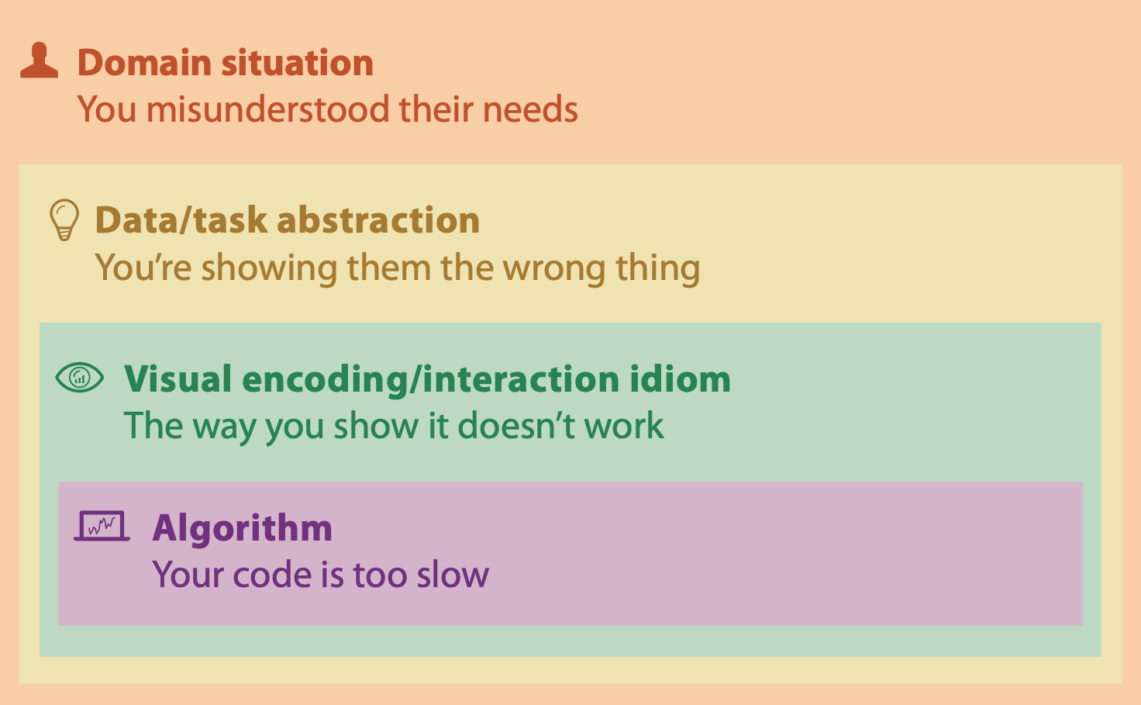
Why is validation difficult?
different ways to get it wrong at each level

Slide 18
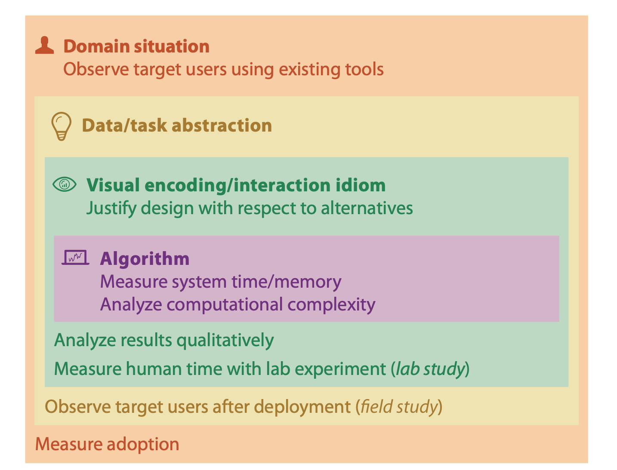
Why is validation difficult?
solution: use methods from different fields at each level
[A Nested Model of Visualization Design and Validation. Munzner. IEEE TVCG 15(6):921-928, 2009 (Proc. InfoVis 2009). ]

Slide 19
Why is validation difficult?
solution: use methods from different fields at each level
computer science
technique-driven work
[A Nested Model of Visualization Design and Validation. Munzner. IEEE TVCG 15(6):921-928, 2009 (Proc. InfoVis 2009). ]

Slide 20
Why is validation difficult?
solution: use methods from different fields at each level
design
computer science
technique-driven work
cognitive psychology
[A Nested Model of Visualization Design and Validation. Munzner. IEEE TVCG 15(6):921-928, 2009 (Proc. InfoVis 2009). ]

Slide 21
Why is validation difficult?
solution: use methods from different fields at each level
problem-driven work (design study)
anthropology/ ethnography
design
computer science
technique-driven work
cognitive psychology
anthropology/ ethnography
[A Nested Model of Visualization Design and Validation. Munzner. IEEE TVCG 15(6):921-928, 2009 (Proc. InfoVis 2009). ]

Slide 22
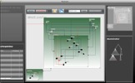
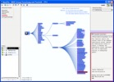
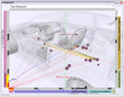
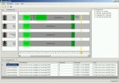
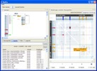
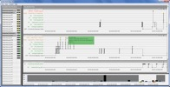
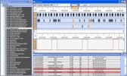
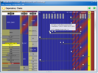
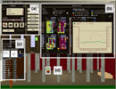
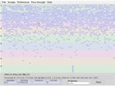
Design Studies: Lessons learned after 21 of them
Cerebral
genomics
MizBee
genomics
Pathline
genomics
MulteeSum
genomics
Vismon
fisheries management
QuestVis
sustainability
WiKeVis
in-car networks
MostVis
in-car networks
Car-X-Ray
in-car networks
ProgSpy2010
in-car networks
RelEx
in-car networks
Cardiogram
in-car networks
AutobahnVis
in-car networks
VisTra
in-car networks
Constellation
linguistics
LibVis
cultural heritage
Caidants
multicast
SessionViewer
web log analysis
LiveRAC
server hosting
PowerSetViewer
data mining
LastHistory
music listening
Notes:
many domains, and visual representations cross-cut them - some different for same domain, some related representations for very different domains

Slide 23
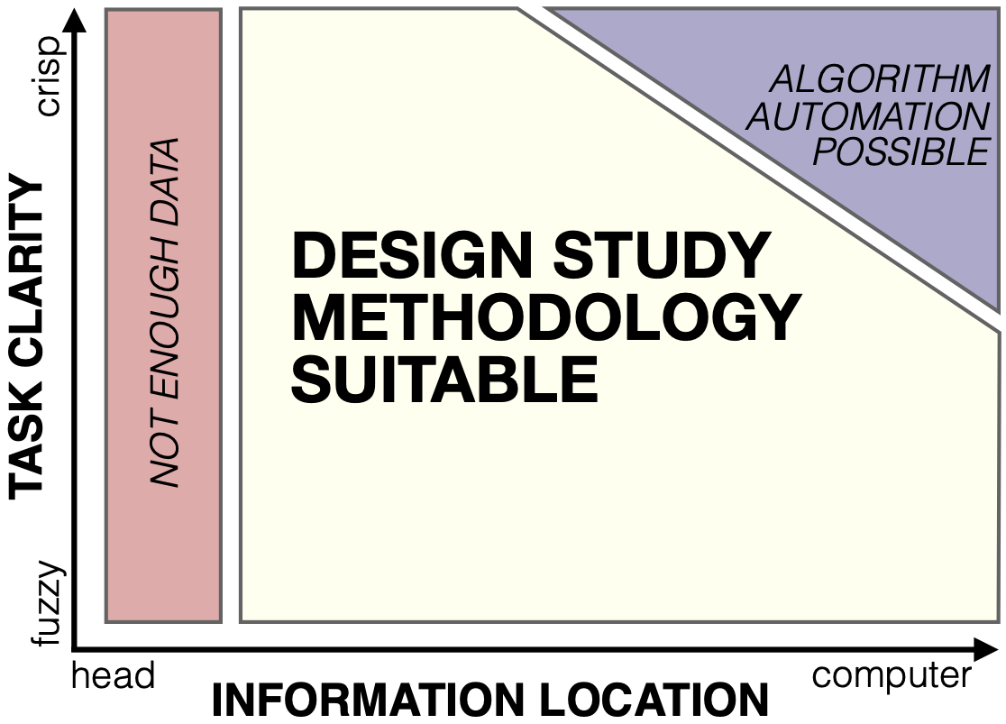
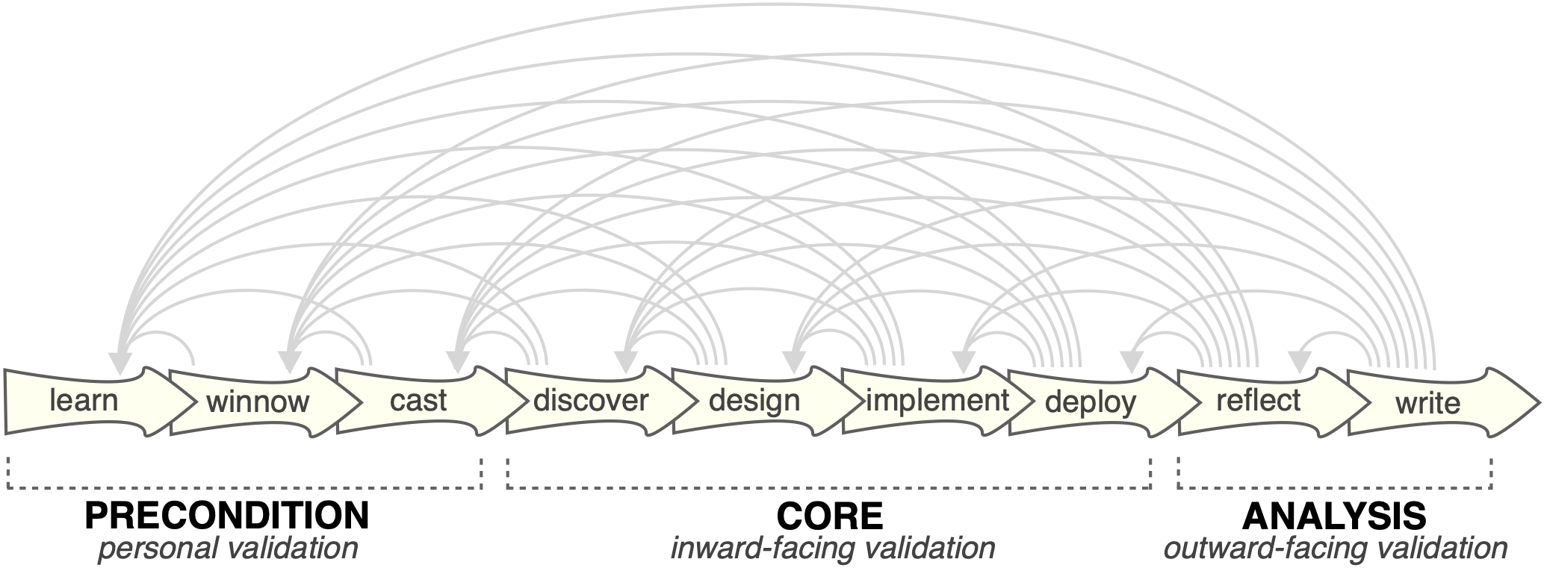
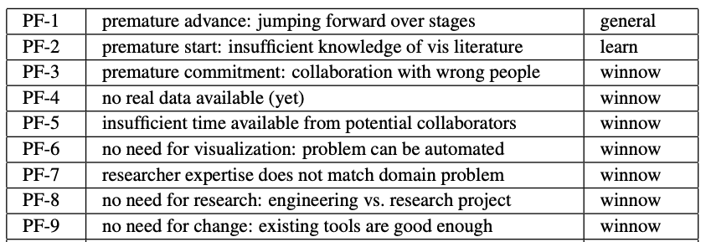
Design Study Methodology: Reflections from the Trenches and the Stacks
definitions
9-stage framework
32 pitfalls and how to avoid them
[Sedlmair, Meyer, Munzner. IEEE Trans. Visualization and Computer Graphics 18(12): 2431-2440, 2012 (Proc. InfoVis 2012).]

Slide 24
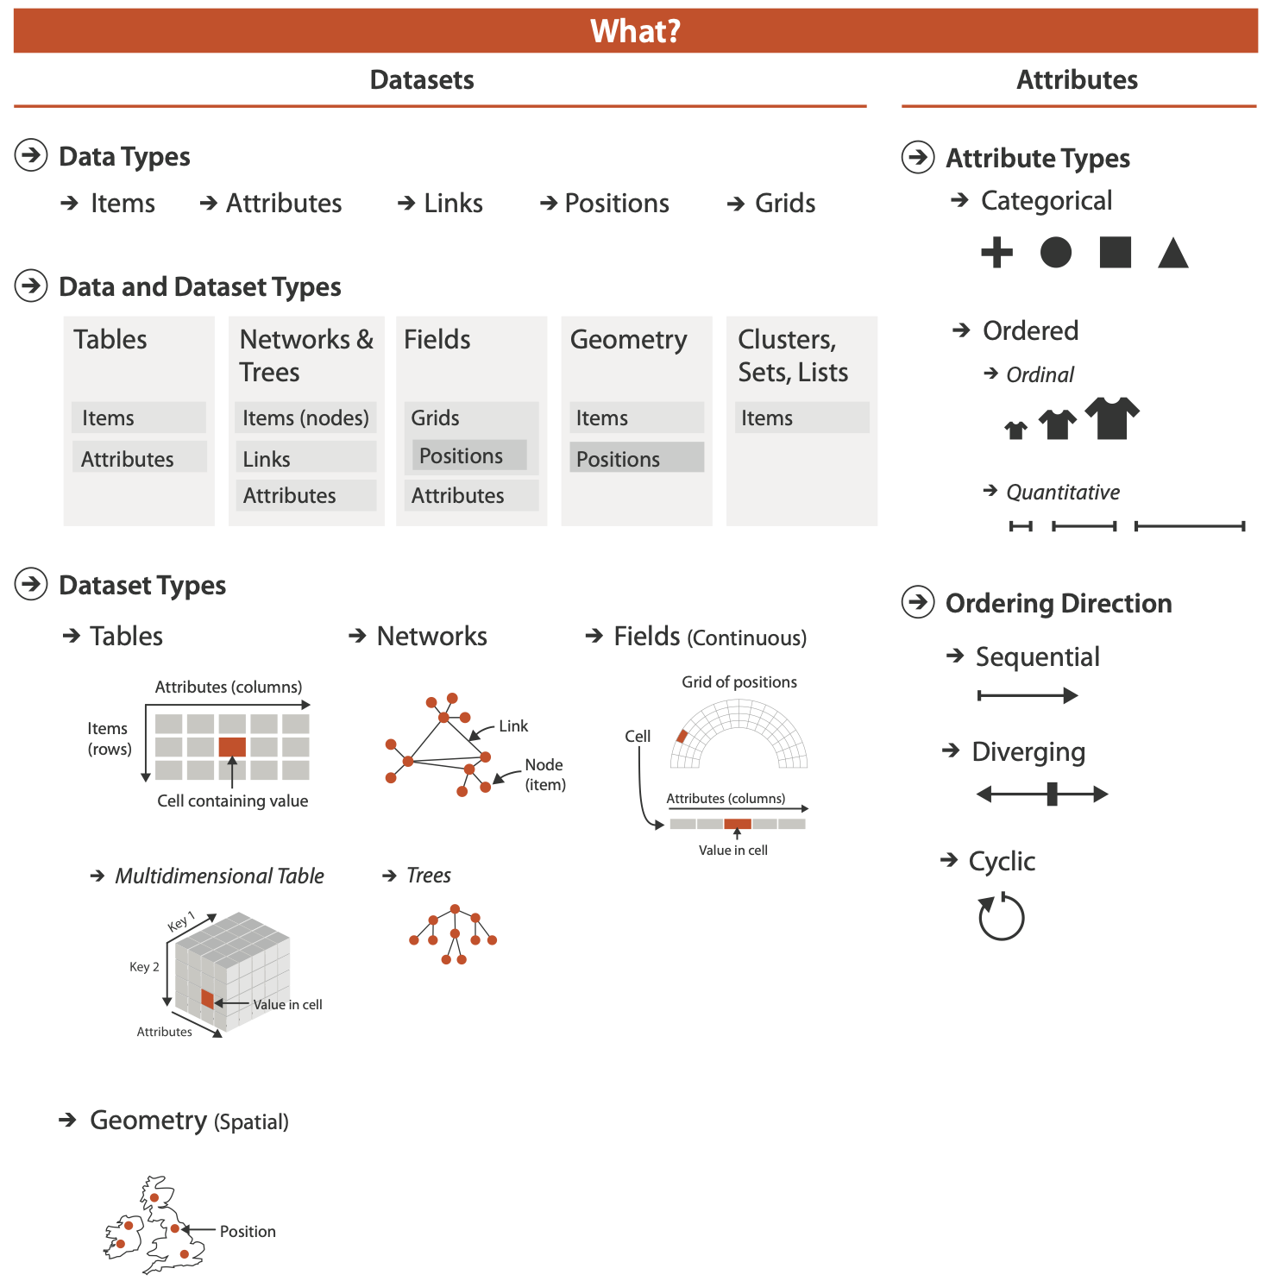

Slide 25
Three major datatypes

Slide 26
Three major datatypes

Slide 27
Three major datatypes

Slide 28
Three major datatypes
Spatial

Slide 29
Three major datatypes
Spatial
visualization vs computer graphics
geometry is design decision

Slide 30
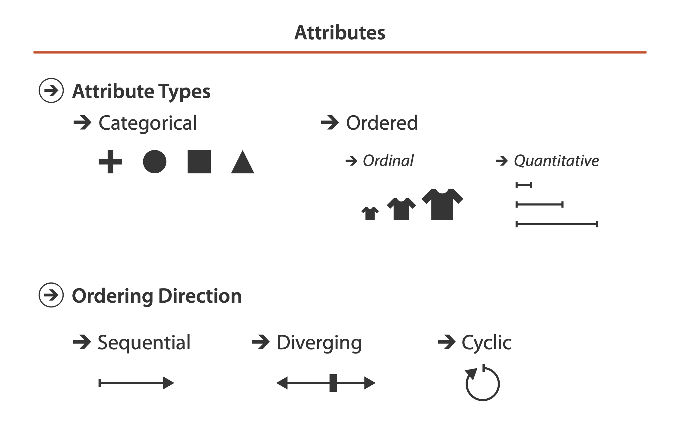
Attribute types

Slide 31
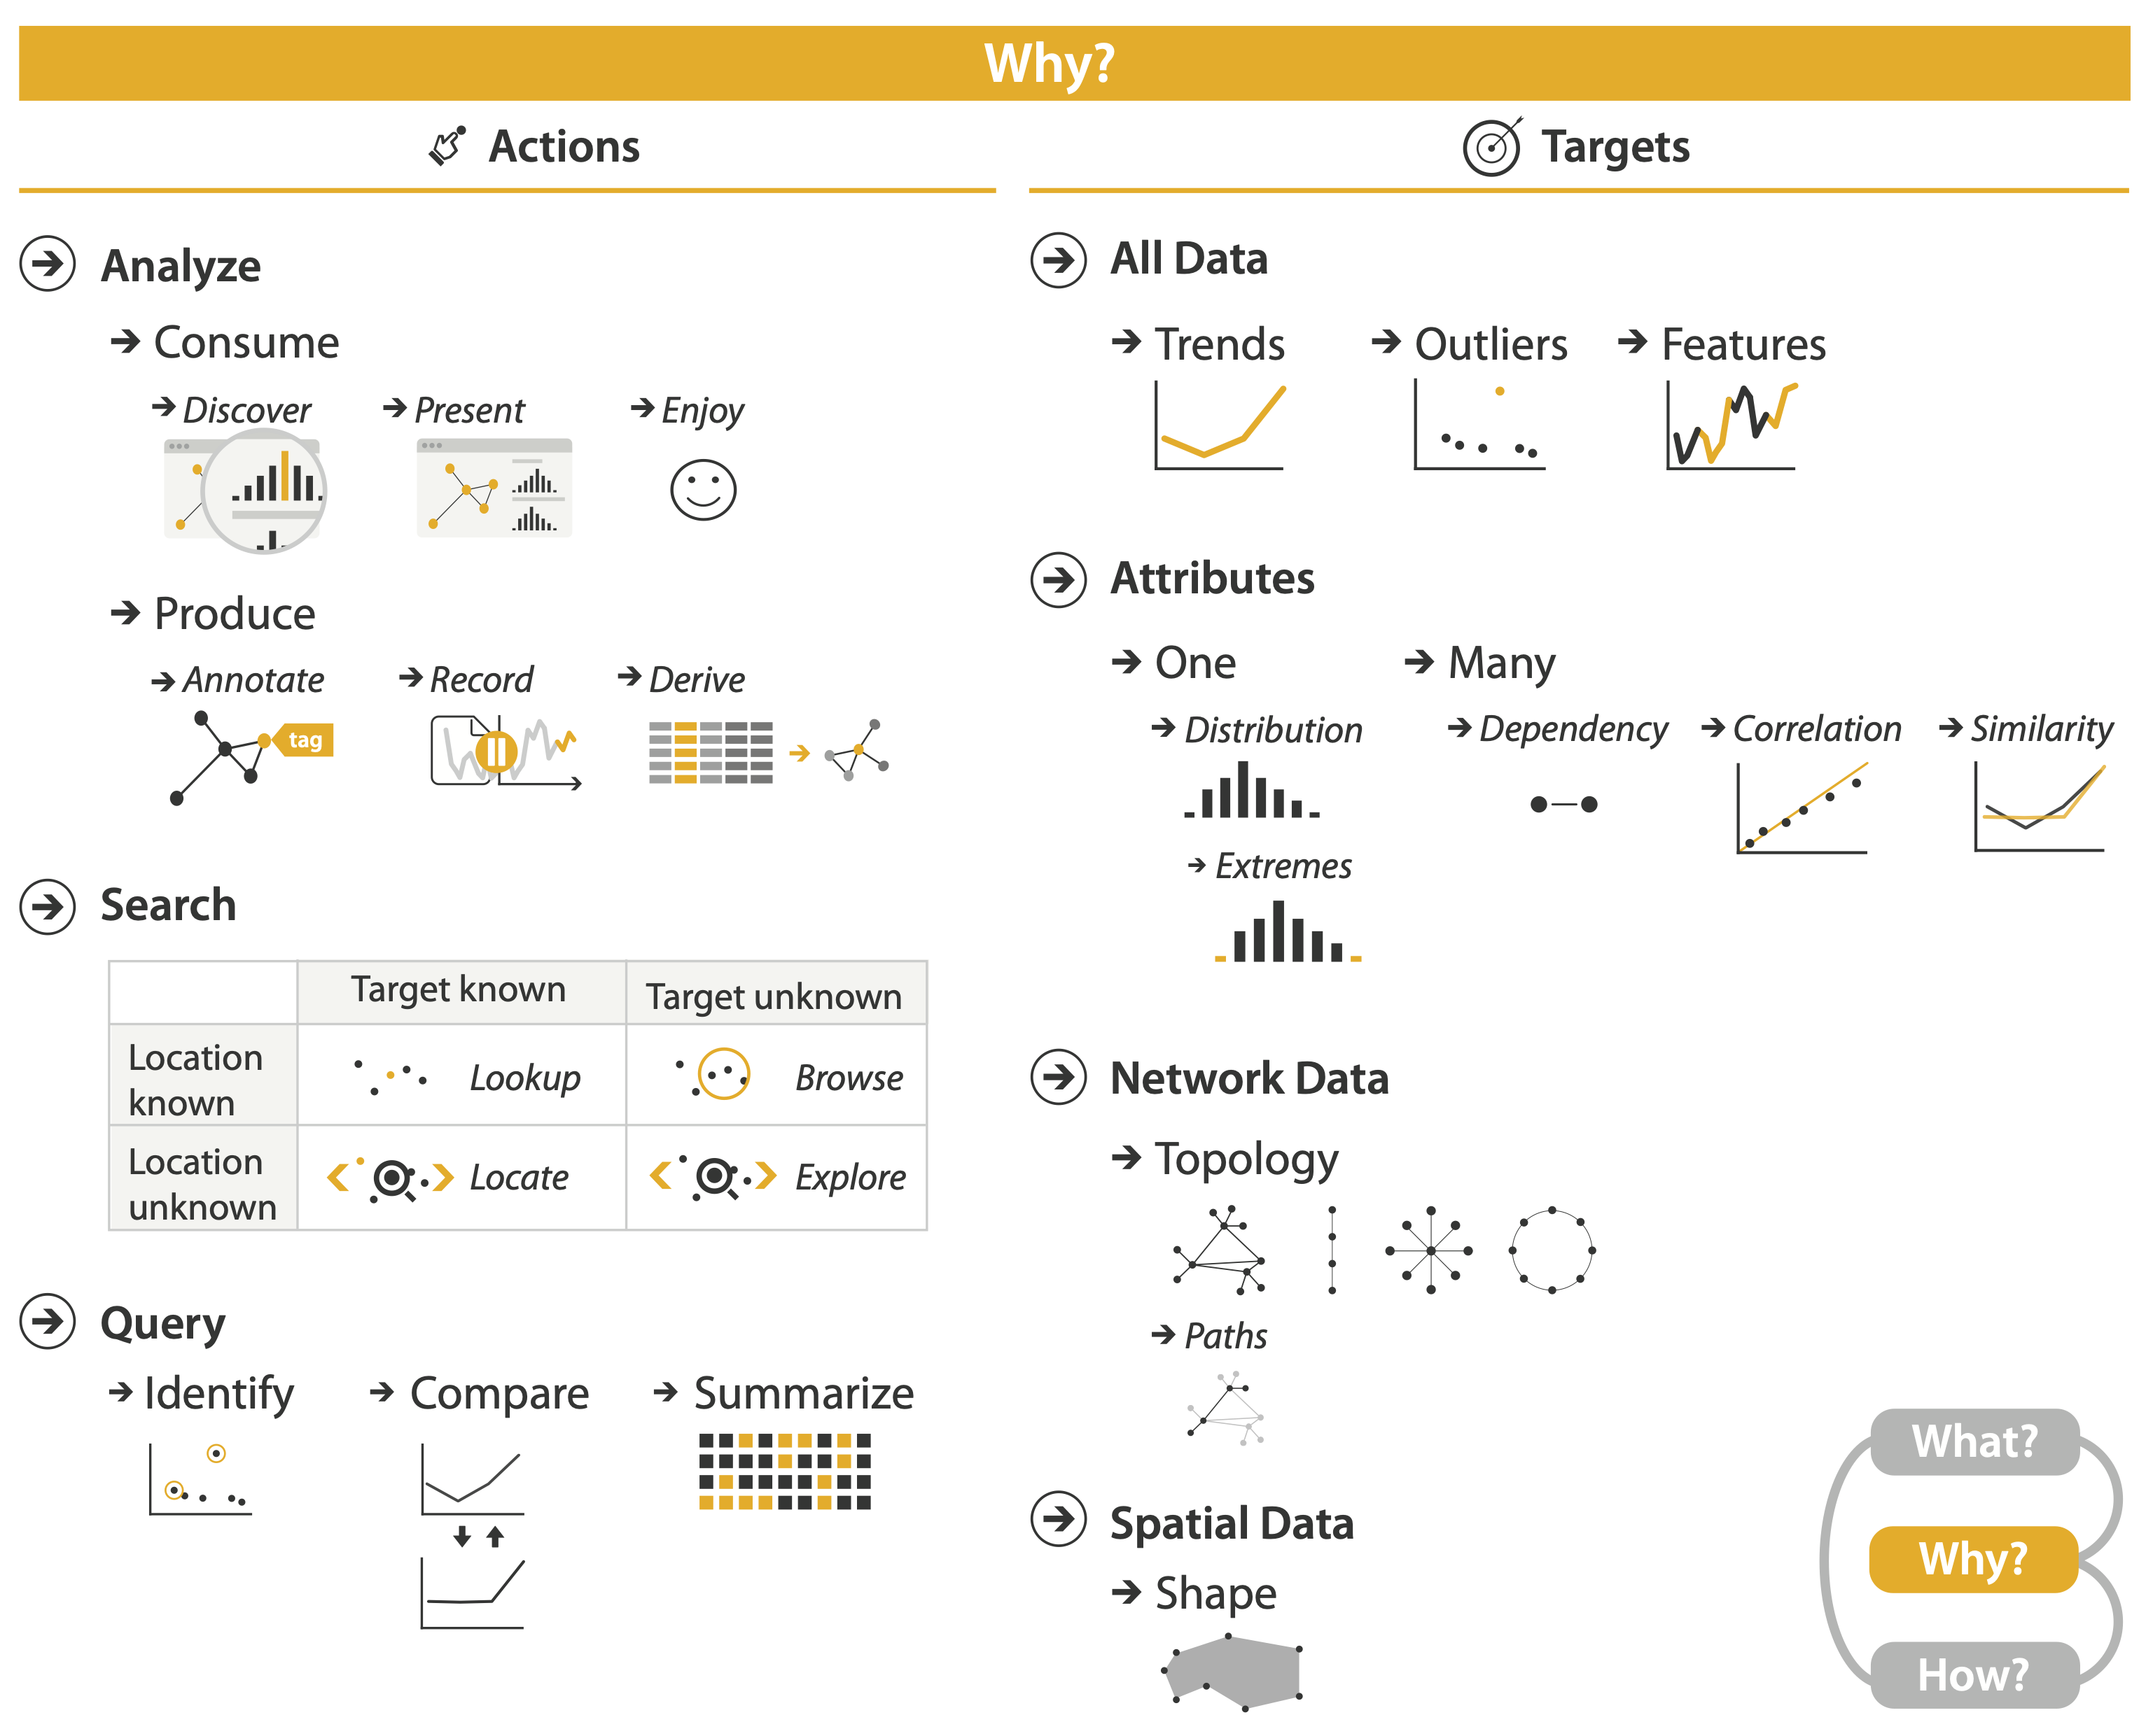
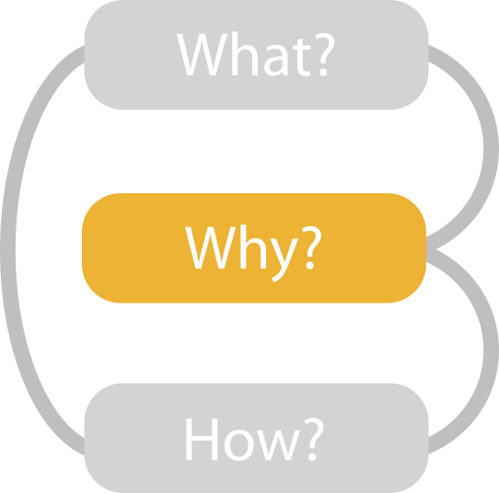

Slide 32
{action, target} pairs
discover distribution
compare trends
locate outliers
browse topology

Slide 33
Actions: Analyze, Query
analyze
consume
discover vs present
aka explore vs explain
enjoy
aka casual, social
produce
annotate, record, derive
query
how much data matters?
one, some, all
independent choices
analyze, query, (search)

Slide 34
Actions: Analyze, Query
analyze
consume
discover vs present
aka explore vs explain
enjoy
aka casual, social
produce
annotate, record, derive
query
how much data matters?
one, some, all
independent choices
analyze, query, (search)

Slide 35
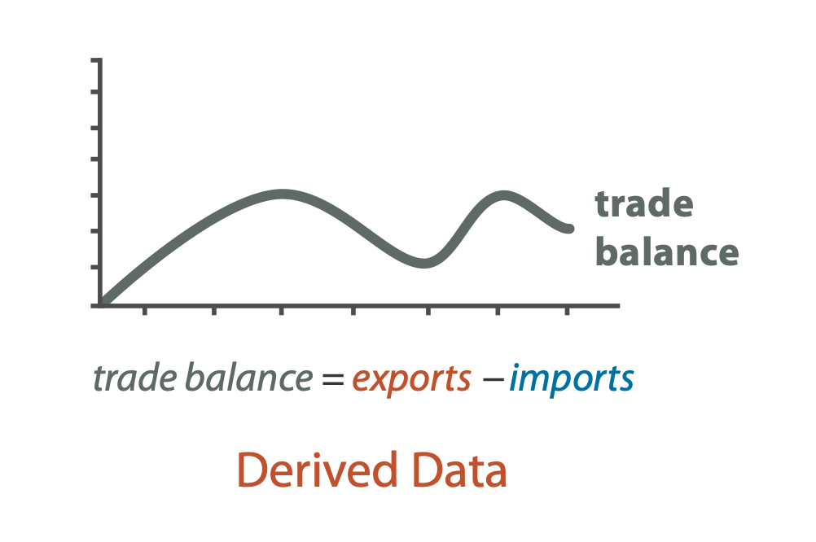
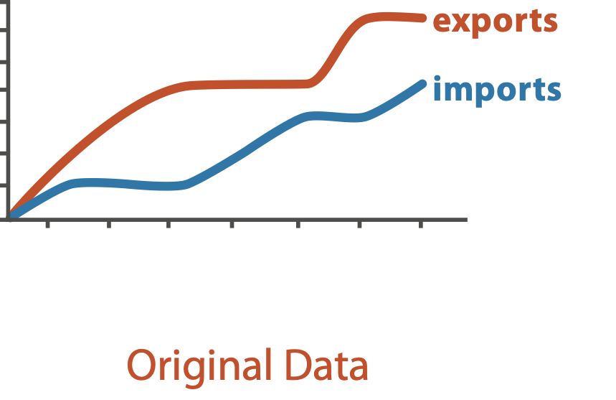
Derive
don’t necessarily just draw what you’re given!
decide what the right thing to show is
create it with a series of transformations from the original dataset
draw that
one of the four major strategies for handling complexity

Slide 36
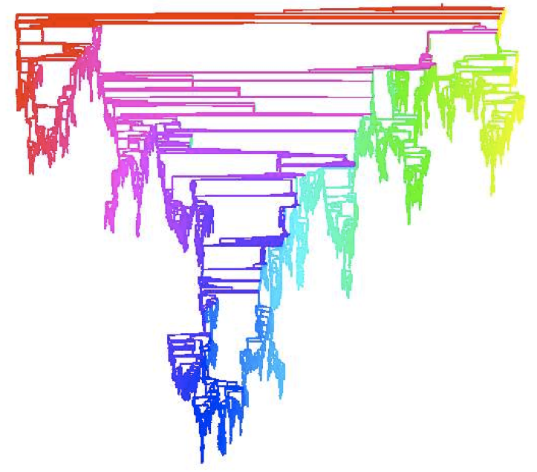
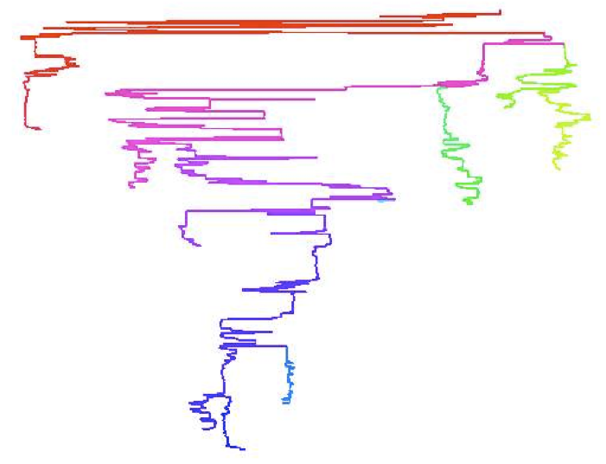
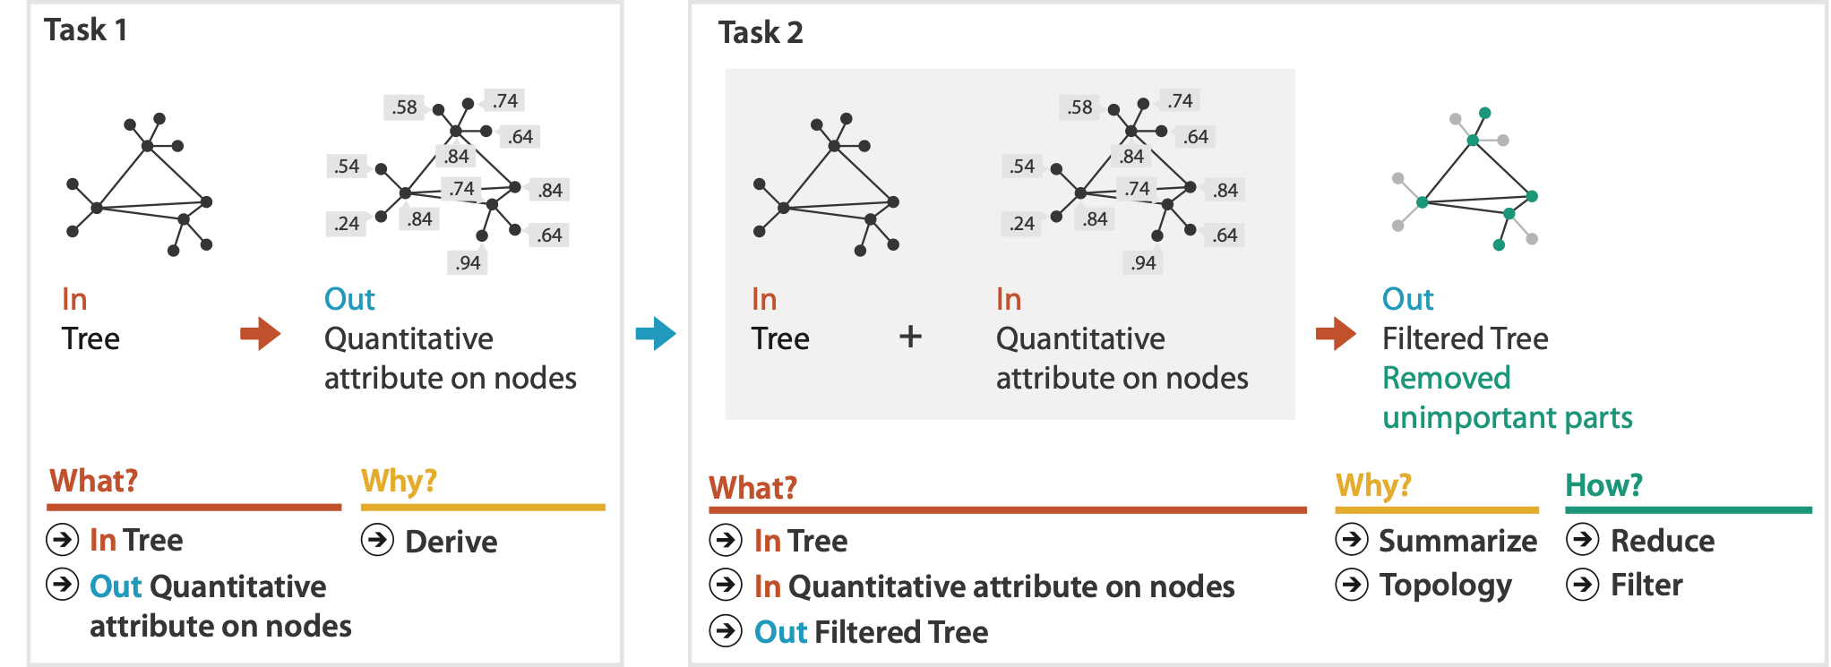
Analysis example: Derive one attribute
Strahler number
centrality metric for trees/networks
derived quantitative attribute
draw top 5K of 500K for good skeleton
[Using Strahler numbers for real time visual exploration of huge graphs. Auber. Proc. Intl. Conf. Computer Vision and Graphics, pp. 56–69, 2002.]

Slide 37
Why: Targets

Slide 38
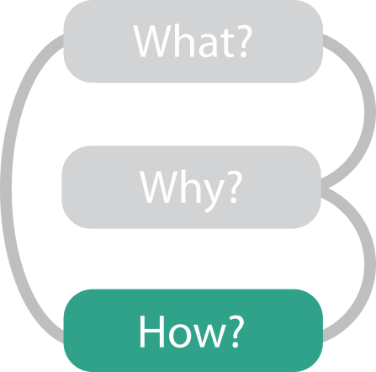

Slide 39
Further reading
Visualization Analysis and Design. Munzner. AK Peters Visualization Series, CRC Press, Nov 2014.
Chap 1: What’s Vis, and Why Do It?
Chap 2: What: Data Abstraction
Chap 3: Why: Task Abstraction
A Multi-Level Typology of Abstract Visualization Tasks. Brehmer and Munzner. IEEE Trans. Visualization and Computer Graphics (Proc. InfoVis) 19:12 (2013), 2376–2385.
Low-Level Components of Analytic Activity in Information Visualization. Amar, Eagan, and Stasko. Proc. IEEE InfoVis 2005, p 111–117.
A taxonomy of tools that support the fluent and flexible use of visualizations. Heer and Shneiderman. Communications of the ACM 55:4 (2012), 45–54.
Rethinking Visualization: A High-Level Taxonomy. Tory and Möller. Proc. IEEE InfoVis 2004, p 151–158.
Visualization of Time-Oriented Data. Aigner, Miksch, Schumann, and Tominski. Springer, 2011.

Slide 40
Visualization Analysis & Design, Half-Day Tutorial
Session 1
Analysis: What, Why, How
Marks and Channels
Arrange Tables
Arrange Spatial Data
Session 2
Arrange Networks and Trees
Map Color and Other Channels
Manipulate: Change, Select, Navigate
Facet: Juxtapose, Partition, Superimpose
Reduce: Filter, Aggregate
@tamaramunzner
http://www.cs.ubc.ca/~tmm/talks.html#halfdaycourse20

Slide 43
Visual encoding
analyze idiom structure
Notes:
How did we decide to use those particular visual channels? How many more visual channels are there? What kinds of information and how much information can each channel encode? Are some channels better than others? Can all of the channels be used independently or do they interfere with each other?

Slide 44
Definitions: Marks and channels

Slide 45
Definitions: Marks and channels
marks
geometric primitives

Slide 46
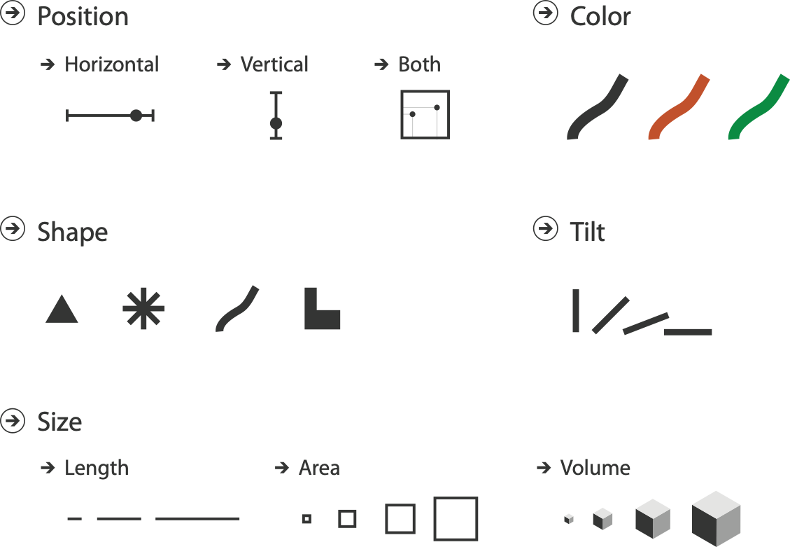
Definitions: Marks and channels
marks
geometric primitives
channels
control appearance of marks

Slide 47
Definitions: Marks and channels
marks
geometric primitives
channels
control appearance of marks
channel properties differ
type & amount of information that can be conveyed to human perceptual system

Slide 48
Visual encoding
analyze idiom structure as combination of marks and channels
1: vertical position
mark: line

Slide 49
Visual encoding
analyze idiom structure as combination of marks and channels
1: vertical position
2: vertical position
horizontal position
mark: line
mark: point

Slide 50
Visual encoding
analyze idiom structure as combination of marks and channels
1: vertical position
2: vertical position
horizontal position
3: vertical position
horizontal position
color hue
mark: line
mark: point
mark: point

Slide 51
Visual encoding
analyze idiom structure as combination of marks and channels
1: vertical position
2: vertical position
horizontal position
3: vertical position
horizontal position
color hue
4: vertical position
horizontal position
color hue
size (area)
mark: line
mark: point
mark: point
mark: point

Slide 52
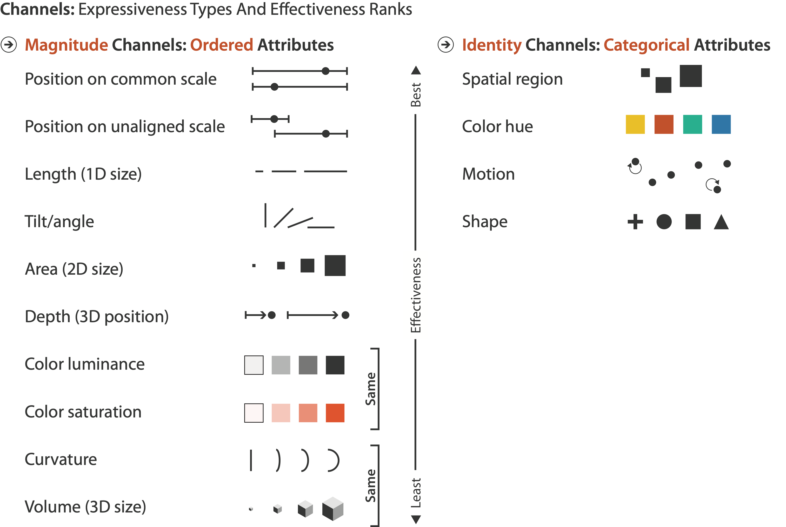
Channels: Rankings

Slide 53
Channels: Rankings
expressiveness
match channel and data characteristics

Slide 54
Channels: Rankings
expressiveness
match channel and data characteristics
effectiveness
channels differ in accuracy of perception

Slide 55
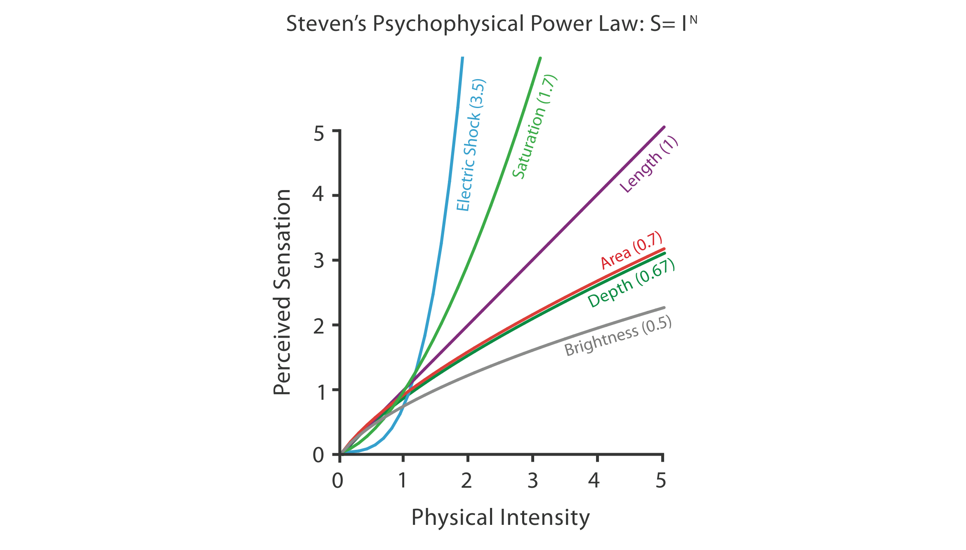
Accuracy: Fundamental Theory

Slide 56
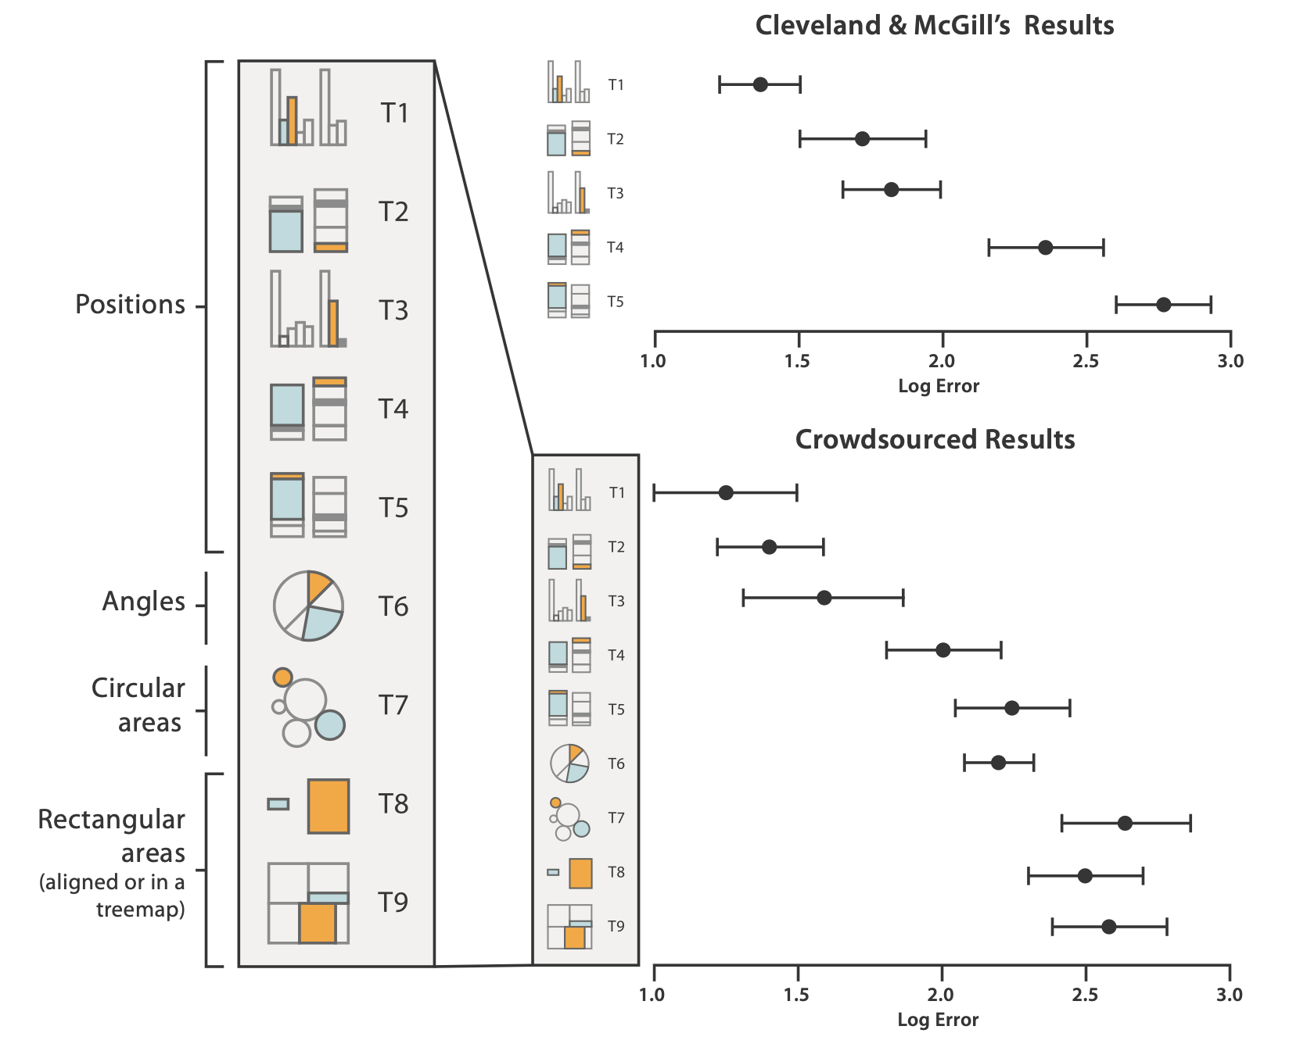
Accuracy: Vis experiments
[Crowdsourcing Graphical Perception: Using Mechanical Turk to Assess Visualization Design. Heer and Bostock. Proc ACM Conf. Human Factors in Computing Systems (CHI) 2010, p. 203–212.]
after Michael McGuffin course slides, http://profs.etsmtl.ca/mmcguffin/

Slide 57
Discriminability: How many usable steps?
must be sufficient for number of attribute levels to show
linewidth: few bins
[mappa.mundi.net/maps/maps 014/telegeography.html]

Slide 58
Separability vs. Integrality
2 groups each
2 groups each
3 groups total:
integral area
4 groups total:
integral hue
Notes:
Fig 5.10
fonts are fine

Slide 59
Popout
find the red dot
how long does it take?
Notes:
Fig 5.11
just fine, no fonts :-)

Slide 60
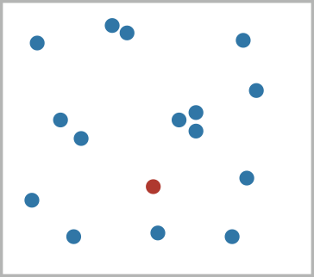
Popout
find the red dot
how long does it take?
Notes:
Fig 5.11
just fine, no fonts :-)

Slide 61
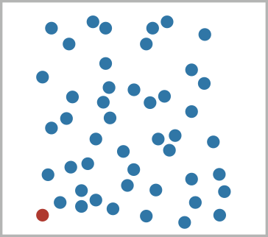
Popout
find the red dot
how long does it take?
Notes:
Fig 5.11
just fine, no fonts :-)

Slide 62
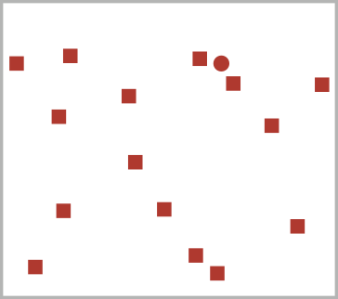
Popout
find the red dot
how long does it take?
Notes:
Fig 5.11
just fine, no fonts :-)

Slide 63
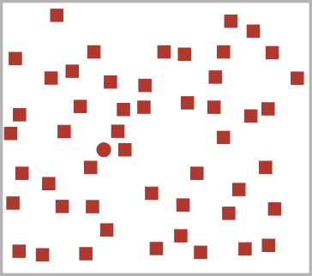
Popout
find the red dot
how long does it take?
Notes:
Fig 5.11
just fine, no fonts :-)

Slide 64
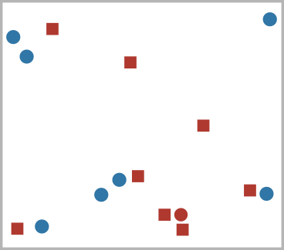
Popout
find the red dot
how long does it take?
Notes:
Fig 5.11
just fine, no fonts :-)

Slide 65
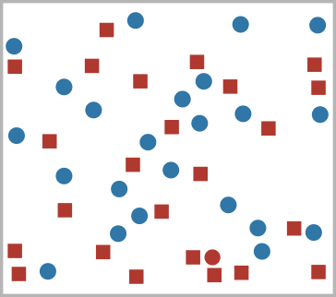
Popout
find the red dot
how long does it take?
Notes:
Fig 5.11
just fine, no fonts :-)

Slide 66
Popout
find the red dot
how long does it take?
parallel processing on many individual channels
speed independent of distractor count
speed depends on channel and amount of difference from distractors
serial search for (almost all) combinations
speed depends on number of distractors
Notes:
Fig 5.11
just fine, no fonts :-)

Slide 67
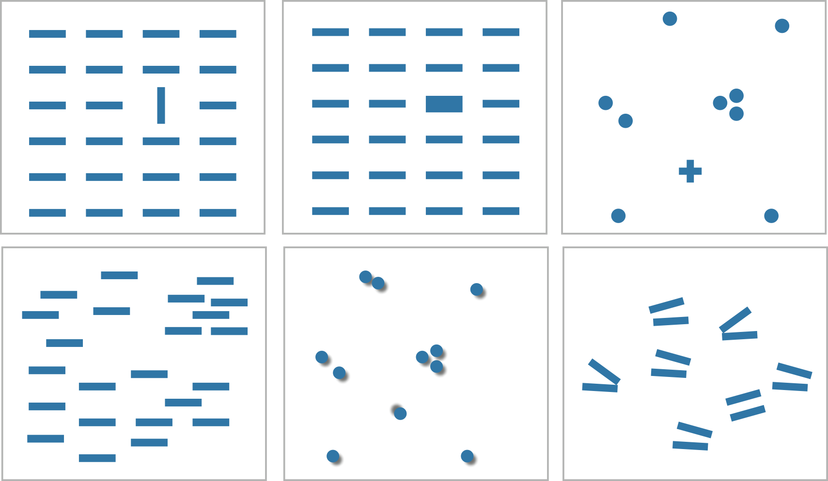
Popout
many channels
tilt, size, shape, proximity, shadow direction, ...
Notes:
Fig 5.12

Slide 68
Popout
many channels
tilt, size, shape, proximity, shadow direction, ...
but not all!
parallel line pairs do not pop out from tilted pairs
Notes:
Fig 5.12

Slide 69
Grouping
containment
connection
proximity
same spatial region
similarity
same values as other categorical channels

Slide 70
Further reading
Visualization Analysis and Design. Munzner. AK Peters Visualization Series, CRC Press, Nov 2014.
Chap 5: Marks and Channels
On the Theory of Scales of Measurement. Stevens. Science 103:2684 (1946), 677–680.
Psychophysics: Introduction to its Perceptual, Neural, and Social Prospects. Stevens. Wiley, 1975.
Graphical Perception: Theory, Experimentation, and Application to the Development of Graphical Methods. Cleveland and McGill. Journ. American Statistical Association 79:387 (1984), 531–554.
Perception in Vision. Healey. http://www.csc.ncsu.edu/faculty/healey/PP
Visual Thinking for Design. Ware. Morgan Kaufmann, 2008.
Information Visualization: Perception for Design, 3rd edition. Ware. Morgan Kaufmann /Academic Press, 2004.

Slide 71
Visualization Analysis & Design, Half-Day Tutorial
Session 1
Analysis: What, Why, How
Marks and Channels
Arrange Tables
Arrange Spatial Data
Session 2
Arrange Networks and Trees
Map Color and Other Channels
Manipulate: Change, Select, Navigate
Facet: Juxtapose, Partition, Superimpose
Reduce: Filter, Aggregate
@tamaramunzner
http://www.cs.ubc.ca/~tmm/talks.html#halfdaycourse20

Slide 73
Arrange tables

Slide 74
Keys and values
key
independent attribute
used as unique index to look up items
simple tables: 1 key
multidimensional tables: multiple keys
value
dependent attribute, value of cell
classify arrangements by key count
0, 1, 2, many...
Notes:
Figs 7.1, 2.2
same small font problem as above

Slide 75
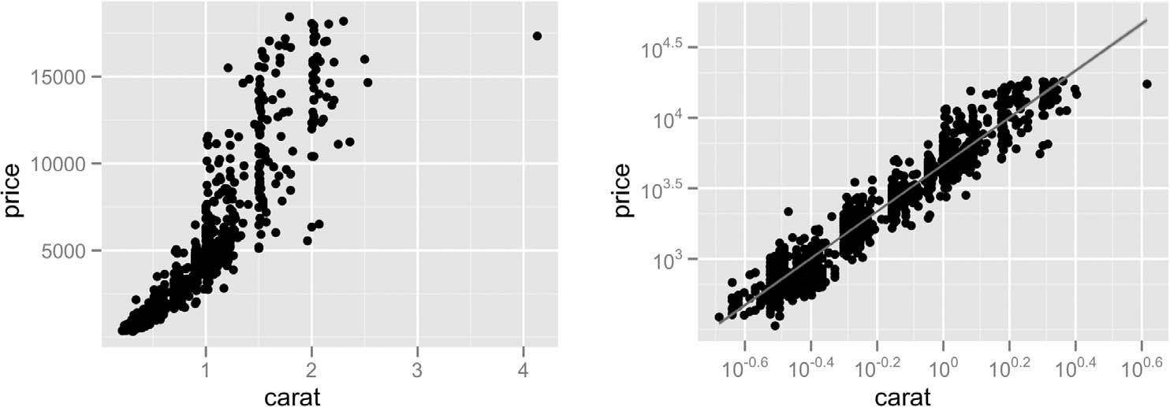
Idiom: scatterplot
express values
quantitative attributes
no keys, only values
data
2 quant attribs
mark: points
channels
horiz + vert position
tasks
find trends, outliers, distribution, correlation, clusters
scalability
hundreds of items
[A layered grammar of graphics. Wickham. Journ. Computational and Graphical Statistics 19:1 (2010), 3–28.]

Slide 76
Some keys: Categorical regions
regions: contiguous bounded areas distinct from each other
using space to separate (proximity)
following expressiveness principle for categorical attributes
use ordered attribute to order and align regions

Slide 77
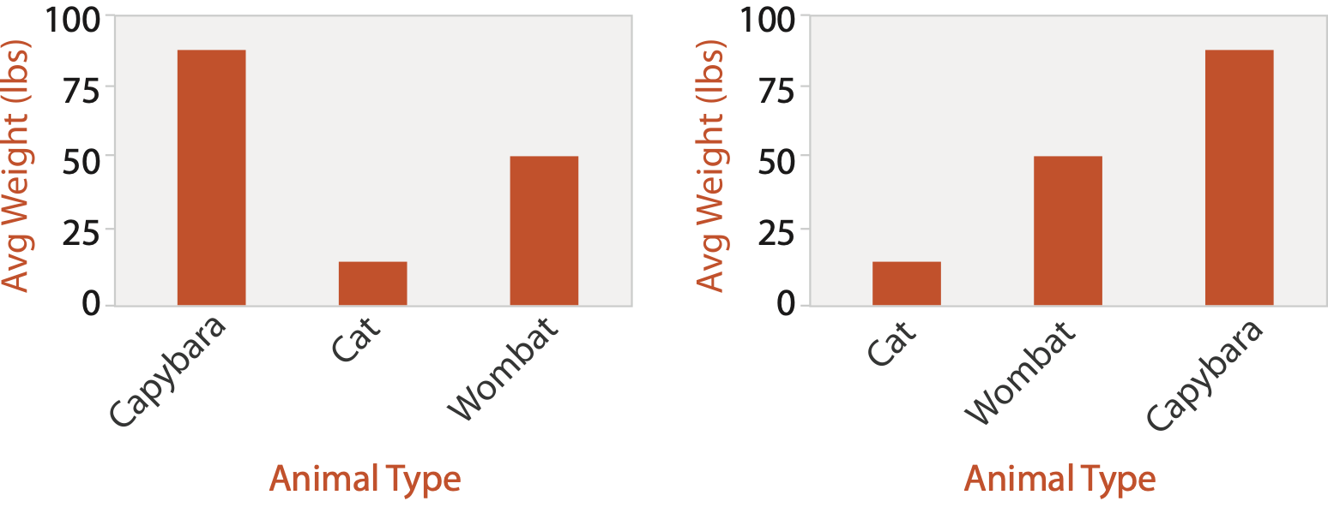
Idiom: bar chart
one key, one value
data
1 categ attrib, 1 quant attrib
mark: lines
channels
length to express quant value
spatial regions: one per mark
separated horizontally, aligned vertically
ordered by quant attrib
by label (alphabetical), by length attrib (data-driven)
task
compare, lookup values
scalability
dozens to hundreds of levels for key attrib

Slide 78
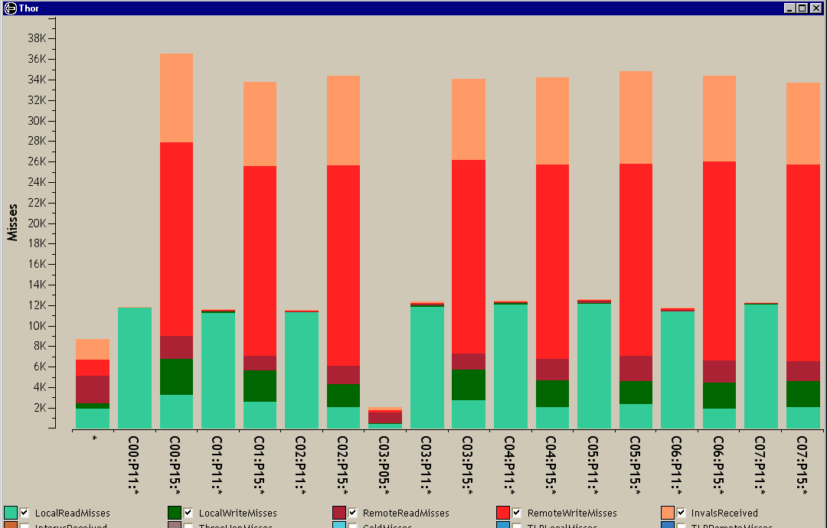
Idiom: stacked bar chart
one more key
data
2 categ attrib, 1 quant attrib
mark: vertical stack of line marks
glyph: composite object, internal structure from multiple marks
channels
length and color hue
spatial regions: one per glyph
aligned: full glyph, lowest bar component
unaligned: other bar components
task
part-to-whole relationship
scalability
several to one dozen levels for stacked attrib
[Using Visualization to Understand the Behavior of Computer Systems. Bosch. Ph.D. thesis, Stanford Computer Science, 2001.]
Notes:
Thor computer memory profiler. The key used to distribute composite bars along the axis is the combination of a processor and a procedure. The key used to stack and color the glyph subcomponents is the type of cache miss; the height of each full bar encodes all cache misses for each processor-procedure combination.

Slide 79
Idiom: streamgraph
generalized stacked graph
emphasizing horizontal continuity
vs vertical items
data
1 categ key attrib (artist)
1 ordered key attrib (time)
1 quant value attrib (counts)
derived data
geometry: layers, where height encodes counts
1 quant attrib (layer ordering)
scalability
hundreds of time keys
dozens to hundreds of artist keys
more than stacked bars: most layers don’t extend across whole chart
[Stacked Graphs Geometry & Aesthetics. Byron and Wattenberg. IEEE Trans. Visualization and Computer Graphics (Proc. InfoVis 2008) 14(6): 1245–1252, (2008).]

Slide 80
Idiom: line chart / dot plot
one key, one value
data
2 quant attribs
mark: points
line connection marks between them
channels
aligned lengths to express quant value
separated and ordered by key attrib into horizontal regions
task
find trend
connection marks emphasize ordering of items along key axis by explicitly showing relationship between one item and the next

Slide 81
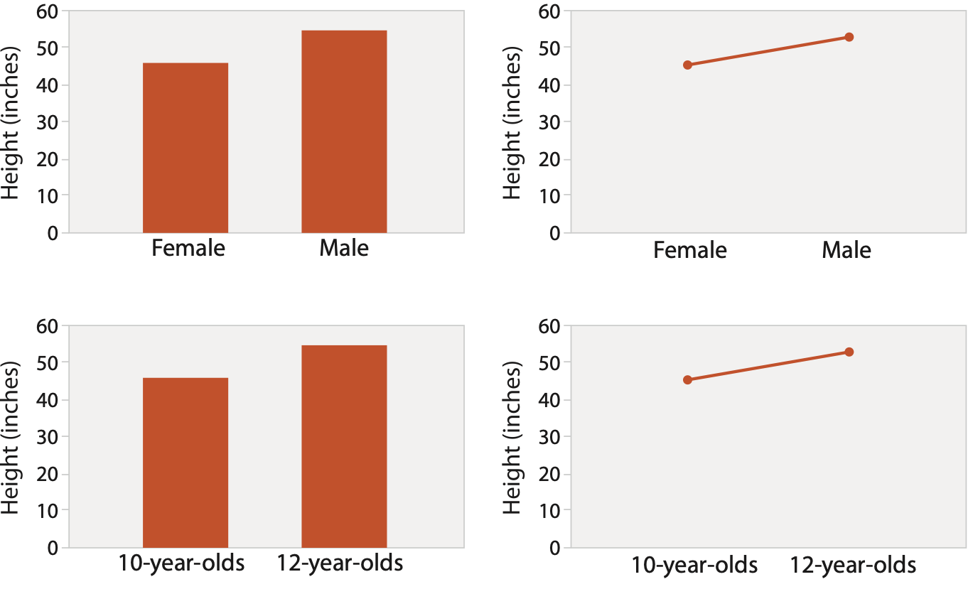
Choosing bar vs line charts
depends on type of key attrib
bar charts if categorical
line charts if ordered
do not use line charts for categorical key attribs
violates expressiveness principle
implication of trend so strong that it overrides semantics!
“The more male a person is, the taller he/she is”
after [Bars and Lines: A Study of Graphic Communication. Zacks and Tversky. Memory and Cognition 27:6 (1999), 1073–1079.]
Notes:
good: height increases with age, 12 year olds are taller than 10 year olds
bad: the more male a person is, the taller he or she is

Slide 82
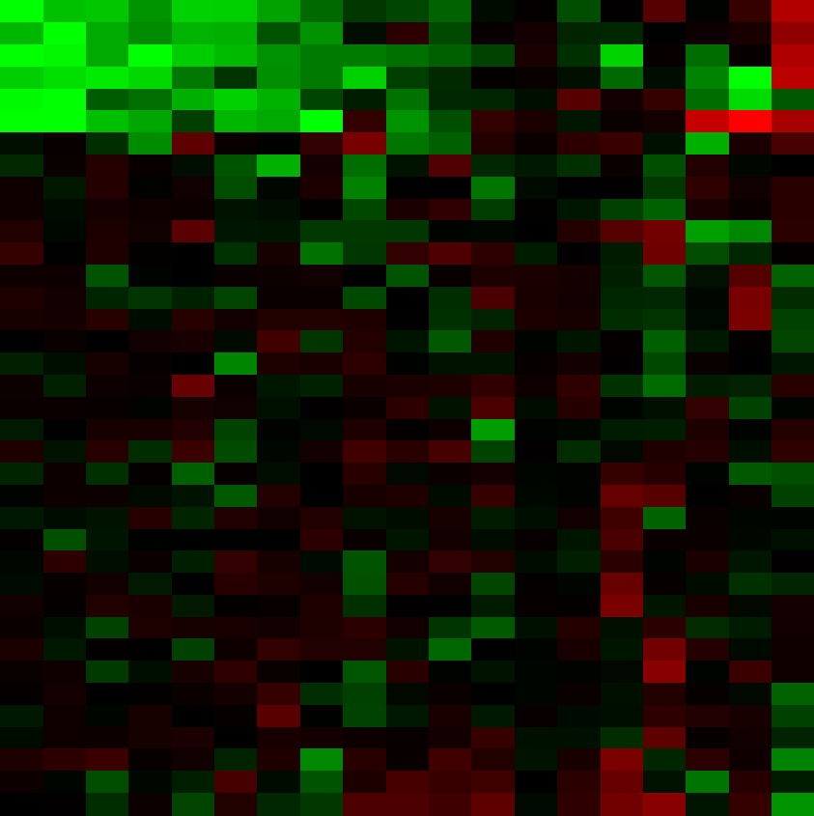
Idiom: heatmap
two keys, one value
data
2 categ attribs (gene, experimental condition)
1 quant attrib (expression levels)
marks: area
separate and align in 2D matrix
indexed by 2 categorical attributes
channels
color by quant attrib
(ordered diverging colormap)
task
find clusters, outliers
scalability
1K categorical levels, 1M items; ~10 quantitative attribute levels

Slide 84
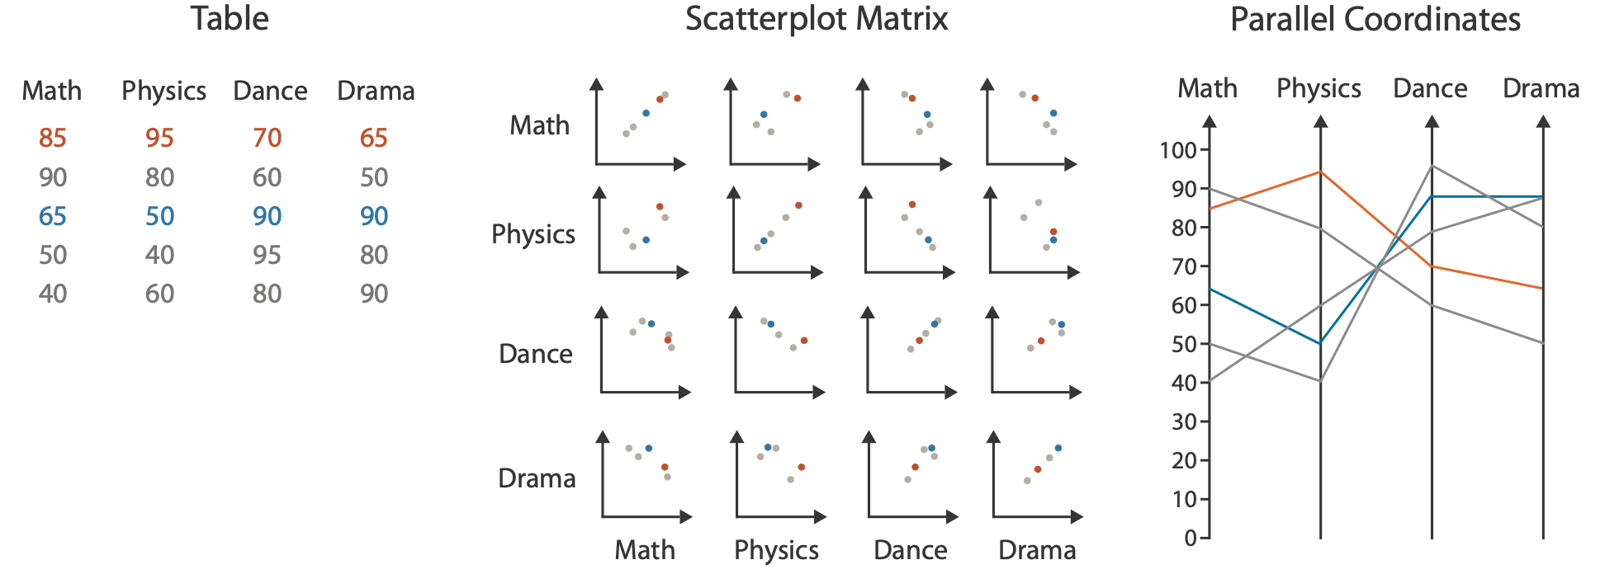
Idioms: scatterplot matrix, parallel coordinates
scatterplot matrix (SPLOM)
rectilinear axes, point mark
all possible pairs of axes
scalability
one dozen attribs
dozens to hundreds of items
parallel coordinates
parallel axes, jagged line representing item
rectilinear axes, item as point
axis ordering is major challenge
scalability
dozens of attribs
hundreds of items
after [Visualization Course Figures. McGuffin, 2014. http://www.michaelmcguffin.com/courses/vis/]

Slide 85
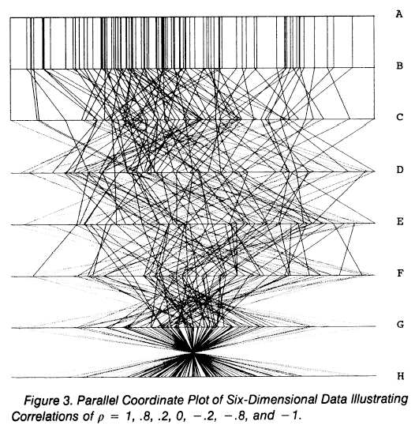
Task: Correlation
scatterplot matrix
positive correlation
diagonal low-to-high
negative correlation
diagonal high-to-low
uncorrelated
parallel coordinates
positive correlation
parallel line segments
negative correlation
all segments cross at halfway point
uncorrelated
scattered crossings
[A layered grammar of graphics. Wickham. Journ. Computational and Graphical Statistics 19:1 (2010), 3–28.]
[Hyperdimensional Data Analysis Using Parallel Coordinates. Wegman. Journ. American Statistical Association 85:411 (1990), 664–675.]

Slide 86
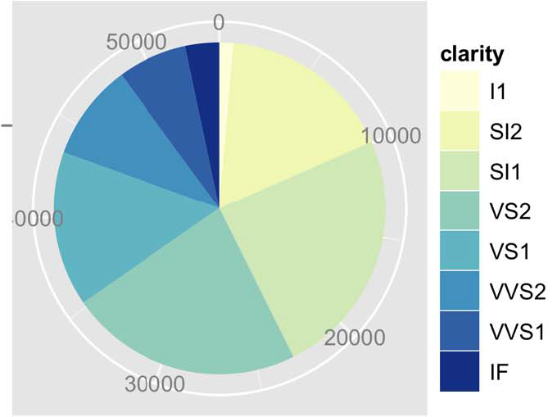
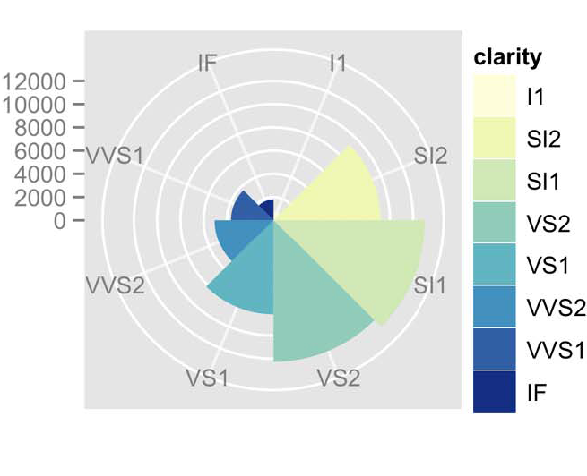
Idioms: pie chart, polar area chart
pie chart
area marks with angle channel
accuracy: angle/area much less accurate than line length
arclength also less accurate than line length
polar area chart
area marks with length channel
more direct analog to bar charts
data
1 categ key attrib, 1 quant value attrib
task
part-to-whole judgements
[A layered grammar of graphics. Wickham. Journ. Computational and Graphical Statistics 19:1 (2010), 3–28.]

Slide 87
Idioms: normalized stacked bar chart
task
part-to-whole judgements
normalized stacked bar chart
stacked bar chart, normalized to full vert height
single stacked bar equivalent to full pie
high information density: requires narrow rectangle
pie chart
information density: requires large circle
http://bl.ocks.org/mbostock/3887235,
http://bl.ocks.org/mbostock/3886208,
http://bl.ocks.org/mbostock/3886394.

Slide 88
Idiom: glyphmaps
rectilinear good for linear vs nonlinear trends
radial good for cyclic patterns
[Glyph-maps for Visually Exploring Temporal Patterns in Climate Data and Models. Wickham, Hofmann, Wickham, and Cook. Environmetrics 23:5 (2012), 382–393.]

Slide 89
Orientation limitations
rectilinear: scalability wrt #axes
2 axes best
3 problematic
more in afternoon
4+ impossible
parallel: unfamiliarity, training time
radial: perceptual limits
angles lower precision than lengths
asymmetry between angle and length
can be exploited!
[Uncovering Strengths and Weaknesses of Radial Visualizations - an Empirical Approach. Diehl, Beck and Burch. IEEE TVCG (Proc. InfoVis) 16(6):935--942, 2010.]

Slide 90
Further reading
Visualization Analysis and Design. Munzner. AK Peters Visualization Series, CRC Press, Nov 2014.
Chap 7: Arrange Tables
Visualizing Data. Cleveland. Hobart Press, 1993.
A Brief History of Data Visualization. Friendly. 2008. http://www.datavis.ca/milestones

Slide 91
Visualization Analysis & Design, Half-Day Tutorial
Session 1
Analysis: What, Why, How
Marks and Channels
Arrange Tables
Arrange Spatial Data
Session 2
Arrange Networks and Trees
Map Color and Other Channels
Manipulate: Change, Select, Navigate
Facet: Juxtapose, Partition, Superimpose
Reduce: Filter, Aggregate
@tamaramunzner
http://www.cs.ubc.ca/~tmm/talks.html#halfdaycourse20

Slide 92
Arrange spatial data
Notes:
placeholder slide, put eamonn fig here

Slide 93
Idiom: choropleth map
use given spatial data
when central task is understanding spatial relationships
data
geographic geometry
table with 1 quant attribute per region
encoding
use given geometry for area mark boundaries
sequential segmented colormap [more later]
http://bl.ocks.org/mbostock/4060606

Slide 94
Beware: Population maps trickiness!
consider when to normalize by population density
general issue
absolute counts vs relative/normalized data
[ https://xkcd.com/1138 ]

Slide 95
Idiom: topographic map
data
geographic geometry
scalar spatial field
1 quant attribute per grid cell
derived data
isoline geometry
isocontours computed for specific levels of scalar values
Land Information New Zealand Data Service

Slide 96
Idioms: isosurfaces, direct volume rendering
data
scalar spatial field
1 quant attribute per grid cell
task
shape understanding, spatial relationships
isosurface
derived data: isocontours computed for specific levels of scalar values
direct volume rendering
transfer function maps scalar values to color, opacity
no derived geometry
[Interactive Volume Rendering Techniques. Kniss. Master’s thesis, University of Utah Computer Science, 2002.]
[Multidimensional Transfer Functions for Volume Rendering. Kniss, Kindlmann, and Hansen. In The Visualization Handbook, edited by Charles Hansen and Christopher Johnson, pp. 189–210. Elsevier, 2005.]

Slide 97
Vector and tensor fields
data
many attribs per cell
idiom families
flow glyphs
purely local
geometric flow
derived data from tracing particle trajectories
sparse set of seed points
texture flow
derived data, dense seeds
feature flow
global computation to detect features
encoded with one of methods above
[Comparing 2D vector field visualization methods: A user study. Laidlaw et al. IEEE Trans. Visualization and Computer Graphics (TVCG) 11:1 (2005), 59–70.]
[Topology tracking for the visualization of time-dependent two-dimensional flows. Tricoche, Wischgoll, Scheuermann, and Hagen. Computers & Graphics 26:2 (2002), 249–257.]
Notes:
three local glyph idioms, one dense texture idiom, and two geometric idioms using streamlines.
a) GRID: arrow glyphs on a regular grid. b) JIT: arrow glyphs on a jittered grid. c) LIT: triangular wedge glyphs inspired by oil painting strokes. d) LIC: dense texture-based idiom. e) OSTR: curved arrow glyphs with image-guided streamline seeding. f) GSTR: curved arrow glyphs with regular grid streamline seeding. From [Laidlaw et al. 05], Fig- ure 1.

Slide 98
Idiom: similarity-clustered streamlines
data
3D vector field
derived data (from field)
streamlines: trajectory particle will follow
derived data (per streamline)
curvature, torsion, tortuosity
signature: complex weighted combination
compute cluster hierarchy across all signatures
encode: color and opacity by cluster
tasks
find features, query shape
scalability
millions of samples, hundreds of streamlines
[Similarity Measures for Enhancing Interactive Streamline Seeding. McLoughlin,. Jones, Laramee, Malki, Masters, and. Hansen. IEEE Trans. Visualization and Computer Graphics 19:8 (2013), 1342–1353.]
Notes:
curvature, namely the curve’s deviation from a straight line; torsion, namely how much the curve bends, out of its plane; and tortuosity, namely how twisted the curve is.

Slide 99
Further reading
Visualization Analysis and Design. Munzner. AK Peters Visualization Series, CRC Press, 2014.
Chap 8: Arrange Spatial Data
How Maps Work: Representation, Visualization, and Design. MacEachren. Guilford Press, 1995.
Overview of visualization. Schroeder and. Martin. In The Visualization Handbook, edited by Charles Hansen and Christopher Johnson, pp. 3–39. Elsevier, 2005.
Real-Time Volume Graphics. Engel, Hadwiger, Kniss, Reza-Salama, and Weiskopf. AK Peters, 2006.
Overview of flow visualization. Weiskopf and Erlebacher. In The Visualization Handbook, edited by Charles Hansen and Christopher Johnson, pp. 261–278. Elsevier, 2005.

Slide 100
Visualization Analysis & Design, Half-Day Tutorial
Session 1
Analysis: What, Why, How
Marks and Channels
Arrange Tables
Arrange Spatial Data
Session 2
Arrange Networks and Trees
Map Color and Other Channels
Manipulate: Change, Select, Navigate
Facet: Juxtapose, Partition, Superimpose
Reduce: Filter, Aggregate
@tamaramunzner
http://www.cs.ubc.ca/~tmm/talks.html#halfdaycourse20

Slide 101
Arrange networks and trees

Slide 102
Idiom: force-directed placement
visual encoding: node-link diagram
link connection marks, node point marks
algorithm: energy minimization
analogy: nodes repel, links draw together like springs
optimization problem: minimize crossings
spatial position: no meaning directly encoded
sometimes proximity meaningful
sometimes proximity arbitrary, artifact of layout algorithm
tasks
explore topology; locate paths, clusters
scalability
node/edge density E < 4N
http://mbostock.github.com/d3/ex/force.html

Slide 103
Idiom: sfdp (multi-level force-directed placement)
data
original: network
derived: cluster hierarchy atop it
considerations
better algorithm for same encoding technique
same: fundamental use of space
hierarchy used for algorithm speed/quality but not shown explicitly
scalability
nodes, edges: 1K-10K
hairball problem still hits eventually
[Efficient and high quality force-directed graph drawing. Hu. The Mathematica Journal 10:37–71, 2005.]
http://www.research.att.com/yifanhu/GALLERY/GRAPHS/index1.html
Notes:
hairball: 26K nodes, 100K edges

Slide 104
Idiom: adjacency matrix view
data: network
transform into same data/encoding as heatmap
derived data: table from network
1 quant attrib
weighted edge between nodes
2 categ attribs: node list x 2
visual encoding
cell shows presence/absence of edge
scalability
1K nodes, 1M edges
[NodeTrix: a Hybrid Visualization of Social Networks. Henry, Fekete, and McGuffin. IEEE TVCG (Proc. InfoVis) 13(6):1302-1309, 2007.]
[Points of view: Networks. Gehlenborg and Wong. Nature Methods 9:115.]

Slide 105
Connection vs. adjacency comparison
adjacency matrix strengths
predictability, scalability, supports reordering
some topology tasks trainable
node-link diagram strengths
topology understanding, path tracing
intuitive, no training needed
empirical study
node-link best for small networks
matrix best for large networks
if tasks don’t involve topological structure!
http://www.michaelmcguffin.com/courses/vis/patternsInAdjacencyMatrix.png
[On the readability of graphs using node-link and matrix-based representations: a controlled experiment and statistical analysis. Ghoniem, Fekete, and Castagliola. Information Visualization 4:2 (2005), 114–135.]

Slide 106
Idiom: radial node-link tree
data
tree
encoding
link connection marks
point node marks
radial axis orientation
angular proximity: siblings
distance from center: depth in tree
tasks
understanding topology, following paths
scalability
1K - 10K nodes
http://mbostock.github.com/d3/ex/tree.html

Slide 107
Idiom: treemap
data
tree
1 quant attrib at leaf nodes
encoding
area containment marks for hierarchical structure
rectilinear orientation
size encodes quant attrib
tasks
query attribute at leaf nodes
scalability
1M leaf nodes
http://tulip.labri.fr/Documentation/3_7/userHandbook/html/ch06.html

Slide 108
Link marks: Connection and containment
marks as links (vs. nodes)
common case in network drawing
1D case: connection
ex: all node-link diagrams
emphasizes topology, path tracing
networks and trees
2D case: containment
ex: all treemap variants
emphasizes attribute values at leaves (size coding)
only trees
[Elastic Hierarchies: Combining Treemaps and Node-Link Diagrams. Dong, McGuffin, and Chignell. Proc. InfoVis 2005, p. 57-64.]
Notes:
many techniques using each method

Slide 109
Further reading
Visualization Analysis and Design. Munzner. AK Peters Visualization Series, CRC Press, Nov 2014.
Chap 9: Arrange Networks and Trees
Visual Analysis of Large Graphs: State-of-the-Art and Future Research Challenges. von Landesberger et al. Computer Graphics Forum 30:6 (2011), 1719–1749.
Simple Algorithms for Network Visualization: A Tutorial. McGuffin. Tsinghua Science and Technology (Special Issue on Visualization and Computer Graphics) 17:4 (2012), 383–398.
Drawing on Physical Analogies. Brandes. In Drawing Graphs: Methods and Models, LNCS Tutorial, 2025, edited by M. Kaufmann and D. Wagner, LNCS Tutorial, 2025, pp. 71–86. Springer-Verlag, 2001.
http://www.treevis.net Treevis.net: A Tree Visualization Reference. Schulz. IEEE Computer Graphics and Applications 31:6 (2011), 11–15.
Perceptual Guidelines for Creating Rectangular Treemaps. Kong, Heer, and Agrawala. IEEE Trans. Visualization and Computer Graphics (Proc. InfoVis) 16:6 (2010), 990–998.

Slide 110
Visualization Analysis & Design, Half-Day Tutorial
Session 1
Analysis: What, Why, How
Marks and Channels
Arrange Tables
Arrange Spatial Data
Session 2
Arrange Networks and Trees
Map Color and Other Channels
Manipulate: Change, Select, Navigate
Facet: Juxtapose, Partition, Superimpose
Reduce: Filter, Aggregate
@tamaramunzner
http://www.cs.ubc.ca/~tmm/talks.html#halfdaycourse20

Slide 111
Idiom design choices: First half

Slide 112
Decomposing color
first rule of color: do not talk about color!
color is confusing if treated as monolithic

Slide 113
Decomposing color
first rule of color: do not talk about color!
color is confusing if treated as monolithic
decompose into three channels

Slide 114
Decomposing color
first rule of color: do not talk about color!
color is confusing if treated as monolithic
decompose into three channels
ordered can show magnitude
luminance
saturation
categorical can show identity
hue

Slide 115
Decomposing color
first rule of color: do not talk about color!
color is confusing if treated as monolithic
decompose into three channels
ordered can show magnitude
luminance
saturation
categorical can show identity
hue
perceptual colorspace, in contrast to three channels of RGB

Slide 116
Decomposing color
first rule of color: do not talk about color!
color is confusing if treated as monolithic
decompose into three channels
ordered can show magnitude
luminance
saturation
categorical can show identity
hue
perceptual colorspace, in contrast to three channels of RGB

Slide 117
Luminance
need luminance for edge detection
fine-grained detail only visible through luminance contrast
legible text requires luminance contrast!
Luminance information
Color information
[Seriously Colorful: Advanced Color Principles & Practices. Stone.Tableau Customer Conference 2014.]

Slide 118
Luminance
need luminance for edge detection
fine-grained detail only visible through luminance contrast
legible text requires luminance contrast!
HLS better than RGB for encoding but beware
L lightness ≠ L* luminance
Luminance information
Color information
[Seriously Colorful: Advanced Color Principles & Practices. Stone.Tableau Customer Conference 2014.]

Slide 119
Categorical color: Discriminability constraints
noncontiguous small regions of color: only 6-12 bins
[Cinteny: flexible analysis and visualization of synteny and genome rearrangements in multiple organisms. Sinha and Meller. BMC Bioinformatics, 8:82, 2007.]
Notes:
emphasize: greens/blues can't tell apart

Slide 120
Ordered color: Rainbow is poor default
problems
perceptually unordered
perceptually nonlinear

Slide 121
Ordered color: Rainbow is poor default
problems
perceptually unordered
perceptually nonlinear

Slide 122
Ordered color: Rainbow is poor default
problems
perceptually unordered
perceptually nonlinear
benefits
fine-grained structure visible and nameable
[A Rule-based Tool for Assisting Colormap Selection. Bergman,. Rogowitz, and. Treinish. Proc. IEEE Visualization (Vis), pp. 118–125, 1995.]
[Why Should Engineers Be Worried About Color? Treinish and Rogowitz 1998. http://www.research.ibm.com/people/l/lloydt/color/color.HTM]

Slide 123
Ordered color: Rainbow is poor default
problems
perceptually unordered
perceptually nonlinear
benefits
fine-grained structure visible and nameable
alternatives
large-scale structure: fewer hues
[A Rule-based Tool for Assisting Colormap Selection. Bergman,. Rogowitz, and. Treinish. Proc. IEEE Visualization (Vis), pp. 118–125, 1995.]
[Why Should Engineers Be Worried About Color? Treinish and Rogowitz 1998. http://www.research.ibm.com/people/l/lloydt/color/color.HTM]

Slide 124
Ordered color: Rainbow is poor default
problems
perceptually unordered
perceptually nonlinear
benefits
fine-grained structure visible and nameable
alternatives
large-scale structure: fewer hues
fine structure: multiple hues with monotonically increasing luminance [eg viridis]
[A Rule-based Tool for Assisting Colormap Selection. Bergman,. Rogowitz, and. Treinish. Proc. IEEE Visualization (Vis), pp. 118–125, 1995.]
[Why Should Engineers Be Worried About Color? Treinish and Rogowitz 1998. http://www.research.ibm.com/people/l/lloydt/color/color.HTM]

Slide 125
Viridis / Magma
monotonically increasing luminance, perceptually uniform
colorful, colourblind-safe
R, python, D3
https://cran.r-project.org/web/packages/viridis/vignettes/intro-to-viridis.html

Slide 126
Ordered color: Rainbow is poor default
problems
perceptually unordered
perceptually nonlinear
benefits
fine-grained structure visible and nameable
alternatives
large-scale structure: fewer hues
fine structure: multiple hues with monotonically increasing luminance [eg viridis]
categorical: segmented saturated rainbow is good!
[A Rule-based Tool for Assisting Colormap Selection. Bergman,. Rogowitz, and. Treinish. Proc. IEEE Visualization (Vis), pp. 118–125, 1995.]
[Why Should Engineers Be Worried About Color? Treinish and Rogowitz 1998. http://www.research.ibm.com/people/l/lloydt/color/color.HTM]
[Transfer Functions in Direct Volume Rendering: Design, Interface, Interaction. Kindlmann. SIGGRAPH 2002 Course Notes]

Slide 127
Colormaps
after [Color Use Guidelines for Mapping and Visualization. Brewer, 1994. http://www.personal.psu.edu/faculty/c/a/cab38/ColorSch/Schemes.html]
Notes:
fix still needed: categorial for qualitative

Slide 128
Colormaps
use with care if more than two levels (binary)!
after [Color Use Guidelines for Mapping and Visualization. Brewer, 1994. http://www.personal.psu.edu/faculty/c/a/cab38/ColorSch/Schemes.html]
Notes:
fix still needed: categorial for qualitative

Slide 129
Colormaps
color channel interactions
size heavily affects salience
small regions need high saturation
large need low saturation
saturation & luminance: 3-4 bins max
also not separable from transparency
after [Color Use Guidelines for Mapping and Visualization. Brewer, 1994. http://www.personal.psu.edu/faculty/c/a/cab38/ColorSch/Schemes.html]
Notes:
fix still needed: categorial for qualitative

Slide 130
Further reading
Visualization Analysis and Design. Munzner. AK Peters Visualization Series, CRC Press, Nov 2014.
Chap 10: Map Color and Other Channels
ColorBrewer, Brewer.
http://www.colorbrewer2.org
Color In Information Display. Stone. IEEE Vis Course Notes, 2006.
http://www.stonesc.com/Vis06
A Field Guide to Digital Color. Stone. AK Peters, 2003.
Rainbow Color Map (Still) Considered Harmful. Borland and Taylor. IEEE Computer Graphics and Applications 27:2 (2007), 14–17.
Visual Thinking for Design. Ware. Morgan Kaufmann, 2008.
Information Visualization: Perception for Design, 3rd edition. Ware. Morgan Kaufmann /Academic Press, 2004.
http://www.r-bloggers.com/using-the-new-viridis-colormap-in-r-thanks-to-simon-garnier/

Slide 131
Visualization Analysis & Design, Half-Day Tutorial
Session 1
Analysis: What, Why, How
Marks and Channels
Arrange Tables
Arrange Spatial Data
Session 2
Arrange Networks and Trees
Map Color and Other Channels
Manipulate: Change, Select, Navigate
Facet: Juxtapose, Partition, Superimpose
Reduce: Filter, Aggregate
@tamaramunzner
http://www.cs.ubc.ca/~tmm/talks.html#halfdaycourse20

Slide 134
How to handle complexity: 1 previous strategy + 3 more
derive new data to show within view
change view over time
facet across multiple views
reduce items/attributes within single view

Slide 135
Manipulate
Notes:
change any of the other choices
encoding itself
parameters
arrange: rearrange, reorder
aggregation level, what is filtered...
most obvious, powerful, flexible
interaction entails change

Slide 136
Idiom: Change order/arrangement
what: simple table
how: data-driven reordering
why: find extreme values, trends
[Sortable Bar Chart](https://bl.ocks.org/mbostock/3885705)

Slide 137
Idiom: Change order
System: DataStripes
what: table with many attributes
how: data-driven reordering by selecting column
why: find correlations between attributes
[http://carlmanaster.github.io/datastripes/]

Slide 138
Idiom: Change align
System: LineUp
stacked bars
easy to compare
first segment
total bar
align to different segment
supports flexible comparison
[LineUp: Visual Analysis of Multi-Attribute Rankings.Gratzl, Lex, Gehlenborg, Pfister, and Streit. IEEE Trans. Visualization and Computer Graphics (Proc. InfoVis 2013) 19:12 (2013), 2277–2286.]
Notes:
video: 1:06 to 1:10 fisheye
1:31 reorder, 2:04 sort, 2:34 end of reordering

Slide 139
Navigate: Changing item visibility
change viewpoint
changes which items are visible within view
camera metaphor
zoom
geometric zoom: familiar semantics
semantic zoom: adapt object representation based on available pixels
dramatic change, or more subtle one
pan/translate
rotate
especially in 3D
constrained navigation
often with animated transitions
often based on selection set
Notes:
jump back 3 slides to show grey selected row

Slide 140
Idiom: Semantic zooming
System: LiveRAC
visual encoding change
colored box
sparkline
simple line chart
full chart: axes and tickmarks
[LiveRAC - Interactive Visual Exploration of System Management Time-Series Data. McLachlan, Munzner, Koutsofios, and North. Proc. ACM Conf. Human Factors in Computing Systems (CHI), pp. 1483–1492, 2008.]

Slide 141
Navigate: Reducing attributes
continuation of camera metaphor
slice
show only items matching specific value for given attribute: slicing plane
axis aligned, or arbitrary alignment
cut
show only items on far slide of plane from camera
project
change mathematics of image creation
orthographic
perspective
many others: Mercator, cabinet, ...
[Interactive Visualization of Multimodal Volume Data for Neurosurgical Tumor Treatment. Rieder, Ritter, Raspe, and Peitgen. Computer Graphics Forum (Proc. EuroVis 2008) 27:3 (2008), 1055–1062.]
Notes:
jump back 3 slides to show grey selected row

Slide 142
Further reading
Visualization Analysis and Design. Munzner. AK Peters Visualization Series, CRC Press, 2014.
Chap 11: Manipulate View
Animated Transitions in Statistical Data Graphics. Heer and Robertson. IEEE Trans. on Visualization and Computer Graphics (Proc. InfoVis 07) 13:6 (2007), 1240– 1247.
Selection: 524,288 Ways to Say “This is Interesting”. Wills. Proc. IEEE Symp. Information Visualization (InfoVis), pp. 54–61, 1996.
Smooth and efficient zooming and panning. van Wijk and Nuij. Proc. IEEE Symp. Information Visualization (InfoVis), pp. 15–22, 2003.
Starting Simple - adding value to static visualisation through simple interaction. Dix and Ellis. Proc. Advanced Visual Interfaces (AVI), pp. 124–134, 1998.

Slide 143
Visualization Analysis & Design, Half-Day Tutorial
Session 1
Analysis: What, Why, How
Marks and Channels
Arrange Tables
Arrange Spatial Data
Session 2
Arrange Networks and Trees
Map Color and Other Channels
Manipulate: Change, Select, Navigate
Facet: Juxtapose, Partition, Superimpose
Reduce: Filter, Aggregate
@tamaramunzner
http://www.cs.ubc.ca/~tmm/talks.html#halfdaycourse20

Slide 144
Facet

Slide 145
Juxtapose and coordinate views

Slide 146
Idiom: Linked highlighting
System: EDV
see how regions contiguous in one view are distributed within another
powerful and pervasive interaction idiom
encoding: different
multiform
data: all shared
[Visual Exploration of Large Structured Datasets. Wills. Proc. New Techniques and Trends in Statistics (NTTS), pp. 237–246. IOS Press, 1995.]
Notes:
Linked highlighting between views shows how regions that are contiguous in one view are distributed within another. (a) Selecting the high salaries in the upper right window shows different distributions in the other views. (b) Selecting the bottom group in the Assists-Putouts window shows that the clump corresponds to specific positions played.

Slide 147
Idiom: bird’s-eye maps
System: Google Maps
encoding: same
data: subset shared
navigation: shared
bidirectional linking
differences
viewpoint
(size)
overview-detail
[A Review of Overview+Detail, Zooming, and Focus+Context Interfaces. Cockburn, Karlson, and Bederson. ACM Computing Surveys 41:1 (2008), 1–31.]

Slide 148
Idiom: Small multiples
System: Cerebral
encoding: same
data:
different items: different condition keys, same gene keys
same attributes: expression values for node colors
(same network layout for nodes=genes)
navigation: shared
[Cerebral: Visualizing Multiple Experimental Conditions on a Graph with Biological Context. Barsky, Munzner, Gardy, and Kincaid. IEEE Trans. Visualization and Computer Graphics (Proc. InfoVis 2008) 14:6 (2008), 1253–1260.]

Slide 149
Coordinate views: Design choice interaction

Slide 150
Coordinate views: Design choice interaction
why juxtapose views?
benefits: eyes vs memory
lower cognitive load to move eyes between 2 views than remembering previous state with single changing view
costs: display area, 2 views side by side each have only half the area of one view

Slide 151
System: Improvise
investigate power of multiple views
pushing limits on view count, interaction complexity
how many is ok?
open research question
reorderable lists
easy lookup
useful when linked to other encodings
[Building Highly-Coordinated Visualizations In Improvise. Weaver. Proc. IEEE Symp. Information Visualization (InfoVis), pp. 159–166, 2004.]
Notes:
geographic and multidimensional table (census data): 1 key attrib (county), many quantitative attribs (demographic information) views: scatterplot matrix, parallel coordinates, choropleth map with size-coded city points, birdseye map overview, scatterplot, reorderable text lists, text matrix. bivariate sequential-sequential colormap partition: small-multiple, multiform, overview-detail views; linked highlighting

Slide 152
Partition into views
how to divide data between views
split into regions by attributes
encodes association between items using spatial proximity
order of splits has major implications for what patterns are visible
Notes:
Partioning and grouping are inverse terms; the term partitioning is natural when considering starting from the top and gradually refining; the term grouping is more natural when considering a bottom-up process of gradually consolidating. Conditioning is a synonym for partitioning that is used heavily in the statistics literature.

Slide 153
Partitioning: List alignment
single bar chart with grouped bars
split by state into regions
complex glyph within each region showing all ages
compare: easy within state, hard across ages
small-multiple bar charts
split by age into regions
one chart per region
compare: easy within age, harder across states

Slide 154
Partitioning: Recursive subdivision
System: HIVE
split by neighborhood
then by type
then time
years as rows
months as columns
color by price
neighborhood patterns
where it’s expensive
where you pay much more for detached type
[Configuring Hierarchical Layouts to Address Research Questions. Slingsby, Dykes, and Wood. IEEE Transactions on Visualization and Computer Graphics (Proc. InfoVis 2009) 15:6 (2009), 977–984.]

Slide 155
Partitioning: Recursive subdivision
System: HIVE
switch order of splits
type then neighborhood
switch color
by price variation
type patterns
within specific type, which neighborhoods inconsistent
[Configuring Hierarchical Layouts to Address Research Questions. Slingsby, Dykes, and Wood. IEEE Transactions on Visualization and Computer Graphics (Proc. InfoVis 2009) 15:6 (2009), 977–984.]

Slide 156
Partitioning: Recursive subdivision
System: HIVE
different encoding for second-level regions
choropleth maps
[Configuring Hierarchical Layouts to Address Research Questions. Slingsby, Dykes, and Wood. IEEE Transactions on Visualization and Computer Graphics (Proc. InfoVis 2009) 15:6 (2009), 977–984.]

Slide 157
Superimpose layers
layer: set of objects spread out over region
each set is visually distinguishable group
extent: whole view
design choices
how many layers, how to distinguish?
encode with different, nonoverlapping channels
two layers achieveable, three with careful design
small static set, or dynamic from many possible?

Slide 158
Static visual layering
foreground layer: roads
hue, size distinguishing main from minor
high luminance contrast from background
background layer: regions
desaturated colors for water, parks, land areas
user can selectively focus attention
[Get it right in black and white. Stone. 2010. http://www.stonesc.com/wordpress/2010/03/get-it-right-in-black-and-white]

Slide 159
Static visual layering
foreground layer: roads
hue, size distinguishing main from minor
high luminance contrast from background
background layer: regions
desaturated colors for water, parks, land areas
user can selectively focus attention
“get it right in black and white”
check luminance contrast with greyscale view
[Get it right in black and white. Stone. 2010. http://www.stonesc.com/wordpress/2010/03/get-it-right-in-black-and-white]

Slide 160
Idiom: Trellis plots
superimpose within same frame
color code by year
partitioning
split by site, rows are wheat varieties
main-effects ordering
derive value of median for group, use to order
order rows within view by variety median
order views themselves by site median

Slide 161
Dynamic visual layering
interactive based on selection
one-hop neighbour highlighting demos: click vs hover (lightweight)
http://mariandoerk.de/edgemaps/demo/
http://mbostock.github.io/d3/talk/20111116/airports.html

Slide 162
Further reading
Visualization Analysis and Design. Munzner. AK Peters Visualization Series, CRC Press, 2014.
Chap 12: Facet Into Multiple Views
A Review of Overview+Detail, Zooming, and Focus+Context Interfaces. Cockburn, Karlson, and Bederson. ACM Computing Surveys 41:1 (2008), 1–31.
A Guide to Visual Multi-Level Interface Design From Synthesis of Empirical Study Evidence. Lam and Munzner. Synthesis Lectures on Visualization Series, Morgan Claypool, 2010.
Zooming versus multiple window interfaces: Cognitive costs of visual comparisons. Plumlee and Ware. ACM Trans. on Computer-Human Interaction (ToCHI) 13:2 (2006), 179–209.
Exploring the Design Space of Composite Visualization. Javed and Elmqvist. Proc. Pacific Visualization Symp. (PacificVis), pp. 1–9, 2012.
Visual Comparison for Information Visualization. Gleicher, Albers, Walker, Jusufi, Hansen, and Roberts. Information Visualization 10:4 (2011), 289–309.
Guidelines for Using Multiple Views in Information Visualizations. Baldonado, Woodruff, and Kuchinsky. In Proc. ACM Advanced Visual Interfaces (AVI), pp. 110–119, 2000.
Cross-Filtered Views for Multidimensional Visual Analysis. Weaver. IEEE Trans. Visualization and Computer Graphics 16:2 (Proc. InfoVis 2010), 192–204, 2010.
Linked Data Views. Wills. In Handbook of Data Visualization, Computational Statistics, edited by Unwin, Chen, and Härdle, pp. 216–241. Springer-Verlag, 2008.
Glyph-based Visualization: Foundations, Design Guidelines, Techniques and Applications. Borgo, Kehrer, Chung, Maguire, Laramee, Hauser, Ward, and Chen. In Eurographics State of the Art Reports, pp. 39–63, 2013.

Slide 163
Visualization Analysis & Design, Half-Day Tutorial
Session 1
Analysis: What, Why, How
Marks and Channels
Arrange Tables
Arrange Spatial Data
Session 2
Arrange Networks and Trees
Map Color and Other Channels
Manipulate: Change, Select, Navigate
Facet: Juxtapose, Partition, Superimpose
Reduce: Filter, Aggregate
@tamaramunzner
http://www.cs.ubc.ca/~tmm/talks.html#halfdaycourse20

Slide 164
Reduce items and attributes
reduce/increase: inverses
filter
pro: straightforward and intuitive
to understand and compute
con: out of sight, out of mind
aggregation
pro: inform about whole set
con: difficult to avoid losing signal
not mutually exclusive
combine filter, aggregate
combine reduce, change, facet

Slide 165
Idiom: cross filtering
System: Crossfilter
item filtering
coordinated views/controls combined
all scented histogram bisliders update when any ranges change
[http://square.github.io/crossfilter/]

Slide 166
Idiom: histogram
static item aggregation
task: find distribution
data: table
derived data
new table: keys are bins, values are counts
bin size crucial
pattern can change dramatically depending on discretization
opportunity for interaction: control bin size on the fly

Slide 167
Idiom: scented widgets
augmented widgets show information scent
better cues for information foraging: show whether value in drilling down further vs looking elsewhere
concise use of space: histogram on slider
[Scented Widgets: Improving Navigation Cues with Embedded Visualizations. Willett, Heer, and Agrawala. IEEE TVCG (Proc. InfoVis 2007) 13:6 (2007), 1129–1136.]
[Multivariate Network Exploration and Presentation: From Detail to Overview via Selections and Aggregations. van den Elzen, van Wijk, IEEE TVCG 20(12): 2014 (Proc. InfoVis 2014).]

Slide 168
Idiom: boxplot
static item aggregation
task: find distribution
data: table
derived data
5 quant attribs
median: central line
lower and upper quartile: boxes
lower upper fences: whiskers
values beyond which items are outliers
outliers beyond fence cutoffs explicitly shown
[40 years of boxplots. Wickham and Stryjewski. 2012. had.co.nz]

Slide 169
Idiom: Continuous scatterplot
static item aggregation
data: table
derived data: table
key attribs x,y for pixels
quant attrib: overplot density
dense space-filling 2D matrix
color: sequential categorical hue + ordered luminance colormap
scalability
no limits on overplotting: millions of items
[Continuous Scatterplots. Bachthaler and Weiskopf. IEEE TVCG (Proc. Vis 08) 14:6 (2008), 1428–1435. 2008. ]

Slide 170
Spatial aggregation
MAUP: Modifiable Areal Unit Problem
changing boundaries of cartographic regions can yield dramatically different results
zone effects
scale effects
[http://www.e-education.psu/edu/geog486/l4_p7.html, Fig 4.cg.6]
https://blog.cartographica.com/blog/2011/5/19/the-modifiable-areal-unit-problem-in-gis.html

Slide 171
Idiom: Hierarchical parallel coordinates
dynamic item aggregation
derived data: hierarchical clustering
encoding:
cluster band with variable transparency, line at mean, width by min/max values
color by proximity in hierarchy
[Hierarchical Parallel Coordinates for Exploration of Large Datasets. Fua, Ward, and Rundensteiner. Proc. IEEE Visualization Conference (Vis ’99), pp. 43– 50, 1999.]
Notes:
8 attribs, 230K items

Slide 172
Dimensionality reduction
attribute aggregation
derive low-dimensional target space from high-dimensional measured space
use when you can’t directly measure what you care about
true dimensionality of dataset conjectured to be smaller than dimensionality of measurements
latent factors, hidden variables
Malignant
Benign
Tumor
Measurement Data
DR
data: 9D measured space
derived data: 2D target space
46

Slide 173
Idiom: Dimensionality reduction for documents

Slide 174
Further reading
Visualization Analysis and Design. Munzner. AK Peters Visualization Series, CRC Press, 2014.
Chap 13: Reduce Items and Attributes
Hierarchical Aggregation for Information Visualization: Overview, Techniques and Design Guidelines. Elmqvist and Fekete. IEEE Transactions on Visualization and Computer Graphics 16:3 (2010), 439–454.
A Review of Overview+Detail, Zooming, and Focus+Context Interfaces. Cockburn, Karlson, and Bederson. ACM Computing Surveys 41:1 (2008), 1–31.
A Guide to Visual Multi-Level Interface Design From Synthesis of Empirical Study Evidence. Lam and Munzner. Synthesis Lectures on Visualization Series, Morgan Claypool, 2010.

Slide 175
Not covered
Rules of Thumb
No unjustified 3D
Power of the plane, dangers of depth
Occlusion hides information
Perspective distortion loses information
Tilted text isn’t legible
No unjustified 2D
Eyes beat memory
Resolution over immersion
Overview first, zoom and filter, details on demand
Responsiveness is required
Function first, form next
Embed: Focus+Context

Slide 176
domain
abstraction
idiom
algorithm

Slide 177
More information
this tutorial http://www.cs.ubc.ca/~tmm/talks.html#halfdaycourse20
book http://www.cs.ubc.ca/~tmm/vadbook
20% promo code for book+ebook combo: HVN17
http://www.crcpress.com/product/isbn/9781466508910
illustration acknowledgement: Eamonn Maguire
full courses, papers, videos, software, talks http://www.cs.ubc.ca/group/infovis http://www.cs.ubc.ca/~tmm
Visualization Analysis and Design. Munzner.
CRC Press, AK Peters Visualization Series, 2014.
@tamaramunzner

