Slide 1
Link Analysis
CPSC 534L
Notes based on the Data Mining book by A. Rajaraman and J. Ullman: Ch. 5.

Slide 2
In the beginning
Pre-pagerank search engines.
Mainly based on IR ideas – TF and IDF.
Fell prey to term spam:
  Analyze contents of top hits for popular queries: e.g., hollywood, grammy, ...
  Copy (part of) content of those pages into your (business’) page which has nothing to do with them; keep them invisible.

Slide 3
Two Key Innovations of Google
Use pagerank (PR) to simulate effect of random surfers – see where they are likely to end up.
Use not just terms in a page (in scoring it) but terms used in links to that page.
  Don’t just believe what you say you’re about but factor in what others say you’re about.
Links as endorsements.
Behavior of random surfer – as a proxy for user’s behavior.
Empirically shown “robust”.
Not completely impervious to spam (will revisit).
What if we used in-degree in place of PR?

Slide 4
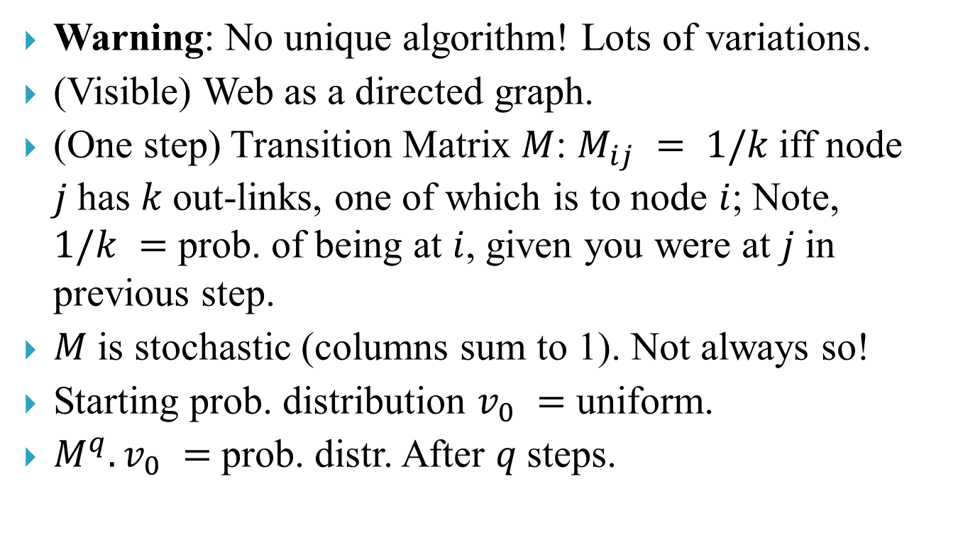
PageRank – basic version
Warning: No unique algorithm! Lots of variations.
(Visible) Web as a directed graph.
(One step) Transition Matrix $M$: $M_{ij} = 1/k$iff node $j$has $k$out-links, one of which is to node $i$; Note, $1/k =$ prob. of being at $i$, given you were at $j$in previous step.
$M$is stochastic (columns sum to 1). Not always so!
Starting prob. distribution $v_{0} =$ uniform.
$M^{q}.v_{0} =$prob. distr. After $q$steps.

Slide 5
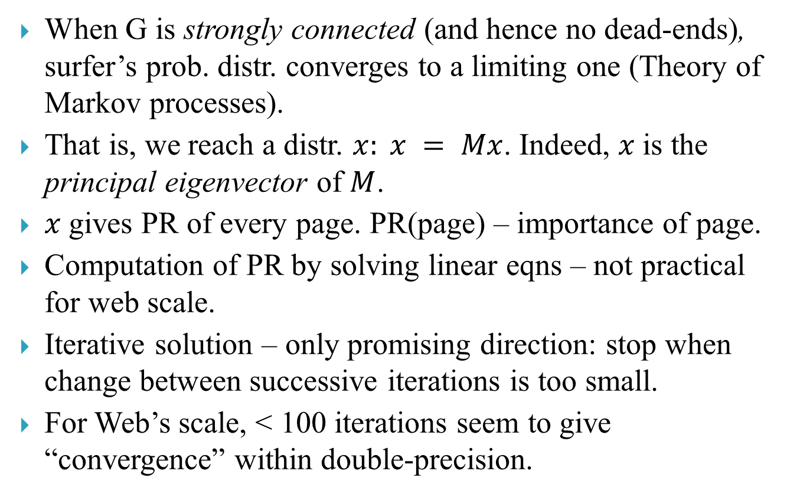
PR – basic version
When G is strongly connected (and hence no dead-ends), surfer’s prob. distr. converges to a limiting one (Theory of Markov processes).
That is, we reach a distr. $x: x = Mx$. Indeed, $x$is the principal eigenvector of $M$.
$x$gives PR of every page. PR(page) – importance of page.
Computation of PR by solving linear eqns – not practical for web scale.
Iterative solution – only promising direction: stop when change between successive iterations is too small.
For Web’s scale, < 100 iterations seem to give “convergence” within double-precision.

Slide 6
Pitfalls of basic PR
But the web is not strongly connected!
Violated in various ways:
  Dead-ends: “drain away” the PR of any page that can reach them (why?).
  Spider traps.
Two ways of dealing with dead-ends:
  Method 1:
  (recursively) delete all deadends.
  Compute PR of surviving nodes.
  Iteratively reflect their contribution to the PR of deadends in the order in which they were deleted.

Slide 7
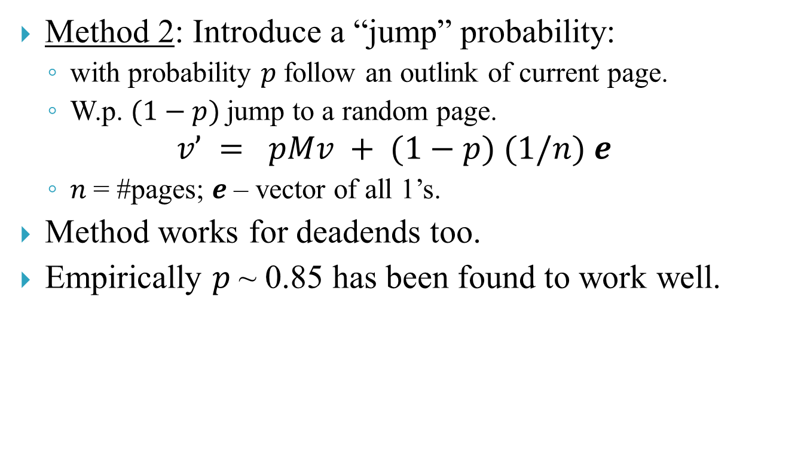
Pitfalls of basic PR
Method 2: Introduce a “jump” probability:
  with probability $p$follow an outlink of current page.
  W.p. $(1−p)$jump to a random page.
$$v’ = pMv + (1−p) (1/n) e$$
  $n$= #pages; $e$– vector of all 1’s.
Method works for deadends too.
Empirically $p$~ 0.85 has been found to work well.

Slide 8
So how does a search engine rank pages?
Exact formula has the status of some kind of secret sauce, but we can talk about principles.
Google is supposed to use 250 properties of pages!
Presence, frequency, and prominence of search terms in page.
How many of the search terms are present?
And of course PR is a heavily weighted component.
We’ll revisit (in your talks) PR for such issues as efficient computation, making it more resilient against spam etc. Do check out Ch:5 though, for quick intuition.

