Slide 1
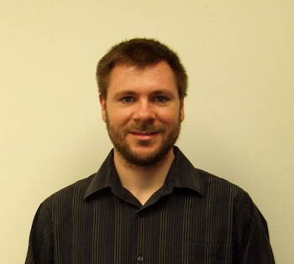
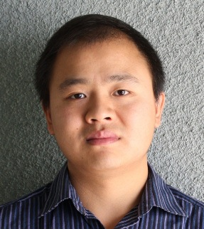



Stackelberg Games with Applications to Security
Chris Kiekintveld
Bo An
Albert Xin Jiang

Slide 2
Outline
Motivating real-world applications
Background and basic security games
Scaling to complex action spaces
Modeling payoff uncertainty: Bayesian Security Games
Human behavior and observation uncertainty
Evaluation and discussion

Slide 3
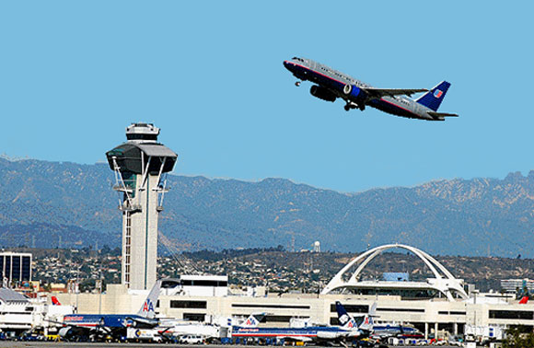

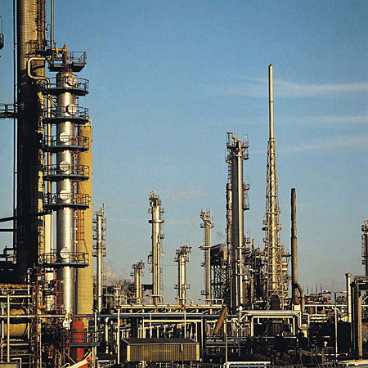
Motivation: Game Theory for Security
Limited security resources: Selective checking
Adversary monitors defenses, exploits patterns
50 miles
LAX

Slide 4
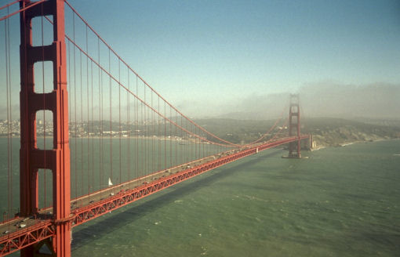
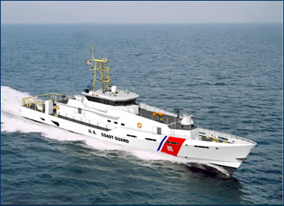
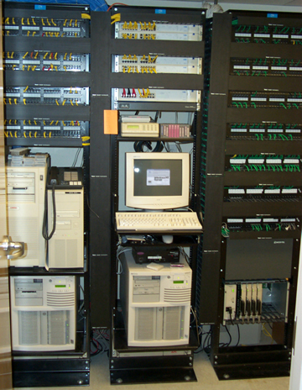
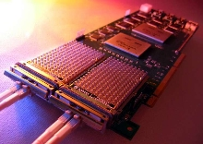
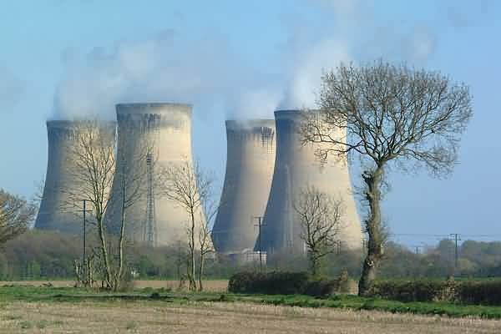
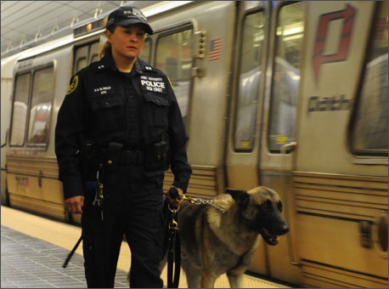
Many Targets Few Resources
How to assign limited resources
to defend the targets?
Game Theory: Bayesian Stackelberg Games

Slide 5
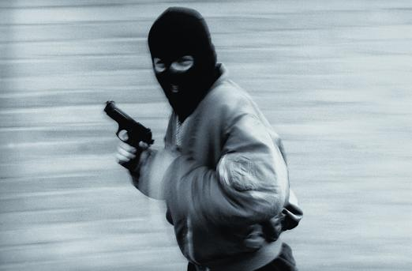

Game Theory: Bayesian Stackelberg Games
Security allocation: (i) Target weights; (ii) Opponent reaction
Stackelberg: Security forces commit first
Bayesian: Uncertain adversary types
Optimal security allocation: Weighted random
Strong Stackelberg Equilibrium (Bayesian)
  NP-hard (Conitzer/Sandholm ‘06)
Adversary
 | Terminal #1 | Terminal #2
Terminal #1 | 5, -3 | -1, 1
Terminal #2 | -5, 5 | 2, -1
Police
Notes:
Not looking for Nash equilibrium of simultaneous move game

Slide 6
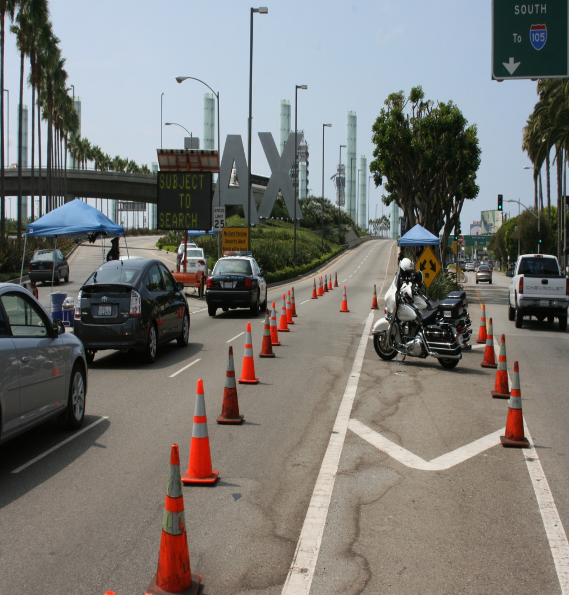
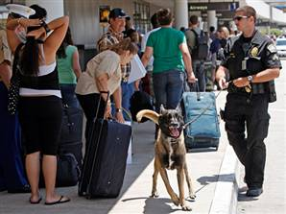
ARMOR: Deployed at LAX 2007
“Assistant for Randomized Monitoring Over Routes”
  Problem 1: Schedule vehicle checkpoints
  Problem 2: Schedule canine patrols
Randomized schedule: (i) target weights; (ii) surveillance
ARMOR-Checkpoints
ARMOR-K9

Slide 7
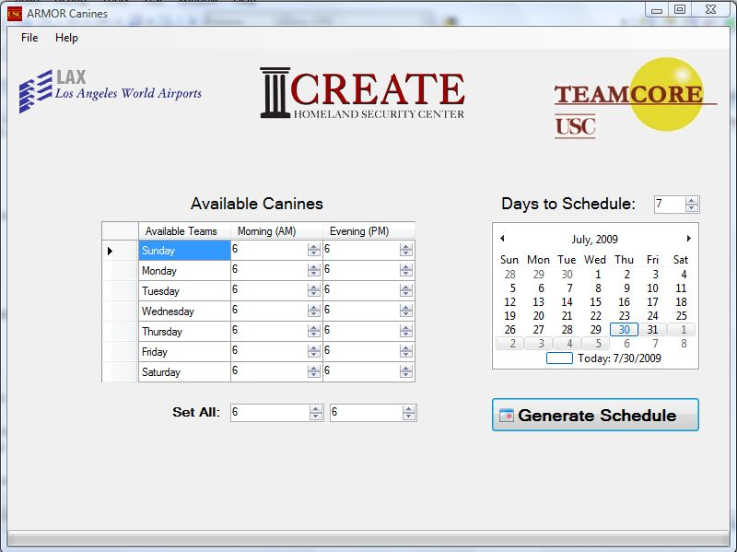
ARMOR Canine: Interface

Slide 8
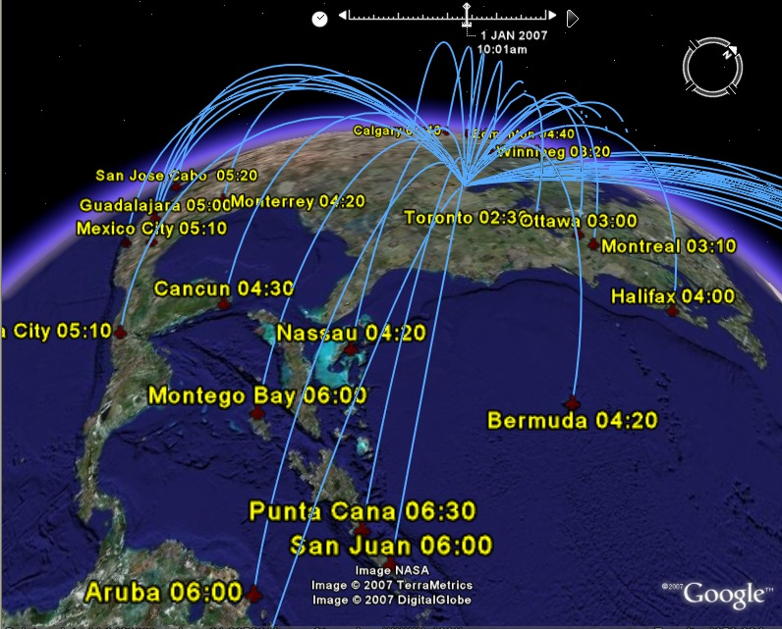
Federal Air Marshals Service (FAMS)
International Flights from
Chicago O’Hare
Undercover, in-flight
law enforcement
Flights (each day)
~27,000 domestic flights
~2,000 international flights
Not enough air marshals:
Allocate air marshals to flights?

Slide 9
Federal Air Marshals Service (FAMS)
Massive scheduling problem
Adversary may exploit predictable schedules
Complex constraints: tours, duty hours, off-hours
100 flights, 10 officers:
1.7 × 10¹³ combinations
Overall problem: 30000 flights, 3000 officers
Our focus: international sector

Slide 10
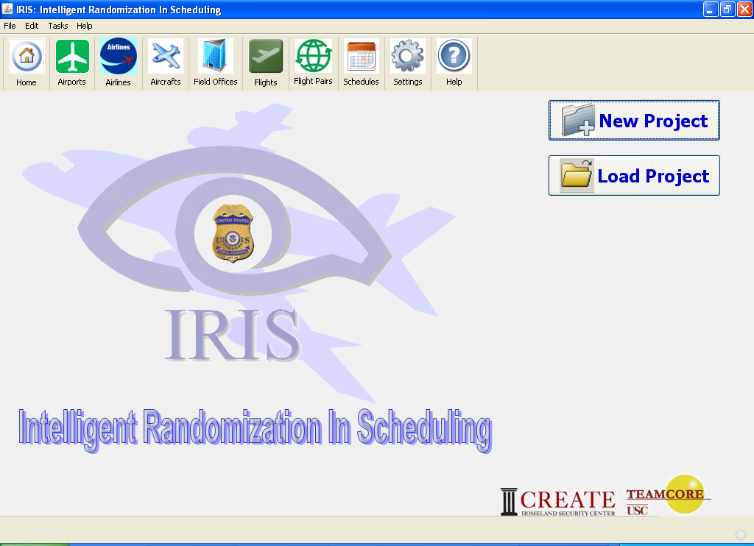
IRIS: “Intelligent Randomization in International Scheduling” (Deployed 2009)

Slide 11

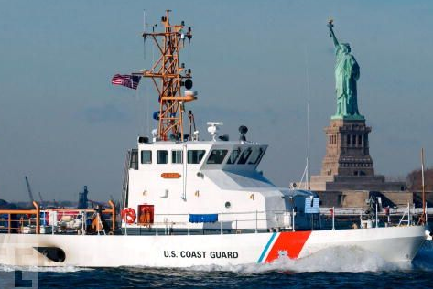

PROTECT (Boston and Beyond)
US Coast Guard: Port Resilience Operational / Tactical Enforcement to Combat Terrorism
Randomized patrols; deployed in Boston, with more to follow
More realistic models of human behaviors
Notes:
Acronyms….

Slide 12
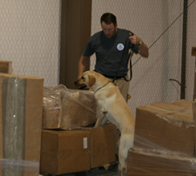
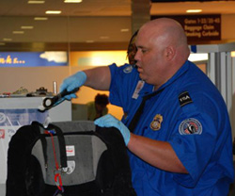
Application in Transition: GUARDS
GUARDS: under evaluation for national deployment
Transportation Security Administration
  Protect over 400 airports
    Limited security resources
    Numerous security measures
    Diverse potential threats
  Adaptive adversary

Slide 13
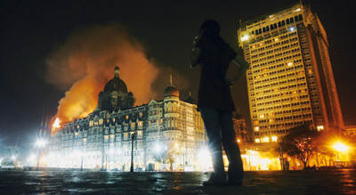
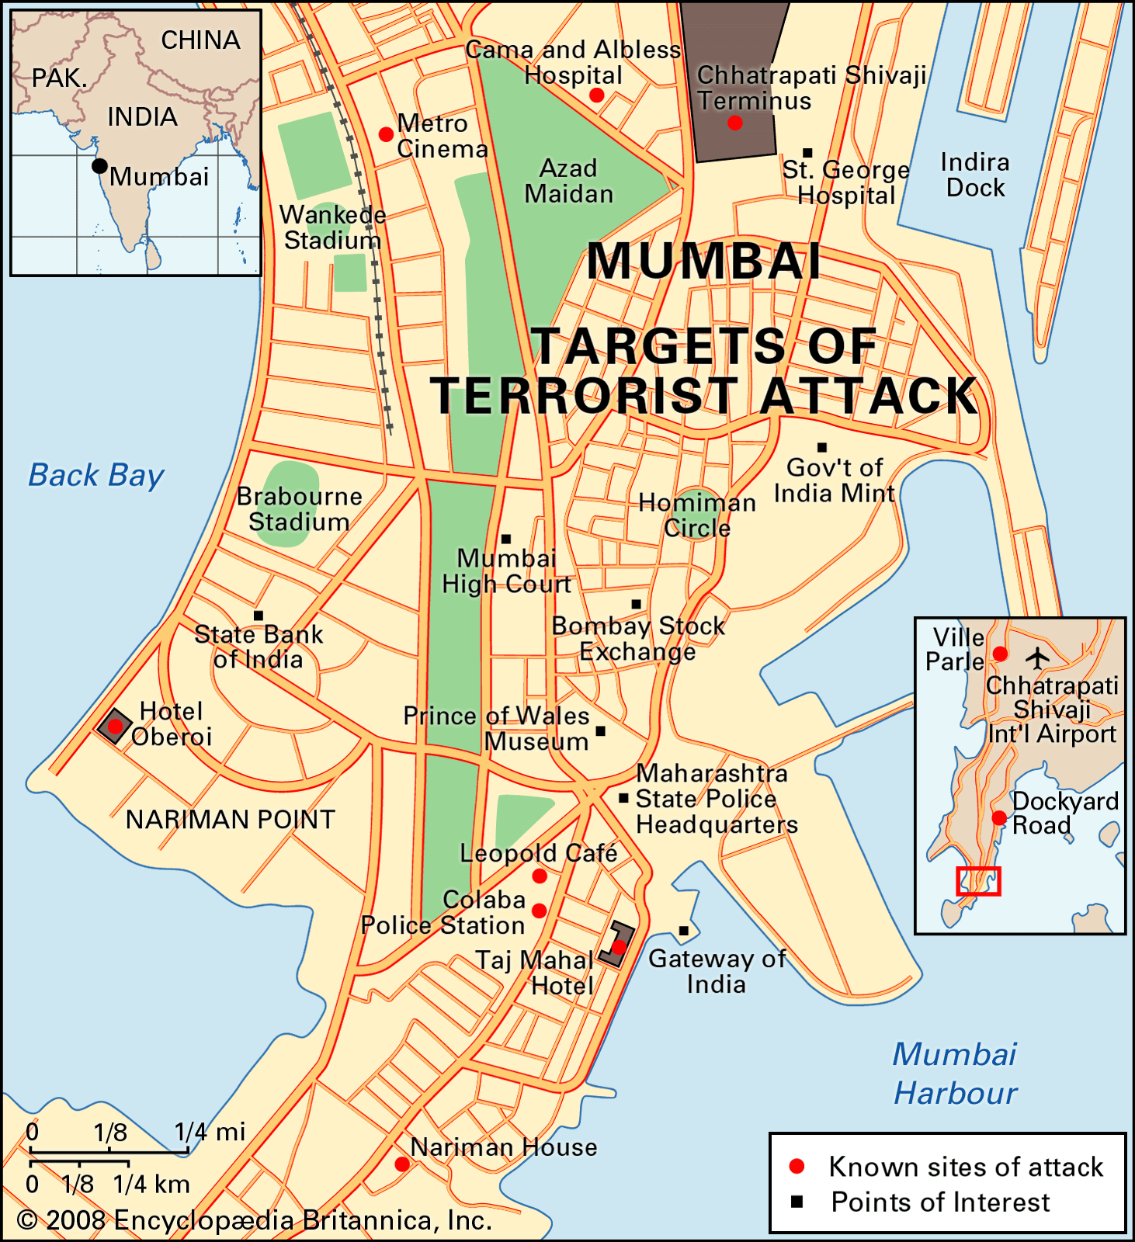
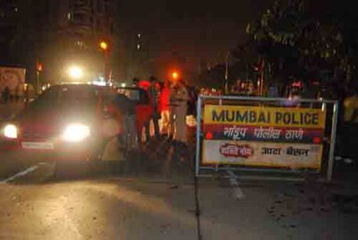
International Interest: Mumbai
Protect networks

Slide 14
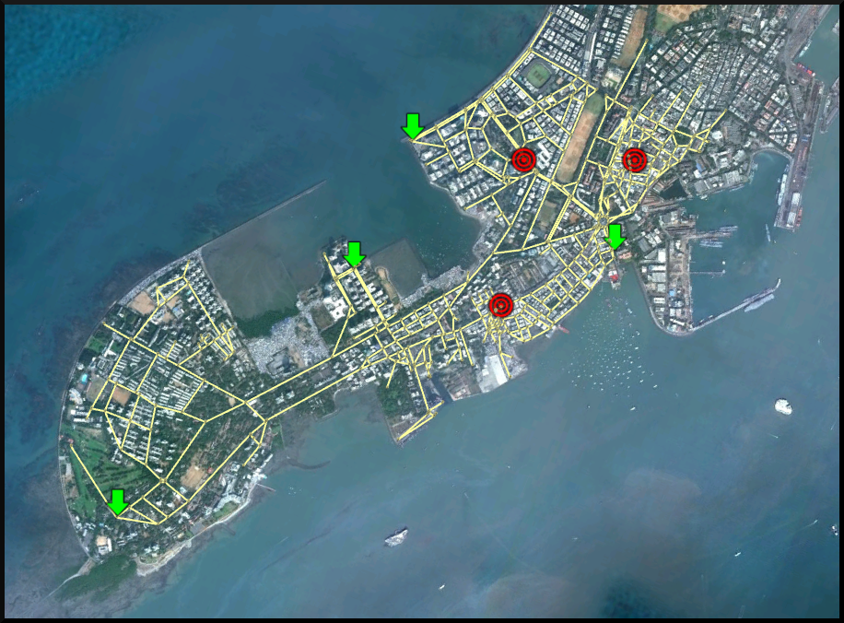
Urban Road Network Security
Southern Mumbai

Slide 15
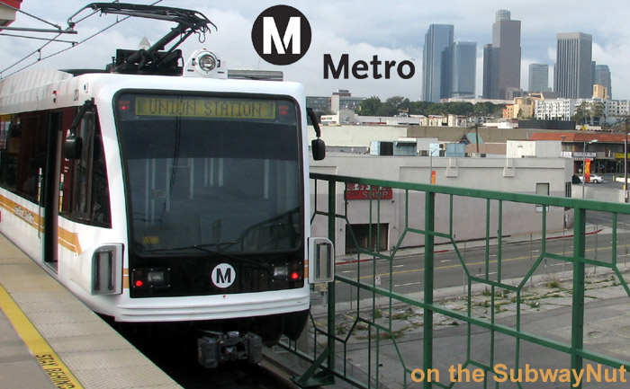

Beyond Counterterrorism: Other Domains
LA Sheriff’s dept (Crime suppression & ticketless travelers):
Customs and Border Protection
Cybersecurity
Forest/environmental protection
Economic leader/follower models

Slide 16
Research Challenges
Scalable algorithms
Rich representations; networks
Payoff uncertainty, robustness
Imperfect surveillance
Evaluation of deployed systems
Human behavior, bounded rationality
Explaining game theory solutions
…

Slide 17
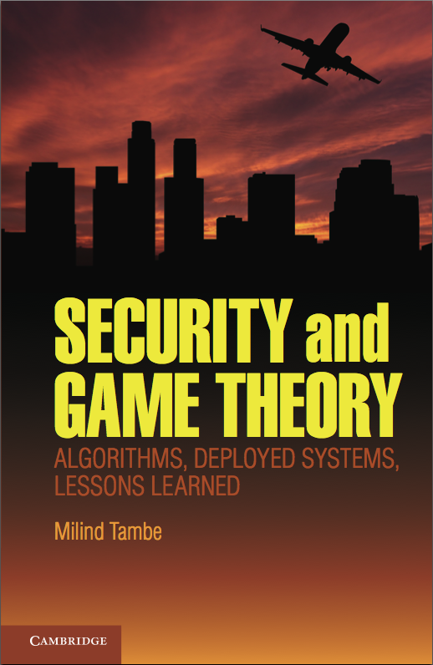
Publications
Publications ~40 rigorously reviewed papers:
AAMAS’ [06-12: (15)]
AAAI[08,10-12: (10)]
IJCAI’11: (2)
ECAI’12: (1)
IAAI’12: (1)
JAIR’11
JAAMAS’12
AI Journal’10, 12
Interfaces’10
AI Magazine’09,12…
Journal ITM’09
Notes:
Deployed applications = Problem Space

Slide 18
Outline
Motivating real-world applications
Background and basic security games
Scaling to complex action spaces
Modeling payoff uncertainty: Bayesian Security Games
Human behavior and observation uncertainty
Evaluation and discussion

Slide 19
Games
Players:
  1, … , n
  focus on 2 players
Strategies
  a_{i} 2 A_{i}
  a = (a₁,...,a_{n}) 2 A
Utility function
  u_{i} : A ! R

Slide 20
Security Games
Two players
  Defender: Θ
  Attacker: ψ
Set of targets: T
Set of resources: R
  Defender assigns resources to protect targets
  Attacker chooses one target to attack
Payoffs define the reward/penalty for each player for a successful or unsuccessful attack on each target

Slide 21
Zero-Sum Payoffs?
Are security games always zero-sum?
  NO!
In real domains attackers and defenders often have different preferences and criteria
  Weighting casualties, economic consequences, symbolic value, etc.
  Player may not care about the other’s cost (e.g., cost of security, cost of carrying out an attack)
We often make a weaker assumption:
  An attack on a defended target is better than an attack on the same target if it is undefended (for the defender)
  The opposite holds for attackers (attackers prefer to attack undefended targets)

Slide 22

Security Game
2 players
2 targets
1 defender resource
Target1
Target 2
Target 1
1, -1
-2, 2
Target 2
-1, 1
2, -1
Notes:
Game model: players, targets/strategies, payoffs
Best response (fix defender strategy at 1)
Nash equilibrium
Stackelberg equilibrium

Slide 23
Game Solutions
Best Response
Target1
Target 2
Target 1
1, -1
-2, 2
Target 2
-1, 1
2, -1
Notes:
Game model: players, targets/strategies, payoffs
Best response (fix defender strategy at 1)
Nash equilibrium
Stackelberg equilibrium

Slide 24
Game Solutions
Best Response
Target1
Target 2
Target 1
1, -1
-2, 2
Target 2
-1, 1
2, -1
Notes:
Game model: players, targets/strategies, payoffs
Best response (fix defender strategy at 1)
Nash equilibrium
Stackelberg equilibrium

Slide 25
Game Solutions
Best Response
Target1
Target 2
Target 1
1, -1
-2, 2
Target 2
-1, 1
2, -1
Notes:
Game model: players, targets/strategies, payoffs
Best response (fix defender strategy at 1)
Nash equilibrium
Stackelberg equilibrium

Slide 26
Game Solutions
Mixed Strategy
Target1
Target 2
50%
Target 1
1, -1
-2, 2
50%
Target 2
-1, 1
2, -1
Notes:
Game model: players, targets/strategies, payoffs
Best response (fix defender strategy at 1)
Nash equilibrium
Stackelberg equilibrium

Slide 27
Game Solutions
Nash Equilibrium
A mixed strategy for each
player such that no player benefits
from a unilateral deviation
Target1
Target 2
Target 1
1, -1
-2, 2
Target 2
-1, 1
2, -1
Notes:
Game model: players, targets/strategies, payoffs
Best response (fix defender strategy at 1)
Nash equilibrium
Stackelberg equilibrium

Slide 28
Game Solutions
Nash Equilibrium
A mixed strategy for each
player such that no player benefits
from a unilateral deviation
67%
33%
Target1
Target 2
40%
Target 1
1, -1
-2, 2
60%
Target 2
-1, 1
2, -1
Notes:
Game model: players, targets/strategies, payoffs
Best response (fix defender strategy at 1)
Nash equilibrium
Stackelberg equilibrium

Slide 29
Stackelberg Equilibrium
Attackers use
surveillance in
planning attacks
{0.1,0.9}
{0.5,0.5}
Defender
commits to a
mixed strategy
...
...
1
2
1
2
(-0.9, 0.9)
(1.8, -0.9)
(0, 0)
(0, -0.5)
Notes:
Breaking ties in favor of the defender (Strong Stackelberg Equilibrium)
Weak may not exist
Can often induce strong (vonstengel zamir)
More robust concepts: eg quantal response

Slide 30
Strong Stackelberg Equilibrium
Strong Stackelberg Equilibrium (SSE)
  Break ties in favor of the defender
  Can often induce SSE by perturbing defender strategy
More robust concepts
  Weak Stackelberg Equilibrium not guaranenteed to exist
  Payoff uncertainty
  Quantal response
  Equilibrium refinement

Slide 31
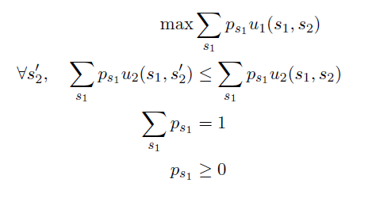
Finding Stackelberg Equilibria
Multi-linear programming formulation Conitzer and Sandholm, 2006
The formulation above gives the maximum utility of the leader when the follower chooses action a
The Stackelberg equilibrium is obtained by maximizing over all the possible pure strategies for player two
Notes:
Contrast: Nash PPAD-complete

Slide 32
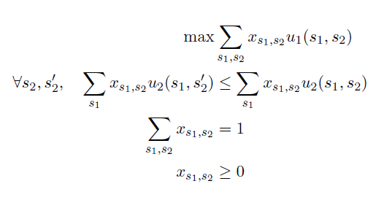
Single LP formulation
(Korzhyk & Conitzer 2011)
Relaxation of the LP for correlated equilibrium
  removed player 1's incentive constraints
Corollary: SSE leader expected utility at least that of best CE
Notes:
Correlated LP
Rel. Von Stengel & Zamir: advantage of commitment

Slide 33
Research Challenges
Scalability
  Large, complex strategy spaces
Robustness
  Payoff & observation uncertainty
  Human decision-makers
Not in this talk:
  Stackelberg equilibria for dynamic games (Letchford & Conitzer 2010, Letchford et al. 2012)
  Multiple objectives (Brown et al. 2012)
Notes:
Not in this talk: stackelberg eq of extensive form; of stochastic games

Slide 34
Outline
Motivating real-world applications
Background and basic security games
Scaling to complex action spaces
Modeling payoff uncertainty: Bayesian Security Games
Human behavior and observation uncertainty
Evaluation and discussion

Slide 35
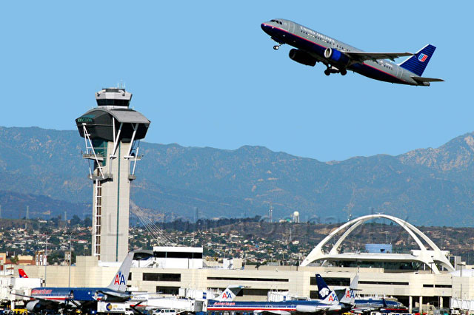

Large Numbers of Defender Strategies
 | Strategy 1 | Strategy 2 | Strategy 3
Strategy 1
Strategy 2
Strategy 3
Strategy 4
Strategy 5
Strategy 6
FAMS: Joint Strategies
or Combinations
784 x
512
1.73 x 10¹³
Schedules:
ARMOR
out of memory
100 Flight tours
10 Air Marshals
 | Strategy 1 | Strategy 2 | Strategy 3
Strategy 1
Strategy 2
Strategy 3
Strategy 4
Strategy 5
Strategy 6
Don’t enumerate ALL joint strategies
Marginals (IRIS I & II)
Branch and price (IRIS III)
100,000,000…
x
1000…

Slide 36
IRIS I & II: Marginals Instead of Joint Strategies
ARMOR: 10 tours, 3 air marshals
Payoff duplicates: Depends on target covered
ARMORActions | Tour combos | Prob
1 | 1,2,3 | x1
2 | 1,2,4 | x2
3 | 1,2,5 | x3
… | … | …
120 | 8,9,10 | x120
 | Attack 1 | Attack 2 | Attack … | Attack 6
1,2,3 | 5,-10 | 4,-8 | … | -20,9
1,2,4 | 5,-10 | 4,-8 | … | -20,9
1,3,5 | 5,-10 | -9,5 | … | -20,9
… | … | … | … | …
CompactAction | Tour | Prob
1 | 1 | y1
2 | 2 | y2
3 | 3 | y3
… | … | …
10 | 10 | y10
MILP similar to ARMOR, y instead of x:
  10 instead of 120 variables
  y1+y2+y3…+y10 = 3
  Sample from “y”, not enumerate “x”
  Only works for SIMPLE tours
  (Korzhyk et al. 2010)
Notes:
Notice that if the attacker is attacking flights in tour 2, whether flights in tour 1 or tour 4 are protected or not have no influence on the payoffs. This key insight is what allows us to generate a more compact representation, providing us speedups

Slide 37
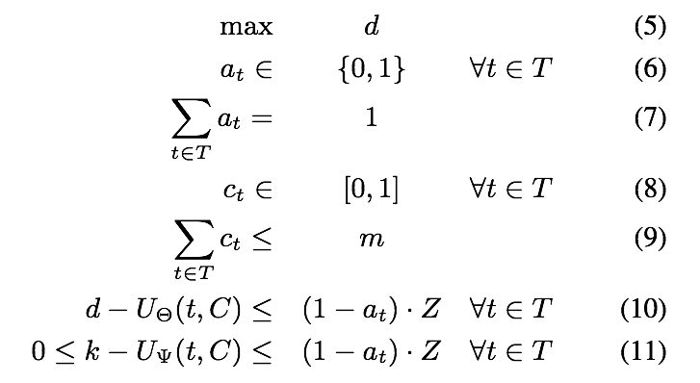
IRIS II
Max Defender Payoff
Attacker Strategy
Definition
Defender Strategy
Definition
Best Responses
Notes:
ERASER

Slide 38

IRIS I
Four flights
One marshal
Zero Sum
Attacker payoffs
Uncovered | Covered
4 | 0
3 | 0
2 | 0
1 | 0
0 | 0 | 0 | 0
Coverage Probability
Notes:
ORIGAMI
Intuition: start with 0 coverage, inc

Slide 39
IRIS I
Attack Set:
Set of targets with
maximal expected
payoff for the
attacker
0 | 0 | 0 | 0
Coverage Probability

Slide 40

IRIS I
Observation 1
It never benefits
the defender to
add coverage outside the attack set.
0 | 0 | 0.5 | 0
Coverage Probability

Slide 41

IRIS I
Compute coverage
necessary to make
attacker indifferent
between 3 and 4
0.25 | 0 | 0 | 0
Coverage Probability

Slide 42

IRIS I
Observation 2
It never benefits the
defender to add coverage to a subset
of the attack set.
0.5 | 0 | 0 | 0
Coverage Probability

Slide 43

IRIS I
0.5 | 0.33 | 0 | 0
Coverage Probability

Slide 44

IRIS I
Need more than one
air marshal!
0.75 | 0.66 | 0.5 | 0
Coverage Probability

Slide 45
IRIS I
Can still assign 0.17
0.5 | 0.33 | 0 | 0
Coverage Probability

Slide 46

IRIS I
Allocate all remaining coverage to flights in the attack set
Fixed ratio necessary for indifference
0.54 | 0.38 | 0.08 | 0
Coverage Probability
Notes:
Example is zero-sum; but works under a more general setting

Slide 47
IRIS Speedups
ARMOR
Actions
ARMOR
Runtime
IRIS
Runtime
FAMS
Ireland
6,048
4.74s
0.09s
FAMS
London
85,275
----
1.57s

Slide 48
IRIS III: Branch and Price:
Tours of Arbitrary Size
Branch & Price: Branch & Bound + Column Generation
Not out of the box
Upper bounds: IRIS I
Column generation:
Network flow
Upper bound:
Adversary → 2…N
Lower bound 1:
Adversary best response → Target1
Lower bound 2:
Adversary best response → Target2
Lower bound N:
Adversary best response → TargetN
Notes:
Find payoff maximizng defender strategy that would cause adversary to attack target 1?
Blue nodes are simple linear relaxation of the constraint to get an upper-bound. It does not work very well. Second blue node is an upper bound on the rest of the children nodes.
The black node if solved optimally would come up with an answer of one of the orange nodes; but it is not solved optimally so we get an upper bound of course.

Slide 49
IRIS III: Branch & Price
Column Generation Quick Overview
LEAF NODE:
Incrementally build support
for mixed strategy
Return the “best” joint schedule:
Minimum reduced cost
“Slave”
Problem
Minimum cost network flow
Lower bound 1:
Adversary→Target1
“Master”
Problem
(mixed integer program)
Solution supported
by N pure strategies
Target 3
Target 7
Resource
Sink
Lower bound 2:
Adversary→Target2
…
…
(N+1)^{th} pure
Strategy
Capacity 1 on all links
Lower bound N
Adversary → TargetN
Notes:
Each {target3, target7} is a single schedule for one FAM
A min cost network flow given the current state of master gives us the joint schedule, e.g. {target3,target7}{target1,target5}, to add to the master problem.

Slide 50
IRIS Results
ARMOR
Runs out of memory
IRIS II
B&P
IRIS III

Slide 51
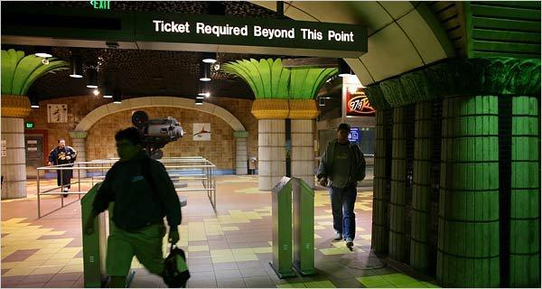
Fare Checking in LA Metro
(Yin et al. 2012)
Los Angeles Metro Rail System
  Barrier-free system with random inspections
  Approximately 300,000 daily riders, ≈6% fare evaders
  Fare evasion costs ≈ $5.6 million annually (Booz Allen Hamilton 2007)

Slide 52
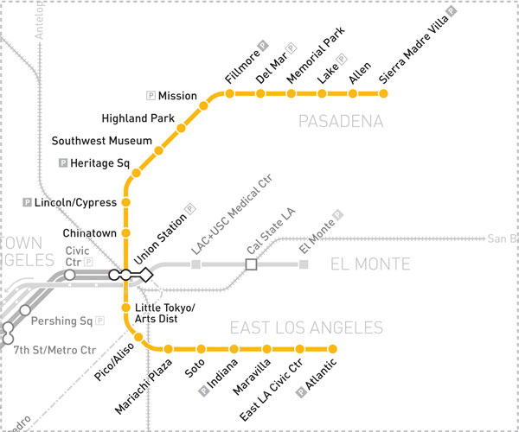
How to Model?
What is a pure strategy of the defender?

Slide 53
How to Model?
What is a pure strategy of the defender?
Check fares at “Mission” station

Slide 54
How to Model?
What is a pure strategy of the defender?
Check fares at “Mission”
Go to “Southwest Museum”
Check fares at “Southwest Museum”

Slide 55
How to Model?
What is a pure strategy of the defender?
Check fares at “Mission” from 7am to 7:50am
Go to “Southwest Museum” at 7:50am
Check fares at “Southwest Museum” from 8am to 9am

Slide 56
How to Model?
What is a pure strategy of the defender?
Check fares at “Mission” from 7am to 7:50am
Go to “Southwest Museum” at 7:50am
Check fares at “Southwest Museum” from 8am to 9am
How many such pure strategies?

Slide 57
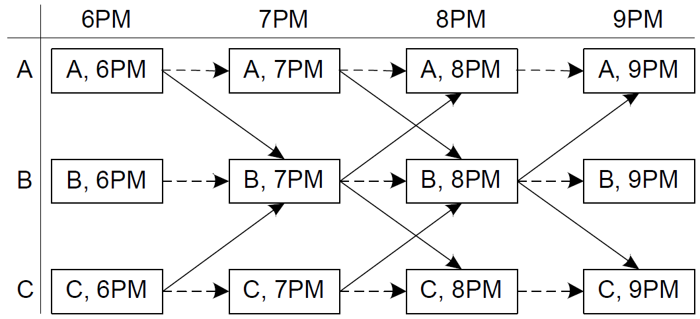
Problem Setting
Transition graph
Vertex: station and time pair

Slide 58
Problem Setting
Transition graph
Edge: inspection action

Slide 59
Problem Setting
Transition graph
Edge: inspection action

Slide 60
Problem Setting
Transition graph
Edge: inspection action
l_{e} - action duration
f_{e} - fare-check effectiveness

Slide 61
Problem Setting
Transition graph
Patrols: bounded-length paths

Slide 62
Problem Setting
Transition graph
Patrols: bounded-length paths
γ – patrol units
κ – patrol hours per unit

Slide 63
Problem Setting cont.
Riders: multiple types
  Each type takes fixed route
  Fully observes the probability of being inspected
  Binary decision: buy or not buy the ticket
  Perfectly rational and risk-neutral

Slide 64
Problem Setting cont.
Riders: multiple types
  Each type takes fixed route
  Fully observes the probability of being inspected
  Binary decision: buy or not buy the ticket
  Perfectly rational and risk-neutral
Why do we need this edge?

Slide 65
Basic Compact Formulation
Based on transition graph
Strategy representation: marginal coverage on edges
0.2
0.8
0.4
0.2
0.4
0.4

Slide 66
Basic Compact Formulation
Based on transition graph
Strategy representation: marginal coverage on edges
0.2
0.2
0.4

Slide 67
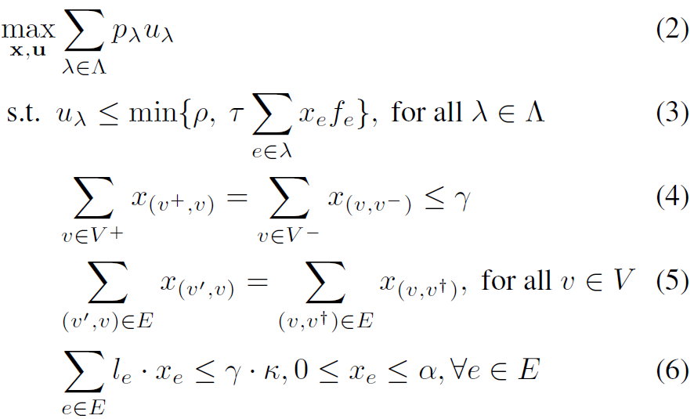
Basic Compact Formulation
Transition graph: G = ˂V, E˃
  Dummy source v⁺, possible starting vertices V⁺
  Dummy sink v⁻, possible ending vertices V⁻

Slide 68
Issues with Basic Compact Formulation
Patrol length may not be bounded by κ
  E.g., γ = 1, κ = 1
0.5
0.5
0.5
0.5
1
v⁺
v₁
v₂
v₃
v⁻
0
0
0

Slide 69
Issues with Basic Compact Formulation
Patrol length may not be bounded by κ
  E.g., γ = 1, κ = 1
  0.5, v⁺ → v₃ → v⁻
  0.5, v⁺ → v₁ → v₂ → v₃ → v⁻
0.5
0.5
0.5
0.5
1
v⁺
v₁
v₂
v₃
v⁻
0
0
0

Slide 70
Extended Compact Formulation
History-duplicate transition graph
  Store history information in vertices
  Access necessary patrol information without exponential blowup

Slide 71
Extended Compact Formulation cont.
History-duplicate transition graph
  Store history information in vertices
  Access necessary patrol information without exponential blowup
E.g., to forbid patrols longer than 2 hours
  What information should be duplicated?

Slide 72
Extended Compact Formulation cont.
History-duplicate transition graph
  Store history information in vertices
  Access necessary patrol information without exponential blowup
E.g., to forbid patrols longer than 2 hours
  2 subgraphs corresponding to 2 starting time: 6pm and 7pm
A
,
6
PM
A
,
7
PM
A
,
8
PM
A
,
7
PM
A
,
8
PM
A
,
9
PM
(
6
PM
)
(
6
PM
)
(
6
PM
)
(
7
PM
)
(
7
PM
)
(
7
PM
)
B
,
6
PM
B
,
7
PM
B
,
8
PM
B
,
7
PM
B
,
8
PM
B
,
9
PM
(
6
PM
)
(
6
PM
)
(
7
PM
)
(
7
PM
)
(
7
PM
(
6
PM
)
)
C
,
6
PM
C
,
7
PM
C
,
8
PM
C
,
7
PM
C
,
8
PM
C
,
9
PM
(
7
PM
(
6
PM
)
)
(
6
PM
)
(
6
PM
)
(
7
PM
)
(
7
PM
)

Slide 73
Outline
Motivating real-world applications
Background and basic security games
Scaling to complex action spaces
Modeling payoff uncertainty: Bayesian Security Games
Human behavior and observation uncertainty
Evaluation and discussion

Slide 74
Robustness
 | Target 1 | Target 2 | Target 3 | Target 4
Defender Reward | 1 | 0 | -1 | 3
Defender Penalty | -1 | -4 | -6 | -10
Attacker Penalty | -2 | -3 | -3 | -5
Attacker Reward | 1 | 3 | 5 | 9
How do we know the model is correct?
If it is not exactly correct, how robust is the solution?

Slide 75
Estimating Target Values
What is the attacker’s value for a successful attack on a particular target?
  What is the likely number of casualties?
  What is the economic cost?
  What is the value of the media exposure?
  What is the symbolic value of the attack?
  How should these factors be weighted?
Answers can only be estimated

Slide 76
Modeling Choices
Players
How many?
Model organizations as individuals?
Specific people or generic types of people?
Are players rational?
If not, how do they behave?
Actions
What is the set of feasible actions?
Do players know all of the actions?
If the set is infinite, how do we represent it?
Are some actions similar to others?
Are actions sequential?
Payoffs
How do we determine payoffs?
Are payoffs known to all players?
What is the uncertainty about the payoffs?
Are payoffs deterministic or stochastic?
Do players care about risk?
Solution concepts
What to do if there are multiple equilibria?
Do we care about the worst case?
Bounded rationality
Limited observability
Can the solution be computed?

Slide 77
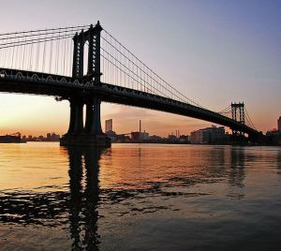
Robustness Perspectives
Game theorist’s perspective
  The model is given, and known to everyone
  We can model uncertainty explicitly by making the model more complex
Engineer’s perspective:
  Do the math
  Add a “fudge factor” to for safety
  The cost is worth the risk reduction
  “Unknown unknowns”
  Confidence is critical
Real problems force us to deal with robustness

Slide 78
Research on Robustness
Payoff uncertainty
  Conitzer et al 2006, Paruchuri et al 2008, Kiekintveld et al 2011, Jain et al 2011, Yin et al 2012, Kiekintveld at al 2012, Brown et al 2012, …
Human behavior
  Jain et al 2008, Pita et al 2009, Pita et al 2010, Yang et al 2011, Pita et al 2012, Yang et al 2012, …
Observation/Execution uncertainty
  Yin et al 2010, Pita et al 2011, Yin et al 2011, An et al 2012, …

Slide 79
Diverse Techniques
Bayesian
Models
Finite Models
Infinite Models
Interval
Models
Modified Strategy
Models

Slide 80
Finite Bayesian Games
P=0.3
P=0.5
P=0.2
 | Term #1 | Term #2
Term#1 | 5, -3 | -1, 1
Term#2 | -5, 5 | 2, -1
 | Term #1 | Term #2
Term#1 | 2, -1 | -3, 4
Term#2 | -3, 1 | 3, -3
 | Term #1 | Term #2
Term#1 | 4, -2 | -1,0.5
Term#2 | -4, 3 | 1.5, -0.5
 | 111 | 121 | 112 | 211 | … | … | … | 222
Terminal #1 | 3.3,-2.2 | 2.3,…
Terminal #2 | -3.8,2.6 | …,…
Harsanyi Transformation
NP-Hard

Slide 81
Multiple LPs Method
[Conitzer and Sandholm 2006]
First optimization formulation for FBSG
Basic idea:
  Enumerate attacker pure strategies
  Solve an LP to maximize leader’s payoff

Slide 82
Finite Bayesian Stackelberg Games
Attacker
Type
Type
 | a₁ | a₂
d₁ | 5, -3 | -1, 1
d₂ | -5, 5 | 2, -1
 | a₁ | a₂
d₁ | 1, -2 | -2, 3
d₂ | -3, 5 | 3, -1
Challenge: Exponential number of type combinations

Slide 83
Handling Multiple Adversary Types:
ARMOR
P=0.3
P=0.5
P=0.2
 | Term #1 | Term #2
Term#1 | 5, -3 | -1, 1
Term#2 | -5, 5 | 2, -1
 | Term #1 | Term #2
Term#1 | 2, -1 | -3, 4
Term#2 | -3, 1 | 3, -3
 | Term #1 | Term #2
Term#1 | 4, -2 | -1,0.5
Term#2 | -4, 3 | 1.5, -0.5

Slide 84
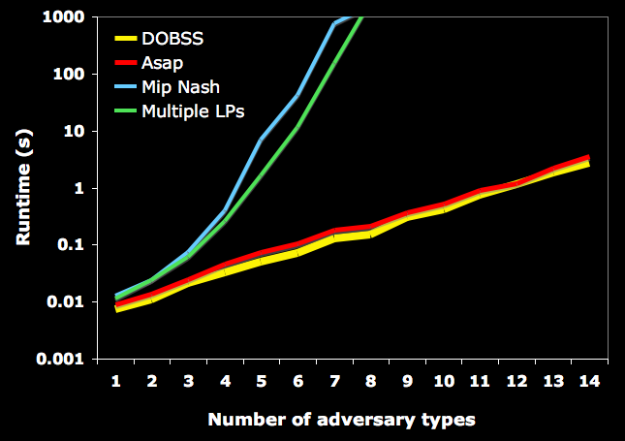
ARMOR: Run-time Results
Multiple LPs
(Conitzer & Sandholm’06)
MIP-Nash
(Sandholm et al’05)
Sufficient for LAX

Slide 85
Scaling Up: Hierarchical Solver (HBGS)
[Jain et al. 2011]
Efficient tree search
  Bounds and pruning
  Branching heuristics
Evaluate fewer LPs
Column generation
  Consider restricted games
  Solve much smaller LPs

Slide 86
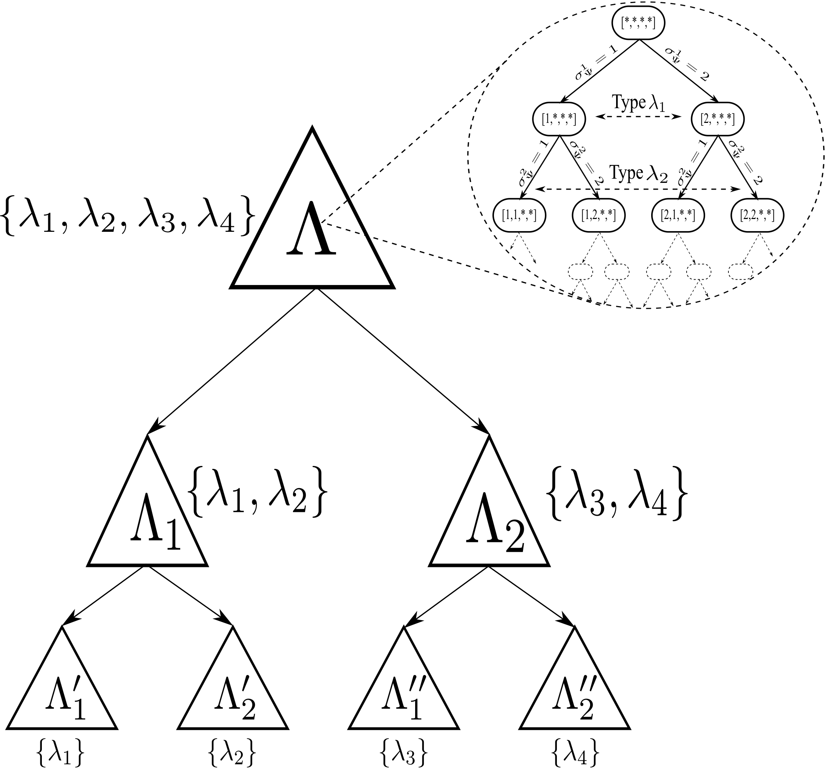
Scaling Up: Hierarchical Solver (HBGS)
Key Idea: solve restricted games (few types)
Use solutions to generate bounds/heuristics
Each node in this tree represents a full Bayesian Stackelberg game
Can use column generation to solve these nodes

Slide 87
Pruning
Theorem 1: If a pure strategy is infeasible in a “restricted” game, all its combinations are infeasible in the Bayesian game.

Slide 88
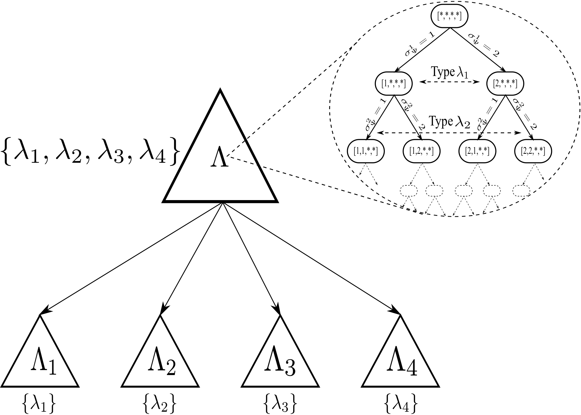
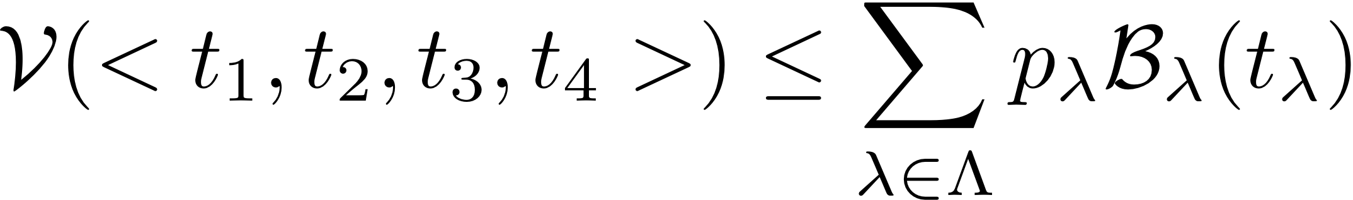
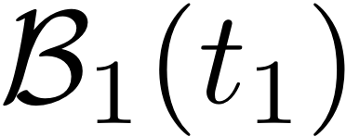
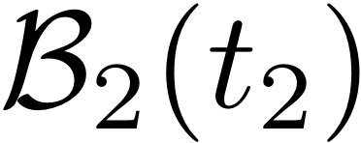
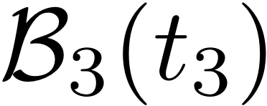
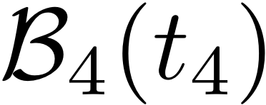
Bounds and Branching Rules
Theorem 2: Leader payoff in the Bayesian game is upper bounded by the sum of leader payoffs in the corresponding restricted games.

Slide 89
Column Generation
Master Problem
Slave Problem
Defender and Attacker Optimization Constraints
Scheduling Constraints

Slide 90
HBGS Results
Types | Follower Pure Strategy Combinations | Runtime (secs)
10 | 9.7e7 | 0.41
20 | 9.5e13 | 16.33
30 | 9.3e20 | 239.97
40 | 9.1e27 | 577.49
50 | 8.9e34 | 3321.68

Slide 91
Approximation
Approximation

Slide 92
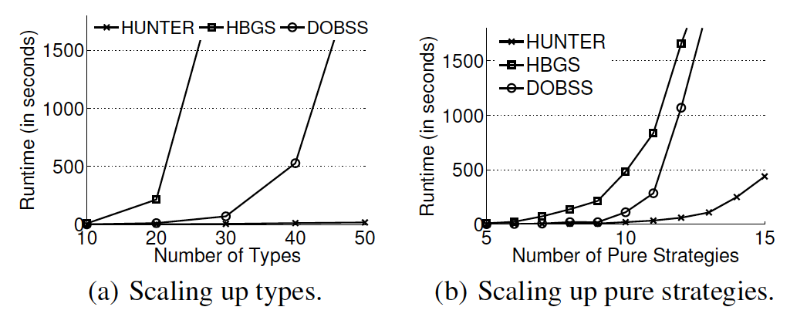
HUNTER
[Yin et al. 2012]
Improves on tree search from HBGS
Improved bounds (convex hulls on types)
Bender’s decomposition on LPs

Slide 93
Finite vs Infinite BSG
Finite games capture distinct attacker types
  Terrorists vs. local criminal activity
  Attackers with different motivations
Infinite games capture distributional uncertainty
  E.g., Gaussian, Uniform distributions
  Natural for expressing beliefs over possible values
  Useful in knowledge acquisition from experts

Slide 94

Distributional Payoff Representation
[Kiekintveld et al. 2011]
coverage
vector
Pb(payoff)
target
covered
target
uncovered
target 1
0
payoff
Pb(payoff)
target 2
0
payoff
.....
Pb(payoff)
target T
0
payoff

Slide 95
Problem 1 of 2
given a coverage
vector C...
...and payoff distributions
Pb(payoff)
target
covered
target
uncovered
20%
target 1
0
payoff
Pb(payoff)
80%
target 2
0
payoff
.....
Pb(payoff)
50%
target T
0
payoff

Slide 96
Problem 1 of 2
given a coverage
vector C...
...and payoff distributions
Pb(payoff)
target
covered
target
uncovered
20%
attack
vector
A(C)
target 1
0
payoff
Pb(payoff)
80%
?
target 2
0
payoff
.....
Pb(payoff)
50%
target T
0
payoff

Slide 97
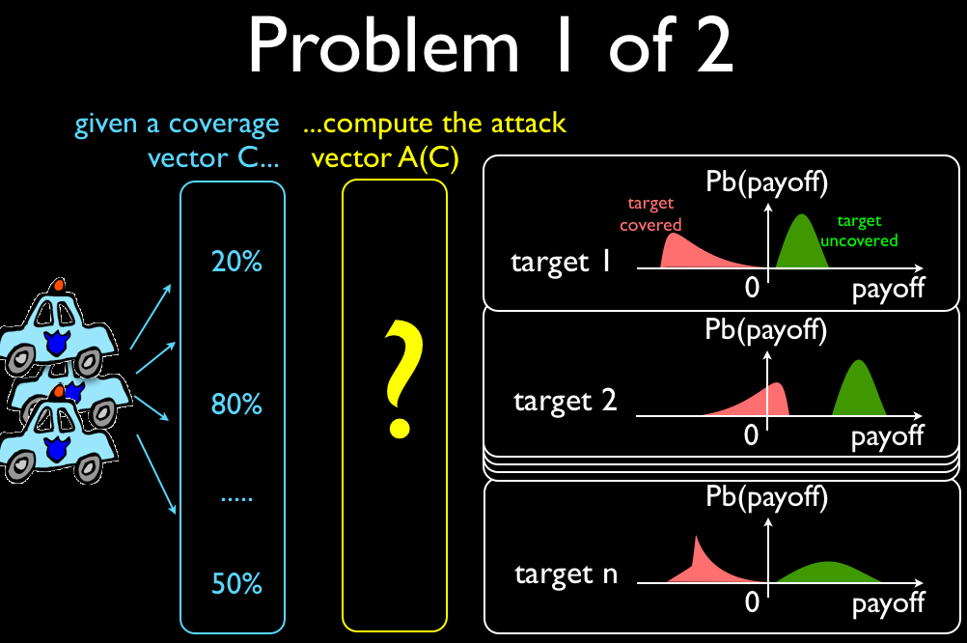
Problem 2 of 2
find the optimal
coverage vector C*.
... given A(C)
for every C
a1(C)
a2(C)
a3(C)
...
aT(C)
?

Slide 98
Approach
Coverage Vector
Attack Vector
(1) Monte-Carlo estimation
(2) Numerical methods
?
?
(1) Optimal Finite Algorithms
(2) Sampled Replicator Dynamics
(3) Greedy Monte-Carlo
(4) Decoupled Target Sets

Slide 99
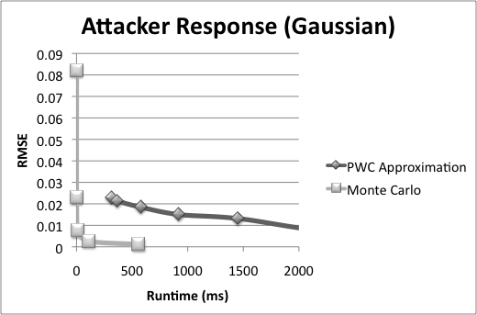
Attacker Response Estimation

Slide 100
Computing Coverage Vectors
Baselines
  Mean (ignore uncertainty)
  Uniform Random
Exact optimization given sampled types
  SBE (ARMOR variation)
Worst-case optimization
  BRASS
Approximate optimization
  Replicator Dynamics (SRD)
  Greedy Monte Carlo (GMC)
  Decoupled Target Sets (DTS)

Slide 101
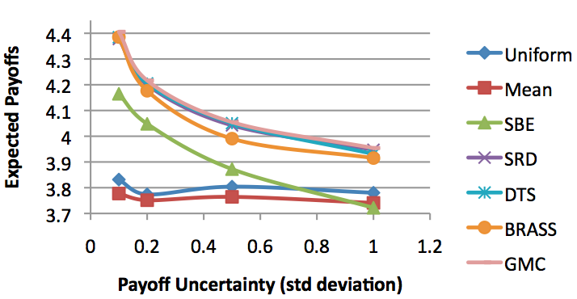
Results for Distributional Games
Sample Types
Approx Optimization
Sample Types
Exact Optimization
Assume
Perfect Information
Assuming perfect information is very brittle
Approximate both type distribution and optimization

Slide 102
Beyond Bayesian Games
Bayesian games are powerful
  General framework for model uncertainty
  Exact behavior predictions based on uncertainty
Some limitations
  Require distributional information
    Even MORE parameters to specify!
    What if these are wrong?
  Computational challenges (NP-hard)
  Uncertainty about human decision making is hard to capture in Bayesian models

Slide 103
Interval Security Games
[Kiekintveld et al. 2012]
 | Target 1 | Target 2 | Target 3 | Target 4
Defender Reward | 0 | 0 | 0 | 0
Defender Penalty | -1 | -4 | -6 | -10
Attacker Penalty | 0 | 0 | 0 | 0
Attacker Reward | [1,3] | [2,5] | [4,7] | [6,10]
Attacker payoffs represented by intervals
Maximize worst case for defender
Distribution-free

Slide 104
Polynomial Interval Solver
[Kiekintveld et al. 2012]
Fast feasibility checks
  Given resource constraint, can the defender guarantee a given payoff?
  Exploits structure of security games
Binary search on defender payoffs
Polynomial time: O(n² * log(1/ε))

Slide 105
Attacker Payoffs
5 Targets
Bars represent range of
possible attacker payoffs
0 | 0 | 0 | 0 | 0
Defender Coverage

Slide 106
Attacker Payoffs
When targets are covered,
payoffs decrease and
range shrinks
0 | 0 | 0 | 0.5 | 0.5
Defender Coverage

Slide 107
Potential Attack Set
Given a coverage strategy,
which set of targets could
be attacked?
R
Minimum attacker payoff is R
Any target with a possible value
greater than R is in the
potential attack set
0 | 0 | 0 | 0.5 | 0.5
Defender Coverage

Slide 108
Polynomial Algorithm
Main Idea:
  Design fast feasibility check to determine if a given defender payoff is possible
  Use binary search on defender payoffs
  Necessary resources increases monotonically with defender payoff
D_{min}
D*₁
D*₃
D*₂
D_{max}

Slide 109
Feasibility Checks
Determine whether we can guarantee a defender payoff of D* using m or fewer resources
Challenge: potential attack set depends on coverage, and number of possible sets is combinatorial

Slide 110
Solution Idea
For any potential attack set, there is some target t’ that determines the value of R
We will guess which target is t’ and construct a minimal solution for this guess (n choices)
As soon as we find a choice of t’ that works, we have a feasible solution

Slide 111

Constructing a Solution
Consider the selection
t’ = t₂
Since t’ is in the PAS,
it must give D* if attacked
Calculate minimal
coverage on t’ using:
0 | 0 | 0 | 0 | 0
Defender Coverage

Slide 112
Constructing a Solution
Consider the selection
t’ = t₂
Since t’ is in the PAS,
it must give D* if attacked
R
Calculate minimal
coverage on t’ using:
0 | 0 | 0.3 | 0 | 0
Defender Coverage

Slide 113
Constructing a Solution
For every other target t’’,
consider two cases:
Target is in the PAS
Target is not in the PAS
R
0 | 0 | 0.3 | 0 | 0
Defender Coverage

Slide 114
Constructing a Solution
For every other target t’’,
consider two cases:
Target is in the PAS
Target is not in the PAS
Case 1
R
Payoff for t’’ must
be at least D*
0 | 0 | 0.3 | 0 | 0
Defender Coverage

Slide 115

Constructing a Solution
For every other target t’’,
consider two cases:
Target is in the PAS
Target is not in the PAS
Case 2
R
Max payoff to attacker
for t’’ must be < R
0 | 0 | 0.3 | 0.7 | 0
Defender Coverage

Slide 116

Constructing a Solution
Final consistency check
No target other than t’
can have a higher minimum attacker payoff
Otherwise, t’ does not set
R contradicting the initial assumption
R
0 | 0 | 0.3 | 0.4 | 0
Defender Coverage

Slide 117
Constructing a Solution
For each target, compute
three coverage values
c¹: coverage for D*
c²: coverage not in PAS
c³: consistency with R
Best value given by:
R
0.2 | 0.5 | 0.3 | 0.4 | 0.7
Defender Coverage

Slide 118
Analysis
Need to check each
target as t’
O(n²) worst case to test
feasibility for D*
Binary search on D
O(n² * log(1/ε))
where ε is error term
R
0.2 | 0.5 | 0.3 | 0.4 | 0.7
Defender Coverage

Slide 119
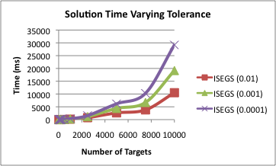
Interval Solver Scalability
Fastest Bayesian solvers (HBGS, HUNTER)
scale only to 10s or 100s of targets

Slide 120
Outline
Motivating real-world applications
Background and basic security games
Scaling to complex action spaces
Modeling payoff uncertainty: Bayesian Security Games
Human behavior and observation uncertainty
Evaluation and discussion

Slide 121
Key Topics
PART I: Integrate models of human decision making as attacker’s response
  Key model used:
    Anchoring bias and epsilon-bounded rationality
    Prospect Theory [Kahneman and Tvesky, 1979]
    Quantal Response [McKelvey and Palfrey, 1995]
  New efficient algorithms
  Results from experiments with human subjects
    Quantal Response (QRE) outperforms other algorithms
PART II: Impact of limited observations assuming rational attacker

Slide 122
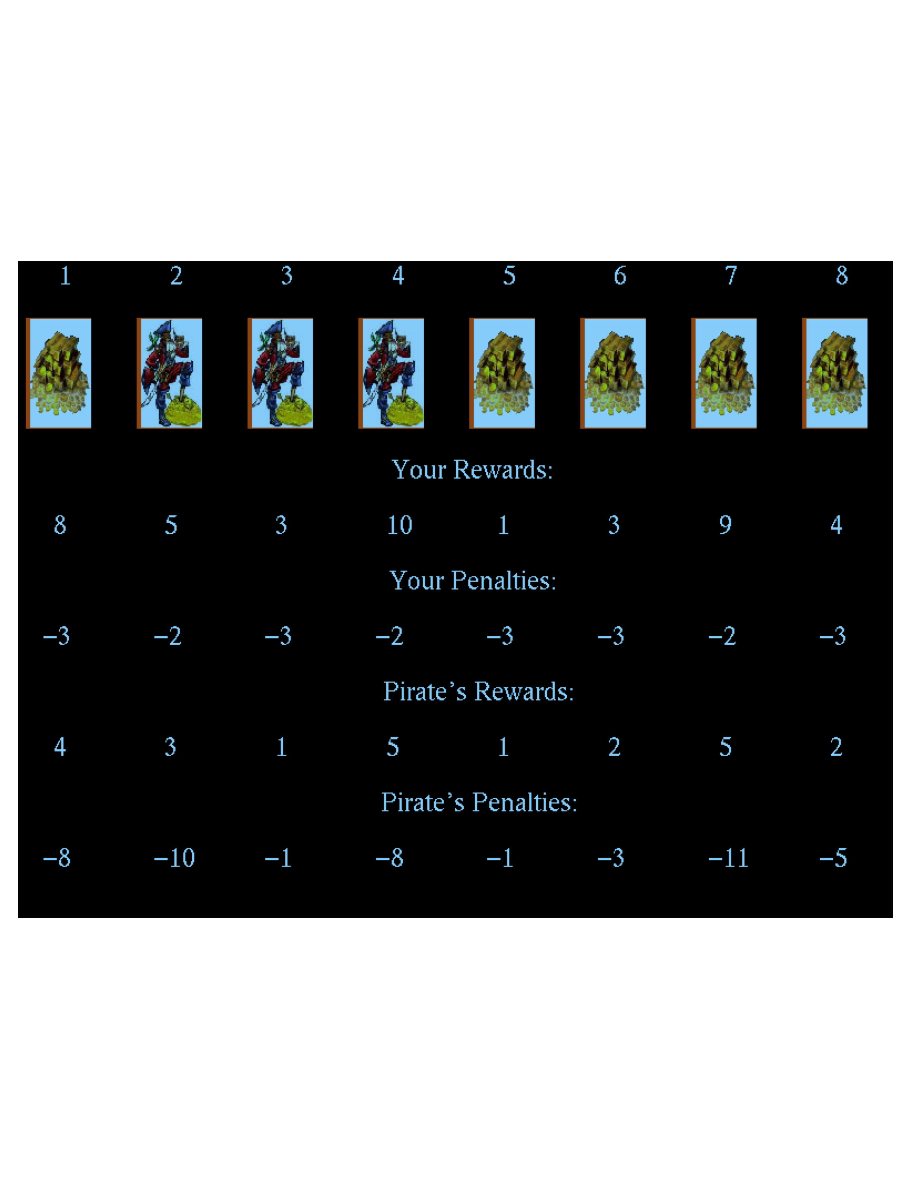
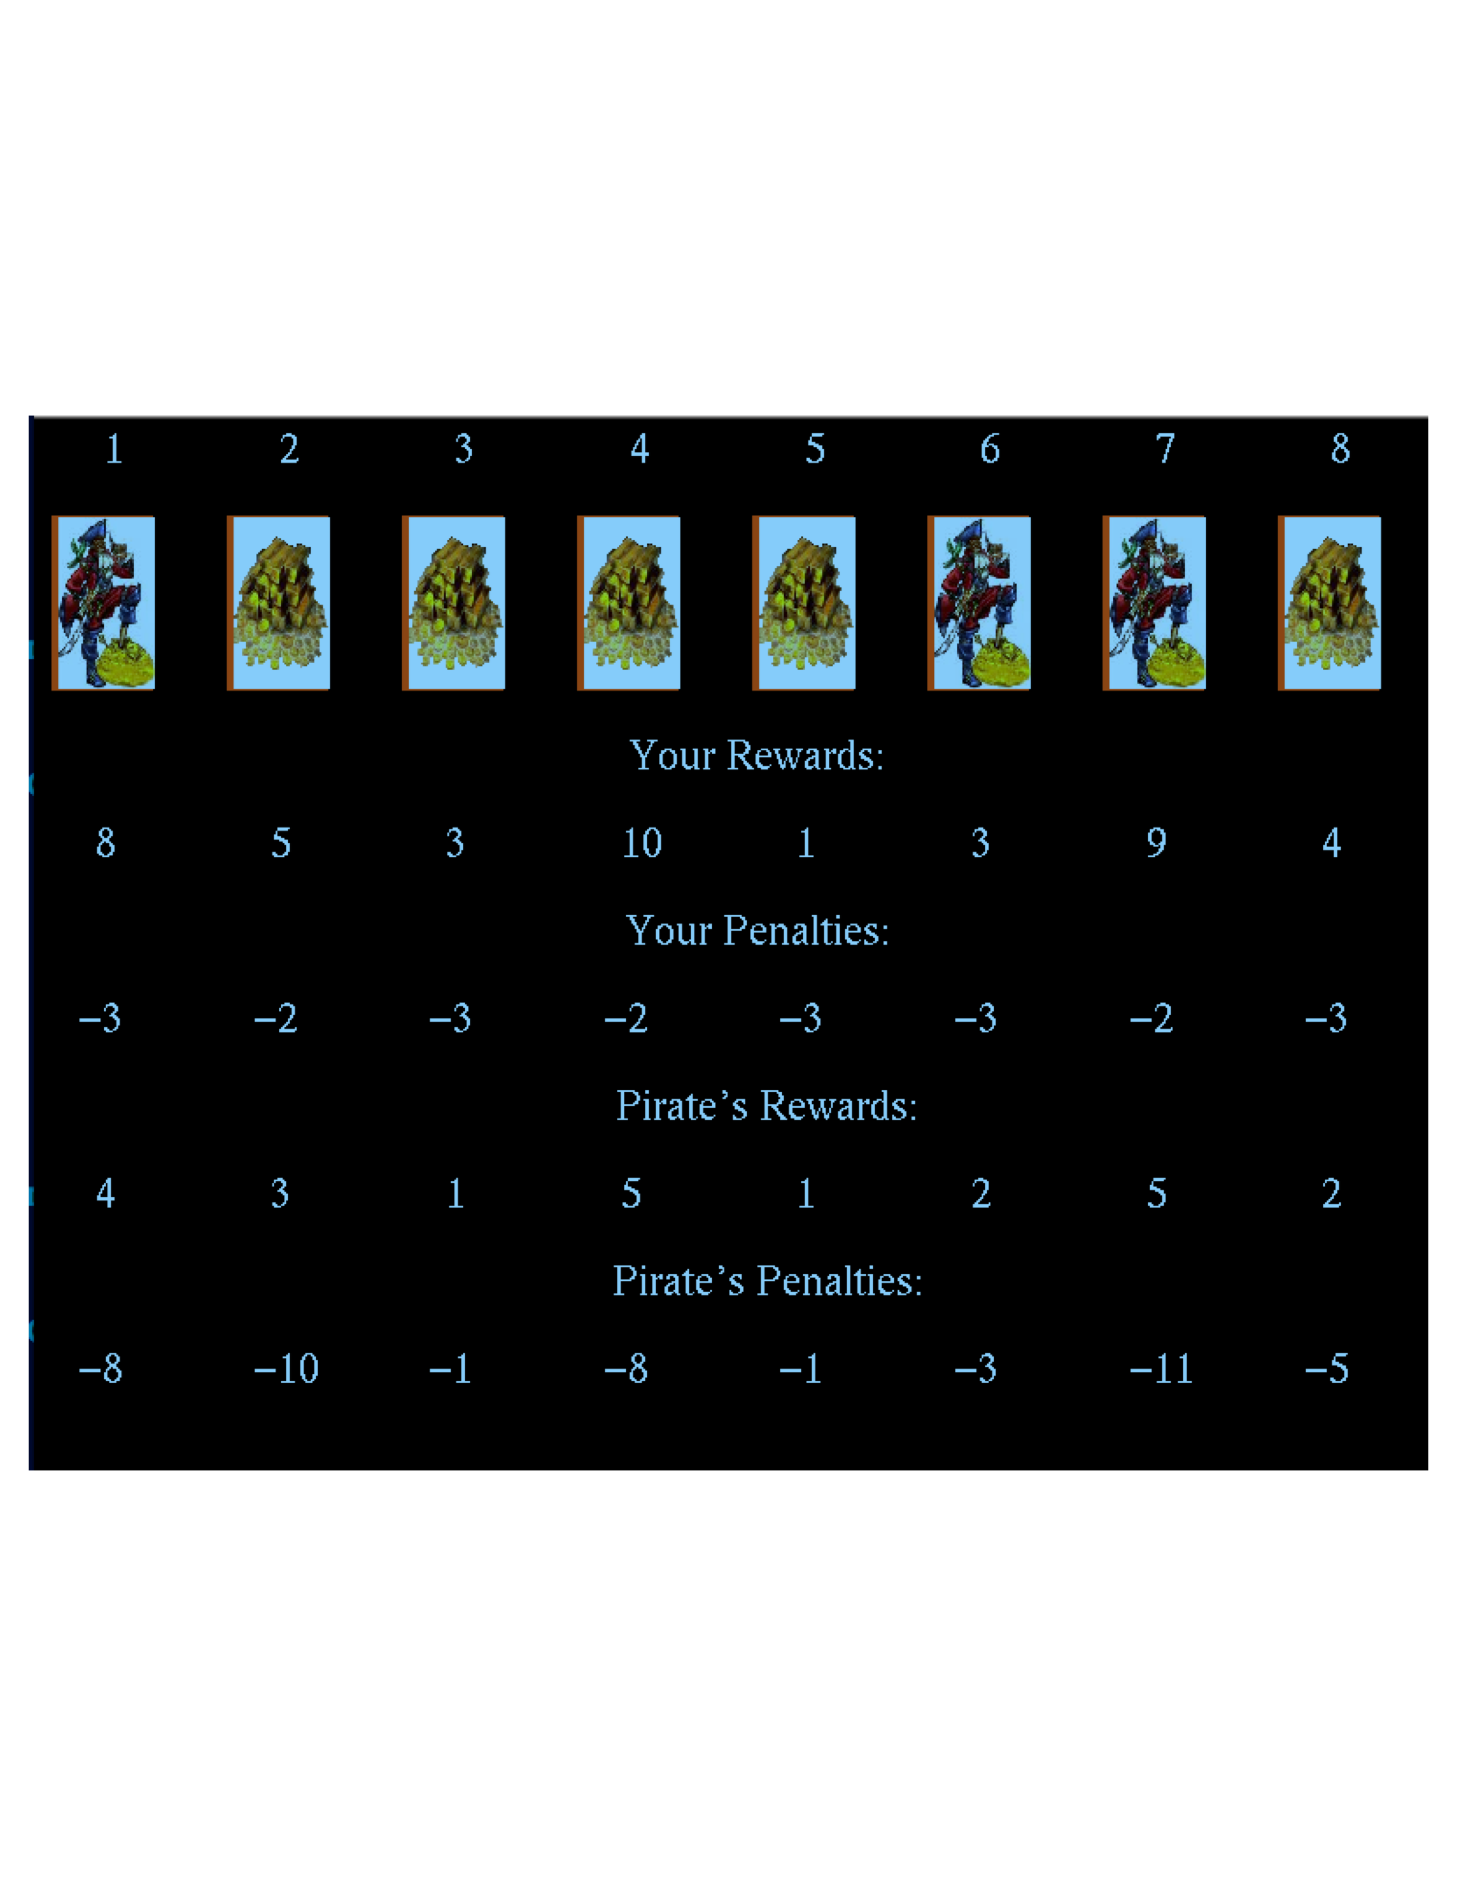
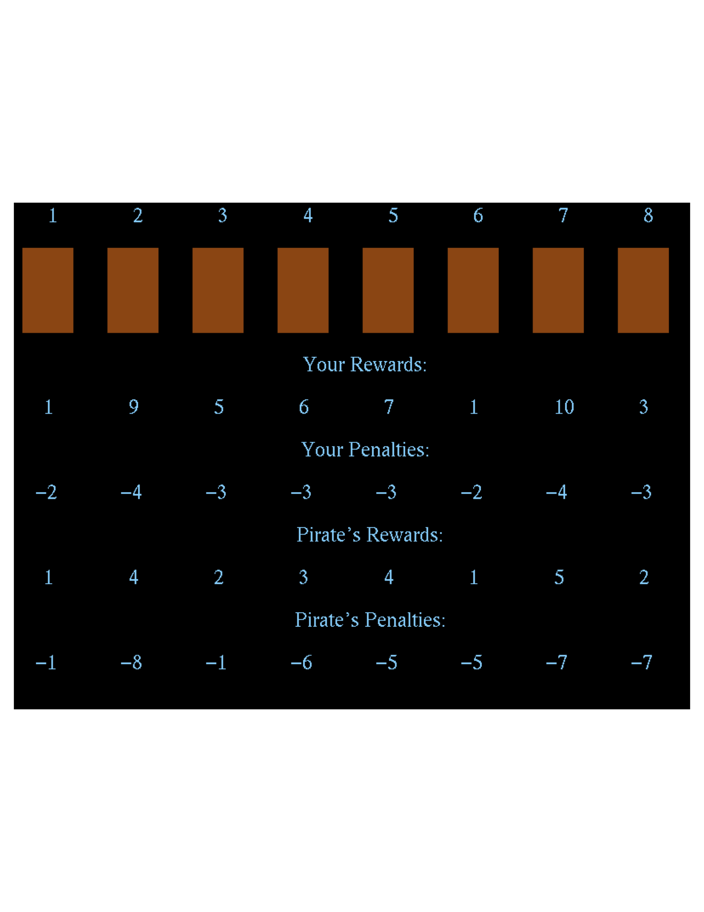

Uncertainty: Attacker Decision Bounded Rationality & Observations: Experimental Setup

Slide 123
Uncertainty: Human Bounded Rationality and Observations
178 total subjects, 2480 trials, 40 subjects for each setting
Four reward structures, four observation conditions
DOBSS: Outperforms uniform random, similar to Maximin

Slide 124
Uncertainty: Human Bounded Rationality and Observations
COBRA:
  “epsilon optimality”
  Anchoring bias: Full observation vs no observation: α
Choosing
α (even for unlimited
observations?)
No observation:
α = 1
Full observation:
α = 0

Slide 125

Unlimited Observations: Choosing α
Notes:
125

Slide 126
Prospect Theory
Model human decision making under uncertainty
Maximize the ‘prospect’ [Kahneman and Tvesky, 1979]
  π(·): weighting function
  V(·): value function

Slide 127

Empirical weighting function
Slope gets steeper as x gets closer to 0 and 1
Not consistent with probability definition
  π(x)+π(1−x) < 1
Empirical value:
γ=0.64 (0<γ<1)

Slide 128
Compute Defender Strategy
Piecewise Linear Approximation

Slide 129

Empirical value function
Risk averse regarding gain
Risk seeking regarding loss
Empirical value:
α=β=0.88, λ=2.25
Notes:
\alpha<=1 represents how risk-averse are human towards gain, when \alpha=1, the value function is a linear function in the gain region, as \alpha becomes smaller, the value function in the gain region becomes more concave, meaning that humans become more risk-averse.
\beta<=1 is similar to \alpha, but it is used for the loss part. It represents how 'risk-seeking' human are towards loss. When \beta=1, the value function in the loss part is linear, as \beta become smaller, the function becomes more 'convex', indicating that human become more 'risk-seeking'
\lambda>1, indicating that people cares more about loss than they do about gain.

Slide 130
BRPT: Best Response to PT
Mixed-Integer Linear Program
Goal: maximize defender expected utility
Weighting Function
Maximize prospect
Notes:
xi, resource assigned to target i
ck, the endpoint of segment k (0=C0<C1…<C5=1)
zik, indicates whether segment k is complete
qj, adversary’s optimal PT pure strategy
C’ ij = V(Cij)

Slide 131
Quantal Response Equilibrium
Error in individual’s response
  Still: more likely to select better choices than worse choices
Probability distribution of different responses
Quantal best response:
λ: represents error level (=0 means uniform random)
  Maximal likelihood estimation (λ=0.76)
Notes:
qj : the probability that adversary takes pure strategy j
U(j,x): adversary’s expected utility by taking pure strategy j, given defender’s mixed-strategy x
λ: captures the rational level of the follower

Slide 132
Optimal Strategy against QR
Solve the Nonlinear optimization problem

Slide 133

The Online Game
Subjects are given $8 as the starting budget
For each point they gain, $0.1 real money is paid

Slide 134
Experiment Setting
7 payoff structures
  4 new, 3 from previous tests with COBRA
5 strategies for each payoff structure
  New methods: BRPT, RPT and BRQR
  Leading contender: COBRA
  Perfect rational baseline: DOBSS
Subjects play all games (randomized orders)
No feedback until subject finishes all games

Slide 135
Evaluate the Strategies
Average expected defender’s utility
  N: total number of subjects
  : defender expected utility against subject i

Slide 136
Average Defender Expected Utility

Slide 137
Average Defender Expected Utility

Slide 138
Result Summary
BRQR outperforms DOBSS in all 7 payoffs
  In payoff 1,3 and 4, the result is statistically significant
BRQR outperforms COBRA in all 7 payoffs
  In payoff 2,3 and 4, the result is statistically significant
The poor performance BRPT is surprising!

Slide 139

Uncertainty in Adversary Decision:
MATCH
Builds on QR, exploiting security game structure:
Like QR: Adversary response error; better choice more likely
Bound loss to defender on adversary deviation
Results on 100 games
 | MATCH wins | Draw | QR wins
α = .05 | 42 | 52 | 6

Slide 140
Uncertainty in Attacker Surveillance:
Stackelberg vs Nash
Defender commits first:
  Attacker conducts surveillance
  Stackelberg (SSE)
Simultaneous move game:
  Attacker conducts no surveillance
  Mixed strategy Nash (NE)
How should a defender compute her strategy?
For security games (*):
Set of defender strategies
NE = Minimax
SSE
Notes:
We can now answer the original question posed in this paper:
when there is uncertainty over the type of game played, should the
defender choose an SSE strategy or a mixed strategy Nash equilibrium
or some combination of the two? For domains that satisfy
the SSAS property, we have proven that any of the defender’s SSE
strategies is also an NE strategy.
Among our motivating domains, the LAX domain satisfies the
SSAS property since all schedules are of size 1. Other patrolling
domains, such as patrolling a port, also satisfy the SSAS property.
In such domains, the defender could thus commit to an SSE strategy,
which is also now known to be an NE strategy. The defender
retains the ability to commit, but is still playing a best-response to
an attacker in a simultaneous-move setting (assuming the attacker
plays an equilibrium strategy – it does not matter which one, due
to the interchange property shown above).

Slide 141
Action Execution & Observation Uncertainty
RECON:
  Worst-case protection against action-execution & observation uncertainty
  Efficient MILP and heuristics

Slide 142
Outline
Motivating real-world applications
Background and basic security games
Scaling to complex action spaces
Modeling payoff uncertainty: Bayesian Security Games
Human behavior and observation uncertainty
Evaluation and discussion

Slide 143
How Do We Evaluate Deployed Systems?
“Main” vs “Application track”: Evaluating deployed systems not easy
  Cannot switch security on/off for controlled experiments
  Cannot show we are “safe” (no 100% security)
Are our systems useful: Are we better off than previous approaches?
  Models and simulations
  Human adversaries in the lab
  Actual security schedules before vs after
  Expert evaluation
  “Adversary” teams simulate attack
  Supportive data from deployment
  Future deployments

Slide 144
Key Conclusions
Human schedulers:
  Predictable patterns, e.g. LAX, FAMS (GAO-09-903T)
  Scheduling burden
Uniform random:
  Non-weighted, e.g. officers to sparsely crowded terminals
Simple weighted random:
  No adversary reactions, & enumerate large number of combinations?
Systems in use for a number of years: without us “forcing” use
  Internal evaluations, e.g. LAX evaluation by FBI, foreign experts
Notes:
These are security experts who are using these systems voluntarily without us forcing them to use these systems. They must find the systems of some use

Slide 145
1. Models and Simulations:
Example from IRIS (FAMS)

Slide 146

3. Actual Security Schedules Before vs After:
Example from PROTECT (Coast Guard)
Patrols Before PROTECT:
Boston
Patrols After PROTECT:
Boston
Notes:
Prev algorithm based on linear programming

Slide 147



4. Expert Evaluation
Example from ARMOR, IRIS & PROTECT
February 2009: Commendations
LAX Police (City of Los Angeles)
September 2011: Certificate of Appreciation (US Federal Air Marshals Service)
July 2011: Operational Excellence Award (US Coast Guard, Boston)

Slide 148
5. “Red” Teaming, Supportive data
Example from PROTECT
“Mock attacker” team deployed in Boston
  Incorporated adversary’s known intent, capability
  Comparing PRE- to POST-PROTECT: “deterrence” improved
Additional real-world indicators from Boston:
  PRE- to POST-PROTECT: Actual reports of illicit activity
  Industry port partners comments:
    “The Coast Guard seems to be everywhere, all the time."
  (With no actual increase in the number of resources)

Slide 149
6. What Happened at Checkpoints before and after ARMOR
-- Not a Controlled Experiment!
January 2009
January 3rd Loaded 9/mm pistol
January 9th 16-handguns,
4-rifles
1-assault rifle;
1000 rounds of ammo
January 10th Two unloaded shotguns
January 12th Loaded 22/cal rifle
January 17th Loaded 9/mm pistol
January 22nd Unloaded 9/mm pistol

Slide 150


Deployed Applications:
ARMOR, IRIS, PROTECT, GUARDS
Research challenges
  Efficient algorithms: Scale-up to real-world problems
  Observability: Adversary surveillance uncertainty
  Human adversary: Bounded rationality, observation power
  Uncertainty…

Slide 151
Thank you!
Chris Kiekintveld
Bo An
Albert Xin Jiang
cdkiekintveld@utep.edu
boa@usc.edu
jiangx@usc.edu
http://teamcore.usc.edu/security

